Slide 1

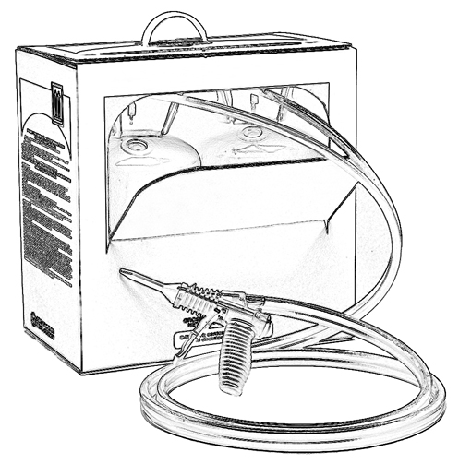


Low Pressure Spray Polyurethane Foam
Chemical Health and Safety Training

Slide 2

The American Chemistry Council
This Low Pressure Spray Polyurethane Foam Chemical Health and Safety Training program was prepared under the Research Foundation for Health and Environmental Effects (RFHEE) by the Center for the Polyurethanes Industry (CPI) of the American Chemistry Council (ACC).
A non-profit organization, RFHEE supports joint research projects sponsored by industry, public agencies, academia and other foundations. Working with these groups, RFHEE furnishes crucial funding for pertinent, peer-reviewed scientific research and provides an important information resource for public policy makers.
The Center for the Polyurethanes Industry (CPI), serves as the voice of the polyurethane industry in North America, promotes the sustainable growth of the polyurethane industry in North America, and coordinates with the polyurethane trade associations across the globe. CPI membership includes raw material producers, systems suppliers, processing machinery and equipment manufacturers, as well as users of polyurethane materials who manufacture products made of or from polyurethanes.

Slide 3
Grant Provided by the Occupational Safety and Health Administration (OSHA), U.S. Department of Labor (DOL)
This material produced under grant SH-22308-SH1 from the Occupational Safety and Health Administration (OSHA), U.S. Department of Labor.
It does not necessarily reflect the views or policies of the U.S. Department of Labor, nor does mention of trade names, commercial products, or organizations imply endorsement by the U.S. Government.

Slide 4
Disclaimer Information
This training was prepared by the American Chemistry Council’s Center for the Polyurethanes Industry. It is intended to provide general information to professional persons who may be involved in installing low-pressure spray polyurethane foam. It is not intended to serve as a substitute for in-depth training or specific requirements, nor is it designed or intended to define or create legal rights or obligations. It is not intended to be a “how-to” manual, nor is it a prescriptive guide. All persons involved in projects including low-pressure spray polyurethane foam have an independent obligation to ascertain that their actions are in compliance with current federal, state and local laws and regulations and should consult with legal counsel concerning such matters.
The training is necessarily general in nature and individual companies may vary their approach with respect to particular practices based on specific factual circumstance, the practicality and effectiveness of particular actions and economic and technological feasibility. Neither the American Chemistry Council, nor the individual member companies of the Center for the Polyurethanes Industry of the American Chemistry Council, nor any of their respective directors, officers, employees, subcontractors, consultants, or other assigns, makes any warranty or representation, either express or implied, with respect to the accuracy or completeness of the information contained in this training; nor do the American Chemistry Council or any member companies assume any liability or responsibility for any use or misuse, or the results of such use or misuse, of any information, procedure, conclusion, opinion, product, or process disclosed in this training.
NO WARRANTIES ARE GIVEN; ALL IMPLIED WARRANTIES OF MERCHANTABILITY OR FITNESS FOR A PARTICULAR PURPOSE ARE EXPRESSLY EXCLUDED.

Slide 5
Occupational Safety and Health Act
“The Occupational Safety and Health Act of 1970 (OSH Act) was enacted to assure safe and healthful working conditions for working men and women.
The OSH Act created the Occupational Safety and Health Administration (OSHA) at the federal level and provided that states could run their own safety and health programs as long as those programs were at least as effective as the federal program.”
- U.S. Department of Labor
For more information about the Act, visit: www.dol.gov/compliance/guide/osha.htm
Notes:
Reference:
http://www.dol.gov/compliance/laws/comp-osha.htm (Overview of OSH Act)

Slide 6
Copyright Information
This work is protected by copyright. The American Chemistry Council, which is the owner of the copyright, hereby grants a nonexclusive royalty-free license to reproduce and distribute this work, subject to the following limitations: (1) the work must be reproduced in its entirety, without alterations; (2) the work may be used only as a training aid for the American Chemistry Council’s (ACC’s) Low Pressure Spray Polyurethane Foam Chemical Health and Safety Training issued (insert month/day, 2012); (3) all copies of the work must bear this notice, including the copyright notice; and (4) copies of the work may not be sold.
Copyright © 2012 American Chemistry Council.

Slide 7
Online Resource
Visit www.spraypolyurethane.org frequently

