Slide 1


WELCOME
Welcome to the
OSHA
Susan Harwood
Safety Training

Slide 2
CLASS INFORMATION
Class Start and Stop Times
Breaks and Lunch
Locations of Restrooms
Emergency Exits/Procedures
Electronic Devices
Class Participation
General Rules
Door Prizes
Questions
Notes:
Added Emergency Exits/Procedures

Slide 3
TRAINING SIGN-IN SHEET
Training Sign-In Sheets are required by OSHA for documentation of training classes.
All participants must sign the class Sign-In Sheet.
Thank you for completing the class
Sign-In Sheet.

Slide 4

GROUP ACTIVITY
GROUP ACTIVITY
Class will divide into groups of 3-5. Participants will introduce themselves to other group members - name, where they work and their job.
Activity: Each group will select an activity to complete: #1, #2, #3 or #4.
#1. Identify several slip, trip or fall hazardous conditions observed in the workplace #2. Identify several accidents and related injuries observed resulting from slips, trips or falls #3. Identify several behaviors observed that could have resulted in slips, trips or falls, OR #4. Answer the question: “Are all slips, trips and falls preventable” - yes or no? - and why or why not?
Volunteer representatives will share their group information with the class.
5-10 Minutes
Notes:
Icebreaker- Get to know the audience activity

Slide 5
OSHA
SUSAN HARWOOD SAFETY TRAINING
What is OSHA?
The Occupational Safety and Health Act of 1970 (OSH Act) was passed to prevent workers from being killed or seriously harmed at work.
This law created the Occupational Safety and Health Administration (OSHA). OSHA sets and enforces protective workplace safety and health standards and also provides information, training and assistance to employees and workers.

Slide 6
OSHA
SUSAN HARWOOD SAFETY TRAINING
What is the Susan Harwood Safety Training Program?
OSHA established its Safety Training Grant Program in 1978 entitled New Directions.
In 1997, the program was re-named in honor of the late Susan Harwood, a 17 year OSHA veteran and director who died in 1996.

Slide 7
OSHA
SUSAN HARWOOD SAFETY TRAINING
What is the Susan Harwood Safety Training Program?(continued)
The Susan Harwood Safety Training Program awards Grants to Nonprofit organizations such as Telamon Corporation to develop and conduct safety and health training and education programs for employers and workers to recognize, avoid and prevent safety and health hazards in their workplaces.
Notes:
Removed the in front of Telamon Corporation

Slide 8

TELAMON CORPORATION
Telamon brings human services to people and communities in twelve states. Telamon’s purpose is to improve the lives of those in need. Telamon provides literacy and early childhood education, job training, emergency services, temporary or permanent housing opportunities, and a number of others. For more information visit our web site www.telamon.org

Slide 9

OSHA
SUSAN HARWOOD SAFETY TRAINING
  Telamon Corporation is pleased to be the recipient of a Susan Harwood grant from OSHA to present this Safety Training to you.

Slide 10
WHY IS SAFETY TRAINING NEEDED?
4,547 workers were killed on the job in 2010 – more than 87 a week or more than 12 deaths every day.
682 Hispanic or Latino workers were killed from work–related injuries in 2010 – more than 13 deaths a week
"Every day in America, 12 people go to work and never come home. Every year in America, 3.3 million people suffer a workplace injury from which they may never recover. These are preventable tragedies that disable our workers, devastate our families, and damage our economy."
– Secretary of Labor Hilda Solis

Slide 11
EMPLOYEE RIGHTS UNDER OSHA
Employees have the right to:
1. Working conditions that do not pose a risk of serious harm.
2. Receive information and training (in a language workers can understand) about chemical and other hazards, methods to prevent harm, and OSHA standards that apply to their workplace.
3. Review records of work-related injuries and illnesses.
4. Get copies of test results done to find and measure hazards in the workplace.

Slide 12
EMPLOYEE RIGHTS UNDER OSHA
Employees have the right to:
  5. File a complaint asking OSHA to inspect their workplace if they believe there is a serious hazard or that their employer is not following OSHA rules. When requested, OSHA will keep all identities confidential.
  6. Use their rights under the law without retaliation or discrimination. If an employee is fired, demoted, transferred or discriminated against in any way for using their rights under the law, they can file a complaint with OSHA. This complaint must be filed within 30 days of the alleged discrimination.

Slide 13
TRAINING EVALUATIONS
Training Evaluations are required by OSHA to measure and ensure the safety training is effective and improved as necessary.
All participants must complete the Training Evaluations.
There are 3 types of required training evaluations.

Slide 14
TRAINING EVALUATIONS
Reaction Evaluation – The Reaction Evaluation is an in class survey that measures the participants perceptions about the quality and usefulness of the training, including the teaching style and presentation skills of the trainer, course content, learning environment, and overall training effectiveness.

Slide 15
TRAINING EVALUATIONS
2. Learning Evaluation – The Learning Evaluation is an in class before and after class (pre and post class) quiz that measures the skills and knowledge the participant retains from the training. To measure learning, participants complete a before class and an after class quiz.
Notes:
Corrected per to pre-

Slide 16
TRAINING EVALUATIONS
3. Behavior / Impact Evaluation
The Behavior / Impact Evaluation is a survey conducted 3 to 6 months after the training class and measures the level of participant involvement in safety including participating in safety programs, safety awareness, safety improvements and sharing safety and health information with others.

Slide 17
TRAINING EVALUATIONS
In this class we will complete the Reaction Evaluation and the Learning Evaluation.
Effective safety training develops and empowers workers to improve safety and health in the workplace.
Thank you for completing the class
Training Evaluations.

Slide 18
TRAINING GOAL
The goal of the safety training today is deliver Quality Safety and Health Training to:
Provide you with tools to help protect you, your health and your life
Help you prevent work related injury or illness for yourself and others

Slide 19
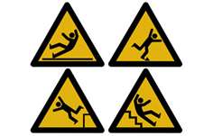
MODULE 4
Safe and Secure Training Series
PREVENTING:
SLIPS
TRIPS
FALLS

Slide 20
OSHA
SUSAN HARWOOD SAFETY TRAINING
This material was produced under grant number
SH-22311-11-60-F-37 from the Occupational Safety and Health Administration, U.S. Department of Labor.
It does not necessarily reflect the views or policies
of the U.S. Department of Labor, nor does mention
of trade names, commercial products, or organizations
imply endorsement by the U.S. Government.
Telamon Corporation is an equal opportunity provider and employer. Auxiliary aids and services are available upon request to individuals with disabilities.

Slide 21
OSHA STANDARDS
SLIPS, TRIPS, FALLS
Special standards have not been adopted for the poultry industry.
Workers in the poultry industry are protected by the act and by general and specific occupational safety and health standards, such as the General Duty Clause and the following:
  29 CFR 1910 Subpart D - Walking/Working Surfaces

Slide 22
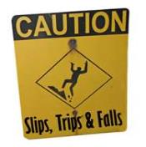
LEARNING OBJECTIVES
In this module participants will learn:
Slip, Trip and Fall Statistics and Costs
Injuries resulting from Slips, Trips and Falls
Definitions of Slips, Trips and Falls
Causes of Slips, Trips and Falls
3 Steps for Preventing Slips, Trips and Falls
Behaviors for Preventing Slips, Trips and Falls

Slide 23
BEFORE CLASS QUIZ
  Questions: (Yes or No)
  By controlling unsafe behaviors and unsafe conditions, all slips, trips and falls can be prevented.
  2. 3 step process for preventing slips, trips and falls: 1) describe 2) develop 3) depend.
  3. When climbing a ladder you should always wear heavy boots.
Notes:
Convert to Turning Technologies as soon as we can.

Slide 24
BEFORE CLASS QUIZ
  Questions:
  4. Keeping walkways, aisles and stairs clear helps prevent slips, trips and falls.
  5. 15% of all accidental deaths are caused by slips, trips and falls.
  6. Wearing proper footwear will help prevent slips, trips and falls.
  7. If necessary, you can use the top step of a ladder.

Slide 25
BEFORE CLASS QUIZ
  Questions:
  8. When walking across a slippery surface it is best to walk as quickly as possible.
  9. Using the hand rail on stairs is only necessary when going down the stairs and not necessary when going up the stairs.
  10. Slips, trips and falls are never caused by unsafe behaviors - they are only caused by unsafe working conditions.

Slide 26
STATISTICS –
SLIPS, TRIPS, FALLS
According to the U. S. Department of Labor, Slips, Trips, and Falls make up the majority of general industry accidents.
15% of accidental deaths are caused by Slips, Trips and Falls
15% to 20% of all workers compensation costs are due to Slips, Trips and Falls

Slide 27

COSTS - SLIPS, TRIPS, FALLS
To the worker:
  Lost wages & out-of-pocket expenses
  Pain
  Temporary or permanent disability
  Reduced quality of life
  Depression
  Death

Slide 28
COSTS - SLIPS, TRIPS, FALLS
To the employer:
  Loss of production & business
  Higher insurance costs
  Costs of training replacement workers

Slide 29




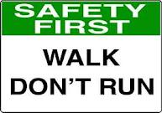
AWARENESS - SLIP, TRIP, FALLS

Slide 30
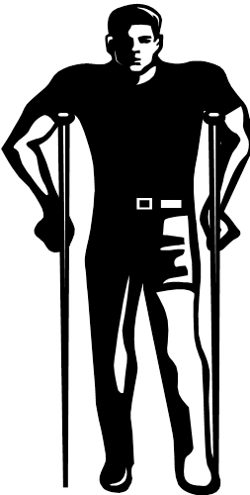
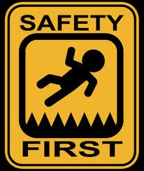
INJURIES - SLIP, TRIP, FALLS
Sprains & strains
Bruises & contusions
Fractures
Abrasions & lacerations

Slide 31


LEARNING GOAL
What is your learning Goal?

Slide 32
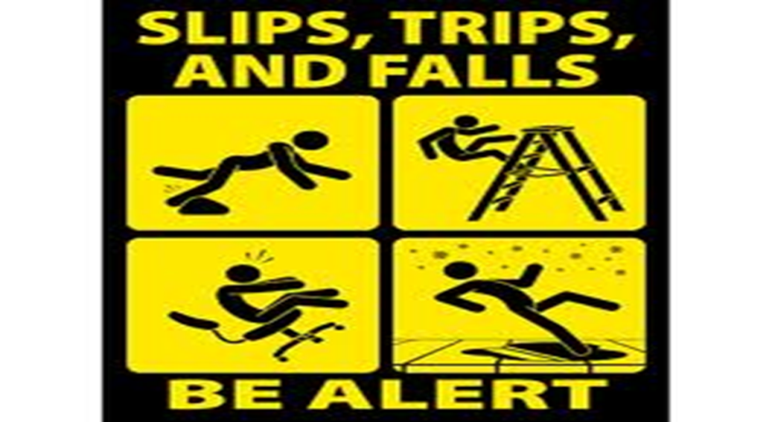
DEFINITIONS
SLIPS, TRIPS, FALLS

Slide 33
DEFINITION - SLIP
Slip
Slips occur when there is too little friction or traction between your feet (footwear) and the walking or working surface, and you lose your balance..
Slips can result in falls

Slide 34
DEFINITION - TRIP
Trip
Trips occur when your foot (or lower leg) hits an object and your upper body continues moving, throwing you off balance.
or

Slide 35
DEFINITION - TRIP
Trip
When you step down to a lower surface and lose your balance.

Slide 36
DEFINITION - FALL
Fall
Falls occur when you are too far off your center of balance – either at the same level or a lower level.

Slide 37
UNDERSTANDING - CAUSES
  By understanding causes of slips, trips, and falls, you can learn to identify and prevent needless and painful injuries.
  Lets learn to how to identify causes of Slips, Trips and Falls

Slide 38
CAUSES - SLIPS
  Items on floors or walking surfaces
      Product
      Ice
      Fat
      Feathers
      Cardboard
      Plastic
      Water

Slide 39
CAUSES - SLIPS
  2. Walking from one surface onto another
    tile to vinyl
    carpet to vinyl
    concrete to tile
  3. Sloped walking surfaces
  4. Loose rugs or floor mats
  5. Ramps without slip resistant surfaces
  6. Climbing up and down ladders

Slide 40
CAUSES - SLIPS
7. Boots and shoes with wet, greasy or oily soles
8. Walking from one area to another - from processing area to cooler or freezer
9. Climbing on and off trucks, trailers and forklifts
10. Weather hazards – rain, sleet, ice, snow, hail, frost
11. Improper or worn out footwear

Slide 41
CAUSES – TRIPS, FALLS
Items and obstacles in or across aisles and walkways
    Wash down hoses
    Pallets
    Employee stands
    Electrical cords
    Pallet jacks
    Boxes/Combos/vats
2. Changes in elevation or levels
    Steps
    Stands
    Ramps

Slide 42
CAUSES – TRIPS, FALLS
3. Rumpled or rolled up floor mats or carpet
4. Steps
  Damaged
  Uneven or irregular
  Missing
5. Uneven surfaces
6. Floor drain covers – missing, broken, or not properly in place

Slide 43
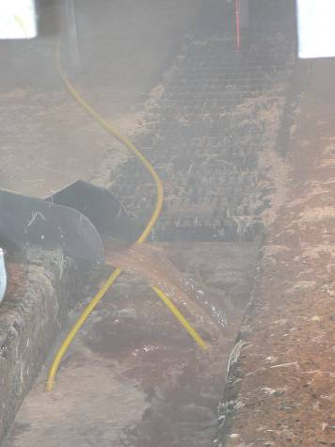
UNSAFE CONDITIONS Causing Slips, Trips and Falls
Poor lighting
Glare
Shadows
Bulky PPE (Improper fitting)
Improper footwear
Excess noise or temperature
Fog or misty conditions
Poor housekeeping
Improper cleaning methods & products
Inadequate or missing signage
Poorly maintained floors

Slide 44
UNSAFE BEHAVIORS Causing Trips, Slips and Falls
Carrying or moving cumbersome objects or simply too many objects at one time
Not paying attention to surroundings or walking distracted
Taking shortcuts – not using designated walkways
Being in a hurry and rushing
Not observing posted signage
Entering unauthorized or restricted areas

Slide 45

LEARNING ACTIVITY
Time For a Group Learning Activity
Handout: Preventing Slips, Trips and Falls
Identify: 1. UNSAFE CONDITIONS and
2. UNSAFE BEHAVIORS
that can cause
SLIPS, TRIPS and FALLS
in your workplace
Volunteers will share their information with the class
10-15 Minutes

Slide 46
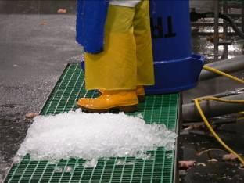
WHAT’S WRONG WITH THIS PICTURE?

Slide 47
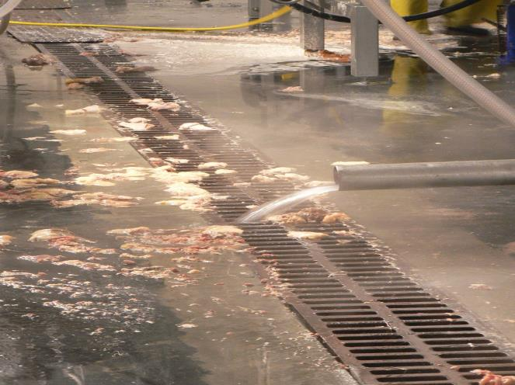
WHAT’S WRONG WITH THIS PICTURE?

Slide 48
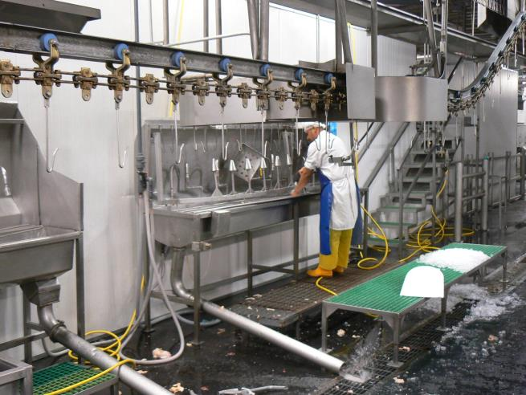
WHAT’S WRONG WITH THIS PICTURE?

Slide 49
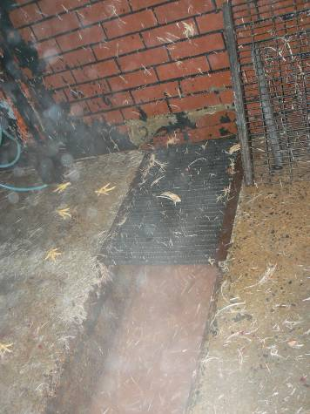
WHAT’S WRONG WITH THIS PICTURE?

Slide 50
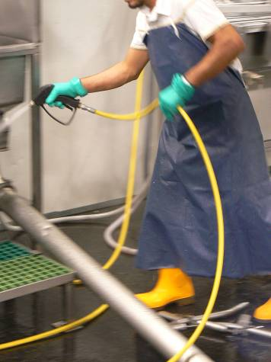
WHAT’S WRONG WITH THIS PICTURE?

Slide 51
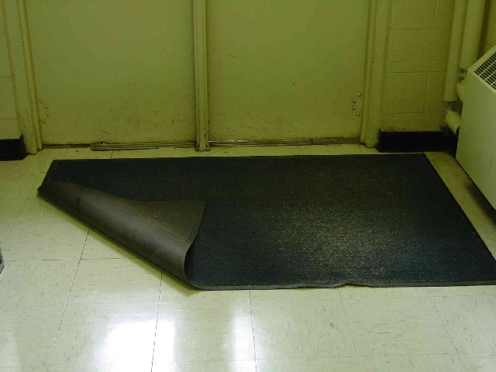
WHAT’S WRONG WITH THIS PICTURE?

Slide 52
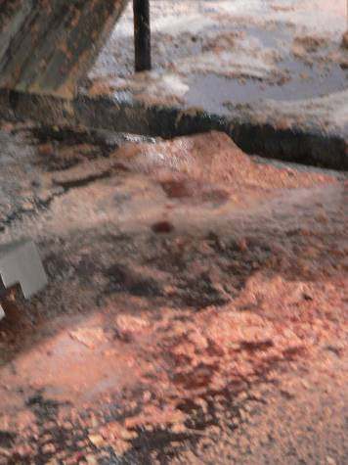
WHAT’S WRONG WITH THIS PICTURE?

Slide 53
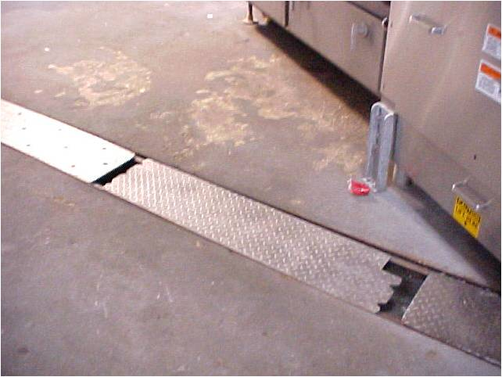
WHAT’S WRONG WITH THIS PICTURE?

Slide 54
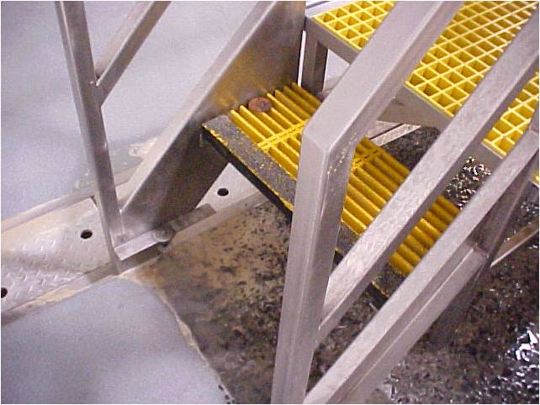
WHAT’S WRONG WITH THIS PICTURE?

Slide 55
PREVENTING
SLIPS, TRIPS, FALLS
Don't FALL for Hazards!
  There is a way to PREVENT every slip, trip, or fall.
  Now that you understand causes of Slips, Trips, and Falls, you can learn how prevent needless and painful injuries.
  Let’s learn how to prevent Slips, Trips and Falls

Slide 56





3 STEPS FOR PREVENTING
SLIPS, TRIPS, FALLS
PREVENT
Unsafe Conditions
Unsafe Behaviors
STEP # 1
STEP
# 2
STEP
# 3

Slide 57

PREVENTING
SLIPS, TRIPS, FALLS
Behaviors for preventing Slips, Trips and Falls
Do not hurry – give yourself
enough time
Watch where you are walking
Walk - do not run

Slide 58
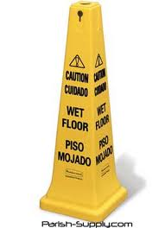
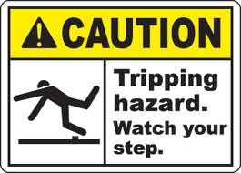
PREVENTING
SLIPS, TRIPS, FALLS
Behaviors for preventing Slips, Trips and Falls
Stay alert at all times
Extra care when carrying objects
Keep safety glasses clean
Always follow all company safety
rules, policies and procedures
A Safety Rule Breaker is an Accident Maker!

Slide 59
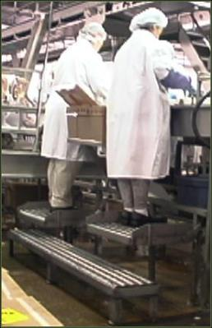
PREVENTING
SLIPS, TRIPS, FALLS
Behaviors for preventing Slips, Trips and Falls
Be aware of work stand heights,
positions and levels
Pay attention to work environmental
conditions

Slide 60
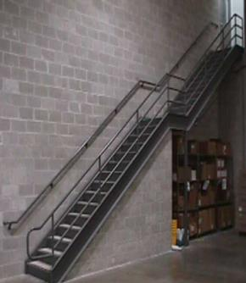

PREVENTING
SLIPS, TRIPS, FALLS
Behaviors for preventing Slips, Trips and Falls
Use handrails when using stairs when going up and down
Do not rush and skip steps

Slide 61
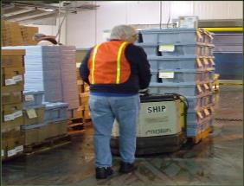
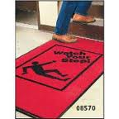
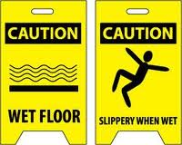
PREVENTING
SLIPS, TRIPS, FALLS
Behaviors for preventing Slips, Trips and Falls
  Walk carefully when walking
  from one surface to another
  and adjust your pace
  Walk slow and take small steps
  if surface is uneven, at an angle
  or slippery

Slide 62
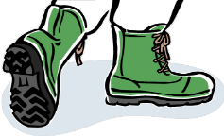
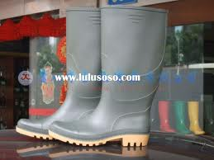
PREVENTING
SLIPS, TRIPS, FALLS
Wearing proper foot wear can help prevent Slips, Trips, and Falls.
Footwear should fit snugly and comfortably
Wear slip-resistant footwear with good tread
Keep your footwear clean and in good condition at all times
Inspect regularly for any damage and replace worn or defective footwear
Replace footwear before soles become
worn smooth

Slide 63
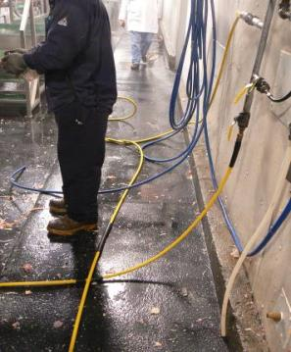
PREVENTING
SLIPS, TRIPS, FALLS
Maintain good housekeeping for preventing Slips, Trips and Falls
  Clean up spills immediately
  Mark spills and wet areas
  Mop or sweep debris from floor
  Rugs and mats not bunched up
  Keep walkways, aisles and stairs clear
  Roll up wash down hoses immediately after use
Notes:
Corrected isles to aisles.

Slide 64
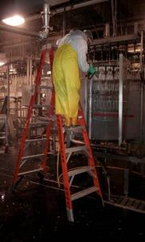
PREVENTING
SLIPS, TRIPS, FALLS
Portable Ladders
Do not jump off ladder – step down carefully
Face ladder at all times
Stepladders 20' maximum
Ladders and safety feet in good condition
Ladders inspected frequently
Ladders with defects withdrawn from service for repair or destruction and tagged "Dangerous, Do Not Use."

Slide 65
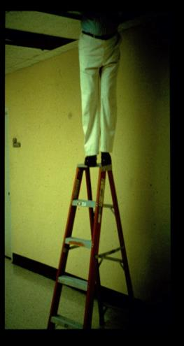
PREVENTING
SLIPS, TRIPS, FALLS
Portable Ladders
Tops of ordinary types of step
ladders shall never be used as steps
Have a good hand hold before
stepping up or down
Ladders not placed in front of
doors unless door is blocked
open, locked or guarded

Slide 66
PREVENTING
SLIPS, TRIPS, FALLS
Controlling Unsafe Conditions
If you cannot fix the unsafe condition yourself then:
  Immediately report all unsafe conditions to your supervisor or manager
  Alert or warn others in the area
    Mark the area or stay there until help arrives
  Unsafe conditions not fixed in a timely manner
    Notify the Plant Safety Officer

Slide 67
SAFE BEHAVIORS

Slide 68

GROUP LEARNING ACTIVITY
Time For a Group Learning Activity
Handout: Preventing Slips, Trips and Falls
Identify ways to PREVENT the Unsafe Conditions
and Unsafe Behaviors you identified in the last group activity.
Step # 1. RECOGNIZE
Step # 2. EVALUATE
Step # 3. CONTROL UNSAFE CONDITIONS and BEHAVIORS
Volunteers will share their information with the class
10-15 Minutes

Slide 69
GROUP DISCUSSION
Don't Slip Up On Safety!
  You take hundreds of steps every day, but how many of those steps do you take seriously?
  Why do you think all Slips, Trips and Falls are Preventable?
  DON’T BECOME A STATISTIC!
All Accidents
Are PREVENTABLE!

Slide 70
LOCATION / SITE SPECIFIC DETAILS
If applicable, discuss any details specifically related to the current location site of training.

Slide 71
FALLING PROPERLY
If you do fall, you can reduce the chance of serious injury if you:
    Bend your elbows and knees and use your legs and arms to absorb the fall
    Get medical attention after a fall to treat anything torn, sprained, or broken
    Roll with the fall; don’t reach out and let your body crumple and roll.

Slide 72
REVIEW - LEARNING OBJECTIVES
Don't Slip Up On Safety!
Don't FALL for Hazards!
1. What ____% of accidental deaths are due to Slip, Trips and Falls?
2. What are some of the costs of Slips, Trips and Falls to:
  Employer
  Employee
3. Name some injuries resulting from Slips, Trips and Falls?

Slide 73
REVIEW - LEARNING OBJECTIVES
Don't Slip Up On Safety!
Don't FALL for Hazards!
4. All Slips, Trips and Falls are Preventable – True or False? Why?
5. All Slips, Trips and Falls can be Prevented by Controlling unsafe:
  _____________ and Unsafe
  _____________

Slide 74
REVIEW - LEARNING OBJECTIVES
Don't Slip Up On Safety!
Don't FALL for Hazards!
6. 3 Steps for Preventing Slips, Trips and Falls are:
1. Recognize 2. Evaluate 3. Control
True or False?

Slide 75
REVIEW - LEARNING OBJECTIVES
Don't Slip Up On Safety!
Don't FALL for Hazards!
7. Wearing proper footwear will help prevent Slips, Trips and Falls.
True or False?
8. You can use the top step of a step ladder if you are in a hurry.
True or False?

Slide 76

PREVENTING
SLIPS, TRIPS and FALLS
QUESTIONS?

Slide 77
AFTER CLASS QUIZ
  Questions: (Yes or No)
  By controlling unsafe behaviors and unsafe conditions, all slips, trips and falls can be prevented.
  3 step process for preventing slips, trips and falls: 1) describe 2) develop 3) depend.
  When climbing a ladder you should always wear heavy boots.

Slide 78
AFTER CLASS QUIZ
  Questions:
  4. Keeping walkways, aisles and stairs clear helps prevent slips, trips and falls.
  5. 15% of all accidental deaths are caused by slips, trips and falls.
  6. Wearing proper foot wear will help prevent slips, trips and falls.
  7. If necessary, you can use the top step of a ladder.

Slide 79
AFTER CLASS QUIZ
  Questions:
  8. When walking across a slippery surface its best to walk as quickly as possible.
  9. Using the hand rail on stairs is only necessary when going down the stairs and not necessary when going up the stairs
  10. Slips, trips and falls are never caused by unsafe behaviors - they are only caused by unsafe working conditions.

Slide 80

SMILE SURVEY
Notes:
Added cheesy picture.

Slide 81
RESOURCES FOR MORE INFO ON SLIPS, TRIPS, FALLS
  https://www.osha.gov/dte/grant_materials/fy06/46e0-ht10-06.html
  National Safety Council - www.nsc.org
  www.oshainfo.gatech.edu
  www.osha.gov

Slide 82
RESOURCES FOR MATERIALS
The following resources were used for presentation materials:
  https://www.osha.gov/dte/grant_materials/fy06/46e0-ht10-06.html
  National Safety Council: PowerPoint, Module 3 Evaluating Slip, Trip and Fall Hazards
  Washington State Department of Labor and Industries: PowerPoint May, 2010 - Slips, Trips and Falls Module 1 and Module 2

Slide 83
CONGRATULATIONS!!!
  Congratulations on completing
  MODULE 4
  Safe and Secure Training Series
  Preventing Slips, Trips and Falls

