Slide 1

Value Stream Mapping
Presented By The University of Texas-School of Public Health
This material was produced under grant number SH-22316-SH-1 from the Occupational Safety and Health Administration, U.S. Department of Labor. It does not necessarily reflect the views or policies of the U.S. Department of Labor, nor does mention of trade names, commercial products, or organizations imply endorsement by the U.S. Government.

Slide 2

Project Funding
This material was produced under grant number SH-22316-SH-1 from the Occupational Safety and Health Administration, U.S. Department of Labor. It does not necessarily reflect the views or policies of the U.S. Department of Labor, nor does mention of trade names, commercial products, or organizations imply endorsement by the U.S. Government.

Slide 3
Learning Objectives
By the end of this module participants should be able to:
Identify the definition of value stream mapping
List the importance of value stream mapping
Develop the value stream mapping based on the five step process for removing waste

Slide 4
The DMAIC Process with Tools
DAY 1
Define
Phase
1&2
Measure
Tools:
Voice of Customer (VOC) Analysis
Process Mapping
Value Stream Mapping
Analyze
Improve
Control

Slide 5
Value Stream Map
What is Value Stream Mapping?
A pictorial representation of the Flow of Material, People and Processes Information
Specific data associated with each step
Touch Time and Cycle Time
Volume
Resources
Errors/rework
Value Stream Map
FTEs
Cycle Time
Volume
Notes:
LP: Tailor examples of the “types of customers”

Slide 6
Why is Value Stream Mapping important for assessing current state?
Characteristics of
Value Stream Map
Possible benefits
Delineation of Process Steps and sequence of steps
Description of bottlenecks and queues within process
Match of specific resources and costs to each Process Step
Root causes identified and linked to specific Process Steps
Root causes of lengthy Throughput times diagnosed
Prioritized process improvements

Slide 7
Five Step Process For Removing Waste
Map the “As Is” State
2. Map the “Ideal Future” State
3. Identify gaps between “As Is” State
and “Ideal Future” State
4. Make the selected changes. Evaluate the improvement. This is the “Target State”
5. Design continuous improvement process

Slide 8
Step 1 – Map the “As Is” State
Case Example – Sales Order Processing For A PC Retailer
Time Customer is On Telephone
Initial Phone
Contact
Wait for Available
Sales Person
Sales Pitch
Configure System
Fill Out Order Form
Promise to Ship
Time = 0
C/T = 5 minutes
W/T = 0
VA/T = 0
C/T = 10 minutes
W/T = 10 minutes
VA/T = 10 minutes
C/T = 30 minutes
W/T = 30 minutes
VA/T = 5 minutes
C/T = 10 minutes
W/T = 10 minutes
VA/T = 5 minutes
C/T = 5 minutes
W/T = 5 minutes
VA/T = 0
Change Ship Date
Triggering
Event
No
Issue Work Order
to Factory Floor
Yes
Mtl.
Available
?
Check Availability
of Materials
Batch Together
Similar Systems
Pending Order
“FIFO” Queue
Measurable
Deliverable
C/T = 1 Day
W/T = 1 hour
VA/T = 15 min
C/T = 3 Days
W/T = 1 hour
VA/T = 0
C/T = 6 Days
W/T = 1 Day
VA/T = 0
C/T = 7 Days
W/T = 0
VA/T = 0
While customer is on telephone:
C/T = 60 min.
W/T = 55 min.
VA/T = 20 min.
From Contact
to Order Launch:
C/T = 17 days
W/T = ~1 day
VA/T = 15 Min
Notes:
*** Need simple a chart table
Bob to put in a Healthcare example

Slide 9
Step 2 – Map the “Ideal Future” State
Case Example – Sales Order Processing For A PC Retailer (Cont’d)
Time Customer is On Telephone
A
Contact
Wait for Available
Sales Person
Sales Pitch
Configure System
Fill Out Order Form
Promise to Ship
C/T = 0
W/T = 0
VA/T = 0
C/T = 5 minutes
W/T = 0
VA/T = 0
C/T = 10 minutes
W/T = 10 minutes
VA/T = 10 minutes
C/T = 30 minutes
W/T = 30 minutes
VA/T = 5 minutes
C/T = 10 minutes
W/T = 10 minutes
VA/T = 5 minutes
C/T = 5 minutes
W/T = 5 minutes
VA/T = 0
Change Ship Date
No
Issue Work Order
to Factory Floor
Yes
Mtl.
Available
?
Check Availability
of Materials
Batch Together
Similar Systems
Pending Order
“FIFO” Queue
C/T = 1 Day
W/T = 1 hour
VA/T = 15 min
C/T = 3 Days
W/T = 1 hour
VA/T = 0
C/T = 6 Days
W/T = 1 Day
VA/T = 0
C/T = 7 Days
W/T = 0
VA/T = 0
Gold – Greatest Potential Impact
Gray – Worthwhile Opportunity
Notes:
*** Need simple a chart table
Bob to put in a Healthcare example

Slide 10
Step 3 – Identify gaps between “As Is” State and “Ideal Future” State
Case Example – Sales Order Processing For A PC Retailer (Cont’d)
Time Customer is On Telephone
A
Contact
Wait for Available
Sales Person
Sales Pitch
Configure System
Fill Out Order Form
Promise to Ship
C/T = 0
W/T = 0
VA/T = 0
C/T = 5 minutes
W/T = 0
VA/T = 0
C/T = 10 minutes
W/T = 10 minutes
VA/T = 10 minutes
C/T = 30 minutes
W/T = 30 minutes
VA/T = 5 minutes
C/T = 10 minutes
W/T = 10 minutes
VA/T = 5 minutes
C/T = 5 minutes
W/T = 5 minutes
VA/T = 0
Change Ship Date
No
Issue Work Order
to Factory Floor
Yes
Mtl.
Available
?
Check Availability
of Materials
Batch Together
Similar Systems
Pending Order
“FIFO” Queue
C/T = 1 Day
W/T = 1 hour
VA/T = 15 min
C/T = 3 Days
W/T = 1 hour
VA/T = 0
C/T = 6 Days
W/T = 1 Day
VA/T = 0
C/T = 7 Days
W/T = 0
VA/T = 0
Gold – Greatest Potential Impact
Gray – Worthwhile Opportunity
Notes:
*** Need simple a chart table
Bob to insert Healthcare example

Slide 11
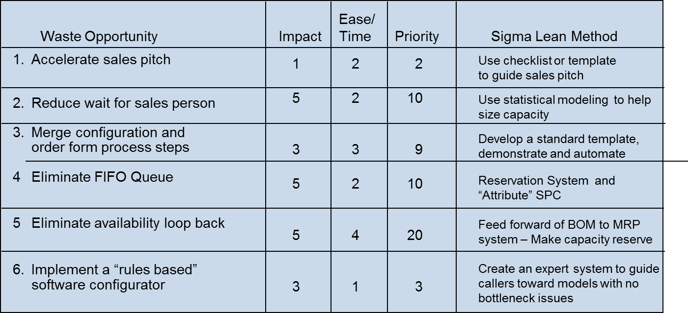
Step 4 – Make the selected changes
Case Example – Sales Order Processing For A PC Retailer (Cont’d)
Notes:
Again Bob to change to Healthcare example

Slide 12
Step 4 – (Cont’d) (Evaluate the improvement)
Case Example – Sales Order Processing For A PC Retailer (Cont’d)
Time Customer is On Telephone
Initial Phone
Contact
Wait for Available
Sales Person
Sales Pitch
Configure System
Fill Out Order Form
(& Config. System)
Mtl.
Available
?
Yes
Promise to Ship
C/T = 0
W/T = 0
VA/T = 0
C/T = 5 minutes
W/T = 0
VA/T = 0
C/T = 10 minutes
W/T = 10 minutes
VA/T = 10 minutes
C/T = 30 minutes
W/T = 30 minutes
VA/T = 5 minutes
C/T = 30 minutes
W/T = 30 minutes
VA/T = 10 minutes
C/T = 5 minutes
W/T = 5 minutes
VA/T = 0
Reconfigure?
No
Issue Work Order
to Factory Floor
Check Availability
of Materials
Optimize Product
Mix
Pending Order
“FIFO” Queue
C/T = 1 Day
W/T = 1 hour
VA/T =15 min
C/T = 3 Days
W/T = 1 hour
VA/T = 0
C/T = 6 Days
W/T = 1 Day
VA/T = 0
C/T = 7 Days
W/T = 0
VA/T = 0
Improvement Targets –
While customer is on telephone:
As-Is Target
From Contact
to Order Launch:
As-Is Target
C/T = 60 min.
W/T = 55 min.
VA/T = 20 min.
45 min.
45 min.
20 min.
C/T = 17 days
W/T = ~1 day
VA/T = 15 min
7 days
~1 day
15 min
Notes:
Bob to insert Healthcare example

Slide 13
Step 5 – Design continuous improvement process
Case Example – Sales Order Processing For A PC Retailer (Cont’d)
Institutionalize the gain.
Make sure that the improvement does not decay.
Automated systems (Mistake Proofed)
Templates
SPC to control inventory

Slide 14
How do you create a Value Stream Map?
Steps:
Helpful hints for initial drafts:
1. Walk through the work unit area to determine the primary material and information flows
2. Draw the Value Stream Map using the list of standard icons to depict flows
3. Use a list of key process measurements and questions to assist in developing the map
4. Return to work unit area as necessary to get more detailed data
Everyone involved should draw their own map (ensures understanding of the complete process)
Draw in pencil (easy to change and reliable) and avoid using computers (time-consuming)
Bring a stopwatch and verify all times
Use standard measurements
View the work unit processes from the customer’s perspective by walking from the point where the work unit delivers a product or service to a customer and walk backwards
Include exception processing and fixing errors

Slide 15
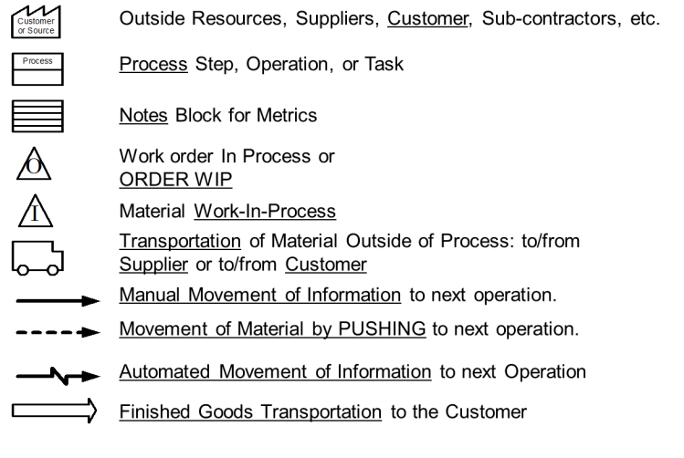
Value Stream Mapping Symbols
Notes:
SK: Do we need this symbols?

Slide 16
Value Stream Map
Key process measurements.
Measurement
Description
Product variations
Cycle Time* (C/T)
Wait Time* (Wait)
Value Add Time* (VA/T)
Setup Time* (S/T)
Working Time (W/T)
Uptime
Number of distinct types of products in each process step
Time elapsing between 1 completed item and the next completed item (includes wait time)
Time spent by the item in a queue
The time an operator actually touches the item (touch time)
Time from last good piece of one product (or service) to the first good piece of the next product (or service)
Maximum theoretical time for each step (minus break, meeting, and clean up)
Actual amount of time available to process items
Capture StDev and average
*Time for all steps measured in days/hours/minutes/seconds
Notes:
We wanted these definitions in the front between slides 5 and 6 or as a handout

Slide 17
Value Stream Map
Key process measurements.
Measurement
Description
Number of FTEs
Number of shifts
Rework rate
Queue size (Q)
Distance traveled (D/T)
Machine capacity (M/C)
People available to fully operate a process step per shift
Number of shifts per day
Percent of items subject to rework as a result of that unit
Number of items waiting for next process step
Distance for transfer of material, paperwork, etc.
Maximum number of items processed per hour per machine, e.g., fax or scanner
Capture StDev and average

Slide 18
Value Stream Map
Process Step Worksheet
Start time: _____________
Distance from last queue (if applicable): __________
Process step: _________________________
End time: _____________
Activity
Number of Workers/FTEs
1. _____________
2. _____________
3. _____________
4. _____________
5. _____________
_____________
_____________
_____________
_____________
_____________
Value Add/Touch time (minutes): _______________________
Type of Patient Move/Transfer:: ________________
Distance to next step (feet): __________________
Wait time in/between Steps (minutes): _______________________

Slide 19
Diagnostic Questions Strategies for Value Stream Map
Value Stream Element
Diagnostic Questions
Signs Of Opportunity
Material flow
How many people touch the item during its time in your work group?
Do you take “expedite” or “rush” requests? How are these handled compared to how other requests are handled?
Do you receive different types of work? Is the employee effort needed to complete different types of work significantly different?
How often do you receive work that should have been sent somewhere else? What do you do with it when you receive it? How long does that take?
Multiple hand-offs for seemingly “simple” processes
Presence of any sort of “rush” process outside the norm
Work varies widely, along with effort required
A lot of misdirected-sent work or a lot of time spent handling misdirected work (even if the volume is small)

Slide 20
Diagnostic Questions Strategies for Value Stream Map
Value Stream Element
Diagnostic Questions
Signs Of Opportunity
Process flow
Do you know what tasks the groups ahead and/or behind yours in the work stream perform on the item?
Little knowledge of or concern for tasks performed by other areas
Quality
What role does quality play in your process? When is it assessed? How is it measured? How are defects corrected? Where do defects come from?
Quality not tracked, quality checked at end of process only, steps where “checkers check checkers,” time to correct defects come from “line” workers; many defective products arrive in the area from outside

Slide 21
Diagnostic Questions Strategies for Value Stream Map
Value Stream Element
Diagnostic Questions
Signs Of Opportunity
Process flow
Do you know what tasks the groups ahead and/or behind yours in the work stream perform on the item?
Little knowledge of or concern for tasks performed by other areas
Quality
What role does quality play in your process? When is it assessed? How is it measured? How are defects corrected? Where do defects come from?
Quality not tracked, quality checked at end of process only, steps where “checkers check checkers,” time to correct defects come from “line” workers; many defective products arrive in the area from outside

Slide 22
Diagnostic Questions Strategies for Value Stream Map
Value Stream Element
Diagnostic Questions
Signs Of Opportunity
Do you track individual productivity?
If so, is the performance band around the mean narrow or wide?
Are your workers trained to do more than one job within your area?
Along what lines do you divide your workforce?
What is the span of education level and salary in your work group? Do the skills required to perform the different functions vary greatly?
No tracking or very wide distribution of productivity
Little or no cross-training
Many cuts of work groups and lots of silos created
Wide ranges in education or salary with little variation in job description or skill set needed
Resources

Slide 23
Diagnostic Questions Strategies for Value Stream Map
Value Stream Element
Diagnostic Questions
Signs Of Opportunity
Queues
Does the work enter the process in large batches or in small batches? What is the size of a batch? Does the work move through the process in small or large batches?
Do you frequently have backlogs? What causes them?
Work enters and/or moves through the process in large batches
Frequent backlogs; intentional backlogs to “keep people busy”
Information flows
Do your workers communicate across functions? If so, what methods do they use? How do they know when to begin and end their work?
Little communication across functions; each group works as hard as it can without regard to progress of other groups

Slide 24
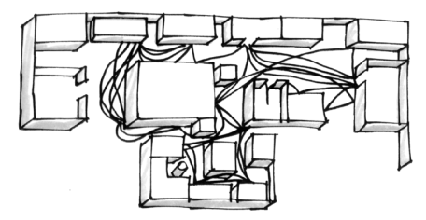
Spaghetti Chart
Obtain a layout
List the steps in the process
Draw the path of the process from start to finish on the layout exactly as the material flows, not “as it should flow”
Multiple products or services plotted on the same chart will clearly show any interference/confusion (use multiple colors)
Examine the patterns or paths
Before

Slide 25
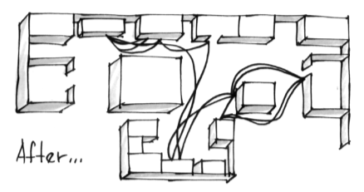
Spaghetti Chart
Spaghetti diagrams can clearly illustrate the inefficiencies in a process related to physical movement. Places where work can be simplified will almost “jump off the page.”
Examples of Spaghetti Charts include:
Movement of people walking around
Movement of materials through an area
Movement of hands performing a series of operations
Movement of documents through an office
After

Slide 26
Standard Work Sheet
Process
Write on Board
Standard Work Sheet
Date Prepared
May 20 03
Name
or Revised
/ /
Model
Scope of
From
Step 1
Department
Department
Number
Operations
Head
Supervisor
Model
To
Step 7
Name
Board
Chair
Identify each machine & significant work area in scale (1ft per Square)
Draw a circle with a number in it for each standard sequence of steps
Show a path of operator
Safety
Standard Work
# of Pieces of
Operator
Show path of work in Process
Quality Check
Precaution
in Process
Std WIP
Takt Time
Net Time
Number
1
26 sec
30 sec
1

Slide 27
Summary
Value steam mapping is a pictorial representation of the flow of material, people and processes information.
Value stream mapping important for assessing current state.
Spaghetti diagrams can clearly illustrate the inefficiencies in a process related to physical movement.
Five Step Process For Removing Waste
1. Map the “As Is” State
2. Map the “Ideal Future” State
3. Identify gaps between “As Is” State and “Ideal Future” State
4. Make the selected changes. Evaluate the improvement. This is the “Target State”
5. Design continuous improvement process

Slide 28

Thank You

