Slide 1

Failure Mode Effects Analysis (FMEA)
Presented By The University of Texas-School of Public Health
This material was produced under grant number SH-22316-SH-1 from the Occupational Safety and Health Administration, U.S. Department of Labor. It does not necessarily reflect the views or policies of the U.S. Department of Labor, nor does mention of trade names, commercial products, or organizations imply endorsement by the U.S. Government.

Slide 2
Learning Objectives
By the end of this module participants should be able to:
Identify the definition of Failure Mode And Effects Analysis (FMEA)
Describe how to apply FMEA in the procedure of design, process, and project.
Identify the terminology of failure mode, effect and cause, severity, occurrence, detection, and current controls.
Select the appropriate methods and strategies to apply Failure Mode And Effects Analysis (FMEA) in the hospital nurse unit.
Develop a completed FMEA using Risk Priority Numbers (RPNs) in the hospital nurse unit.

Slide 3
The DMAIC Process with Tools
DAY 2
Define
Phase
3&4
Measure
Tools:
FMEA
Quick Wins 5S
The 8 Wastes
Analyze
Improve
Control

Slide 4
What Is an FMEA?
A structured approach to:
Identify the ways in which a product or process can fail
Estimate the risk associated with specific causes
Prioritize the actions that should be taken to reduce the risk
A Process FMEA will:
Capture the entire process and the key inputs (Xs)
Identify ways the product or process can fail because of these Xs
Facilitate the documentation of a plan to prevent those failures

Slide 5
Applications For FMEA
Design:
Used to analyze product designs before they are released to production. A DFMEA should always be completed well in advance of a prototype build. Focuses on product function.
Process:
Used to analyze manufacturing, assembly, or any other processes. Focuses on process inputs. This is the topic for this module.
Project:
Documents and addresses failures that could happen during a major
program

Slide 6
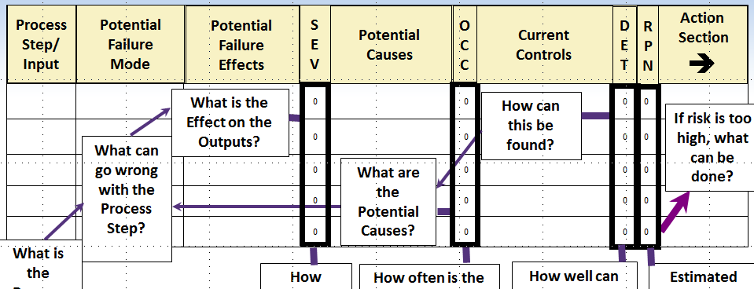
Key Source Material For An FMEA
PAPERWORK
TURN STEAM ON
TO DICY TANK
LOAD DMF
LOAD DICY
LOAD 2MI
1
Process Map
BILL OF MATERIALS
ISO PROCEDURES
REWORK
SCALE ACCURACY
PREHEATING
LOAD ACCURACY
CLEANLINESS
RAW MATERIAL
LOAD ACCURACY
ENVIRONMENT
(HUMIDITY)
RAW MATERIAL
MIXER SPEED
LOAD ACCURACY
ENVIRONMENT
(HUMIDITY)
RAW MATERIAL
MIXER SPEED
FMEA

Slide 7
The FMEA Form The Analysis Section
The FMEA Form - The Analysis Section
Process
Step/
Input
Potential
Failure
Mode
S
E
V
Potential
Causes
O
C
C
Current
Controls
Action
Section
➔
Potential
Failure
Effects
Current
Controls
D
E
T
R
P
N
What is the Effect on the Outputs?
How can this be found?
If risk is too high, what can be done?
What can go wrong with the Process Step?
What are the Potential Causes?
What is the Process Step
How serious is such an Effect?
How often is the cause likely to occur and result in a Failure Mode?
How well can we detect a cause before it creates a Failure Mode and Effect?
Estimated risk is “Sev” x “Occ” x “Det”

Slide 8
Definition Of Terms – Failure Mode
Failure Mode: The way in which a specific process input fails
If it is not detected and either corrected or removed, it may cause a negative “Effect” to occur
Can be associated with a defect (in discrete manufacturing) or a process input variable that goes outside of specification
Anything that an operator can see that’s wrong is considered a Failure Mode
Note 1: Just because a dimension is out of spec (a Failure Mode), it does not imply with 100% certainty that the product will not function (an effect)
Note 2: Just because the process is improperly setup (a failure cause), it does not imply with 100% certainty that the dimension will be out of spec (a Failure Mode)

Slide 9
Definition Of Terms – Effect And Cause
Effect: The adverse impact on customer requirements. Generally has an external customer focus, but can also include downstream processes.
A product or process that does not perform satisfactorily to design
Cause: Whatever causes the Failure Mode to occur. How a specific part of the process (operation or component) can cause a Failure Mode.
A worn spindle (cause) may cause a dimension to be out of tolerance (mode) which may cause the part to not fit (effect)

Slide 10
Definition Of Terms – Severity, Occurrence, And Detection
Severity: An assessment of how serious the Failure Effect (due to the Failure Mode) is to the customer
Occurrence: An assessment of the likelihood that a particular Cause will happen and result in the Failure Mode
Detection: An assessment of the likelihood that the current controls will detect the Cause of the Failure Mode or the Failure Mode itself, should it occur, thus preventing the Failure Effect from reaching your customer. The customer in this case could be the next operation, subsequent operations, or the end user

Slide 11
Definition Of Terms – Current Controls
Current Controls: Systematized methods/devices in place to prevent or detect failure Modes or Causes (before causing effects)
Prevention-based controls may include Mistake Proofing, automated controls, setup verifications, Preventive Maintenance, and Control Charts
Detection-based controls may include audits, checklists, inspection, laboratory testing, and Control Charts

Slide 12
Rating Definitions Typical Scales
Severity | Occurrence | Detection
Hazardous without warning | Very high and almost inevitable | Cannot detect
Loss of primary function | High repeated failures | Low chance of detection
Loss of secondary function | Moderate failures | Moderate chance of detection
Minor effect | Occasional failures | Good chance of detection
No effect | Failure unlikely | Almost certain detection
Severity
Occurrence
Detection
Rating
High 10
Low 1
Note : Determine if your company has rating scales and rules. In some companies, rating a “10” on severity may have legal consequences.

Slide 13
Risk Priority Number (RPN)
A key output of an FMEA is the “Risk Priority Number”
The RPN is a calculated number based on information you provide regarding:
The likelihood of potential causes of Failure Modes
The seriousness of the resulting effects
The current ability of the process to detect the causes of the Failure Modes before they cause an effect to reach a customer
It is calculated as the product of three (3) ratings, each one related to the severity, frequency, and detect ability
RPN = Severity x Occurrence x Detection Regardless of RPN, high severity scores should be given special attention.

Slide 14
Risk Priority Numbers (2)
The Risk Priority Number need not be limited to Severity, Occurrence, and Detection.
Some examples:
Add an “Impact” score to estimate the overall impact of the Failure Mode on the process (10 = high, 1 = low)
Add an “EHS” rating to a project FMEA to incorporate possible environmental impact (10 = high, 1 = low)
Add an “EOC” or Ease Of Completion (10 = easy, 1= hard) to help prioritize/focus projects

Slide 15
Comments On Detection Scores
Low Det Score
High Det Score
Virtually certain Prevention
Virtually no Prevention
Failure Mode
(Defect)
Cause
Effect
High detection scores imply that we will not easily catch the existence of a Failure Cause until after the resulting Failure Mode creates a Failure Effect. Usually, this means that we detect the effect at the end of the line or, even worse, our customer finds it.
A very low detection score generally implies that you catch the cause before it creates the Failure Mode.

Slide 16
FMEA Model
Cause
Mode
Effect
Cause
Faculty inverter
High particle count
Temp controller out
Drill not properly
Part not clamped
Drill not properly sharpened
Mode
Agitator too slow
Pits
Temp too high of calibration
Hole not drilled sharpened
Hole not drilled square in fixture
Hole not drilled
Effect
Extractable too high
Internal opens on printed circuit in clean room
Conversion rate too low
Part will not assemble straight
Part will not assemble straight
Part will not assemble to proper diameter
Notes:
Lets come up with some Healthcare examples here…

Slide 17
Linking Failure Modes To Effects Note: The Last Three (3) Examples On Prior Slide
Failure Mode 1
Effect 1
Failure Mode 2
Effect 2
Effect 1
Failure Mode 1
Effect 2
Failure Mode 1
Effect 1
Failure Mode 2
Note that the relationship between the Failure Mode and the Effect is not always 1-to-1.

Slide 18
A Second Look At The Analysis Section File: FMEA_Form.XLS
Process/Product - FMEA
Failure Modes and Effects Analysis
Process or
Product
Prepared by:
Page ____ of ____
Name:
Responsible:
FMEA Date (Orig) ______________ (Rev) _____________
Key
Potential Failure
Potential Failure
S
O
D
R
Process Step
Process
Mode
Effects
E
Potential Causes
C
Current Controls
E
P
Input
V
C
T
N
What is the
What is the
In what ways
What is the impact
What causes the
What are the existing
process step
Key
does the Key
on the Key Output
Key Input to go
FM occur?
controls and procedures
Process
Input go wrong?
Variables (Customer
wrong?
(inspection and test) that
cause or FM?
Input?
Requirements) or
to the customer?
prevent either the cause
Sev x Occ x Det
internal
How Severe is the effect
How often does cause or
or the Failure Mode?
How well can you detect
requirements?
Should include an SOP
number.
0
0

Slide 19
The FMEA Form The Action Section
Analysis
Section
⬅
R
P
N
Actions
Recommended
Responsibility
Actions
Taken
S
E
V
O
C
C
D
E
T
R
P
N

Slide 20
9 Strategies To Complete An FMEA
For each Process Input, determine the ways in which the Process Step can go wrong (Failure Modes)
For each Failure Mode associated with the inputs, determine Effects
Identify potential Causes of each Failure Mode
List the Current Controls for each Cause
Assign Severity, Occurrence, and Detection ratings to each Cause
Calculate RPN
Determine Recommended Actions to reduce High RPNs
Take appropriate actions and document
Recalculate RPNs
Notes:
SK: Changed the title

Slide 21
Getting Started
Utilize Process Maps, C&E Diagrams, C&E Matrices, data collection, warranty analysis, testing, and other pertinent information
Select people from functions both upstream and downstream from the process under analysis
Engineering
Manufacturing
Maintenance
Tooling
Quality Assurance
Marketing
Suppliers
Health, Safety, and Environment (HSE)

Slide 22
Exercise # 1: The FMEA Analysis
Notes:
Provide FMEA Excel files to exercise

Slide 23
Practical Tips for FMEA
Do not try FMEA alone, it is a group activity
FMEA, done right, may be a time consuming process
Activities are required for completion, it is not just a paperwork
activity
The team will likely need training and coaching
Prepare properly for meetings
Summarize often
Make sure voting is independent (suggest anonymous ballots)
Negotiate issues
Notes:
SK: Changed the title

Slide 24
Summary
Failure modes and effects analysis (FMEA) is a step-by-step approach for identifying all possible failures in a design, a manufacturing or assembly process, or a product or service.
A key output of an FMEA is the “Risk Priority Number.”

Slide 25

Thank You

