Slide 1

Quick Wins 5S and 8 Wastes
Presented By The University of Texas-School of Public Health
This material was produced under grant number SH-22316-SH-1 from the Occupational Safety and Health Administration, U.S. Department of Labor. It does not necessarily reflect the views or policies of the U.S. Department of Labor, nor does mention of trade names, commercial products, or organizations imply endorsement by the U.S. Government.

Slide 2
Learning Objectives
By the end of this module participants should be able to:
Identify the value of a quick win
Identify the principles of 5S
Select the appropriate strategies to apply the 5S approach in the hospital unit environment.
Describe the 8 types of wastes
Analyze the 8 wastes in the hospital unit environment.

Slide 3
The DMAIC Process with Tools
DAY 2
Define
Phase
3&4
Measure
Tools:
FMEA
Quick Wins 5S & The 8 Wastes
Analyze
Improve
Control

Slide 4
Value of a Quick Win
It is easy to achieve
Gives a project a jumpstart to help build momentum
Offers a team a rallying point
Builds confidence of team members

Slide 5
What is 5S?
Purpose:
To create and maintain an organized, clean, safe and high performing workplace.
Enables anyone to distinguish between normal and abnormal conditions at a glance
A systematic way to improve workplace and processes through frontline staff involvement

Slide 6
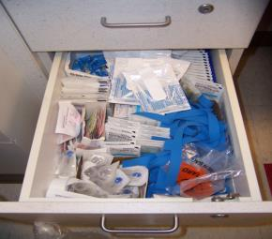
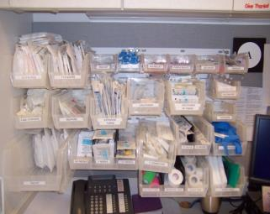
Example of 5S
Before:
After:

Slide 7
The Principles of 5 S
S
ORT
S
TRAIGHTEN (Set in Order)
S
CRUB
S
TANDARDIZE
S
USTAIN

Slide 8
5 S Steps
S
S
ort
traighten
(Set in Order)
MAY 1996
JUNE 1996
JULY 1996
S
S
S
crub
tandardize
ustain

Slide 9
An Orderly Environment
An orderly environment consists of three things:
Evaluation of the usefulness of all things located within the physical space, and elimination of all that is not useful
Organization of the useful items so they are always within reach and easily found when needed
A workplace that is clean and neat at all times
Benefits of an orderly environment
Elimination of wasted space
Improved productivity
Enhanced morale

Slide 10

The First S:
S
ORT
Determine what is needed and remove the rest.
Organization improves work flow; this will have a huge impact on Productivity and Quality
Organization also helps improve communication; it communicates visually

Slide 11
Red Tag Method
Establish rules for distinguishing between what is and is not needed
Identify needed and unneeded items and attach Red Tags to all potentially unneeded items. Write specific reason for Red Tagging and sign and date each tag
Remove Red Tag items and temporarily store them in an identified holding area
Sort through Red Tag items; dispose of those which are truly superfluous. Other items can be eliminated at an agreed upon interval when it is clear that they have no use. Ensure that all stakeholders agree
Determine ways to improve the workplace so that unnecessary items do not accumulate
Continue to Red Tag regularly

Slide 12
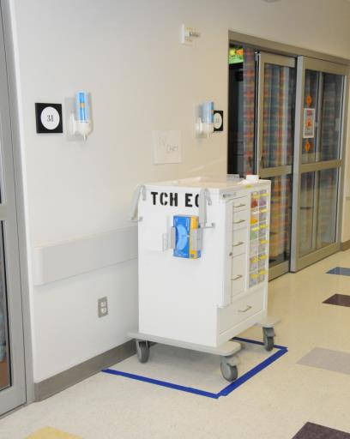
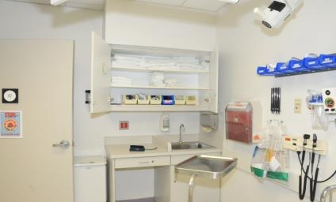
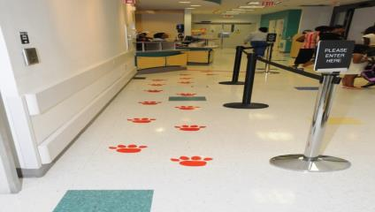
S
The Second S:
TRAIGHTEN (Set in Order)
Make a place for everything and label items for easy recovery.

Slide 13
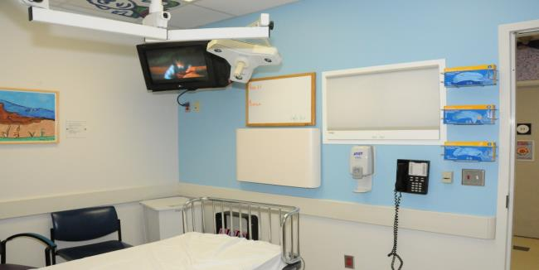
S
CRUB
The Third S:
Definition
Keeping areas clean on a continual basis
Why
A clean workplace is indicative of a quality product and process
Dust and dirt cause product contamination and potential health hazards
Helps to identify abnormal conditions

Slide 14
S
The Fourth S: TANDARDIZE
Standardize and make the orderly condition routine
This photo is a 5S checklist, which spells out the tasks needed to maintain the area
Without standardization, conditions will go back to their prior state
- Sample Form -

Slide 15
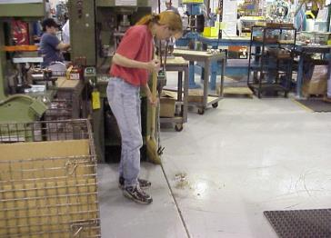
S
The Fifth S: USTAIN
Definition
To maintain our discipline, we need to
practice and repeat until it becomes a
way of life
Why
To build 5-S’s into our every day process
Things to Remember
Develop schedules, check lists
Good habits are hard to break
Commitment and discipline toward housekeeping is essential in taking the first step in being world class

Slide 16
S
The Fifth S: USTAIN

Slide 17
S
The Fifth S: USTAIN

Slide 18
S
The Fifth S: USTAIN

Slide 19
S
The Fifth S: USTAIN
THE 5S OBSERVATION SUMMARY
SHIFT: AREA:
Two noted 5S successes:
Score Results:
/4
Five priority areas needing attention:
Current situation Score:
Desired situation Score:
1
2
3
4
5
5S target objective:
/4

Slide 20
5S Levels Of Achievement
Level
Sort
Straighten
Scrub
Standardize
Sustain
0
Just Beginning
Needed and not
needed items are
mixed throughout
the area.
Items are randomly
placed throughout
the workplace.
Key area items
checked are not
identified and are
unmarked.
Work area methods
are not always
followed and are
not documented.
Work area checks
are randomly done
and there is no
5S measurement.
1
Focus On
Basics
Necessary and un-
necessary items are
identified; those not
needed are gone.
Needed items are
safely stored and
organized according
to usage frequency.
Key area items
are marked to check
and required level of
performance noted.
Work group has
documented area
arrangement and
controls.
Initial 5S level
is established and
and is posted in
the area.
2
Make It Visual
Initial cleaning is
done and mess
sources are known
and corrected.
Needed items are
outlined, dedicated
locations are labeled
in planned quantities.
Visual controls and
indicators are set
and marked for
work area.
Agreements on
labeling, quantities,
and controls are
documented.
Work group is
routinely checking
area to maintain
5S agreements.
3
Focus On
Reliability
Cleaning schedules
and responsibilities
are documented
and followed.
Minimal needed
items arranged in
manner based on
retrieval frequency.
Work area cleaning,
inspection, and
supply restocking
done daily.
Proven methods for
area arrangement
and practices are
used in the area.
Sources, frequency
of problems are
noted w/ root cause
and corrective action.
4
Continuous
Improvement
Cleanliness problem
areas are identified
and mess prevention
actions are in place.
Needed items can
be retrieved in 30
seconds with
minimum steps.
Potential problems
are identified and
countermeasures
documented.
Proven methods for
area arrangement
and practices are
shared and used.
Root causes are
eliminated and
improvement actions
include prevention.
Notes:
Handout for learners

Slide 21
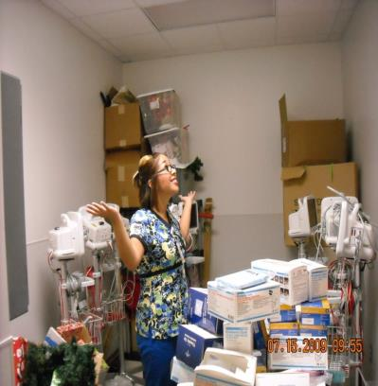
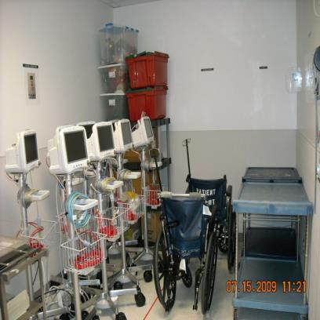
Why is Value Stream Mapping important for assessing current state?
Before:
After:

Slide 22
The 8 Wastes
Wastes
The simple explanation…
D
It just doesn’t meet expectations
Defects
O
Doing more than you need to – Output of a process
Overproduction
W
Things just don’t happen when they should
Waiting
N
Non-Utilized Human Intellect
Not including the input of those people most directly involved in the process
T
Transportation
Shipping stuff to different locations
I
Excess Inventory
Keeping stuff on-hand when it isn’t required
M
Excess movement-person/material – within a process
Motion
E
Extra Processing
Doing more than you need to – within a process

Slide 23
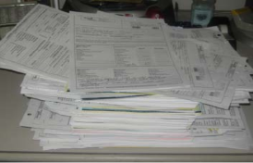
The 8 Wastes in Detail
1. DEFECTS
Repair of a product or service to fulfill customer requirements
Scrap
Warranty
Customer returns
2. OVERPRODUCTION
Producing more than needed (beyond customer demand)
Producing faster or sooner than needed
Visible as stored material
Result of producing to speculative demand (forecast)

Slide 24
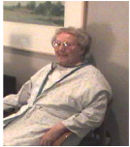
The 8 Wastes in Detail
3. WAITING
Idle time that results when dependent activities are not fully synchronized
Waiting for a machine to process or a machine waiting for an operator to load
4. NON-UTILIZED HUMAN INTELLECT
Not listening to employees ideas who are involved first hand in the actual work
Not incorporating front line workers in the process of new product design
Not acting on employee complaints about legitimate problems and solutions

Slide 25
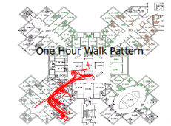
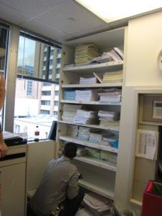
The 8 Wastes in Detail
5. TRANSPORTATION
Any material movement or handling
Transportation does not add value and should be minimized or eliminated
6. INVENTORY
Excessive in-process or finished goods inventory caused by large lot production or processes with long Cycle Times
Inventory should exist for two reasons:
Buffer required to maintain throughput in an
environment where variation is present
Satisfy customer demand
Reducing variation enables inventory reduction

Slide 26
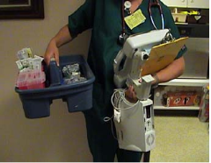
The 8 Wastes in Detail
7. MOTION
Any movement of people or machines which does not contribute added value to the product or service
Programming delay times
Excessive walking distance between operations
Ergonomically inefficient motion
8. EXTRA PROCESSING
Effort which adds no value to a product or service
Enhancements which are “invisible” to the customer
Work which could be combined with another process

Slide 27
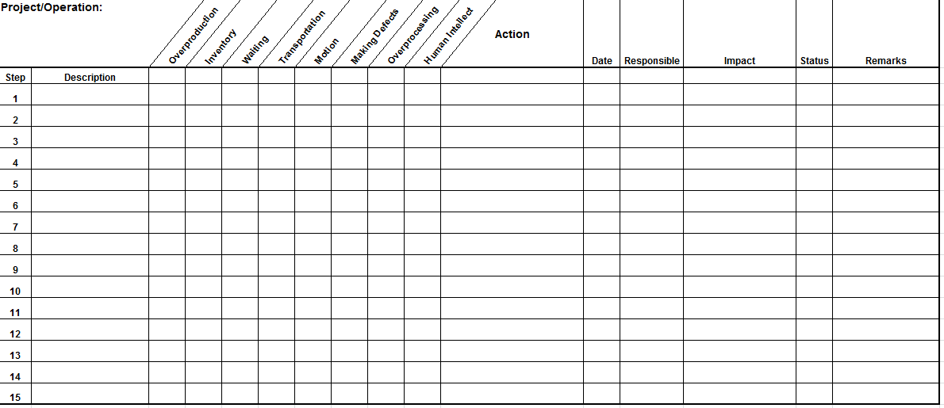
Exercise # 1: The 8 Wastes
Notes:
Provide the worksheets for the participants

Slide 28
Summary
Quick wins 5S is to create and maintain an organized, clean, safe and high performing workplace.
The Principles of 5 S :
Sort
Straighten
Scrub
Standardize
Sustain
The 8 Wastes in Detail:
Defects
Overproduction
Waiting
Non-Utilized Human Intellect
Transportation
Excess Inventory
Motion
Extra Processing

Slide 29

Thank You

