Slide 1

Lean Visual Controls
Presented By The University of Texas-School of Public Health
This material was produced under grant number SH-22316-SH-1 from the Occupational Safety and Health Administration, U.S. Department of Labor. It does not necessarily reflect the views or policies of the U.S. Department of Labor, nor does mention of trade names, commercial products, or organizations imply endorsement by the U.S. Government.

Slide 2
Learning Objectives
By the end of this module participants should be able to:
Identify the definition of visual control.
Identify the four different types of visual control tools.
Select appropriate methods using four visual control tools to develop Lean visual controls.
Notes:
Define the concept of a visual control
Describe the goal of incorporating visual controls into a process
Understand the purpose and application of Takt boards, performance productivity boards, 5 S boards, and Kanbans
Identify opportunities to use visual controls in projects

Slide 3
The DMAIC Process with Tools
DAY 3
Define
Phase
5
Measure
Tools:
Controls Plans
Lean Visual Controls
Mistake Proofing (Poke Yoke)
Analyze
Improve
Control

Slide 4
Visual Control
Visual Control: A technique where control of an activity or process is made easier or more effective by deliberate use of visual signals.
  They give feedback to an operator about how a process is working and can alert the operator to act
  Usually used in 5S, but can be implemented with any process improvement initiative
  Visual Controls can also include audible signals
  The 3 beeps from your microwave once your food has finished cooking

Slide 5
Visual Control
The goal of visual controls is to make a process:
  Self-explaining
    Scoreboard at a baseball game
  Self-ordering
    Omnicells
  Self-regulating
    Traffic lights
  Self-improving
    Facilitate corrections in MS Word or email

Slide 6
Examples of Visual Control
The red light on your DVR indicating a movie is recording
Different colored clothing for different football teams
Painted lines on the freeway
The red, yellow and green flags outside of a patient’s room at a doctor’s office
Tracking boards in EC driving physician behavior

Slide 7
4 Visual Control Tools
1
Takt boards
2
3
5S boards
4
Kanban cards
Issue boards

Slide 8
1. TAKT Board
Process summary
Part number specific
Number of parts/patients in a process
Quantity of WIP or quantity of patients waiting
Daily Takt rate for each part/patient
Daily summary information
  Takt
  Actual output
  WIP
  Cycle time
Jobs in process
Value of WIP
Daily Takt rate for process
Daily summary information
  Productivity
  Actual output
  WIP
  Cycle time

Slide 9
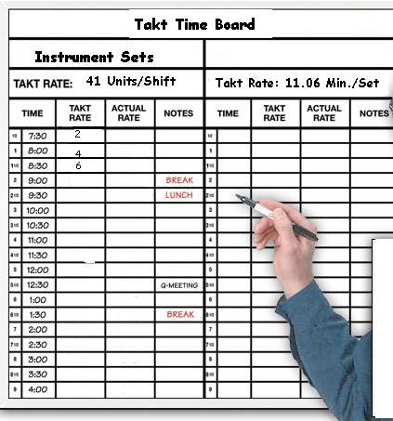
1. TAKT Board

Slide 10
2. Performance/Productivity Board
Production/process related issues
  “Can-do” items → can be resolved by the team
  “Need help” → need external assistance from management team, engineer, maintenance to resolve
Dashboard metrics
  Productivity
    First pass yield (scrap, repair, rework)
    Rolled throughput yield
  Timeliness
    On-time delivery
    Weekly Takt rate average
    Equipment uptime/downtime
    (unscheduled maintenance)
  Quality
    Process capability and stability indices
  Financial
Cross-training matrices
2
Performance/Productivity Board

Slide 11
3. 5S Board Information
Used to maintain 5S
  Set in order maps
  Standardize checklists
  5S audit results (checklist)
  5S audit results (spider graph)
  Action plan for improvement
  Before/after photos

Slide 12
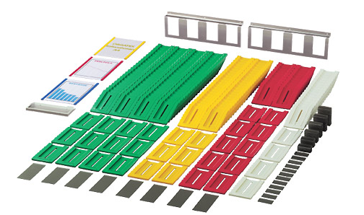
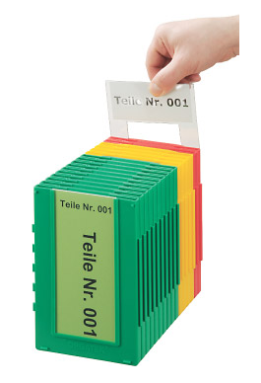
4. Kanbans
Visual signal to:
  Replenish materials consumed in the production process over time
  Trigger action

Slide 13
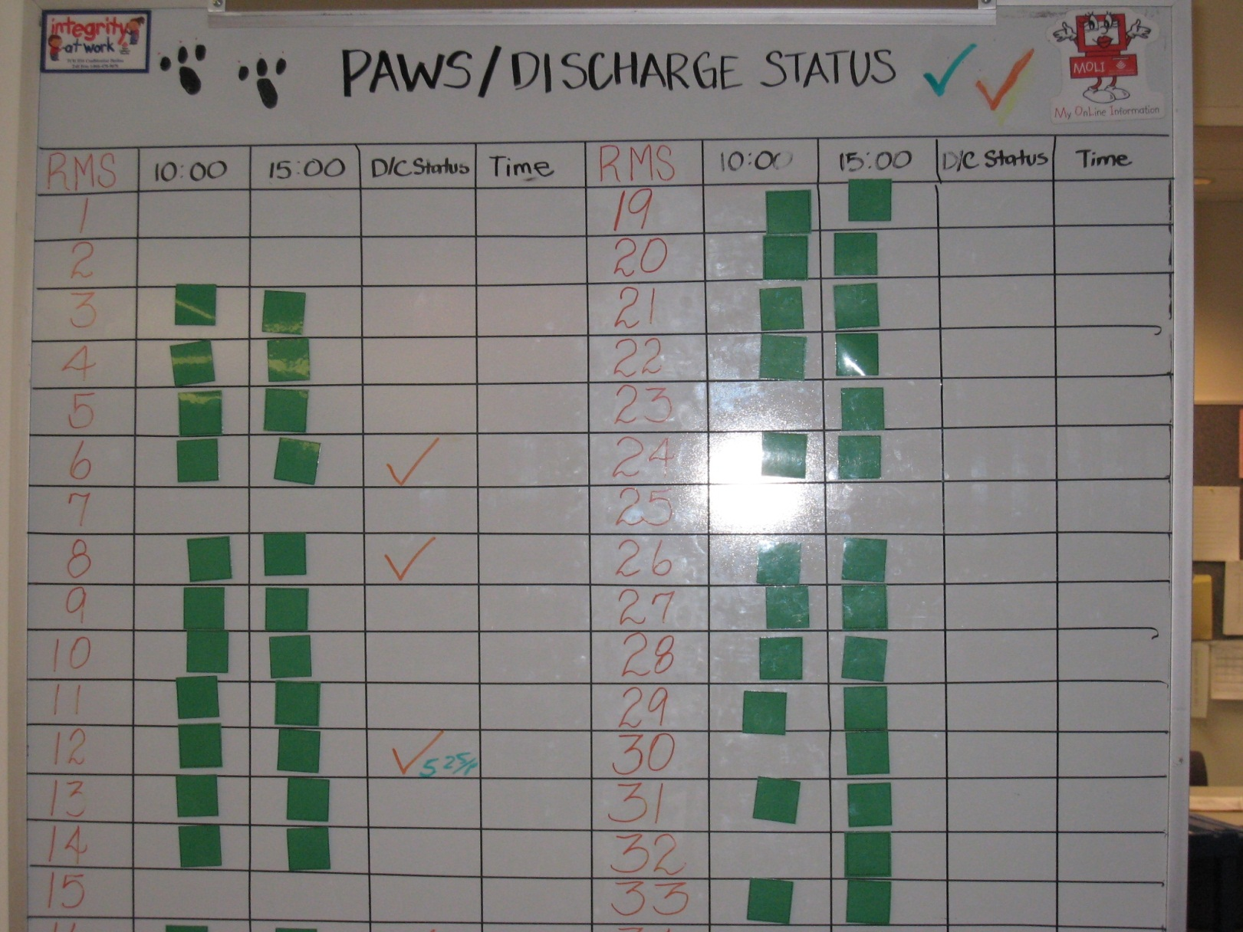
Examples of Visual Controls

Slide 14
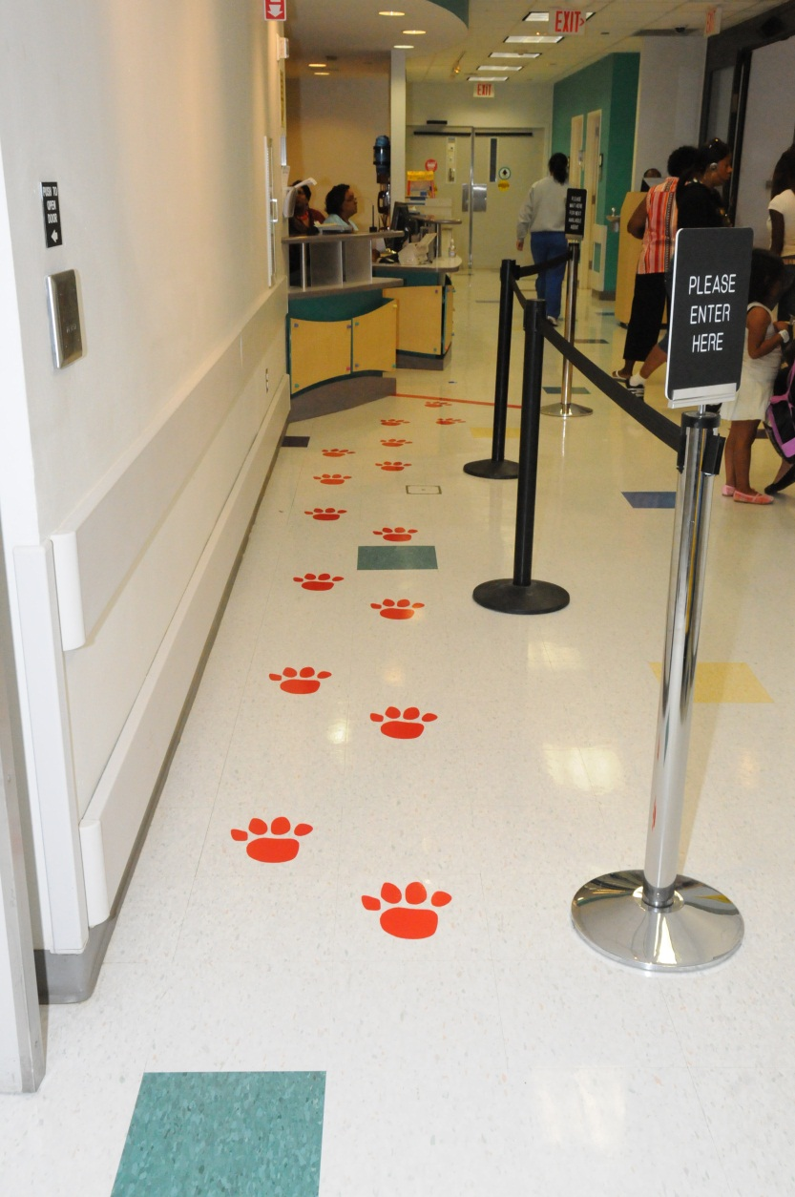
Examples of Visual Controls

Slide 15
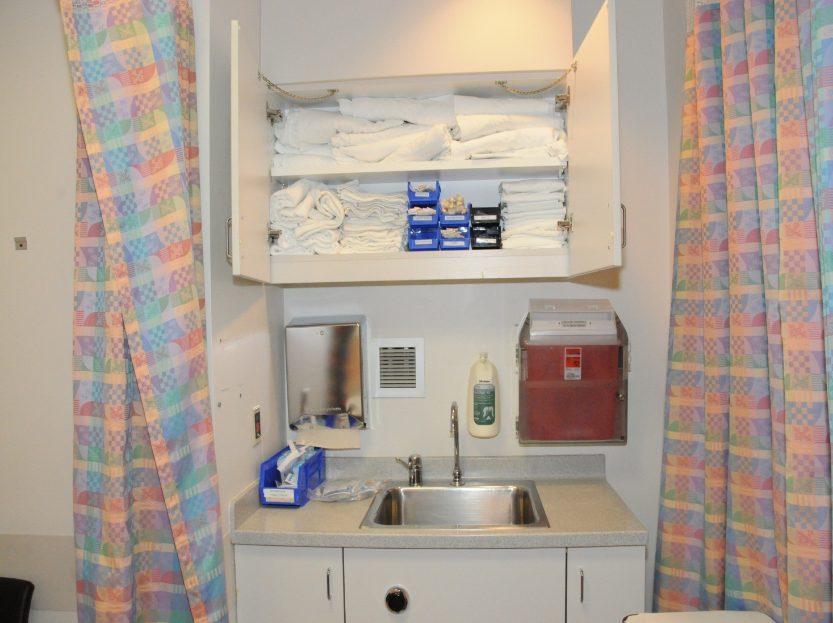
Examples of Visual Controls

Slide 16
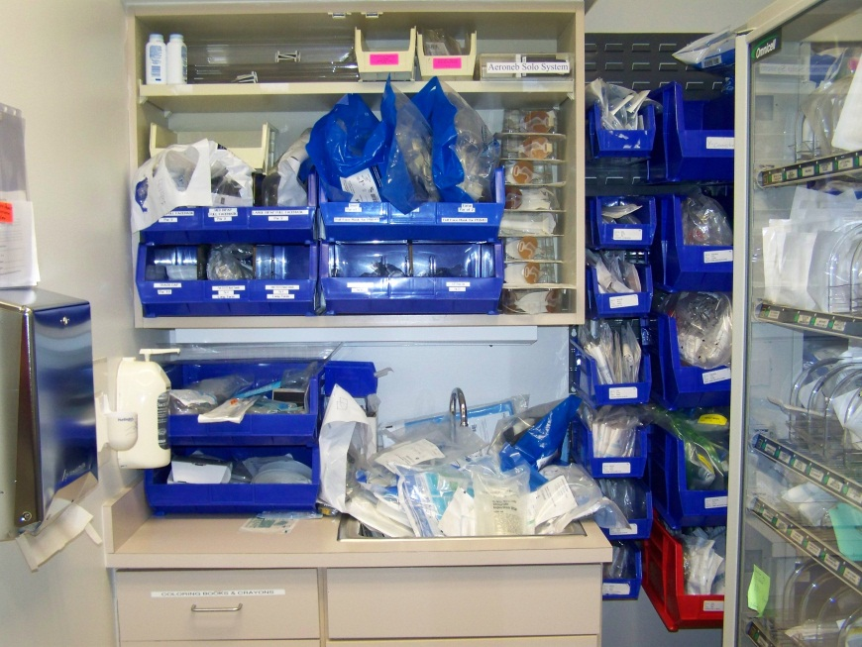
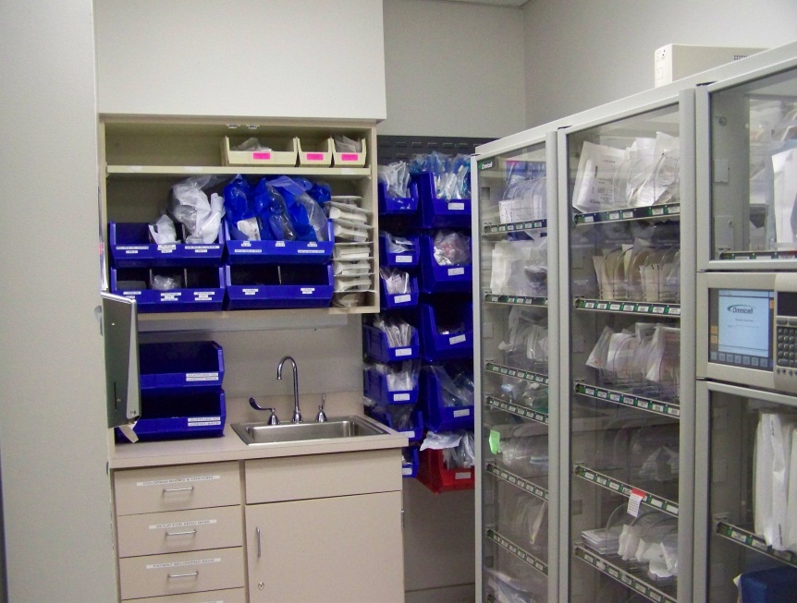
Examples of Visual Controls
Before:
After:

Slide 17
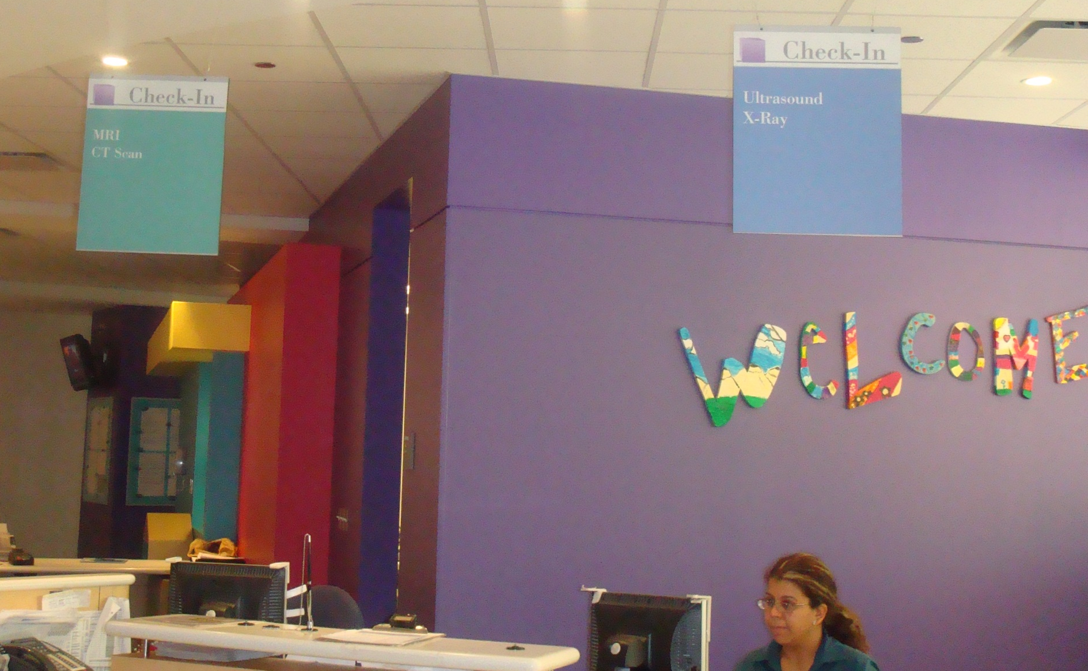
Examples of Visual Controls

Slide 18
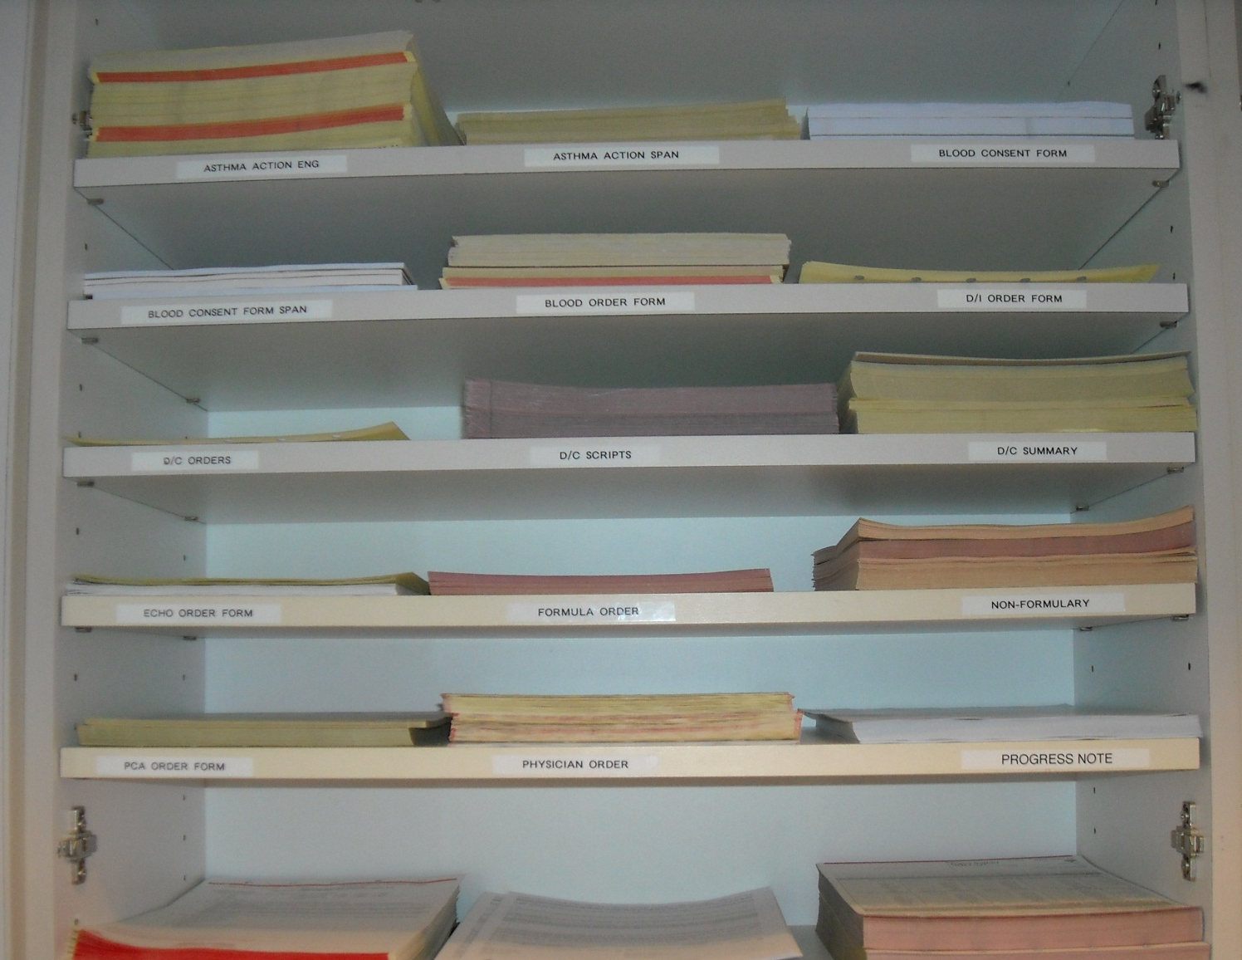
Examples of Visual Controls

Slide 19
Exercise # 1:
Break into teams
Select one project from your team and brainstorm as many visual controls that you can
Think of visual controls that could be put in place for:
  How to prevent something from going wrong
  How to improve process efficiencies or reduce waste
  How to improve customer/patient satisfaction
  How to notify someone that work is waiting or process is completed
  How to help staff be visually aware of policies or procedures
Time: 20 minutes
Report out: select one person from your team to report your findings at the end of the exercise
Notes:
Provide the worksheets for the participants

Slide 20
Summary
Visual control is a technique where control of an activity or process is made easier or more effective by deliberate use of visual signals.
Four different visual control tools are
  1. Takt boards
  2. Issue boards
  3. 5S boards
  4. Kanban cards

Slide 21
Thank You

