Slide 1

Mistake Proofing (Poke Yoke)
Presented By The University of Texas-School of Public Health
This material was produced under grant number SH-22316-SH-1 from the Occupational Safety and Health Administration, U.S. Department of Labor. It does not necessarily reflect the views or policies of the U.S. Department of Labor, nor does mention of trade names, commercial products, or organizations imply endorsement by the U.S. Government.

Slide 2
Learning Objectives
By the end of this module participants should be able to:
Identify the concept and importance of mistake proofing (poke yoke)
Apply Poke Yoke methods as a control on identified key Xs to reduce or eliminate process errors and defects from occurring
Select the appropriate strategies and methods for mistake proofing based on DMAIC Implementation road map

Slide 3
The DMAIC Process with Tools
DAY 3
Define
Phase
5
Measure
Tools:
Controls Plans
Lean Visual Controls
Mistake Proofing (Poke Yoke)
Analyze
Improve
Control

Slide 4
What is Mistake Proofing (Poke Yoke)?
Japanese phrase:
Yokeru
Poke
Poke Yoke
(to avoid)
(errors)

Slide 5
Concept of Mistake Proofing (Poke Yoke)
A strategy for preventing errors in processes
Makes it impossible for defects to pass unnoticed and corrects them immediately
Technique detects defects and prevents them from moving into next area
Developed by Dr. Shigeo Shingo to achieve zero defects
Mistake Proof devices cannot be implemented until the key Xs
needing to be controlled have been identified and settings
established

Slide 6
Importance of Mistake Proofing
Improved quality and customer satisfaction
Prevents error occurrence
Prevents defect occurrence
If defects occur, ensures effective action
Little or no formal training
Cost effective
Easy to implement
30-50 Inputs
10-15 Xs
8-10 KPIVs
4-8 Key KPIVs
3-6 Key KPIVs
Y
Apply Mistake Proofing to key Xs or directly to the Y to ensure
metrics remain at optimum project defined settings.

Slide 7
Basics Of Mistake Proofing
Effective Mistake Proofing requires two basic concepts
1
A focus on controlling the factors which cause errors
Not fixing the resulting defective output
2
Inspection which is effective and tireless
This IS NOT a traditional 100% inspection by inspectors.
This IS a mechanical or process improvement that automatically performs the inspection with little to no human interaction.

Slide 8
Basics Of Mistake Proofing
Anybody can and should practice poke yoke in the workplace.
It’s not rocket science!
Sometimes it just needs common sense and the appropriate poke yoke device.
Poke yoke devices should have the following characteristics:
Useable by all workers
Simple to install
Does not require continuous attention from the operator (ideally, it should work even if the operator is not aware of it)
Low-cost
Provides instantaneous feedback, prevention, or correction. A lot of Shingo's poke yoke devices cost less than $50!

Slide 9
Common Examples Of Mistake Proofing
Home
auto shut off on iron
Auto
car won’t start unless transmission is in park/neutral
Sport/Recreation
dead man’s lanyard on personal watercraft
Amusement Parks
sensors on roller coaster tracks
Work/Commerce
pull down menus on forms

Slide 10

Mistake Proofing Business Processes
Mistake Proofing is the primary means of control for many business processes.
Spell check
Checklists
Color coding (boxes, work areas, products, components)
Pull down menus
Required fields

Slide 11
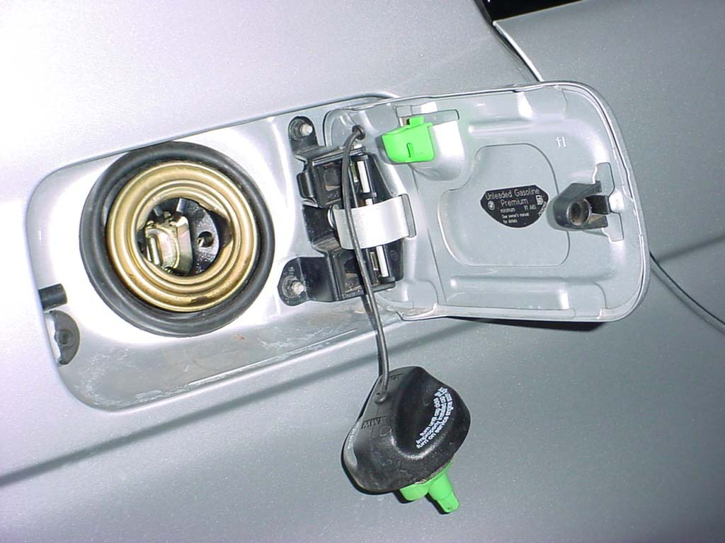
Error Proofing In Action
What are the error opportunities in this everyday item?
How has it been error proofed?
How could it be further error proofed?

Slide 12
Evolution Of Defectives And Application Of Mistake Proofing
ERRORS
DEFECTS
DEFECTIVES
Prevention
Detection in Process:
Detection After Mistake:
Elimination of issues at the source, or prevention of errors from occurring
Catch errors during processing before becoming a problem
Detect defects before they move to next step
Best
(prevention)
Good
(detection)

Slide 13
Human Errors That Lead To Potential Key X Variation
Forgetfulness
Errors due to misunderstanding
Errors in identification
Errors made by untrained workers
Willful errors (ignore rules)
Inadvertent errors (distraction, fatigue)
Errors due to delay in decision making
Errors due to lack of standards
Surprise errors (malfunctions)
Intentional errors (sabotage)
Prevention
Detection in Process:
Detection After Mistake:
Also consider Mistake Proofing against these having any impact on your Key Xs.

Slide 14

Red Flag Condition
What is a Red Flag condition?
You will find that in some projects, after you have identified the Key Xs and their optimal settings, one or more of them may be extremely difficult to control. The control plan should attempt to provide robust control mechanisms, however it may be difficult to do so without Mistake Proofing. Some examples:
Training was found to be critical, but the operation has 150% turnover
Cycle Times are very long, so the operators tend to lose concentration and Key X breakdowns may not be observed even though gages/process measurements show the issue
Mistake Proofing is a good control application for conditions such as these.

Slide 15
Implementation Road Map For Mistake Proofing
(Define)
Describe the defect or potential defect including the rate
Apply 5 Why analysis to the error conditions to determine root causes
(Measure)
Identify where the defect is likely to occur
(Improve/Control)
Identify (using a team approach) Mistake Proofing strategies
(Analyze)
Analyze current tasks associated with the operation
(Control)
Identify error conditions contributing to the defect
Verify the efficiency of the Mistake Proofing actions

Slide 16


Mistake Proofing Considerations
Create an environment that…
Emphasizes quality work
Promotes involvement and creativity
Strives for continuous improvement

Slide 17

Mistake Proofing Considerations
How to create an environment ?
Eliminate, simplify, or combine operations
Use one piece flow rather than process batch flow
Beware of overproduction and inventory
(high inventory makes poor quality difficult to see)
Involve everyone in error and defect prevention
(standard practices, daily improvements, training, and incentives)

Slide 18
Exercise # 1:
Going around the class, name a Mistake Proofing idea from one of the following:
Home, e.g., auto shut off on flat iron
Auto, e.g., car won’t start unless transmission is in park/neutral
Sport/Recreation, e.g., dead man’s lanyard on personal watercraft
Amusement Parks, e.g., sensors on roller coaster tracks
Work/Commerce, e.g., pull down menus on forms
Etc.
Break into your groups and pick one project per group.
Identify a common, recurring issue within the project and list the defects contributing to it. Then, determine the errors that cause the defect and brainstorm for potential mistake-proofing on all levels.
Are you Preventing, Detecting During the Process, or Detecting After the Process?
Notes:
Provide the worksheets for the participants

Slide 19
Summary
Mistake Proofing (Poke Yoke) is a strategy for preventing errors in processes.
Effective Mistake Proofing requires two basic concepts:
1. A focus on controlling the factors which cause errors
2. Inspection which is effective and tireless

Slide 20
Thank You

