Slide 1
Fall Protection Training

Slide 2
DISCLAIMER: This material was produced under grant number SH22317-11-60-F-53 from the Occupational Safety and Health Administration, U.S. Department of Labor. It does not necessarily reflect the views or policies of the U. S. Department of Labor, nor does mention of trade names, commercial products, or organizations imply endorsement by the U. S. Government. The U.S. Government does not warrant or assume any legal liability or responsibility for the accuracy, completeness, or usefulness of any information, apparatus, product, or process disclosed.

Slide 3
COPYRIGHT INFORMATION: This material is the copyrighted property of University of Washington. By federal regulation, OSHA reserves a license to use and disseminate such material for the purpose of promoting safety and health in the workplace. The University of Washington hereby authorizes employers and workplace safety and health professionals to use this material, distributed by or through OSHA, in their workplaces or practices in accordance with the guidance contained in the material.
To this end, permission is granted to use such copyrighted material solely for non-commercial, instructional, personal, or scholarly purposes. The material may be used and incorporated into other workplace safety and health programs on the condition that no fee may be charged for the subsequent use of the material. Use of the material for any other purpose, particularly commercial use, without the prior, express written permission of the copyright owner/s is prohibited. Furthermore, any modification to the material is prohibited without the prior, express written permission of the copyright owners.

Slide 4
CONTACT INFORMATION:
Please contact the Department of Construction Management, University of Washington if you have any questions or comments about the materials.

Slide 5
All information available at http://cm.be.washington.edu/Research/SHARE/2011OSHA/index.html

Slide 6


Slide 7
Case 1
When removing old shingles at the peak of a pitched roof of a residential building, a roofing helper struck with his body the new stacked bundle of shingles located next to him. The victim chased the shingles to stop them from falling off the roof, lost his balance and fell 16.5 feet.

Slide 8
1
Stacked new shingles
24˚
16.5 ft
“Remove old shingles and install new ones.” (3-tab asphalt composite roofing shingles (1’*3’*4”))

Slide 9
2
“Let’s get started.”

Slide 10
3
“Oops! I should stop the shingles.”

Slide 11

4
“Helpppppppppppp.”

Slide 12
5
?
What could I have done differently before my death?

Slide 13
Why was the method used to perform the task in this example unsafe?
2. Which is the correct, or safe, way of performing the task?
“Add slide-guard?”
“Add guardrail on the sloped roof?”
“Wear harness and use lifeline?”
A
B
C

Slide 14
Case 2
The workers were assigned a job to remove the old metal panels of a church roof and replace them with the new ones. The victim, a sheet metal mechanic, removed the screws that attached an old metal roof panel to the roof joists. The worker then stood up and stepped backward into a roof opening which was covered only with fiberglass insulation. The worker fell 30 feet to the hardwood floor inside the church and died.

Slide 15
1
Plan
140ft
A
80ft
23.5ft
Roof joist (8”*4”)
Corrugated metal panel
(Old: 3’*6’; New:20”*16’)
Fiberglass insulation panel
4.76˚
40ft
30ft
28.5ft
27ft
Section A-A
“Remove screws of roof metal panels.” (Old panels: corrugated metal panels of 3’*6’)

Slide 16
2
9ft
9ft
New panel
(20”*16’)
Old panel
(3’*6’)
Plan
Section
“Remove screws of roof metal panels.” (Old panels: corrugated metal panels of 3’*6’)

Slide 17
3
“Let’s get started.”

Slide 18

4
Covered only with insulation
Covered with metal panels
“Oops! This part of roof was covered just with insulation.”

Slide 19

5
“Auuuuuuuuuuuu!”

Slide 20
6
?
What could I have done differently before my death?

Slide 21
Why was the method used to perform the task in this example unsafe?
2. What is the safest way of performing the task?
“Use harness and life line + guardrail?”
“Use guard-rail + slide-guard?”
“Use harness and life line + plywood blocks?”
A
B
C

Slide 22
Case 3
When installing a light bulb on top of a step ladder, a worker lost his balance and fell off the ladder through the unprotected open-sided edge of a porch. He hit his head on the concrete block retaining wall across the porch and died.

Slide 23
1
9ft
3ft
7ft
“Change light bulb in the balcony.”

Slide 24

2
12
12
9
3
9
3
End
6
6
Start
How much time do I have to do the task?

Slide 25
3
+
What should I use to reach the light bulb? (Extension ladder, swivel chair, Stacked buckets, step ladder)
Where should I put the tool? (ditch, balcony floor)

Slide 26

4
Let’s get started. (The worker decided to use the 3-foot step ladder and put it on the unprotected balcony floor.)

Slide 27

5
Oops! (He fell off the ladder into the ditch and got injured.)

Slide 28
6
?
What could I have done differently before my death?

Slide 29
Why were the methods available to perform the task in this example unsafe?
A
B
Use a swivel chair.
Use a bucket.
C
D
Use a stepladder.
Use the extension ladder.

Slide 30
2. Which is the correct, or safe, way of performing the task?
Use a shorter ladder?
Use a longer ladder
and rotate it?
Use an extension ladder?
Protect the open edge
and use an extension pole?
A
B
C
D

Slide 31
3. You can avoid the hazards identified in the scenario by making sure you follow the safeguards listed below:
Stay behind a guardrail,
Find the right tool to do the task.

Slide 32
Case 4
The victim was working on the top of an unstable steep extension ladder doing touch up paintings and installing metal roof tie-downs when the ladder with the victim on tipped over backward. As a result, the worker struck his head on the concrete floor and died due to injuries.

Slide 33
1
roof support post
18.5˚
16ft
10ft
20ft
“Do touch up paintings and install roof tie-downs.”

Slide 34
2
“Let’s get started with an extension ladder.”

Slide 35

3
“Oops! The ladder tipped over.”

Slide 36
4
?
What could I have done differently before my death?

Slide 37
Why was the method used to perform the task in this example unsafe?
2. Which is the correct, or safe, way of performing the task?
Use a step ladder.
Rest an extension ladder on the column at the 4:1 angle?
Rest an extension ladder on the column at the 6:1 angle?
A
B
C

Slide 38
Case 5
A drywall finisher was assigned a finishing task at the upper part of a wall. To do that, he positioned a step ladder on top of the platform in a rolling scaffold and leaned the top of the ladder against the wall. When the victim climbed the ladder, the scaffold rolled as a result of the force applied at the ladder’s foot. The victim fell 19 feet and died.

Slide 39
1
25ft
7ft
5ft
17ft
“Fill the heads of screws, at the upper section of the wall, with the filler compound.”

Slide 40
2
Wheels not locked!!!!
“Let’s get started.”

Slide 41

3
“Oops! The scaffold is rolling.”

Slide 42
4
“Helpppppppppppp!”

Slide 43
5
?
What could I have done differently before my death?

Slide 44
Why was the method used to perform the task in this example unsafe?
2. Which is the correct, or safe, way of performing the task?
“Use a bucket instead of a ladder and lock the wheels?”
“Use a scaffold with guardrails, locked wheels, and a safe ladder?”
“None of the options (above)?”
A
B
C

Slide 45
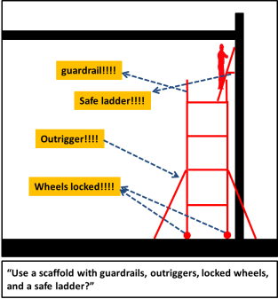
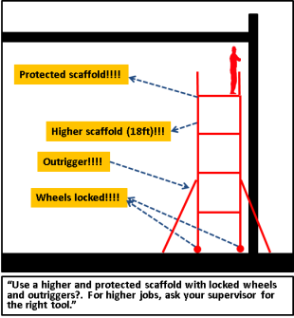
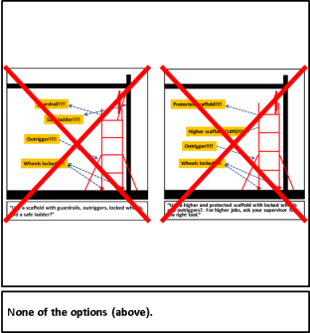
3. Of the following, which is the correct, or safe, way of performing the task?
A
B
C

Slide 46
Case 6
Working on top of the scaffold to scrape the roof eaves, a worker fell 15 feet through the gap between the floor board and scaffold rails, struck the scaffold cross brace, was flipped to the outside of the scaffold and fell additional 20 feet before hitting an air conditioning unit. He died later due to the injuries.

Slide 47
1
3ft
41ft
3ft
6ft
35ft
35ft
“Scrape the roof eave.”

Slide 48
2
Plan
Scaffold floor board
(12”*6’*1”)
Air conditioning
unit
Section
“Let’s get started.”

Slide 49

3
1
Plan
15ft
2
3
20ft
Section
“Oops! I fell through the gap within scaffold floor.”

Slide 50
4
?
What could I have done differently before my death?

Slide 51
Why was the method used to perform the task in this example unsafe?
2. Which is the correct, or safe, way of performing the task?
“Use fully-covered floor, and fall protection equipment?”
“Use fall protection equipment, fully-covered floor, guardrail, adequately-secured scaffold and access ladder?”
“Use guardrail and adequately-secured scaffold?”
A
B
C

Slide 52
You have the RIGHT to:
Ask OSHA to inspect your workplace. (1-800-321-OSHA)
Exercise your rights under the law without retaliation and discrimination.
Receive information and training about hazards, methods to prevent the harm, and OSHA standards that apply to your workplace. The training must be in a language you can understand.
Get copies of test results done to find hazards in your workplace.
Review records of work-related injuries and illnesses.
Get copies of your medical records.

