Slide 1
Introduction To the occupational safety and health administration

Slide 2
Learning objective
Upon completion of this unit the participants will be able to summarize the foundations and functions of OSHA as it pertains to Wisconsin dairy farmers.

Slide 3
Learner Outcomes
1. Explain the importance of OSHA, including its history.
2. Identify the rights of the employer as well as the employee when working with OSHA.
3. Identify the components of Material Safety Data Sheets (MSDS).
4. Interpret the information provided on the MSDS.
5. Explain your responsibilities as an employer.
6. Identify the record keeping requirements for employee injury and illness.
7.Explain how OSHA inspections are conducted.

Slide 4
Credits
This presentation has been adapted from the Introduction to OSHA, OSHA Directorate of Training and Education
This material was produced under grant number SH-22318-11 from the Occupational Safety and Health Administration, U.S. Department of Labor. It does not necessarily reflect the views or policies of the U.S. Department of Labor, nor does mention of trade names, commercial products, or organizations imply endorsement by the U.S. Government.

Slide 5
Section one: history of OSHA

Slide 6
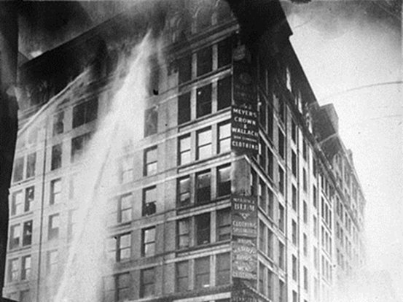
History
Triangle Shirtwaist Fire, New York: 1911

Slide 7
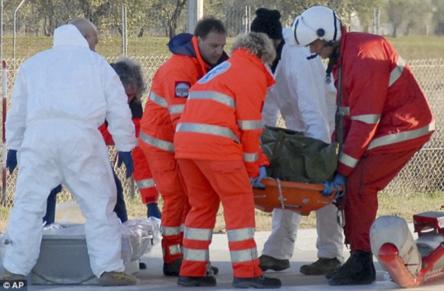
History
1960’s: 14,000 workers died yearly

Slide 8
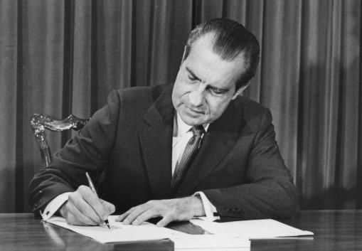
History
President Nixon signs OSH Act December 29th, 1970

Slide 9
OSHA
By law, all employers in the United States must provide a safe environment for employees.

Slide 10

OSHA established
Reduce workplace hazards
Gather research data
Keep records/report information
Establish training programs

Slide 11
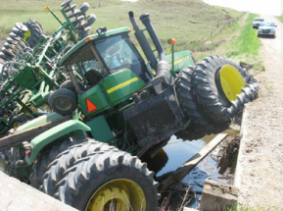
OSHA Established
Determine employer/employee responsibilities
Develop mandatory safety and health standards
Development, analysis, evaluation and approval of safety programs

Slide 12
Groups Not covered under federal osha
Self-employed
Members of farm families working on their family farm
Public employees in state and local government
  with the exception of states with state plans such as Minnesota

Slide 13
Who Is Covered by OSHA
Covered by OSHA? | Worker
YES NO | 1.Harry Adams, a miner at Below Ground Inc.
YES NO | 2. Jack Phillips, milks on his father’s family run farm
YES NO | 3. Adrian Smith, one of 3 employees of ABC landscaping.
YES NO | 4. Taylor Dell, an accountant in business for herself.
YES NO | 5. Rob Jones, one of 10 carpenters working for Furniture Expressions, Inc.
YES NO | 6. Bill Cook, one of 23 employees on a dairy farm

Slide 14
Who Is Covered by OSHA
Covered by OSHA? | Worker
NO | Harry Adams, a miner at Below Ground Inc. Miners are covered by the Mine Safety & Health Administration
YES NO | 2. Jack Phillips, milks on his father’s family run farm
YES NO | 3. Adrian Smith, one of 3 employees of ABC landscaping.
YES NO | 4. Taylor Dell, an accountant in business for herself.
YES NO | 5. Rob Jones, one of 10 carpenters working for Furniture Expressions, Inc.
YES NO | 6. Bill Cook, one of 23 employees on a dairy farm

Slide 15
Who Is Covered by OSHA
Covered by OSHA? | Worker
NO | 1. Harry Adams, a miner at Below Ground Inc. Miners are covered by the Mine Safety & Health Administration
YES NO | 2. Jack Phillips, milks on his father’s family run farm
YES NO | 3. Adrian Smith, one of 3 employees of ABC landscaping.
YES NO | 4. Taylor Dell, an accountant in business for herself.
YES NO | 5. Rob Jones, one of 10 carpenters working for Furniture Expressions, Inc.
YES NO | 6. Bill Cook, one of 23 employees on a dairy farm

Slide 16
Who Is Covered by OSHA
Covered by OSHA? | Worker
NO | 1. Harry Adams, a miner at Below Ground Inc. Miners are covered by the Mine Safety & Health Administration.
NO | 2. Jack Phillips, milks on his father’s family run farm Family employees at a family run business are not covered.
YES NO | 3. Adrian Smith, one of 3 employees of ABC landscaping.
YES NO | 4. Taylor Dell, an accountant in business for herself.
YES NO | 5. Rob Jones, one of 10 carpenters working for Furniture Expressions, Inc.
YES NO | 6. Bill Cook, one of 23 employees on a dairy farm

Slide 17
Who Is Covered by OSHA
Covered by OSHA? | Worker
NO | 1. Harry Adams, a miner at Below Ground Inc. Miners are covered by the Mine Safety & Health Administration.
NO | 2. Jack Phillips, milks on his father’s family run farm – Employees in a family run business are not covered.
YES NO | 3. Adrian Smith, one of 3 employees of ABC landscaping.
YES NO | 4. Taylor Dell, an accountant in business for herself.
YES NO | 5. Rob Jones, one of 10 carpenters working for Furniture Expressions, Inc.
YES NO | 6. Bill Cook, one of 23 employees on a dairy farm

Slide 18
Who Is Covered by OSHA
Covered by OSHA? | Worker
NO | 1. Harry Adams, a miner at Below Ground Inc. Miners are covered by the Mine Safety & Health Administration.
NO | 2. Jack Phillips, milks on his father’s family run farm Employees in a family run business are not covered.
YES | 3. Adrian Smith, one of 3 employees of ABC landscaping.
YES NO | 4. Taylor Dell, an accountant in business for herself.
YES NO | 5. Rob Jones, one of 10 carpenters working for Furniture Expressions, Inc.
YES NO | 6. Bill Cook, one of 23 employees on a dairy farm

Slide 19
Who Is Covered by OSHA
Covered by OSHA? | Worker
NO | 1. Harry Adams, a miner at Below Ground Inc. Miners are covered by the Mine Safety & Health Administration.
NO | 2. Jack Phillips, milks on his father’s family run farm – Employees in a family run business are not covered.
YES | 3. Adrian Smith, one of 3 employees of ABC landscaping.
YES NO | 4. Taylor Dell, an accountant in business for herself.
YES NO | 5. Rob Jones, one of 10 carpenters working for Furniture Expressions, Inc.
YES NO | 6. Bill Cook, one of 23 employees on a dairy farm

Slide 20
Who Is Covered by OSHA
Covered by OSHA? | Worker
NO | 1. Harry Adams, a miner at Below Ground Inc. Miners are covered by the Mine Safety & Health Administration.
NO | 2. Jack Phillips, milks on his father’s family run farm – Employees in a family run business are not covered.
YES | 3. Adrian Smith, one of 3 employees of ABC landscaping.
NO | 4. Taylor Dell, an accountant in business for herself. Self employed are not covered
YES NO | 5. Rob Jones, one of 10 carpenters working for Furniture Expressions, Inc.
YES NO | 6. Bill Cook, one of 23 employees on a dairy farm

Slide 21
Who Is Covered by OSHA
Covered by OSHA? | Worker
NO | 1. Harry Adams, a miner at Below Ground Inc. Miners are covered by the Mine Safety & Health Administration.
NO | 2. Jack Phillips, milks on his father’s family run farm – Employees in a family run business are not covered.
YES | 3. Adrian Smith, one of 3 employees of ABC landscaping.
NO | 4. Taylor Dell, an accountant in business for herself. Self employed are not covered.
YES NO | 5. Rob Jones, one of 10 carpenters working for Furniture Expressions, Inc.
YES NO | 6. Bill Cook, one of 23 employees on a dairy farm

Slide 22
Who Is Covered by OSHA
Covered by OSHA? | Worker
NO | 1. Harry Adams, a miner at Below Ground Inc. Miners are covered by the Mine Safety & Health Administration.
NO | 2. Jack Phillips, milks on his father’s family run farm – Employees in a family run business are not covered.
YES | 3. Adrian Smith, one of 3 employees of ABC landscaping.
NO | 4. Taylor Dell, an accountant in business for herself. Self employed are not covered.
YES | 5. Rob Jones, one of 11 carpenters working for Furniture Expressions, Inc.
YES NO | 6. Bill Cook, one of 23 employees on a dairy farm

Slide 23
Who Is Covered by OSHA
Covered by OSHA? | Worker
NO | 1. Harry Adams, a miner at Below Ground Inc. Miners are covered by the Mine Safety & Health Administration.
NO | 2. Jack Phillips, milks on his father’s family run farm – Employees in a family run business are not covered.
YES | 3. Adrian Smith, one of 3 employees of ABC landscaping.
NO | 4. Taylor Dell, an accountant in business for herself. Self employed are not covered.
YES | 5. Rob Jones, one of 10 carpenters working for Furniture Expressions, Inc.
YES NO | 6. Bill Cook, one of 23 employees on a dairy farm

Slide 24
Who Is Covered by OSHA
Covered by OSHA? | Worker
NO | 1. Harry Adams, a miner at Below Ground Inc. Miners are covered by the Mine Safety & Health Administration.
NO | 2. Jack Phillips, milks on his father’s family run farm – Employees in a family run business are not covered.
YES | 3. Adrian Smith, one of 3 employees of ABC landscaping.
NO | 4. Taylor Dell, an accountant in business for herself. Self employed are not covered.
YES | 5. Rob Jones, one of 10 carpenters working for Furniture Expressions, Inc.
YES | 6. Bill Cook, one of 23 employees on a dairy farm

Slide 25
OSHA Mission Statement
Save lives, prevent injuries and protect the health of America’s workers

Slide 26

Wisconsin’s Dairy Farms
11,715 herds
1,265,000 cows
Immigrant labor = 5,300 people (40%)

Slide 27
Importance of Training
12 workers die daily from job injuries
4,600 workers died 2011
Over 4 million non-fatal injuries
Cost = $145-290 billion
551 deaths in agriculture
*Bureau of Labor Statistics

Slide 28
Wisconsin: Fatalities by comparison
 | 2006 | 2007 | 2008 | 2009 | 2010
Number of fatalities all industries | 91 | 104 | 77 | 94 | 91
Number of fatalities dairy Industry | 8 | 12 | 10 | 9 | 13
*Bureau of Labor Statistics

Slide 29
FAT/CAT Report
Weekly Summary (Federal and State data tabulated week ending,)
FATALITIES
Date of Incident | Company and Location | Preliminary Description of Incident
01/18/2012 | Hastings Acquisitions, Hastings, NE | Worker dies when he is pulled into a conveyor after his scarf gets caught in the machine.
02/01/2012 | Wauneta Mills LLC, Wauneta, NE | Worker using an auger to fill truck with feed pellets was found dead inside the truck bin.
02/08/2012 | Larry Simon Dairy Farm, Westphalia, MI | Worker was run over and killed by a front-end loader.
01/11/2012 | Tubal Cain Industries Inc., Laredo, TX | Hydraulic system blew back striking worker on the head.
01/26/2012 | Prestige Exterior Maintenance LLC, North Bergen, NJ | Worker was crushed by the arm of a skid steer.
01/19/2012 | Live Oaks Planting Company LLC, Itta Bena, MS | Employee was working in a 60,000 bushel grain silo when the worker sank and was engulfed in 20,000 bushels of soybean.

Slide 30
Catastrophes
CATASTROPHES
01/26/2012 | Countryside Hides Inc., Alma Center, WI | Ten workers were hospitalized as a result of carbon monoxide overexposure from forklifts or a wood-fueled furnace.

Slide 31
Section Two:
Rights of employees

Slide 32

Employee Rights

Slide 33
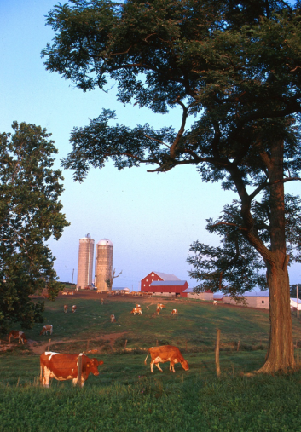
Employee Rights
Right to a safe and healthful workplace

Slide 34
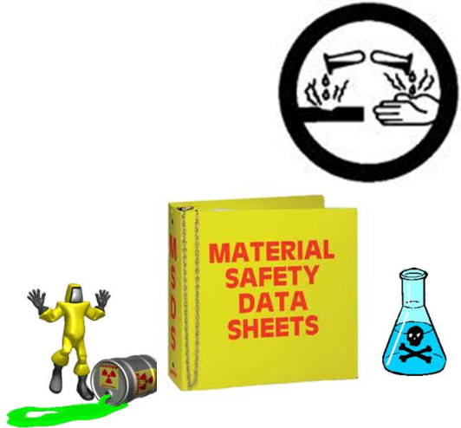
Employee Rights
Right to know about hazardous chemicals

Slide 35

Employee Rights
Right to information about injury and illness

Slide 36

Employee Rights
Right to file complaints or request correction of hazardous conditions

Slide 37

Employee Rights
Right to proper trainings

Slide 38
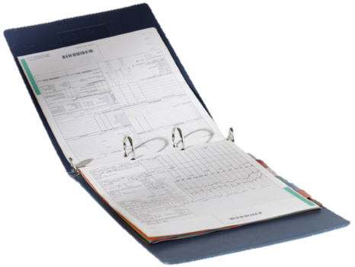
Employee Rights
Right to view hazard exposure and medical records

Slide 39

Employee Rights
Right to participate in OSHA inspections

Slide 40
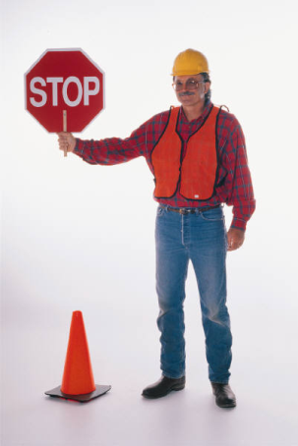
Employee Rights
Right to be free from retaliation for exercising safety and health rights

Slide 41

Employee Rights
An employer cannot retaliate against any employee who provides information to a Federal Regulatory Agency

Slide 42
Section three:
Employer responsibilities

Slide 43

Employer Responsibilities
Provide a workplace free from recognized hazards and comply with OSHA standards

Slide 44

Employer Responsibilities
Provide training required by OSHA

Slide 45

Employer Responsibilities
Keep records of injuries and illnesses

Slide 46
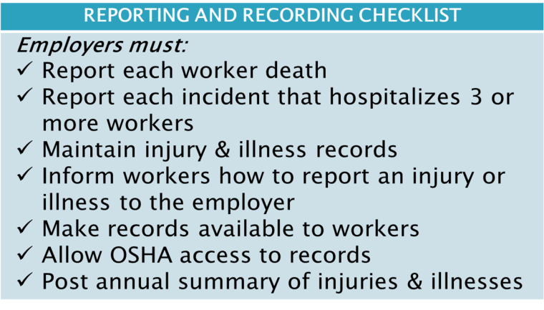
Employers are required to
Keep records of injuries and illnesses

Slide 47
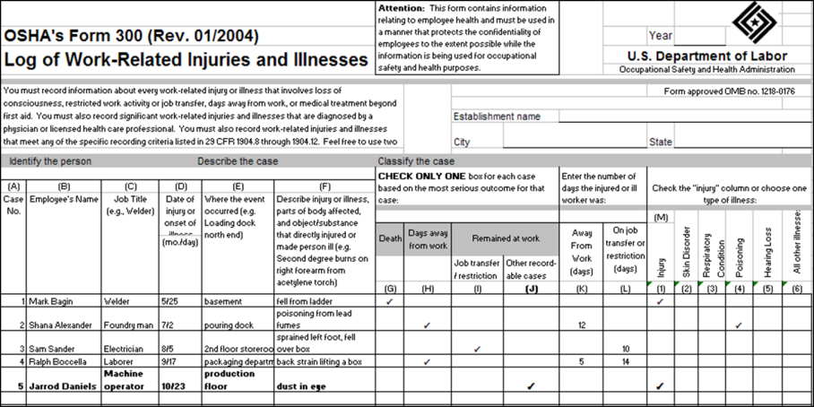
Forms to keep

Slide 48
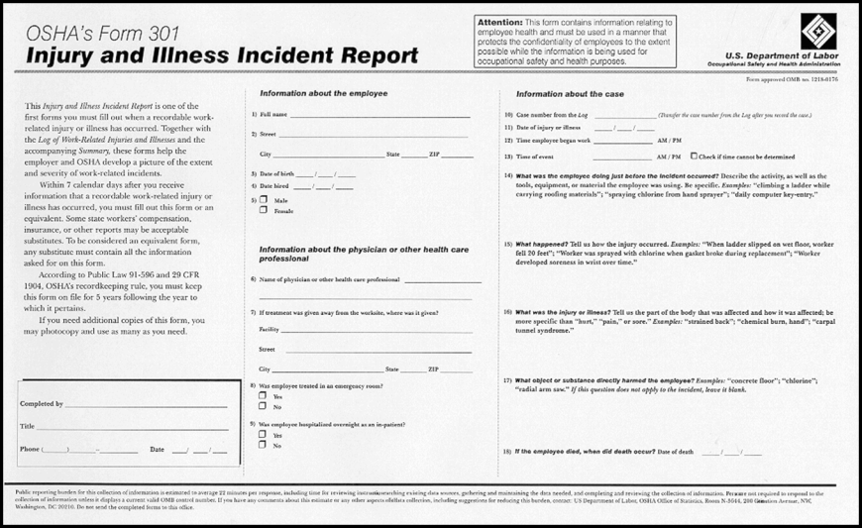
Forms to Keep

Slide 49
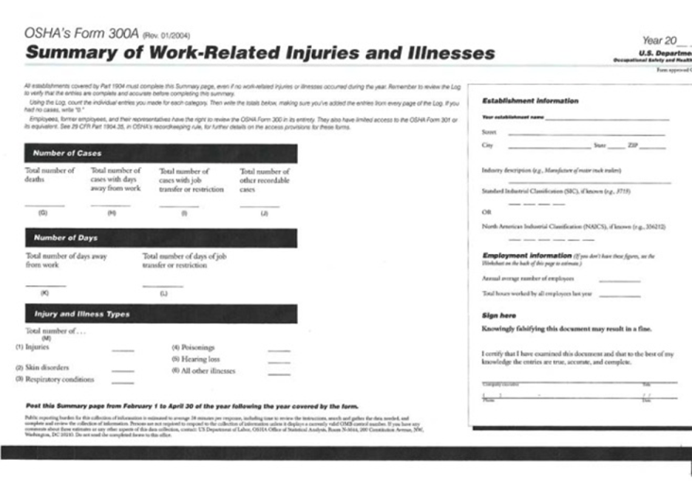
Forms to keep

Slide 50
Work related?
An injury or illness is work related when:
  An event or exposure in the work environment either caused or contributed to the resulting condition, or
  Significantly aggravated pre-existing injury or illness

Slide 51

Exceptions
General public vs. employee
Result of non-work event or exposure
Voluntary participation in wellness program or recreational activity

Slide 52
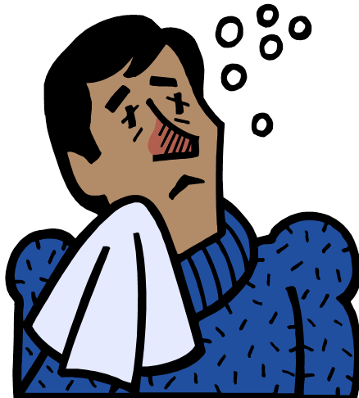
Exceptions
Accident while commuting to or from work
Common flu or cold
Mental illness unless employee voluntarily presents employer with a medical opinion that it is a work-related mental illness

Slide 53

Exceptions
Eating, drinking or preparing food for personal consumption
Result of doing personal tasks outside of normal work hours
Result of personal grooming, self-medication for non-work related illness or self-inflicted

Slide 54
Is this work related?
George was in Green bay, Wisconsin to attend safety training at the Technical College. The employer paid for his training.
While walking to the classroom he slipped on melted snow in the entryway and broke his right arm.

Slide 55
Is this work related?
George checked into a hotel in Eau Claire, Wisconsin. He had worked 3 days supervising field application of nutrients.
On his way back to the hotel his truck was hit when someone ran a red light. George received severe injuries to his left side including a broken hip and crushed leg.

Slide 56
Is this work related?
Juan had to go out for a part for the machine he was fixing.
He goes to the parts store and on his way back decides to stop at the bank. Walking across the parking lot he trips on the curb and sprains his wrist.

Slide 57

Medical Treatment or First Aid
Medical Treatment DOES NOT include:
  Dr. Visit for observation or counseling
  Diagnostics
    (x-rays, blood tests)
  First aid

Slide 58
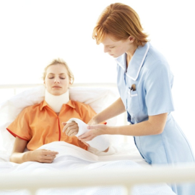
What is first aid?
Use of a temporary immobilization device during transport
Drilling a nail
Eye patches

Slide 59

First Aid
Removing foreign substances with eye washes or cotton swabs
Using finger guards
Drinking fluids for relief of heat-related illness

Slide 60

First Aid
Over-the-counter non-prescription medication and non-prescription strength
Administering tetanus immunization
Cleaning, flushing or soaking wounds

Slide 61

First Aid
Using wound coverings such as Band-Aids, steri-strips, or butterfly bandages
Applying hot/cold treatments

Slide 62
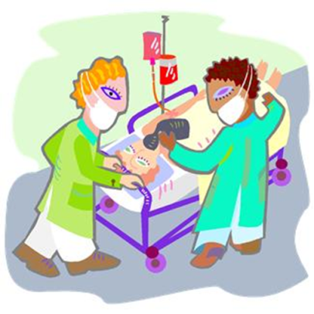
What is medical treatment?
Immunizations - rabies
Wound – closing devices, stiches, staples

Slide 63

What is medical treatment?
Device used to immobilize parts of the body
Physical therapy or chiropractic treatment
Dosages of prescription medication

Slide 64
Medical Treatment
Dosages of prescription medication
OTC med at prescription strength is medical treatment
Ibuprofen (such as Advil™) | Greater than 467 mg
Diphenhydramine (such as Benadryl™) | Greater than 50 mg
Naproxen Sodium (such as Aleve™) | Greater than 220 mg
Ketoprofen (such as Orudus KT™) | Greater than 25 mg

Slide 65

Automatic Recording Criteria
Fracture of bones or teeth
Punctured ear drum
Cancer only if caused by work related exposure
Chronic irreversible disease

Slide 66

Special Recording Criteria
Needle sticks and sharps injuries
Medical removal from specific duty
Occupational hearing loss 10 dB STS and 25 dBA in same ear
Tuberculosis if work related

Slide 67

Employer Responsibilities
Provide and pay for PPE

Slide 68
Employer PPE Responsibilities
Determine if PPE should be used to protect their workers
Train employees on proper usage and care of the PPE
Replace or maintain PPE
Periodically review, update and evaluate PPE program

Slide 69

Employee PPE Responsibilities
Wear the PPE properly
Attend training session
Care for, clean and maintain PPE
Inform the supervisor of any needed repair or replacement

Slide 70
Section four:
OSHA standards

Slide 71
What are OSHA standards?
Four categories:
  General Industry 1910
  Construction 1926
  Maritime 1915, 1916, & 1918
  Agriculture 1928

Slide 72
Reading a standard
29 CFR 1910.21
  29 = title for labor
  CFR = Code of Federal Regulations
  1910 = General Industry
  .21 = subpart (walking and working surfaces)

Slide 73
29 CFR 1910.23 (d)(1)(i)
.23 pertains to guarding floor and wall openings and holes (for definitions of these terms see 1910.21)
“wall opening” = an opening at least 30” high and 18” wide, in any wall or partition, through which persons may fall.

Slide 74
29 CFR 1910.23 (d)(1)(i)
(d) = stairways, railings and guards

Slide 75
29 CFR 1910.23 (d)(1)(i)
(1) = Every flight of stairs having four or more risers shall be equipped with standard stair railings or standard handrails as specified in paragraphs (d)(1)(i) through (v) of this section, the width of the stair to be measured clear of all obstructions except handrails

Slide 76
29 CFR 1910.23 (d)(1)(i)
(i) On stairways less than 44 inches wide having both sides enclosed, at least one handrail, preferably on the right side descending.

Slide 77
Standards
29 CFR 1928.57(b)(1)(ii)

Slide 78
29 CFR 1928.57(b)(1)(ii)
OSHA Labor Code of Federal Regulations
1928 = Agriculture standard

Slide 79
29 CFR 1928.57(b)(1)(ii)
.57 = guarding of farm field equipment, farmstead equipment and cotton gins

Slide 80
29 CFR 1928.57(b)(1)(ii)
(b) = farm field equipment

Slide 81
29 CFR 1928.57(b)(1)(ii)
(1) = Power take-off guarding

Slide 82
29 CFR 1928.57(b)(1)(ii)
(iii) = All tractors shall be equipped with an agricultural tractor master shield on the rear power take-off except where removal of the tractor master shield is permitted by paragraph (b)(1)(iii) of this section. The master shield shall have sufficient strength to prevent permanent deformation of the shield when a 250 pound operator mounts or dismounts the tractor using the shield as a step.

Slide 83
General Duty Clause
(a) Each employer –
  (1) shall furnish to each of his employees employment and a place of employment which are free from recognized hazards that are causing or are likely to cause death or serious physical harm to his employees;
  (2) shall comply with the OSH standards promulgated under this act
  (b) each employee shall comply with OSH standards are all rules, regulations and orders issued pursuant to this Act which are applicable to his own actions and conduct.

Slide 84
Standards
Many of the standards cross between industries (general industry and construction) depending on the issue.

Slide 85
Section five:
How inspections are conducted

Slide 86
OSHA inspection priority
Priority | Category of Inspection
1st | Imminent Danger
2nd | Fatality/Catastrophe
3rd | Complaints/Referrals
4th | Programmed Inspections

Slide 87
Stages of an inspection
There are 4 major stages of an OSHA inspection:
  Presenting credentials
  Opening conference
  The walk around
  Closing conference

Slide 88

Inspections
Conducted at reasonable times and without prior notice
Credentials displayed

Slide 89
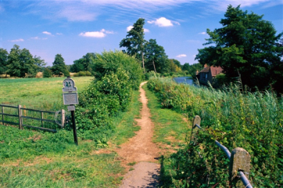
Inspections
Visit selection and purpose
Inspector determines the route to be taken

Slide 90

Inspections
Work disruptions minimized
Pictures, measurements and instrument readings will be recorded
  The person who accompanies the inspector should take the same records

Slide 91

Inspections
Injury/illness records, hazard communication program reviewed
Closing conference

Slide 92

Inspections
Explanation of appeal rights
Issue citations

Slide 93

Citations and penalties
CSHO writes report
Area Director reviews report, makes final decision on citations or penalties

Slide 94

Citations
Regulations allegedly violated
General Duty Clause
Time set for abatements
Penalties

Slide 95

Citations
Certified mail
Post a copy of citation at or near violation for 3 days or until it is fixed
Inform workers of the corrections

Slide 96
Citations and Penalties
VIOLATION TYPE | PENALTY
WILLFUL A violation that the employer intentionally and knowingly commits or a violation that the employer commits with plain indifference to the law. | OSHA may propose penalties of up to $70,000 for each willful violation, with a minimum penalty of $5,000 for each willful violation.
SERIOUS A violation where there is substantial probability that death or serious physical harm could result and that the employer knew, or should have known, of the hazard. | There is a mandatory penalty for serious violations which may be up to $7,000.
OTHER-THAN-SERIOUS A violation that has a direct relationship to safety and health, but probably would not cause death or serious physical harm. | OSHA may propose a penalty of up to $7,000 for each other-than-serious violation.
REPEATED A violation that is the same or similar to a previous violation. | OSHA may propose penalties of up to $70,000 for each repeated violation.

Slide 97
Other penalties
Failure to abate
Falsifying information
Violation of posting

Slide 98

Employers can
Request extensions for abatement
Petition for modification of abatement

Slide 99

Appeals
Can disagree with an OSHA citation

Slide 100

Appeals
Request an informal conference
Inspection
Citations
Penalties
Notice of contest

Slide 101

Appeals
May reach a settlement agreement with OSHA

Slide 102

Appeals
Submit in writing within 15 working-day contest period

Slide 103

Appeals
Participate in the hearing

Slide 104
Section six: where to get help

Slide 105

Within the workplace
Employer/supervisor
MSDSs
Labels and warning signs
Owner’s manuals
Employee orientation manuals
Procedure instructions

Slide 106
Outside the workplace
OSHA website: www.osha.gov
OSHA offices
www.cdc.gov/niosh
Education centers
Community organizations

