Slide 1
Hazard identification and Risk assessment

Slide 2
Learning Objective
Upon completion of this unit you will understand how to identify hazards and assess risks for your dairy operation.

Slide 3
Learner Outcomes
Understand that behind each fatality or serious injury there are thousands of at-risk behaviors and unidentified hazards that contributed to the incident.
State the definition of a hazard and explain how to identify hazards in the workplace.

Slide 4
Learner Outcomes
Determine methods for controlling hazards in the workplace.
Complete a job hazard analysis for a typical dairy farm task.

Slide 5
Introduction
Safety management leads to
  Increased productivity
  Avoiding injuries
  Avoiding costly, time consuming, stressful and inconvenient incidents

Slide 6
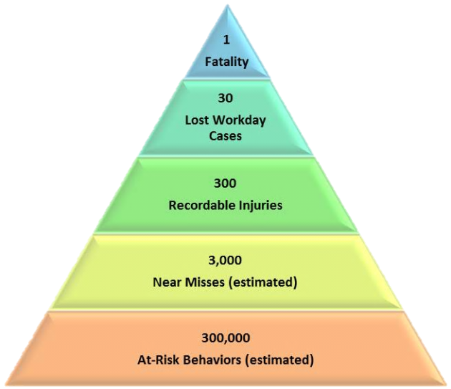
Safety Pyramid

Slide 7
Safety Pyramid
ConocoPhillips Marine, 2003
Ratio of serious accidents to near misses
1 fatality : 300,000 at-risk behaviors

Slide 8
Safety Pyramid
At-risk behavior: activities not consistent with safety programs, training and components on machinery
  Bypassing safety components on machinery
  Eliminating safety steps to save time
Can be reduced with machine guarding and training

Slide 9
Hazards
Hazard: condition or set of circumstances that present a potential for harm
Two categories

Slide 10
Hazards
Health hazards: occupational illnesses
Safety hazards: physical harm, injuries

Slide 11
Hazard Identification
Process of identifying all hazards in the workplace
May be grouped by Dairy LEP

Slide 12
Dairy LEP
Manure storage facilities and collections structures
Dairy bull and cow behavior/worker positioning
Electrical systems

Slide 13
Dairy LEP
Skid-steer loader operation
Tractor operation
Guarding of Power Take-Offs (PTOs)

Slide 14
Dairy LEP
Guarding of other power transmission and functional components
Hazardous energy control while performing servicing and maintenance on equipment
Hazard communication

Slide 15
Dairy LEP
Confined spaces
Horizontal bunker silos
Noise

Slide 16
Hazard
Identification
Main cause of occupational health and safety problems
Eliminating hazards or controlling risks is the best way to reduce workplace injury and illness

Slide 17
How to Start
Check your farm for:
  Regular hazard assessment surveys of operations, equipment, substances and tasks
  A system of recording injuries, near misses and identified hazards
  Safe procedures for dairy farm tasks

Slide 18
How to start
  Safety training and supervision for new and young employees
  Protective clothing and equipment
  Safety training and practice for each new piece of equipment

Slide 19

How to start
  Safety discussions between employers, contractors and employees
  Safety information readily available for hazardous substances
  Copies of the regulations

Slide 20
Develop a plan
Written plan
Store with other safety information

Slide 21
Develop a plan
Discuss the program with others during development
  Assure all safety concerns are met
  Incorporate a system for hazard identification, risk assessment and risk control

Slide 22
Develop a Plan
Ensure employees are familiar with:
  the plan
  safe work procedures
  current legal safety and health requirements

Slide 23
Develop a plan
Other components
  Providing farm workers with safety information
  Orientation for new employees
  Safety training for new procedures
  Special safeguards for young employees
  Record of injuries, near misses and potential hazards

Slide 24
Identify the Hazard
24 hour approach
Environments
Substances
Workplace layout

Slide 25
Identify the hazard
Work organization
Equipment
Farm animals

Slide 26
Identify the hazard
Heights
Electricity

Slide 27
Hazard Identification
Observation
Material Safety Data Sheets (MSDSs)
Hazard and risk surveys
Children and visitor considerations

Slide 28
Hazard
Identification
Record analysis
Discussion groups
Safety audits

Slide 29
Hazard Identification
Information updates
Consumer information
Regulations and best practices

Slide 30
Assess the Risk
Assess likelihood and possible severity of injury
Determine how to best minimize risk
Address high risk hazards first

Slide 31
Assess the Risk
The same hazard could lead to several outcomes
Consider likelihood of each possibility
Prioritize

Slide 32
Make the Changes
Potential control measures include:
Remove the hazard
Substitute
Isolate

Slide 33
Make the changes
Add engineering controls
Safe work practices
Provide PPE
Implement and monitor controls

Slide 34
Make the changes
Controls should be agreed upon
Make changes as soon as possible
May require more than one risk control measure

Slide 35
Checking the Changes
May need to be tested
  Ensure that risk is minimized
  No new hazard created
Consultation
New procedures

Slide 36
Job Hazard
Analysis (JHA)
Focus on job tasks
Prevention
Relationship between
  worker
  task
  tools
  environment

Slide 37
JHA Priorities
Highest injury or illness rates
Potential for severe injuries or illness
Possibility of incident with simple human error

Slide 38
JHA Priorities
New or changed
Complex

Slide 39

Where do I begin?
1. Involve employees

Slide 40
Where do I begin?
2. Review accident history

Slide 41
Where do I begin?
3. Conduct preliminary job review

Slide 42

Where do I begin?
4. List, rank, and set priorities for hazardous jobs

Slide 43
Where do I begin?
5. Outline steps or tasks

Slide 44
Class Activity
Complete a Job Hazard Analysis Form for a typical dairy farm job.

Slide 45
OSHA consultation Program
Free
Professional advice and assistance
On-site
Defer OSHA inspections
Create safety routine

Slide 46
Consultants’ Role
Help employers recognize hazards
System development
Problem solving
Additional resources
Written summary
Safety and health training

Slide 47
Consultants’ role
Consultants will not:
  Issue citations during consultation
  Guarantee a workplace will “pass”

Slide 48
Consultation visit
Request for services
Initial meeting
Walkthrough
Closing conferences and follow-up
Detailed written report
Follow-up
Continued contact for assistance

Slide 49

Correcting Hazards
Imminent danger
Serious violation
Failure to eliminate or control hazards

Slide 50
Review
Identify a hazard from each section of the Dairy LEP that may be found on your farm:
Manure storage
Animals
Electrical
Skid-steer
Tractor
PTO guarding
Power transmission guarding
Hazardous energy control
Hazard communication
Confined spaces
Horizontal bunker silos
Noise

Slide 51
Review
List the steps necessary to conduct a Job Hazard Analysis on your farm

Slide 52
This material was produced under grant number SH-22318-11 from the Occupational Safety and Health Administration, U.S. Department of Labor. It does not necessarily reflect the views or policies of the U.S. Department of Labor, nor does mention of trade names, commercial products, or organizations imply endorsement by the U.S. Government.

