Slide 1
Tractors and machines

Slide 2
Learning Objective
Upon competition of this unit the participant will be able to identify the safety precautions needed when working with tractors and machinery.

Slide 3
Learner Outcomes
^{You will be able to:}
1. Understand the training that is necessary for employees using tractors and other machinery on your farm.
2. Evaluate your farm procedures to ensure the use of rollover protection, seatbelts and PTO guards.
3. Identify the requirements of 29CFR1928 sub part D 1928.57 machine guarding

Slide 4
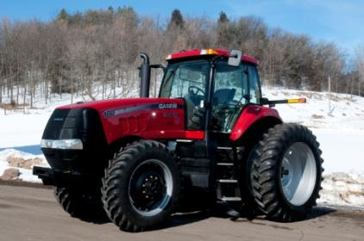
Tractor safety
Tractor rollovers = most fatal farm accident
Tractors account for 36.7% fatalities
Farm machines account for 26.3% fatalities
*UW Extension Ag Safety and Health website

Slide 5
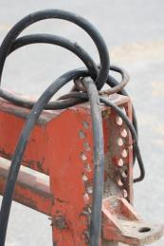
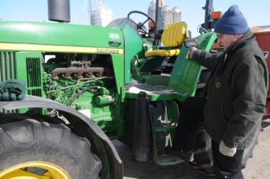
Tractor related injuries
Incidents with motor vehicles
Slips and falls while mounting and dismounting
Running over bystanders
Overhead hazards
Flying objects, hydraulic fluids
Exhaust
Human factors

Slide 6
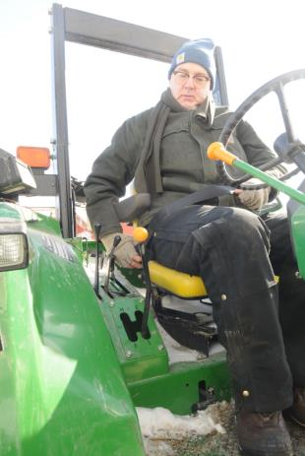
29 CFR 1928
1. Fasten seat belt if ROPS.
2. Avoid ditches, embankments, and holes.
3. Reduce speed when turning, crossing slopes, and on rough, slick, or muddy surfaces.

Slide 7
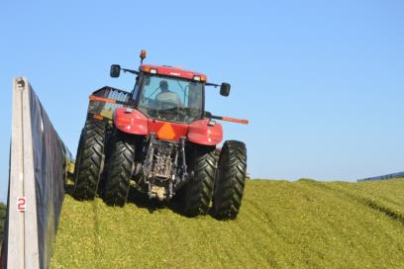
29 CFR 1928
4. Stay off slopes too steep for safe operation.
5. Watch where you are going, especially at row ends, on roads, and around trees.
6. Do not permit others to ride.

Slide 8
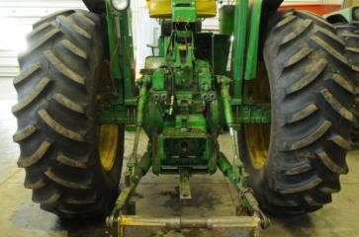
29 CFR 1928
7. Operate the tractor smoothly - no jerky turns, starts, or stops.
8. Hitch only to the drawbar and hitch points recommended by tractor manufacturers.
9. When tractor is stopped, set brakes securely and use park lock if available.

Slide 9
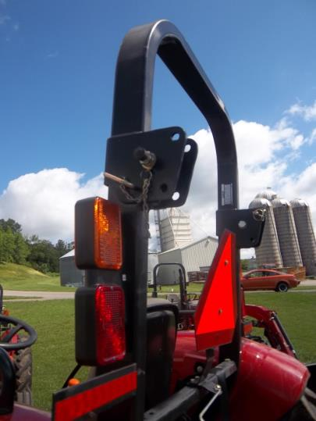
Employee training
Tractor operation
Hitching
Roll Over Protection / seatbelt usage
PTOs
Skid steers

Slide 10
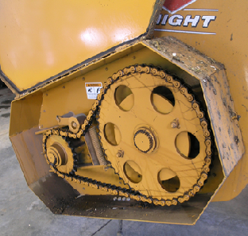
Employee training
Recognizing hazards
Batteries
Hydraulics
Machine Guarding

Slide 11
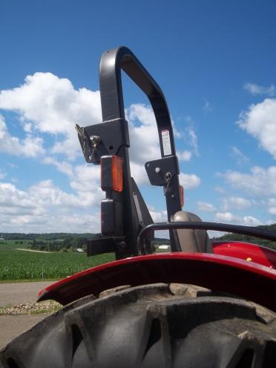
Roll Over Protection (ROPS)
Tractors over 20 hp
Manufactured after October 25, 1976
Performance tested by ASAE (American Society of Agriculture Engineers)
Absorb energy
Limits degree of rollover

Slide 12
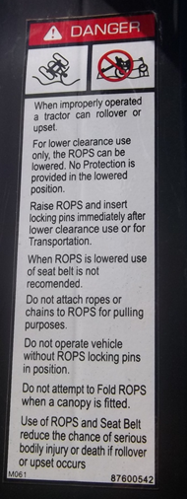
Roll Over Protection (ROPS)
Reducing damage to tractor
Factory installed have certification labels
Use the seatbelt
Can retro fit older tractors

Slide 13
Care of ROPS
Inspect roll bars
Inspect seatbelt
Do not drill holes in ROPS
Do not use as anchor point to pull things
Replace if tractor is in a roll over
Do not make your own

Slide 14
Reducing roll overs
Avoid sharp turns
Avoid using a single brake on incline
Avoid steep embankments
Reduce speed
Keep front end loaders low
Hitch only to draw bar

Slide 15

Road Travel
1/3 of tractor accidents occur on public roads
Machinery traveling less that 25 mph need slow moving vehicle sign
Amber strobe
Tractors over 40 mph do not need SMV emblem - many use an amber strobe

Slide 16
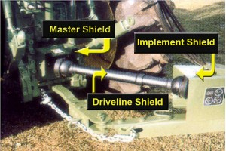
Power Take OFFS (PTO)
Most incidences involve clothing becoming caught
PTO at 540 rpm travels 2 yards per second

Slide 17
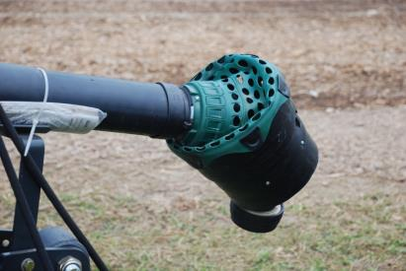
PTO SAFETY
Keep component shielded
Regularly test shields
Use correct draw bar length
Disengage PTO when dismounting the tractor
Make repairs promptly

Slide 18
PTO SAFETY
Walk around the machinery
Watch your step
Don’t wear loose clothing
Tie back long hair
Keep children away

Slide 19
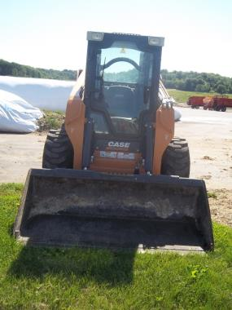
Skid Steers
Must use seat belts or interlock system when operating
  General Duty Clause citation

Slide 20
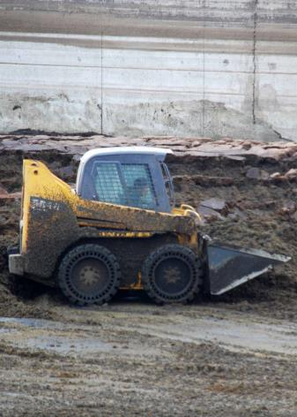
Skid Steers handling
With no load 2/3 weight is on rear axels
With a load weight is on front axels
Don’t overload -excessively front heavy
Don’t use levers from out of cab
Stability decreases as bucket is raised

Slide 21
Work Safely
Study owner’s manual
Check soil conditions
Check for overhead power lines
Never allow passengers in cab or bucket
Do not use the bucket as a work platform
Adjust speed to terrain

Slide 22
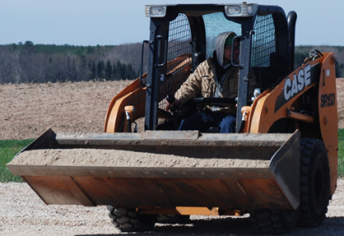
Work Safely
Never lift over person or animal
When lifting loose material do not lift bucket too high - roll back of materials
Avoid dumping over fences or other objects that can impale the operator if machine tips forward
Never undercut an
embankment

Slide 23
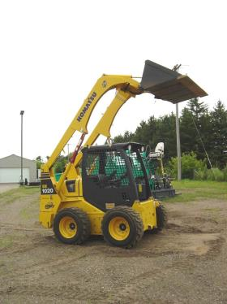
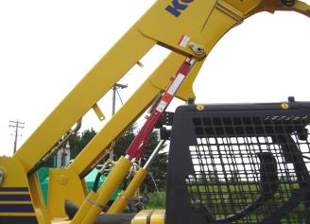
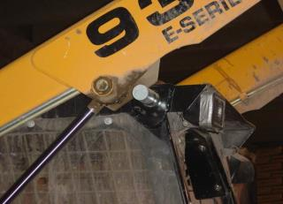
Work Safely
If repairs need to be made make sure arms are locked in place - use proper blocking of equipment

Slide 24
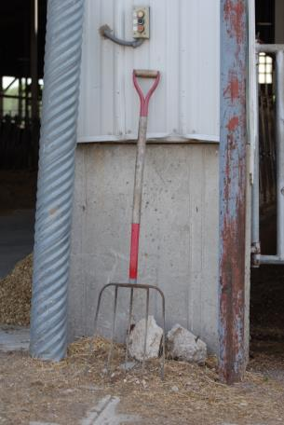
Recognize safety hazards
Eliminate secondary distractions
Keep work area clean
Control work area access
Human reaction time varies with age & physical condition
Gravity: faster than human reaction time

Slide 25
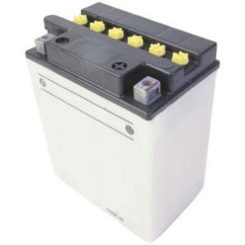
Batteries
Work on in area free from sparks / well ventilated
Wear PPE: eyes, hands, full face shields
Disconnect ground cable first
Clean terminals
Make sure it is secure
Connect ground cable last

Slide 26
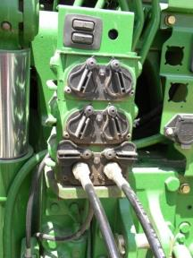

Hydraulics
Carry 2900 psi - pin hole leak can penetrate the skin
Look for leaks with a piece of cardboard
Properly blocked when repairing
Never allow children to play on equipment

Slide 27
Machine Guarding
Provide protection for the employees from the hazards associated with moving machinery, parts of farm equipment, and farmstead equipment.
Agricultural machine guarding standard took effect October 25, 1976

Slide 28

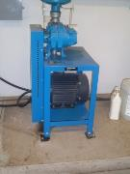
Definitions
Farm Field Equipment: Tractors or implements, including self propelled implements or combination.
Farmstead Equipment: agricultural equipment used in a stationary manner

Slide 29
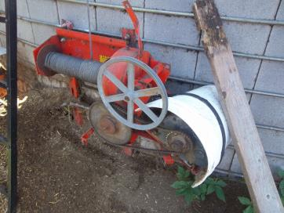
Definitions
Ground driven components- powered by turning motion of a wheel as the equipment travels (side rakes)
Guard or shield – barrier designed to protect against employee contact

Slide 30
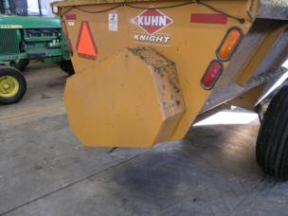
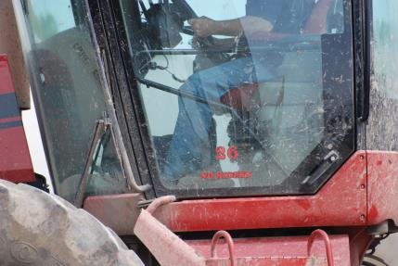
Machine Guarding
Training on safe operation and servicing of equipment shall happen at the time of hire and annually there after.
Keep all guards in place
Do not allow riders on farm field equipment

Slide 31
Machine Guarding
Stop engine
Disconnect power source
Wait for machine to stop moving before servicing
Make sure everyone is clear before starting engine or machine
Lock out electrical power before performing maintenance

Slide 32
methods of guarding
Shields
  Provide protection against inadvertent contact with the hazard
  Support 250 pounds of force from an individual leaning or falling against it

Slide 33

methods of guarding
Guarding by location
  A component is guarded because of its location. Employee cannot inadvertently come in contact with the hazard (mechanical room rotary parlors).

Slide 34
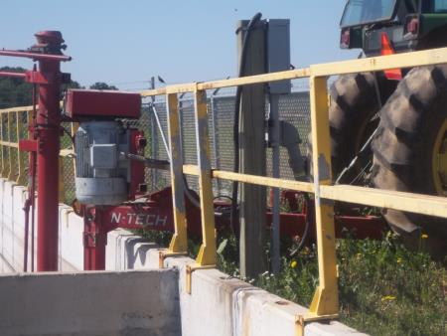
methods of guarding
Guarding by railings
  Shall be able to protect against employees inadvertently entering the hazardous area

Slide 35
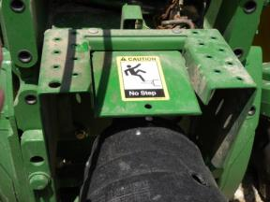
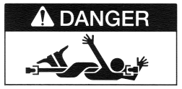
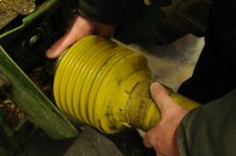
Farm Field Equipment
PTO Guarding-
All PTOs shall be guarded by a master shield
If master shield is removed to operate a machine the equipment shall also include protection from that portion of the tractor PTO shaft
Signs shall be placed at prominent locations on tractors and PTO shafts

Slide 36
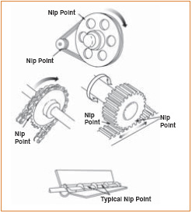
Farm Field Equipment
Mesh or nip points, power driven gears, shall be guarded

Slide 37
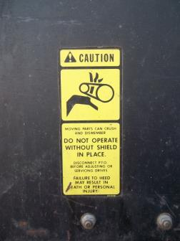
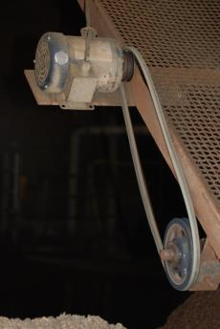
Farm Field Equipment
Belts shall be guarded

Slide 38
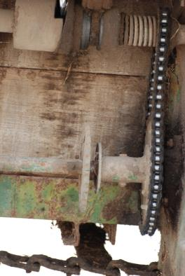
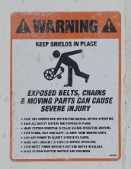
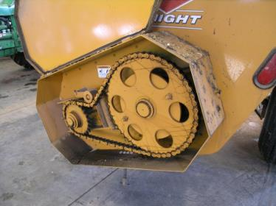
Farm Field Equipment
Chains shall be guarded

Slide 39
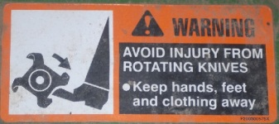
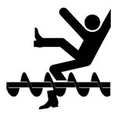

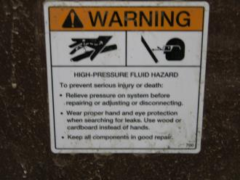
Farm Field Equipment
Maintain your safety signage /stickers

Slide 40
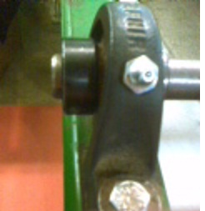
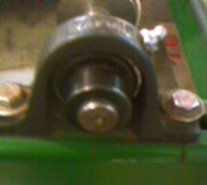
Farm Field Equipment
Smooth revolving shafts do not have to be guarded if there are no bolts, screws, keys or other protrusions.

Slide 41
Access to moving parts 1928.57(b)(3)
Guards, shields and access doors shall be in place.
Where removal of a guard or access door will expose employee to any component which continues to rotate after power is disengaged employer shall provide
  Readily visible or audible warning of rotation
  Look and listen for evidence of rotation
  Not remove the guard or access door until all components have stopped
  Electrical disconnect

Slide 42
Farmstead equipment
PTO Guarding
Other power transmission components
Refer back to Farm Field Equipment

Slide 43
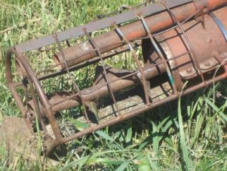
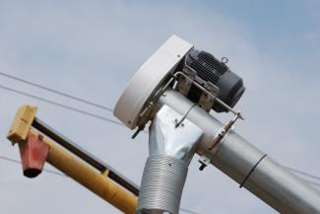
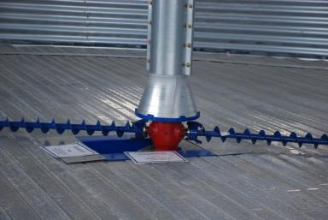
Farmstead equipment
Augers
Sweep arm mechanisms

Slide 44
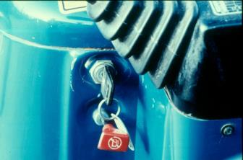
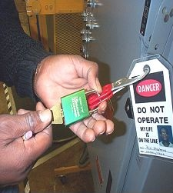
Electrical disconnect
Exclusive
Positive locking on main switch
Controlled by person doing servicing
Remove the key

Slide 45
REVIEW
1. What are the nine areas that 1928 addresses with tractors?
  1. Securely fasten your seat belt if the tractor has a ROPS.
  2. Where possible, avoid operating the tractor near ditches, embankments, and holes.
  3. Reduce speed when turning, crossing slopes, and on rough, slick, or muddy surfaces.
  4. Stay off slopes too steep for safe operation.
  5. Watch where you are going, especially at row ends, on roads, and around trees.
  6. Do not permit others to ride.
  7. Operate the tractor smoothly - no jerky turns, starts, or stops.
  8. Hitch only to the drawbar and hitch points recommended by tractor manufacturers.
  9. When tractor is stopped, set brakes securely and use park lock if available.

Slide 46
REVIEW
2. How often must you train your employees on the use of tractors and equipment?
At the time of hiring and yearly thereafter

Slide 47
REVIEW
3. What is the difference between farmstead equipment and farm field equipment?
Farm stead equipment is usually permanent machines (ex. milk machine pumps, motors on augers, elevators) Farm field equipment is machinery that is used around the farm and in the fields.

Slide 48
REVIEW
4. How often should you inspect your machine guards?
^{Daily}

Slide 49
This material was produced under grant number SH-22318-11 from the Occupational Safety and Health Administration, U.S. Department of Labor. It does not necessarily reflect the views or policies of the U.S. Department of Labor, nor does mention of trade names, commercial products, or organizations imply endorsement by the U.S. Government.

