Slide 1
Animal HANDLING AND FARM structures

Slide 2
Learning Objective
Upon completion of this unit you will be able to identify the hazards related to animal handling and farm structures on your operation and implement safety protocols to address these hazards.

Slide 3
Learner Outcomes
Identify and implement proper animal handling techniques.
Identify OSHA requirements on floor holes, floor openings, stairs and handrails.
Explain safety considerations related to electrical energy.
Define “confined space” and “permit required confined space.

Slide 4
Learner Outcomes
Explain lock-out/tag-out procedure.
Describe safety measures to be taken with manure storage and handling facilities, upright and horizontal silos, and grain bins.
Outline techniques for teaching employees about hazards in animal handling and farm structures.

Slide 5
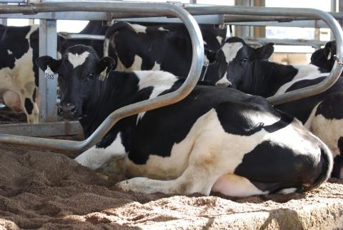
General animal handling
Excited animals
Cattle perception
Noise
Memory
Kicking

Slide 6
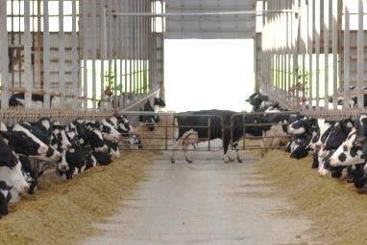
Areas of Focus
Flight patterns
Restraints
Bulls
Post-parturition cows
Zoonotic diseases
Hormones

Slide 7
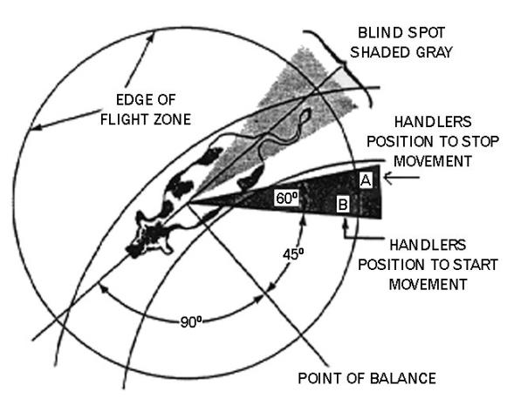
Flight Patterns

Slide 8
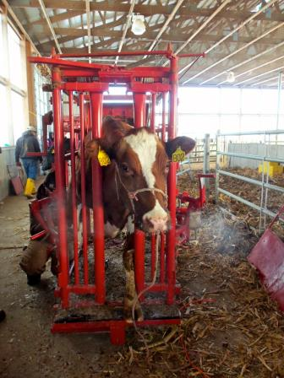
Restraints
Chute construction
Application of pressure
Working knowledge of chute operation
Sorting gates

Slide 9
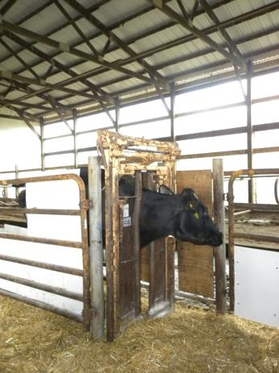
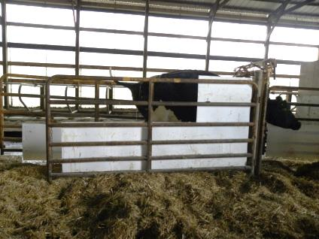
Chute Construction

Slide 10
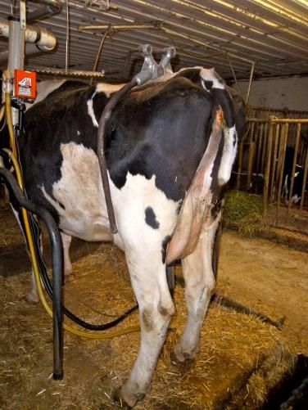
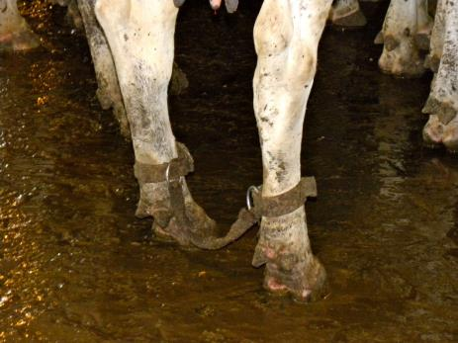
Milking Restraints

Slide 11
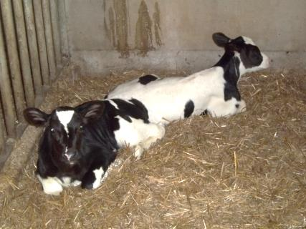
Bulls
Higher incidence of aggression in dairy bulls
Attributed to methods of raising
  bottle/bucket fed
  benefits of group housing

Slide 12
Identifying aggression
Turning broadside with back arched
Head lowering/shaking
Neck flexing
Eyeballs protruding
Hair along back standing on end

Slide 13
Responding to a threat
Look away
Back away slowly
Retreat from flight zone

Slide 14
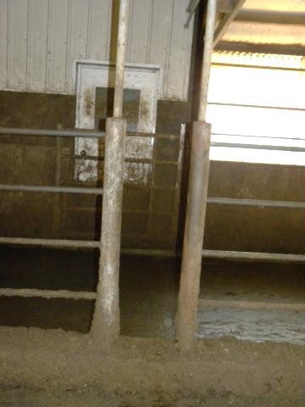
General Safety
Design of facilities
Man gates
Warnings
Report aggressive behavior
Cull
Never work alone/escape route
Cow bell

Slide 15
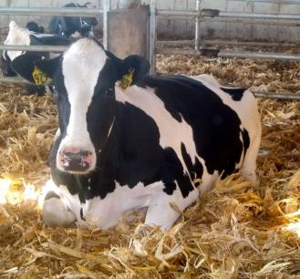
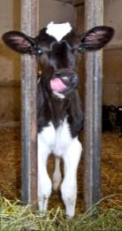
Post-Parturition cows
“Mothering instinct”
Plan escape route prior to entry
Separate quickly
Remove cow from calf for safer handling

Slide 16
Zoonosis
Any disease that can be transmitted between animals and humans
Warn employees of risk

Slide 17
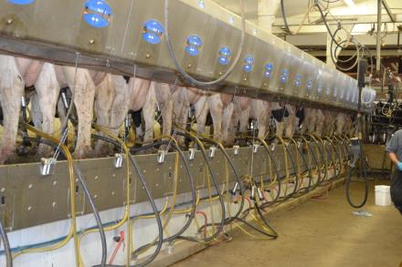
Routes of infection
Amniotic fluids, placenta and fetal membranes
Urine, milk, manure
Sores/wounds
Needle sticks
Inhalation of dust

Slide 18
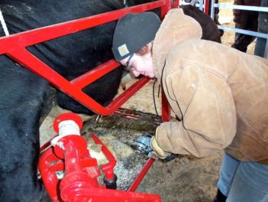
Best preventative Measures
Hand washing
Avoid unpasteurized milk
Isolation of infected animals
Use of PPE
Disinfecting measures
Test/quarantine new animals
Sharps container

Slide 19
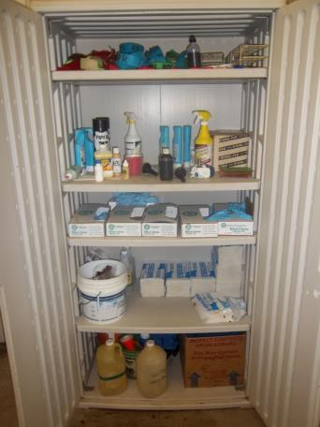
Common Diseases
Inform employee
  Name
  Spread
  Symptoms
ex.: ringworm

Slide 20
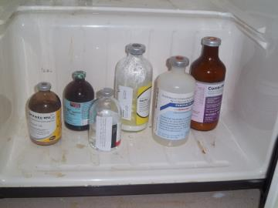
Hormones
Women
  Pregnancy
Men
  Hormone imbalances
PPE

Slide 21
Conclusions
Minimize risk
  Training
  Positioning
  Communication

Slide 22
Farm Structures
Information based on the needs assessment distributed by PDPW

Slide 23
Farm Structures
Information based on the needs assessment distributed by PDPW

Slide 24
Farm Structures
Information based on the needs assessment distributed by PDPW

Slide 25
What is OSHA looking for?
Consensus standards
OSHA 1910, 1928

Slide 26
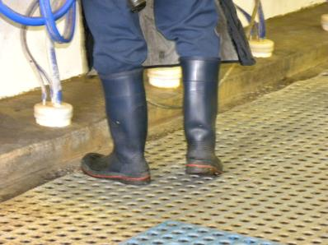
Organization and housekeeping
Organization and housekeeping
Facility walkthroughs
Floors/footwear

Slide 27
Agricultural Structures
“A shelter for farm animals or crops; or when incidental to agricultural production, a shelter for processing or storing equipment. An agricultural building is not for use by the public, or for any human habitation.”

Slide 28
Common Elements of Farm Structures
Walking and working surfaces
Holes and floor openings
Handrails and railings
Stairs
Fixed ladders and cages

Slide 29
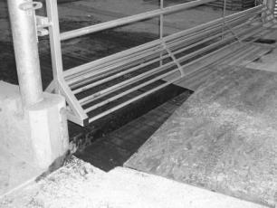
Holes and floor openings
Floor hole
  Less than 12”, more than 1”
  Placement in floor, platform, pavement or yard
  Size means materials but not people may fall through
  May include water or waste pipe opening

Slide 30
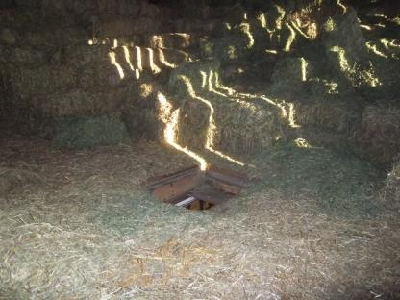
Holes and floor openings
Floor opening
  12” or more in it’s least dimension
  Placement in any floor, platform, pavement or yard
  People may fall through
  Examples: hatchway, stair/ladder opening, pit, manhole, haymow opening

Slide 31
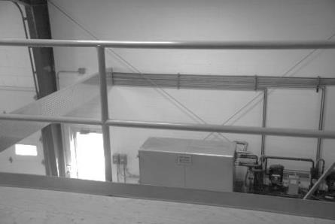
Handrail and
Railing Requirements
Railing must consist of:
  Top rail
  Intermediate rail
  Posts
  Vertical height 42”

Slide 32
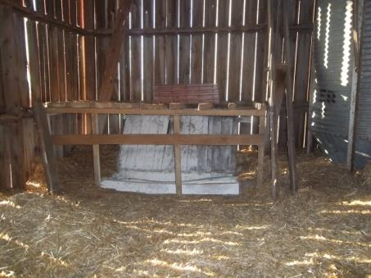
Handrail and
Railing Requirements
4” toe board may be required
200 lbs. of force
Transitions
Handrails 30-34”

Slide 33
Stairs
Minimum width 22”
Stair treads of less than 9” must have open risers
Riser height 7.0-8.75 “
Handrails
  open on both sides
  meet previously mentioned requirements

Slide 34
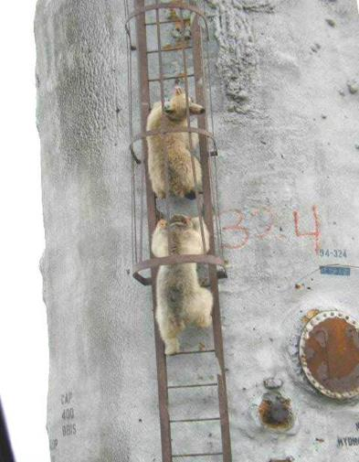
Fixed ladders and cages
Inspection
Rungs
Written ladder safety program and training
Fall protection devices
Slip-resistant footwear

Slide 35
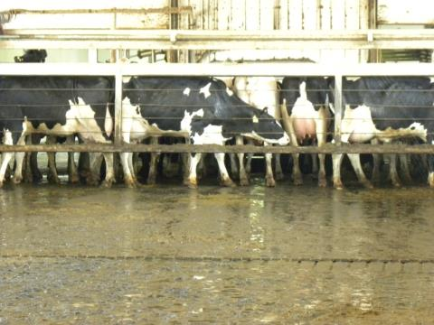
Animal Handling Structures
Housekeeping
Chemical hazards
Crowd gates
  stop measures
  gaps

Slide 36
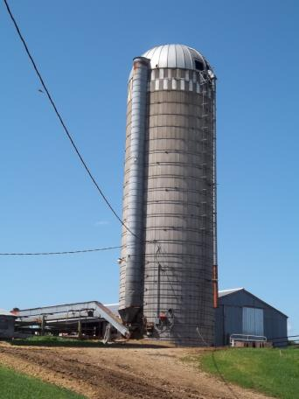
Electricity
National Electric Code (NEC)
Electrical consultant
10 foot distance for employees or equipment
Clearance distances for grain storage
  use of a spotter

Slide 37
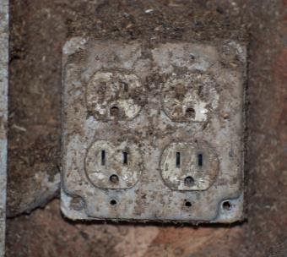
Clues that a hazard may exist
Tripped breakers or blown fuses
Worn tools, wires, cords, connections, junction boxes
GFCI
Worn/frayed insulation
Employees should report conditions

Slide 38
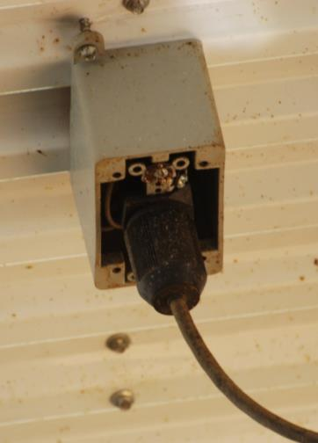
Electrical Safety
Grounding path
Hand-held tools
Live part guarding
Covers
Use of flexible cords

Slide 39
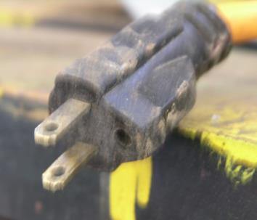
Employee Training
De-energizing
Tools in good repair
Good judgment
Jobs requiring a qualified employee or certified electrician
Procedures for reporting concerns

Slide 40
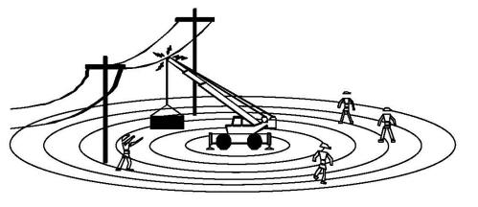
Electrical Incidents
Remain in vehicle cab, call for help
If risk of staying in vehicle is higher
  Jump, not step
Shuffle from site of incident
Do not re-enter

Slide 41
Confined Spaces:
OSHA Definition
A work area that is considered a “confined space” has the following characteristics:
  large enough and configured to allow a person to bodily enter
  not designed for continuous employee occupancy
  limited or restricted means for entry or exit.

Slide 42
Confined Spaces:
OSHA Definition
Permit-required confined space:
  Contains or has the potential to contain a hazardous atmosphere.
  Contains a material that has the potential to engulf an entrant.
  Has walls that converge inward or floors that slope downward and taper into a smaller area that could trap or asphyxiate an entrant.
  Contains any other recognized safety or health hazard, such as unguarded machinery, exposed live wires, or heat stress.

Slide 43
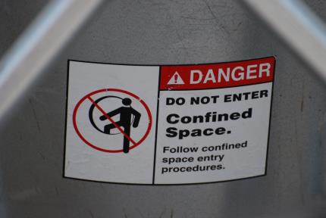
Confined Spaces
Permit-required = considered hazardous until determined otherwise
Assessment
  qualified person
Stranded investment?

Slide 44
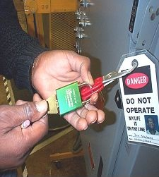
Lock-out / Tag-out
Best practice
Lock-out = physical barrier
Tag-out = visual barrier
Training

Slide 45
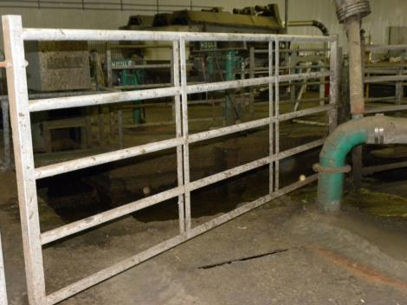
Manure storage and handling
Four main deadly gases
  Carbon dioxide
  Methane
  Ammonia
  Hydrogen sulfide

Slide 46
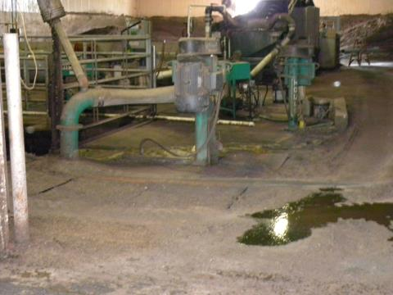
Manure storage and handling
Servicing manure pits
  Only qualified people
  Ventilation
  Test air quality
  Safety equipment
  Standby person
Contracting

Slide 47
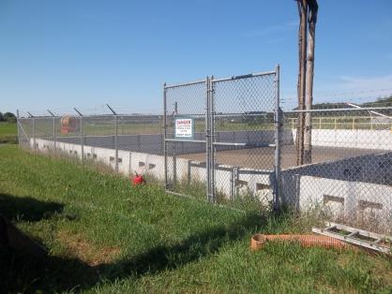
Manure storage and handling
Pit and lagoon guidelines
  Fencing
  Signs
  Emergency plan
  Machine guarding
  Fall prevention
  Construction planning
  Employee training
  “No Smoking” areas

Slide 48
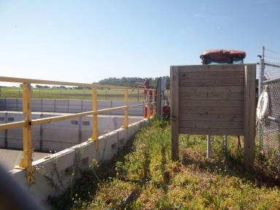
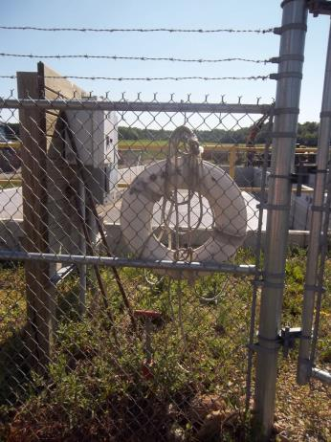
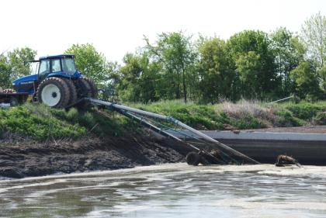
Manure storage and handling

Slide 49
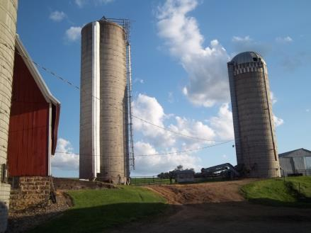
Upright silos
Upright silos
  Silo gas
  Carbon dioxide
Dangers after filling
Warning signs
Safety equipment
Standby person
Lock unloading mechanisms

Slide 50
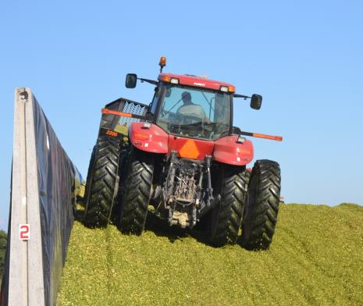
Horizontal silos
Filling safety
  ROPS
  plastic sheeting
  back tractor up slopes
  wide wheel base
  firm, even surface for dumping
  silage height
  slope
  bucket position

Slide 51
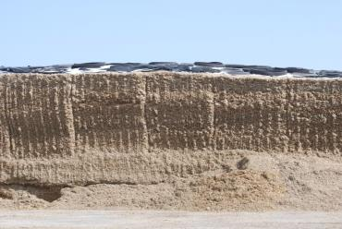
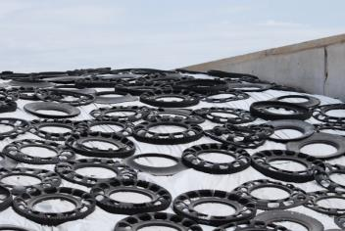
Horizontal silos
Feeding safety
  shearing silage face
  vehicle positioning
  sampling
  plastic removal
Bunker silos
  sight rails

Slide 52
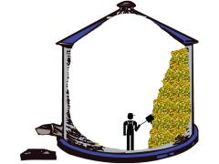
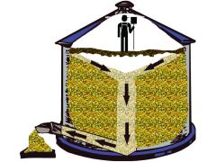
Grain bins
Engulfment, falls
  6’ worker can be engulfed in 11 seconds
    unable to move in 5 seconds
Grain cave-ins
Collapse of bridges/crusts of grain

Slide 53
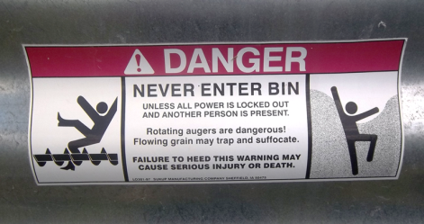
Grain bin Deaths
Larger bins, faster unloading
Wet harvest years
Working alone
No lock-out/tag-out
Lack of accident response plan

Slide 54
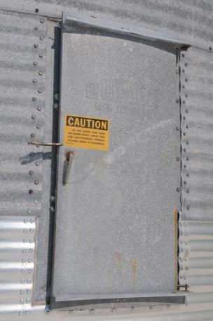
Grain bin Safety
Use lock-out/tag-out
Never run equipment with worker inside
Prohibit “walking down” grain
Prohibit entrance when there is a bridge or crust formed
Train workers for specific grain bin risks

Slide 55
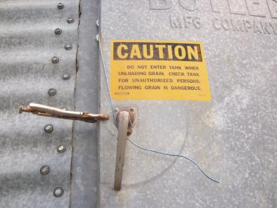
Grain bin Safety
Safety harness
Rescue equipment
Standby person for rescue
Communication
Test air quality
Ventilation
Permit entry
Confined space entry procedure

Slide 56
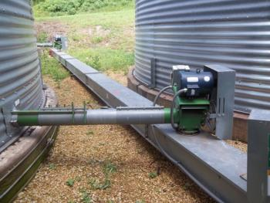
Combustible Dust
2 phases of explosion
  cascade effect
Location of explosions

Slide 57
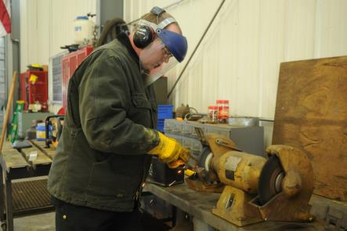
Farm Shops
Chemical inventory
Machine guarding
OSHA standards for stairs, railings, etc.
Slip/fall hazards
Welding equipment

Slide 58
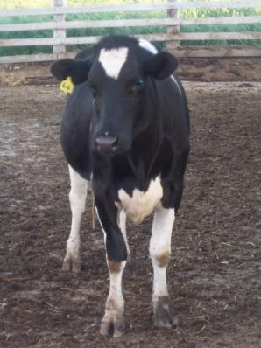
Contractors
Make aware of emergency plan
Agree to comply with OSHA standards
Make aware of hazards

Slide 59
Review
What is a cows “flight zone” and how does it affect her movement?
  The flight zone refers to a cow’s “personal space.” When a human enters her flight zone she will move, just as when a human leaves her flight zone she will stop moving.

Slide 60
Review
What aspects of electrical safety should employees be trained on?
  De-energizing electric equipment
  Using electric tools that are in good repair
  Using good judgment when working near energized lines
  Jobs that are to be completed by a “qualified” employee or certified electrician
  Procedures for reporting any electrical concerns in their workplace or with equipment

Slide 61
Review
What are some risks associated with manure storage and handling?
  Manure gas, suffocation, asphyxiation, slips/falls, explosion/fire related to smoking

Slide 62
Review
What are some risks associated with silos?
  Silo gas, falls, engulfment, tractor rollover

Slide 63
Review
List confined spaces on your operation that should only have a qualified person enter:
  Will vary by operation. May include grain bin or manure pit.

Slide 64
Review
Confined spaces that should never be entered:
  Will vary by operation. May include spaces that are contracted out by the farmer.

Slide 65
This material was produced under grant number SH-22318-11 from the Occupational Safety and Health Administration, U.S. Department of Labor. It does not necessarily reflect the views or policies of the U.S. Department of Labor, nor does mention of trade names, commercial products, or organizations imply endorsement by the U.S. Government.

