Slide 1

Hazard Awareness, Identification, Recognition, and Control for Beauty and Grooming Professionals
Training Developed by:
Photo available under public domain from Wikimedia Commons
Notes:
Welcome to our training on identifying, recognizing and controlling hazards in the cosmetology industry. This training was developed specifically for beauty and grooming professionals and students by National Jewish Health in Denver, CO, with support from Colorado State University in Fort Collins, CO. Funding for these training materials was provided by a grant from the U.S. Department of Labor, OSHA, under the Susan Harwood Targeted Topic Training Grant Program.
[Go to CosmetologyActivities, slide 1]

Slide 2
Disclaimers
This presentation was produced under grant number SH-23540-SH2 from the Occupational Safety and Health Administration, U.S. Department of Labor. It does not necessarily reflect the views or policies of the U.S. Department of Labor, nor does mention of trade names, commercial products, or organizations imply endorsement by the U.S. Government.
Notes:
These training materials were produced under grant number SH23540SH2 from the Occupational Safety and Health Administration, U.S. Department of Labor. It does not necessarily reflect the views or policies of the U.S. Department of Labor, nor does mention of trade names, commercial products or organizations imply endorsement by the U.S. government.

Slide 3
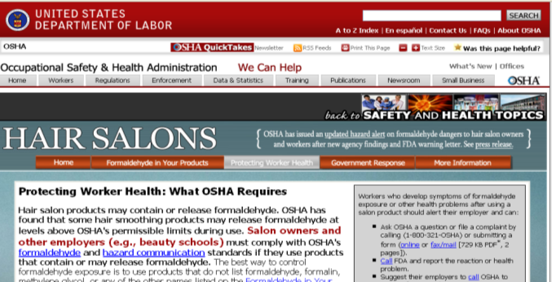
Why are we here?
http://www.osha.gov/SLTC/hairsalons/protecting_worker_health.html accessed 1/11/2013
Provide information to workers:
Possible health effects from exposures to chemicals in salons.
Ways to identify chemical exposures that may be hazardous.
Methods to reduce exposures to chemicals in salons.
Notes:
Why are we here? OSHA is very interested in salon workers because of the health hazards they face. They even have a website dedicated to protecting the health and safety of salon workers. We will provide you with information about health effects that can be caused by exposures to chemicals in salons, tell you about ways to identify hazardous exposures, and give you information on how to reduce your exposure to these chemicals.

Slide 4

Why are we concerned?
Exposures from formaldehyde in hair smoothing process
Exposures to other chemicals that may cause:
Skin problems
Allergies
Cancer
Breathing problems
Problems with fertility and pregnancy
Photo by Dean Wissing available under public domain from Wikimedia Commons
Notes:
You may wonder why OSHA is so concerned about salon exposures. The main reason is exposure to formaldehyde, which is primarily used in hair straightening processes, specifically keratin smoothing processes. OSHA is also concerned about exposure to other chemicals that can cause health problems, including skin problems, allergies, breathing problems, problems with pregnancy and fertility, and even cancer.

Slide 5
Outline
Introduction to OSHA
Health effects from chemical exposures
Overview of cosmetology exposures
Exposures to formaldehyde
Recognizing and controlling chemical exposures
Infection control
Ergonomics
Safety hazards
Notes:
Here is an outline of what we are going to talk about today. We will start with an introduction to OSHA. Then, we will talk about health effects that can happen as a result of chemical exposures. We will give you an overview of exposures that can be present in salons. We will spend a lot of time talking about formaldehyde, because that’s the chemical we’re most concerned about. Then, we’ll talk about recognizing and controlling chemical exposures, so that if you are exposed to chemicals, you’ll know what to do about it. We’ll talk about preventing infections in your workplace. We will talk about some physical hazards, namely ergonomics and we’ll finish by talking about some safety hazards.

Slide 6
Definitions
Salon chemicals
Chemicals in the products used in salons
Hair and nail products, cleaners
Health effects
Injury or illness due to an exposure
Chemical exposure
Inhalation or skin contact with salon chemicals
Part per million (ppm)
Small unit of concentration
1 ppm = 1 drop in 13 gallon gas tank
Notes:
Here are some definitions of words we will be using in this presentation. When we say salon chemical, we’re talking about the chemicals in the products used in your salon—both the chemicals in hair and nail products as well as the chemicals you use to clean the salon. When we say health effect, we’re talking about injury or illness that can happen as a result of an exposure to a chemical or physical hazard. A chemical exposure is anytime you come into contact with a chemical, which can happen when you breathe one in or get it on your skin. We’re going to talk a lot about a unit called a “part per million” or “ppm.” This is a really tiny unit of concentration. Picture one drop from an eyedropper in a 13 gallon gas tank; that’s how small a part per million really is. For some of these chemicals, we are concerned about exposures that small.

Slide 7
Introduction to OSHA Training Goals
Understand the role of OSHA in occupational safety and health
Describe employer responsibilities and employee rights provided by OSHA
Understand specific OSHA and industry standards related to salon for handling chemicals
Notes:
We will start with an introduction to OSHA. The goals of this section are: to understand the role of OSHA in occupational safety and health, to describe employer responsibilities and employee rights under OSHA, and review some OSHA standards that apply to salons.

Slide 8
What is OSHA?
Occupational Safety and Health Administration
Government agency within the U.S. Department of Labor
Responsible for worker safety and health protection
Created in 1970 by the Occupational Safety and Health (OSH) Act
Notes:
I’m sure most of you have already heard of OSHA. OSHA is the Occupational Safety and Health Administration. It’s a government agency within the U.S. Department of Labor. OSHA is responsible for worker safety and health protection. It was created in 1970 by the Occupational Safety and Health Act or OSH Act. The OSHA Act allows states to take responsibility for implementing the OSH Act, provided their regulations are at least as stringent as federal OSHA.

Slide 9
What does OSHA do?
Requires employers to implement programs to reduce workplace safety and health hazards
Investigates workplace fatalities or catastrophic accidents
Enforces safety and health standards through workplace inspections by compliance officers
Monitors job-related injuries and illnesses through required record-keeping
Provides assistance, training, and other support programs to help employers and workers
Notes:
What does OSHA do? OSHA requires employers to implement programs to reduce workplace safety and health hazards. They investigate workplace fatalities or catastrophic accidents. OSHA enforces safety and health standards through workplace inspections by compliance officers, and they monitor job-related injuries and illnesses through required record-keeping. OSHA may have a reputation of being “the bad guy” who comes in and enforces rules, but they also provide assistance, training and other support programs to help employers and workers, like this training program that we’re providing you today.

Slide 10
What are employers’ responsibilities under OSHA?
Provide employment and a workplace that is:
In compliance with established OSHA standards.
Free from recognized hazards that are causing or are likely to cause death or serious physical harm to employees.

Slide 11
What are employees’ rights under OSHA?
Get training from your employer as required by OSHA standards
Request information from your employer about OSHA standards, worker injuries/illnesses, and job hazards
Request action from your employer to correct hazards or violations of OSHA standards
File a complaint with OSHA if you believe there are violations of OSHA standards or serious hazards
Must be submitted in writing, signed by a current employee or employee representative, and state the reason for the inspection request
Complaints won’t initially result in an inspection if it is verbal and/or you are not a current employee.
Forms and more information available at www.osha.gov
Notes:
As an employee, you have a number of rights under OSHA. You have the right to get training from your employer as required by the OSHA standards. You also have the right to request information from your employer about OSHA standards, worker injuries, illnesses, and job hazards. In addition, you can request action from your employer to correct hazards or violations of OSHA standards. You have a right to file a complaint with OSHA if you believe there are violations of OSHA standards, or serious hazards. This complaint must be submitted in writing, signed by a current employee, or an employee representative, and state the reason for the inspection request. Forms and more information on how to do this are available on the OSHA website at www.osha.gov.

Slide 12
What are employees’ rights under OSHA?
Be involved in OSHA’s inspection of your workplace
Find out results of an OSHA inspection
Get involved in meetings or file a formal appeal concerning your employer’s timely abatement of OSHA citations
File a discrimination complaint
Request a research investigation by the National Institute for Occupational Safety and Health (NIOSH)
Provide comments and testimony to OSHA during rulemaking on new standards
Notes:
If OSHA ever inspects your workplace, you have the right to be involved the inspection and find out the results. You have the right to get involved in meetings or file a formal appeal concerning your employers’ timely abatement of OSHA citations, and to file a discrimination complaint. You can also request a research investigation by the National Institute for Occupational Safety and Health, or NIOSH. And lastly, you can provide comments and testimony to OSHA during rule-making on new standards.

Slide 13

What about whistleblower protection?
Section 11(c) of the OSH Act and more than twenty statutes protect employees who report violations
Employees must be allowed to exercise rights including reporting injuries, reporting violations, and participating in health and safety activities
Employers are prevented from discriminating against employees for exercising their rights under OSHA
Notes:
There’s a whole section of OSHA website dedicated to protecting whistleblowers. Section 11 C and more than 20 other statutes protect you if you want to report a violation. You’re allowed to exercise your rights including reporting any injuries, reporting any violations, and participating in health and safety activities, like this training. Your employer may not like it if you file a report, but they are prevented from discriminating against you if you exercise your rights under OSHA.

Slide 14
Are booth renters covered by OSHA?
No set definition of employee versus independent contractor (booth renter)
Courts and state agencies will look at a long list of factors to determine whether you are an employee or independent contractor
Owner give you an IRS form 1099 instead of W-2
Does not mean that you are an independent contractor
Employees have the right to workplace health & safety, minimum wage, workers’ compensation, and other benefits
Independent contractors do not
No clear-cut answer
Notes:
You may wonder if booth renters are covered by OSHA. The problem is that there’s no clear-cut answer. Courts and state agencies look at a long list of things to determine whether you’re an employee or an independent contractor. If you get an IRS form 1099 instead of a W-2, that might mean you’re an independent contractor. If someone else is in charge of setting your schedule, that might mean you’re an employee. Employees have the right to a lot of things that aren’t available to independent contractors, like rights under OSHA, minimum wage, and workers’ compensation. Because there’s no set definition, the decision is made on a case-by-case basis.

Slide 15
Are there specific OSHA standards that apply to my workplace?
Recordkeeping
Housekeeping
Medical & First Aid
Walking/Work Surfaces
Emergency Action
Personal protective equipment
Fire protection
Electrical
Respiratory protection
Bloodborne Pathogens
Hazard communication
Formaldehyde
There may also be others that apply to your workplace!
Notes:
There are other OSHA standards that apply to your workplace. There are OSHA standards for record keeping, housekeeping, first aid, personal protective equipment, bloodborne pathogens, and hazard communication. There is a specific standard for formaldehyde. This list isn’t comprehensive, so there may be other standards that apply to your workplace as well.
[Go to CosmetologyActivities, slide 2]

Slide 16
Health Effects of Hair and Nail Salon Work
Chemicals
Skin rash
Chemical eye burns
Breathing symptoms
Asthma
Allergies
Cancer
Reproductive problems
Neurologic problems
Ergonomic problems
Musculoskeletal disorders
Infections
Colds and flu
Skin infections
Bloodborne pathogens
Injuries
Slips, trips, falls
Electrical injuries
Burns
Cuts
Workplace violence
(Not covered in this training)
Notes:
There are a lot of possible health effects from hair and nail salon work. We will spend a lot of time talking about the different types of health effects that can be caused by chemicals. We’ll talk about the musculoskeletal disorders that can happen as a result of ergonomic problems. We’ll talk about infections, including cold and flu, skin infections, and bloodborne pathogens. We’ll talk a little about injuries, including slips, trips, falls, and electrical injuries. The hazards in red-- burns, cuts, and workplace violence are some other hazards that salon workers face, but we will not have time to cover these important topics in this presentation.

Slide 17
Chemical Health Effects Training Objectives
Learn how chemicals in hair and nail products can cause health effects
By contact with your skin and eyes
By entering the body
Describe health effects that can be caused by salon chemicals
Understand the hazards of formaldehyde and special precautions that are needed when working with it.
17
Notes:
17
17
In the Chemical Health Effects section, we want you to learn how chemicals in hair and nail products can cause health effects. This can happen when the chemicals come into contact with your skin and eyes, as well as when chemicals enter your body, like when you breathe them in. At the end of this section, you will be able to describe health effects that can be caused by salon chemicals. We especially want you to understand the hazards of formaldehyde, and the special precautions that are needed when you work with it.

Slide 18





Chemical Symbol Definitions for Each Type of Health Effect
Allergies
Cancer
Irritation
Neurologic
Reproductive Problems
Notes:
We are going to use some symbols that go along with each type of health effect. “A” is for allergies. “C” will come up when we’re talking about something that’s a carcinogen, which means it can cause cancer. “I” is for irritation. “N” is for neurologic symptoms or problems with your brain—like you’re seeing stars, and the pink and blue “R” is for reproductive problems.
[Go to CosmetologyActivities, slide 3]

Slide 19


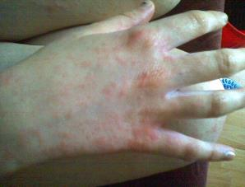
Hand Rash is the Most Common Health Effect in Salon Workers
Hand rash can be due to:
Irritation
Allergy
Higher risk in people with other skin problems
“Sensitive skin”
Photo by RainbowKatie available under public domain from Wikimedia Commons
It is important to take good care of your skin.
Notes:
Hand rash is the most common health effect in salon workers. Rash can be caused by irritation, or it could be caused by an allergy. People with other skin problems, so called “sensitive skin” are at higher risk for developing hand rash due to irritation and allergy.

Slide 20

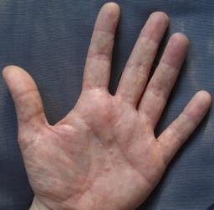
There are many causes of skin irritation in a salon
Too much washing
Hair
Hands
Friction from hair
Heat from dryers
Irritation from gloves
Putting on gloves while hands are still wet
Chemicals in hair and nail products
Photo available under public domain from Wikimedia Commons
Notes:
There are many things that can cause skin irritation in a salon. You can have irritation from too much washing, either washing hair or washing your hands. Friction from hair can cause irritation, and so can heat from dryers. You can get irritation from gloves, especially from putting on gloves when your hands are still wet. There are a lot of chemicals in hair and nail products can cause irritation as well.

Slide 21

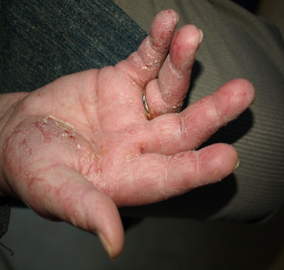
Some hand rashes are due to allergy
Much less common
Severe and hard to treat
You may need to stop working with the chemical.
Risk of allergic rash is increased by
Eczema
Rash due to irritation
Klaus D. Peter, Gummersbach, Germany; Creative Commons Attribution 3.0
It is important to find rashes early, get proper
medical treatment, and reduce exposures.
Notes:
Some hand rashes are due to allergy. Rashes due to allergy are much less common, but the problem is they are often severe and can be very difficult to treat. Because you may need to stop working with the chemicals to which you are allergic, this could end your career. Having skin problems such as eczema or rash caused by irritation can increase your risk of developing an allergy. That’s why it’s very important to take care of your hands, find rashes early, get medical treatment, and reduce exposures.

Slide 22



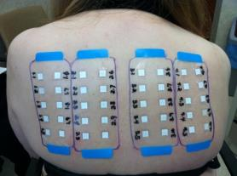
Both irritation and allergy can cause severe hand rash
You often can’t tell if a rash is due to allergy or irritation by looking at it
A doctor often can’t tell
Special allergy testing is often needed to know the cause of a rash
Photo by RainbowKatie available under public domain from Wikimedia Commons
Patch Testing For Allergy
Photo by National Jewish Health
Notes:
Both irritation and allergy can cause a severe hand rash, and you can’t tell the cause of the rash just by looking at it. Even a doctor can’t tell. Special allergy testing, called patch testing, is needed. In patch testing, special patches with chemicals are placed on your back and removed two days later. We will show you in a few slides what a positive patch test looks like.

Slide 23

Very irritating chemicals can cause serious eye injury!
!
Chemical burns
High pH
Ammonia
Hydroxides
Can result in permanent injury and loss of vision
GNU Free Documentation license licensed under the Creative Commons Attribution-Share Alike 3.0 Unported
Notes:
Very irritating chemicals can also cause serious eye injury! Chemicals like ammonia and hydroxides are basic, which means they have a high pH. Bases can burn your eyes and skin. If it gets in your eyes, it could cause permanent injury and loss of vision. Whenever you work with something with a high pH, you will want to protect your eyes against splashes.

Slide 24

Chemicals can also cause health effects by entering the body
Chemicals can enter the body through:
Breathing them in
Swallowing them
Contact with the
Eyes
Nose and mouth
Breaks in the skin
Contact
with eyes, nose and mouth
Breathing
Swallowing
Breaks in the skin
Photo by National Jewish Health
Even intact skin is not good protection from all chemicals.
Notes:
We have talked about how chemicals can cause effects by touching your body. Now we are going to talk about health effects from chemicals entering the body. Chemicals can enter your body when you breathe them in, swallow them, or if they contact the special tissues called mucous membranes in your eyes, nose and mouth. Chemicals can also enter your body through breaks in the skin, like a rash or a cut, but even normal, intact skin isn’t good protection against all chemicals.

Slide 25



Irritants and allergy can cause breathing symptoms
Cough
Dry cough
Cough with phlegm
Wheeze
Chest tightness
Shortness of breath
Photo by National Jewish Health
Breathing symptoms due to irritants are usually mild and get better when you leave exposure.
Photo by National Jewish Health
Notes:
Both irritants and allergy can cause breathing symptoms. Breathing symptoms are cough, wheezing or whistling in the chest, chest tightness, and shortness of breath. Breathing symptoms caused by irritants are often mild and get better when you leave the exposure, like when you finish working with a certain chemical, when you go home for the day, or when you go outside and get fresh air.

Slide 26
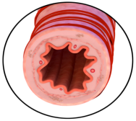
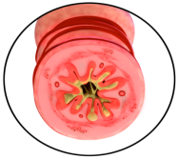
Asthma can be triggered by irritation and allergies
Normal airway
Airway in asthma
Asthma
Medications
Muscle
tightening
Mucus
Swelling
Figures by National Jewish Health
Airways become inflamed and narrowed
Breathing symptoms: mild or severe
Treatment with medications is often needed
Workers with asthma should be extra careful to
avoid breathing in irritating chemicals.
26
Notes:
26
26
Asthma can be triggered by irritation and allergies. Asthma can also be caused when you develop an allergy to a chemical. The airways become inflamed and narrowed, which can cause breathing symptoms, both mild and severe. The diagram on the left shows a normal airway, which is hollow like a straw. The diagram on the right shows what happens in asthma, where the muscles in the airway wall tighten and inflammation that cause the airway to become narrow. Treatment with medications is often needed. If you have asthma, you should be extra careful to avoid breathing in irritating chemicals.

Slide 27


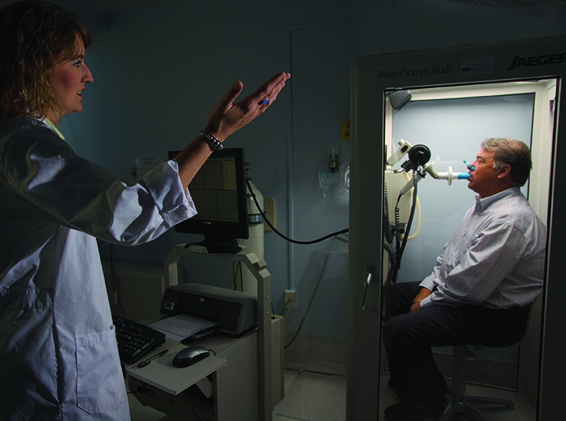
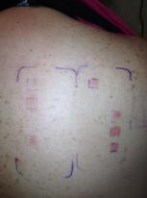
Breathing in chemicals that cause allergic rash can also cause asthma and “hayfever” (allergic rhinitis)
Special medical testing is needed to diagnose:
asthma
“hayfever”
and
if the asthma or “hayfever” is due to an allergy to a chemical at work
Photo by National Jewish Health
Photo by National Jewish Health
Notes:
Breathing in chemicals that cause the allergic rashes can also cause asthma and symptoms like hayfever, called allergic rhinitis. You need special medical testing to diagnose asthma, shown in the picture at the top. You also need special testing for allergies, which is the patch testing shown before. The photograph on the bottom shows the red raised areas that develop on the skin under the patches that had chemicals to which the person is allergic.

Slide 28
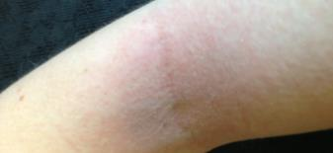
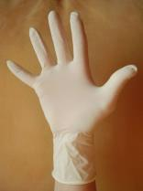


Certain chemicals can trigger other allergic reactions
Hives
Itchy red bumps on the skin
Sudden, severe allergic reaction
Hives
Swelling of the tongue and throat
Breathing difficulty
Dizziness
Loss of consciousness
Anaphylaxis
Photo by National Jewish Health
Latex powder
Persulfates
Henna
Photo by Werneuchen available under public domain from Wikimedia Commons
Photo by W. Oelen available under public domain from Wikimedia Commons
Photo by Andrey Sitnik available under public domain from Wikimedia Commons
Notes:
Some chemicals can trigger other allergic reactions. You can get hives, which are itchy red bumps on the skin. More severe reactions are called anaphylaxis. This is the type of severe reaction that can happen from allergies to peanuts or bee stings. Symptoms of anaphylaxis include swelling of the tongue and throat, difficulty breathing, loss of consciousness, and even death. These reactions are rare, but can be caused by a few chemicals that are in salons, namely henna, persulfates, and the powder on latex gloves. This one of the reasons why we recommend you use nitrile gloves instead of latex gloves.

Slide 29


Work as a hairdresser or barber probably increases risk of cancer
Few specific chemicals have been identified
Brilliante
Formaldehyde
Probable human carcinogen
“Hairdresser or barber (occupational exposure as)”
Different types of cancer
Many possible chemicals
Photo by IARC
Minimize exposure to salon chemicals to decrease risk of cancer.
Notes:
Work in a salon probably increases risk of cancer. Only a few specific chemicals have been identified as known carcinogens, including Brilliante, a hair dye that was banned in the 1970s, as well as formaldehyde. But, studies have shown that people who work as a hairdresser or barber had a higher risk of getting cancer than the rest of the population, and an international group of scientists concluded these are a probable human carcinogen. There were a lot of different types of cancer and there are so many chemical used in salons, it’s a good idea to minimize exposure to salon chemicals as much as you can to decrease your risk of getting cancer in the future.

Slide 30


Work as a hairdresser may increase risk of reproductive problems
Lower fertility
Females
Males
Miscarriages
Smaller babies
Problems during pregnancy
Chemicals
Long work hours on your feet
Photo by Nina Matthews available under public domain from Wikimedia Commons
Minimize exposure to salon chemicals to decrease the risk of reproductive problems, especially during pregnancy.
Notes:
Work as a hairdresser or a barber may also increase your risk for reproductive problems. Lower fertility has been seen in both males and females. There’s an increased risk for miscarriages, as well as smaller babies. Problems during pregnancy are not just from chemicals, but also from the long hours spent working on your feet. We recommend that you minimize exposure to salon chemicals to decrease the risk of reproductive problems, especially during pregnancy.

Slide 31


Neurologic Effects
Feeling “drunk” or lightheaded
There is too much chemical in the area for the ventilation system.
Photo by National Jewish Health
If you start to feel “drunk” while working indoors:
First, go outside to get fresh air
then take steps to improve ventilation inside
Notes:
Some of the chemicals that you work with can cause neurological effects, like feeling drunk or lightheaded. If you get this feeling from breathing in chemicals, it means that there’s too much chemical in the area for the amount of ventilation in the room, and that you are being overexposed. If you ever start to feel drunk while working indoors, first, go outside and get fresh air. When you feel better, you should then go back in and take steps to improve the ventilation.
[Go to CosmetologyActivities, slide 4-5]

Slide 32
Salon Exposure Recognition Training Goals
Recognize products and work processes that may cause exposures that result in health effects
Notes:
In this section, we are going to talk about how to recognize exposures you might have in a salon. We want you to be able to recognize the products and processes where you can have exposures that result in health effects.

Slide 33

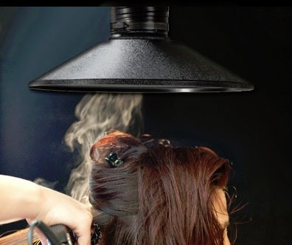
What do exposures look like?
Photo used by National Jewish Health with written permission.
Photo available under public domain from Wikimedia Commons
Notes:
What do exposures look like? The picture shows a stylist performing the flat ironing step of the keratin smoothing process. The picture on the right shows a close up view of the client’s hair, which lets you see the steam coming off from the hair during this process. That steam contains the chemicals that were applied to her hair, including formaldehyde. That same steam containing chemicals is coming off of the hair and into the breathing zone of the stylist who is not using ventilation in the picture on the left, even though you can’t see it.

Slide 34




How do I know if it is hazardous?
Allergies
Hazard Communication
Product labeling
MSDS or SDS readily available
Information from industry professionals
Cancer
Irritation
Neurologic
Look at product labels prior to use to identify hazards and determine appropriate precautions.
Reproductive Effects
Notes:
How do you know if what you’re working with is hazardous? We are going to talk a lot about hazard communication. This involves product labeling, and making sure that you only work with products that have the correct label. You want to make sure that the MSDS or SDS for everything that you work with is readily available, and that you know how to read it. Hazard communication also involves getting information from industry professionals, who should be experts on the product. In this presentation, we’re going to keep using the symbols that we told you about before, listed again on the right. It’s really important that you look at product labels before you start your work to identify hazards and determine appropriate precautions.

Slide 35



Key elements of OSHA’s hazardous communication standard
Identify & communicate hazards in the workplace
Label each hazard
Use Globally Harmonized System (GHS) to communicate hazards
Have corresponding Safety Data Sheet (SDS)
Update when new sheets are available
Train workers on the hazard labeling system
Figures by Torsten Henning available under public domain from Wikimedia Commons
Notes:
OSHA has a standard on hazard communication. It requires the employer to identify and communicate all chemical hazards in the workplace. Each hazard should be labeled using the Globally Harmonized System (GHS) to communicate hazards. You should have the corresponding Safety Data Sheet (SDS), which need to be updated when new ones are available. All workers should be trained on the hazard labeling system—the labels won’t do you any good if you don’t know what they mean.

Slide 36
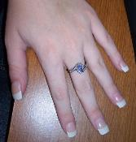

What exposures are possible in artificial nail work?
Neurologic
Acetone – Polish remover
Toluene – Nail polish, hardeners, polish removers
Acetonitrile – Artificial nail removers
Cancer, Irritation
Formaldehyde – Nail hardeners
Allergies
Methacrylate – Monomers in acrylics & gels
MMA, (methyl methacrylate) Can’t be 100%
EMA (ethyl methacrylate)
HEMA (hydroxyethyl methacrylate)
Irritation
Methacrylic Acid (MAA) – Nail primers
Ethyl cyanoacrylate – (> 90%) in nail glue
Picture by ImGz available under public domain from Wikimedia Commons
Notes:
Now, we are going to talk about the different chemical exposures that are possible when you are working in salons. You are going to see a lot of chemical names. This is not meant to overwhelm you, but we do want you to be aware of all of the different types of products that can contain chemicals that can cause health effects. When you are working with artificial nails, neurologic symptoms can be caused by some of the chemicals in nail polish remover and nail hardeners. Formaldehyde in nail hardeners can cause both irritation and cancer. We think mostly about formaldehyde in keratin smoothing for hair, but small amounts can be found in some nail products as well. Any time you see methacrylate, you should think about allergy. Methacrylates are found in acrylic and gel nails. Methyl methacrylate or MMA is very potent, and products aren’t allowed to be made of 100% methylmethacrylate any more because of allergy. Irritation can also be caused by other chemicals in nail primers and in nail glues.

Slide 37
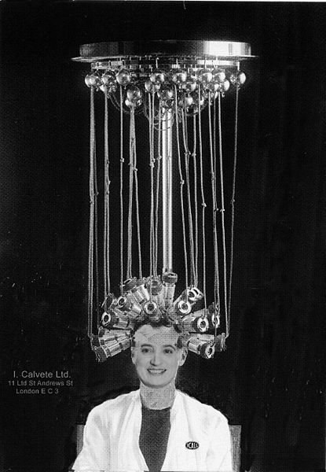
What exposures are possible from giving permanents?
Allergies
Ammonium thioglycolate
Glyceryl monothioglycolate
Irritation
Sodium or potassium bromate
Sodium or potassium perborate
Hydrogen peroxide
Ammonia substitutes
Monoethylamine (MEA)
Aminomethyl propanol (AMP)
Picture by Louis Calvete available under public domain from Wikimedia Commons
Notes:
A lot of exposures are possible when you give perms. We know they’re not as popular as they were when this photo was taken, but you should be aware that thioglycolates in perms can cause allergy, and there are a lot of chemicals in perms can cause irritation. You can see that this list includes ammonia and hydrogen peroxide, which are both very basic meaning they have a high pH like we talked about before. That means they can cause a lot of irritation and eye injury.

Slide 38

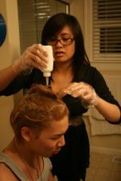
What exposures are possible from using hair dyes?
Irritation
Aniline derivatives
2,5-diaminotoluene
Ammonia and substitutes (AMP,MEA)
Peroxide
Allergies
p-phenylenediamine dyes
Para dyes (p- or 4-amino)
Photo by National Jewish Health
Photo by Avi Loud available under public domain from Flickr Creative Commons
Lead acetate is an active ingredient in products like Grecian formula which is a probable carcinogen and may be a reproductive hazard in humans.
Notes:
Some exposures are also possible when you’re working with hair dyes. There’s a lot of chemicals that can cause irritation, and you can see that this list also includes ammonia and peroxide. Some dyes also include chemicals that can cause allergy. Dyes are less hazardous than some of the other chemicals we’ve been talking about, but because we are worried about irritation and allergy, it’s a good idea to wear gloves when you’re working with them.

Slide 39
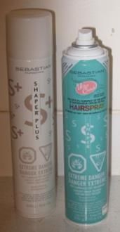
What are possible exposures from hairsprays?
Allergies
Gum Arabic
Vegetable gum
Benzophenone-4
Lauryl dimethyl benzyl ammonium chloride
Neurologic
Denatured alcohols
Methoxyethene
Isobutane
Irritation
Propylene glycol
Potassium hydroxide (KOH)
Ammonium benzoate
Amino methyl propanol
Tert-butyl alcohol
Picture by Trekphiler available under public domain from Wikimedia Commons
Notes:
Some of the chemicals in hairspray can cause allergies, including Gum Arabic and vegetable gum that make hairspray sticky. Hairspray also includes chemicals that can lead to neurologic symptoms, including denatured alcohols. Remember, feeling drunk at work means that you have too much chemical in the area for your ventilation system. There are also chemicals in hairspray that can cause irritation, including propylene glycol, hydroxides, and alcohols.

Slide 40
What are possible exposures from using disinfectants?
Allergy & Irritation
Quaternary ammonia compounds (“Quats”)
Ex: benzalkonium chloride
Irritation
Phenols
Phenol or o-Phenylphenol
Bleach
Sodium hypocholorite
Neurologic
Alcohols
Ethanol
Isopropanol
Bleach is not advised for use in salons due to ammonia in hair products!
Use “Quats” Carefully!
Notes:
You use a lot of disinfectants to keep your salon safe and clean, but it’s important to know that some of the disinfectants can have their own health effects. We recommend disinfectants that are called quaternary ammonia compounds, or “quats”, such as benzalkonium chloride. Quats are excellent disinfectants, but they can cause irritation and allergies. Other cleaners, like phenols and bleach, can also cause irritation. Some disinfectants are made of alcohols, which can cause neurologic symptoms. Remember, cleaning bleach isn’t the same thing as hair bleach to make platinum blonde hair. We recommend that you never use cleaning bleach in a salon, because you use a lot of products that contain ammonia, and ammonia and bleach have a very dangerous chemical reaction.

Slide 41
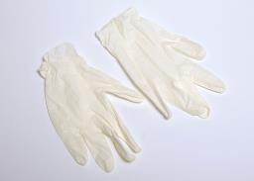
What are possible exposures from using latex gloves?
Allergy
Latex
Rash
Powder can cause anaphylaxis
Additives
Rash
Picture available under public domain from CC Attribution-Share Alike 3.0 Unported Wikimedia Commons
Nitrile gloves may also have the additives that can cause rash. Additive free gloves are available, but are difficult to find.
Notes:
Latex can cause allergy. Both latex and the chemicals added to the gloves can cause a rash. The powder in latex gloves also contains latex, which can get into the air when latex gloves are put on and taken off. If a latex allergic worker or client breaths in the latex powder, this can cause an anaphylactic reaction. Even though nitrile gloves can contain additives that can cause rash, the risk is much less than with latex gloves. Nitrile gloves do an excellent job of protecting your hands, and additive free gloves are available, although they can be difficult to find.

Slide 42

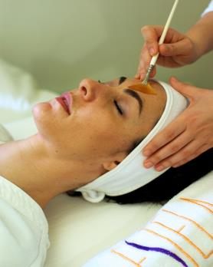

What are possible exposures from chemical peels?
Allergy, irritation and sun sensitivity
Salicylic acid (Jessner’s peel)
Aspirin allergy
The risk in pregnancy is not known
Irritation and sun sensitivity
Alpha hydroxy acids
“Fruit” acids”
Citric, glycolic malic, lactic
Beta hydroxy acid
Salicyclic acid
Jessner’s peel
Salicylic & lactic acid, resorcinol
Photo by estelabelleza available under public domain from Flickr Creative Commons
It is important to wear gloves when handling facial peel products.
Notes:
If you work with skin and do chemical peels, you can be exposed to other chemicals. Salicylic acid in Jessner’s peel can cause allergy, irritation, and sun sensitivity. It may be a risk to people with an allergy to aspirin, and the risk from exposure during pregnancy is not known. You can also get irritation and sun sensitivity from chemical peels that contain “fruit acids” like citric acid, and beta hydroxyl acids, like salicylic acids. Health effects can result from the amount of exposure and how often you are exposed– your exposure from giving treatments every day would be higher than your clients’ exposures from getting treatments much less frequently. If you work with these products, it is important to wear gloves when handling facial peel products.

Slide 43
What are possible exposures from traditional hair straighteners?
Relaxers
High pH (11.5-13.5) Irritants
Sodium hydroxide (NaOH)
Calcium hydroxide (CaOH)
Potassium hydroxide (KOH)
Permanent Relaxers “Japanese Method”
Allergies
Ammonium thioglycolate
Irritation
Hydrogen peroxide
Sodium bromate
High pH relaxers can cause severe eye and skin irritation.
Notes:
Traditional hair straighteners have a high pH and are very basic, meaning they are very irritating chemicals. Be sure to protect your skin and your eyes any time you see “hydroxide.” Chemicals used for the “Japanese method” of straightening can cause both irritation and allergy.

Slide 44
What are possible exposures from keratin smoothing products? (aka Brazilian Blowout, Global Keratin, & Others)
Cancer
Most release formaldehyde as intermediate
Irritation
Aldehydes – released as intermediates from Zero+
Photo used by National Jewish Health with written permission.
It is important to increase ventilation when using keratin smoothing products.
Notes:
Keratin smoothing products, like Brazilian blowout, is one of the most hazardous exposures in a salon, and it is a large part of the reason for this training. These products can contain formaldehyde and/or release formaldehyde during the heating process. These products can also contain other aldehydes that can cause irritation, even when the product label says it’s formaldehyde-free. Because formaldehyde is such a bad actor, it’s very important to increase ventilation whenever you use keratin smoothing products.

Slide 45
How do I know what I am being exposed to when I use a product?
We have described the possible exposures in different product types that can cause health effects.
The SDS and the product label will give you information about the chemicals in the product you are using.
Notes:
We’ve talked a lot about the various chemicals that you could be exposed to in a salon. You can use the product label and the safety data sheet to get more information about the chemicals and any product that you’re using.

Slide 46

What should you be concerned about in this hair dye?
Photo by National Jewish Health
Notes:
Take a look at this label for a hair dye. Do you see any chemicals that you should be concerned about?

Slide 47
Let’s take a closer look at the hair dye label.
Ingredients:
Aqua/Water/EAU, Cetearyl Alcohol, Ammonium Hydroxide, Oleth-30, Hexamidethrine Chloride, Oleic Acid, Oleyl Alcohol, Pentasodium Pentetate, Ethanolamine, Parfum/Fragrance, Ammonium Thiolactate, p-Phenylediamine, p-aminophenol, Resorcinol, 2-Methyl-5-hydroxyethylaminophenol,
2-Oleamido-1,3-octadecanediol,
2,4-Diaminophenoxyethanol HCl.
Notes:
If you take a closer look, you can see that it has a hydroxide, which causes irritation. It also has some phenols, and we know that those cause irritation as well. You can also see that it has p-phenylediamine, and we saw earlier that that can cause allergies.

Slide 48
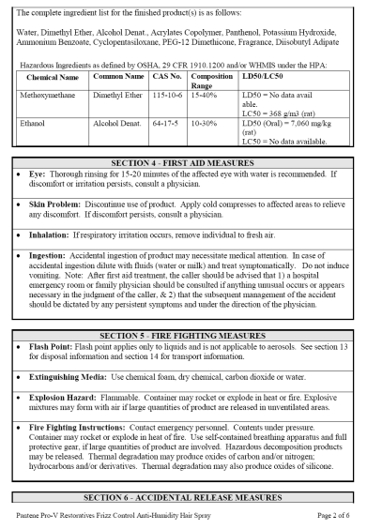
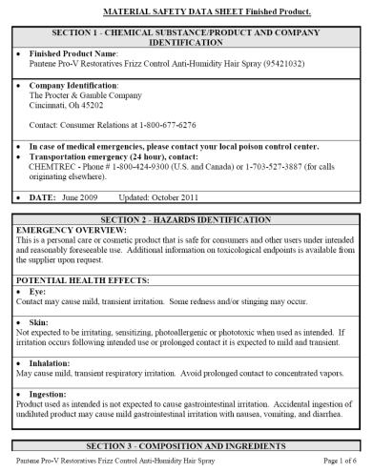
What should you watch out for in this hairspray product?
Notes:
Next, let’s look at this label for a hairspray.

Slide 49
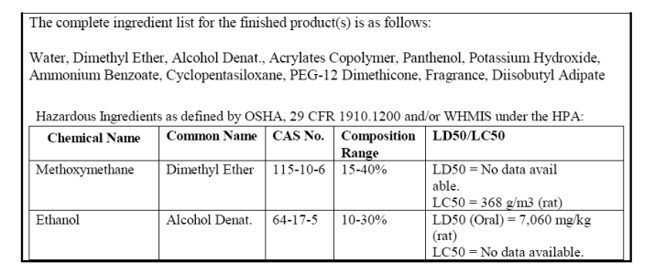
Let’s take a look at the MSDS for the hairspray.
Picture by Trekphiler available under public domain from Wikimedia Commons
Notes:
If you take a close look, you can see that this hairspray has alcohol, and other compounds that can cause neurologic symptoms, that “drunk at work” feeling we want you to avoid. It also has a few chemicals that can cause irritation, like hydroxides.

Slide 50
Formaldehyde
Special precautions are needed when working with formaldehyde
Notes:
We’re going to talk a lot about formaldehyde, because you need to take extra special precautions if you work with this chemical.

Slide 51
Key elements of OSHA’s formaldehyde standard
Use controls to reduce and maintain exposure below the permissible airborne exposure limits
Ventilation
Work practice
Personal Protective Equipment (PPE)
Gloves
Aprons
Goggles
Showers & Eyewash stations
Communicate the hazards
Labels and signs
Employee training
Medical testing for exposed workers
Notes:
Because of the health effects, OSHA has a formaldehyde standard. The standard requires that you use controls to reduce exposure levels and keep them below permissible airborne exposure limits. You can do that with ventilation or by changing your work practices. The standard includes use of personal protective equipment, or PPE, including gloves, aprons, and goggles. The standard includes showers and eyewash stations must be available. It requires the employer communicate hazards, both with labels and signs, as well as employee training, like this one. It requires that medical testing should be available for certain workers exposed to formaldehyde.

Slide 52




Formaldehyde is hazardous to your health!
Very irritating
Eyes and nose
Cough and wheeze
Allergic reactions
Asthma-like symptoms
Skin rash
Reproductive hazard
Known carcinogen
IARC Group 1
Nose & throat cancer
May also cause
Leukemia
Sinus cancer
Notes:
In this presentation, we are placing a lot of emphasis on formaldehyde because it is very hazardous to your health! This slide contains almost all of our health effect symbols. It is very irritating: it irritates the eyes and nose, can even cause nosebleeds, and can cause a cough or a wheeze. Formaldehyde can cause allergic reactions, both asthma-like symptoms or a skin rash. It is a reproductive hazard. It is also a known carcinogen, which cause nose and throat cancer. It also may cause leukemia and sinus cancer.

Slide 53
Do other products contain formaldehyde or produce formaldehyde?
Nail hardeners
Some nail polish products (ones not labeled formaldehyde-free)
Products containing
DMDM-Hydantoin
Quaternium-15
Diazolidinyl urea (or Germall 115)
Imidiazolidinyl urea (or Germall II)
Notes:
We have focused so far on keratin smoothing products, but other products contain formaldehyde. Nail hardeners, some nail polish products—even the ones that say they’re formaldehyde-free—and products containing DMDM-Hydantoin, Quaternarium-15, and Germall all contain small amounts of formaldehyde.

Slide 54

What are other names for formaldehyde?
Methanal
Methyl aldehyde
Methylene glycol
Methylene oxide
Formalin
Formol
Picture by Wereon available under public domain from Wikimedia Commons
Notes:
Formaldehyde can be listed under different names. These chemicals—methanol, methylene aldehyde, methylene glycol, formalin, formol,—are all formaldehyde.

Slide 55
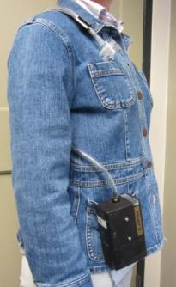
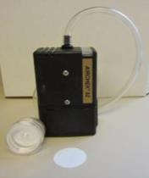
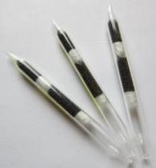

How do I know how high my formaldehyde exposure is?
Sample collector in “breathing zone”
Personal air samples
Estimate the amount of chemical a worker might inhale into their lungs
Badge samples: Passive sampler placed in breathing zone.
Different air sampling collectors for different chemicals
Worker “wears” sampling pump
Photos by National Jewish Health
Exposures can change depending on the tasks performed, ventilation, and the products being used.
Particle/Dust Collectors
Gas/Vapor Collectors
Badge Sampler
Notes:
If you work with formaldehyde, you want to know how high your exposure is. When we measure exposures, we use personal air samples which estimate the amount of chemical that a worker is inhaling into their lungs as they work. The worker wears a sampling pump and sample collector, and formaldehyde gets pulled into the collector. The collector is usually worn on the collar so it can measure how much you actually breathed in during your shift, the so-called “breathing zone”. At the end of the day, the collector can be sent to the lab to measure how much formaldehyde was collected. There is a badge, which can tell you whether or not you were exposed to formaldehyde, but it does not measure the amount. There are different air sampling collectors for different chemicals.

Slide 56
What levels of formaldehyde have been measured in salons during keratin treatments?
Short-Term Exposure Limits (15 minutes)
OSHA: 2 ppm (legally enforceable)
NIOSH: 0.1 ppm (scientific recommendation)
ACGIH: 0.3 ppm (c) (best practice guideline)
Task | Concentration (ppm)
Product Application | 1.3
Blow Drying | <0.05-2.29
Flat Ironing | 0.08-1.26
Exposures depend upon the quantity of formaldehyde in the product, tasks performed, and amount of heat used.
If multiple people are doing keratin smoothing treatments exposures are likely to exceed the short-term exposure limits as well as the 8-hour exposure limits especially if multiple treatments are done each day.
Notes:
You are probably curious about what levels of formaldehyde have been measured in salons during keratin smoothing treatments. OSHA has a short term exposure limit of two parts per million. Remember one part per million is about one drop in a 13 gallon gas tank. If you have levels over two parts per million, this exceeds OSHAs short term exposure limits. Other groups have recommended limits that are even lower. NIOSH recommends a level of 0.1 part per million, which would be one drop in a 130 gallon gas tank. ACGIH, the American Council for Government Industrial Hygienists, publishes numbers that are considered best practice, and their guideline for formaldehyde is 0.3 part per million.
The table shows the levels of formaldhyde measured during the different steps in the keratin smoothing treatment process. You can see that the level measured during product application was 1.3 parts per million. Is that a concentration we should be concerned about? It is below the enforceable limit set by OSHA, but it is higher the recommended limits of the other groups. What about the measurements listed for blow drying in flat ironing? During blow drying, we can see that they measured levels up to 2.29 parts per million, which is above all of the recommendations and the OSHA standard. During flat ironing, they measured levels up to 1.26 parts per million, which is below OSHA’s legally enforceable limit but above the recommended limits. Exposures will also vary depending on the amount of formaldehyde in the product and the amount of heat used. This clearly shows that the steps where the product is heated lead to much higher exposures.

Slide 57
What is the amount of formaldehyde in these Keratin Smoothing Products?
Product Name | Average % Concentration
Brazilian Blowout (Original Formula) | 11.5
Global Keratin | 8.3
Coppola | 3
La Brasiliana | < 1%
These products release additional formaldehyde during the blow drying and flat ironing processes!
Products with greater percentages of formaldehyde
will have higher exposures.
Notes:
The amount of formaldehyde in keratin smoothing products varies quite a bit. The original Brazilian Blowout formula had 11.5% formaldehyde, and this product has been banned. Newer products have a much lower levels of formaldehyde, sometimes under 1%. It is important to remember that these products can release additional formaldehyde when they are heated during the blow drying and flat ironing processes. We recommend you read the label and try to use the products with the lowest amount of formaldehyde.
[Go to Cosmetology Activities, slides 6-13]

Slide 58
Controlling Chemical Exposures Training Goals
Understand the methods to control chemical exposures in salons
Understand what PPE is, and when it should be used
Notes:
We hope we didn’t scare you when we talked about health effects from chemical exposures, because there’s something you can do about it. Next, we’ll talk about ways you can control exposures in your salon, and how you can protect yourself.

Slide 59
How are chemical exposures controlled?
High Exposure
Elimination & Substitution
Engineering Controls
Work Practice Controls
PPE
Changes in raw materials or chemicals
Changes that capture or enclose the source of exposure
Decreasing Effectiveness
Changes in procedures or worker behavior to reduce exposure
Increasing dependence on worker behavior
Personal protective equipment: respirators, gloves, goggles, and protective clothing
Acceptable Exposure
Notes:
Exposures are controlled with a “hierarchy of controls” that can bring exposures from a higher level down to an acceptable exposure. The best approach is elimination and substitution, which means you don’t use the chemical or substitute a less hazardous chemical so you can avoid being exposed in the first place. Next, we recommend engineering controls, which are changes that capture or enclose the exposure before it can get to your breathing zone. After that, we recommend work practice controls, which are changes in how you do your work to reduce your exposure. The last line of defense is personal protective equipment, or PPE, such as gloves or respirators.

Slide 60
Elimination or Substitution
Use an alternative chemical if possible
Example: Brazilian Blowout Zero+ instead of Original Brazilian Blowout
If an alternative chemical can’t be used, avoid performing processes using those chemicals
Sometimes substitutions have their own health effects!
Notes:
When we talk about elimination or substitution, that means using an alternative chemical when possible. For example, you might want to use Brazilian blowout zero or another product that doesn’t have high levels of formaldehyde like the original Brazilian blowout product. Or, if an alternative chemical just can’t be used, you might want to avoid performing processes that use those more dangerous chemicals. It’s important to remember that sometimes, substitutions can have their own health effects, so if you substitute chemicals you want to look at the safety data sheet for the new chemical as well.

Slide 61
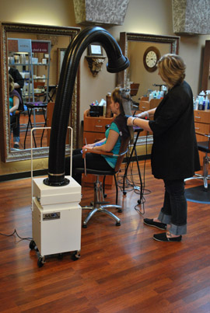
What types of engineering controls can be used?
Ventilation
Fans
Open doors/windows
Mixing stations
Ventilated nail stations
Photo used by National Jewish Health with written permission.
Notes:
Sometimes, if your client wants a certain look, you’re not going to be able to substitute or eliminate chemicals, and that is when we recommend engineering controls. Remember, engineering controls are changes you can make that will reduce the exposure or just remove it from your work area. Some options for engineering control include ventilation, fans, opening doors and windows, mixing stations, and ventilated nails stations: basically, we want to be able to move the air around so that the air you’re breathing where you work doesn’t have dangerous concentrations of chemicals.

Slide 62
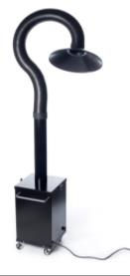
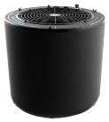
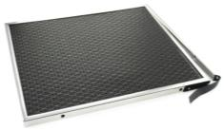
What types of ventilation exist?
Local Exhaust Ventilation or Source Capture System
Air purifiers
Special filtration systems
Natural ventilation
Photos used by National Jewish Health with written permission.
Notes:
There are few types of ventilation that you might use in a salon. The one we most recommend is called local exhaust ventilation or source capture system, but other options might include air purifiers, special filtration systems, and natural ventilation.

Slide 63

What is local exhaust ventilation or a source capture system?
Suction to remove chemical exposure prior to worker exposure
Effective if properly designed and used
Requires worker training
Requires special activated charcoal for filtration
Requires a change out schedule for activated charcoal
Photo used by National Jewish Health with written permission.
Most important control to reduce salon worker’s exposure
to chemicals!
Notes:
Local exhaust ventilation is action to remove chemicals from the air prior to worker exposure. Local exhaust ventilation is really the best option in terms of engineering controls, but it only effective if it’s properly designed and used. The system has to be close enough to the chemical in your breathing zone in order to remove it properly. If you look at the picture, you can see that the ventilation for this system is right about the client’s head. If the system was across the room from where she’s working, it probably wouldn’t do any good because it wouldn’t be removing the chemicals that she’s breathing. The systems require worker training, can require special activated charcoal for filtration, and also require a change out schedule for activated charcoal. If you have one of these systems, it’s important that you follow all of the instructions so that you know it’s working. That said, this can be the most important control to reduce salon workers’ exposures to chemicals!

Slide 64
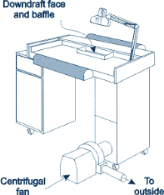
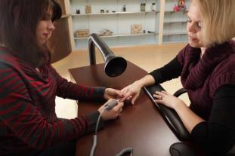
What are local exhaust/source capture systems for nails?
Downdraft tables
Should be vented outside
Removes dust & debris
Removes chemical vapors/odors
Source capture hoods
Removes dust & debris
Removes chemical vapors/odors
Contains public sector information published by the CDC available on CDC.gov
Photos used by National Jewish Health with written permission.
Notes:
There are also local exhaust systems specifically for people who work with nails. They have a downdraft table, which uses a vacuum system that pulls the chemicals away from your clients’ hands, and vent them to the outside. These tables can be effective at removing solids, like dust and debris, as well as chemical vapors and odors. Another option is source capture hoods; you’ll see that the picture on the bottom looks a lot like the ventilation system on the previous slide. These systems can remove dust and debris as well as chemical vapors and odors.

Slide 65
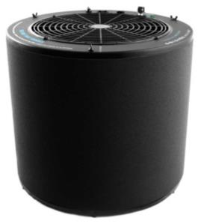
Will an air purifier help?
Salon specific air purifier
Filters dust and debris
Removes chemical vapors and odors
Has little effect on personal exposures
Not acceptable for Keratin Smoothing Products alone
Contains specialized activated charcoal
NOT ionic cleaners
Photo used by National Jewish Health with written permission.
Can be used to reduce general odors and ambient formaldehyde, but will not provide protection for stylist.
Notes:
We get asked a lot if an air purifier will help. There are salon specific air purifiers that can filter dust and debris as well as remove vapors and odors. These air purifiers can be really helpful for improving the air in your salon in general, but they really don’t do anything for your personal exposure. If I put an air purifier across the room from where I am now, it makes sense that it wouldn’t do anything for the chemicals in my breathing zone. Because of that, these aren’t acceptable for keratin smoothing products alone-you have to use local exhaust ventilation as well. Air purifiers also contain activated charcoal, so having a change out schedule is important. You also want to make sure that you aren’t using ionic cleaners-the ozone from these cleaners can actually change the chemicals they are working with to other chemicals, and then you won’t know what you’re being exposed to. Overall, you can use these for reducing odors and ambient formaldehyde, but you shouldn’t use them as your only line of defense when you’re being exposed to hazardous chemicals.

Slide 66
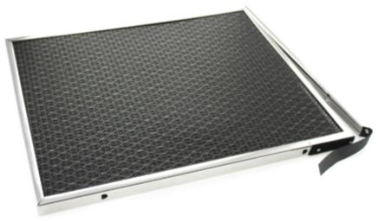
Do special furnace filters help?
Help remove chemical vapors & dust
Contains special activated charcoal filter
May improve general odors
Will not likely reduce personal exposures
Photo used by National Jewish Health with written permission.
Notes:
We also get asked if special furnace filters can help. These are the furnace filters that you could buy at any hardware store. Again, these filters are helpful for removing vapors and dust, and they may improve the smell around your salon, but they won’t do anything to reduce your personal exposure.

Slide 67

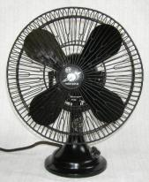
What other things can you do to increase ventilation?
Open windows and doors as much as possible
This allows additional fresh air to enter the work area
Use fans to blow air away from your breathing zone
But not into your coworkers’ breathing zones
Picture by National Jewish Health
Picture by MASA available under public domain from Wikimedia Commons
Notes:
There are some other things you can do to increase ventilation. It’s good to open windows and doors as much as possible, because that lets fresh air into your work area. You also can use fans to blow air away from your breathing zone, but you want to be careful that you aren’t just blowing it into your coworkers’ breathing zones.

Slide 68
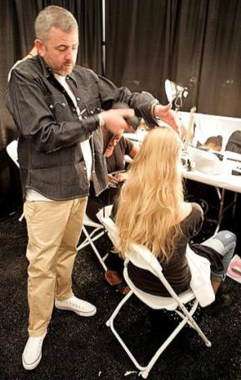
What else can I do to reduce exposure?
Use mixing stations to prepare products.
Replace lids immediately after using a chemical.
Use the smallest quantity of a chemical.
Make sure other workers in your area know when you are using keratin smoothing products.
Open doors and windows when performing work that produces chemical fumes/vapors.
Use a lidded trash can and empty it frequently.
Picture by John Mullan available under public domain from Wikimedia Commons
Use engineering controls properly all of the time!
Notes:
There are some other things you can do to reduce your exposure. It’s a good idea to use mixing stations away from your normal work area to prepare products. You should replace the lids immediately after using a chemical, so that the vapors are released into your breathing zone. You want to use the smallest amount of chemical that you can. You want to make sure the other workers in your area know if you’re working with formaldehydes or keratin smoothing products-that way, they can avoid exposure if they want to you, and you can make sure that you don’t schedule two appointments with formaldehyde at the same time and overload your ventilation system. You should try to open doors and windows if you’re doing work that produces fumes or vapors. When you throw away chemicals, you should use a lidded trash can and empty it frequently so that you’re not breathing chemicals released from the trash. And most importantly, if you have engineering controls, you want to use them properly, all the time.

Slide 69
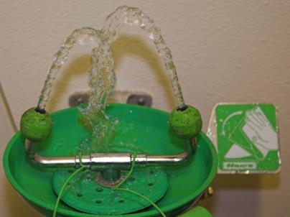
What controls help prevent eye injuries?
Use goggles when mixing chemicals if there’s a chance you could be splashed
After splash in the eye with a very irritating chemical
Wash your eyes immediately
Wash for a minimum for 15 minutes
If pain, burning, or blurred vision persist seek medical attention urgently
Photo by Peter Baer available under public domain from Flick Creative Commons
Notes:
There are controls that you can use to help you prevent eye injuries when you’re working with irritating chemicals. We recommend that you use goggles if there’s a chance you could be splashed while mixing chemicals. The goggles, which cover your eyes from the sides as well as the front, are more protective than glasses. If you are splashed in the eye with a very irritating chemical, you should wash your eyes immediately for a minimum of 15 minutes. If you still have any pain, burning, or blurred vision after that, we recommend that you go to the emergency department as soon as possible.

Slide 70
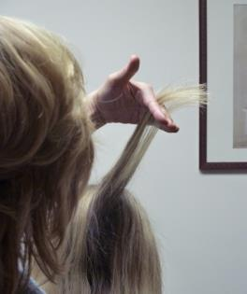
“Hand hygiene” is important to prevent skin issues
Take good care of your hands to reduce irritation
Use gloves when washing
Moisturize after washing
Use gloves when handling chemicals.
Dry your hands completely before putting on gloves.
Use barrier creams.
Avoid rubbing hair in web spaces between your fingers
Photo by National Jewish Health
Notes:
“Hand hygiene” is important to prevent skin problems. Taking good care of your hands reduces the irritation. It may be a good idea to use gloves when washing, even washing hair. You should moisturize after washing, because having your hands wet so much of the time can dry out the skin. It is a good idea to use gloves whenever you are handling chemicals, especially irritating chemical. You should make sure that your hands are completely dry before you put on gloves. Barrier creams can help. You should also avoid rubbing hair in that webbed space between your fingers, because the skin in that area is more delicate than other parts of your hand.

Slide 71
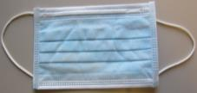


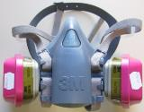
What type of respiratory protection should I use?
Respirators
Surgical mask – only when you want to protect the client from your illness
N95 – to protect you from dust exposures especially when doing nails
Should be NIOSH approved
Air purifying respirator – when working with chemicals such as formaldehyde
May need special cartridges based on exposure
Photos by National Jewish Health
Notes:
There is respiratory protection available for the chemicals that are released into the air. You may have seen people working with surgical masks. This is pictured at the top. These will only protect your client from catching your cold—surgical masks do not protect you at all from breathing in dust or chemicals. An N95 mask is a respirator that can protect you from dust exposures, which is helpful when you are doing nails. N95 masks are shown in the middle pictures. You need to make sure you are using a mask that fits you properly and says “NIOSH” approved. Unfortunately, N95 masks do not protect you from chemical fumes or vapors. For protection from chemicals, you have to use an air purifying respirator, which is shown in the bottom picture. Air purifying respirators work against chemicals like formaldehyde. These masks need the right cartridge for the exposure. It is unlikely that you would want to wear one of these respirators while working with clients in your salon, which is why we talked so much about other ways to reduce your exposure, namely elimination, substitution, engineering controls, and work practice controls, so you don’t have to use PPE to keep yourself safe.

Slide 72

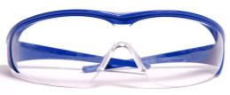
What other personal protective equipment should I use?
Gloves
Nitrile – these will protect from most chemical exposures use when doing hair or nails
Vinyl gloves do not protect against all chemical exposures
Best practice is to use nitrile
Eye Protection
Use safety glasses/goggles when mixing chemicals
Photo by National Jewish Health
Picture by Lilly_M available under public domain from Wikimedia Commons
Notes:
We recommend you wear gloves when you’re working with chemicals. The best kind of glove is nitrile, because nitrile will protect you from most chemicals. Vinyl gloves are not as good because they have tiny holes that can let chemicals through. Because of the allergy problems with latex gloves, the best practice is to use nitrile. For eye protection, it’s a good idea to use safety glasses, or even better, goggles when you’re mixing chemicals to prevent splashes into the eye.
[Go to CosmetologyActivities, slides 14-17]

Slide 73
Ergonomics Training Goals
Define ergonomics
Describe health effects caused by ergonomic problems
Learn ways to reduce ergonomic hazards
73
Notes:
73
73
Now we are going to talk about ergonomics. We will define ergonomics, describe the health effects that can be caused by ergonomic problems, and learn ways to reduce those problems through work practices, using the right tools, and adjusting your body mechanics.

Slide 74
Ergonomics is the science of fitting the job to the worker (OSHA)
Every worker has their own set of:
Capabilities (Physical and mental)
Limitations
Enhancing the worker’s capabilities, while minimizing the impact of their limitations by using proper:
Tools and equipment
Job task assignment and training
Workplace environment
Notes:
OSHA defined ergonomics as the science of fitting that job to the worker, meaning to make the job fit you. Everyone has their own set of capabilities and limitations. The goal is ergonomics is to enhance each workers capabilities while minimizing their limitations by using the right tools, proper job assignment and training, and proper workplace environment.

Slide 75

Ergonomic problems can lead to musculoskeletal disorders (MSDs)
Soreness and Stiffness
MSDs
Most common
Gets better with rest and stretching
If not, may be sign of more serious problem
“Injuries” that happen over time
Tendons
Joints
Nerves
Easy to treat early
Break from activity
Physical therapy
Harder to treat later
Photo by Musespeak available under public
Domain from Flickr Creative Commons
It is important to seek medical attention for MSDs early!
Notes:
Ergonomics problems can lead to musculoskeletal disorders, or MSDs. Most of us have soreness and stiffness– it’s pretty common. It gets better with rest and stretching. If it doesn’t get better with rest and stretching, it may be a sign of a more serious problem, called a musculoskeletal disorder. MDSs are “injuries” that happen over time, and can affect your tendons, joints, or nerves. MSDs are usually easy to treat if you find them early: you may need to take a break from the activity that caused the problem, and have treatment such as physical therapy. However, these disorders can be very difficult to treat later, and sometimes can cause you to need to leave your work. Because of this, it is very important to seek medical attention early if you think you may have an MSD.

Slide 76
Physical risk factors for MSDs: Force, Repetition, and Posture
Force
How hard is the effort?
Posture
How far are you from “neutral” posture?
Repetition
How many times are you doing it?
How long are you holding the same position?
Which one is most important?
Notes:
The risk factors for musculoskeletal disorders are force, posture, and repetition. Force is what it sounds like: how much effort does it take to do the work? For posture, we want you to be in a “neutral” posture that doesn’t take much effort to maintain—we will talk more about neutral posture in a few minutes. For repetition, it not just how many times you have to do a certain motion but also how long you have to hold the same position.
Which of the listed risk factors do you think is the single most important?
[Go to CosmetologyActivities, slide 18]

Slide 77
Reduce risk factors for MSDs
Reduce required force
Use the right tools and techniques
Use only as much force as necessary
Use good posture
Change position frequently
Avoid unnecessary repetitive work
Get rest during away from work
Working overtime may not be a good idea
Reducing force and improving posture helps decrease risk from repetitive work.
Notes:
There are ways to reduce your risk factors for musculoskeletal disorders. You can reduce the required force by using the right tools and techniques and using only as much force as needed to do your job. You should optimize your body mechanics, and change position frequently. Avoid unnecessary repetitive work. It’s also helpful to get rest during your time away from work, to give your body a break. That is why working overtime may not be the best idea. Overall, reducing fours and improving posture helps reduce your risk from repetitive work.
[Go to CosmetologyActivities, slides 19-23]

Slide 78
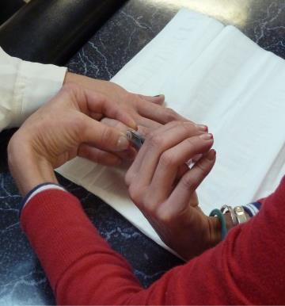
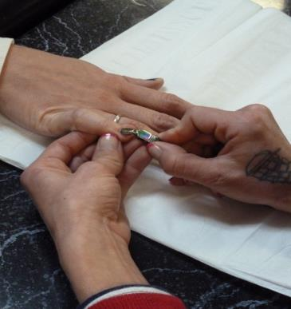
Proper technique can help keep your wrist straight and reduce required force
Photos by National Jewish Health
Wrong way to hold a client’s hand
Better way
125
Notes:
Proper technique can help you keep your wrist straight and reduce the required force. Look at the picture on the left: what do you see wrong with this picture?
You can see that both of her wrists are bent, and that position just doesn’t look comfortable.
What about the picture on the right? Her wrist is straight, so she can use less force to use her tool properly. That puts less strain in her hand. You can tell by just looking that the position on the right is a lot more comfortable.

Slide 79
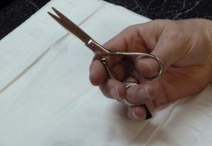
The right tools will help keep your wrist straight and reduce required force
Ergonomic haircutting scissors and shears
Off set blade handles
Curved blades
Curved blade handles
Select proper size and weight
Keep tools sharpened
Photo by National Jewish Health
Properly selected ergonomic tools will be comfortable and feel easy to use.
Notes:
The right tools can make a difference. They can help you keep your restraint introduced the amount of force you have to use. Do any of you use economic scissors and shears?
Tools with offset blade handles, curved blades, and curved blade handles can all be really helpful. If you want to select a school that has the proper size and weight for you. It also is a good idea to keep your tools sharpened, because sharper scissors will allow you to make them fewer cuts. You can tell a tool is the right one for you when it feels comfortable and easy to use.

Slide 80
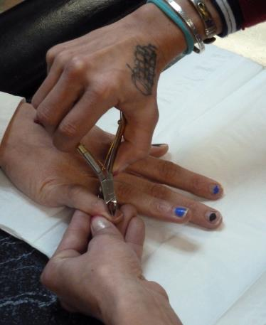
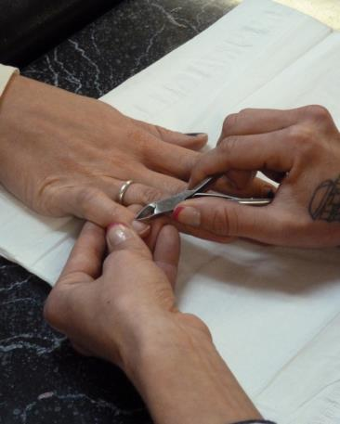
Use Tools the Right Size for Your Hand
Photos by National Jewish Health
Tool is too big
Smaller tools fit small hands
Notes:
Let’s look at the picture on the left. What is going on in this picture?
The clippers are too big for her hand to hold comfortably and she has to put her hand at an awkward angle to work.
The picture on the right shows smaller clippers that fits her smaller hands. It lets her keep her wrist straight, and again, just looks more comfortable.

Slide 81
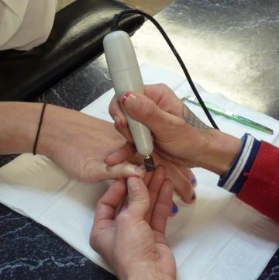
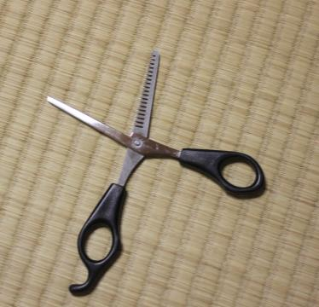
Special tools can reduce need for repetitive hand movements
Photo by National Jewish Health
Photo by Usagi-kun available under public domain from Flickr Creative Commons
Nail machines can reduce filing and buffing
Texturizing and thinning scissors can reduce razor cutting
Notes:
There are special tools that can reduce the need for repetitive hand movements. If you are doing a lot of nail work, there are nail buffing machines that can reduce the amount of filing and buffing you have to do. There are also texturizing and thinning scissors that can reduce razor cutting. Have you ever used tools like these in your salon?

Slide 82

Stand and Sit in Neutral Posture
Feet flat on the floor
Back and neck not bent
Normal spinal curves
Shoulders squared and relaxed
Avoid holding your arms aways from your body
Look straight ahead
Arms and hands in “handshake position”
Image by Skoivuma available under Creative Commons Attribution-Share Alike 3.0 Unported
Notes:
Next, we’re going to talk about neutral posture. There are some common principles in both sitting and standing. Your feet should be flat on the floor. You want your back and neck to be straight, and avoid bending forward or twisting. You want your shoulders to be square and relaxed. You want to avoid holding your arms away from your body for extended periods, and keep your elbows below your shoulders. Keep your hands by your sides with wrists straight in so-called handshake position.

Slide 83
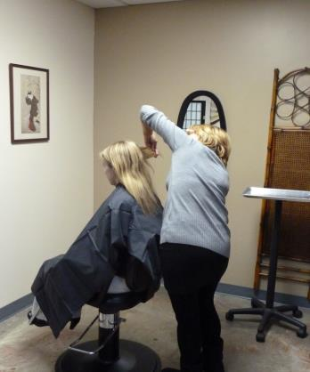
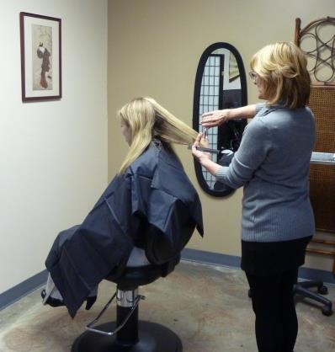
Stand in neutral position while cutting hair
Wrong Way
Better Way
Photos by National Jewish Health
Notes:
What is wrong in the picture on the left?
There are a lot of things wrong with this picture: she is leaning to the right, her back is twisted, her shoulder is up in an awkward elevated position, and her feet are probably not flat on the floor.
In the picture on the right, her body posture is much better. While her right arm is out away from her body, she will keep her arm out only as long as needed.

Slide 84
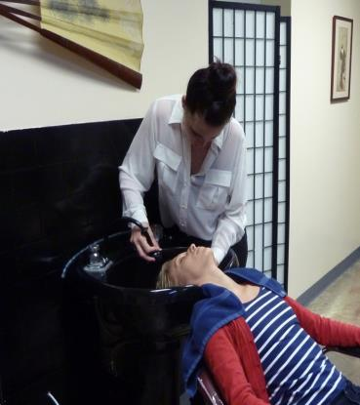
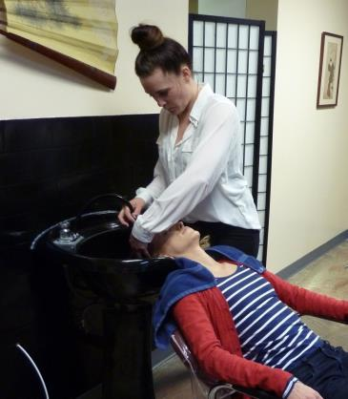
Stand in neutral position while washing hair
Wrong Way
Better Way
Photos by National Jewish Health
Notes:
What is wrong in the picture on the left-- focus on the stylist rather than the client?
Her back and neck are bent and twisted and her right shoulder is raised.
In the picture on the right, she has shifted her position, which allows her to work with her neck, back and shoulders in a more neutral position.

Slide 85


Sit in neutral position while doing facials
Wrong Way
Better Way
Photos by National Jewish Health
Notes:
You also want to stay in neutral position when doing facials. What do you think about the picture on the left?
Her back is curved forward, she’s sitting on the edge of her seat, and her neck is bent forward as well.
The picture on the right looks much better: her back is straight, her shoulders are squared and even, and her neck is much straighter as well.

Slide 86

Standing on Your Feet All Day is Hard Work!
Flat shoes keep your feet flat on the floor
Wear shoes with support and cushion
Use anti-fatigue mats
Whenever you can
Walk
Elevate one foot
2-4 inch block
Photo by Martinson-Nicholls, Inc. used by National Jewish Health with written permission
Notes:
Standing on your feet all day is hard work! Heels may be more stylish, but since you’re on your feet all day, flat shoes are a better idea since they keep your feet flat on the floor. It’s a good idea to wear shoes that have support and cushion. Anti-fatigue mats can help as well. Whenever you can, walk around a little bit to avoid standing still. If you need to stand in one place for a period of time, it is helpful to elevate 1 foot on a 2 to 4 inch block to help keep the curve in the small of your back. It is easier on your muscles if you’re able to move around and be not stuck in one position.

Slide 87

Health Effects Due to Infections Training Objectives
Define the types of infections that can be spread in the salon industry
Describe the health effects of those infections
Understand how infections can be spread in salons
Learn ways to help prevent spread of infections
Image by r8r available under public domain under Flickr Creative Commons
87
Notes:
87
87
Now we will talk about infections. The objectives are to define the types of infection that can be spread in the salon industry, describe the health effect of those infections, understand how infections can be spread in salons, and learn ways to prevent spread of infections

Slide 88
Infections Can Be Spread While Working with Clients
Infection can be spread by:
Breathing in cold and flu virus or touching your eyes, nose, and mouth before washing your hands
Contact with infected skin
Direct contact with infected blood
Infections in the blood are not spread through casual contact.
Intact skin is a good barrier
Notes:
Infections can be spread while working with clients in a number of different ways, including breathing in cold or flu virus, or touching your eyes and nose and mouth before washing your hands, through contact with infected skin, or direct contact with infected blood. Infections in the blood are not spread through casual contact like touching. Intact skin is a good barrier.

Slide 89


Colds and flu are spread from person to person
Infected droplets come out when you
Cough
Sneeze
Blow your nose
Infection is spread by:
Breathing in air with infected droplets
Touching your eyes, nose and mouth with infected droplets
Photo by CDC
Available under public domain from Wikimedia Commons
Notes:
Cold and flu are spread from person to person. They are spread by infected droplets that come out when you cough, sneeze, or blow your nose, as shown in the top picture. These droplets can remain in the air for some time. Infection is spread by breathing in air that contains the infected droplets. If, the person has coughed or sneezed and then touched an object like a doorknob, infection can be spread by touching your eyes, nose or mouth when you have infected droplets on your hand.

Slide 90


One of the best ways to stop spread of infection is hand washing
Wash with soap and water
At least 20 seconds
Sing “Happy Birthday”
Hand sanitizers are effective except:
When hands are visibly dirty
They do not remove chemicals
Photo available under public domain from CDC
Photo available under public domain from CDC
Notes:
One of the best ways to stop to stop spread of infection is to wash your hands. Wash your hands with soap and water for at least 20 seconds, which is about the same amount of time as it takes to sing “happy birthday”. Hand sanitizers can help prevent spread of infection, but they don’t work when hands are visibly dirty, and they do not remove chemicals.

Slide 91

Practice cold and flu protection
Protect Yourself
Wash your hands before you touch your eyes, nose and mouth
Ask clients who are coughing to put on a mask
Get the flu vaccine
Protect Others
Get the flu vaccine
The elderly, young children and pregnant woman are at increased risk from flu
Dracula Sneeze
Safe Sneeze
Talk to your doctor to see if the flu vaccine is right for you
Photo by Fairfax County available under public domain from Flickr Creative Commons
Notes:
Because you work with clients of all ages, it is important that you practice cold and flu protection. To protect yourself, wash your hands before you touch your eyes, nose and mouth. If you have a client who is coughing, it is smart to ask them to put on a mask. While surgical masks don’t do anything for protection against dust and chemicals, they are very good at stopping the spread of germs from someone who is coughing. We also recommend getting the flu vaccine, but you should talk to your doctor to be sure the flu vaccine is right for you. Getting the flu vaccine helps to protect others as well, because the elderly, young children, and pregnant women, are at increased risk from the flu. If you have a cold, try to practice the “Dracula sneeze” or safe sneeze, where you sneeze into your elbow instead of into your hand. This helps stop the spread of germs.

Slide 92

Skin infections spread very easily
Bacteria can infect skin
MRSA
Open wounds should be covered, including your own
Do not perform the service if the wound can’t be covered
Wear nitrile gloves if your client has an open wound
Wash all tools after each client
Dispose of single use tools
Wash your hands after each client
Photo available under public domain from the CDC Public Health Image Library
MRSA is caused by bacteria resistant to many antibiotics.
Notes:
Skin infection spread very easily, and can be spread in salons. Bacteria can infect skin, and we are especially worried about MRSA, which stands for methicillin-resistant Staph aureus . MRSA is caused by bacteria that is resistant to many antibiotics and is very, very difficult to treat. To prevent the spread of skin infections, all open wounds should be covered, including your own. If you have a client whose wound can’t be covered, don’t perform the service! Another option is be to wear nitrile gloves. You should wash all re-usable tools after each client, and dispose of anything designed to be single-use. You also want to wash your hands after each client.

Slide 93

Footbaths can spread skin infection
Mycobacteria
Not common
Can be very severe
Starts as skin boil
Can grow large
With pus
Can leave scars
Ways to prevent spread of skin infections from foot baths
Do not perform pedicure on clients with broken skin
Follow the regulations for cleaning of footbaths every day
Tell clients not to shave their legs within 24 hours of pedicure
Photo available under public domain from the CDC Public Health Image Library
Notes:
Footbaths can spread skin infection as well. Some of these infections are caused by a germ called mycobacteria, which are not very common but can cause very severe infections. These infections start as a skin boil, but can grow very large and fill with pus. They can be treated, but they often leave scars. To prevent the spread of skin infections in foot baths, do not perform pedicures on clients with broken skin. Follow the regulations for cleaning your foot bath every day. We’ll talk more about cleaning and disinfecting in a bit. It may be hard to enforce, but we recommend that you tell your clients not to shave their legs within 24 hours of getting a pedicure, because shaving can cause tiny cuts and abrasions that put them at higher risk for infection.

Slide 94


Infections Spread by Contact with Infected Blood
Bloodborne Pathogens
Hepatitis B
Hepatitis C
HIV/AIDS
Bloodborne Pathogens are spread by infected blood:
On objects that cut into the skin
Splashes to eyes, nose, mouth
Splashes to broken skin
Splash of blood
Sharp
objects
Photo by National Jewish Health and Microsoft Office ClipArt
Notes:
Infections can be spread by contact with infected blood. These are called bloodborne pathogens, and include Hepatitis B, Hepatitis C, and HIV. These bloodborne pathogens can be spread by infected blood on objects that cut into the skin, like scissors, splashes to the eyes, nose, or mouth, or splashes to broken skin. Intact skin is a good barrier against bloodborne pathogens, but skin with cuts, scrapes or rashes can allow viruses to pass through.
[Go to CosmetologyActivities, slides 24-25]

Slide 95
Hepatitis B and C infect and cause inflammation in the liver
Hepatitis B
Mild stomach flu
Yellow skin (jaundice)
Rarely abnormal liver tests
There is no treatment
Hepatitis B gets better
There is a good vaccine
Hepatitis C
Usually no symptoms
Does not get better
Chronic infection
Can affect liver function
There are medicines to treat hepatitis C
Many side effects
Better drugs may be available soon
There is no vaccine
We recommend that you talk to your doctor about Hepatitis B vaccination.
Notes:
Hepatitis B and hepatitis C cause infection and inflammation in the liver. Hepatitis B usually starts with mild symptoms like stomach flu. There is no treatment for hepatitis B, but Hepatitis gets better. There is a good vaccine for hepatitis B. Hepatitis C, on the other hand, usually has no symptoms, but it does not get better. Chronic infection can affect liver function. There are medications to treat Hepatitis C, but the drugs that are currently available have many side effects, although better medications may be available soon. There is no vaccine for hepatitis C. We recommend that you talk to your doctor about hepatitis B vaccination because in your work with sharp objects, you are at risk for exposure to infected blood.

Slide 96

HIV affects the immune cells in the blood
Immune Cells
HIV Slowly Destroys Immune Cells
White blood cells
Protect the body from infection
No symptoms or mild flu-like illness at first
No symptoms while HIV slowly destroys immune cells
AIDS
Not enough immune cells
Severe infections develop
Public domain in the United States because it is a work prepared by an officer or employee of the United States Government
There are good medicines to treat HIV that help prevent AIDS.
Notes:
HIV affects the immune cells in the blood. There are two types of cells in the blood, the red blood cells that carry oxygen and white blood cells, or immune cells, that protect the body from infection. HIV slowly destroys these immune cells. There are usually no symptoms with HIV, but the virus is slowly destroying the immune cells. When enough blood cells have been destroyed, it causes AIDS, when there are not enough immune cells to fight off infections. There are good medications now to treat HIV to help prevent AIDS.

Slide 97
Treat all blood and body fluids as if they are infected
“Universal precautions”
Any fluid that comes out of the body
Urine
Vomit
Stool/Diarrhea
Blood can be contained in any of these “fluids”
If you (or your client) are exposed to blood in a way that can spread infection, see your doctor as soon as possible.
Notes:
Because we are so worried about these bloodborne pathogens, we recommend that you treat all blood and body fluids as if they are infected. This is called “universal precautions.” This applies to any fluid that comes out of the body because it could contain blood. If you or your client is exposed in a way that might spread infection, you should see your doctor as soon as possible.

Slide 98

Steps to take if injury causes bleeding
If you are bleeding
Cover your wound
If your client is bleeding
Have your client cover their wound
If needed, put on nitrile gloves before you cover your client’s wound
Be sure the bleeding stops
Wipe up/dispose of any spilled blood
Decontaminate all surfaces with hospital-grade disinfectant
Double bag and label contaminated waste (or use biohazard bag)
Photo available under public domain from the CDC Public Health Image Library
Notes:
If an injury causes bleeding, the first step is to cover the wound. If your client is the one who is bleeding, try to have them cover their own wound, or if needed, put nitrile gloves on before you cover it for them. Make sure that the bleeding stops. Wear gloves to wipe up any spilled blood, and decontaminate anything it touched with a hospital-grade disinfectant. You want to double bag and label contaminated waste so that nobody else is exposed—you could also use a biohazard bag.

Slide 99
Key elements of OSHA’s bloodborne pathogens standard in a salon
Universal precautions for all blood and body fluids
Control measures
Bandaids
“Quats” for disinfection
Sharps containers for disposal of sharp objects (lancets, etc.)
Personal protective equipment (PPE)
Nitrile gloves
Make medical care available if there is any question about exposure to blood/body fluids
Communicate the hazards
Label contaminated waste
Worker training
Hepatitis B vaccination offered to workers
Notes:
OSHA has a bloodborne pathogens standard. It was mainly designed for hospitals, but it does have elements that apply to work in a salon. The standard says you should use universal precautions for all blood and body fluids. Control measures should be available, such as band-aids, quats for disinfection, and a sharps container for getting rid of sharp objects such as lancets. PPE should be available, which in this case means nitrile gloves. Medical care should be available if there’s any question about exposure to blood or body fluids. It is important to communicate the hazard, both by labeling contaminated waste and providing worker training so you can keep yourself safe in these situations. Hepatitis B vaccination should also be offered to employees who work with sharp objects on clients.

Slide 100


What do I need to disinfect?
Work area
Non-disposable nail equipment
Shears/clippers
Metal tools
Non-porous tools
Capes/towels
Pedicure Spas
Picture by Piercetheorganist available under public domain from Wikimedia Commons
Important:
Anything that touches someone
– hands, salon tools, implements, or applicators –
must be thrown away, cleaned or disinfected!
Picture by Salon Jaffa available under public domain from Wikimedia Commons
Notes:
What you need to disinfect in a salon? Well, basically anything that touches your client. You want to disinfect your work area, any equipment that isn’t disposable, your shears and clippers, any metal tools, any non-porous tools, your capes and towels, and your pedicure spas. Basically, everything that touches somebody including your hands, tools, and applicators should be either thrown away or cleaned and disinfected.

Slide 101
Disinfection Guidelines
Item | Level of Infection Control | Procedure | Examples
Tools/implements that have contacted blood or body fluids | Disinfection – Kills certain bacteria | Use antibacterial, EPA-registered disinfectant effective against HIV and Hepatitis B. | Barbicide II Envirocide® Hospital Disinfectant Shockwave RTU
Tools/implements that have not contacted blood or body fluids | Disinfection – Kills certain bacteria | Use broad-spectrum, EPA-registered bactericidal, virucidal, fungicidal, pseudomonacidal disinfectant. | Barbicide Clippercide Lysol IC
KILLING POWER
Notes:
Here are some disinfection guidelines. For tools that have come into contact with blood or potentially infected body fluids, you need to use a hospital-grade disinfectant that is effective against bacteria as well as HIV and hepatitis B. Some examples are Barbicide II and Shockwave. If you are cleaning tools that haven’t contacted blood or body fluids, you still need to disinfect against bacteria, and use a broad spectrum EPA-registered disinfectant, such as Barbicide, Clipperside, and Lysol IC.

Slide 102
Disinfection Guidelines Continued
Item | Level of Infection Control | Procedure | Examples
Countertops Sinks Floors Toilets Towels/Linens | Sanitation | Use EPA-registered cleaning product. Efficacy label will state, “appropriate for floors, countertops, sinks, toilets, towels and/or linens.” | Hard Surfaces & Linens Shockwave RTU Hard Surfaces Only RMC Non Acid Cleaner Disinfectant Lysol IC – Quaternary 409
Your hands before each client | Sanitation | Use liquid soap. Avoid bar soaps. Antimicrobial (antibacterial) is recommended. | Dial® Antimicrobial Ecolab Bacti-Foam® Liquid Dial® Sensitive Skin Antimicrobial
Your hands & client’s hands and/or feet prior to manicure or pedicure service | Sanitation | Use antiseptic designed for hands and/or feet. | Safetec Hand Sanitizer SaniHands ALC Wipes
KILLING POWER
Notes:
For surfaces such as countertops or sinks and for your towels and linens that you need to sanitize and not disinfect, you should use an EPA-registered cleaning product, such as those listed on the slide. You want to sanitize your hands before each client, and we recommend antimicrobial liquid soap over bar soap. You also want to use antiseptic designed for hands or feet on your client before you perform a manicure or a pedicure.

Slide 103
Disinfection details matter!
It is important to follow the manufacturer’s guidelines for disinfection guidelines
Pre-clean any tools, or area before using disinfectants to reduce the amount of disinfectant necessary
Contact time is critical for effective disinfection
Regularly change disinfectant solution
Store disinfected tools in an airtight container
It is important to use proper personal protective equipment based on the disinfectant you are using
Always wear gloves & safety glasses when mixing disinfectants
Proper disinfection requires careful attention to required contact times to kill the virus/bacteria!
Notes:
Disinfection details really do matter. It is important to follow the manufacturer’s guidelines for disinfection. Pre-clean any tools or areas to reduce the amount of disinfectant you have to use. Contact time is critical for effective disinfection: if the disinfectants have to sit on a surface for ten minutes, and you only leave them there for five, you may think you’ve removed all of the germs when many could still be there. You want to regularly change your disinfectant solutions, and store them in an airtight container. It’s also really important to use PPE when you are working with disinfectants, since they can cause health effects.
[Go to CosmetologyActivities, slide 26-

Slide 104

Salon Safety Hazards
Electrical
Slips, trips, falls
Contains public sector information published by the Work Place Learning Centre available on workplacelearningcentre.co.uk
Notes:
We will finish up by talking briefly about safety hazards, including electrical hazards and slips, trips, and falls.

Slide 105

What should I do to protect myself from electrical hazards?
Ensure adequate electrical outlets at each workstation
Do not overload outlets
Do not use multiple power strips
Use one appliance at a time
Do not use equipment that has a damaged cord
Do not use electrical appliances in areas where you come into contact with liquids
Picture by Ivy Main available under public domain from Wikimedia Commons
Notes:
To protect yourself from electrical hazards, make sure that there are enough outlets at each workstation. You don’t want to overload outlets or use multiple power strips. If you’re using a powerstrip, only use one appliance at a time—something like multiple hair driers could blow your system. Never use equipment with a damaged cord, and remember that electricity and water don’t mix—don’t use appliances where they could come into contact with liquids.

Slide 106

How do you avoid slips, trips & falls?
Re-route cables overhead if possible
Unplug equipment when not in use
Keep area around workstation clear
Sweep up hair after each client
Clean up after using glossers or shine sprays
Mop up any wet areas immediately to prevent falls
Picture by Gunnar Ries available under public domain from
Wikimedia Commons
Notes:
To avoid slips, trips and falls, route your cables overhead if possible, and unplug equipment when you’re not using it. You want to keep the area around your workstation clear. That means you should sweep up hair after every client, and clean up after using shine sprays because they’re especially slippery. You also want to mop up any wet areas to prevent falls.
[Go to CosmetologyActivities, slide 30]

Slide 107
How does it all fit together?
Health Effects Awareness
Allergy
Chemical Exposure Recognition and Control
Formaldehyde
Ergonomics and Safety Hazards
Infection Control
Bloodborne pathogens
Asthma
Reproductive Effects
Neurological Effects
Cancer
Irritation
Cold and flu
Skin infections
Importance of handwashing
Reduce force
Avoid repetitive motion
Electrical hazards
Avoid slips, trips and falls
Use of PPE
Use of ventilation
Exposure recognition
107
Notes:
How does it all fit together? We talked about health effects, and how some of these chemicals can cause irritation, allergy, asthma, reproductive effects, neurological effects, and even cancer. We talked a lot about formaldehyde, how to recognize chemical hazards, how to use ventilation, and how to use PPE. We talked a lot about ergonomics—how we want you to reduce force, repetition and awkward postures. We also talked about infections—everything from bloodborne pathogens to cold and flu and the importance of handwashing. Combining all of these pieces will help you work safely in a salon.
[Go to CosmetologyActivities, slide 31]

Slide 108

Questions?
Photo by National Jewish Health
This material was produced under grant number SH-23540-SH2 from the Occupational Safety and Health Administration, U.S. Department of Labor. It does not necessarily reflect the views or policies of the U.S. Department of Labor, nor does mention of trade names, commercial products, or organizations imply endorsement by the U. S. Government.

