Slide 1
Quiz Bowl
10
You are exposed to hazards in your workplace.
True
False
1
Notes:
You are exposed to hazards in your workplace. True or false?
For those of you who answered no to this question, we will see if we can change your mind about this by the end of this presentation.
[Go to CosmetologyTrainingPresentationWithScript, slide 2]

Slide 2
Quiz Bowl
10
What does OSHA stand for?
Occupational Safety and Health Alliance
Occupational Security and Health Association
Occupational Safety and Health Administration
Ordinary Super Hero Alliance
2
Notes:
Correct Answer: 3
[Go to CosmetologyTrainingPresentationWithScript, slide 16]

Slide 3
Quiz Bowl
10
Which health effect causes the greatest number of cosmetology students to drop out of school?
Asthma
Cancer
Allergies
Skin rash
3
Notes:
Correct answer: 4

Slide 4
Quiz Bowl
10
Work as a hairdresser may increase your risk of problems during pregnancy.
True
False
4
Notes:
Correct answer: 1

Slide 5
Quiz Bowl
10
If you start to feel “drunk” while working with nail polish remover, what should you do?
Put on party hat
Use more nail polish remover
Shut all windows
Get fresh air
5
Notes:
Correct answer: 4
[Go to CosmetologyTrainingPresentationWithScript, slide 32]

Slide 6
Quiz Bowl
10
How do you know what you are being exposed to when you use a product?
Read the product label
Read the SDS
Read the product label and/or the SDS
Smell it
6
Notes:
Correct answer: 3

Slide 7
Quiz Bowl
10
Which of the following hair products contain chemicals that can cause allergy?
Hair dyes
Bleaching solutions
Permanent wave solutions
All of the above
7
Notes:
Correct answer: 4

Slide 8
Quiz Bowl
10
Which of the following nail products contain chemicals that can cause allergy?
Acrylic nail liquids and powders
Nail gels
Nail glues
All of the above
8
Notes:
Correct answer: 4

Slide 9

Quiz Bowl
10
Formaldehyde exposure can be detected by a specially trained Blowout Badger.
True
False
Photo by BadgerHero available under public domain from Wikimedia Commons
9
Notes:
Correct answer: 2
9

Slide 10
Quiz Bowl
10
What products can expose you to formaldehyde in the workplace?
Keratin Smoothing Products
Some nail polish
Nail hardeners
All of the above
10
Notes:
Correct answer: 4

Slide 11
Quiz Bowl
10
What are some of the health effects caused by formaldehyde?
Irritation
Allergies
Reproductive effects
All of the above
11
Notes:
Correct answer: 4

Slide 12
Quiz Bowl
10
While working with Keratin Smoothing Products, it is important to let your coworkers working in the area know they might also be at risk for exposure.
True
False
12
Notes:
Correct answer: 1

Slide 13
Quiz Bowl
10
There is a federal OSHA standard for exposure to formaldehyde.
True
False
13
Notes:
Correct answer: 1
[Go to CosmetologyTrainingPresentationWithScript slide 58]

Slide 14
Quiz Bowl
10
Which is an example of a work practice that can be used to reduce worker exposure to salon chemicals?
Use the smallest quantity of a chemical
Use mixing stations to prepare products
Replace lids immediately after using a chemical
All of the above
14
Notes:
Correct answer: 4

Slide 15
Quiz Bowl
10
What type of personal protective equipment could be worn when working on artificial nails?
Latex gloves
Surgical mask
N95 mask & nitrile gloves
Latex glove and surgical mask
15
Notes:
Correct answer: 3

Slide 16
Quiz Bowl
10
Salons that don’t have appropriate ventilation should not perform Keratin Smoothing treatments.
True
False
16
Notes:
Correct answer: 1

Slide 17
Quiz Bowl
10
Which of the following controls should be used to reduce worker exposure to formaldehyde?
Open windows & doors
Local exhaust ventilation
Use a salon specific air purifier
All of the above
17
Notes:
Correct answer: 4
[Go to CosmetologyTrainingPresentationWithScript, slide 73]

Slide 18
Quiz Bowl
10
Pick the single best answer.
Which is the most important ergonomic risk factor for MSDs?
Force
Repetition
Posture
Force and/or posture and/or repetition
18
Notes:
Correct answer: 4
[Go to CosmetologyTrainingPresentationWithScript, slide 77]

Slide 19
Ergonomic Activity
Reducing Required Force: Ways to get a stronger grip

Slide 20
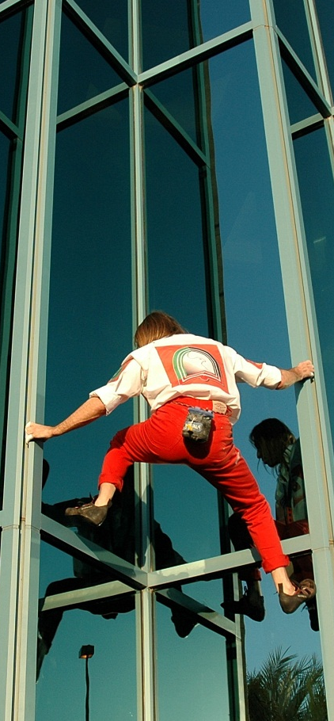

Size of Object
10
Would you want to hold onto a beam the size of a pen, your wrist, or your thigh?
Pen
Wrist
Thigh
There is no difference
Image by JakeBrewer available under public domain from Flickr Creative Commons
20

Slide 21

Type of grip
10
Would you hold the bars using a hand grip or a pinch grip?
Hand grip
Pinch grip
There is no difference
Photo by Richard Elzey available under public domain in Flickr Creative Comons
21

Slide 22
Wrist position
10
Do you have a stronger grip when your wrist is straight or bent?
Straight
Bent up
Bent down
There is no difference
22

Slide 23
Ergonomic Activity
Use good posture: Standing and sitting in “neutral” posture
Notes:
[Go to CosmetologyTrainingPresentationWithScript, slide 78]

Slide 24
Blood Borne Pathogen Activity
10
Would the skin on your hands be good protection from bloodborne pathogens if you got blood onto them?
Yes
No
24

Slide 25
Blood Borne Pathogen Activity
10
Please look at your hands. Do you see any breaks in the skin or rash?
No breaks on the skin or rash
Breaks only
Rash only
Both breaks and rash
25
Notes:
[Go to CosmetologyTrainingPresentationWithScript, slide 95]

Slide 26
Quiz Bowl
10
It is important to treat all blood and body fluids as if they are infected.
True
False
26
Notes:
Correct answer: 1

Slide 27
Quiz Bowl
10
Your employer is required to offer you Hepatitis B vaccination under the OSHA Bloodborne Pathogen Standard since you are at risk for exposure to blood.
True
False
27
Notes:
Correct answer: 1

Slide 28
Quiz Bowl
10
One of the best ways to stop the spread of infection in a salon is hand washing.
True
False
28
Notes:
Correct answer: 1

Slide 29
Quiz Bowl
10
It is very important to follow the manufacturer’s guidelines for disinfection very closely.
True
False
29
Notes:
Correct answer: 1

Slide 30
Quiz Bowl
10
How can you protect yourself from electrical hazards in the workplace?
Use multiple power strips linked together
Do not use electrical appliances where you come into contact with liquids
Use multiple appliances at the same time
Use equipment with damaged electrical cords
30
Notes:
Correct answer: 2
[Go to CosmetologyTrainingPresentationWithScript, slide 108]

Slide 31
Quiz Bowl
10
You are exposed to hazards in your workplace.
True
False
31
Notes:
Correct answer: 1
[Go to CosmetologyTrainingPresentationWithScript, slide 108]

