Slide 1


The Nature of Chemical Hazards &
Implications of GHS Applied to Industry
7.5 Hour
University of Medicine & Dentistry of New Jersey (UMDNJ), School of Public Health (SPH)
Office of Public Health Practice (OPHP)
http://ophp.umdnj.edu
Copyright © 2013 UMDNJ School of Public Health All rights reserved

Slide 2
Federal Disclaimer
This material was produced under grant number SH-23527-12-60-F-34 from the Occupational Safety and Health Administration, U.S. Department of Labor. It does not necessarily reflect the views or policies of the U.S. Department of Labor, nor does mention of trade names, commercial products, or organizations imply endorsement by the U.S. Government.

Slide 3
Today’s Goals & Objectives
Introduction
The two primary goals of this training :
Introduce the newly revised Hazard Communication Standard (HCS) aligning it with the Globally Harmonized System (GHS) of Classification and Labeling of Chemicals.
Provide a basic awareness training emphasizing the nature of chemicals.
Note: The Hazard Communication Standard (HCS) is now aligned with the Globally Harmonized System of Classification and Labeling of Chemicals (GHS).

Slide 4
Section One: Rights and Responsibilities
The Occupational Safety and Health Act of 1970: “General Duty Clause”
5. General Duties
Each employer
(1) shall furnish to each of his employees employment and a place of employment which are free from recognized hazards that are causing or are likely to cause death or serious physical harm to his employees;
(2) shall comply with occupational safety and health standards promulgated under this Act.
(b) Each employee shall comply with occupational safety and health standards and all rules, regulations, and orders issued pursuant to this Act which are applicable to his own actions and conduct.

Slide 5
Section One: Rights and Responsibilities
Mandatory Training
OSHA’s Hazard Communication requirements are Identical in:
General Industry,
Construction,
Maritime industries.
It is found in the Code of Federal Regulations (CFR) Title 29 §1910.1200 and has specific mandatory language that spells out required employee training in the workplace:
Employers shall provide effective information and training to employees
at the time of initial assignment,
For new chemical hazards (not previously trained)
Note: Information and training may be designed to cover categories of hazards (e.g., flammability, carcinogenicity) or specific chemicals. Chemical-specific information must always be available through labels and safety data sheets.

Slide 6
Section One: Rights and Responsibilities
Mandatory Training Must Include
1. Methods and observations to detect the presence or release of a hazardous chemicals (such as monitoring, visual appearance, odors of hazardous chemicals when being released, etc.); 1910.1200(h)(3)(i)
2. The physical, health, simple asphyxiation, combustible dust, and pyrophoric gas hazards, as well as hazards not otherwise classified, of the chemicals in the work area; 1910.1200(h)(3)(ii)
3. Protective measures, including specific procedures the employer has implemented to protect employees from exposure to hazardous chemicals, such as appropriate work practices, emergency procedures, and personal protective equipment. 1910.1200(h)(3)(iii)
4. Details about the employer’s hazard communication program, including an explanation of the labels, the safety data sheet, including the order of information and how employees can obtain and use the appropriate hazard information. 1910.1200(h)(3)(iv)

Slide 7

Section One: Rights and Responsibilities
A Right to Be Heard: Your Rights as a Whistleblower
OSHA's Whistleblower Protection Program enforces the whistleblower provisions of more than twenty whistleblower statutes. Rights afforded by these whistleblower acts include, but are not limited to, worker participation in safety and health activities, reporting a work related injury, illness or fatality, or reporting a violation of the statutes.
Protection from discrimination means that an employer cannot retaliate by taking "adverse action" against workers, such as:
Firing or laying off
Blacklisting
Demoting
Denying overtime or promotion
Disciplining
Denial of benefits
Failure to hire or rehire
Intimidation
Making threats
Reassignment affecting prospects for promotion
Reducing pay or hours

Slide 8
Section One: Rights and Responsibilities
Limited Right to Refuse to Work
Employees have a limited right under the OSH Act to refuse to do a job because conditions are hazardous.
You may do so under the OSH Act only when:
1. You believe that you face death or serious injury (and the situation is so clearly hazardous that any reasonable person would believe the same thing);
2. You have tried to get your employer to correct the condition, and there is no other way to do the job safely; and
3. The situation is so urgent that you do not have time to eliminate the hazard through regulatory channels such as calling OSHA.
Regardless of the unsafe condition, you are not protected if you simply walk off the job

Slide 9
Section One: Rights and Responsibilities
Right to Know vs. Right to Understand
Activity One: Critical Assessment:
Can you remember receiving right-to-know training yourself?
What did you learned?
Who performed the training?
Where in the workplace are your certifications?
Where can you find chemical hazard information?
Do you feel your training was effective, why or why not?

Slide 10
Key elements of an Effective Hazard Communication Program
Section One: Rights and Responsibilities
Company Policy
Container Labeling (HCS 2012 Compliant)
Safety Data Sheet (HCS 2012 Compliant)
Employee Training and Information
Procedures and Communication for Non Routine Tasks
Procedures and Communication for third party contractors
Hazardous Materials Inventory/Lists
Chemicals in Unlabeled Pipes
Program documentation and availability
Periodic regular program maintenance

Slide 11
Section Two: Global Harmonization and Hazard Communication
The GHS provides a standardized approach, including detailed criteria for determining what hazardous effects a chemical poses, as well as standardized label elements assigned by hazard class and category
OSHA's Hazard Communication Standard (HCS) requires the development and dissemination of such information:
Chemical manufacturers and importers are required to evaluate the hazards of the chemicals they produce or import, and prepare labels and safety data sheets to convey the hazard information to their downstream customers;
All employers with hazardous chemicals in their workplaces must have labels and safety data sheets for their exposed workers, and train them to handle the chemicals appropriately.

Slide 12

Reasons For A GHS
Growing international trade
Different requirements for labeling of chemicals
Different classifications of identical products in different countries
Need for an international safety standard

Slide 13

GHS History
The ILO (International Labor Organization) developed and adopted a convention and recommendation on Safety in the Use of Chemicals at Work in 1989-90
The OECD (Organization for Economic Cooperation and Development) helped classify health and environmental hazards
The UN Sub-Committee of Experts on the Transport of Dangerous Goods (UNSCETDG)
Notes:
The International Labor Organization recognized the need for worldwide safety conventions for the use of hazardous chemicals. They studied the tasks required to achieve harmonization and, thus paved the way for the development of a Globally Harmonized System.
The other organizations listed on this slide, like the Organization for Economic Cooperation and Development, served as additional technical focal points for development of GHS.

Slide 14
GHS History
The United Nations Conference on Environment and Development (UNCED) first proposed GHS in 1992
This goal later endorsed by several international organizations
More than a decade of work has gone into the new global system

Slide 15

GHS History – The UN Mandate
“A globally-harmonized hazard classification and compatible labeling system, including material safety data sheets and easily understandable symbols, should be available, if feasible, by the year 2000.”
The Purple Book
Notes:
This statement was made in 1992. The United Nations really thought a GHS could be put in place worldwide within the following 8 years. But like so many projected timelines involving more than one entity, this implementation schedule has been delayed considerably.

Slide 16
Section Two: Global Harmonization and Hazard Communication
Major changes to the Hazard Communication Standard
Hazard classification: Provides specific criteria for classification of health and physical hazards, as well as classification of mixtures. The revised HCS has specific criteria for each health and physical hazard, along with detailed instructions for hazard evaluation and determinations as to whether mixtures or substances are covered. It also establishes both hazard classes and hazard categories—for most of the effects; the classes are divided into categories that reflect the relative severity of the effect. The current HCS does not include categories so this new approach provides additional information that can be related to the appropriate response to address the hazard.
Labels: Chemical manufacturers and importers will be required to provide a label that includes a harmonized signal word, pictogram, and hazard statement for each hazard class and category.
Precautionary statements must also be provided.
Safety Data Sheets: Will now have a specified 16-section format.
Information and training: Employers are required to train workers by December 1, 2013 on the new labels elements and safety data sheets format to facilitate recognition and understanding

Slide 17
Harmonization Principles
Comprehensibility is # 1
Maintain current Worker/User protection
Cover all chemical Uses & Modes
All existing systems must change
May use a step-by-step “Building Block” approach
Classifications will be Hazards-based, not Risk-based
Notes:
The GHS classification and communication requirements can be thought of as a collection of building blocks.
Countries may first implement the portions of GHS that makes the most sense to them or is more easily adopted. Then they can add additional GHS elements and ease into global harmonization. Once GHS is implemented, it will allow all chemical workers and users to more easily understand the hazards of chemical products.

Slide 18
Hazard Vs. Risk Basis
Hazards represent intrinsic danger or ability of chemicals to cause adverse effects
Hazards are there despite quantity or use
Risk is the probability of adverse effects occurring
Risk may change depending on use and application of chemicals
Notes:
GHS uses Classification of Hazards and not Risks to communicate the dangers of chemical products. None-the-less the GHS Purple Book includes a discussion of an example of how risk-based labeling could be considered for chronic health effects of consumer products in consumer use settings.

Slide 19
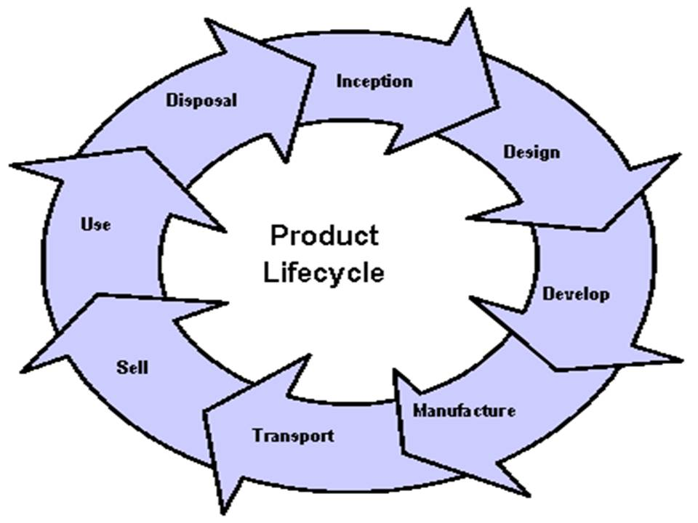
End Here
Start Here
Chemical
Product Lifecycle
Notes:
The need for GHS labels and Safety Data Sheets will vary by the stage the chemical is in during its lifecycle. There may be no label and SDS requirements for materials in the R&D or production stages, but there will be for transporting, selling and using them.
The lifecycle events in this Figure for pharmaceuticals, food additives, cosmetics and pesticide residues in food will not require labels and SDSs when used, but they will be needed for possible workplace exposures and when being transported. Critical information for pharmaceutical use by humans or animals is provided by in-package inserts, not by HazCom systems.

Slide 20
Section Two: Global Harmonization and Hazard Communication
Unchanged Parts of the Hazard Communication Standard
The revised Hazard Communication Standard (HCS) is a modification to the existing standard. The parts of the standard that did not relate to the GHS (such as the basic framework, scope, and exemptions) remained largely unchanged.
There have been some modifications to terminology in order to align the revised HCS with language used in the GHS. For example, the term "hazard determination" has been changed to "hazard classification" and "material safety data sheet" was changed to "safety data sheet."
In regards to labeling, the current standard provides employers with flexibility regarding the type of system to be used in their workplaces and OSHA has retained that flexibility in the revised Hazard Communication Standard (HCS). Employers may choose to label workplace containers either with the same label that would be on shipped containers for the chemical under the revised rule, or with label alternatives that meet the requirements for the standard. Alternative labeling systems such as the National Fire Protection Association (NFPA) 704 Hazard Rating and the Hazardous Material Information System (HMIS) are permitted for workplace containers. However, the information supplied on these labels must be consistent with the revised HCS, e.g., no conflicting hazard warnings or pictograms.

Slide 21
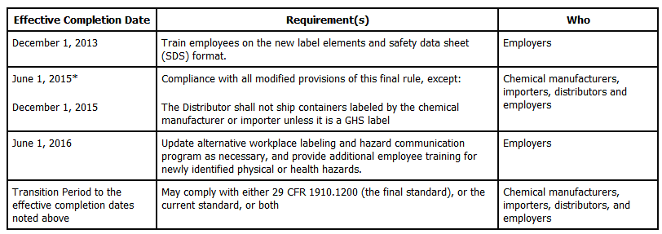
Section Two: Global Harmonization and Hazard Communication
Effective Dates to Remember:

Slide 22

Benefits Of The GHS
Enhances human health, safety and environmental protection
Promotes sound management of chemicals worldwide
Reduces barriers and Facilitates Trade
Reduces costs involved in developing, manufacturing, distributing, and transporting hazardous chemicals
Notes:
The results of GHS will be improved worker safety, environmental protection and easier international trade. With one harmonized system, the costs associated with R&D, production, distribution and transportation of hazardous materials is expected to go down in each country and internationally.

Slide 23
Governments Benefit
Fewer chemical accidents and incidents
Lower health care costs
Improved protection of workers and public from chemical hazards
Reduce costs and ease coordination for legislation, implementation and monitoring,
Supports improved inter-agency coordination and cooperation
Notes:
Through GHS, governments can avoid duplication of effort in creating national systems. They can also reduce the costs of enforcement and improve communication on chemical issues both in their own countries and internationally.

Slide 24
Companies & Workers Benefit
Safer work environment and transport of chemicals
Improved employee relations
Increased compliance with HazCom regs
Minimizing labor and costs
Fewer accidents and illnesses
Improved corporate image and credibility
Notes:
As you can see, companies are likely to benefit from GHS in a number of ways including clear ways to expand the use of health and safety training programs.

Slide 25









Stakeholders
A multitude of countries
International organizations
Stakeholder organizations
Domestic Manufacturers & Importers
Notes:
GHS will impact and benefit all stakeholders, whether in the manufacturing and distribution sectors, or those who importer and export chemical products. This will be so for not only the major countries of the world but also for developing nations as well.

Slide 26
Stakeholders & Other interested Parties
Chemical Manufacturers
Users/Consumers
Trade Associations
Federal, State and Local Government
Emergency Responders
Transporters
Unions
Consultants
Individuals
and Others
Notes:
This is a partial list of stakeholders and people or organizations who are interested in the finalization of GHS, as it will likely impact them in many ways, most especially, financially. Aside from the initial costs of implementation and ultimate cost savings expected from GHS, it will foster a cottage industry for consultants and trainers to assist companies that choose to outsource services for determining GHS classification and authoring SDSs & labels.

Slide 27
Interagency Working Group On Harmonization
Formed by 4 key independent regulatory authorities in the US: – OSHA – DOT – EPA (FIFRA) Federal Insecticide Fungicide and Rodenticide Act – CPSC
…Also FDA and Commerce
Notes:
The Occupational Safety and Health Administration, The Department of Transportation, The Environmental Protection Agency (through the Federal Insecticide Fungicide and Rodenticide Act) and the Consumer Products Safety Commission have been working together to help implement GHS. OSHA has already started actions toward changing their Hazard Communication Standard, 29CFR1910.1200, to synchronize better with the United Nations initiative on a Globally Harmonized System. Other federal agencies like the Department of Commerce and the Food and Drug Administration (FDA) got involved.
The DOT already harmonized much of its hazardous materials regulations to be consistent with the UN’s classification and labeling recommendations for transportation of dangerous goods.
The EPA is also working on harmonizing their pesticide requirements with GHS, and the CPSC is looking for ways to do the same.

Slide 28
Section Two: Global Harmonization and Hazard Communication
By the Numbers: Anticipated Statistical Shifts, Costs and Benefits
Workers affected by HCS: Over 40 million workers
Affected Industries: Over 5 million workplaces
Total cost, an estimated $201 million a year on an annualized basis for the entire United States, is the sum of four major cost elements.
Prevent 43 fatalities
Prevent 585 injuries and illnesses annually.
Prevent 318 non-lost-workday injuries and illnesses.
Prevent 203 lost-workday injuries and illnesses.
Prevent 64 chronic illnesses annually.
Generate net monetized benefits of $556 million annually,

Slide 29
Section Two: Global Harmonization and Hazard Communication
Practical Advantages of Global Harmonized System (GHS) to Industry
More efficient dissemination of information: Since SDS are arranged in uniform order, an employer can choose to training by categories comparing “apples to apples” and more effectively train right-to-know details. Easier means of training results in more compliance and less exposures in the workplace. Categorical training modules by similar hazard groupings, hence flammables, corrosives, caustics with each grouping side-by-side.
Hazard grouping of category matrix: An inventory of chemical product SDS’s can translate to an employer creating a cross-matrix according to hazards that shortens retrieval and response times.
International uniformity allows companies that work in the global economy to work with less lose of vital information due to errors in translation.
Easier selection of hazards controls such as personal protection equipment.
Readily understandable: Since pictograms, once familiarized, are so much easier to recognize at a glance than various texts and non-uniform symbols, employees can have faster warnings.

Slide 30
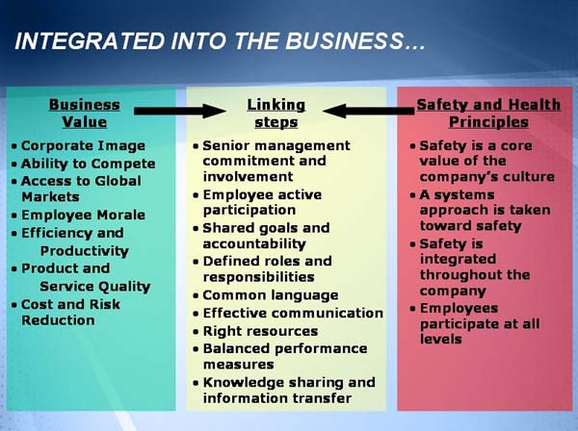

Slide 31
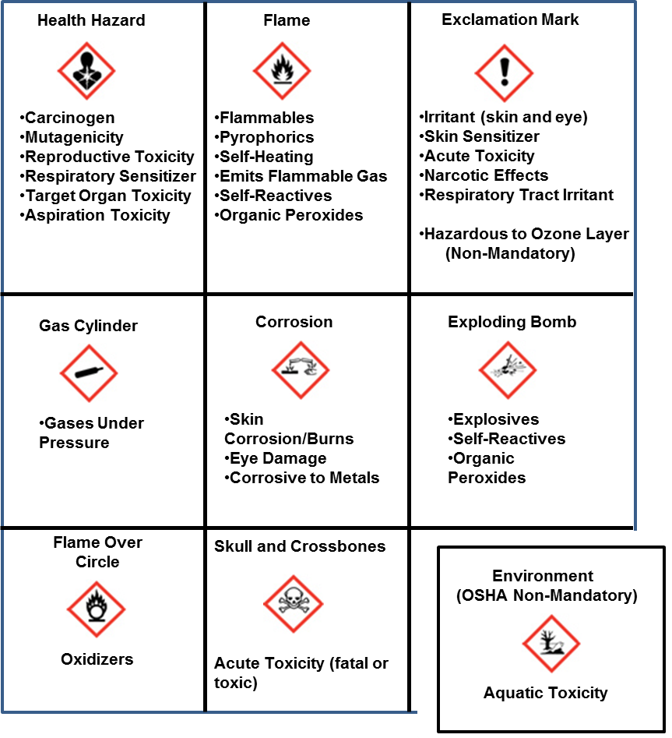
Section Two: Global Harmonization and Hazard Communication
Hazard Communication Standard Pictogram
As of June 1, 2015, the Hazard Communication Standard (HCS) will require pictograms on labels to alert users of the chemical hazards to which they may be exposed. Each pictogram consists of a symbol on a white background framed within a red border and represents a distinct hazard(s). The pictogram on the label is determined by the chemical hazard classification.

Slide 32
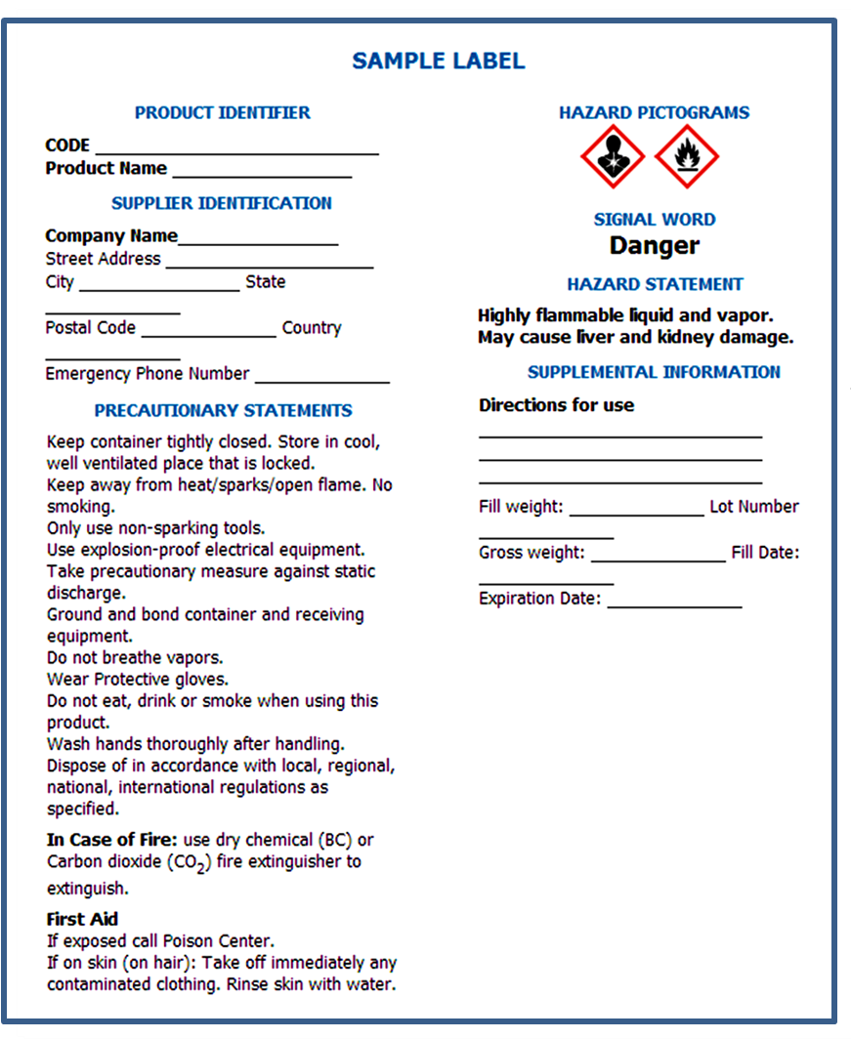
Section Two: Global Harmonization and Hazard Communication

Slide 33
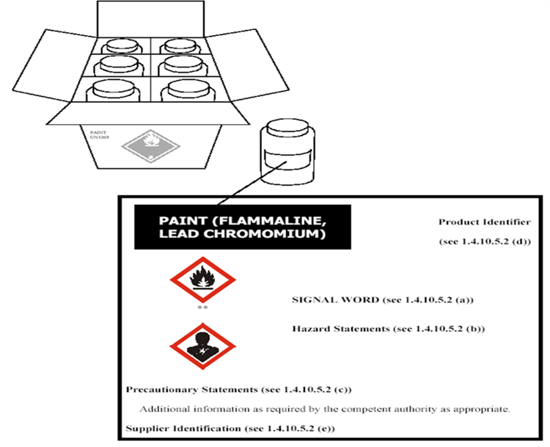
Section Two: Global Harmonization and Hazard Communication

Slide 34
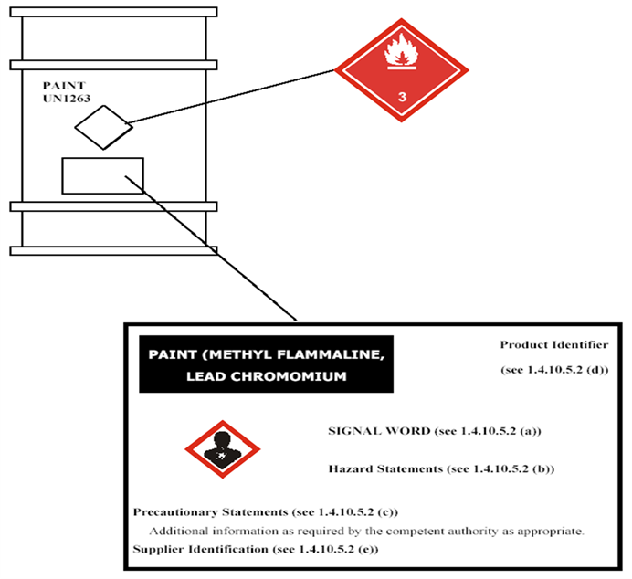
Section Two: Global Harmonization and Hazard Communication

Slide 35
Section Three: Job Hazard Analysis
Job Hazard Analysis
Safety Process
Assess
Plan and Control (hierarchy of controls)
Train
Implement
Monitor
Re-Assess
Routes of Entry (Exposure)
Absorption
Ingestion
Inhalation
Injection
(The front door into your home)

Slide 36
Introduction to
Hazard Communication
Rights & Responsibilities
Globally Harmonized System of Classification
and Labeling of Chemicals (GHS)
Global Harmonization and Hazard Communication
Job Hazard Analysis
Nature of Hazards
Flammability
Permissible Exposure Limits
Caustics and
Corrosives
Oxygen and
Oxidizers
Health
Reactivity
Storage
Applications to
Various Industries
Construction
Green
Industry
Hair Salons
Healthcare
Dry Cleaning
Landscaping

Slide 37
Simple Job Safety Analysis and the Application of Controls
A Job Safety Analysis (JSA) or Job Hazard Analysis (JHA) is a technique that focuses on job tasks as a way to identify hazards before they occur. It focuses on the relationship between the worker, the task, the tools, the work environment and the necessary steps to control a hazard.
Job Steps | Hazards/ Potential Accidents | Control Measures | Means of Implementation
Break tasks down to smaller sub-tasks. | List all possible associated hazards preferably in an order of severity | Use the Hierarchy of Controls Elimination Prevent Protect Mitigate | Should set out steps and procedures that are easy to understand. And explain the proper use of the equipment and requisite training and administration.
Notes:
White board exercise. Define Competent Person (someone who has knowledge of safety and health procedures, experience in the task at hand, and authority to take corrective action-give examples of corrective action. Define a Qualified Person as someone who has knowledge and experience but no authority.

Slide 38
Critical Thinking
(Good-Better-Best)
No matter how large or how small a task or job you can apply
a logical thought process. It’s universal!
1. ELIMINATE: Simply ELIMINATE the hazard.
2. PREVENTION: prevent accident or exposure from occurring.
3. PROTECTION: Mitigate or Minimize effects of hazards i.e.
Job Rotation
Scheduling
Personal Protective Equipment (Mitigation) PPE
Work Practices, Training
Specialized Training

Slide 39
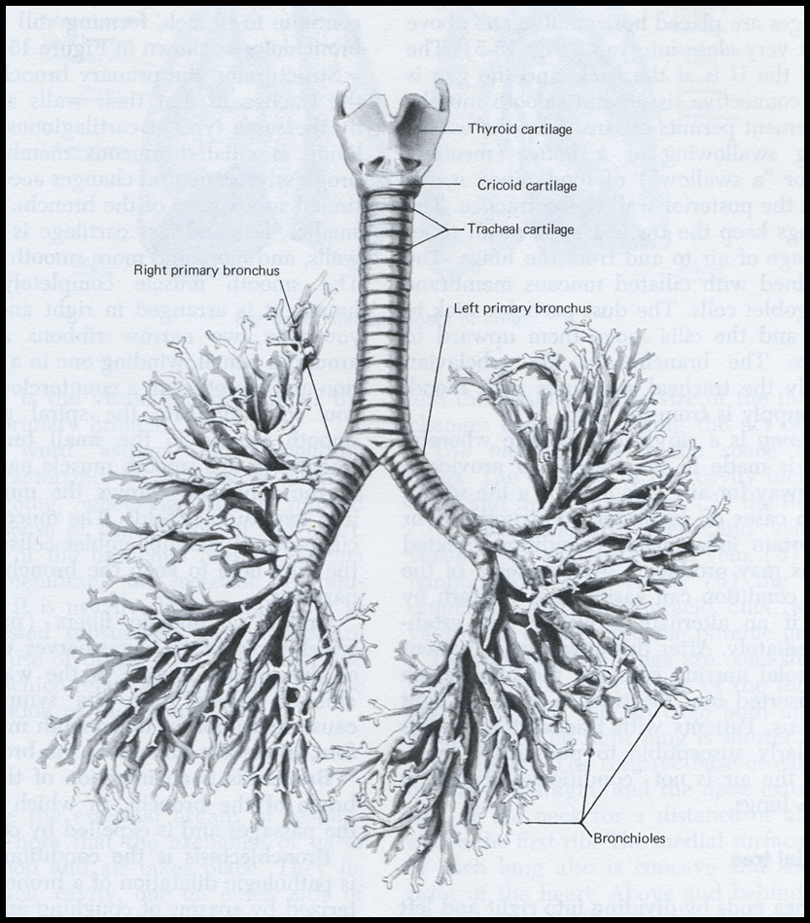
Routes of exposure
Inhalation The most common type of exposure occurs when you breathe a substance into the lungs. The lungs consist of branching airways (called bronchi) with clusters of tiny air sacs (called alveoli) at the ends of the airways. The alveoli absorb oxygen and other chemicals into the bloodstream.
Sometimes a chemical is present in the air as small particles (dust or mist). Some of these particles, depending on their size, may be deposited in the bronchi and/or alveoli. Many of them may be coughed out, but others may stay in the lungs and may cause lung damage. Some particles may dissolve and be absorbed into the blood stream, and have effects elsewhere in the body

Slide 40

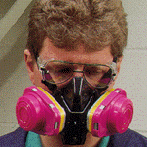

Personal Protective Equipment
Particulate
Respirators
Combination
Respirators
Gas & Vapor
Respirators

Slide 41
Routes of exposure
Skin Contact The skin is a protective barrier that helps keep foreign chemicals out of the body. However, some chemicals can easily pass through the skin and enter the bloodstream. If the skin is cut or cracked, chemicals can penetrate through the skin more easily. Also, some caustic substances, like strong acids and alkalis, can chemically burn the skin. Others can irritate the skin. Many chemicals, particularly organic solvents, dissolve the oils in the skin, leaving it dry, cracked, and susceptible to infection and absorption of other chemicals.

Slide 42
Routes of exposure
Eye Contact Some chemicals may burn or irritate the eye. Occasionally they may be absorbed through the eye and enter the bloodstream. The eyes are easily harmed by chemicals, so any eye contact with chemicals should be taken as a serious incident.

Slide 43
Routes of exposure
Ingestion The least common source of exposure in the workplace is swallowing chemicals. Chemicals can be ingested if they are left on hands, clothing or beard, or accidentally contaminate food, drinks or cigarettes. Chemicals present in the workplace as dust, for example, metal dusts such as lead or cadmium, are easily ingested

Slide 44
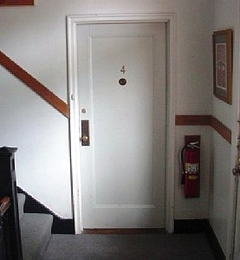

Routes of exposure
Remember: Your front door could be a Route of Entry for bringing contaminants home from work and exposing family members

Slide 45
The GHS Elements
Classification Criteria
Health and Environmental Hazards
Physical Hazards
Mixtures
Hazard Communication
Labels
Safety Data Sheets

Slide 46
Health & Environmental Hazards
Acute Toxicity
Skin Corrosion/Irritation
Serious Eye Damage/Eye Irritation
Respiratory or Skin Sensitization
Germ Cell Mutagenicity
Carcinogenicity
Reproductive Toxicity
Target Organ Systemic Toxicity – Single and Repeated Dose
Hazardous to the Aquatic Environment (Not OSHA)

Slide 47
Physical Hazards
Explosives
Flammability – gases, aerosols, liquids, solids
Oxidizers – liquid, solid, gases
Self-Reactive
Pyrophoric – liquids, solids
Self-Heating
Organic Peroxides
Corrosive to Metals
Gases Under Pressure
Water-Activated Flammable Gases
Notes:
Focal Point: UN Committee of Experts on Transport of Dangerous Goods, in cooperation with the ILO.

Slide 48
Comprehensibility
Guiding principles:
Information should be conveyed in more than one way.
The comprehensibility of the components of the system should take account of existing studies and evidence gained from testing.
The phrases used to indicate the degree (severity) of hazard should be consistent across different hazard types.

Slide 49
Key Label Elements
Product identifier
Supplier identifier
Chemical identity
Hazard pictograms*
Signal words*
Hazard statements*
Precautionary information
*Standardized

Slide 50









Transport Pictograms

Slide 51






GHS Pictograms
!

Slide 52
Signal Words
“Danger” or “Warning”
Used to emphasize hazard and discriminate between levels of hazard.

Slide 53
Hazard Statements
A single harmonized hazard statement for each level of hazard within each hazard class
Example: Flammable liquids
Category 1: Extremely flammable liquid and vapour
Category 2: Highly flammable liquid and vapour
Category 3: Flammable liquid and vapour
Category 4: Combustible liquid

Slide 54
Precautionary Information
GHS label should include appropriate precautionary information.
The GHS document includes examples of precautionary statements which can be used.
The intent is to harmonize precautionary statements in the future.

Slide 55
Role of the SDS in the GHS
The SDS should provide comprehensive information about a chemical substance or mixture.
Primary Use: The Workplace
Employers and workers use the SDS as a source of information about hazards and to obtain advice on safety precautions.

Slide 56
SDS Format: 16 headings
1. Identification
2. Hazard(s) identification
3. Composition/information on ingredients
4. First-aid measures
5. Fire-fighting measures
6. Accidental release measures
7. Handling and storage
8. Exposure control/personal protection

Slide 57
Format: 16 headings (cont.)
9. Physical and chemical properties
10. Stability and reactivity
11. Toxicological information
12. Ecological information
13. Disposal considerations
14. Transport information
15. Regulatory information
16. Other information

Slide 58
Confidential Business Information
National authorities should establish appropriate mechanisms for CBI protection. CBI will not be harmonized under the GHS.
The provisions for CBI protection should not compromise the health and safety of users.
CBI claims should be limited to the names of chemicals and their concentrations in mixtures.
Mechanisms should be established for disclosure in emergency and non-emergency situations.

Slide 59

Key GHS Words
Pictogram: Symbols comprehensible worldwide
Signal Words: Also indicates degree of danger but gets user attention
Hazard Statement: Phrases to summarize product hazards on labels and SDSs
Notes:
These are some of the major concepts used throughout the GHS.

Slide 60
GHS Point Of Use Exemptions
Pharmaceuticals
Food Additives
Cosmetics
Pesticide Residues in food
Notes:
As noted earlier, these items are not covered by GHS at the point of use, but are covered where there is the potential for worker exposure as well as in transportation.

Slide 61
Hazard Classification and Hazard Categories

Slide 62
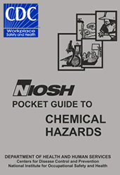
Chemical Hazards
Chemicals can pose a danger for human health and the environment from: - Production - Handling - Storage - Transportation - Use - Disposal
Notes:
The OSHA concept of chemical hazards, namely flammability, corrosivity, reactivity and toxicity are expanded in the GHS and covered under Physical hazards and Health hazards.

Slide 63
Basic Hazard Categories Under GHS
Physical, e.g., fire/explosion, corrosion - Use standard tests (e.g., FP), Structure Activity Relationships & Expert Judgment
Health Effects - Chronic & Acute - Tox testing, LD₅₀, human data, calculations
Environmental - Aquatic environment, i.e., Marine pollutants (Not OSHA Regulated)
Notes:
Under GHS, classification of hazards is broken down to 3 main types, Physical, Health and Environmental. They are determined by the use of available data, testing, comparison to other materials with similar composition (structure activity relationships) and reliance on the judgment of highly knowledgeable people.

Slide 64
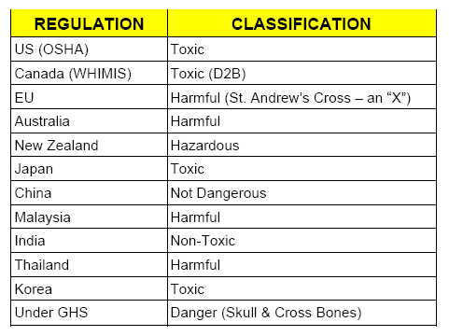
Worldwide Classification Frequently Different Example: Chemical w/ LD₅₀ = 260 mg/kg
Notes:
The EU classification for acute toxicity was 200 mg/kg (oral), while some Canadian systems defined acute toxicity as 500 mg/kg. As a result all chemicals between 200 and 500 mg/kg would therefore be labelled differently.
As you can see from this table, some countries classify the example material as “toxic” while others classify it as “not dangerous” or “non-toxic”. GHS will allow all countries to define hazardous materials by the same set of classifications.

Slide 65
GHS Categories Based On Severity
5 Categories - Category 1 = Most Hazardous - Category 5 = Least Hazardous
Not all Categories are regulated in all modes
Notes:
Under GHS, not all Hazard Categories are applied universally to Health, Safety and Transportation concerns. Many Category 4 materials are regulated for health & safety but not for transportation.

Slide 66
Example: GHS Hazard Categories For ETHANOL
Acute Toxicity (oral): Category 5
Eye Irritation: Category 2A
Flammable Liquid: Category 2
Respiratory Irritation: Category 3
Skin Corrosion/ Irritation: Category 3
Notes:
If you are determining the hazards of a common chemical, like ethyl alcohol (ethanol), you would consider its acute toxicity, flammability, ability to irritate skin, eyes and respiratory tract. And based on the degree of severity ethanol poses for these things, you can assign a Hazard Category to each of them.
Here we see that ethanol is very flammable (Category 2), but is not acutely toxic (Category 5). In other words, ethyl alcohol burns readily but will usually only make you drunk and not kill you on ingestion.

Slide 67
Pictograms
Notes:
The use of Pictograms is important to GHS, so let’s look at them in some detail.

Slide 68

GHS Pictograms
Description | Pictogram | Hazard class and hazard category:
Exploding Bomb |  | Unstable explosives Explosives of Divisions 1.1, 1.2, 1.3, 1.4 Self reactive substances and mixtures, Types A,B Organic peroxides, Types A, B
Notes:
The “exploding bomb” symbol in the GHS Pictogram is nothing new. This symbol has been used for many years in Hazardous Materials Transportation hazard class labels and placards. Two significant differences between GHS Pictograms and DOT labels an placards are the absence of text and their size.
The Pictograms may be sized to fit any label or SDS. DOT hazard class labels must always be approximately 4 inches on each side and placards have to be about 11 inches on a side.
The Hazard Class is from Transportation regulations and the Hazard Category is from GHS

Slide 69

GHS Pictograms
Description | Pictogram | Hazard class and hazard category:
Flame |  | Flammable gases, category 1 Flammable aerosols, categories 1,2 Flammable liquids, categories 1,2,3 Flammable solids, categories 1,2 Self-reactive substances and mixtures, Types B,C,D,E,F Pyrophoric liquids, category 1 Pyrophoric solids, category 1 Self-heating substances and mixtures, categories 1,2 Substances and mixtures, which in contact with water, emit flammable gases, categories 1,2,3 Organic peroxides, Types B,C,D,E,F
Notes:
The “Flame” symbol in the GHS Pictogram is very recognizable from transportation hazard class 3, flammable liquids.
[Read some of the hazard classes and hazard categories from the slide.]

Slide 70

GHS Pictograms
Description | Pictogram | Hazard class and hazard category:
Flame Over Circle |  | Oxidizing gases, category 1 Oxidizing liquids, categories 1,2,3
Notes:
Likewise, the “Flaming O” symbol has been borrowed from transportation hazard class 2, oxygen, and class 5, oxidizers.

Slide 71

GHS Pictograms
Description | Pictogram | Hazard class and hazard category:
Gas Cylinder |  | Gases under pressure: - Compressed gases - Liquefied gases - Refrigerated liquefied - gases Dissolved gases
Notes:
The gas cylinder symbol is borrowed from transportation labels/placards for division 2.2, non-flammable, non-toxic gases.
[Read some of the hazard classes and hazard categories from the slide.]

Slide 72

GHS Pictograms
Description | Pictogram | Hazard class and hazard category:
Corrosion |  | Corrosive to metals, category 1 Skin corrosion, categories 1A,1B,1C Serious eye damage, category 1
Notes:
The symbol of chemicals corroding metal and destroying skin on a hand is one of the most recognized symbols found on shipping labels on containers in laboratories and manufacturing sites alike.

Slide 73

GHS Pictograms
Description | Pictogram | Hazard class and hazard category:
Skull and Crossbones |  | Acute toxicity (oral, dermal, inhalation), categories 1,2,3
Notes:
The skull and crossbones symbol has been used to denote poisons or toxic materials for a very long time and is yet another highly recognizable symbols to chemical workers and people in all walks of life.

Slide 74

GHS Pictograms
Description | Pictogram | Hazard class and hazard category:
Exclamation Mark |  | Acute toxicity (oral, dermal, inhalation), category 4 Skin irritation, category 2 Eye irritation, category 2 Skin sensitization, category 1 Specific Target Organ Toxicity – Single exposure, category 3
Notes:
While the Skull and Crossbones pictogram symbolizes Categories 1, 2 and 3 Acute Toxicity, the Exclamation Point is to be used for Category 4 acute toxicity, as well as, Skin and Eye irritation, Skin sensitization, and specific target organ toxicity.

Slide 75

GHS Pictograms
Description | Pictogram | Hazard class and hazard category:
Health Hazard |  | Respiratory sensitization, category 1 Germ cell mutagenicity, categories 1A,1B,2 Carcinogenicity, categories 1A,1B,2 Reproductive toxicity, categories 1A,1B,2 Specific Target Organ Toxicity – Single exposure, categories 1,2 Specific Target Organ Toxicity – Repeated exposure, categories 1,2 Aspiration Hazard, category 1
Notes:
As you can see from this slide, the “Man Who Swallowed A Star” symbol is to be used for Respiratory sensitization,
Germ cell Mutagenicity, Carcinogenicity, Reproductive toxicity, and Aspiration hazard, etc.
[Read some of the hazard classes and hazard categories from the slide.]

Slide 76
Current North American Labels
US Workforce labels follow: - OSHA - ANSI - NJ Right to Know Law - CA Proposition 65
Canada Workforce labels follow WHMIS
Lots of differences among these
Notes:
Labeling for hazard identification by private sector and public sector workers is covered by the federal government and various states. In addition, labeling of hazards in our Northern neighbor, Canada, is regulated by their specific law, the Workplace Hazardous Materials Information System. None of these requirements are exactly alike – yet!

Slide 77
Six Elements Of The GHS Label
Product Identifier
Supplier Identification
Chemical Identification
Hazard Pictograms
Signal Words
Hazard Statements describing nature of hazards
Notes:
Of the 6 GHS labeling requirements shown here, the last 3 all have standardized styles or text. Regardless of a country’s language, the Pictograms will always be the same and the Signal Words and Hazard Statements will always have the same text.

Slide 78
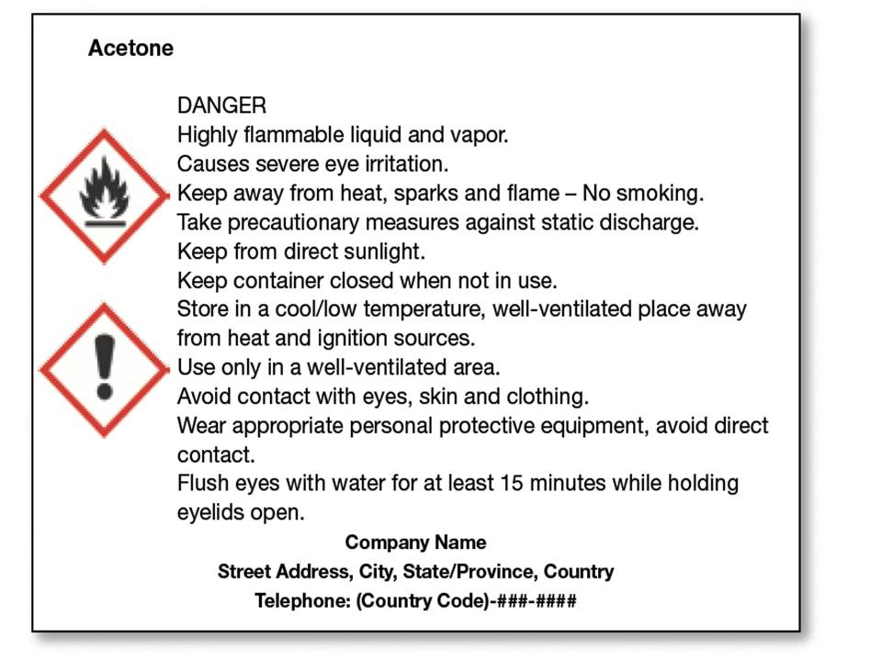
GHS Label For Acetone
Notes:
This is an example of a GHS label for the commonly used solvent, acetone. You will notice the name, Signal Word (Danger), Pictograms, Hazard Statements, Precautionary Statements and supplier information are shown. Where you place the Pictogram on the label is optional.

Slide 79




GHS Label For Epichlorohydrin
Epichlohydrin 1-Chloro-2,3-epoxypropane CAS No. 106-89-8 UN No. 2023
Hazard
Hazard statements: ・Toxic if swallowed ・Toxic in contact with skin ・Fatal if inhaled ・May cause an allergic skin reaction. ・May cause genetic defects. ・May cause cancer ・Cause severe skin burns and eye damage ・Cause serious eye irritation ・Toxic to aquatic life
Top Half Of Label
Notes:
The same key labeling elements are shown on a GHS label for the highly toxic chemical, epichlorohydrin. The top part of the label in on this slide and the next slide shows the bottom part of the label.

Slide 80
GHS Label For Epichlorohydrin
Precautionary statements: ・Keep out of reach of children. ・Keep container tightly closed. ・Do not handle until all safety precautions have been read and understood. ・Wear eye/face protection. ・Wear protective gloves/clothing. ・Wear respiratory protection, as specified by the manufacturer. ・Do not breathe dust/fume/gas/mist/vapors/spray. ・Use appropriate ventilation. ・Wash thoroughly after handling.
United Nations Co., Ltd. 1-1, Peace Avenue Geneva, Switzerland Tel. 41 22 917 00 00 Fax. 41 22 917 00 00
Bottom Half Of Label

Slide 81
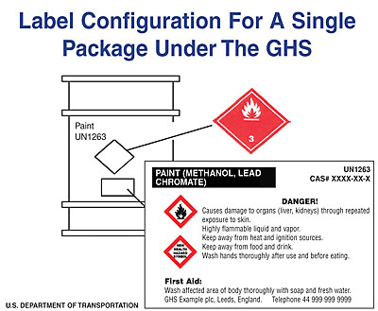

GHS Label Placement
GHS label Pictogram is optional, if shipping label has hazard symbol
Notes:
Single containers or packages must have the GHS label on them. If the package also serves as a shipping container, there must also be a hazard class shipping label affixed to it as well. In this case, because the hazard class label has a hazard symbol already on it, the use of a GHS Pictogram on the GHS label is optional.

Slide 82
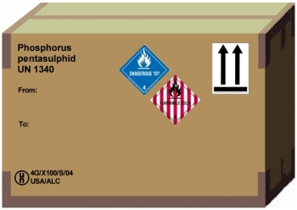

GHS Label Placement For Combination Packages
Put 6 Units
in box
No GHS Label on Outer Package if Danger is noted by diamond label(s)
GHS Single Package Label
Notes:
For combination packages, that is, where hazardous materials containers are placed in an outer packaging, the GHS label is required on all inner containers but not on the outer package, providing the transportation labels display the hazards of the product.

Slide 83
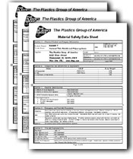
Safety Data Sheets
Notes:
GHS requires a 16-section Safety Data Sheet that will include more extensive information than what OSHA and Canada's Workplace Hazardous Materials Information System (WHMIS) currently require.

Slide 84
Safety Data Sheets Under GHS
Section 1. Identification
Section 2. Hazard(s) classification & labeling statements
Section 3. Composition/information on ingredients
Section 4. First-aid measures
Section 5. Fire-fighting measures
Section 6. Accidental release measures
Section 7. Handling and storage
Section 8. Exposure controls/personal protection
Notes:
You will note that the required information in Sections 2 and 3 are the reverse of our typical OSHA required Material Safety Data Sheets. We show the hazardous materials composition in Section 2 and the Hazard warnings in Section 3.
Because OSHA does not presently require a standard format for MSDSs, it is completely acceptable to switch Sections right now, if you want to. However, most workers trained in the Haz Com Standard know to look at Section 2 for the hazardous ingredients. This potential confusion should not last long, if they actually read the whole MSDS.

Slide 85
Safety Data Sheets Under GHS
Section 9. Phys and Chem Properties/Measurements
Section 10. Stability & reactivity (Heat, water, incompatibles)
Section 11. Toxicological information (Health info)
Section 12. Ecological information (Environ effects)
Section 13. Disposal considerations
Section 14. Transport info (49CFR, Can DGR...)
Section 15. Regulatory info (CA Prop 65, NJRTK…)
Section 16. Other info (Preparer, Contact #, Date…)
Notes:
While the typical OSHA MSDSs have the date of issue at the top of the first page, many MSDSs have been written where the date is either at the bottom of all pages or just the last page. Again, workers and handlers of hazardous chemical materials should read MSDSs in their entirety, so where the date appears should not cause any confusion.

Slide 86
Confidential Business Information
GHS will not address confidentiality exemptions
But end-users’ health & safety must not be compromised by CBI
Non-disclosure claims limited to chemical names & concentrations in mixtures
Need mechanism for disclosure in emergencies
Each country must determine requirements for protecting CBI, OSHA, therefore, will likely still allow Safety Data Sheets to show Trade Secret Registry Numbers (TSRNs) in the hazardous ingredients section
Notes:
GHS does not cover proprietary information exemptions. That is going to be left up to each country to deal with. OSHA, therefore, will likely still allow Safety Data Sheets to show Trade Secret Registry Numbers (TSRNs) in the hazardous ingredients section.

Slide 87

Section Four: Nature of Chemical Hazards
“INFORMATION IS OUR BEST DEFENSE”
Notes:
This presentation is designed to assist trainers conducting OSHA 10-hour General Industry outreach training for workers. Since workers are the target audience, this presentation emphasizes hazard identification, avoidance, and control – not standards. No attempt has been made to treat the topic exhaustively. It is essential that trainers tailor their presentations to the needs and understanding of their audience.
This presentation is not a substitute for any of the provisions of the Occupational Safety and Health Act of 1970 or for any standards issued by the U.S. Department of Labor. Mention of trade names, commercial products, or organizations does not imply endorsement by the U.S. Department of Labor.

Slide 88
Section Four: Nature of Chemical Hazards
”
The Nature of Chemical Hazards
The Nature of Flammables
The Nature of Reactive agents
Corrosives and Caustics
The Nature and Effects of oxygen
The Nature and Effects of temperature pressure
Specific gravity and relative vapor density
Toxins, Carcinogens, Mutagens and Teratogens

Slide 89
Section Four: Nature of Chemical Hazards
“INFORMATION IS OUR BEST DEFENSE”
Air borne: dusts fumes smoke aerosols mists gases vapors
Flammables and Combustibles
Oxygen
Health Hazards?
Latency Period
Acute and Chronic
Local and Systemic
Asphyxiants
Nuisance dusts
Biological Toxins (considered hazardus)
Carcinogens
Mutagens
Teratogens

Slide 90
Section Four: Nature of Chemical Hazards
”
Chemicals
States of Matter
The Environment
Temperature
Pressure/altitude
Oxygen
Flammability
Reactivity
Acids and Bases

Slide 91
Basic Chemistry
Dr. William Haddon Jr. a physician with degrees from the Massachusetts Institute of Technology, Harvard Medical School and Harvard School of Public Health and the first director of the National Highway Traffic Safety Administration, proposed a general idea that accidents and injuries involve the transfer of energy.
The Energy Release Theory, poses that objects, events, or environments interaction with people cause harm.
Many sources of energy are obvious to us such as the moving parts of a machine, motor vehicles, projectiles, gravity, or even wind and weather systems yet we often overlook the tremendous energy found in chemicals simply because we cannot see the energy.
Example: Energy in Chemicals
None Electrolytes Sugar
Strong Electrolytes Salt
Weak Electrolytes Vinegar

Slide 92
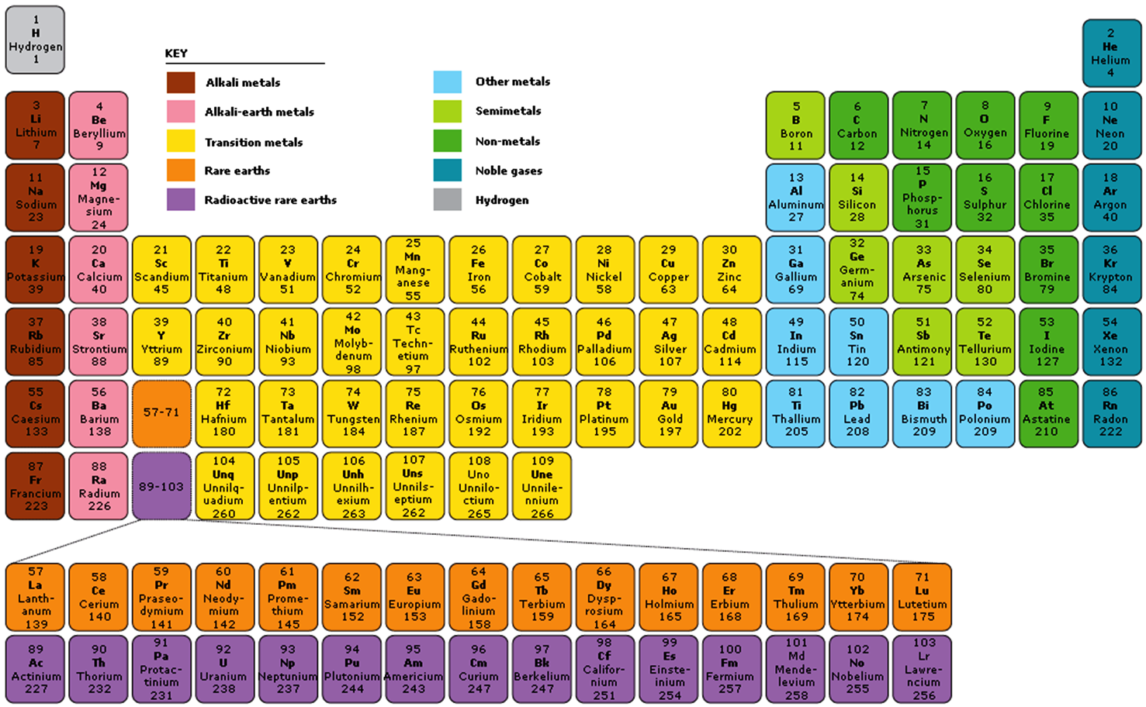

Slide 93

Elements –Compounds- Molecules – Mass and Energy

Slide 94
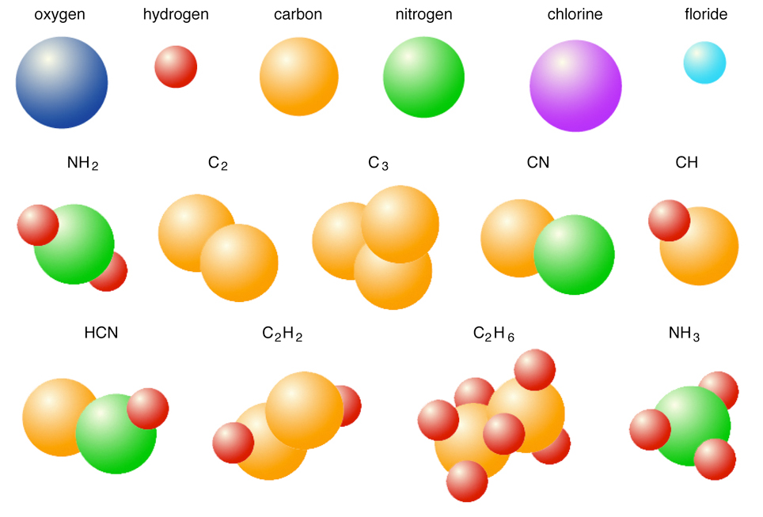
Molecules

Slide 95
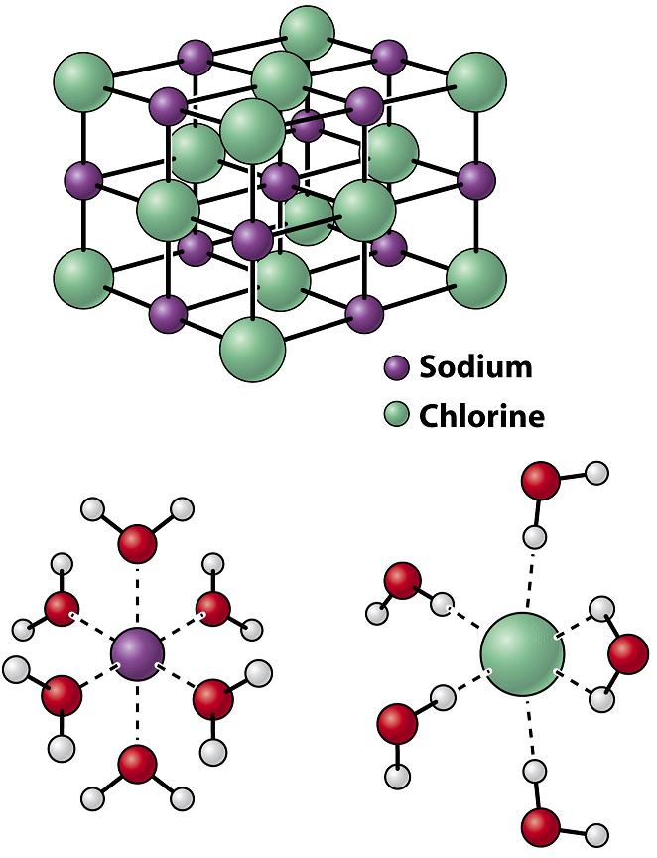

States of Matter

Slide 96
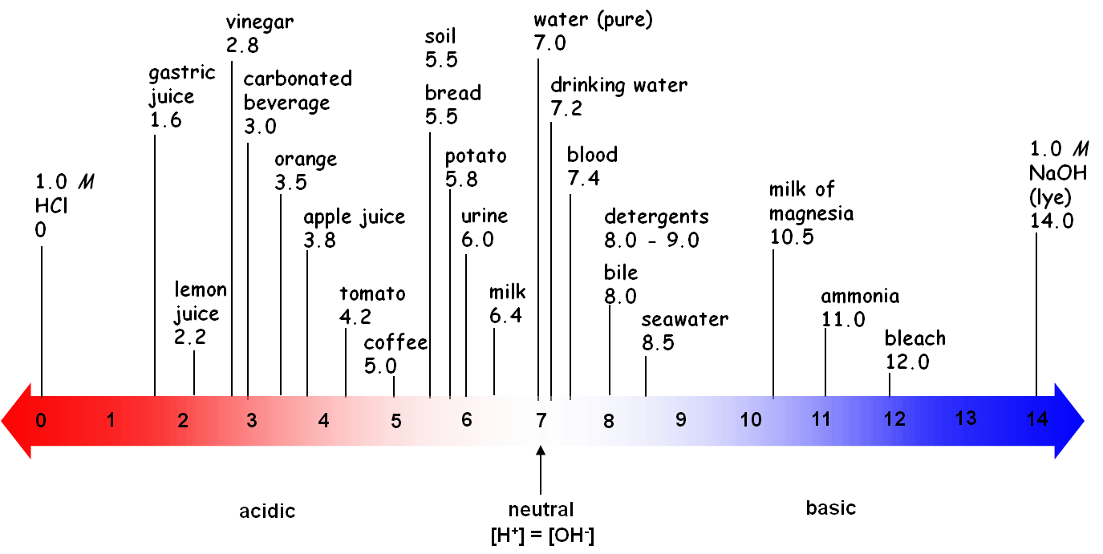
The Nature of Corrosives and Caustics
Acids and Bases

Slide 97
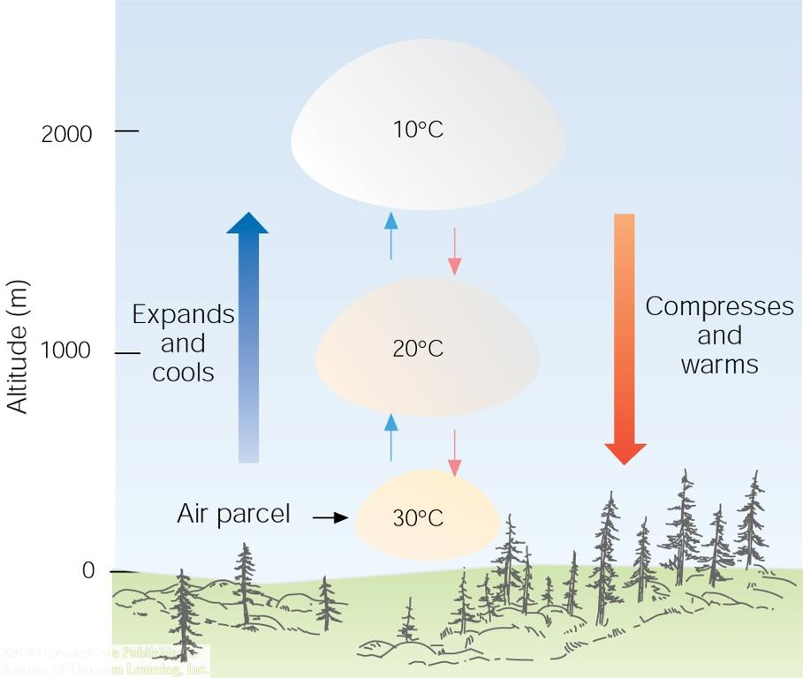
Affects of Pressure /Attitude & Temperature

Slide 98
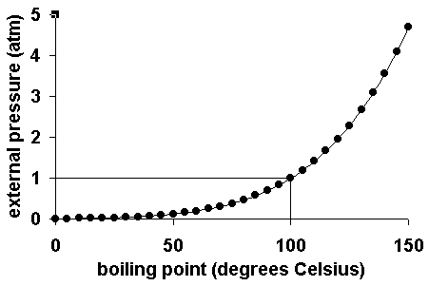
Affects of Pressure /Attitude & Temperature
Boiling Points: As a liquid is heated, its vapor pressure increases until the vapor pressure equals the pressure of the gas above I The temperature of a boiling liquid remains constant, even when more heat is added yet the liquid change state into a vapor. Pressure (altitude) and temperature can affect the states of matter.

Slide 99
The Nature and Effects of Oxygen
Oxygen is essential to life. Its normal concentration in the air we breathe is approximately 21 % (20.9%)
OSHA 19.5 % to 23.5 %
We can breathe in a 50-60% oxygen enriched atmosphere for several hours under medical care (oxygen therapy)
Oxygen is not flammable but supports combustion.
Most materials burn fiercely sometimes explosively in oxygen.
As the oxygen concentration in air increases, the potential fire risk increases. Oxygen enrichment cannot be detected by the human senses
At concentrations above 23.5 % in air, the situation becomes dangerous due to the increased fire hazard.
Oxygen is colourless, tasteless and has no odour.
Oxygen is heavier than air, oxygen can accumulate in low lying areas. such as pits or underground rooms especially in cases of liquid spillage.
3 Means of losing oxygen
Displacement
Consomption
Reaction

Slide 100
Properties of oxygen Oxygen supports life and Combustion (19.5 % - 23.5%)
It is not flammable but supports combustion.
Most materials burn fiercely sometimes explosively in oxygen !
As the oxygen concentration in air increases, the potential fire risk increases.
At concentrations above 23.5 % in air, the situation becomes dangerous due to the increased fire hazard.
Oxygen is essential to life
Its normal concentration in the air we breathe is approximately 21 %
We can breathe in a 50-60% oxygen enriched atmosphere for several hours under medical care (oxygen therapy)
But it is dangerous to do so without knowing the associated risks due to oxygen enrichment !

Slide 101
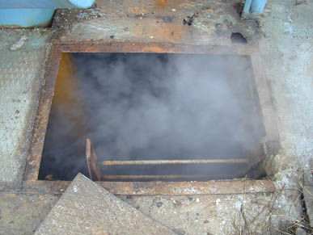

Properties of oxygen Oxygen is heavier than air
Being heavier than air, oxygen can accumulate in low lying areas !
such as pits or underground rooms,
especially in cases of liquid spillage.

Slide 102
The Fire Triangle
Combustible
Material
Ignition source
Oxygen
When one of the 3 elements is missing,
a fire cannot occur!

Slide 103
Flammable Range
Explosion Pressure
LEL
UEL
Vapor/Gas Concentration in Air (%)
Notes:
These boundary-line mixtures of vapor with air are known as the lower and upper flammable or explosive limits (LEL or UEL) respectively, and they are usually expressed in terms of percentage by volume of vapor in air.

Slide 104
Oxidizing Agents
An oxidizing agent is a chemical substance that reacts with another chemical called the reactant and results in the removal electrons. This reaction is referred to as a redox chemical reaction and can in some oxidizers release a great deal of chemical energy, which has the potential to cause injury, illness and damage.
Common Oxidizing Agents
Oxygen (O₂)
Ozone (O₃)
Hydrogen peroxide (H₂O₂) and other inorganic peroxides
Fluorine (F₂), chlorine (Cl₂), and other halogens
Hexavalent chromium compounds such as chromic and dichromic acids and chromium trioxide, pyridinium chlorochromate (PCC), and chromate/dichromate compounds
Permanganate compounds such as KMnO₄
Sodium perborate
Nitric acid (HNO₃) and nitrate compounds
Sulfuric acid (H₂SO₄)
Peroxydisulfuric acid (H₂S₂O₈)
Peroxymonosulfuric acid (H₂SO₅)
Chlorite, chlorate, perchlorate, and other analogous halogen compounds
Hypochlorite and other hypohalite compounds, including household bleach (NaClO)
Nitrous oxide (N₂O)
Silver oxide (Ag₂O)
Osmium tetroxide (OsO₄)

Slide 105
Compatibility of Mixtures and Substances
Only certain materials are suitable for use in oxygen service
Most materials - including metals - will burn in oxygen enriched atmospheres
Equipment and material contaminated with oil or grease can ignite easily and burn with explosive violence in oxygen enriched atmospheres
Never use oil or grease to lubricate oxygen equipment!

Slide 106
Specific gravity and relative vapor density
Specific gravity and vapor density comparative measurements based on the respective relative weight of a liquid and a gas or vapor compared to water or air. This “weight” of water or air is an arbitrary value of one (1). If a gas has a vapor density of less than one it will generally rise in air. If the vapor density is greater than one the gas will generally sink in air. Propane for example has a vapor density of 1.554, so it will sink in air, the vapor density of helium is 0.145 so it is significantly lighter than air so it will rise. Acetone is twice as heavy as air so its vapor density is 2. Mercury vapor is nearly seven times heavier the air. As you would imagine, the density of a chemical has great safety and health implications for example storage of chemicals especially flammables, oxidizers or other highly reactive chemicals that can displace air, possibly presenting hazard to employees.

Slide 107
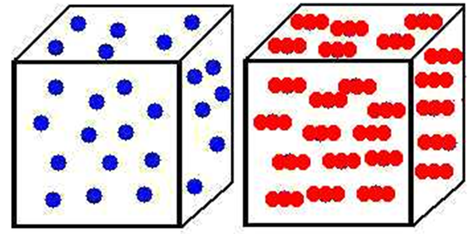
Specific gravity and relative vapor density
Helium
Molecular Weight 4g
Carbon Dioxide
Molecular Weight 44g

Slide 108
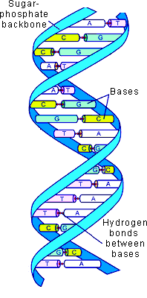
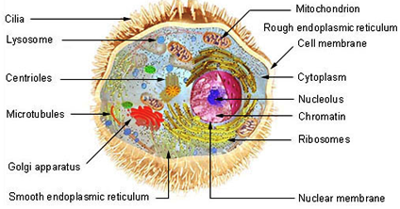
Toxins Carcinogens, Mutagens and Teratogens

Slide 109
Section Five: Debriefing Workshop
As is proper with any form of training or education, there should be a means of evaluating the experience and assessing its effectiveness. Let us take a few moments and talk about what this program has achieved and where it can be made better. Also, let’s take notes so we can look back on our notes say in the months to come and see if, at all, has this training and what we accomplished today had some longer-term effect on our workplace.

