Slide 1

Introduction to osha
Preventing Runovers
and Backovers
Module 1

Slide 2

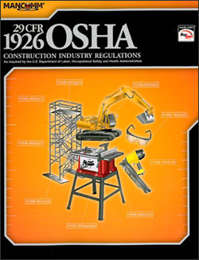
Introduction to OSHA
Objectives
  Provide information about worker rights under OSHA law
  Learn how to file a complaint, and rights against discrimination and retaliation
  Provide information about the elements of a valid complaint
Notes:
1
The purpose of this module is to introduce participants to safety and health regulatory issues and compliance. Emphasis is placed on the OSH Act and its major provisions, OSHA standards and enforcement procedures, as well as basic compliance guidelines that relate to the construction industry are highlighted.
Upon completion of this module, participants will be able to:
Provide information about worker rights under OSHA law
Learn how to file a complaint, and rights against discrimination and retaliation
Provide information about the elements of a valid complaint

Slide 3


What is OSHA?
Federal agency located with in the Department of Labor
On December 29, 1970, President Nixon signed the OSH Act; it opened April 28, 1971
“[T]o assure … every working man and woman in the Nation safe and healthful working conditions and to preserve our human resources.”
Notes:
The Occupational Safety & Health Administration (OSHA) was created in 1970 through the “Occupational Safety and Health Act,” also known as the Williams-Steiger Act. It was developed to consolidate several other safety laws (including the Construction Safety Act) into one agency, and to correct what was perceived as a failure of existing programs to adequately protect workers. OSHA is part of the U.S. Department of Labor.

Slide 4
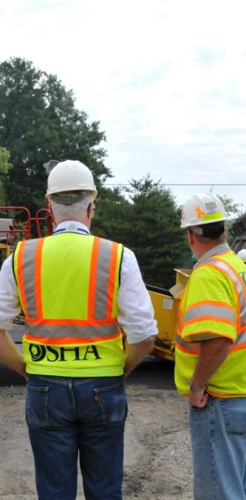
What Does OSHA Do?
Develop standards
Inspect employers
Investigate injuries and fatalities
Issue citations and impose penalties (financial or criminal)
Assist in occupational safety and health training
Notes:
There are five primary activities for OSHA:
-Develop standards
-Inspect employers
-Investigate injuries and fatalities
-Issue citations and impose penalties (civil or criminal)
-Assist in occupational safety and health training

Slide 5

Who is accountable to OSHA?
An EMPLOYER is defined as a person engaged in a business affecting commerce who has employees; it does not include the United States or other government entity.
An EMPLOYEE is defined as a person employed by an employer who affects commerce.
Notes:
OSHA was designed to make EMPLOYERS responsible for the safety and health of their EMPLOYEES. Under the OSH Act, both employers and employees have safety responsibilities, but OSHA only enforces the law against employers.
An EMPLOYER is defined as a person engaged in a business affecting commerce who has employees; it does not include the United States or other government entity.
An EMPLOYEE is defined as a person employed by an employer who affects commerce.

Slide 6
State Plan States
States may assume responsibility for enforcing occupational safety and health regulations in lieu of federal OSHA
State must issue and enforce standards that are substantially equal to the federal standards
Notes:
State Plans—Another provision of the OSH Act allows states to assume responsibility for enforcing occupational safety and health regulations in lieu of federal OSHA. If a state chooses to do this, it must issue and enforce standards that are substantially equal to the federal standards. Approximately 26 states have taken this option and enforce their own regulations, with assistance from federal funds.
This state plan option creates several interesting problems. Because of constitutional and federal legal limitations, the U.S. government cannot enforce OSHA regulations against employees of state governments. Therefore, in states that operate under federal OSHA, OSHA cannot issue citations against the state if its employees are not working in safe and healthful conditions. For example, if an OSHA compliance officer arrived at a road construction site and noticed a state DOT inspector walking on a bridge without necessary fall protection, OSHA cannot cite the state DOT.
If, however, worker safety and health regulations are enforced under a “state plan,” it is entirely possible that the state-employed inspector could cite another state agency for failure to protect its employees.
While the federal government cannot cite state employees, the opposite is also true—a state government cannot cite federal employees. As a result, federal OSHA has offices and inspectors in “state plan” states solely for the purpose of inspecting and enforcing the federal standards for employees of federal institutions.

Slide 7
State Plan States
Notes:
Check to see if your state has a state plan. If it does, state government workers will be covered by the state OSHA plan. If you live in a federal OSHA state (those indicated in white), state workers will not be covered by federal OSHA.

Slide 8
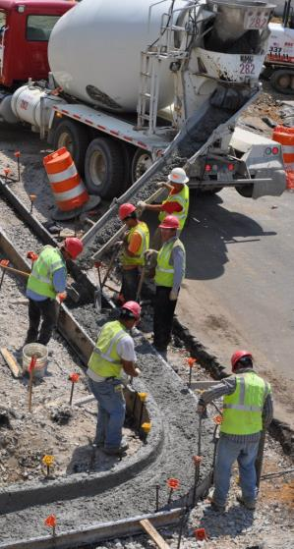
Worker rights under OSHA Act
Section 5(a)(1) of the OSH Act states: “Each employer shall furnish to each of his employees employment and a place of employment which are free from recognized hazards that are causing or are likely to cause death or serious physical harm to his employees."
Notes:
The creation of OSHA provided workers the right to a safe and healthful workplace. Section 5(a)(1) of the OSH Act states: "Each employer shall furnish to each of his employees employment and a place of employment which are free from recognized hazards that are causing or are likely to cause death or serious physical harm to his employees." A safe and healthful workplace means
that hazards are removed and workers are trained. If a hazard cannot be removed completely, protection (for example, respirators or earplugs) must be provided.
Some examples of a safe/healthful workplace include:
-Fall protection and training are provided and required when working at high levels on a construction site.
-Trenches are inspected and have protective systems in place.

Slide 9

Worker rights under OSHA Act
OSHA also provides workers with the right to:
  Ask OSHA to inspect their workplace;
  Use their rights under the law without retaliation and discrimination;
  Receive information and training about hazards, methods to prevent harm, and the OSHA standards that apply to their workplace. The training must be in a language you can understand;
  Get copies of test results done to find hazards in the workplace;
  Review records of work-related injuries and illnesses;
  Get copies of their medical records
Notes:
Workers have rights to be protected under the OSHA act from unsafe conditions. In addition, they can ask OSHA to inspect and unsafe work place, receive information about hazards and training in safe work practices, and can review their medical records created by their employer.

Slide 10

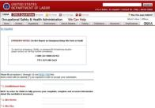
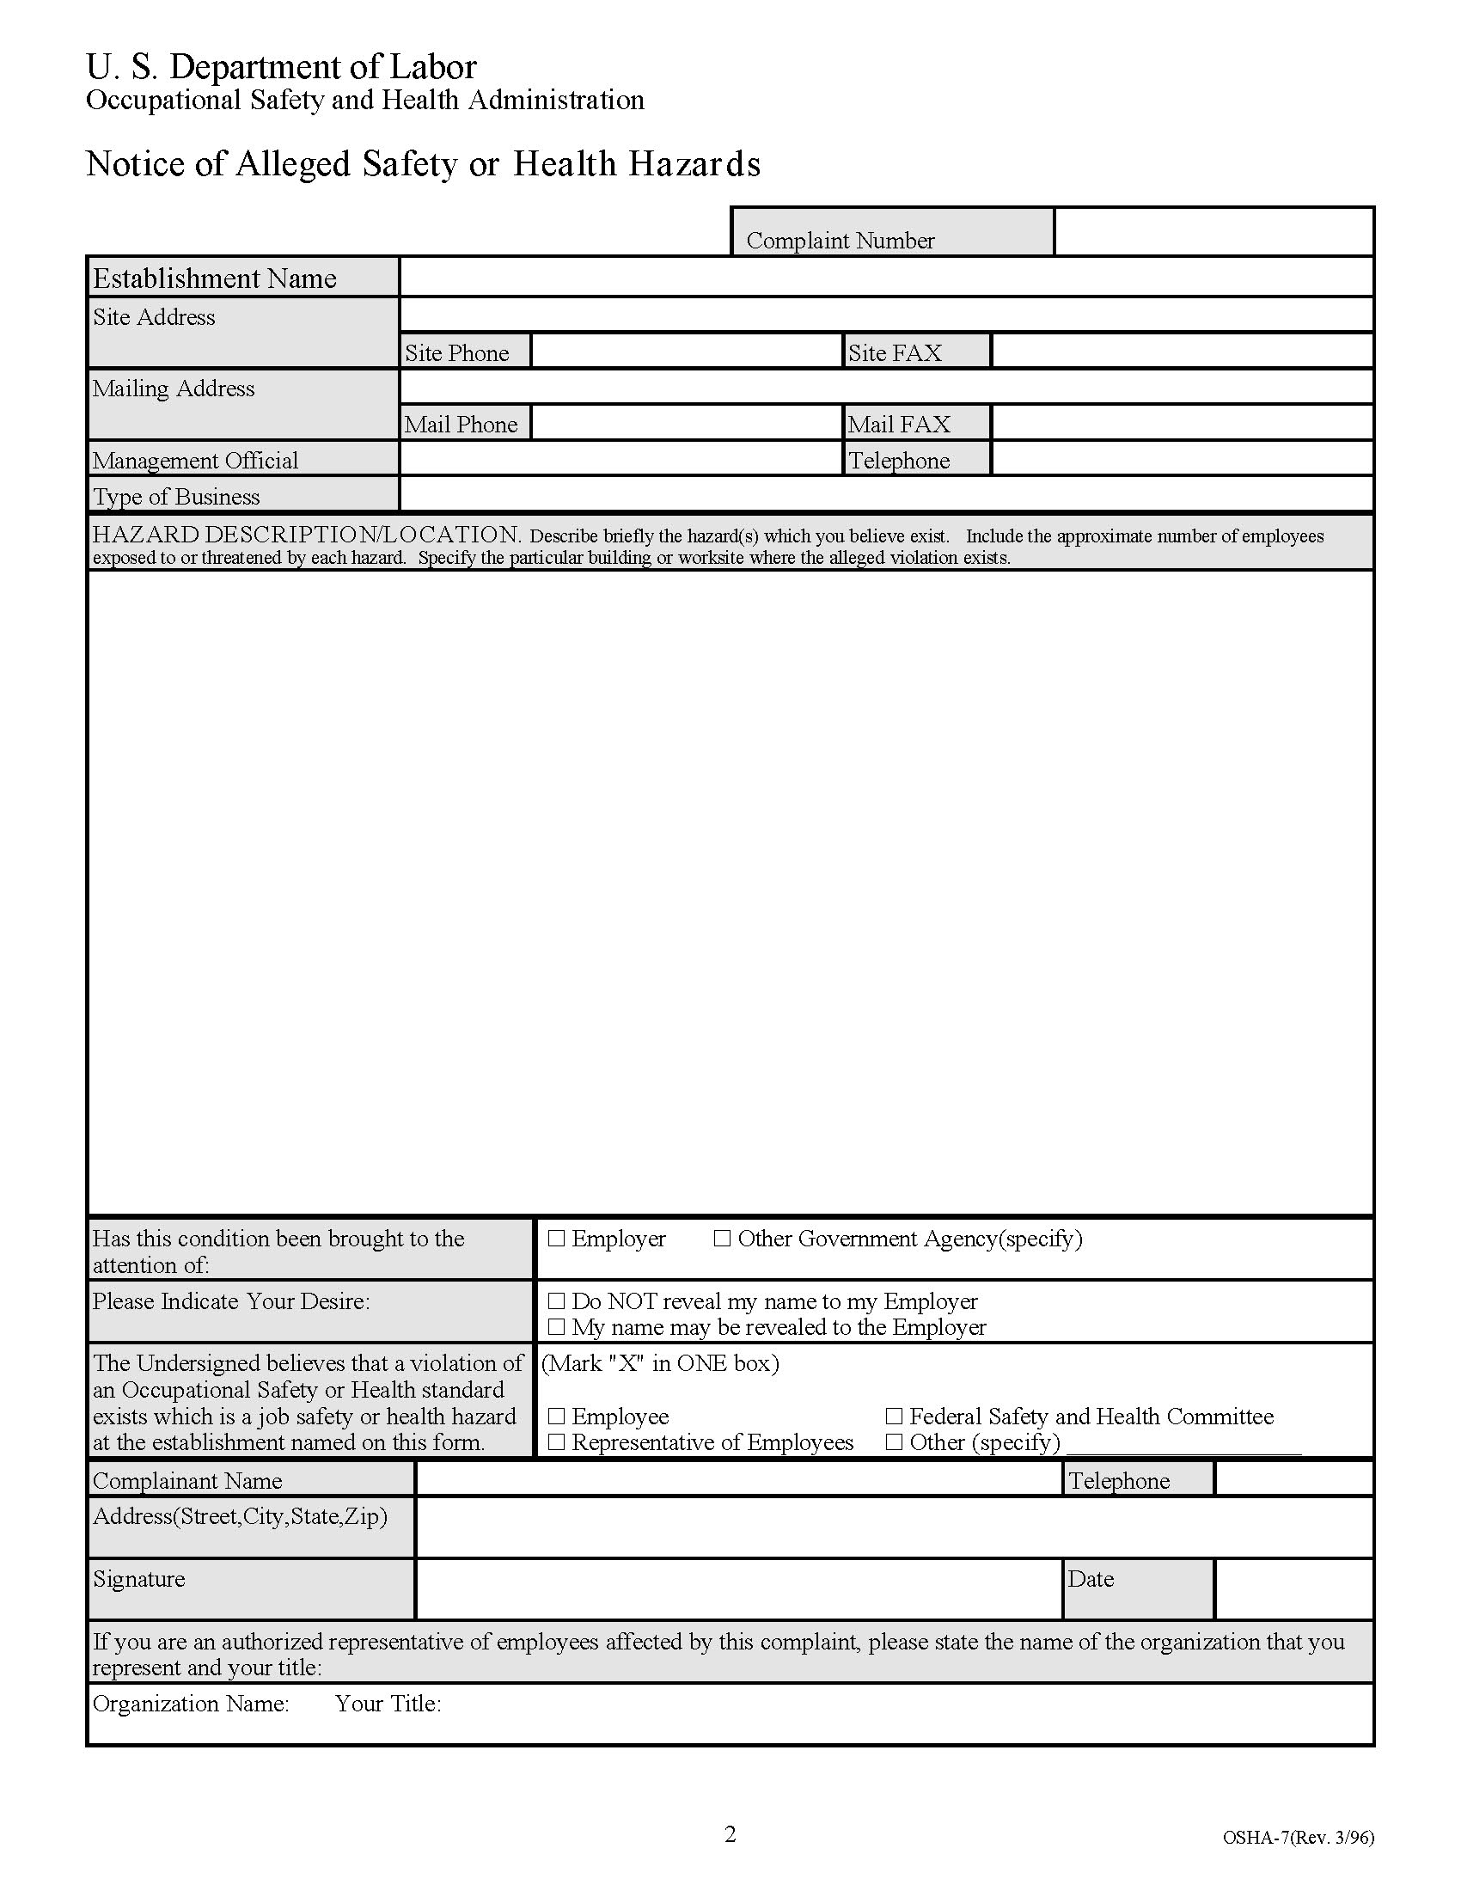
How to file a complaint with OSHA
Complaint Filing Options
You have three options to file your safety and health complaint:
Online
Download and Fax/Mail
Telephone
1-800-321-0SHA
Notes:
Online - Go to the Online Complaint Form Written complaints that are signed by workers or their representative and submitted to an OSHA Area or Regional office are more likely to result in onsite OSHA inspections. Complaints received on line from workers in OSHA-approved state plan states will be forwarded to the appropriate state plan for response.
Download and Fax/Mail - Download the OSHA complaint form* [En Espanol*] (or request a copy from your local OSHA Regional or Area Office), complete it and then fax or mail it back to your local OSHA Regional or Area Office. Written complaints that are signed by a worker or representative and submitted to the closest OSHA Area Office are more likely to result in onsite OSHA inspections. Please include your name, address and telephone number so we can contact you to follow up. This information is confidential.
Telephone - your local OSHA Regional or Area Office. OSHA staff can discuss your complaint and respond to any questions you have. If there is an emergency or the hazard is immediately life-threatening, call your local OSHA Regional or Area Office or 1-800-321-OSHA.

Slide 11
File your Discrimination Complaint
You may file discrimination complaint if your employer has punished you for using any employee rights established under the OSH Act or for refusing to work when faced with an imminent danger of death or serious injury and there is insufficient time for OSHA to inspect.
No form is required, but you must call or file a letter with the OSHA Area Office nearest you within 30 days of the alleged discrimination.
Notes:
Workers have a right to seek safety and health on the job without fear of punishment. That right is spelled out in Section 11(c) of the OSH Act. The law says the employer shall not punish or discriminate against employees for exercising such rights as complaining to the employer, union, OSHA, or any other government agency about job safety and health hazards. Workers are also protected for participation in OSHA inspections, conferences, hearings, and other OSHA-related activities. Workers also have the right to refuse to do a job if they believe in good faith that they are exposed to an imminent danger. "Good faith" means that even if an imminent danger is not found to exist, the worker had reasonable grounds to believe that it did exist. Since the conditions necessary to justify a work refusal are very stringent, refusing work should be an action taken as a last resort. If time permits, the condition should be reported to OSHA or the appropriate government agency.
If you believe you have been punished for exercising your safety and health rights, you must contact OSHA within 30 days.

Slide 12

When Can a Complaint be filed?
OSHA recommends that employees try to resolve safety and health issues first by reporting them to their supervisors, managers or the safety and health committee.
At any time, however, employees can complain to their local OSHA Area or Regional Office and ask for an inspection or an investigation.
Notes:
(Complaints to federal OSHA from workers in states with OSHA-approved state plans will be forwarded to the appropriate state plan for response.)

Slide 13

Who Can Complain?
Employees or their representatives, who for the purposes of filing a complaint, are defined as any of the following:
An authorized representative.
An attorney.
Any other person: clergy, social workers, spouses and other family members, and government officials or nonprofit groups and organizations.
Anyone who knows about a workplace safety or health hazard.
Notes:
Employees or their representatives have a right to request an inspection of a workplace if they believe there is a violation of a safety or health standard, or if there is any danger that threatens physical harm, or if an "imminent danger" exists. Employee representatives, for the purposes of filing a complaint, are defined as any of the following:
An authorized representative of the employee bargaining unit, such as a certified or recognized labor organization.
An attorney acting for an employee.
Any other person acting in a bona fide representative capacity, including, but not limited to, members of the clergy, social workers, spouses and other family members, and government officials or nonprofit groups and organizations acting upon specific complaints and injuries from individuals who are employees.
In addition, anyone who knows about a workplace safety or health hazard may report unsafe conditions to OSHA, and OSHA will investigate the concerns reported.

Slide 14

What Information Must the Employee Provide?
Employees or their representatives must provide enough information for OSHA to determine that a hazard probably exists. Workers do not have to know whether a specific OSHA standard has been violated in order to file a complaint.
Notes:
When filing a complaint, the worker (or his/her representative) must be able to provide OSHA with sufficient, credible information that will enable OSHA to respond.

Slide 15
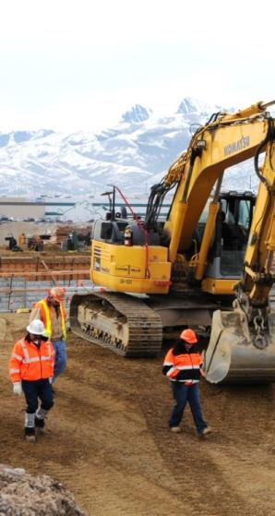
What Information Must the Employee Provide? I
The following are examples of the type of information that would be useful to OSHA when receiving a complaint.
How many employees work at the site and how many are exposed to the hazard?
How and when are workers exposed?
What work is performed in the unsafe or unhealthful area?
What type of equipment is used? Is it in good condition?
Notes:
It is not necessary to have the answers to all these questions in order to file a complaint. The list is provided here as a guide to help you provide as much complete and accurate information as possible.

Slide 16
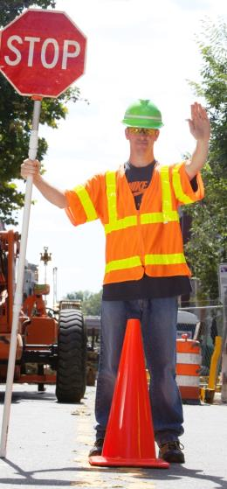
What Information Must the Employee Provide? II
What materials and/or chemicals are used?
Have employees been informed or trained regarding hazardous conditions?
What process and/or operation is involved?
What kinds of work are done nearby?
How often and for how long do employees work at the task that leads to their exposure?
Notes:
The bulleted items above are examples of they type of information OSHA needs to be able to respond to your complaint.

Slide 17

What Information Must the Employee Provide? III
How long (to your knowledge) has the condition existed?
Have any attempts been made to correct the problem?
On what shifts does the hazard exist?
Has anyone been injured or made ill as a result of this problem?
Have there been any "near-miss" incidents?
Notes:
You need not have all the information listed, but enough so your claim is credible.

Slide 18
How Can We Contact OSHA?
Phone: 1-800-321-OSHA
Web: www.osha.gov
Browse: “OSHA 1926” for construction standards

Slide 19

OSHA Rights Activity

Slide 20
Discussion and Questions
“This material was produced under the grant SH-23551-12-60-F-11 from the Occupational Safety and Health Administration, U.S. Department of Labor, and contract 212-2009-M-32109 from the National Institute for Occupational Safety and Health. It does not necessarily reflect the views or policies of the U.S. Department of Labor or U.S. Department of Health and Human Services, respectively, nor does mention of trade names, commercial products, or organizations imply endorsement by the U.S. Government.”
End Module 1

