Slide 1
Preventing Runovers and Backovers
Principles of “Internal Traffic Control” for Roadway Construction
Module 2

Slide 2
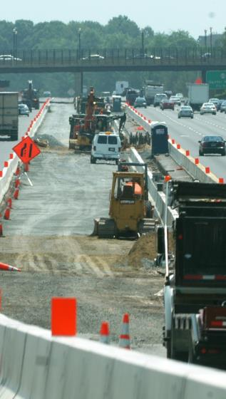
Internal Traffic Control - Overview
An effective Internal Traffic Control Plan (ITCP) informs all workers within the work space about the location of others.
ITCP creates “zones” designed to minimize interaction between workers on foot and construction vehicles.
Notes:
In simple terms, ITCPs are a protocol to inform all parties operating within the work space about the location of others. ITCPs create “zones” designed to minimize interaction between workers on foot and construction vehicles by designating routes and operating procedures for large trucks delivering materials inside the “cone zone.”

Slide 3
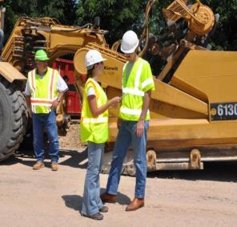
Internal Traffic Control - Overview
An ITC plan designates routes and operating procedures for large trucks delivering materials.
The plan creates a traffic pattern minimizing backing.
ITC facilitates communica- tion among key work zone parties in advance of arrival to the construction site.
Notes:
An effective plan enables communication among all work zone parties in advance of arrival to the construction site, making sure all parties know the location of access points and the proper path for truck and equipment movement, including pickup trucks and other work vehicles.

Slide 4
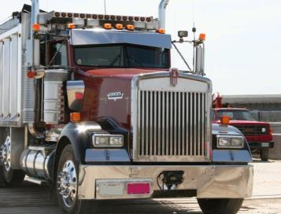
Internal Traffic Control - Overview
  Limits access points to the work zone
  Coordinates truck and equipment movements
  Provides Information on traffic paths and safe/unsafe work areas for workers
  Heightens awareness of workers on foot in relation to vehicle traffic in the work area
Notes:
When construction drivers understand there is an ITC Plan, they will be motivated to take ownership of the program and contribute to its success. The drivers may also provide input if they see a problem if they feel part of the “team.” Drivers rarely receive a “thank you” for their efforts, and expressions of gratitude for safe performance can go a long way towards getting their buy-in and cooperation. Once all parties understand how an ITCP operates, they will better understand instructions and verbal communications used to explain daily plans and changes.

Slide 5
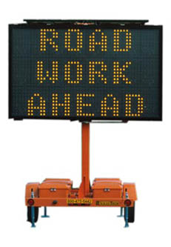

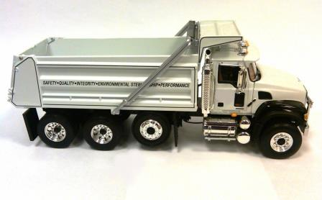
What is the difference between Internal Traffic Control and a Temporary Traffic Control?
Notes:
Those involved in roadway construction are likely familiar with temporary traffic control plans (TTCP) which describe how a specific work zone is to be set up to ensure the safety of the motoring public. Activity in the work space (hatched area) of the TTCP is not addressed in most TTC plans or MUTCD Typical Applications. This is the area where construction workers, equipment and vehicles interact. Internal Traffic Control Plans address this planning gap.

Slide 6
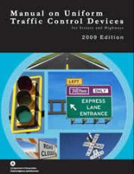
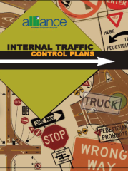
Temporary Traffic Control Plans
Temporary Traffic Control Plans are defined and prescribed in the U.S. Federal Highway Administration’s “Manual on Uniform Traffic Control Devices” or “MUTCD.”
Internal Traffic Control is an industry recommended practice and is not prescribed by law.
Notes:
Temporary Traffic Control Plans (to guide traffic) are REQUIRED by federal regulations. Internal Traffic Control to prevent runovers is an industry BEST PRACTICE.

Slide 7

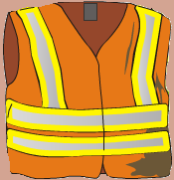

Temporary Traffic Control Plans
Temporary Traffic Control Plans focus on moving traffic safely through a work zone.
Internal Traffic Control Plans focus on keeping workers on foot from being struck by construction equipment and large trucks within the activity area of a work zone.
Notes:
The movement of workers and equipment within the work space should be planned in a manner similar to the way the TTC plan guides road users through a work zone. Whereas Temporary Traffic Control Plans focus on moving traffic safely through a work zone, Internal Traffic Control Plans focus on keeping workers on foot from being struck by construction equipment and large trucks.

Slide 8
Concepts in Common
While TTCPs and ITCPs each have a distinct focus, they carry common themes including:
  Providing clear direction to drivers
  Separating moving vehicles from workers on foot
  Using temporary traffic control devices to mark traffic paths
  Maintaining a smooth traffic flow
Notes:
TTCPs and ITCPs contain common principles, including:
Providing clear direction to drivers
Separating moving vehicles from workers on foot
Using temporary traffic control devices to mark traffic paths, and
Maintaining a smooth traffic flow

Slide 9
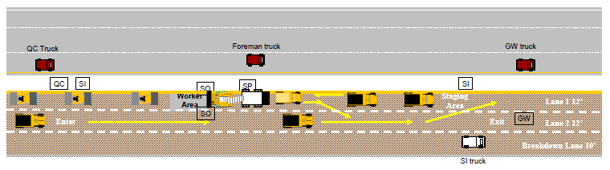
Part 2: Why Internal
Traffic Control?

Slide 10

ITCPs Protect Workers on Foot
Workers on foot or “pedestrian workers” are those employees who perform most of their duties outside vehicles and equipment. They are particularly vulnerable to being struck by equipment. Every person on the site has the responsibility to be vigilant and work safely.
Notes:
Workers on foot – or pedestrian workers - ground workers – are those employees who perform their tasks outside construction equipment and other vehicles. They are exposed to the hazards of being struck by motorists and construction vehicles. While there are many terms used to describe such workers, in this course we will refer to them as “workers on foot.”

Slide 11

Two “Struck-By” Hazards
Workers Killed by Motorists
Workers Killed by Construction Trucks and Equipment
MORE WORKERS ARE KILLED BY CONSTRUCTION
VEHICLES THAN BY MOTORISTS

Slide 12
Runovers/Backovers are the Primary Cause of Roadway Worker Deaths
Source: U.S. Bureau of Labor Statistics
Notes:
On average, 50-60 workers are killed in struck-by incidents on roadway construction sites. Greater industry and public education needs to be focused on eliminating distractions, such as cell phone use, which can contribute to these deaths and injuries to reduce incidents caused by motorists. ITCPs can protect against accidents caused by construction vehicles. See article on worker fatalities by Stephen Pegula contained in the Instructor Background Materials.

Slide 13
More Workers are Killed by Construction Equipment than Motorists
Source: Bureau of Labor Statistics/ Stephen Pegula
Notes:
More workers are killed by construction-related vehicles or equipment (38 percent) than by cars, tractor-trailer trucks, and vans (33 percent). Coordination of workers and equipment doing different activities in close proximity can improve work flow and reduce conflicts between workers on foot and equipment operators. (See state –by-state statistics in instructor materials.)

Slide 14
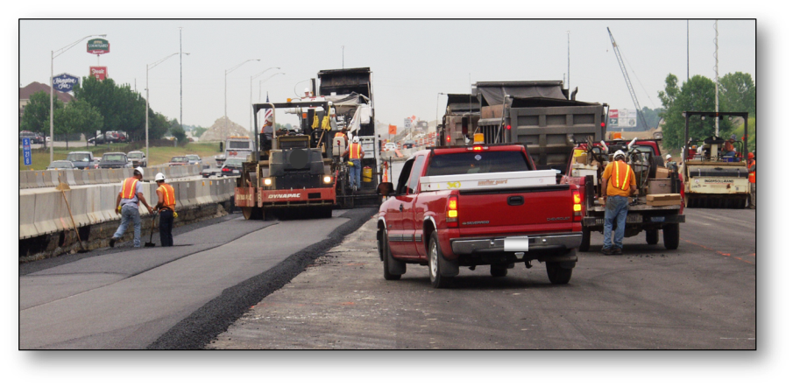
Construction Vehicles are the Greatest Hazard
Notes:
Compliance with the MUTCD and OSHA regulations is a necessary first step in providing a safe work environment. However, these sources, taken together, do not provide comprehensive guidance to ensure worker safety in roadway work zones. The interaction between workers on foot and construction trucks and equipment is the single biggest hazard in the heavy and highway industry. There are several exposures workers should be aware of to enable them to protect themselves against work zone hazards.

Slide 15
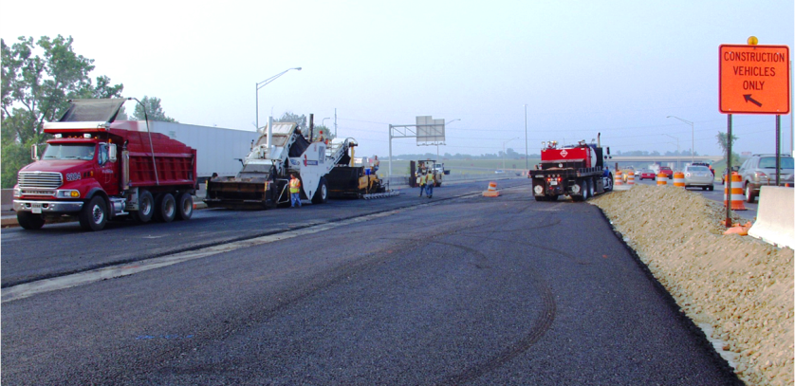
Vehicles Frequently Enter and Exit
Notes:
The constant movement of vehicles in and out of the work area can create hazards if the travel paths are not set and coordinated. ITCPs can also be used to communicate the need to keep entry and exit points free of parked vehicles and equipment. Note the tire marks on the pavement indicating vehicles are turning around in the work area. Ideally, ITCPs minimize backing and turning. Start each day with a risk assessment discussion with workers and subcontractors (including employees).

Slide 16
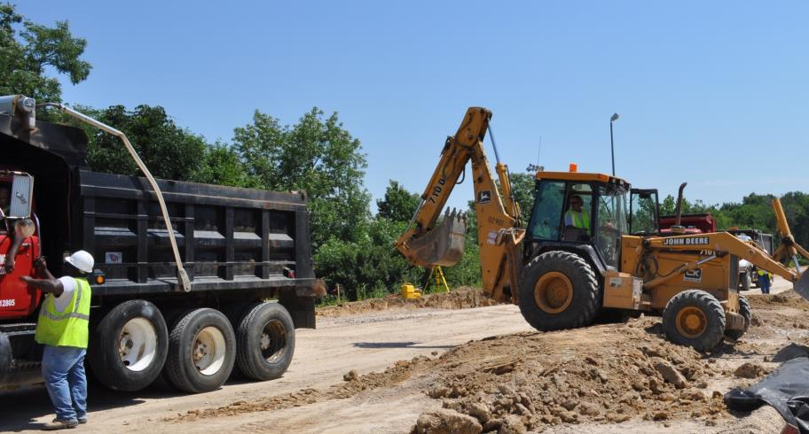
Workers on Foot Labor in Close Proximity to Large Vehicles
Notes:
Note the size of workers on foot in relation to the size of the construction equipment and vehicles. Because workers are relatively short compared to construction vehicles, it can be difficult or impossible to see them, especially in areas known as “blind spots.”

Slide 17
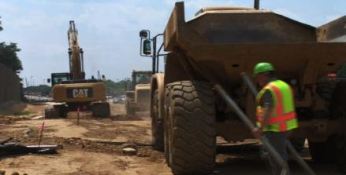
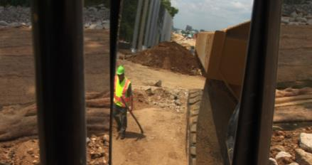
Blind Spots
Blind Spots are the locations around equipment and vehicles where workers on foot are invisible to the operator through his windows and mirrors.
Behind the Vehicle
Outside Mirror Range
Notes:
A blind spot (or blind area) is the area around a vehicle or piece of construction equipment that is not visible to the operator, either by direct line-of-sight or indirectly by use of internal and external mirrors. Blind areas can be reduced by properly setting mirrors on equipment in a “mirror check station.”

Slide 18
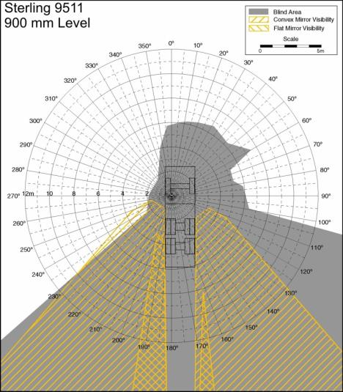
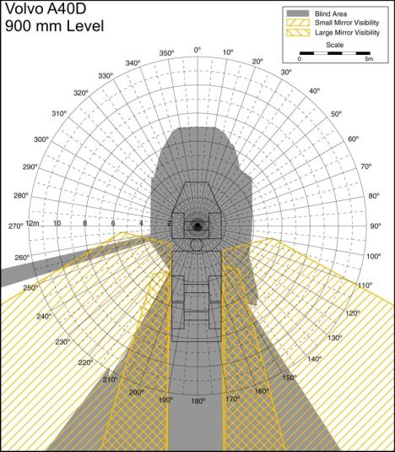
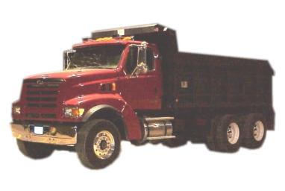

Be Familiar with Your
Vehicle's Blind Spots
Notes:
Each vehicle has its own, unique blind spots. Operators should be familiar with the blind spots surrounding each piece of equipment he or she operates and should be sensitive to the fact workers and other objects cannot be seen – even when using mirrors.

Slide 19
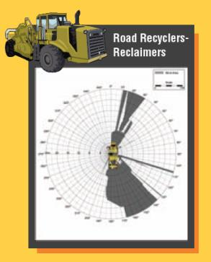
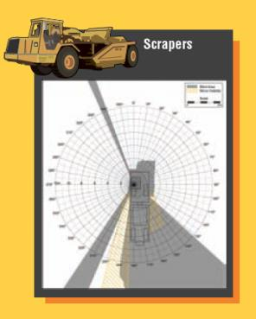
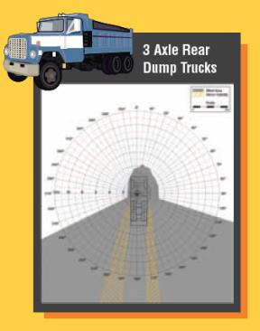
Blind Spots
Each type and make of vehicle has its unique blind spots.
Notes:
Note the gray areas in the diagrams indicating the various shapes and sizes of blind spots for different vehicles. The yellow hatched lines show areas visible using the mirrors. More examples can be found at: http://www.cdc.gov/niosh/topics/highwayworkzones/BAD/imagelookup.html. See also Blind Spot poster from the National Work Zone Safety Information Clearinghouse. These posters are available for free from the Clearinghouse and would make a good handout for this section. You can create maps like these--and appreciation for the blind areas for your vehicles--by having workers on foot take turns sitting in the cab and viewing their surroundings. Have another worker walk around the vehicle so the person in the cab can identify the blind spots.

Slide 20
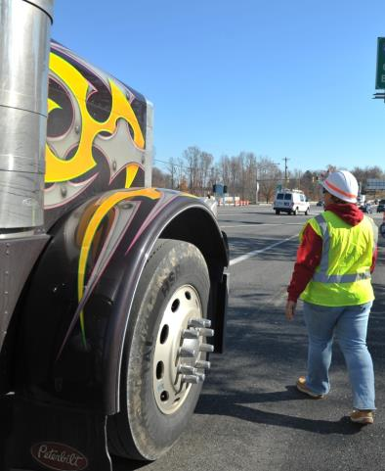
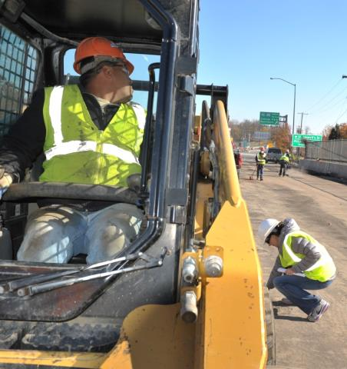
Workers Are Vulnerable in Blind Spots
Notes:
As a worker on foot, if you can’t see the driver and the driver can’t see you, you’re in a dangerous situation. Companies and projects should identify a specific side of the vehicle where a worker should walk for each operation. Consistency is important for safety.

Slide 21
Discussion and Questions
End Module Two
“This material was produced under the grant SH-23551-12-60-F-11 from the Occupational Safety and Health Administration, U.S. Department of Labor, and contract 212-2009-M-32109 from the National Institute for Occupational Safety and Health. It does not necessarily reflect the views or policies of the U.S. Department of Labor or U.S. Department of Health and Human Services, respectively, nor does mention of trade names, commercial products, or organizations imply endorsement by the U.S. Government.”

