Slide 1
Preventing Runovers and Backovers
Safety for Workers on Foot
Module 3

Slide 2
Workers on Foot
Safe Practices

Slide 3
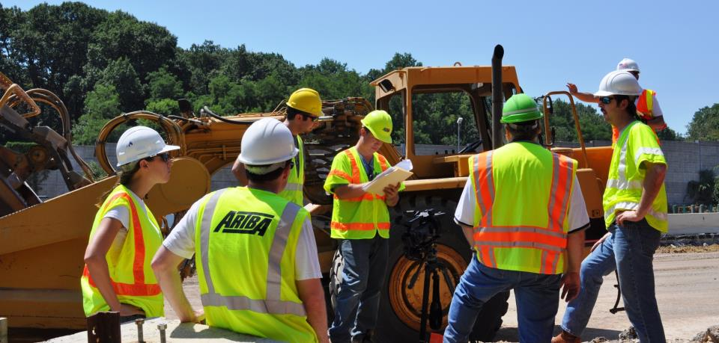
Communicate Safety
Plan with Workers
Notes:
Workers, operators and other drivers navigating the work space need to know planned routes and locations for equipment and delivery vehicles before they arrive on the site. This will require development and communication of the ITCP. Fundamental information about the ITCP should be provided to key personnel on the project, including inspectors, subcontractors and vendors. This could be done with paper copies, radio communications, or even using a phone or other mobile device. The ITCP should be updated daily at safety meetings. Subcontractors should be required to attend ITCP briefings. During the project, the ITCP should be consulted when reviewing construction progress and adapting to the daily changes that are routine will all projects. During construction, the safety officer, site supervisors and foremen should update and review the ITCP with workers daily. The plan is useful in showing the project owner and personnel that worker safety is being addressed. The primary objective of these efforts is to inform workers of the hazards present to they can stay clear of danger.

Slide 4
Worker Habits and Behavior
Consider worker behavior when developing the ITCP. Determine locations where workers are likely to go and ensure safe routes to get there.
Outdoor John
WATER
Notes:
The organization of the work space can and does impact worker behavior. Workers are more likely to take risks such as entering the traffic space if circumstance entice or compel them to do so. When creating your safety/ITCP plan, consider the location of rest areas, water stations, parking, etc. To the extent feasible, these should be located to minimize workers crossing traffic or construction vehicle pathways. For example, where are workers likely to stand or congregate? On hot days, is there shade nearby? Where are the latrines? Where might workers stand when cold? If raining? If workers are likely to walk to a location, is there a safe route for them to get there? A good ITCP will include such considerations.

Slide 5
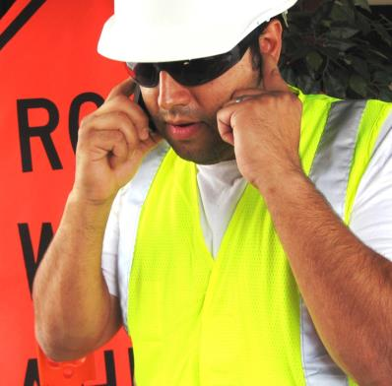
Worker Habits and Behavior
Consider common phone behavior:
  Plugging the ear away from the phone
  Looking to the ground so one can concentrate
  Trying to block out busy, noisy environment
What hazards are created?
Notes:
Radio and cell phone use occurs with increasing frequency. Can workers use phones on the job? How does the foreman communicate with all the other parties? When talking on the phone, people frequently plug the ear away from the phone and look to the ground so they can concentrate on the call in a busy, noisy environment. When they do so, they will not see dangers or hear alarms. How might the ITCP control for this behavior? Can a place(s) be designated to making and receiving calls? Human factors play an important role in ITCP development and should be considered carefully.

Slide 6
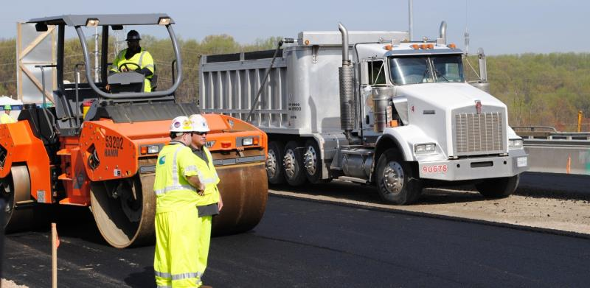
Workers Must Be Visible
Workers must be visible with regards to their location around equipment . . .
Notes:
Construction equipment is typically large and has an enclosed cab. These characteristics can make the blind areas very large and difficult for the operator to see. Also, the size of construction vehicles and equipment often place truck drivers and equipment operators high above the ground. They cannot see workers on foot crossing close in front of them. There is an ANSI standard that addresses issues of worker visibility in roadway work zones. ANSI A10.47 standard, “Work Zone Safety for Highway Construction.” is a worker safety standard specifically defining roadway construction terminology and best practices in the following areas: Traffic Control, Flagger Safety, Runover/Backover Prevention, Equipment Operator Safety, Excavation, Electrical and Power Tool Safety, Fall Prevention, Materials Handling, Health Hazards, Night Work, and Personal Protective Equipment.

Slide 7
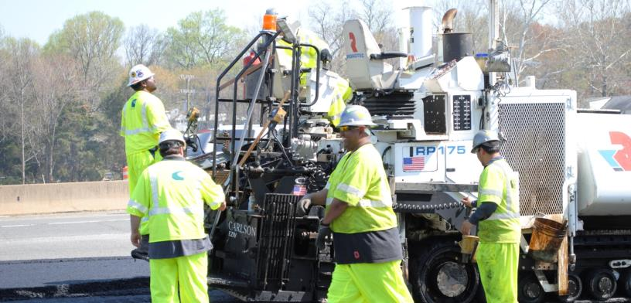
Workers Must Be Visible
Workers must be visible with regards to their high visibility clothing. . .
Notes:
Workers must be clearly visible to drivers and operators. High visibility garments are now required by both FHWA and OSHA for all workers, not just those exposed to motorists/on-road traffic. These agencies require workers to be dressed in a minimum ANSI Class II vest. The make-up of these vests is explained in a standard known as the ANSI/ISEA 107 "American National Standard for High-Visibility Apparel.“ The standard also recommends high visibility hard hats for workers to improve worker visibility.

Slide 8
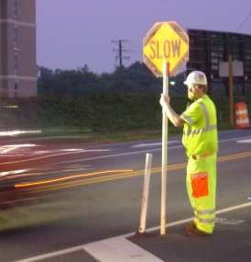
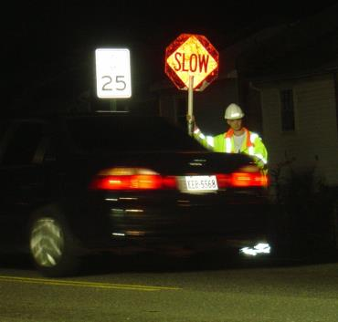
Workers Must Be Visible
Workers must be visible in a variety of conditions, especially during night work.
Notes:
During night time hours, inclement weather and other low-light conditions, ANSI/ISEA Class III garments are highly recommended.

Slide 9
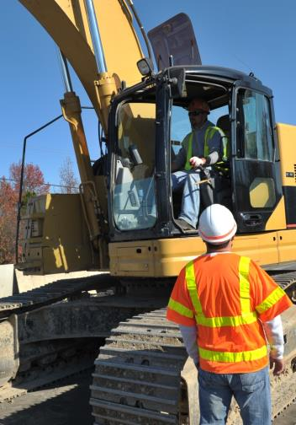
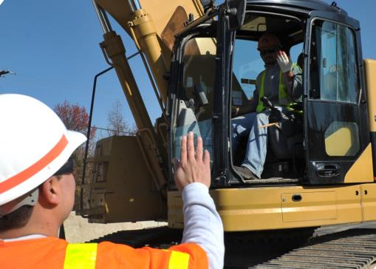
Operators Must Confirm Before Workers Approach Equipment
Wait for a clear signal from the operator before approaching equipment.
Notes:
It is difficult for workers to tell if the operator is looking at them or someone or something directly behind or in front of them. The worker may think the operator is looking at him or her and it is safe to approach when in fact the operator is focused on something else. Before approaching a vehicle, wait for a clear signal from the operator that you have permission to do so.

Slide 10

Class Activity
If you think the instructor is looking at you, raise your hand.
Notes:
Class activity. If class is not already arranged in rows, have a group of students sit in a row, one behind another (about 10 feet from the instructor). Stare at one of the students and ask them to raise their hand if they think you are looking at them. Generally, several will raise their hands. Use this activity to illustrate the point that just because it appears as if the operator is looking at them, he or she may in reality be focused on something else.

Slide 11
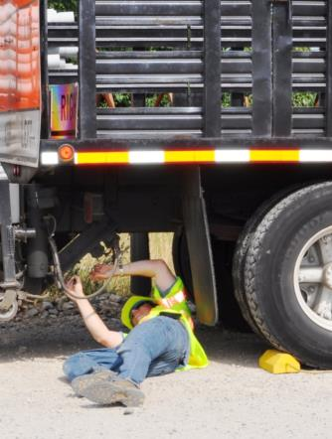
High Risk Operations
Certain Operations Create High Risks
When the “ordinary” changes, incidents are more likely to occur
Trucks back more frequently
Workers on foot are closer to equipment
More equipment or vehicles are on-site, moving
Repairs bring more people and equipment near moving equipment
Notes:
The majority of construction activities are regular and relatively safe. Operations become more risky when the ordinary has changed, such as when there is a change in the operational process, the asphalt plant breaks down, the operation is in tight quarters (i.e. aprons, bridges, drainage areas), and even mobilizing to begin a new lift of asphalt. All these operations cause modifications to the normal plan.

Slide 12
Mitigating Risk
Minimize movement of vehicles when workers on foot are performing change-over, repair or other tasks
Do not sacrifice safety procedures during such times.
Notes:
Simple things, like holding trucks in place while workers finish setting up the equipment, help save lives and do not reduce overall productivity. Such precautions ensure everyone is out of the way and focused when equipment begins to move.

Slide 13

High Risk Operations
Change from the “Routine” Increases Risk
Notes:
It can’t be overstated . . . Any change from the routine creates risk. When something out of the ordinary takes place, be on guard.

Slide 14
Drivers and Operators
Safe Practices

Slide 15
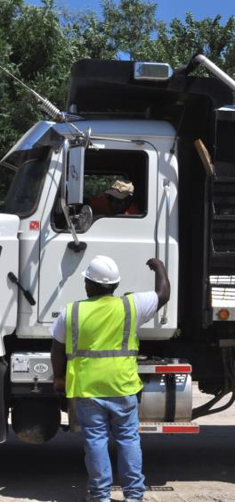
Backing Safety
There are several key principles to safe backing in work zones:
Backing should be controlled, used only when necessary and under specified conditions;
There should be clear communication between the operator and workers on foot before backing begins;
Everyone should understand the blind areas around the equipment on site.
Notes:
“Backing” is one of the most dangerous situations in which workers on foot are vulnerable, especially if the equipment is a large dump truck. There are several key principles to safe backing in work zones:
*Backing should be a controlled operation, used only when necessary and then under specified conditions
*The work area should be organized to minimize backing;
*There should be clear communication between the operator and workers on foot before backing begins;
*Operators and workers should understand the blind areas around the equipment on site.

Slide 16
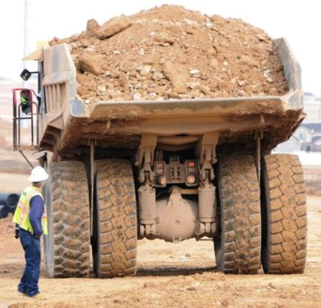
Backing Safety
Remember/Review:
Avoid backing up unless necessary
Walk around vehicle to check for hazards
Be aware of blind areas
Use a spotter when- ever possible
Notes:
*Operators and drivers must walk around their vehicle to check for hazards
*Operators, drivers and workers on foot should be aware of blind areas
*Operators and drivers should use a spotter whenever possible when backing or maneuvering near workers on foot or other hazardous conditions. (This would not apply if no workers on foot or other vehicles are in the area.)

Slide 17
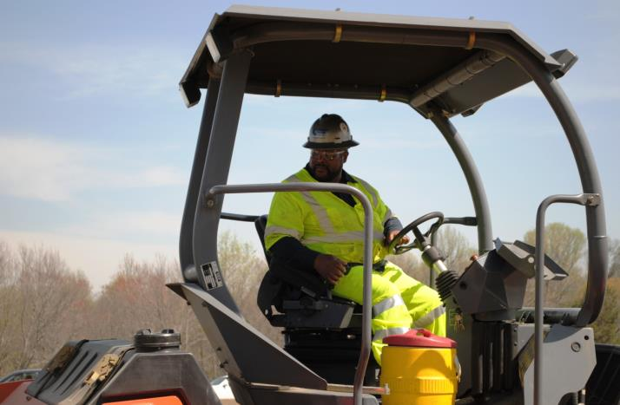
Know Your Surroundings
Notes:
The operator needs to be fully aware of his or her surroundings. This includes objects at ground level, other vehicles and workers on foot. An important practice is to communicate site conditions and safety practices with truck drivers before they enter the work space, and then continuously during operations. Keep them informed about the site safety plan and changing conditions.

Slide 18
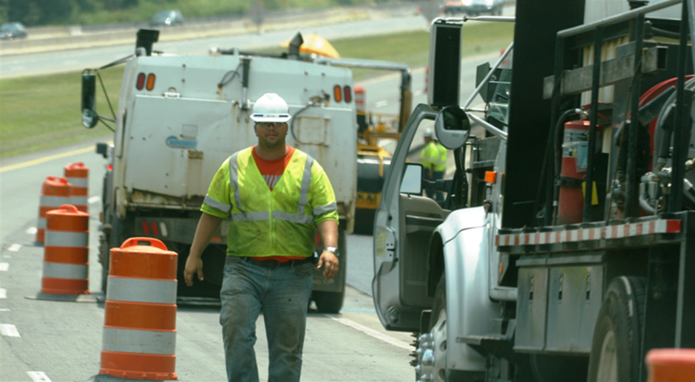
Walk Around Vehicle Before Backing
Notes:
Before moving vehicles or equipment, the operator should walk around it to ensure no person or obstacle is in the blind areas. An alternative plan is for the operator to use a spotter.

Slide 19
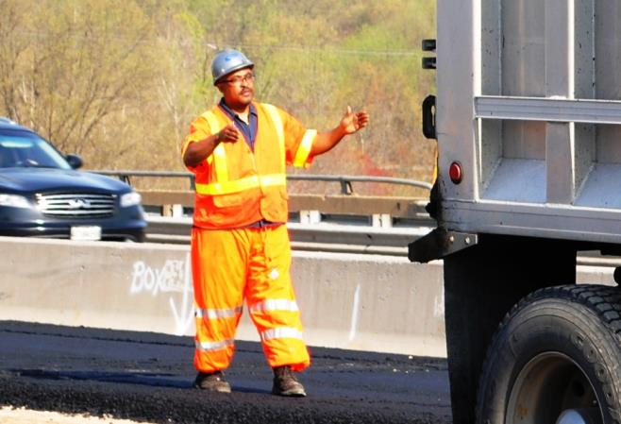
Designate a Spotter
Notes:
Trained spotters are essential in work areas where there are numerous workers on foot nearby, many vehicles operating in a confined area, or obstacles that may not be visible to the driver. A member of the crew should be designated to carry out this duty when needed.

Slide 20
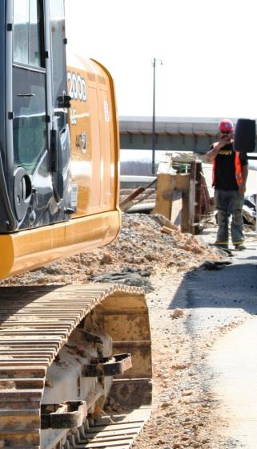
Spotters
Spotters are recommended by ANSI and other agencies;
Required in some states when camera/radar systems not used ;
Spotters are in danger from vehicles – who spots the spotter?
Spotters help when you must work with back to equipment or traffic;
If visual contact is lost with the spotter, stop immediately.
Notes:
Spotters are recommended by ANSI and other agencies. They are required by some states when camera/radar systems not used, including Virginia and Washington State. A spotter can be designated from the on-site crew, but should be trained in proper signaling and self-positioning. If multiple people are near the spotter, or more than one person tries to give the driver directions, it will be confusing. Designate ONE spotter and have other workers remain clear of him or her. A good practice is to conduct a morning risk assessment of the day’s operations to determine if a spotter should be designated.

Slide 21
Activity
Practice Spotting Signals

Slide 22
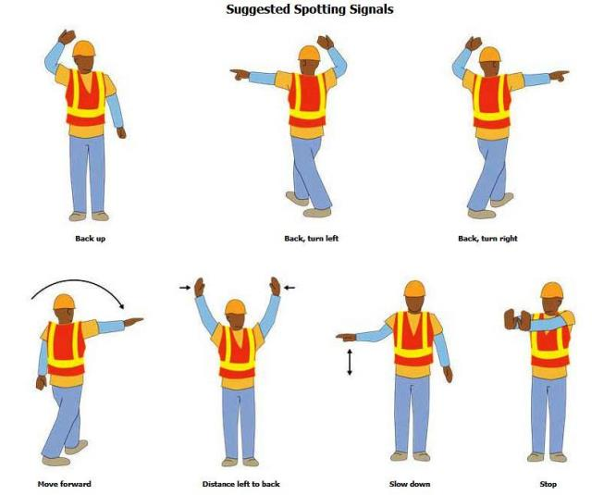
Recommended Signals

Slide 23
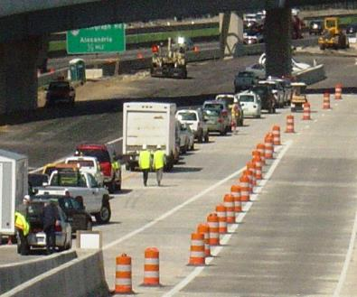
Vehicle Pathways
A key element of the Internal Traffic Control Plan is to develop a route plan vehicles will follow when entering, exiting, and traveling through the work space.
The route may be marked with temporary traffic control devices.
The plan must be communicated.
Notes:
A critical step in developing an ITCP is plotting where pedestrians will normally be located, the types of equipment in the work area, and the path for each piece of equipment. The paths for truck and construction vehicle movement should be planned in conformance with the principles of safe construction traffic control. Long backing maneuvers for dump trucks should be avoided and points of access and egress of trucks moving within the work space should be controlled. TTCDs may be used inside the work space to separate areas designated for workers and routes for construction vehicles and equipment. When creating vehicle pathways, the primary concerns are ensuring the drivers/operators know where they should- and should not go and ensuring workers know the areas to avoid. Route planning occurs before vehicles arrive on site. Workers on foot should be located as far as possible from vehicle paths. Parking, toilet, and break areas should be staged away from the principal conflict points involved with the paving rollers and dump trucks.

Slide 24
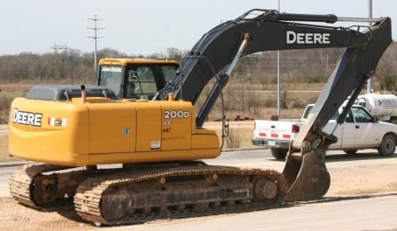
Worker Free & Equipment Free Zones
Worker Free Zones are locations from which workers on foot must stay clear, including:
  Blind areas around equipment
  Equipment travel lanes and queue areas in paving trains
  Moving equipment, including swing radius, pinch points and moving parts
  Other hazardous areas, i.e. near power lines
Notes:
In some instances, workers must enter “worker free zones” to perform their duties. This might include those performing quality control and density measurement for asphalt, as the worker free zone would include the roller area. In this instance there must be clear and constant communication between the QA technician and the roller operators as to where the QA tech will stand during roller passes.

Slide 25
Worker Free & Equipment Free Zones
Worker Area
Breakdown Lane
Exit
Paver
Staging
Area
Lane 1
Enter
Lane 2
= Worker-Free Zone
Notes:
Based on your current knowledge of work zone hazards, what areas would you identify as “worker free zones” – or areas where workers on foot would be in danger of being struck by a vehicle? (After Click) The red area is a sample solution to the location of worker free zones. You will notice the active traffic lane, delivery access and egress points, and the activity area surrounding the rollers are marked.

Slide 26
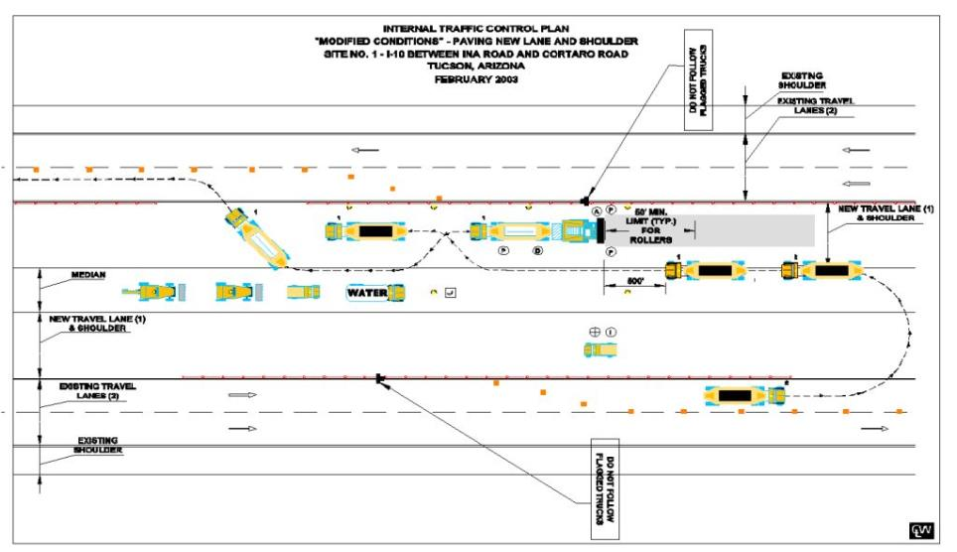
Sample ITCP (Equipment Path)
Notes:
The key principles for creating vehicle pathways are 1) Planning routes in advance; 2) Communicating the routes to site personnel and delivery drivers; 3) Delineating worker-free zones and equipment-free zones so all workers and operators know where they are expected to be. This is a sample of a plan for delivering asphalt to a paving operation. It shows how delivery trucks will enter the work space, queue for delivery, back-up to a paver, empty their load, then exit. While this is an example of a detailed “model” plan, the same can be accomplished with hand-drawn diagrams. More detailed information on creating ITCPs will be presented later in the course.

Slide 27
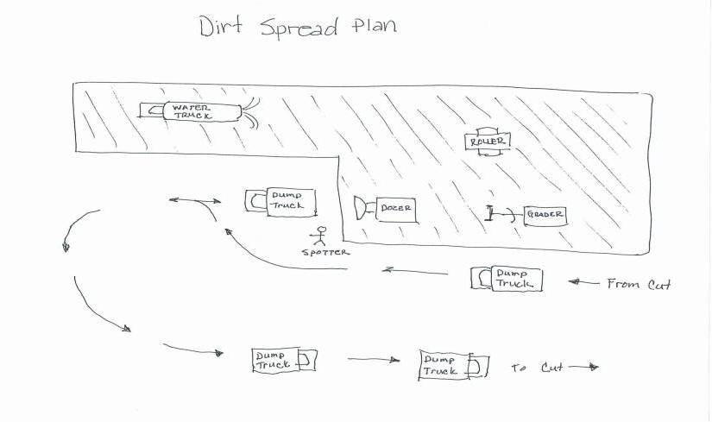
Sample ITCP (Equipment Path)
Notes:
ITC plans can be detailed, such as the CAD (computer aided design) drawing on the previous slide, or as uncomplicated as a hand drawing seen here. The only purpose is to communicate equipment paths and worker zones. In this dirt spread operation, the simple drawing demonstrates how dump truck access points are limited. Backing operations are controlled by the spotter and dirt spreaders.

Slide 28

Case Study:
Concrete Paving Operation
Turn-around
Staging Area
Minnesota Face Program (MN9207)
Not to Scale
Notes:
ITCP plans are used to identify potential problems in the work process. This is a fatality case analysis where a properly designated ITC plan could have prevented the fatality. Setting: the grey areas represent a divided highway being paved with concrete. The loaded trucks delivering concrete arrive at the site from the left and queue ahead of the approaching paver. As a truck empties it’s load, it leaves the site by pulling forward and to its left, passing the line of trucks waiting for their turn to pull forward, do a K turn and back to the paver. With six trucks waiting in line, the paver passed the turn-around spot and the trucks needed to move back. A worker was asked to instruct the drivers to back-up, so he went to the last truck and told the driver to back-up. (Note, the way vehicles are staged (lined-up, queued, etc.) may vary from area to area. The important think to note is the concept of keeping workers on foot away from moving vehicles; and to communicate with drivers so they know where to look for workers.)

Slide 29

Case Study:
Concrete Paving Operation
Turn-around
Staging Area
New Truck
Last Truck
Not to Scale
Minnesota Face Program (MN9207)
Notes:
As the last truck began to back, a new truck arrived at the site and was pulling up to the truck queue. The driver of the last truck, seeing the new truck, began to turn to right as he backed. Meanwhile, the worker, who had also seen the arriving truck walked toward the new truck and was backed over by the last truck. How could this operation have been planned to prevent this death? Possible Answer: If the line of trucks had been held to the left of the next turn-around-spot and waited until they were needed to approach the crew, there would have been no need to back the whole line of trucks. Turn around areas will change constantly. Site personnel need to communicate with the drivers the point at which the turn around area will change.

Slide 30
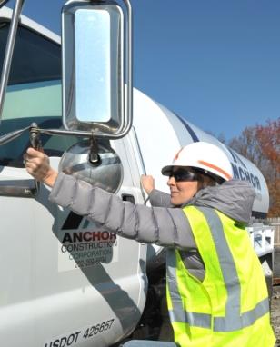
Vehicles Entering the Work Space
Plan locations and procedures for assigned workers to approach vehicles (such as taking load tickets and communicating delivery locations and procedures).
Notes:
Delivery vehicles should be made aware of the procedures that will be employed when workers approach them to receive information or provide instruction. This notification will alert drivers where to anticipate seeing workers on foot.

Slide 31
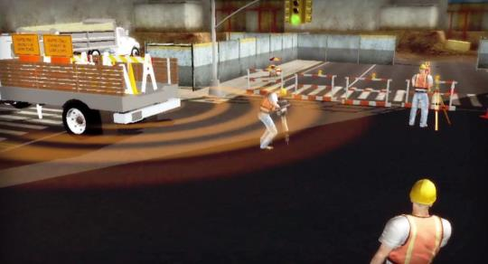
Can Technology Help?
There are a variety of technologies—old and new—that have been developed to warn drivers and operators when workers on foot are near, including:
Alarms
Cameras
Radar
Sonar
Tag Systems
Notes:
In most work zone situations, there are technological solutions that can alert drivers and operators to the presence of workers on foot. These technologies include alarms, cameras, radar, sonar, and tag systems. Each of these technologies have unique deployment challenges, ranging from dirty lenses to high cost. As this equipment grows in use and experience, many of these challenges are being overcome. (For an in-depth presentation on technology solutions, the instructor may elect to show Module Seven, which goes into greater detail.)

Slide 32
Discussion and Questions
End Module Three
“This material was produced under the grant SH-23551-12-60-F-11 from the Occupational Safety and Health Administration, U.S. Department of Labor, and contract 212-2009-M-32109 from the National Institute for Occupational Safety and Health. It does not necessarily reflect the views or policies of the U.S. Department of Labor or U.S. Department of Health and Human Services, respectively, nor does mention of trade names, commercial products, or organizations imply endorsement by the U.S. Government.”

