Slide 1
Preventing Runovers and Backovers
Construction Vehicle Access and Egress
Module 4
Notes:
This module focuses on how ITCP planning can improve safety at vehicle entry and exit points. It explains how access/egress locations provide transitions between TTC plans and ITC plans.

Slide 2
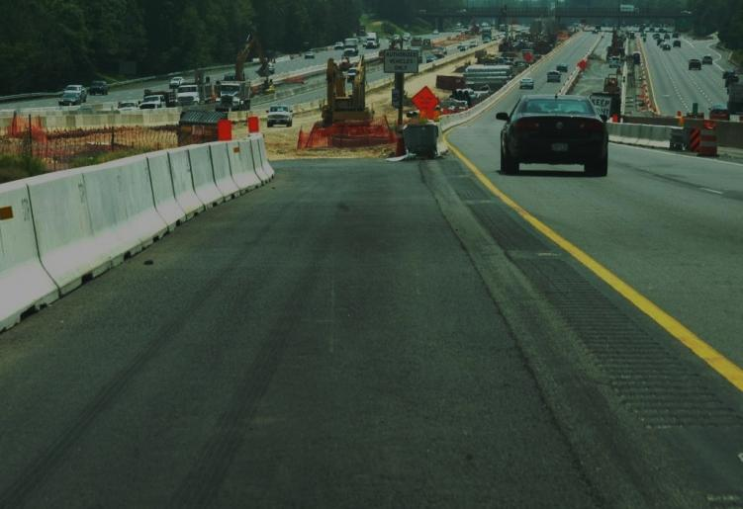
Why is Access and Egress Control Important?
Access to- and egress from work zones presents significant challenges. Hazards are compounded when the roadway carries high traffic volumes or operates at high traffic speeds. Safety challenges include:
Motorists following construction vehicles into the work space;
Acceleration and deceleration of construction vehicles as they exit and enter open traffic lanes;
Proximity of workers on foot to access and egress locations.
Notes:
Why is access and egress control important? (Discuss this question.)
The establishment and maintenance of safe access and egress points are key determinants of project safety. In order for roadway construction jobs to maintain safe operations, there must be procedures to allow for safe and efficient passage of work vehicles into and out of the work space and for motorists to travel through the work zone. Effectively addressing safe access and egress at the project level requires planning during the project development phase and implementing traffic control plans throughout the entire project.

Slide 3
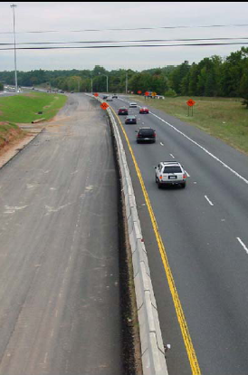
Primary Challenge
Getting materials and equipment into the work zone safely and efficiently.
Notes:
The primary challenge with regards to work zone access and egress is getting materials in and out of the work space. Of necessity, this involves acceleration and deceleration of large, heavy trucks and equipment hauling the materials. These construction vehicles must leave and enter the traffic space, where motorists often drive at high speeds, and transition to the work space, filled with slow moving equipment and workers on foot.

Slide 4
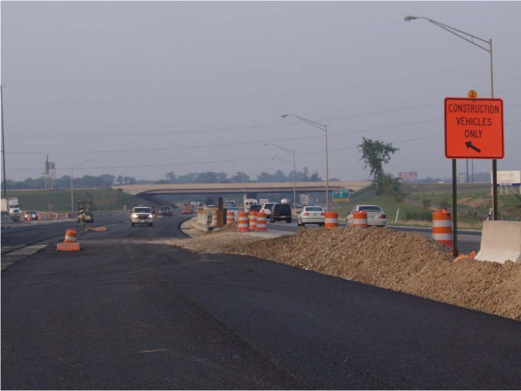
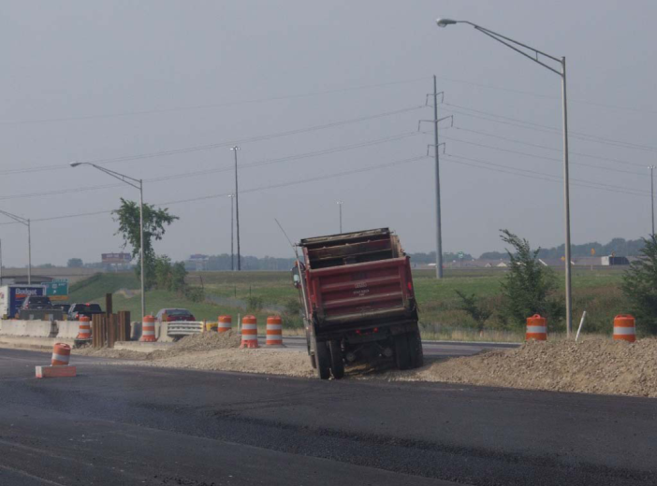
Access and Egress Challenges
Notes:
Note the entrance to the work area is provided via an earthen ramp between the work area and travel lanes. The truck must enter from and exit to the high speed left travel lane without much acceleration or deceleration space.

Slide 5
Access and Egress Challenges
Acceleration / Deceleration Lanes
Short or Non-existent
Signage Indicating Merge / Exit Points
Signs give vague information
Messages left up 24 / 7
Flagging Operations
Works best with low traffic and moderate trucks
Low trucks = intermittent flagging
Proper rules are forgotten
Night Work
Poor sight distance, impaired drivers, others?
Notes:
(Have class discuss how the identified operations are compounded or made more complicated by having large vehicles entering and exiting the work space.) In some situations it may be necessary to have a flagger assist construction vehicles in entering and exiting the work space by slowing traffic and preventing motorists from entering the work space by accident.

Slide 6
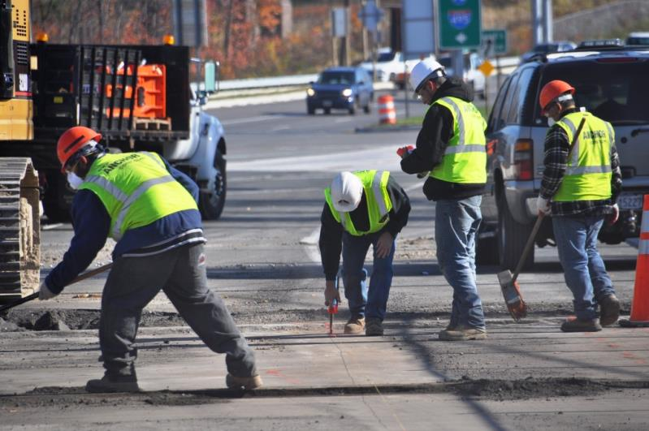
ITCPs Coordinate Tasks
Parked employee
vehicles.
Delivery access
and egress point.
Moving construction
Equipment.
Workers
on Foot.
Notes:
The work area can be complex with delivery trucks entering and exiting the work space near workers on foot and other operating/moving equipment. The ITCP should coordinate these activities so all know what the other is doing and each stays out of the path of the other. In this slide, the employee vehicle and worker on foot would be in direct path of a vehicle entering the work area. A risk analysis would identify the location of the parked vehicle as a hazard; a different parking site should be identified. Employer should train employees on where to and where not to park on site. Employers should also train on particularly hazardous areas like access and egress points.

Slide 7
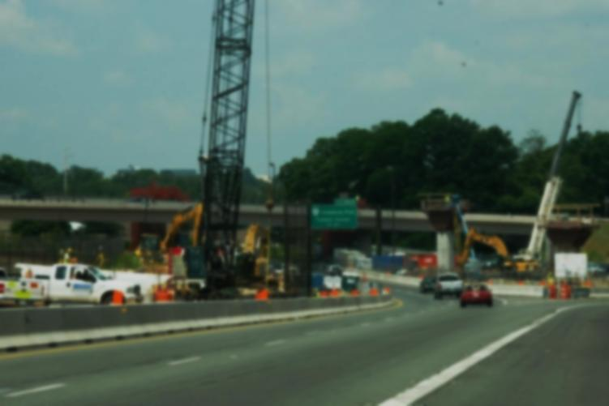
How does this apply to ITCPs?
Access and egress challenges can be addressed by an ITCP in the following ways:
Isolating workers on foot from trucks and equipment;
Limiting/controlling vehicle access points;
Coordinating truck and equipment movements;
Providing guidance to workers on foot, truck drivers, and equipment operators.
Designating locations for parked vehicles and equipment
Raising awareness about vehicle intrusions with workers and operators/drivers
Notes:
Workers, operators and drivers inside the workspace should be aware and vigilant when working near access and egress points. Drivers entering the work space likewise need to be very attentive when doing so as this is a high-hazard area for all workers.

Slide 8
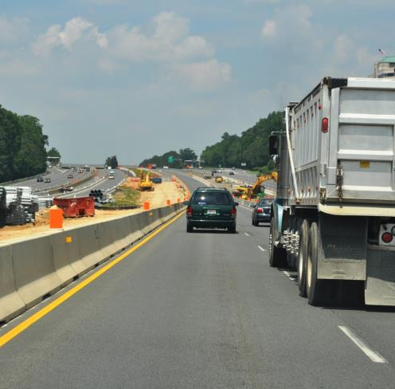
Challenge #1
Trucks entering the work zone put motorists and those on other side of wall at risk.
Notes:
Entering and exiting the work space can require rapid acceleration and deceleration. (Discuss with the class the dynamics of how this situation is impacted if the truck in loaded or empty. Taking the load into consideration, how might that knowledge be used to make the work environment safer?

Slide 9
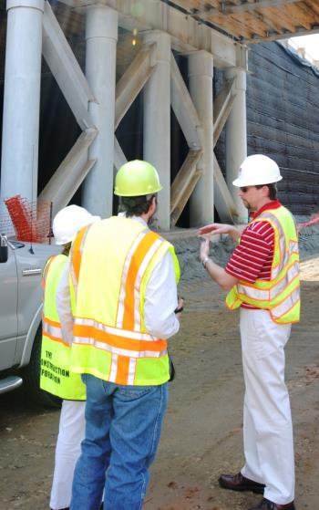
ITCP Solution
Training truckers to pay attention to work space dynamics.
Instruct workers to stay clear of access and egress points.
Instruct employees on proper locations for parking and staging vehicles, away from entry and exit points.
Notes:
Activities that occur under the direction of construction contractors include maintaining a clear/open area around access/egress points where equipment or vehicles should not be parked. Contractors are also responsible for educating on-site employees about areas near access/egress points that are prone to heavy truck traffic. Workers should avoid crossing open traffic lanes, particularly those on high-speed roadways.

Slide 10
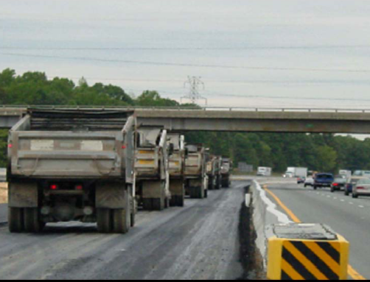
Challenge #2
Trucks queued inside the work zone create obstacles for workers and operators.
Notes:
When truck queues form near exit and entry points they create hazards for other vehicles attempting to enter (with little deceleration space) and exit (with little acceleration space). If queues threaten to block these spots, queues should be redirect, or different access and egress spots should be identified for drivers to use.

Slide 11
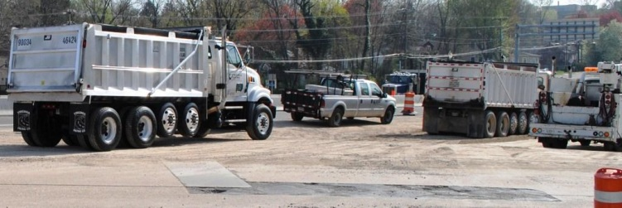
ITCP Solution
If queues threaten to block access and egress locations, queues should be redirected, or different access and egress spots should be opened and identified for drivers to use.
Notes:
If queues threaten to block access and egress locations, queues should be redirected, or different access and egress spots should be opened and identified for drivers to use.

Slide 12
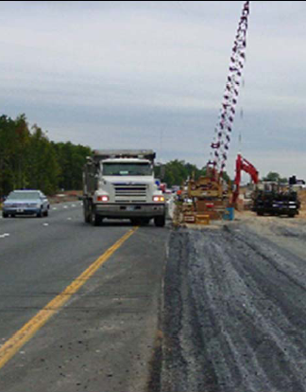
Challenge #3
Trucks do not have sufficient space to slow down when entering, or match traffic speeds when exiting.
Notes:
Speed differential between traffic lanes and work space is a challenge for truck drivers, and can create significant hazards for both workers and motorists.

Slide 13
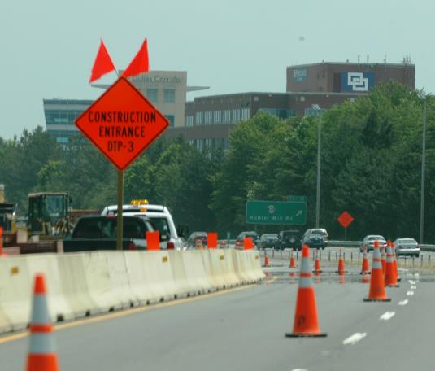
ITCP Solution
Use shoulder areas or closed lanes to create ramps that will provide safe acceleration and deceleration zones.
Notes:
In addition to creating special ramps or other lanes, all access and egress areas should be kept clear of debris, signage, parked vehicles, etc.

Slide 14
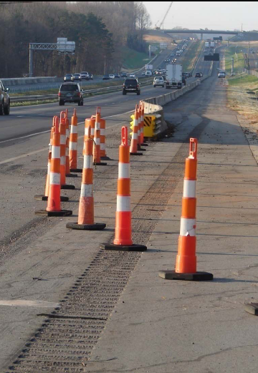
Challenge #4
Crew, operators, inspectors, subcontractors and others may not be up-to-date on access/egress locations as work progresses.
Notes:
Roadway construction involves moving operations. As the work progresses, so moves the work site. With continual changing conditions, access and egress points may change.

Slide 15
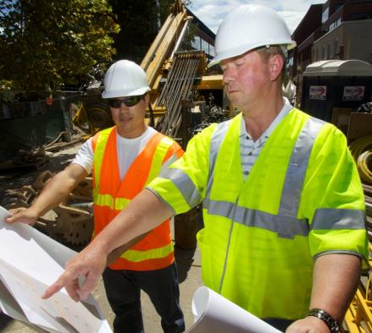
ITCP Solution
Hold pre‐shift meeting with all involved
Everyone must be informed on daily activities and changes.
Notes:
The best way to keep all members of the construction team up-to-date is to hold pre-shift meetings where the day’s activities are discussed and those involved can receive updates.

Slide 16
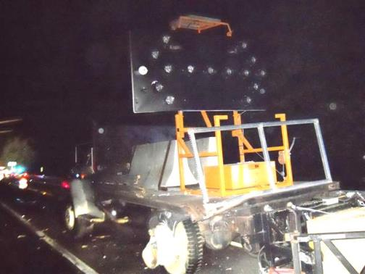
Challenge #5
Motorists may breach barriers and strike workers near access and egress points.
Notes:
Access and egress points require gaps in barriers and traffic delineation. These gaps can allow traffic to enter the work space unimpeded and therefore create increased exposures to workers.

Slide 17
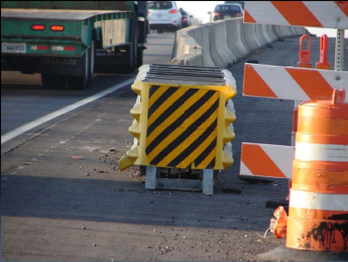
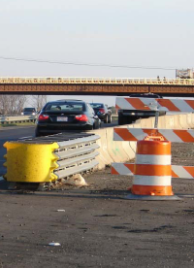
ITCP Solution
When openings are not in use they should be evaluated to see if it is necessary to close them.
Watch for vehicles that do not belong in or near the work area.
Check for problems such as blunt ends on barriers
Notes:
Temporary traffic control devices, particularly end treatments, should be checked regularly to ensure they are in good operating condition. Part of the ITCP is to evaluate end treatments when access/egress points are opened and closed.

Slide 18
Discussion and Questions
End Module Four
“This material was produced under the grant SH-23551-12-60-F-11 from the Occupational Safety and Health Administration, U.S. Department of Labor, and contract 212-2009-M-32109 from the National Institute for Occupational Safety and Health. It does not necessarily reflect the views or policies of the U.S. Department of Labor or U.S. Department of Health and Human Services, respectively, nor does mention of trade names, commercial products, or organizations imply endorsement by the U.S. Government.”

