Slide 1
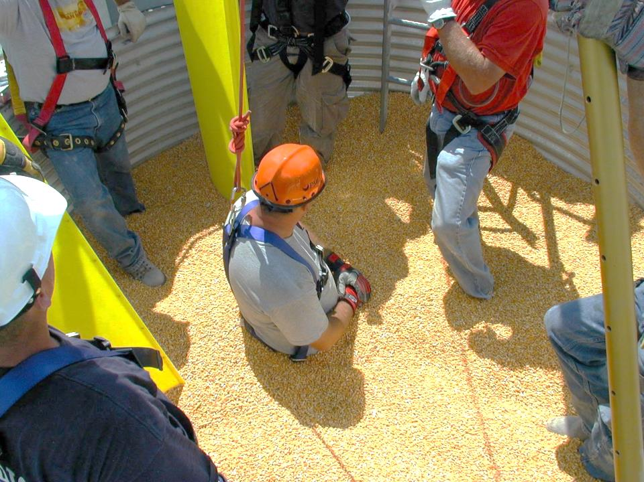
Title Page
Train-the-Trainer Overview
Basic First Responder Training for Incidents Involving Grain Storage, Processing, and Handling Facilities
Developed by:
  Purdue University
  Agricultural Safety and Health Program
  Department of Agricultural and Biological Engineering
  West Lafayette, IN
This material was produced under grant number SH23575SH2 from the Occupational Safety and Health Administration, U.S. Department of Labor. It does not necessarily reflect the views or policies of the U.S. Department of Labor, nor does mention of trade names, commercial products, or organizations imply endorsements by the U.S. Government.
Notes:
Instructor Notes:
Please acknowledge that development of the training resources was made possible by a grant from the U.S. Department of Labor and has been reviewed by OSHA staff. You do not need to read the disclaimer at the bottom of the slide.

Slide 2
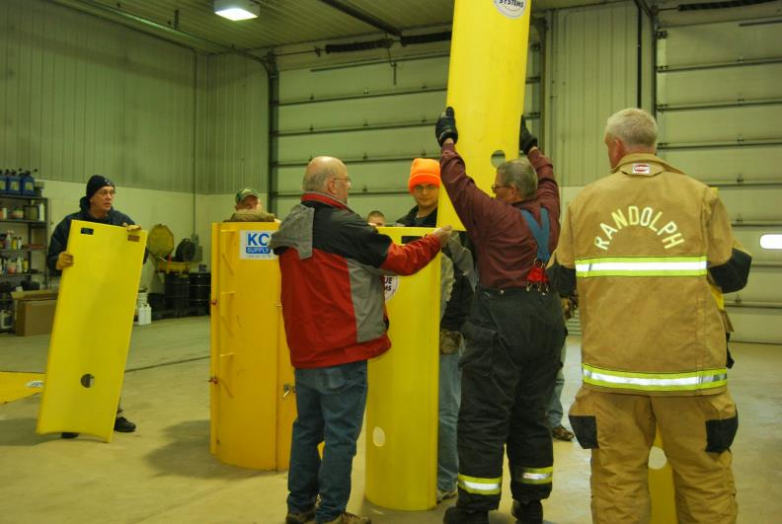
Overview and Introductions
Scene of grain rescue class
Notes:
Instructor Notes:
Introduce yourself and briefly share your qualifications and/or experiences that you will draw upon to teach the class.
Encourage participants to turn off their cell phones or switch them to silent mode.

Slide 3

Recommended Instructor Qualifications
Be a current first responder instructor
Prior completion of NIMS training
Working knowledge of grain storage, transport, processing, and handling facilities and equipment
Prior completion of first responder training related to grain storage, processing, and handling
Familiarity with relevant OSHA Standards
Familiarity with NFPA 1670 and 1006
Notes:
Instructor Notes:
These qualifications were used to select individuals to participate in the train-the-trainer training for teaching the Basic First Responder Training for Incidents Involving Grain Storage, Processing and Handling Facilities. It is anticipated that each individual completing the train-the-trainer class will be equipped and motivated to conduct the basic first responder training to first responders they serve in their communities.
Since participation in the train-the-trainer class and conducting follow-up training is completely voluntary, it is important to invite or select participants who are most likely to utilize the training. This is often demonstrated by previous experience as a first responder instructor.

Slide 4
Objectives of Instructor Training
Explain goals and objectives of Basic First Responder Training Curriculum
Explain and review teaching resources included in curriculum
Review strategies to plan, promote, and conduct an evidence-based workshop using the Basic First Responder Training Curriculum
Identify potential hazards to first responders at grain-related incidents
Explain the need for OSHA compliance when required
Describe basic rescue equipment needed for responding to grain-related incident
Explain basic first response strategies
Affirm the importance of conducting a class evaluation and assessment of student learning
Identify and locate supplemental teaching resources
Notes:
Instructor Notes:
This is a list of anticipated learning objectives for those participating in the train-the-trainer class. An assumed objective is to motivate the participants to conduct follow-up instruction using the curriculum in their local communities.

Slide 5
Desired Outcomes of Instructor Training
Increase the number of instructors teaching evidence based first responder training related to emergencies at grain storage, processing, and handling facilities
Increase the number of first responders trained to safely and effectively respond to incidents at grain storage, processing, and handling facilities
Increase the probability of successful response
Ensure greater compliance with relevant OSHA workplace safety and health regulations
Reduce the probability of secondary victims and injuries
Notes:
Instructor Notes:
In addition to the learning objectives, it is anticipated that there will be other potential outcomes from conducting the train-the-trainer classes and increasing the number of trainers capable of presenting the Basic First Responder Training for Incidents Involving Grain Storage, Processing and Handling Facilities curriculum.

Slide 6
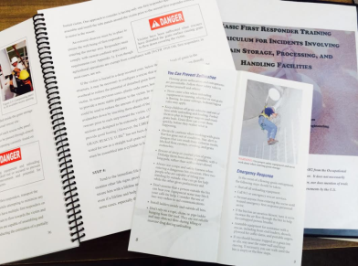
Fair Use of the Curriculum
Developed with U.S. Department of Labor funding
Contents are for public use
Can only be used for non-profit purposes
Cannot be repackaged for sale
Notes:
Instructor Notes:
Trainers should be made aware of the source of the training material and that commercial use of it for the purpose of making a profit is prohibited.

Slide 7
Instructor Training Agenda
Introductions, Pre-Test, and Training Overview
Unit 1: Confined Spaces in Agriculture Definitions/key terms Types of confined spaces found in agriculture Relevant OSHA Standards Hazards related to agricultural confined spaces OSHA exempt vs. non-exempt facilities Overview of facilities used to transport, handle, and store grain Augers and other energized equipment Role of out-of-condition grain Importance of preplanning
Break
Unit 2: Summary of Emergencies at Grain Storage and Handling Facilities Definitions Frequency of problem Contributing factors Nature and characteristics of free flowing grain Common categories of flowing grain/feed entrapments and engulfments Entanglements Asphyxiations Falls Electrocutions
Notes:
Instructor Notes:
Review the instructor training agenda for the day. Remind participants that time does not allow a comprehensive review of all issues related to emergencies at grain storage, processing, and handling facilities. Encourage participants to review the contents of the curriculum package and the supplemental online resources suggested.

Slide 8
Instructor Training Agenda
Unit 3: Preplanning/Training/Rescue Equipment Components of preplanning Role of training Personal protective equipment Rescue equipment Grain handling equipment Grain containment systems
Unit 4: Emergency Response Strategies Importance of rapid response Potential hazards to first responders First steps in responding Review of key rescue equipment that would be beneficial Identifying appropriate and inappropriate anchor points Types of injuries victims may experience Techniques for rapid removal of grain Potential for structure failure during rapid removal
Lunch (Video Presentation)
Overview of Demonstrations and Hands-on Exercises Break up into teams Assign safety officer for each team Unit 5: Demonstrations and Hands-on Exercises Group tour of grain safety and handling facility Group review of activities Q&A, Post-test, and Training Evaluation
Notes:
Instructor Notes:
Continuation of training agenda.

Slide 9

Questions?
Notes:
Instructor Notes:
Answer any questions anyone has from this unit before moving on

