Slide 1
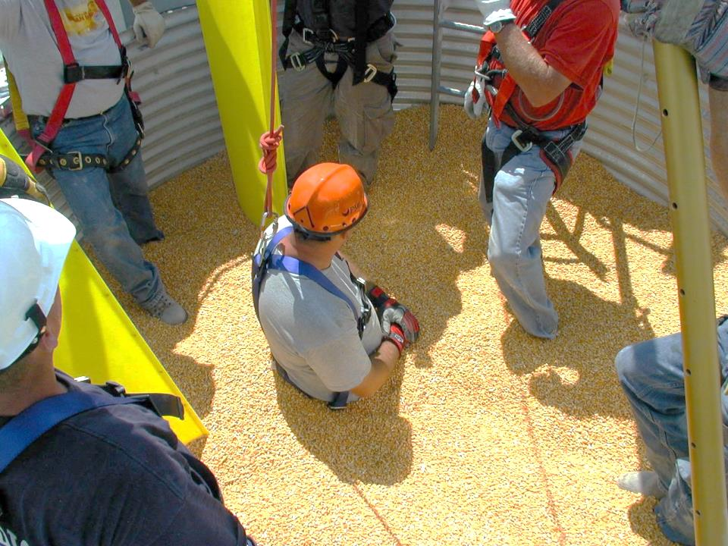
Title Page
Basic First Responder Training
For Incidents Involving
Grain Storage and Handling Facilities
Unit 4 – Emergency Response Strategies for Incidents at Grain Storage and Handling Facilities
Developed by:
  Purdue University
  Agricultural Safety and Health Program
  Department of Agricultural and Biological Engineering
  West Lafayette, IN
This material was produced under grant number SH23575SH2 from the Occupational Safety and Health Administration, U.S. Department of Labor. It does not necessarily reflect the views or policies of the U.S. Department of Labor, nor does mention of trade names, commercial products, or organizations imply endorsements by the U.S. Government.
Notes:
Instructor Notes:
This unit is the fourth that will be presented during the first half of the class. It provides instruction at the basic awareness level regarding emergency response strategies that are applicable to incidents involving grain storage and handling facilities.
The contents address the “response” component of emergency management. In other words, something bad has happened and there is a call for assistance. At this point it is too late to prevent the problem. Efforts need to be made to respond, mitigate the damages and to assist, to the extent possible, with the recovery process. Again, it is important to stress that emergency response must be conducted in a way to minimize the potential for secondary victims, especially for first responders.

Slide 2
Objectives
Discuss the operational assumptions under which emergencies at grain storage and handling facilities should be responded to
List the immediate action steps that should be taken when notified of an emergency at a grain storage and handling facility
Identify action steps that should be taken upon arrival at the scene
Describe the hazard assessment process
Describe the speed of engulfment in grain and the forces required to pull a trapped victim from grain
Describe the two primary approaches to grain rescue
  Grain removal
  Grain rescue tube
Notes:
Instructor Notes:
Briefly review each of the learning objectives of this unit.
Remind participants of the level of the training – basic awareness. Participants should be encouraged to pursue additional study and hands-on experiences on their own or by attending related training such as confined space entry, high angle rescue, machinery extrication, contact with overhead power lines, and victim packaging.
It is also important to keep reminding participants that no one person or response agency will have all the answers. Grain entrapments and engulfments are complex situations and require a team approach.

Slide 3
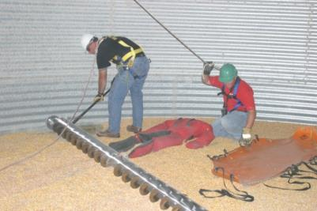
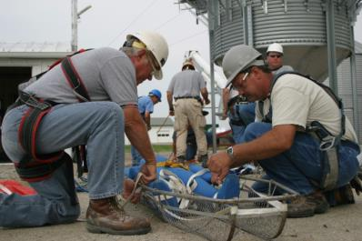
Disclaimer
The recommendations and procedures presented are solely for educational purposes. There is no claim made concerning the effectiveness of any method or procedure in any specific circumstances.
Notes:
Instructor Notes:
Every emergency situation has a life of its own. No two are exactly the same. Each involves different settings, different environmental conditions, different victims and different combinations of emergency response capabilities. Consider the definition of an “emergency” –
“an unforeseen combination of circumstances or the resulting state that calls for immediate action” (Webster, 10th Edition)
No one-day class is capable of preparing emergency first responders to effectively address every situation that might occur at a grain storage and handling facility. Some circumstances will be unforeseen, there may be multiple circumstances that need attention and many will require immediate action.
The purpose of this unit is not to provide comprehensive instruction for all or even the most frequent types of emergencies that occur. Rather it is to present basic response strategies with the intent of reducing the risk to those responding, and improving the probability of a successful rescue.

Slide 4
Operational Assumptions
Victim(s) cannot self-extricate
The site will be under the supervision of an Incident Commander
Tactical rescue teams may not be readily available to provide a timely response
Site owner/supervisor is available for consultation
Some level of pre-planning has taken place
Notes:
Instructor Notes:
The contents presented are based upon a few basic assumptions. These include:
There is a real need for an emergency response. Someone is entrapped, engulfed, asphyxiation, entangled, has fallen or been electrocuted at a grain storage and handling facility.
There is someone at the scene who is in charge of the emergency response. Lack of leadership, knowledge or a disorganized response can, and often does, lead to secondary victims. Most emergency response agencies operate under the National Incident Management System (NIMS) that requires that an Incident Commander be designated to provide leadership at the scene in consultation with other responding agencies.
In many rural communities where most of the grain storage facilities are located, access to tactical rescue teams is limited. Response and set-up time may exceed 2-3 hours. The assumption being made is that the initial response team does not have access to some of the skill sets and equipment available from a tactical rescue team.
Because of the complexities of many larger grain storage and handling facilities, the Incident Commander is greatly benefitted by collaborating with the owner/supervisor of the site. This becomes especially important if automated equipment is involved that may energize unexpectedly.
With the growing awareness of grain-related incidents and the thousands of first responders who have taken some level of training on responding to these incidents, it is assumed that many first response agencies have now completed some pre-planning for emergencies at grain storage and handling facilities.

Slide 5

Immediate Action Steps Following the 911 Call for Assistance
Entrapment/Engulfment/Asphyxiation/Entanglement
Determine the precise nature and location of the incident from the caller
Activate mutual aid
Request that emergency medical services and law enforcement respond to the scene
Request assistance from local or regional tactical rescue team
Implement pre-planning steps to direct grain handling and transport equipment to the scene
Notes:
Instructor Notes:
The moment that the 911 call is received reporting an entrapment, engulfment, asphyxiation, or entanglement at a grain storage and handling facility a series of pre-planned responses should be carried out. These include:
Determine exactly where the incident has occurred. Remember, the call may be coming from a farmstead phone or cell phone, but the incident may have occurred at a facility at another location miles away. Responding to the address from which the 911 call is being made can be a mistake, resulting in a confused group of first responders at the wrong location. It is also important, to the extent possible, to get a good description of the incident and the number of victims involved.
Almost every grain entrapment, engulfment, asphyxiation, or entanglement, in the past, has involved multiple emergency agencies. In some cases, over 100 first responders were engaged at the scene. A single rural volunteer fire department, generally, does not have the capability to respond to these incidents alone. At least one aerial platform truck should be sent to the scene.
Emergency medical services and law enforcement need to be requested to provide care and ensure that order and an appropriate perimeter is maintained. Emergency medical services are there to provide assistance to both the victim(s) and first responders.
At the same time as other local assistance is being requested, a call should be made to the nearest available tactical rescue team to request their help at the scene.
If appropriate pre-planning has been done, other action steps can be implemented such as contacting pre-arranged providers of grain handling equipment, including grain vacuum machines, semi-trucks, front end loaders and portable augers. This action step, if not pre-planned may be carried out by personnel of a local commercial grain operation, who have working relationships with many businesses who could provide the needed equipment.

Slide 6

Action Steps Upon Arrival at the Scene
STOP anyone from entering a structure in which an entrapment, engulfment, asphyxiation, or entanglement has occurred
Lockout and secure all relevant energized equipment
Establish and maintain perimeter
Confirm the location and number of victims
Assess immediate hazards to first responders
Establish locations for placing emergency vehicles
Consult with owner/supervisor of site
Develop a response plan
Notes:
Instructor Notes:
The Incident Commander should clearly communicate upon arrival at the scene that no first responder should enter any structure where a victim is entrapped or engulfed in free flowing material, where there is evidence of crusted or bridged material, where there is grain stuck to the inside walls of the structure, where victims may have been exposed to a toxic environment or there is a potential for energized equipment or electrocution . In far too many cases, first responders have entered a situation attempting to save a life only to lose their own from hazards they were not aware of.
All relevant power equipment at the site should be locked out and/or secured to prevent intentional or unintentional operation. If the facility is complex it may be necessary to have the power supplier cut service to the entire facility.
Upon arrival at the scene, the Incident Commander should establish a workable perimeter to be maintained by law enforcement or assigned rescue personnel. This should prevent non-essential parties from entering the scene.
The location and number of victims should be determined before beginning any response activities. There may be multiple victims, especially if a toxic environment is involved. Some victims may be completely submerged in the grain and not visible.
To ensure that the work space remains accessible to needed rescue equipment, like the positioning of an aerial platform truck, other responding vehicles need to be parked appropriately. Access routes need to be kept clear at all times.
Because of the complexities of many grain storage and handling facilities, consultation with the facility manager is critical. He or she should be able to identify needed anchor points, location of controls for equipment, access points, and to provide details on the structural characteristics of the facilities.
All of these initial steps may seem burdensome, but can take place very quickly if pre-planning has occurred. Now, it is time to develop a response plan that can be carried out in the most orderly fashion possible, with the greatest potential for success and the lowest risk to first responders.

Slide 7
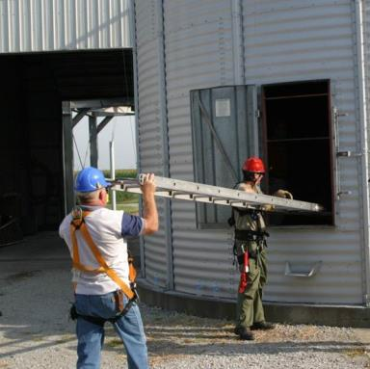
Comply with Standard Operating Procedures
Recognize limitations of:
  Personnel
  Equipment
Request needed resources
Hold personnel accountable for complying with established procedures
Notes:
Instructor Notes:
Every emergency agency has established a set of standard operating procedures to guide their actions during emergencies. In most cases these are written procedures, but they may also be unwritten. It is strongly encouraged that every fire/rescue service, that has grain storage and handling facilities in their jurisdiction, develop standard operating procedures for responding to incidents at these facilities.
These procedures should include restraints that recognize the limitations of both the agency’s personnel and equipment. These might include:
Personnel without appropriate certification or training should be prohibited from operating manlifts, using self-contained breathing apparatus, or accessing locations above a certain height.
The working height and load capacity of ladders and manlifts should not be exceeded.
Standard operating procedures provide a guide that directs the Incident Commander in deciding when additional resources or help is needed. They can also provide some level of protection, if complied with, from potential liability in the event of follow-up litigation if the rescue is not successful or a secondary injury occurs.
A site safety officer should be responsible for ensuring that first responders are in compliance with the standard operating procedures and has sufficient authority to remove workers from the scene if not in compliance.

Slide 8
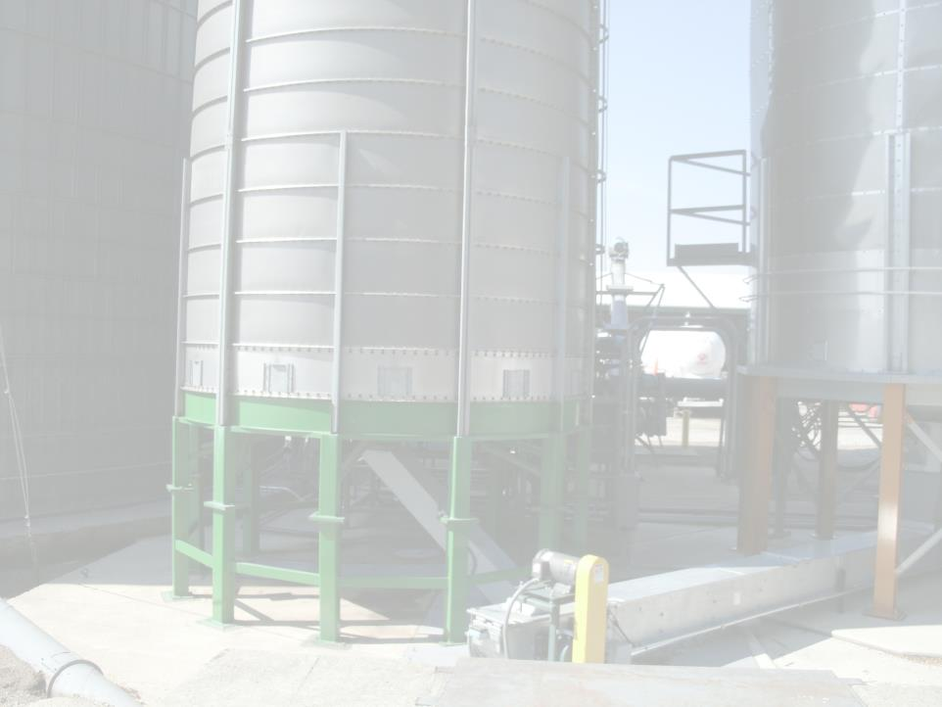
Assessing the Hazards
Location of victim (confined space, flowing material, high elevation)
Presence of toxic atmosphere
Presence of crusted or bridged material
Proximity of LP gas storage
Proximity of overhead power lines
Presence of energized equipment
Untrained personnel assisting with the rescue
Bin steps and ladders have a 350LB limit
Notes:
Instructor Notes:
Briefly review the potential hazards that may be present at the scene of almost any incident at a grain storage and handling facility. These have been covered earlier, but they are so important to the well-being of the first responder they should be reviewed again.
In many previous incidents, a large number of local farmers, grain elevator workers and family members are already on the scene when fire/rescue personnel arrive. In some cases, these highly passionate volunteers are performing tasks that have the potential for causing injury to themselves or to the victim(s).
It may be necessary for the Incident Commander to stop the informal or unorganized rescue efforts in order to better assess the situation and identify potential hazards. These efforts may not be well received, and maybe viewed as hindering the rescue attempt already underway. However, this action may be necessary to reduce the risk of secondary injuries and further injury to the victim(s).

Slide 9

OSHA Compliance if Applicable
Consider the following provisions:
Responders should only do what they have been trained to do
Permit vs. non-permit confined space classification should be determined
Monitoring of atmosphere
Entering under bridged or crusted material
Depth of grain
Use of lifeline and harness
Use of trained observers
Notes:
Instructor Notes:
There is considerable confusion, as noted earlier, over the application of current OSHA standards to emergency situations at grain storage and handling facilities. These standards were drafted to protect employees during normal work activities, not first responders during the conduct of a victim extrication. There are however provisions of the standards (28 CRF 1910.146 and 29 CFR 1910.272) that provide useful directives that should be considered during a rescue effort. They have the potential for preventing secondary victims. If not familiar with the emergency-related provisions, the standards should be reviewed. Copies are included as Attachments 1 and 2.
The two standards should be reviewed by all emergency first responders who may be called on to respond to a grain storage and handling incident. This should be part of preplanning activities.
Because there are different interpretations regarding the application of these standards, from state-to-state, it would be useful to contact the State OSHA Office or State Fire Marshall’s office to request specific guidance. Again, this should be done as a preplanning activity.

Slide 10
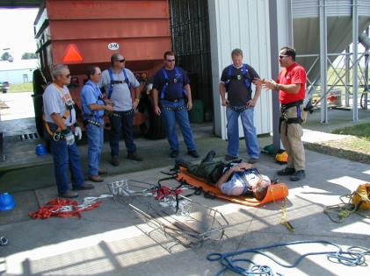
Potential for Survival from Grain
Approximately half of all documented grain bin entrapments and engulfments have resulted in fatalities
Victims have survived complete engulfment in free flowing grain, but very few
Notes:
Instructor Notes:
Historically, the majority of documented entrapments and suffocations in grain or other free flowing material have resulted in fatalities. The fact that the victims of these incidents were often working alone while the unloading equipment was operating greatly reduces the probability of survival. The victim has simply spent too much time beneath the surface of the grain and ends up inhaling or ingesting the grain into his airways or suffocating due to a lack of air. First responders, however, should not assume that the victim is deceased even if buried for a long time.
Victims of full engulfment have survived, though rarely, after being buried under grain for several hours. Their successful extrication was a surprise to everyone.
In a few cases the victim had covered his nose and mouth with his hands and in one case the victim was wearing a dust filtration respirator that kept his face free of grain. In these cases the victims felt the pressure of the surrounding grain, but were able to breath because their nose and mouth were protected.

Slide 11
Types of Documented Entrapments
Flowing grain
Collapse of horizontally crusted grain surface
Collapse of vertically crusted grain surface
Grain transport vehicles
Use of grain vacuum machines
Outdoor pile avalanche
Storage structure failure
Notes:
Instructor Notes:
As noted earlier, there are seven different types of entrapment in flowing agricultural material that will require emergency assistance. Each of these may require a different response strategy and each presents unique hazards to first responders. Each type can result in either a partial entrapment or full engulfment.
Point out that time does not allow for covering all types of rescue strategies that have been used in the past, both successful and unsuccessful. Participants should be referred to other resources that provide more in-depth information on current approaches to freeing victims from entrapment in free-flowing materials, including items that are included as attachments to the Instructor’s Guide.

Slide 12
Rescues/Recoveries Will Involve:
Partial entrapment
  Upper body of the victim is above the grain surface
  Self extrication is not possible
  Victim may be located inside a confined space
Complete engulfment
  Victim is not visible on the grain surface
  Exact location may be unknown
  Length of time submerged may be unknown
  Victim may be located inside a confined space
Notes:
Instructor Notes:
First responders will encounter two typical scenarios at the scene of a flowing grain entrapment:
Partial entrapment
Complete engulfment
Rescue strategies will vary between these two situations. As noted previously, the probability of a victim surviving complete engulfment is very low, especially if the location of the victim is unknown.
Review the characteristics of each type of entrapment and challenge the participants to explore why response strategies could differ in each situation.

Slide 13
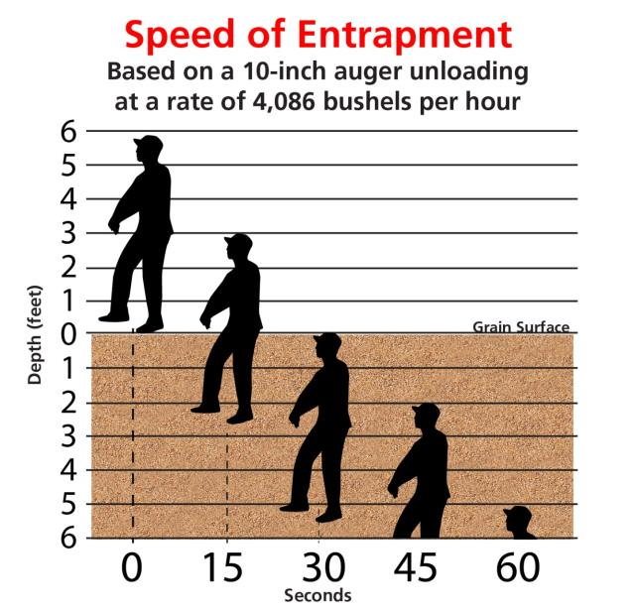
Speed of Entrapment chart
Notes:
Instructor Notes:
Use this chart to point out that getting caught in a column of free-flowing grain in the middle of a grain bin is a race that you can’t win. The flow of grain being unloaded from a bin can pull a person down to knee-level in seconds, at which time most victims are helpless to save themselves.
As the bin empties, a rapidly moving flow of grain forms over the outlet. Grain flows at nearly the same rate as the unloading auger, so once a person is trapped in the flow, escape on their own is almost impossible.

Slide 14
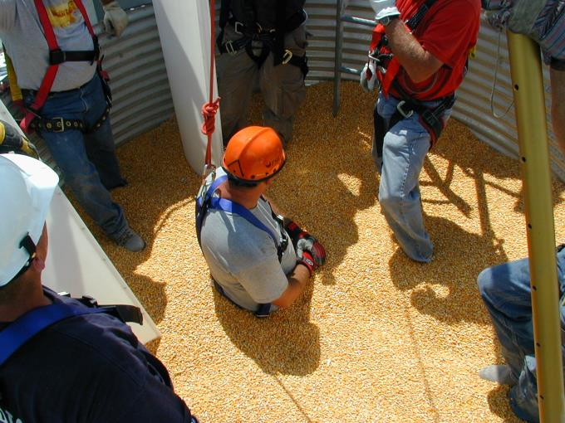
Partial Entrapment
Notes:
Instructor Notes:
This picture represents what a first responder will see inside a bin when a person has been partially pulled into flowing grain.
It takes 4 or 5 seconds to be submerged to the point where he or she is helpless, and takes fewer than 20 seconds to be completely submerged at the center of the bin.
Note the problem that will occur if first responder activity causes the grain to flow down on the victim. Even a minor shifting of grain can cause an avalanche that could completely engulf the previously partially buried victim.
This is why the most widely used rescue strategy is to begin emptying the grain from the bin using openings cut in the side of the bin.

Slide 15
Two Primary Rescue Strategies for Partial Entrapments
Removing the grain from around the victim
  Using grain vacuum from the top
  Cutting open the structure
Isolating the victim using a grain containment device or grain rescue tube
  Separates victim from grain mass
  Reduces the amount of grain needing to be removed
  Provides safer access to victim
Notes:
Instructor Notes:
There are two general strategies that have been used to free a victim entrapped in a grain mass when self extrication is not possible.
Removing the grain from around the victim
Isolating the victim using a grain containment device or grain rescue tube
There is a third way that has been used in the past but it has a high risk of causing secondary injury to the victim. In this approach rescuers attempt to pull the victim from the grain using physical or mechanical means such as a powered winch. This approach has been used in some cases where the victim was wearing a full body harness which distributes the load placed on the body. This approach, however, is inconsistent with basic extrication procedures involving entrapped or entangled victims. The recommended approach is to remove, if possible, the elements of entrapment away from the victim.

Slide 16
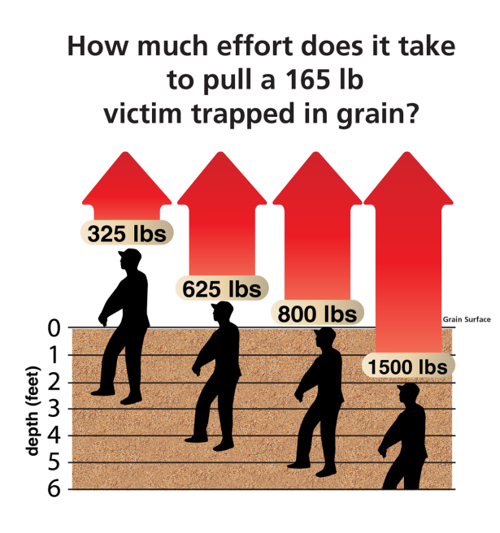
Effort to pull a victim trapped in grain graph
Notes:
Instructor Notes:
Discuss the power of flowing grain and why it is almost impossible to forcefully pull someone deeply buried in grain without injury.
Attempting to pull someone deeply buried in grain using mechanical assist could result in severe injuries.
Cases have been documented in which victims forcefully removed from a grain mass have experienced injuries to their joints and possible internal injuries.

Slide 17
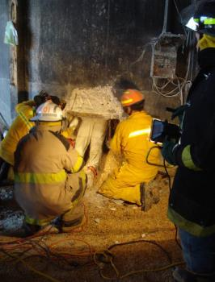
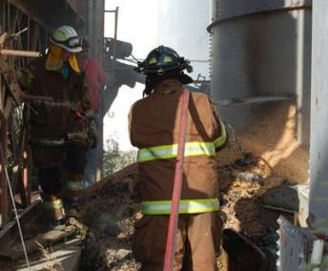
Removing the Grain from Around the Victim Requires:
Substantial manpower
Large capacity material handling equipment
Understanding of structural limitations
Appropriate cutting equipment
Notes:
Instructor Notes:
There will be a substantial need for manpower and equipment to remove grain from a structure.
Large capacity material handling equipment such as grain vacuum machines, will be essential. In most cases there will be a large amount of grain that will need to be removed from around the base of the bin as it is emptied from the openings cut in its side.
First responders need to understand the structural limitations of the structure being emptied, making sure that removing the grain from one side of the bin does not cause uneven loading on the bin walls causing the bin to collapse. Cutting the bin at 4 opposite locations and opening them at about the same time is highly recommended.
Having access to multiple pieces of cutting equipment is essential due to the high risk of equipment failure. Multiple holes may have to be cut.

Slide 18
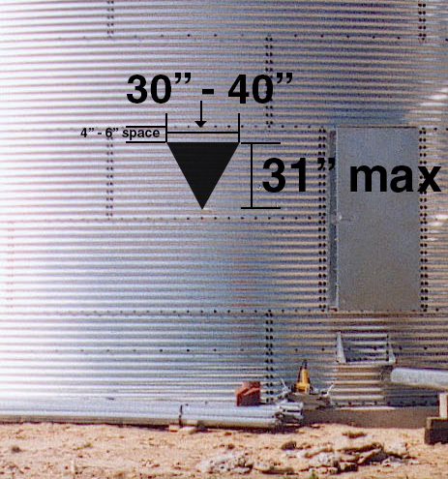
Cutting Open Smaller Bins
Notes:
Instructor Notes:
Grain bins of less than 50,000 bushels can be successfully cut open without fear of collapse, if cut in a manner that allows grain to flow somewhat uniformly from the structure.
Openings should be cut as high as possible or approximately level with the victim to reduce the amount of grain that must be removed to access the victim. These cuts will remove the higher ring of grain around the victim reducing the risk of engulfment due to avalanching grain. The use of an aerial platform truck would provide safer access to the level needed.
Point out the size of the opening and the need to form a hinge along the top to allow control over the grain flow.
Even though this strategy results in damage to the structure, bin panels can be replaced with minimal costs.
First responders should not be standing on the surface of the grain when the openings in the bin are cut. There are documented incidents in which rescuers working in the bin, attending to the victim, were drawn into the flowing grain leaving the structure and becoming wedged into the opening.

Slide 19
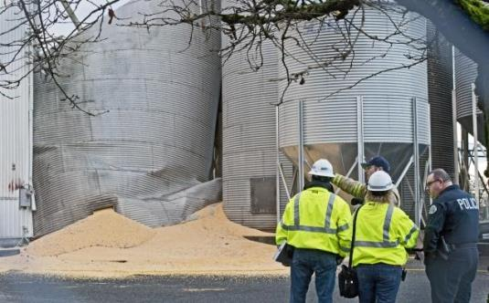
Preventing Bin Failure
Cut high
Avoid struts and stiffeners
Cut away from bolted seams
Cut openings at 12, 6, 3 and 9 o’clock
Consult with a structural engineer or manufacturer if in doubt
Notes:
Instructor Notes:
There is no record of a bin completely failing during a rescue or recovery operation. However, as storage structures have gotten larger this possibility has been widely discussed due to the forces involved. For example, a 500,000 bushel bin can contain 28 million pounds of grain or 14,000 tons. The forces at work on the outer shell of the bin are enormous. Compromising the integrity of the bin under stress can have devastating consequences.
Larger bins or bins in poor condition should not be cut without consulting a structural engineer or someone experienced in the fabrication of grain storage structures.
All non-essential personnel should be moved away from the base of the bin during bin cutting operations. A sudden release of grain can travel dozens of feet and has the power to push railcars off their tracks.

Slide 20
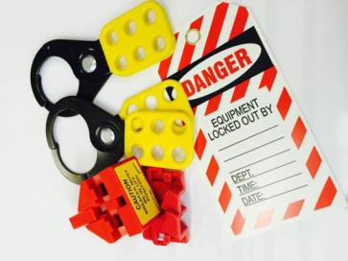
Full Engulfment
Do not enter the bin – it will only add additional risk to the victim if still alive
Do not turn on any unloading equipment
Turn on aeration equipment
The victim is most likely directly beneath the inverted cone or directly over the opening in the floor, do turn on fans at the storage structure
Engulfment rarely involves
entanglement in the in-floor
auger
Remove the grain
Notes:
Instructor Notes:
As noted, the probability of surviving a complete engulfment is very low. First responders, however, should not assume that the victim has died because he is not visible.
Review the steps listed and respond to questions. There is often push-back regarding the recommendation to not enter the bin. The justification for this position is as follows:
Entering the bin will cause more grain to flow in on the victim.
Activity on the grain surface will increase the density of the grain.
Entering the bin may expose first responders to the same hazards that led to the initial entrapment.
The location of the victim can be accurately determined by the configuration of the grain surface. He will be directly under the bottom of the cone formed over the outlet in the floor.
Procedures should be started to remove the grain from the structure using the safest methods possible. This could include methods described under the section on partial entrapments and using grain vacuum machines.
At no time should the unloading equipment be turned on to remove grain from around the victim.

Slide 21
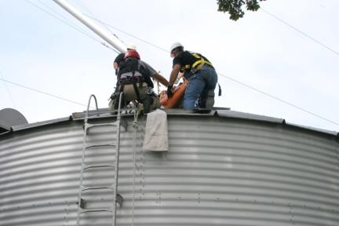
Case Study #1
Delayed Request for Assistance
Why are calls to 911 delayed?
What problems develop due to delayed calls for assistance?
What added risks to first responders are generated by delayed calls?
Notes:
Instructor Notes:
In one case, an employee at a commercial grain facility entered a bin to break up crusted grain and was partially buried to his waist due to an avalanche of grain. He was working without a lifeline or harness. Fellow workers attempted to dig him free but their actions only resulted in the victim becoming buried deeper in the grain. One employee made a call to an outside source knowledgeable in grain rescue to ask for advice. The consultant immediately asked the employee to call 911 for assistance. By the time the first unit of first responders arrived almost 3 hours had passed, and the victim was now buried chest deep.
Ask participants to discuss the following:
Why do those involved with entrapments and engulfments delay calling 911 for assistance?
How does a delay in calling for assistance reduce the probability of a successful rescue?
What added risks to first responders are generated by delayed calls for assistance?

Slide 22
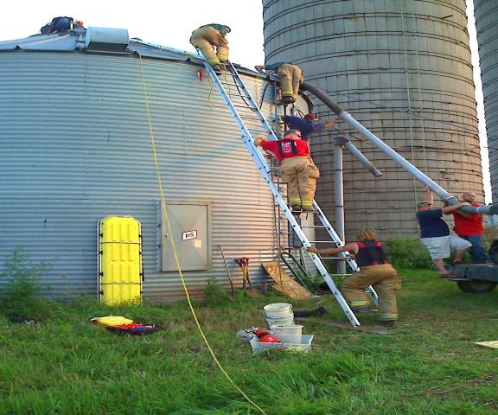
Cast Study # 2
Successful Grain Bin Rescue
Notes:
Instructor Notes:
In this case, a farmer is entrapped while attempting to unplug the floor outlet of a relatively small bin. Several fire/rescue units responded to the scene.
Take a moment and allow participants to examine the picture taken at the scene. Have them identify some of the problems that can be observed. These might include:
Portable ladder wrong angle, not 35⁰
Portable ladder should be set so that it extends higher above the eve of the bin
Multiple responders on both the portable and fixed ladders. Weight capacity of fixed ladders may be exceeded. Current practices set 350 pounds as maximum load on bin ladders.
Responder reaching beyond the rail of the ladder without adequate support
Spotter at bottom of ladder not correctly positioned to ensure ladder won’t slip
Too many responders on roof. The roof load capacity may be exceeded. Additional personnel do not serve a useful function.

Slide 23
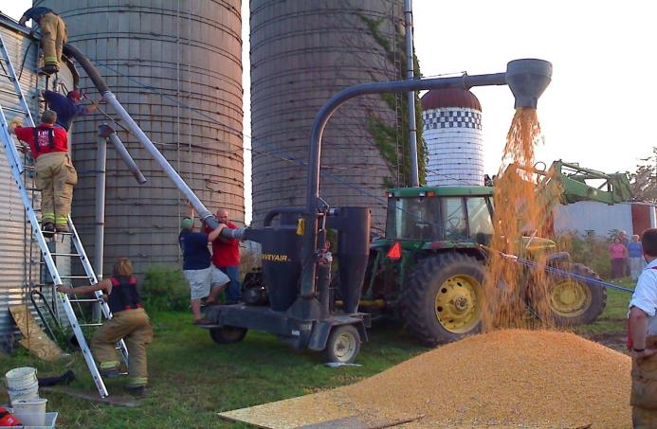
Case Study #2
Use of Grain Vacuum Machine
Notes:
Instructor Notes:
In this picture, the grain vacuum machine powered by a tractor can be seen in use. This unit has the capacity to vacuum about 1,200 bushels per hour.
Note that no one has been designated to be at the controls of the tractor, the power source, in the event that the vacuum operators encounter a problem inside the bin and need to shut off the machine immediately.
Why the two responders were assigned to support the solid vacuum line feeding the vacuum machine is unclear, but could be attempting to maintain a seal in the vacuum line.
An observer should be stationed to ensure that no one unintentionally comes into contact with the power-take-off shaft transferring power from the tractor to the machine.

Slide 24
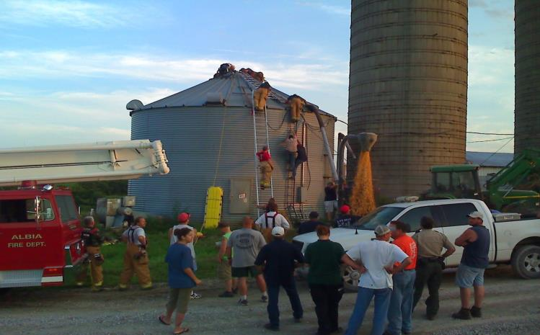
Case Study #2
Establishing a Perimeter
Notes:
Instructor Notes:
One issue that comes up at almost every scene of a grain entrapment is spectators or the presence of non-essential personnel. In some cases dozens of family members, friends, and neighbors end up in close proximity to the scene, or trying to assist. Each may consider himself or herself as an essential stakeholder in the outcome of the rescue, but has no real functional role. Each one of these non-essential attendees is at a greater than needed risk of injury due to the activities being conducted and environmental hazards like the toxic dusts being generated.
As noted earlier, the immediate rescue scene should be protected by an established perimeter and only essential personnel should be allowed inside the perimeter.
Ask participants to discuss ways to prevent non-essential persons from entering the rescue scene.

Slide 25

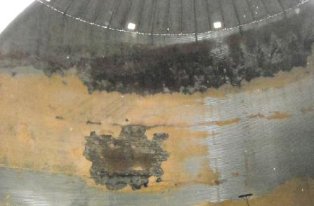
Case Study #3 Successful Grain Bin Rescue
Case Study #3
Successful Grain Bin Rescue
Notes:
Instructor Notes:
In this case there was considerable crusting of grain due to it being out-of-condition. Some of it was so moldy that it had turned black. There were layers of grain 2 feet thick hanging off the bin wall.
The farmer was trying to knock the crusted material off the walls with a piece of electrical conduit, causing the grain to break free and partially burying him.
In these cases, first responders need to take great care not to enter the structure if there is still grain clinging to the walls.
Ask participants to discuss how the victim, who is unable to extricate himself or herself, can be reached without exposing first responders to the same risks of entrapment.

Slide 26
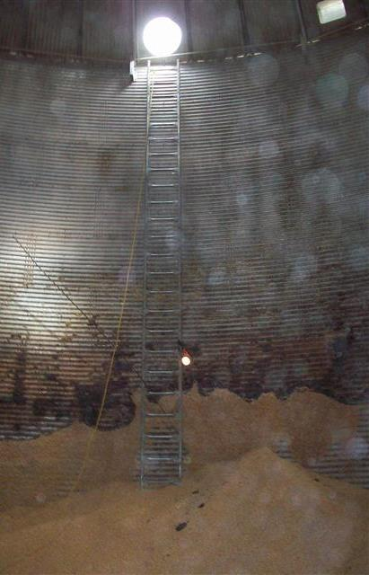
Case Study #3 Use of Inside Bin Ladder
Case Study #3
Use of Inside Bin Ladder
Notes:
Instructor Notes:
Since there was no inside bin ladder, access to the victim was made by lowering a ladder through the roof access hatch.
Note the long electrical conduit still standing next to the ladder. Poles and other long tools are evidence that the victim was trying to breakup a plug.
First responders were provided M-95 dust masks to protect them from the moldy grain dust caused by the rescue activities.
It was noted that the unload auger was still operating when first responders arrived on the scene. All powered equipment at the site should be locked out and protected from inadvertent start up.

Slide 27
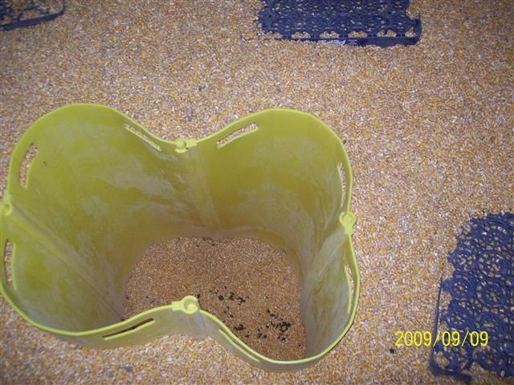

Case Study #3 Successful Use of Grain Rescue Tube
Case Study #3
Successful Use of Grain Rescue Tube
Notes:
Instructor Notes:
A multi-section grain rescue tube was placed around the victim to protect him from additional inflowing grain. The grain from inside the tube was vacuumed out allowing rescuers to lift him free of the grain. The tube was deformed because of the excessive numbers of rescuers who were inside the bin and removal of more grain from inside the tube than was necessary to free the victim. It is recommended that no more than two rescuers ever be inside the structure during a rescue attempt.
The empty soda crates shown in the picture were used by first responders to provide a more stable working surface. Other materials could be used to perform the same function such as tarps, plywood sheets, and door mats.

Slide 28
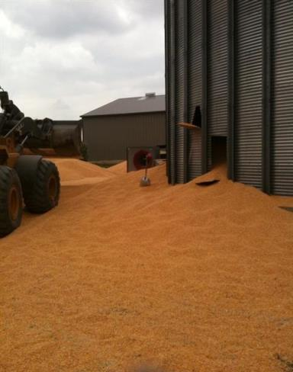
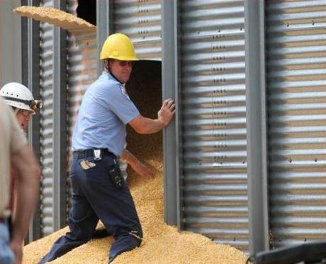
Case Study #3 Removing Grain from the Bin
Case Study #3
Removing Grain from the Bin
Notes:
Instructor Notes:
Openings were cut in the side of the bin to allow rapid removal of the grain. As can be noted, the openings were not cut uniformly, but were sufficient to empty the grain.
The large opening shown was made to remove the victim from the bin rather than taking him up on the inside and lowering him down on the outside. A top extrication would have required a high angle rescue team. Cutting an access opening on a bin of this size is safer than using ropes to raise and lower the victim. The large opening, however, should not be cut until the level of grain is near the bottom of the bin.

Slide 29
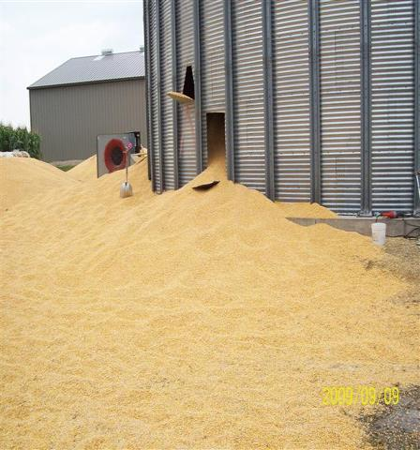
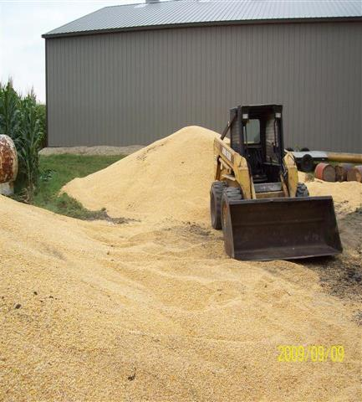

Case Study #3 Moving Evacuated Grain
Case Study #3 Moving Evacuated Grain
Notes:
Instructor Notes:
A substantial amount of grain had to be moved from the base of the bin to keep the grain inside flowing freely out. The need for large front end loaders has become obvious in many of these cases. Arranging for access to grain handling equipment should be part of emergency preplanning.
The potential for being run over is great during the emergency removal of grain. The area being cleaned of grain needs to be free of bystanders and only trained personnel should be allowed to operate grain handling equipment.

Slide 30


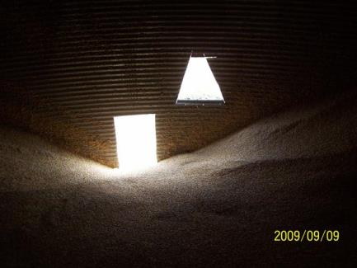
Case study #3 Bin Openings from Inside
Case study #3 Bin Openings from Inside
Notes:
Instructor Notes:
This is a view of the bin openings from inside the bin, taken after the rescue.
Have participants discuss the methods used to cut the bins and the location of the openings. On a larger bin, these openings could have increased the risk of structure failure.
Remind participants of the importance of removing the grain uniformly from the bin to reduce uneven pressures on the bin walls but could lead to bin failure.

Slide 31
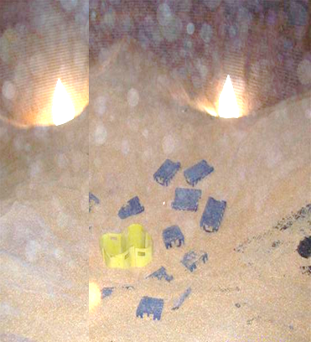
Case Study #3 Providing a Working Platform
Case Study #3 Providing a Working Platform
Notes:
Instructor Notes:
Due to the instability of grain, forming a working surface for those needed to free the victim has been found useful. A stable surface can be made from carpeting laid around the grain containment device, empty plastic bottle crates, narrow sheets of plywood or backboards. Use of these platforms should also reduce the pressure on the victim from the weight of the first responders.
There is no need to have more than two first responders inside the bin at any time. As noted earlier, additional activity on the surface of the grain will cause the victim to be buried deeper and increase the bulk density of the grain.

Slide 32
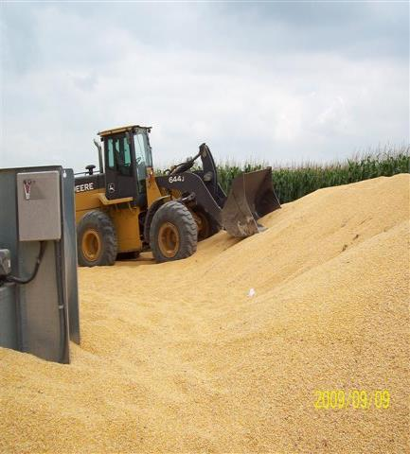
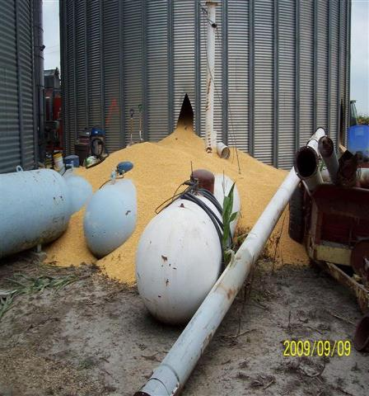
Case Study #3
Potential Electrical and LP Gas Hazards
Case Study #3
Potential Electrical and LP Gas Hazards
Notes:
Instructor Notes:
Grain bin rescuers may be exposed to hazards from nearby electrical service components and LP gas storage tanks.
All electrical service to the site should be de-energized by the local service provider and all sources of flammable gas should be checked for leaks. If possible turn off the tanks at the main control valve.
Rapid evacuation of grain can cause power lines and gas lines to be stressed or even broken if grain is allowed to pile up on them.
If the victim is fully engulfed, it may be beneficial to keep the bin air ventilation fans operating. Consequently a power source will be needed for these fans.

Slide 33
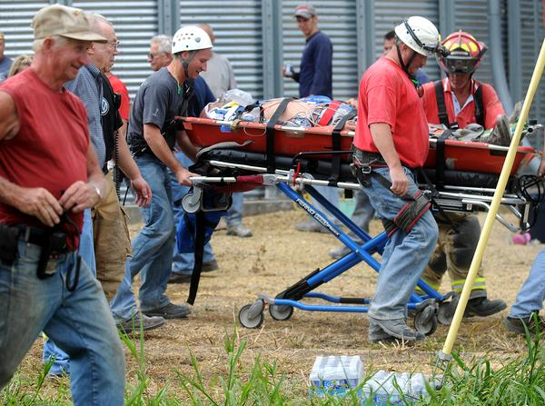
Case Study #3 Removal of the Victim
Case Study #3 Removal of the Victim
Notes:
Instructor Notes:
At the end of the day all responders were safe, and the victim is safely extricated. Note: this was done with a large amount of equipment and manpower. This rescue also took several hours to perform.
If the victim has been buried for any length of time he should be transported to the hospital for observation. Other complaints may develop such as ingestion of grain, respiratory distress due to exposure to moldy grain dust, dehydration, hypothermia, and post-traumatic stress. In some cases, the victim worked so hard physically to free himself, that emergency medical personnel were concerned about internal injuries.

Slide 34
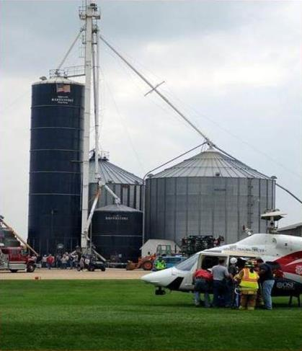
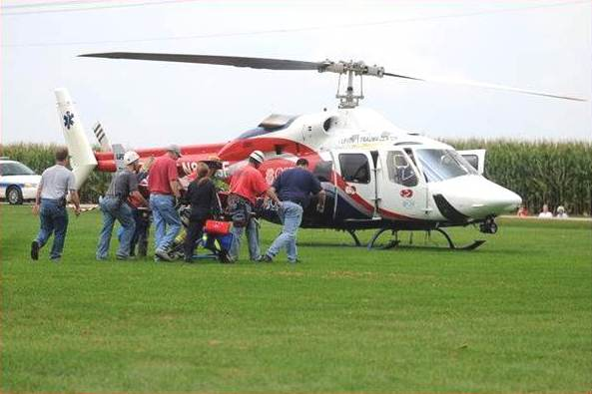
Case Study #3 Use of Medical Helicopter
Case Study #3 Use of Medical Helicopter
Notes:
Instructor Notes:
Approximately half of all grain entrapments and engulfments end up in body recovery. Few have required the use of medical helicopters, even though their use is increasing during these situations. In many cases, if the victim survives, he is able to walk out under his own power.
As noted, the victim should be transported, regardless of how he feels, due to the potential of other complicating factors.

Slide 35
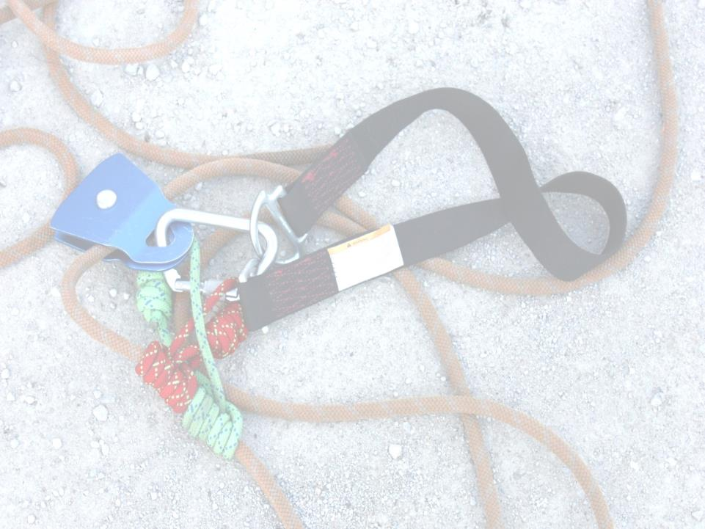
Summary of Rescue
The best rescue is one that never happens
Never enter an emergency situation alone
Use confined space entry procedures or best practices available
Conduct a hazard assessment
Have a plan
Remember who is the most important person at the scene: YOU!
Notes:
Instructor Notes:
Review this unit by stressing the following points:
Grain entrapments and engulfments are preventable. It is hoped that no one attending the training will ever have to use it.
In no case should a first responder enter an entrapment situation alone, especially if he or she is the first one on the scene. The risk of becoming a secondary victim is much too high.
When responding to an entrapment or engulfment, first responders need to remember that there was a reason that the victim became entrapped and it was most likely due to failure to follow safe work practices. First responders must also comply with standard operating procedures to ensure their safety.
Before implementing a response, the scene needs to be carefully assessed for potential threats to first responders.
A well planned rescue is more likely to be successful for the victim and less hazardous to the first responders.
Close this unit by reminding every participant that he or she is the most important person at the scene and that they are responsible to act in a safe manner. Becoming a secondary victim does not contribute to solving an already difficult event.

Slide 36

Questions?
Notes:
Instructor Notes:
Answer any questions anyone has on this unit prior to moving on

