Slide 1
The Use of Chemicals in the Workplace
NDLON
This material was produced under a Susan Harwood Training Grant #SH-23584-12-60-F-6 from the Occupational Safety and Health Administration, U.S. Department of Labor. It does not necessarily reflect the views or policies of the U. S. Department of Labor, nor does mention of trade names, commercial products, or organizations imply endorsement by the U. S. Government. The U.S. Government does not warrant or assume any legal liability or responsibility for the accuracy, completeness, or usefulness of any information, apparatus, product, or process disclosed.

Slide 2
What are chemical products?
Hazardous chemical products are those that can harm people or the environment.
Notes:
Ask participants to help you read each section. Give examples after each section is read.
Explain:
For the majority of chemicals used and developed, there is no information about their possible immediate or long-term health effects, yet workers are still required to work with potentially toxic substances. Many workers are required to work - without any protection - with chemicals that are known to be hazardous to human health.

Slide 3
There are different factors that influence how dangerous and harmful a chemical can be:
• The level of toxicity • If it can enter the body • How long you are exposed to it • The health of the person using the chemical • The reactivity of the chemical product

Slide 4
How useful are chemicals?
Every day we are exposed to countless chemical products that have become essential in our life but unfortunately we are not informed about their effects and consequences.

Slide 5
Risks of the chemical products:
Even nowadays, the possible effect that many products can produce on people’s health and on the environment is not exactly known. .

Slide 6
Types of chemicals found at the workplace:
The physical form of a chemical can influence the way in which it enters the organism, and to some extent, the harm it causes. The main physical forms of chemicals are solids, dusts, liquids, vapors and gases.
Notes:
SOLIDS: Solids are the least likely of the chemical forms to cause chemical poisoning. However, certain chemical solids can cause poisoning if they get onto your skin or food and you then ingest them. Personal hygiene is important to prevent the ingestion of chemical solids. The greatest danger with solids is that some work processes can change them into a more dangerous form.
LIQUIDS: Many hazardous substances, for example acids and solvents are liquid in room temperature.Many liquid chemicals detach vapors that can be inhaled. The skin can absorb liquid chemicals. Some liquid chemicals can damage the skin immediately. Other liquids go on directly through the skin to the bloodstream, from which they can transfer to different parts of the organism and have harmful effects.
VAPORS: The steams are droplets of liquid suspended in the air.
A lot of chemical liquid substances evaporate at room temperature, which means that they form a vapor and remain in the air.
Vapors from some chemicals can irritate the eyes and the skin.
The inhalation of certain chemical toxic vapors can have different serious health consequences.
Vapors can be inflammable or explosive. To avoid fires or explosions, it is important to keep the chemical substances that evaporate far from heat sources.
VAPORS & GASES: It is easy to detect some gases for based on their color or smell, but there are other gases that cannot be seen nor smelled, and they can only be detected through the use of special equipment.
Gases can be inhaled.
Some gases produce irritating effects immediately. The effects that other gases have in the health of people can only be identified once the health of the individual has been seriously compromised.

Slide 7
Routes of entry to the organism of chemical pollutants
Notes:
Show participants the drawing of the route of entry. In the back you will be able to read information about the drawing that you can explain to the participants. Then ask participants how they can protect themselves from chemicals based on the routes of entry. Possible answers will be provided in a “prevention” table.

Slide 8
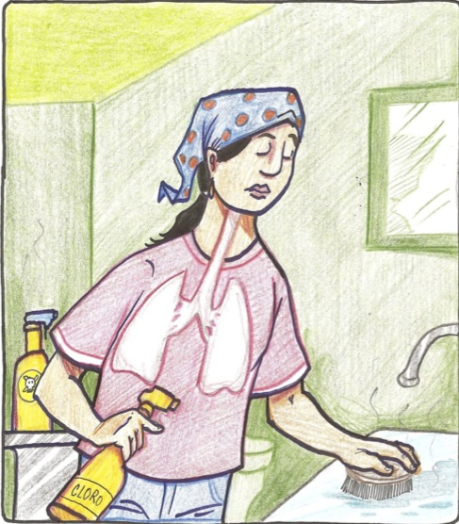
Respiratory Route
Notes:
This is one of the most important routes of entry or penetration because it is through the air that many toxic substances such as dust, smokes, aerosols and gases can enter our bodies.

Slide 9
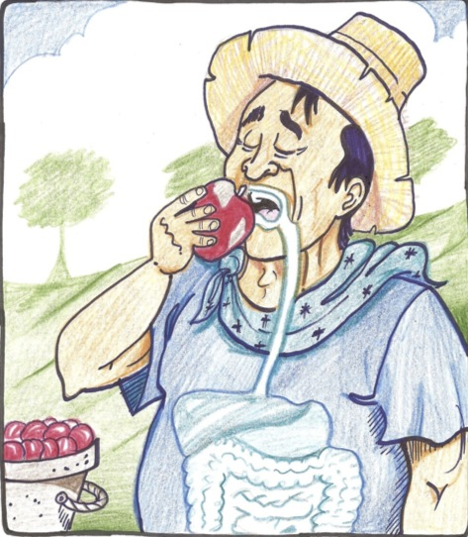
Digestive Route
Notes:
Route of entry through the mouth, the esophagus, the stomach and the intestines. Pollutant ingestions dissolved in mucus in the respiratory system should also be considered.

Slide 10
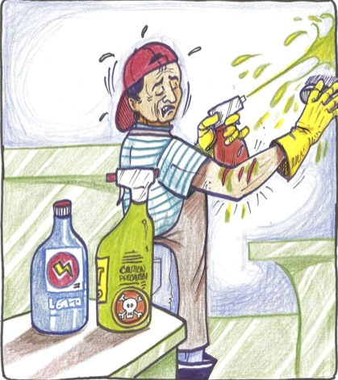
Parenteral Route
Por medio de heridas abiertas, ampollas, etc.
Notes:
Route of entry of the pollutant to the body through open wounds, sores, etc.

Slide 11
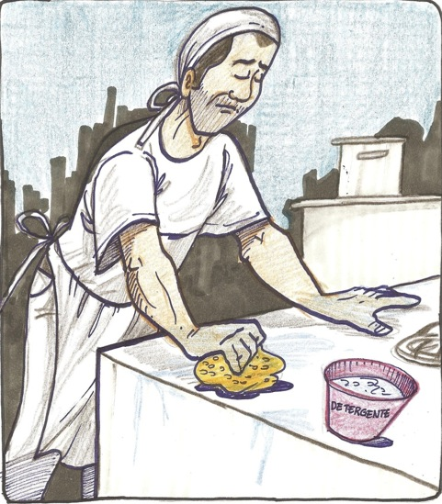
Dermal Route
Notes:
Route of entry of many substances that are able to go through the skin without causing erosion or noticeable alterations and that can enter the blood to later be spread to the whole body.

Slide 12
Chemical Labeling – How to read them!
Notes:
Tell participants:
Health and safety information on chemical substances is public, so you have the right to ask for the facts!
OSHA’s Hazard Communication standard requires chemical manufacturers or importers to classify the hazards of chemicals, which they produce or import. Also, it requires all employers to provide information to their employees about the hazardous chemicals to which they are exposed, by means of a hazard communication program, labels and other forms of warning, safety data sheets, and information and training.
Explain to the participants that OSHA defines a hazardous chemical as anything that is a physical or health hazard.
Physical hazards are pretty straightforward. They include flammable and combustible liquids, compressed gasses, explosives, organic peroxides, oxidizers, pyrophorics, and water reactive.
Health hazards are a little harder to determine, however OSHA indicates they include the following: carcinogens; reproductive toxins; sensitizers; irritants; corrosives; neurotoxins; hapatotoxins; nephrotoxins; agents that act the hematopoietic system; and agents that damage the lungs, skin, eyes or mucus membranes.

Slide 13
According to OSHA, chemical labels must include:
Notes:
We have stated before that most of us are exposed to chemicals in one way or another, but how many of us can read a label and understand it? Have any of you read the labels of the chemicals we use?
Ask participants to name some of the things they have noticed on a chemical label:
The list may include: the name of the chemical, a drawing, the active ingredients, a warning, who makes it, etc. Write them on a sheet of butcher paper.

Slide 14
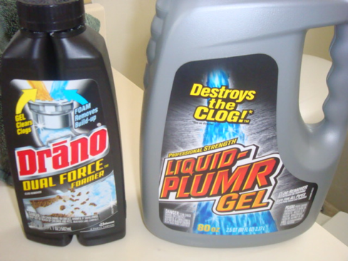
1. The common name of the chemical
Sodium hydroxide = Drano
Notes:
http://www.csudh.edu/oliver/chemdata/com_name.htm

Slide 15
2. The name, address and emergency phone number of the company responsible for the product

Slide 16
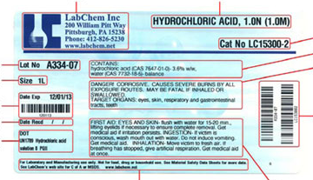

Slide 17
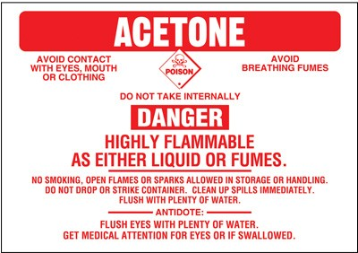
3. An appropriate hazard warning
Notes:
The warning may be a single word - "danger", "warning" and "caution" - or may identify the primary hazard, both physical (i.e., water reactive, flammable or explosive) and health (i.e., carcinogen, corrosive, or irritant). Most labels will provide you with additional safety information to help you protect yourself while working with substances. This includes protective measures to be used when handling the material, clothing that should be worn, first aid instructions, storage information and procedures to follow in the event of a fire, leak or spill.

Slide 18
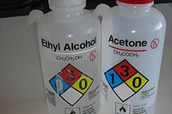
How to read the NFPA Chemica Hazard Label
Notes:
You may have noticed a diamond shaped label with 4 different colors and numbers in some chemical products. The label may look simple, but it actually carries a lot of information and it may help you identify the hazards associated with that product. This label is color-coded and each color represents a different type of hazard. Also, as mentioned before, it also uses a number system and each number represents the degree of a particular hazard.

Slide 19
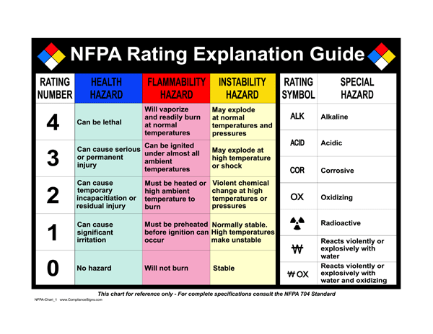
Notes:
The label may look simple, but it actually carries a lot of information and it may help you identify the hazards associated with that product. This label is color-coded and each color represents a different type of hazard. Also, as mentioned before, it also uses a number system and each number represents the degree of a particular hazard.
Special Notice Key (White)- This table contains special indications for some products. For example, if it is an oxidizing product, corrosive, water reactive or radioactive.

Slide 20
How can I protect myself?
Notes:
Let participants know that it is very important for them to be well informed of the chemical products they have to use at work and to know what to do in case they are overexposed to chemical hazards. Since day laborers often do not have the proper training, it is important for them to be aware of a few things they can do that can potentially protect them and their co-workers:

Slide 21
The Right to Know
Notes:
everyone who works with toxic substances should know the names, toxicity, and other hazards of the substances they use. Employers are required by law to provide this information, along with training in how to use toxic substances safely.

Slide 22
PELs- Permissible Exposure Limits
Notes:
the surest way to prevent toxic chemicals from causing harm is to minimize or prevent exposure. Limiting exposure at the source is the preferred way to protect workers.

Slide 23
Substitution
Notes:
Substitution- use a less hazardous substance. But before choosing a substitute, thoroughly consider its physical and health hazards. Also consider environmental aspects such as air pollution and waste disposal.

Slide 24
Ventilation
Notes:
Ventilation- make sure there is circulation of fresh air sufficient to keep concentrations of toxic substances diluted below hazardous levels.

Slide 25
Work practices and behaviors
Notes:
Work practices and behaviors- workers can control dust dispersion by spraying water (or dust suppressant products), closing containers of volatile chemicals when not in use, and labeling containers of hazardous substances.

Slide 26

Use of PPE
Notes:
Respiratory protective equipment consists of devices that cover the mouth and nose to prevent substances in the air from being inhaled. A respirator is effective only when used as part of a comprehensive program established by the employer, which includes measurement of concentrations of hazardous substances, selection of the proper respirator, training the worker in its proper use, fitting of the respirator to the worker, maintenance, and replacement of parts when necessary. A health care professional must first determine whether the individual worker can wear a respirator safely.
Protective clothing includes gloves, aprons, goggles, boots, face shields, and any other materials worn as protection. It should be made of material designed to resist penetration by the particular chemical being used. Such material may be called impervious to that chemical. However, most materials do not remain impervious for very long. The manufacturer of the protective clothing usually can provide some information regarding the substances that are effectively blocked and how often replacement is necessary.

Slide 27
What if I have been exposed?
Notes:
If you or your co-workers experience symptoms known to be caused by a chemical during or shortly after its use, you may have been overexposed. Symptoms might include irritation and tearing of the eyes, a burning sensation of skin, nose, or throat, and cough, dizziness, or headache.

Slide 28
Here are some things you can do in case of overexposure to chemical hazards:
Stop what you are doing and leave the space contaminated. Alert your supervisor. Call 911 for emergencies or the Poison Control Center 1-800-222-1222.

Slide 29
In case inhalation: clean air, rest in a semi recumbent position, artificial respiration if needed and medical care.
In case of a spill: take off contaminated clothing, wash area with plenty of water, seek medical care.
In case of splashing: Rinse with plenty of water for several minutes and seek medical care.
In case of consumption: rinse the mouth, DO NOT induce vomiting, drink plenty of water, and seek medical care.

