Slide 1
Sawmill Safety
Module 4 - Kilns

Slide 2
Timber Products Safety
There is a high incidence of serious and fatal injuries in our industry.
The Timber Products Manufacturers Association along with your employer recognizes the need for improved safety training for the industry.
With a grant from OSHA, TPM has developed the following training module to contribute toward the need for improved safety training and hazard recognition skills for those employed in America’s timber industry.

Slide 3
This Training Module
Uses adult learning techniques
Photos and video of actual practices at sawmills
Interviews with experienced timber industry workers
Short interactive exercises
New techniques for recognizing hazards

Slide 4
Training Module Worksheet
Since adults learn the most by doing, a worksheet has been prepared to help you retain the most important information.
You will complete the worksheet as we move through the material. This means that you will fill in the blanks or complete lists.
You can keep the worksheet as a reference to the key points presented in this module.

Slide 5
Safety:
A process for reducing risk and preventing incidents by effectively managing the movement of people, equipment, material and energy.
Notes:
Let’s get started with a functional definition of safety. It is called a functional definition because it is easy to remember and is fundamental to incident prevention. “Safety is a process for reducing risk and preventing incidents by effectively managing the movement of people, equipment, material and energy”. There are some key words in this definition. The first one is movement. No injury or incident has ever occurred without some form of movement. The other key words are people, equipment, material and energy. They are key because they are the only four things that can move. Think about it, if we were able to effectively control the movement of people, equipment, material and energy in our process, we would have no injuries or incidents.

Slide 6
Hazard:
Any source of danger.
The two major types of hazard are:
Unsafe conditions
and
Unsafe behaviors

Slide 7
Incident:
An unplanned event that happens after an unsafe behavior or unsafe condition or both that interrupts the normal progress of an activity and may result in injury or damage.
Notes:
An incident is an unplanned event that happens after an unsafe behavior or unsafe condition or both that interrupts the normal progress of an activity and may result in injury or damage. Three bad things can happen when incidents occur. Someone may be injured, equipment may be damaged or the process may be interrupted. All three are unnecessary, expensive and in one way or another painful. The most important thing to remember is that before every incident there is an unsafe behavior or unsafe condition or a combination of the two. If you wanted to be proactive and prevent incidents, What would you do? I think we can all agree that we would focus on the elimination of unsafe behaviors and unsafe conditions because they always happen before an incident

Slide 8
A sequence of events lead to incidents
The Hazards
(Unsafe Behaviors and Unsafe Conditions)
The Event
(Movement)
The Result
(Incident)

Slide 9
What is the Best Way to Prevent Incidents?
Recognize the Hazards
Manage the Movement of People, Equipment, Material and Energy
Notes:
First of all recognize the hazards. Once the hazards are recognized there is an opportunity to manage the movement of people, equipment, material and energy. The objective is to separate people from the hazards in an organized and controlled manner.

Slide 10
Manage the Movement
All incidents are initiated with movement.
Either the person moves to the hazard or the hazard moves to the person.
Notes:
Remember that all incidents begin with some form of movement. Either the person moves to the hazard or the hazard moves to the person in an uncontrolled or disorganized environment.

Slide 11
#1 Potential for Serious Injury
The number one potential for serious injury in terms of severity involving kiln operation is being struck by something.
And that is a fact!
About 40% of all serious injuries during the drying process involve a worker being struck by something.

Slide 12
No. 1 Hazard – Falling Boards Video Removed

Slide 13
Event Classification
Contact with objects and equipment.
Struck by
(Fractures, punctures, foreign bodies in eye, amputations etc....)

Slide 14
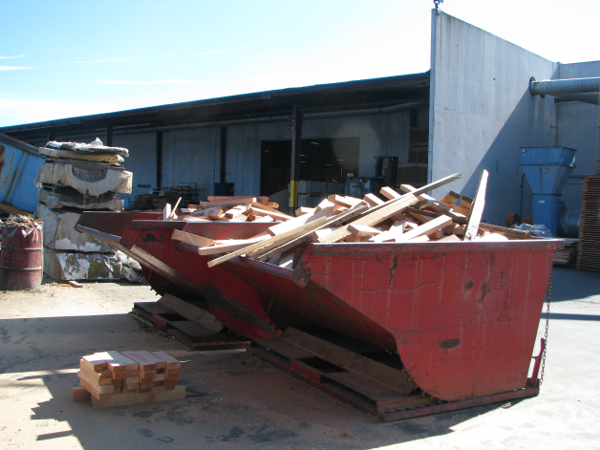
What Do You See?

Slide 15
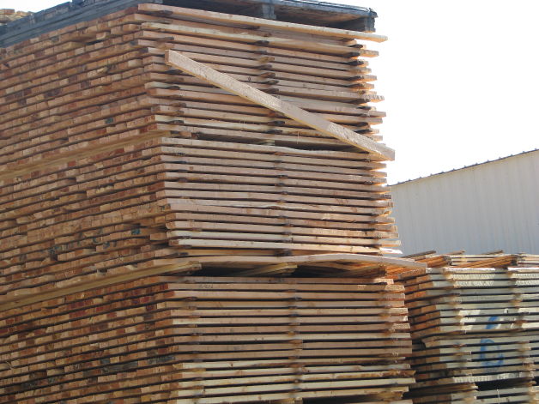
Potential to be Struck By

Slide 16
‘Struck By’ Boards
January 12, 1999, A worker enters a kiln to clear boards that had fallen from a kiln truck. While clearing the first stack of boards, a second stack falls onto the worker.
Hazards:
Unsecure stack of boards
Worker in danger area

Slide 17
‘Struck By’ Kiln Door
March 22, 1990, a worker places a steel kiln door in front of the kiln. The worker inspects the door from the front and a gust of wind blows the door onto the worker.
Hazards:
Unsecure Door
Worker in danger area
High wind

Slide 18
‘Struck By’ Kiln Door Again
April 6, 2004, a worker exits the kiln. A gust of wind blows the 2,000-lb. door closed on the worker.
Hazards:
Unsecure Door
Worker in danger area
High wind

Slide 19
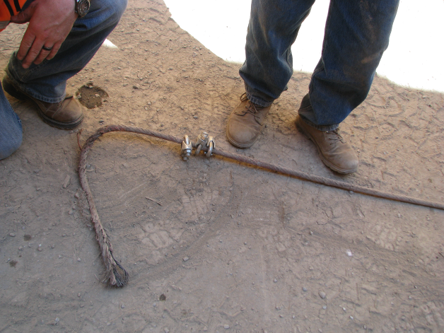
It Happens – You Just Don’t Know When!

Slide 20
Line of Fire
Remember, the longer the sling, the wider the recoil radius!

Slide 21
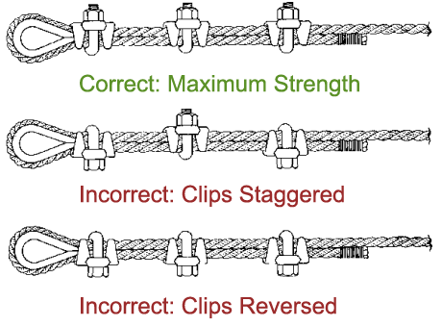
Clip Diagram

Slide 22
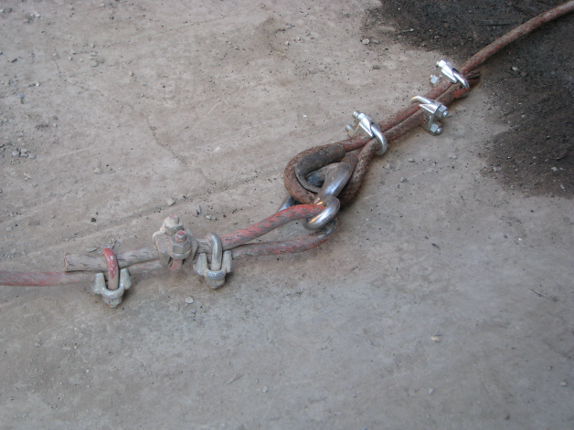
What Do You See Here ?

Slide 23

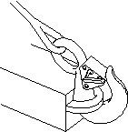

Hooks
Never use a hook whose throat opening has been increased, or whose tip has been bent.
Hooks should not be side loaded, back loaded, or tip loaded.
Side Loaded
Back Loaded
Tip Loaded

Slide 24
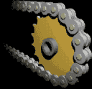
Event Classification
Contact with objects and equipment.
Caught in, on or between
(Amputations, fractures, crushing injuries etc....)

Slide 25
Caught In – On – Or – Between
On October 2, 2000, Employee #1 was working at a sawmill. He was operating a transfer car that moves stacked lumber that is staged for the dry kilns. The car operates in a shallow pit and moves on rails. The operator stands on a 2 ft. X 3 ft. platform mounted to the transfer car about 1 ft. off the ground. The transfer car was moving in reverse when the operator fell into the shallow pit. The car continued to move and Employee #1was caught in an estimated 2” to 6” space between the frame of the transfer car and concrete. He sustained fatal injuries. There was no door on the cab to prevent the operator from falling from the platform.

Slide 26
Caught In On or Between 2
November 6, 1997, a worker with a radio in a poorly lighted area guides a kiln truck into a kiln out of view of the forklift operator. A board comes loose and pushes the worker into the door casing producing fatal injuries.
Hazards:
Worker in danger area
Workers out of view from each other
Poor lighting
Dislodged board

Slide 27
Small Group Exercise
At approximately 10:18 a.m. on August 28, 2003, Employee #1 and three coworkers were using a push-pull method to move lumber through a drying process. The drying process involved a kiln truck on wheels, 72 ft. long by 8 ft. wide, with an estimated load of 172,800 pounds. Normally, two forklifts would be used to perform the push-pull task. One forklift would be on the south end pushing lumber, and one forklift would be on the north end pulling lumber out of the kiln dryer. This time the normal process was not working since the wheels on the kiln truck met with resistance that caused the kiln truck to stall. Two additional forklifts were positioned on the south side of the kiln. Employee #1 was operating the forklift on the north side pulling lumber out. Employee #1 was later found dead pinned between the kiln truck lumber and his forklift.

Slide 28
Small Group Exercise
At approximately 10:18 a.m. on August 28, 2003, Employee #1 and three coworkers were using a push-pull method to move lumber through a drying process. The drying process involved a kiln truck on wheels, 72 ft. long by 8 ft. wide, with an estimated load of 172,800 pounds. Normally, two forklifts would be used to perform the push-pull task. One forklift would be on the south end pushing lumber, and one forklift would be on the north end pulling lumber out of the kiln dryer. This time the normal process was not working since the wheels on the kiln truck met with resistance that caused the kiln truck to stall. Two additional forklifts were positioned on the south side of the kiln. Employee #1 was operating the forklift on the north side pulling lumber out. Employee #1 was later found dead pinned between the kiln truck lumber and his forklift.

Slide 29
Caught In On or Between 1
August 28, 2003, one forklift pushes the kiln truck and one pulls. The kiln truck becomes stuck. The front forklift operator dismounted the forklift to inspect kiln truck. Two additional forklifts join the rear forklift and push the kiln truck forward crushing worker in front.
Hazards:
Worker in danger area
Workers out of view from each other
Miscommunication

Slide 30

Event Classification
Exposure to Harmful Substances or Environments:
Contact with Temperature Extremes
(Steam, Condensation Pits, Hot Surfaces)

Slide 31
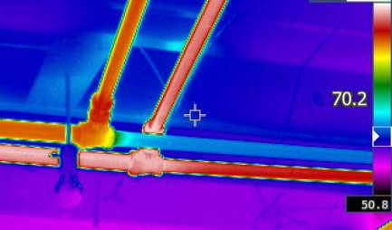
What you can do to avoid contact with temperature extremes
Assume surfaces are hot, hot surfaces look identical to cold surfaces.

Slide 32
Body’s Response To Temperature
When your body is hot-
When your body is cold-
Blood vessels get bigger so more blood enters the skin and heat is released.
Your glands also release sweat which helps cool the body.
Blood vessels get smaller so less blood enters the skin and heat is retained.
Your body begins to shiver to create heat.

Slide 33
The Regulations
OSHA 1910.265 (f) (8)
WAC-296-78-71017 (3)
Kiln tender room. A warm room shall be provided for kiln employees to stay in during cold weather after leaving a hot kiln.
A heated room shall be provided for the use of the kiln operator in inclement weather. He should remain in such room for at least ten minutes after leaving a hot kiln before going to cold air outside.

Slide 34
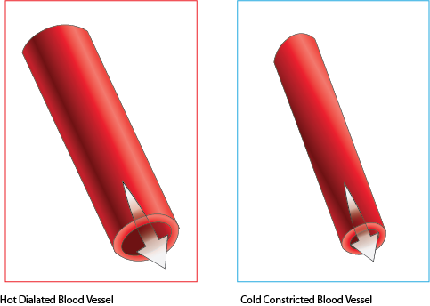
Danger: Extreme Temperature Change
Movement from the hot interior of a Kiln to very cold weather can cause constriction of blood vessels.
Hot Dilated Blood Vessel
Cold Constricted Blood Vessel

Slide 35
Hot Water Burns
On March 19, 1998, Employee #1 was working at a sawmill as a maintenance person. He was exiting a building when he stepped into a hole that was filled with hot water from steam pipes. He received second and third degree burns to his lower right leg and was hospitalized.

Slide 36
Fatal Condensate Burns
On January 14, 2000, Employee #1, a boiler operator at a sawmill, fell into an open sump pit and adjacent excavation (6 ft. wide by 4.5 ft. deep) that had become filled with hot condensate that had drained from the dry kiln and overflowed the holding tanks in the sump pit (approximately 8 ft. deep by 15 ft. square). The sump pumps did not maintain adequate drainage. The employee was fatally injured from the burns he sustained.

Slide 37
Susan Harwood Training Grant
"This material was produced under grant SH23591SH2 from the Occupational Safety and Health Administration, U.S. Department of Labor. It does not necessarily reflect the views or policies of the U.S. Department of Labor, nor does mention of trade names, commercial products, or organizations imply endorsement by the U.S. Government”

