Slide 1
Sawmill Safety
Module 5
Shipping and Handling
“Assume they can’t see you”

Slide 2
Timber Products Safety
There is a high incidence of serious and fatal injuries in our industry.
The Timber Products Manufacturers Association along with your employer recognizes the need for improved safety training for the industry.
With a grant from OSHA, TPMA has developed the following training module to contribute toward the need for improved safety training and hazard recognition skills for those employed in America’s timber industry.

Slide 3
This Training Module
Uses adult learning techniques
Photos and video of actual practices in the timber products industry
Interviews with experienced timber industry workers
Short interactive exercises
New techniques for recognizing hazards

Slide 4
Training Module Worksheet
Since adults learn the most by doing, a worksheet has been prepared to help you retain the most important information.
You will complete the worksheet as we move through the material. This means that you will fill in the blanks or complete lists.
A completed worksheet contains most of the key points presented in this module. You will need the worksheet to complete the interactive exercise.

Slide 5
Safety:
A process for reducing risk and preventing incidents by effectively managing the movement of people, equipment, material and energy.

Slide 6
Incident:
An unplanned event that happens after an unsafe behavior or unsafe condition or both that interrupts the normal progress of an activity and may result in injury or damage.

Slide 7
Hazard:
Any source of danger.
The two major types of hazard are:
Unsafe conditions
and
Unsafe behaviors

Slide 8
A sequence of events lead to incidents
The Hazards
(Unsafe Behaviors and Unsafe Conditions)
The Event
(Movement)
The Result
(Incident)

Slide 9
What is the Best Way to Prevent Incidents?
Recognize the Hazards
Manage the Movement of People, Equipment, Material and Energy

Slide 10
Manage the Movement
All incidents are initiated with movement.
Either the person moves to the hazard or the hazard moves to the person.

Slide 11
#1 Potential for Serious Injury
The number one potential for serious injury in terms of severity during the shipping and handling process is being struck by a forklift.
And that’s a fact!
59 % of all serious injuries during shipping and handling involve forklifts!

Slide 12
Event Classification
Contact with objects and equipment.
Struck by
(Fractures, punctures, foreign bodies in eye, amputations etc....)

Slide 13
Forklift Facts
Every three days someone is killed in a forklift related incident.
One out of every six occupational fatalities involve a forklift.
44% of forklift incidents involve a pedestrian.

Slide 14
Forklift – Pedestrian Interface
Wherever forklifts and people share the same area, there is DANGER. There are no exceptions.
In every collision involving a pedestrian and a forklift, the pedestrian loses.

Slide 15
Forklift Strikes Sawmill Worker
At approximately 3:40 p.m. on August 16, 1994, employee #1 was leaving a large sawmill after his shift. He was walking west in a crosswalk on his way to the front office when he was struck by a forklift. He sustained multiple fractures to the head and chest.

Slide 16
Forklift – Pedestrian Interface One More Time
Wherever forklifts and people share the same area, there is DANGER. There are no exceptions.

Slide 17
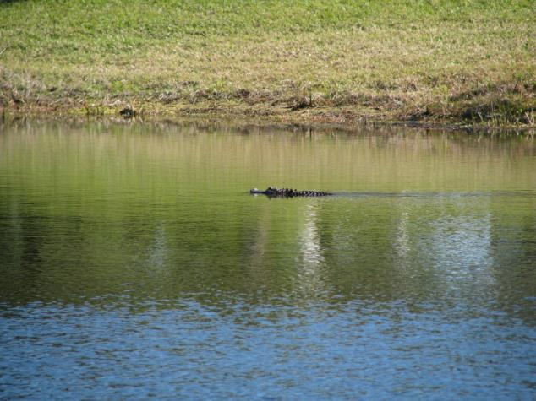
Anyone want to share this pond for a Swim?

Slide 18
Worker Struck By Forklift
At approximately 2:00 p.m. on November 8, 2010, employee #1, a pedestrian, was struck in the chest by a pack of lumber being moved by a forklift. The load of lumber was unstable as the forklift approached a blind corner intersection. Stacks of lumber were stored at the intersection which created the blind corner. A collision with the load of lumber occurred as employee #1 began to round the corner. Employee #1 died ten days later.

Slide 19
Why are so many pedestrians injured by forklifts?
There are four key points that everyone who works at a facility using forklifts need to know.

Slide 20
Point #1
The forklift operator has limited visibility because of the mast, lift cylinders, chains and hydraulic hoses at the front of the truck.

Slide 21
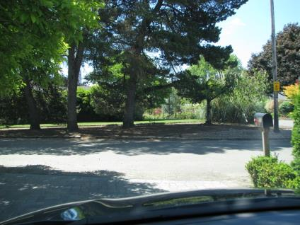
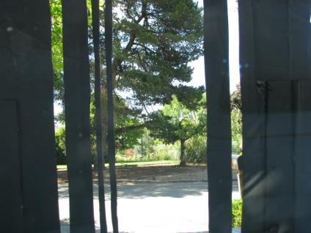
Driver Seat View
Honda CRV
If The CRV Was A Forklift

Slide 22
Point #2
Forklift operators have limited visibility when traveling in reverse because their seats face forward and they must turn their heads and look over their shoulder.

Slide 23
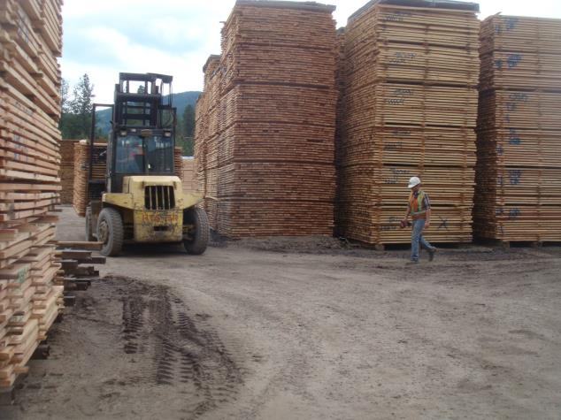
Limited Field of Vision
No Vision
Vision

Slide 24
A sequence of events lead to incidents
The Hazards
(limited vision for the operator)
(head down walking toward a moving forklift)
The Event
(forklift and pedestrian moving toward each other)
The Result
(Incident)

Slide 25
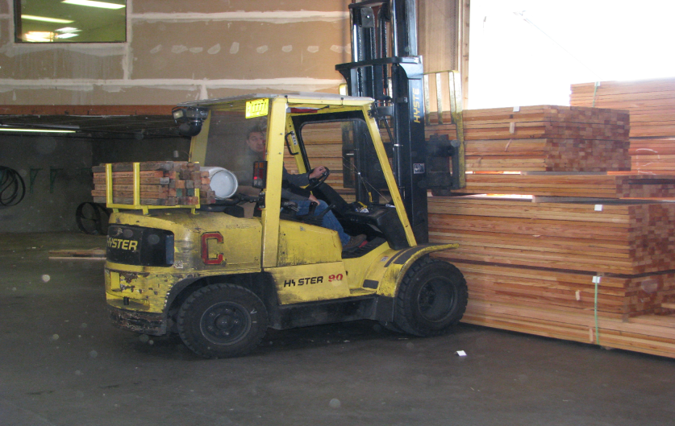
Limited Vision
No Vision on Left
Side of this truck
Vision Area

Slide 26
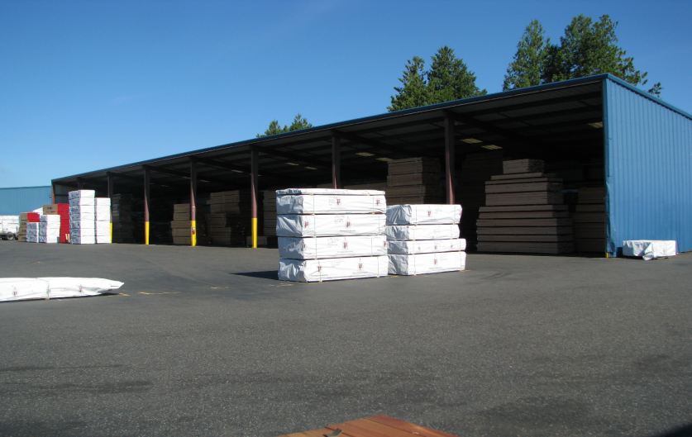
Temporary Blind Corner

Slide 27
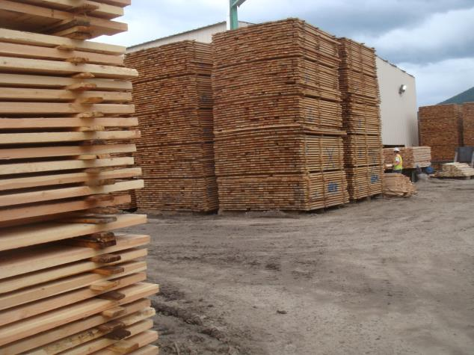
Blind Corners
Here
Here

Slide 28
Small group exercise #1
At approximately 11:55 p.m. on October 16, 2007, Employee #1 wearing a dark color hooded jacket entered the sawmill through the walk area designated for pedestrian traffic. This area passes through an area where there is forklift traffic. As Employee #1 was crossing the cross walk, a forklift was travelling through the area to get one last load of lumber from inside the sawmill before the end of the shift. The area is lighted, but it was raining very hard. The forklift operator did not see Employee #1 and struck him. Employee #1 was transported to the hospital where he was admitted for treatment.

Slide 29
Point #3
Forklifts steer with their rear wheels so any turning will cause the rear end of the forklift to go in the opposite direction.

Slide 30
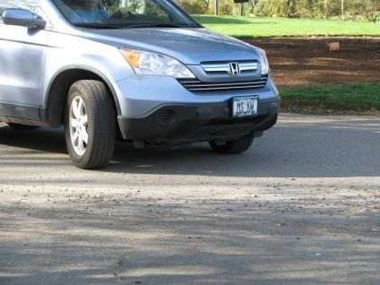
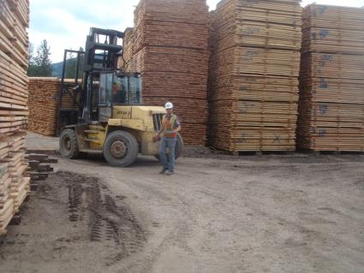
Steering Differences
Front Wheels
Rear Wheels

Slide 31
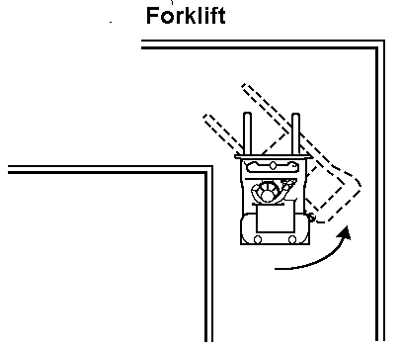

Rear End Swing

Slide 32

The Rear End Swing Can Take You Out

Slide 33
Point #4
Forklifts do not stop quickly.

Slide 34


Point #4: Forklift Stopping Distance
Stopping Distance (10 MPH)
Stopping Distance (10 MPH)
17 feet
38.7 feet

Slide 35
Vehicle Speed 10 MPH
Stopping Distance
Stopping Distance
17 feet
38.7 feet

Slide 36

How Close Would You Go?

Slide 37
Why are so many pedestrians injured by forklifts?
Forward visibility is limited on forklifts
Rear visibility is limited on forklifts
Forklifts steer with their rear wheels.
Forklifts do not stop quickly.

Slide 38
Experience and Wisdom Have Spoken
To the pedestrian:
“Assume they can’t see you.”

Slide 39
Pedestrians
“Assume they can’t see you.”

Slide 40
Experience and Wisdom Have Spoken
To the Forklift Operator:
“You need to be for watching out for other people coming up along side of you or behind you.”

Slide 41
Forklift Operators
“You need to be for watching out
for other people coming up along side
of you or behind you.”

Slide 42
Experience and Wisdom Have Spoken
To the Pedestrians and Forklift Operators:
“Not only paying attention to what you need to be doing but watch out for the other people around you too!”

Slide 43
Pedestrians and Forklift Operators
“Not only paying attention to
what you need to be doing but
watch out for the other people
around you too!”

Slide 44
Small group exercise #2
Use the information on the handout and identify three things that can be done at your facility to reduce or eliminate the potential for forklift related incidents. After the three things have been identified, select the best one and provide the additional information.

Slide 45
Susan Harwood Training Grant
“This material "This material was produced under grant SH23591SH2 from the Occupational Safety and Health Administration, U.S. Department of Labor. It does not necessarily reflect the views or policies of the U.S. Department of Labor, nor does mention of trade names, commercial products, or organizations imply endorsement by the U.S. Government”

