Slide 1
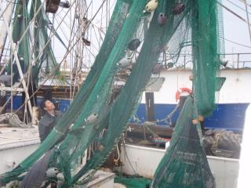
Strains, Sprains, & Pains: Ergonomic Injury Prevention for Commercial Fishermen
Section A- Introduction & Back Issues
www.amsea.org

Slide 2

Susan Harwood project
This material was produced under grant number SH-23541-12-60-F-2 from the Occupational Safety & Health Administration, U.S. Department of Labor. It does not necessarily reflect the views or policies of the U.S. Department of Labor, nor does mention of trade names, commercial products, or organizations imply endorsement by the U.S. government.

Slide 3
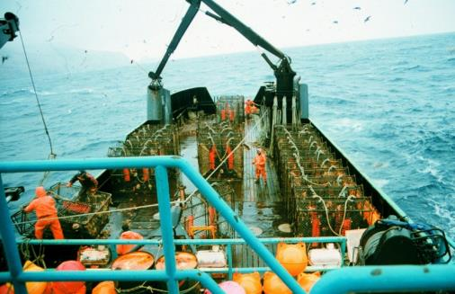
Ergonomics
The science of adapting workspace, tools, equipment, and work methods for more efficient, comfortable, and error-free use.

Slide 4
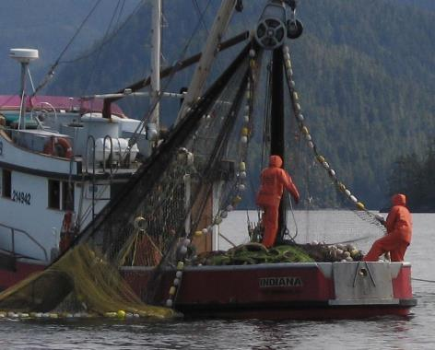
Commercial Fishing is Hard Physical Work!
- Moving deck
- Confined space
- Obstacles
- Cold/heat/wet
Long hours
Poor diet/sleep
Work is home
A challenging ergonomic environment!

Slide 5
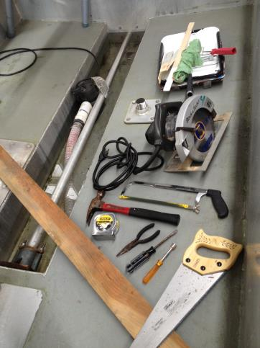
…plus fishermen need to work on…
Electrical systems
Engine mechanics
Hull maintenance
Refrigeration
Fishing gear
Hydraulics
Carpentry
Plumbing
Hand/power tools
Welding….and more!
Notes:
All these activities involve different ergo issues- just think of the bad postures one assumes when working on an engine in a small space!

Slide 6

Musculoskeletal Disorders (MSDs)
in Commercial Fishing:
Alaska Fishermen’s Fund data indicates @ 40% of claims due to strains, sprains, MSDs, and Carpal Tunnel Syndrome (CTS). - 2009-2012
In North Carolina 39% had a traumatic injury in 12 months. 50% strains, sprains, CTS; 70% due to lifting/moving; 18% said it limited work ability.
1/2 of Swedish fishermen had low back
pain in last 12 months. 2/3 of New Zealand fishermen have lower back problems.
Notes:
It’s a world wide problem in fisheries.

Slide 7
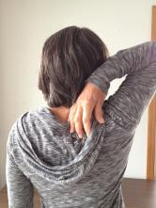
Prevention: cheaper than the cure
Then: (DePalma & Rothman, 1970)
“No operation in the field of surgery leaves in its wake more human wreckage than surgery on the lumbar disks”-
Now: (Weinsten et al; 2006)
Surgical success rates for
Disc surgery= 42.6% vs 32.4% for
non-operative
Notes:
POINT BEING THAT SURGICAL BACK SUCCESS RATE IS LESS THAN 50% (“so don’t just assume you can work till your back hurts too much to carry on and then just get it fixed”).
Remember that “Minor surgery is only minor when it happens to someone else”

Slide 8
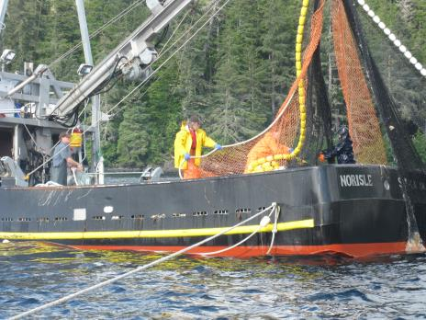
Musclo-skeletal system-
Your bodies winch system
Muscles are the motor (generate force).
Tendons are the cables (transfer force)
Skeletal system is metal framework.
Notes:
In a winch system muscles are the motor/engine, tendons are the cables, bones are the metal structure.
Tendons connect muscle to bones. Tendons and muscles work together.
Muscles get sore, but TENDONS get damaged.
(Ligaments join one bone to another bone, and fascia is the fibrous connective tissue enveloping, separating, or binding together muscles, organs, and other soft structures of the body).

Slide 9
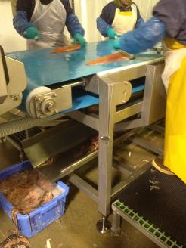
Risk Factors for “Ergonomic Injuries” (Musculoskeletal Disorders - MSDs)
“BIG FOUR” RISK FACTORS
High Force
Bad Posture
Exertion Repetition and Duration
Work Shift Duration
OTHER RISK FACTORS
Environment- cold, heat
Personal Characteristics- age, BMI, smoking, diet, fatigue, supportive
home environment.
Notes:
BMI= Body Mass Index (or how fat you are).
Univ of Utah study found out that people from non-supportive home environments have more MSD problems (Bloswick et al).

Slide 10
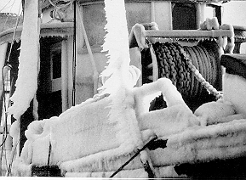
MSD - Risk Factors (Cold temp)
Direct hazard to tissues/desensitize receptors in hands - workers grip tools harder.
Little research, but cold appears to increase MSD symptoms. This tendency increases with years of exposure.
Back – yes
Shoulder – maybe
Wrist – yes, with repetition
Notes:
Reported carpal tunnel syndrome appears to increase when cold temperatures are combined with repetitive wrist movement.

Slide 11
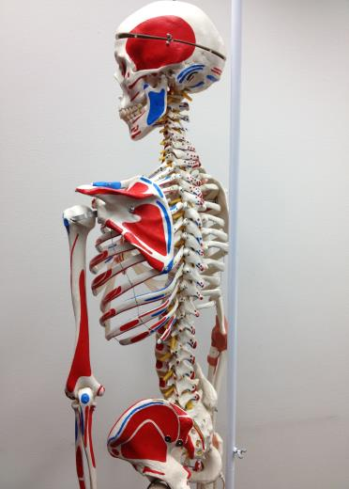
Musculoskeletal Injuries Section 1: Back (and shoulder)
Vertebrae- 4 curves:
CervicalC1-C7
ThoracicT1-T12
SPINE
Lumbar
L1-L5
L5-S1
Sacral
S1
Notes:
4 curves- acts as a spring– LUMBAR CURVE gets most of the bending AND compressive force. “Preserve the Curves” !
Disc between L5 – S1 has most problems. It’s the bending point between the flexible Lumbar and the not-so-flexible Sacrum.
(Note: Some people have a 6th Lumbar vertebra but it doesn’t seem to cause any problems).
There are 5 vertebrae in the sacrum which totally fuse by the age of 34.

Slide 12
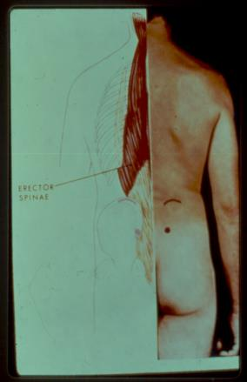
Back Anatomy
The back muscle (erector spinae) resists the tendency for the upper body to bend forward when lifting the load AND the upper body weight.
Notes:
Hunters will recognize this muscle as the “backstrap” in venison.
This muscle helps you from falling forward when you bend.
It is a LARGE muscle!

Slide 13
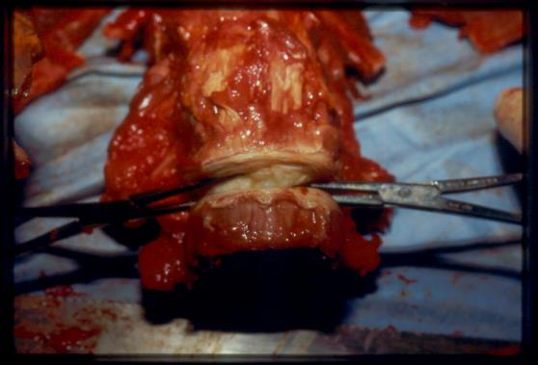
Spinal Disc Anatomy
The spinal disc is composed of a harder outer layer (rings of ligament) with a soft inside (sponge like)
(Like a jelly roll.)
Notes:
The muscle contracts for lifting thus produces a Compressive Force on the spinal discs
Disc is very well designed! The spongy inside (nucleus) acts as a shock absorber. This soft inside is held together by the outside rings of ligament.
When outside ligament is torn/worn out, the inside spongy part leaks out – you get a Herniated Disk. Leaking causes 3 problems: 1- Mechanical pain due to pressure on disc & ligaments, 2- if interior sponge mixes with blood you get inflammation 3- pressure against a nerve causes radiating pain.
The term “slipped disk” is inaccurate.

Slide 14
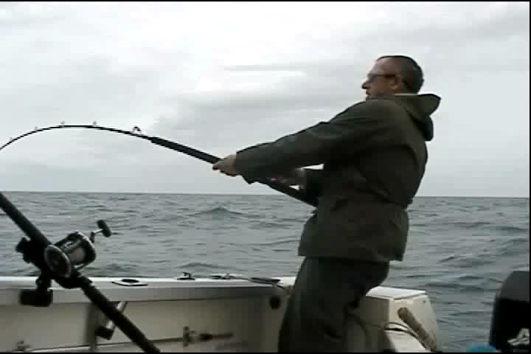
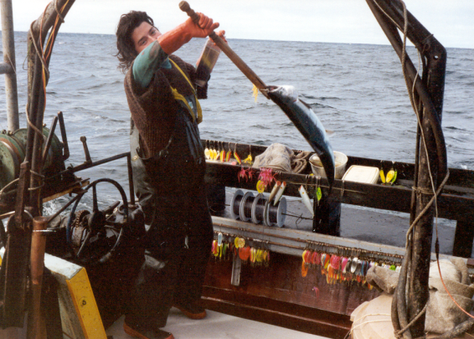

5 risk factors of musculoskeletal back injury:
1. The weight/size and direction of the load or force on the hands.
Notes:
Gaffing a salmon and bringing it onboard- note force above the shoulders.
But some weight/size and direction of load movements cannot be easily changed due to the nature of a fishery and constraints of the fishing vessel.

Slide 15
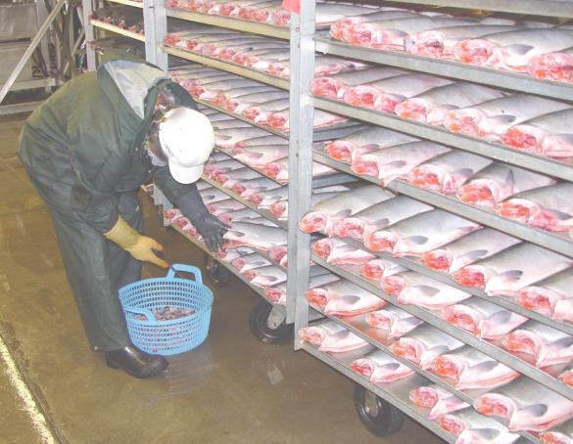
2. The posture assumed (Including twisting of body and horizontal distance of load out from body.)

Slide 16
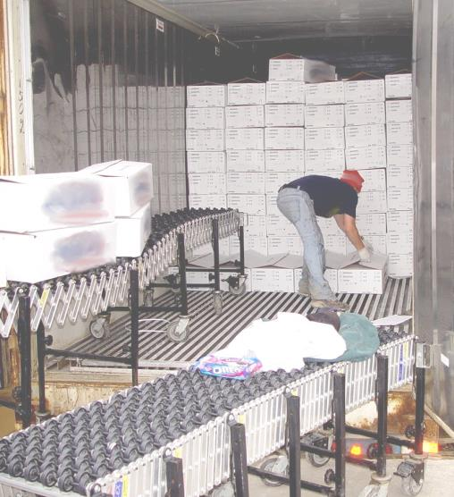
1 & 2 Stress from force and posture.
Notes:
She is lifting 40 lb boxes of fish.

Slide 17
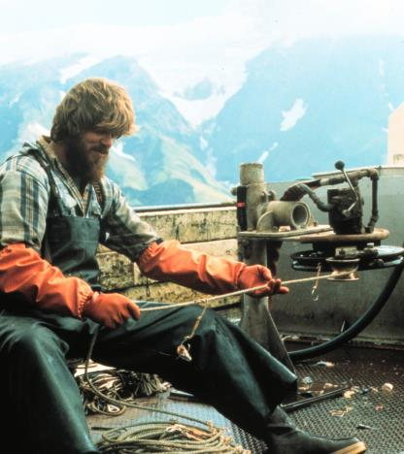
1. Force and 2. posture cause biomechanical stress. Stress is also increased due to ……
3. Frequency
of force
4. Duration
of activity
5. Fixed or
stationary postures

Slide 18
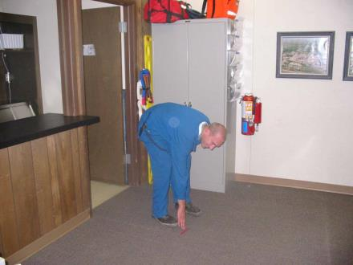
Compressive Force
Assume Joe is 6’2”, weighs 185 pounds, and is picking up his pen.
What do you think his back compressive force is in this posture?
~585 pounds (assuming straight legs, torso at 90 degrees, and no arm support on knee).

Slide 19
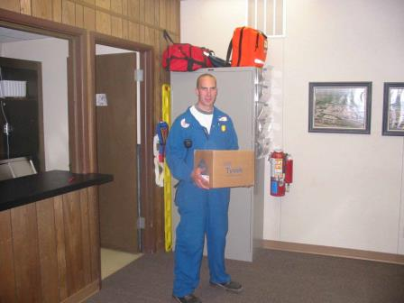
Compressive Force
How much does the box in the picture have to weigh to produce a back compressive force the same as when Joe was picking up his pencil?
Just over 80 pounds (assuming an upright posture).

Slide 20
Similar Compressive Force
80 lbs
These are equivalent, what does this tell you?
Notes:
When you bend up a heavy load (just your upper body) its similar to the weight of picking up the 80 lb box.

Slide 21
The Lever, Fulcrum & Force
Muscle Force
500
50 lbs
550
2”
20”
Note: The 500 lb muscle force needed to lift 50 lb load alone. But upper body weight must also be supported by lower back. If back is bent, back muscle force is even greater!
Notes:
The 550 lbs number includes the 50# weight in his hands)
So keeping the back straight is easier on back since you don’t have to lift up the back as well as the weight.
- L5/sacral is at the tip of the fulcrum.
Hold ruler horizontal with pinch grip at one end. Place a weight like a square rubber eraser (or a large nut) near pinch grip and note it takes little effort to hold ruler level. Move eraser or nut to opposite end of ruler and note extra effort needed to keep ruler level. It’s all about the lever.
Take 12” ruler and hold end with pinch grip. Place square rubber eraser on ruler near finger and note negligible effort to keep ruler horizontal. Slide eraser to opposite end of ruler and note extra effort fingers take to keep ruler level.
2” behind the fulcrum (spine) it takes 500 lbs to balance a 50lb weight 20 inches out from the fulcrum (spine). The moment caused by the upper body weight would make the back muscle force even greater.
To demonstrate the principle of keeping the load close, think of a simple lever. The overall length of this lever is 22 inches. The back muscle is 2 inches behind the top of the fulcrum but the 50lb weight is 20 inches out from the fulcrum. So the long side of the lever with the 50lb weight is 10x further out than the short side. To create balance for lifting, the 2 inch side of the lever has to produce 10x as much force to balance= 500lbs.
This is to illustrate the importance and impact of keeping the load and the work as close to the body as possible.

Slide 22

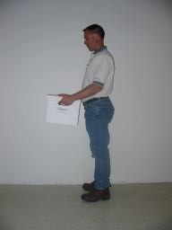
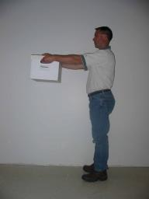
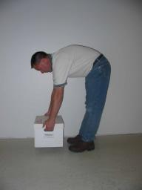
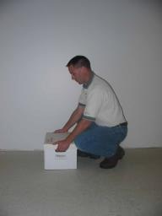
Compressive Force
~275 lbs ~480 lbs ~635 lbs ~520 lbs
~520 lbs
For a load, musculoskeletal stress is reduced by keeping load close to body. This reduces back compressive force.
Notes:
These forces have been measured and verified by analytical, mathematical and computer models.

Slide 23
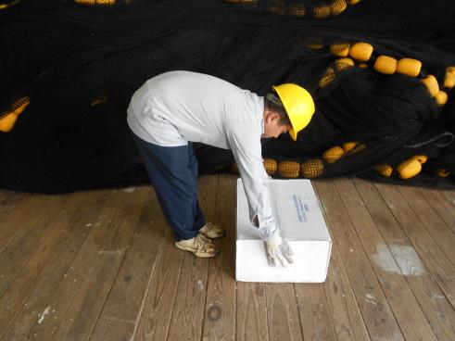
When lifting/lowering a weight, the torso weight can contribute more stress.
Keep torso as upright as possible. NOT like this!
Notes:
Try to avoid bending at waist when lifting if possible.

Slide 24
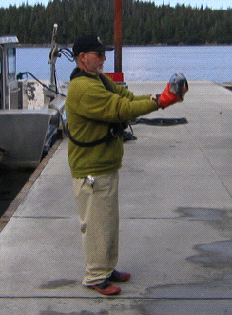
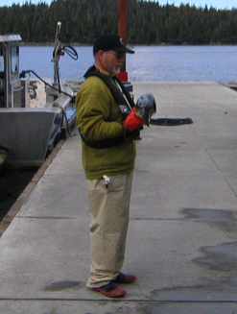
How to hold a heavy salmon
CORRECT way to hold
NOT like this.
Notes:
Keep the weight close to the body.

Slide 25
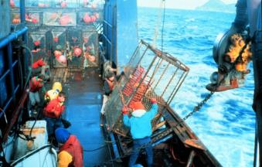
National Institute for Occupational Safety & Health (NIOSH)
GENERAL RECOMMENDATION
Avoid lift of more than 51 lbs at one time, especially if frequent and long duration BUT…..
often NOT possible in the
fishing industry!
Notes:
Some research recommends a maximum of 35 lbs, especially when lifting frequently.
GENERAL recommendation and there are wide ranges of human size and strength.

Slide 26
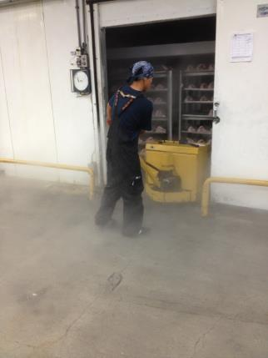
STRESS DURING PUSH/ PULL TASKS
Low-back compressive force less when the force direction is close to the waist.
Shoulder stress less when force direction is through the shoulder by work design and/or work practices.

Slide 27
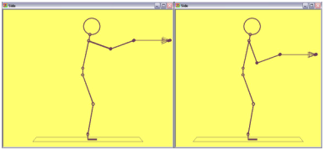
To lower shoulder stress
To lower back stress
Notes:
Fishermen often develop work practices that optimize the overall stress on the body, but do not minimize the stress on any one joint.
An example of this is locating the hands about half way between low back and shoulder when pulling or pushing so neither back nor shoulder is highly stressed.

Slide 28
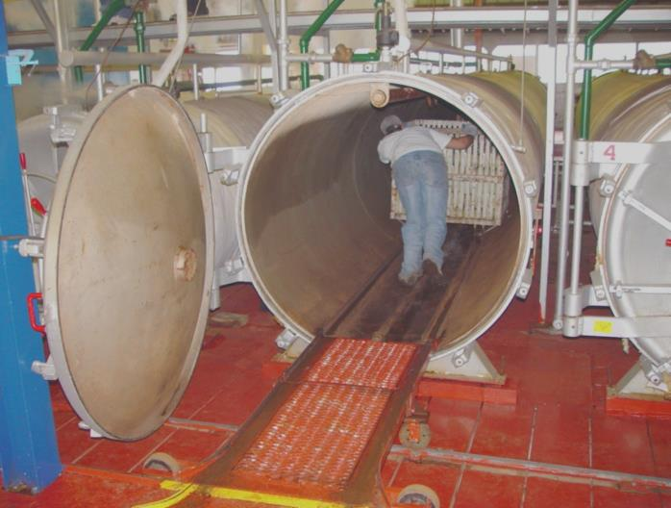
In general, pushing is lower stress than pulling.
Notes:
Salmon cans into pressure cooking retort-

Slide 29
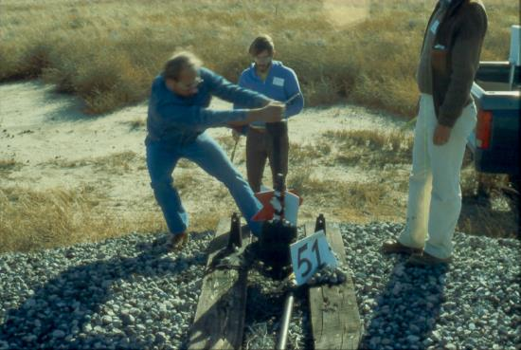
Low-Back Stress
Move your feet - don’t twist your body while using force.
Notes:
Picture: throwing a railroad switch.
Move your feet, NOT your waist!

Slide 30

Low-Back Stress
Body twisting can cause additional stress on spinal discs

Slide 31
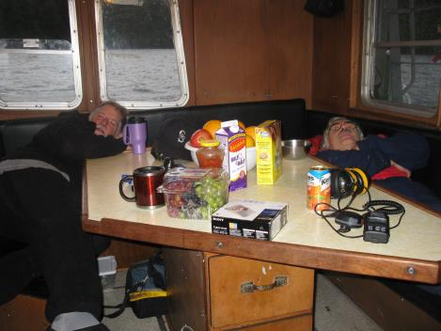
Low-Back stress
Fatigue may alter the way a task is performed and poor posture.
Notes:
Resting between salmon seine sets in Alaska.
FATIGUE ALSO RESULTS IN POOR BODY POSTURE THUS INCREASES STRESS.

Slide 32
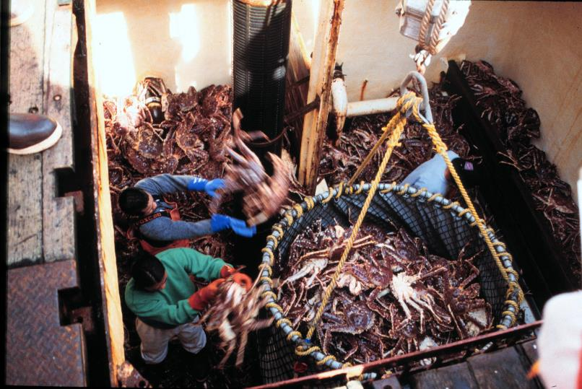
Effort Repetition and Task Duration (Physical Stress) 2. Physiological Stress
Notes:
Note throwing crabs above shoulders.

Slide 33
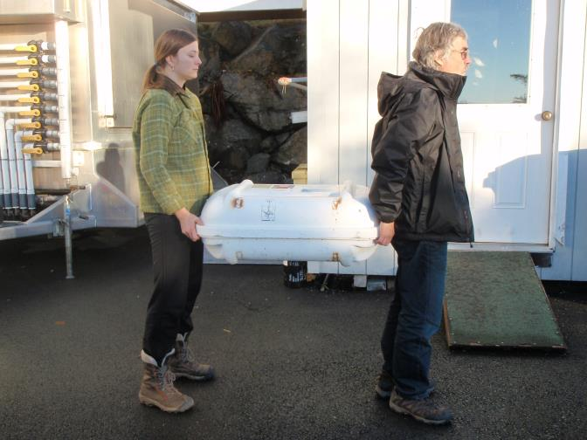
Other Things to Think About: Two person lift
Notes:
Hand Force for two people lifting is about 60% of load weight for each person because people don’t cooperate perfectly with lifting.
NOTE: Hands Behind Back Lift. The position of man in front with hands behind back causes less stress on back. Weight is closer to his spine and hands are more in line with spine and posture more erect.

Slide 34
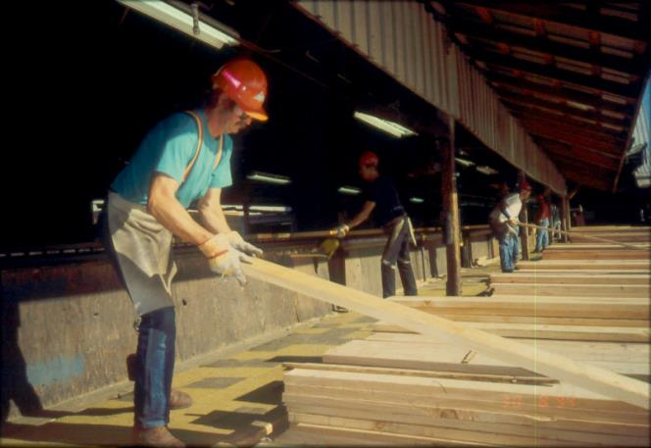
Other Things to Think About: Lift end of Board
Max Hand Force = 50% of board weight
Notes:
To move heavy weights, pick up one end at a time to move. The higher the board gets, the less strain on the back.

Slide 35
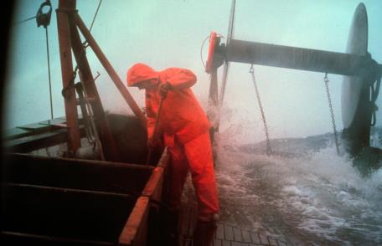
Other Things to Think About: Environmental Conditions
Hot temperatures increase fatigue & affect lifting posture.
Cold temperatures require bulky clothing, which affect lifting posture also.
Notes:
Cold may cause more muscle strain but no study shows that cold is transferred to spinal discs.

Slide 36
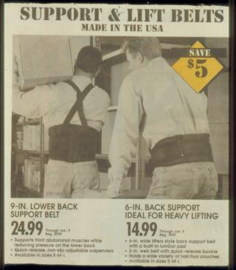
BACK BELTS?
NIOSH: little evidence that belts prevent back injuries.
In the “Home Depot Study” use of back belts was associated with reduction in low back injuries, but there were confounding factors.
Notes:
There is often no training to teach workers how and when to use back belts.
No good studies that account for variables demonstrate it makes a difference.
May help keep the back in better posture however.
Downside is that the brace effect may make people feel feel they can lift more than they should

Slide 37
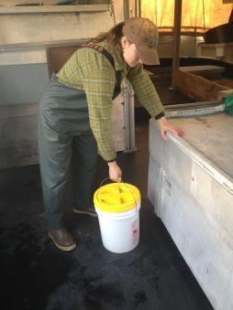
8 Back Recommendations
Keep body upright (as much as possible)
2. Keep load/force close to body.
3. Push/pull mid-torso height.
4. Don’t twist body.
5. Don’t jerk.
6. Get help moving.
7. Make a “bridge”.
8. Tighten stomach, exhale when lifting.
Notes:
Its more subtle than tighten the belly: its more pull naval away from belt and exhale as you lift.
A “Bridge” helps support both the load AND the weight of the upper body.
Valsalver” maneuver is caused by grunting- involves the stomach muscles assisting the back when lifting.

Slide 38
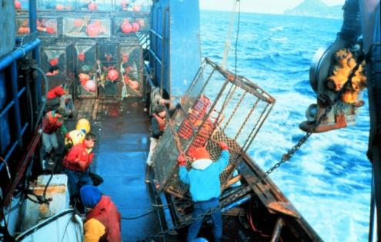
LOW BACK ISSUES - Summary
Use Better
POSTURE
Use less
FORCE
Decrease FREQUENCY & DURATION
Notes:
Focus on:
Better Posture
Using less force
And less frequency and duration of task.

