Slide 1

Strains, Sprains, & Pains: Ergonomic Injury Prevention for Commercial Fishermen
Section B- Upper Extremity- Shoulder, Elbow, Wrist, Hand Issues
www.amsea.org

Slide 2

Susan Harwood project
This material was produced under grant number SH-23541-12-60-F-2 from the Occupational Safety & Health Administration, U.S. Department of Labor. It does not necessarily reflect the views or policies of the U.S. Department of Labor, nor does mention of trade names, commercial products, or organizations imply endorsement by the U.S. government.

Slide 3
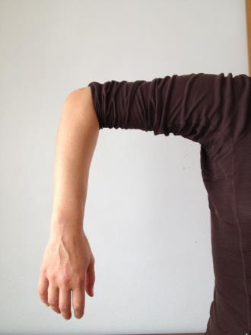
Musculoskeletal Injuries
Section B:
Upper Extremity (shoulder, elbow, wrist, hand)

Slide 4
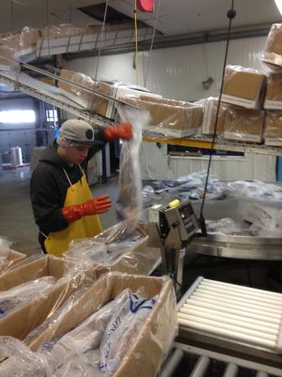
Upper Extremity Stress Causes (same issues as back)
1. Force.
2. Posture.
3. Effort repetition/
effort duration.
4. Shift duration.

Slide 5
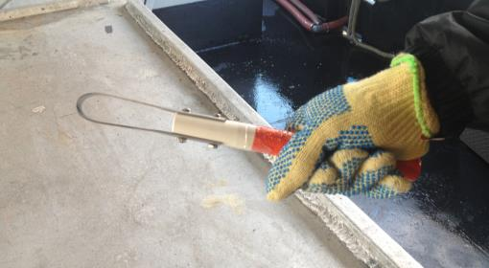
Specific Risk Factors for Upper Extremity Musculoskeletal Disorders (UEMSD)
1. Grip Force
2. Posture
3. Frequency/
repetition
4. Contact
5. Cold Temperature

Slide 6
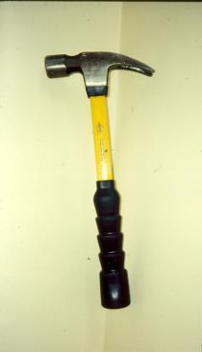
UEMSD - Risk Factors
Grip Force - Reduction
Tool design-decrease hand force
Use power grip
Improve mechanical advantage
Improve friction grip/
glove characteristics
Automate if possible

Slide 7
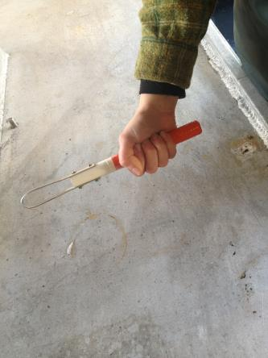
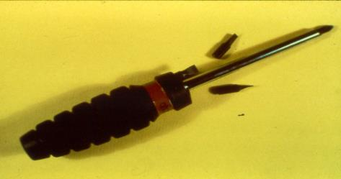
UEMSD - Risk Factors
Force – Reduction: handle easier to grip and turn
Full force grip

Slide 8
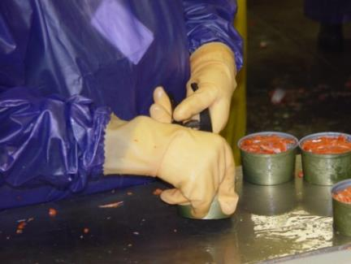
UEMSD- Risk Factors – (Posture)awkward postures increase stress
High forces and/or awkward posture can cause tendonitis (inflammation of the tendons.)

Slide 9
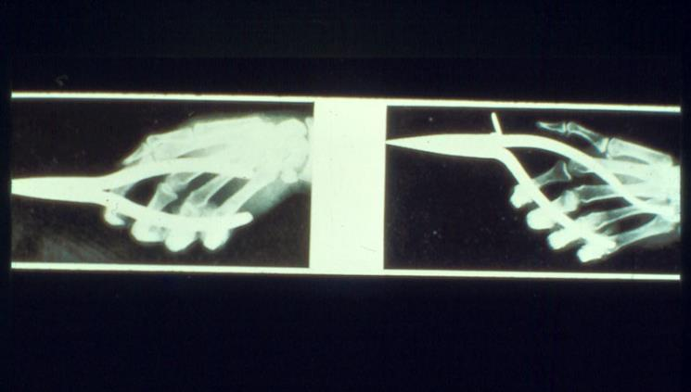
UEMSD - Risk Factors (Posture)
Put the bend in the tool - not the hand.
Notes:
Put bend in the tool, not the wrist.

Slide 10
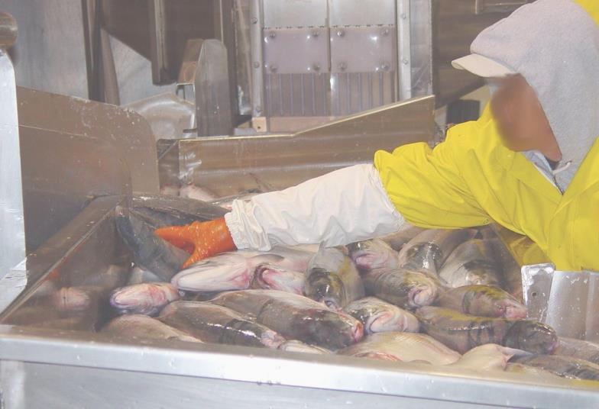

UEMSD - Risk Factors (Posture)
Notes:
Avoid excessive forward reaches. Use/make a tool to reach with if doing this frequently.

Slide 11
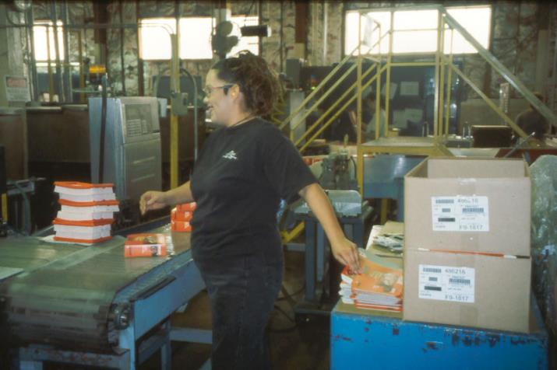
UEMSD - Risk Factors (Posture)
Notes:
Avoid moving shoulder behind body. The “Fix” in this case was simply moving the table behind her in the picture to her left side.

Slide 12
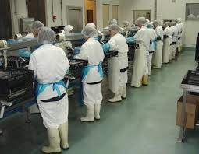
UEMSD - Risk Factor Reduction
Posture –
1. Workplace design/work orientation
2. Minimize wrist/shoulder deviation
3. Try to keep the hand in front below mid-torso
4. Work methods
Automate if possible

Slide 13
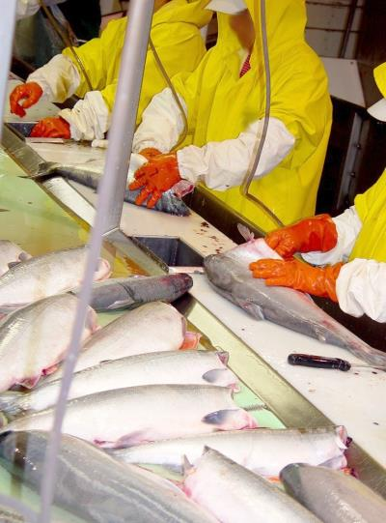
UEMSD - Risk Factors (Freq/Rep)
The stress on the body appears to accumulate with repeated exertions.
Notes:
High frequency on the slime line! Common risk for CTS.

Slide 14
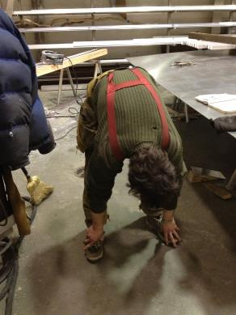
UEMSD – Reduce Risk Factors
High Repetition - Minimize
1. < decrease repetition
2. Worker rotation
3. Alternate hands
4. More rest breaks
5. Greater job variety
6. Automate
CATCH + FISH WITH – EFFORT = + $$$$
Notes:
Goal is to catch or process more fish, with less effort and less medical cost which equals more efficiency and earning/saving more money and a longer working career!

Slide 15
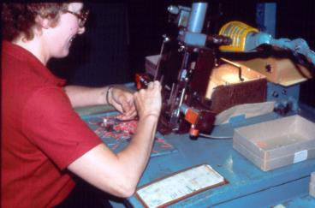
UEMSD - Contact Trauma
Caused by direct contact with the work piece, tool, or work surface.
Hazardous when hand used repeatedly to pound/push on parts.
Injury possible when elbows/forearms rest on hard surface.
Notes:
Work related padding.
Coamings around vessel tables keep objects from sliding but are uncomfortable and cause contact trauma.

Slide 16
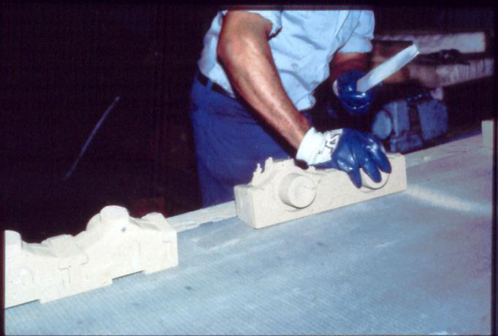
UEMSD - Contact Trauma
Notes:
Even though using gloves he is hitting with the palm of right palm. We tend to use the heel of our palm for pounding but it has little padding & is directly over nerve junction.
Note how he is holding the file in his left hand.
Shaded parts of graphics show the force in the hand holding the file.

Slide 17
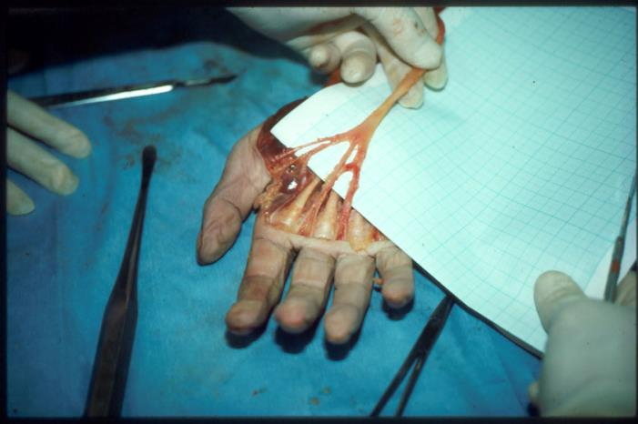
UEMSD - Contact Trauma
Notes:
This does trauma to the Median nerve

Slide 18
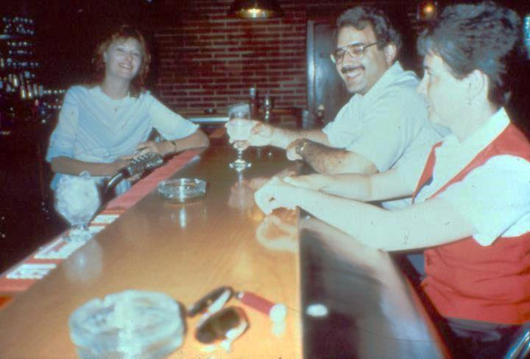
UEMSD - Risk Factors (Contact)
Notes:
Padding has been on bars since 1910 but padding not used in workplace till 1970’s! Use of ergonomics in workplace took a long time to realize. If you want to keep customers/employees around, use padding!

Slide 19
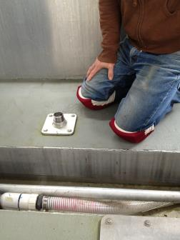
UEMSD - Risk Factors
Contact Trauma – Reduction
Padding
2. Distribute force among fingers
3. Alternate hands
4. Workplace redesign
5. Automate
Notes:
For contact trauma buy pipe insulation-cheap at building supply stores.
Don’t forget about knee pad protection as well!

Slide 20
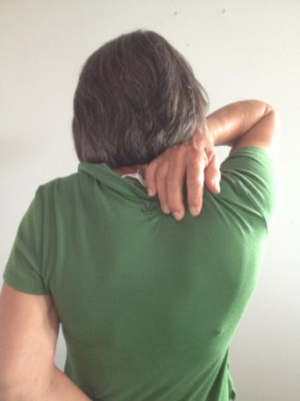
Shoulder Problems
Tendonitis- inflamed tendon
Bursitis- inflamed bursa- fluid filled sac
Caused by:
Using arms
overhead tasks.
2. Imbalance shoulder.
3. Muscle weakness.
Major risk factors:
force,
posture,
repetition.
Notes:
Overhead work can cause tendonitis and bursitis (an inflammation of the bursa- a fluid filled sac that cushions tendons. Arms used overhead can get the tendons and bursa near the shoulder joint caught between bone and ligaments.

Slide 21
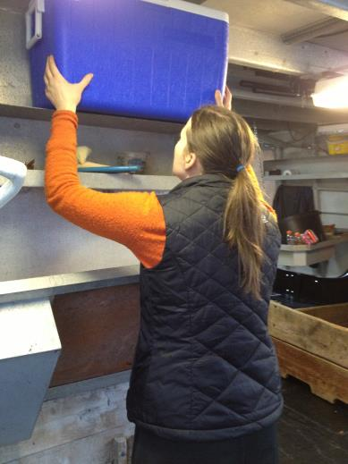
Shoulder Problem Prevention
Avoid work at or
above shoulders.
2. Get help with over-
head work.
3. Keep shoulders
square, rolled back.
4. Exercise shoulders
and mid back.
Notes:
If possible, store heavier objects at mid torso level.

Slide 22
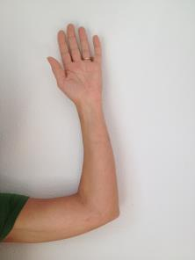
Elbow Problems
Tendonitis at the elbow is called “epicondylitis”.
Tennis elbow - outside of elbow.
Golfers elbow – inside of elbow.
Pain increasing around outside of elbow due to lifting, gaffing, baiting, cleaning.

Slide 23
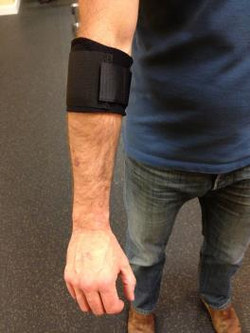
Epicondylitis Treatment
Avoid pain causing activity.
Ice pack 30 minutes - 2x/day.
Anti-inflammatory drugs.
Use forearm brace.
Use gloves that grip.
Physical therapy.
Notes:
Place brace pad on top of muscle: pad assists muscle in tasks but also prevents it from working so hard.
Braces available at drugstores and physical therapists.
Use high grip friction gloves to reduce effort.

Slide 24
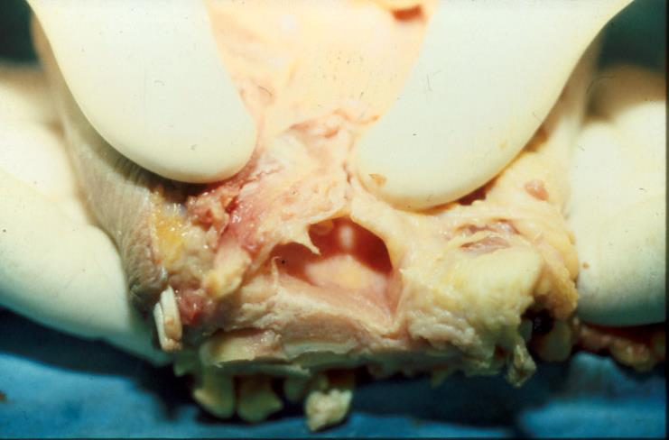
The Carpal Tunnel- Hand/finger forces from forearm muscle via tendons to the fingers. Causes tendonitis and results in Carpal Tunnel Syndrome (CTS).
Notes:
Tendon stretches but the Sheath does not expand when tendon swells. Tendon swelling then cuts off O2 to nerves.
Tendons in the wrist swell (tendonitis) and then push against the medial nerve in the wrist. Thus symptoms of CTS usually appear in the thumb, index, middle and part of ring finger.
9 hand tendons - 2 for each finger, 1 for thumb.

Slide 25
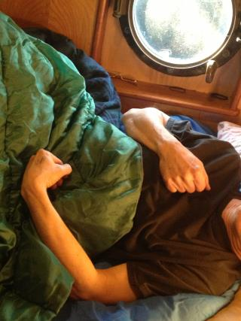
CTS SYMPTOMS
Pain, tingling, cramping.
Numbness in thumb, pointer, middle, inside of ring finger.
3. Weak grip, clumsiness.
4. Burning pain (worse at night).
5. Tendency to find affected hand with bent wrist when at rest.
Notes:
#5 is why it is important to wear splint when resting/asleep.

Slide 26
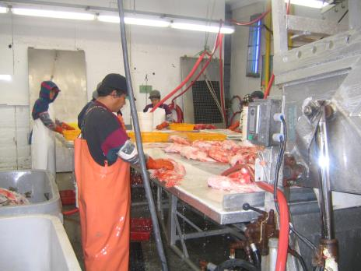
Carpal Tunnel Syndrome- CTS
When to be concerned:
Swelling, Tingling, Numbness:
more than > 24 hrs.
Pain, Stiffness:
more than
1- 2 weeks
(after activity
ceases)

Slide 27
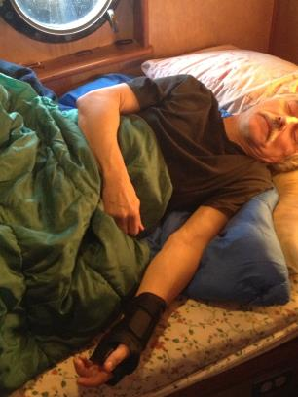
CTS TREATMENT
Stop activity- it only gets worse - rotate jobs.
Keep wrist neutral position.
Wear splints (not where it interferes with work).
Keep warm.
Cortisone shots.
Vitamin B-6 has mild effect.
Anti-inflammatories before, during, after activity. (ibuprofen, aspirin etc.)
8. Surgery – generally very effective.
Notes:
Make sure wrist splint is large enough- many are not.
For carpal tunnel syndrome, 100-200 milligrams of vitamin B6 has been taken by mouth daily for 10-12 weeks. 8 studies supported vitamin B6 supplementation and the results of another 6 studies were unclear or non-supportive. The main conclusions to be drawn from these studies are that, in some cases, vitamin B6 could improve symptoms of CTS because of an underlying nerve condition not previously diagnosed that might be related to vitamin B6 status or to the fact that vitamin B6 acts as an analgesic by raising pain thresholds.²High doses of vitamin B6 can cause nerve damage. The Institute of Medicine has established an upper safe limit of 100 mg a day for adults. Talk to your doctor before taking vitamin B6 supplements for carpal tunnel syndrome.
Some evidence that surgery can cause up to 5% loss of strength in some cases.
ACUPUNCTURE may be helpful.

Slide 28
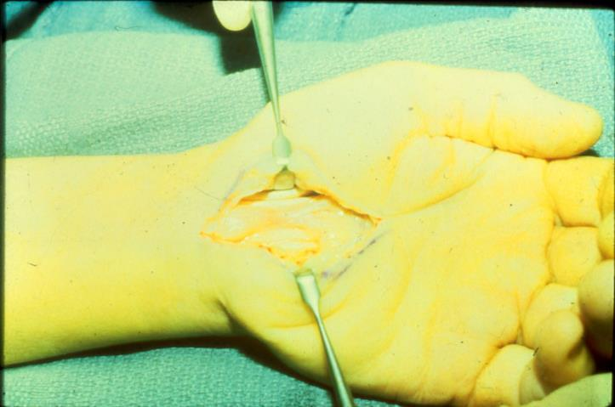
Carpal Tunnel Surgery
Notes:
Surgery widens the carpal tunnel allowing tendon to swell without constriction by tendon sheath and tunnel. Surgery is highly effective.
Endoscopic surgery is lass invasive than this photo.
Some studies show slight (up to 5%) loss in grip strength after surgery however.

Slide 29
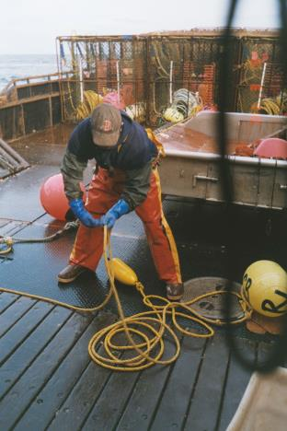
UEMSD Recommendations
Tool and work design to decrease hand force.
Improve friction/grip.
Tool grip diameter (@ 2 inches).
Power grip, no pinch grip.
Minimize wrist/shoulder deviation.
- exertion time (+ muscle recovery time.)
Alternate hands.
Less repetition through job variety.
Use PPE.
Pad to reduce contact stress.
Notes:
PPE = Personal Protective Equipment

