Slide 1
Strains, Sprains, & Pains: Ergonomic Injury Prevention for Commercial Fishermen
Part C- Stretching exercises
www.amsea.org

Slide 2

Susan Harwood project
This material was produced under grant number SH-23541-12-60-F-2 from the Occupational Safety & Health Administration, U.S. Department of Labor. It does not necessarily reflect the views or policies of the U.S. Department of Labor, nor does mention of trade names, commercial products, or organizations imply endorsement by the U.S. government.

Slide 3
STRETCH BEFORE YOU CATCH
BACK STRETCHES
Why stretch?
More blood & O2
More flexibility & agility
More mentally alert
More productive!
“Motion is the Lotion”
When do you stretch?
Before work/season
During work
After work
Notes:
Biggest issue is making stretching a regular part of your everyday routines throughout the year! But at least start 6 weeks before the fishing season.

Slide 4
Stretching Considerations
1. Professionally assess posture/ underlying issues.
2. If MSD issue exists, get
professional help.
3. Stretch slowly, no bouncing or
pain/worsen condition.
4. No exercises if they will cause
harm/pain!
5. Make stretching a daily routine.
6. Goal- increase flexibility.

Slide 5
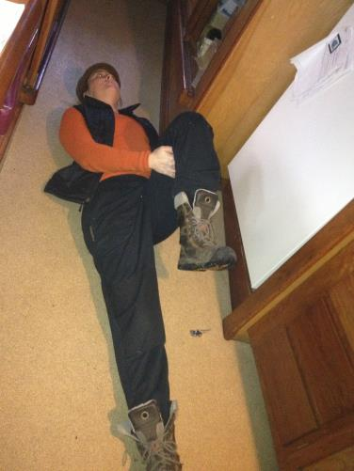
Before Work: Knee to Chest Stretch
Hand behind knee, pull knee to chest until comfortable stretch felt in lower back /butt.
Relax back.
Hold 30”- Repeat 3x alternate legs.
Notes:
You can also pull with hands over knees if easier.

Slide 6
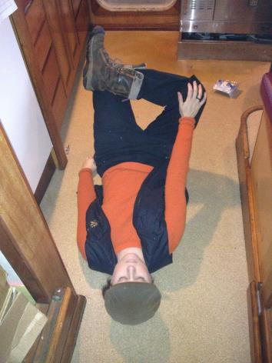
Before Work: Back Adductor Stretch
1. Place ankle on opposite knee.
2. With hand push away on bent knee.
3. Hold 30”-
4. Alternate legs - Repeat 3x.
Notes:
These stretches can be done on most fishing vessels.

Slide 7
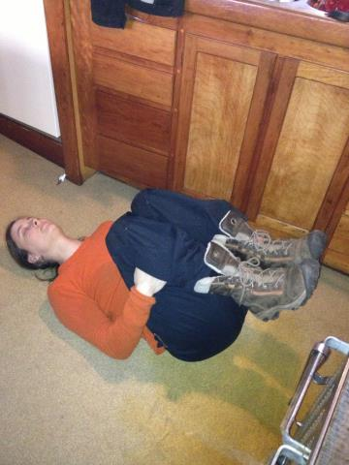
Before Work: Knees to Chest
Lie on back with knees bent.
Bring knees to chest using arms.
Do 2 sets, 3
Notes:
Grab back of thighs if easier to to bring knees to chest.

Slide 8
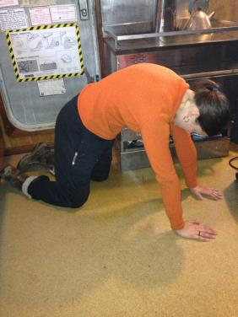
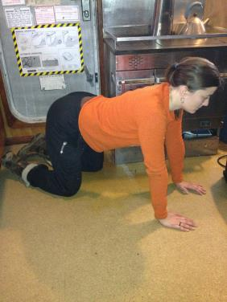
Before Work: Cat/Cow
Arch back 30”- sag back 30”
Do 2 sets of 3 reps
Notes:
You can add a variation to this by looking looking over your R shoulder at your R foot and alternate looking over your L shoulder at your L foot.

Slide 9
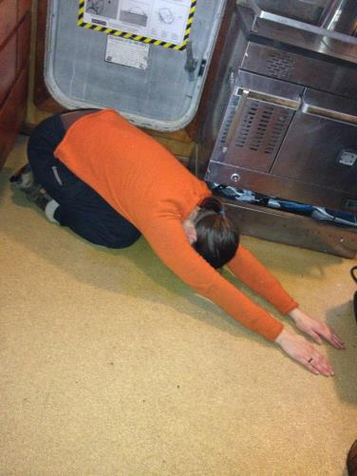
Before Work: Trunk Stretch
Reach arms out, elbows straight.
Gently sit back on heels.
Hold 30”
Do 2 sets, of 3 reps.
Notes:
.

Slide 10
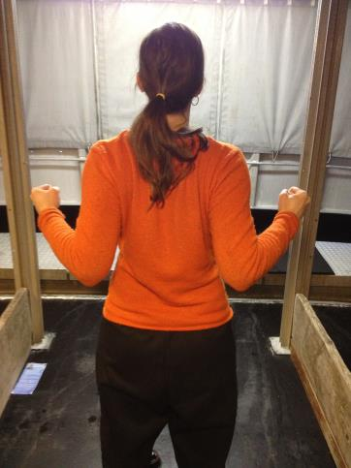
Shoulder Stretches- Scapular Retraction
Elbows bend to 90°.
Pinch shoulder blades
together.
3. Rotate arms out.
4. Keep elbows bent.
repeat 10-30x/set every few hours

Slide 11
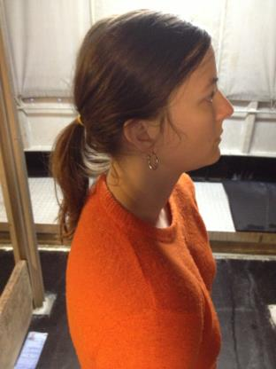
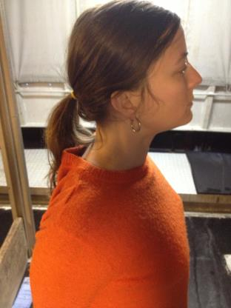
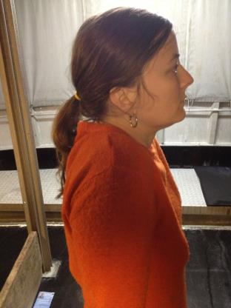
Shoulder Stretches- Shoulder Shrug
Shrug shoulders up and backward.
20-30x/day. Every few hours.

Slide 12

Shoulder Stretches-
Scapula Retraction
Bend elbows 90°.
Pinch shoulder blades together, rotate arms out.
Repeat 10-30x per set.
Every few hours.

Slide 13
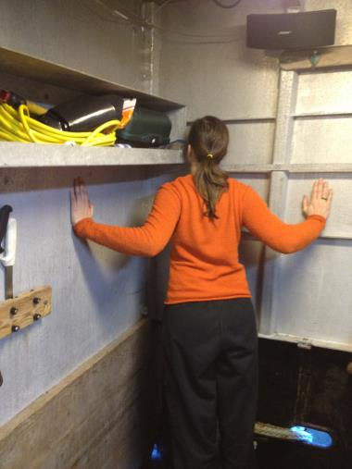
Shoulder Stretches-
Corner Stretch
Lean into corner with hands shoulder level.
One feet ahead of other until stretch felt across chest.
3. Hold 30”.
4. Repeat 3x.
5. 1 – 3x/day.

Slide 14
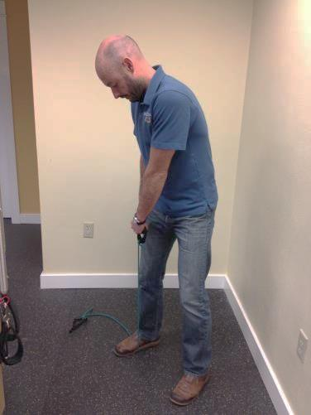
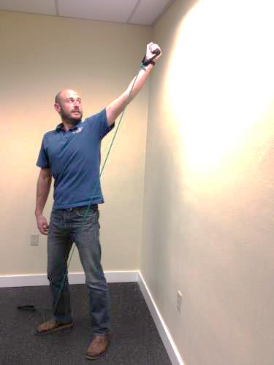
Shoulder Stretches Bungees - foot/outstretched hand
Notes:
Resistance tubing can be bought at a pharmacy or physical therapist and used at home or boat.
This motion is similar to drawing a sword from a sheath.

Slide 15
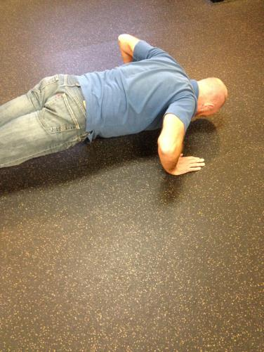
Shoulder Stretches - push ups
Notes:
Keep knees/hips off floor in the lowered position.
If you have lower back problems, keep knees on floor in both positions.

Slide 16
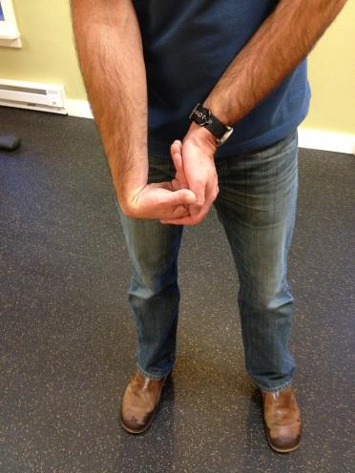
Elbow – Hand bend
Move hand against fixed resistance.
Hold 3 seconds, 10x

Slide 17
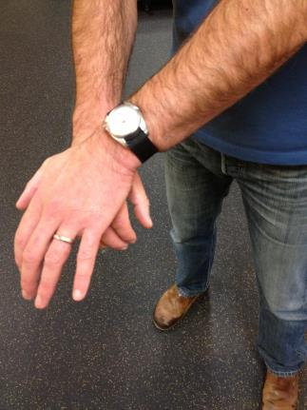
Elbow – Hand Press
Move wrist back against fixed resistance.
Hold 3 seconds, 10x
Notes:
Other exercises for wrists further on in presentation are also good for elbows.

Slide 18
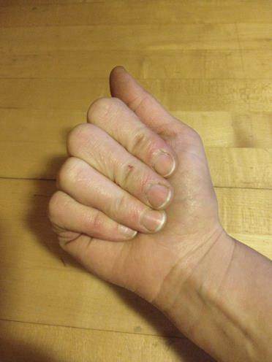
Carpal Tunnel Syndrome- Exercises
Active Straight Fist
Fingers straight.
Bend knuckles & middle joint.
Touch fingertips to palm.
4. Repeat 10x, 1-2x/day
Notes:
These exercises should be done BEFORE an activity that may cause CTS or as part of a professional therapy program! They should NOT be practiced during an acute CTS episode since what the tendons need at that point often is rest.

Slide 19
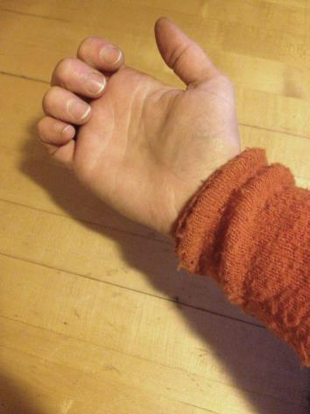
Carpal Tunnel Syndrome- Exercises
Active Hook Fist
With fingers & knuckles straight, bend middle & tip joints.
2. Do not bend large knuckles.
3. Repeat 10x-1 or 2x/day.

Slide 20
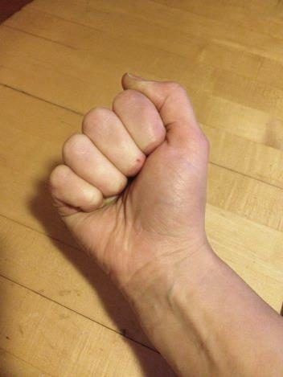
Carpal Tunnel Syndrome - Exercises
Active Full fist
Straighten all fingers.
2. Make a fist.
3. Bending all joints.
4. Repeat 10x; 1-2x/day

Slide 21
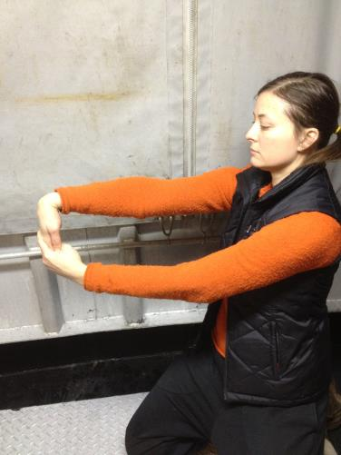
Carpal Tunnel Syndrome & Elbow Exercises- Wrist Extensor Stretch
Keep elbow straight.
Grasp hand & slowly bend wrist forward until stretch is felt.
3. Hold 30 seconds.
4. Relax.
5. Repeat 3x/day & every few hours

Slide 22
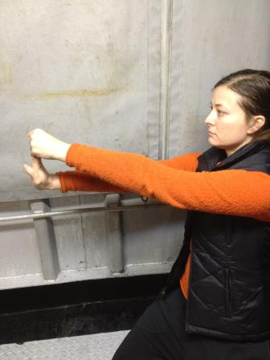
Carpal Tunnel Syndrome & Elbow Exercises- Wrist Flexor Stretch
1. Straight, grasp hand
Slowly bend wrist back till stretch is felt.
3. Hold 30 seconds.
4. Relax
5. 3x per set
6. Every few hours/day

Slide 23
Design your own 2-5 minute warm-up before going on deck!
There are many exercises available.
Determine which address your needs.
Stretch! Regularly!

