Slide 1

Hazard Communication (HAZCOM) and the
Globally Harmonized System of Classification and Labeling of Chemicals (GHS)
Understanding the changes
2014

Slide 2
Department of Labor
Occupational Health and Safety Administration (OSHA) Susan Harwood Training Grant
Department of Labor
Occupational Health and Safety Administration (OSHA) Susan Harwood Training Grant
This material was produced under Susan Harwood grant number SH-24928-SH3 Occupational Safety and Health Administration, U.S. Department of Labor. The contents in this presentation do not necessarily reflect the views or policies of the U.S. Department of Labor, nor does the mention of trade names, commercial products, or organizations imply endorsement by the U.S. Government.

Slide 3
Work Team
Work Team
The Pennsylvania State University University Park, PA
Outreach & Professional Education

Slide 4
Learning Objectives
Learning Objectives
At the end of this training session, you will be able to:
Define & Describe what GHS is
List GHS Target Sectors
Identify and Use GHS Elements for Labeling &
Communicating to your colleagues/employees
Understand, Describe and Construct a template of
your own Safety Data Sheet (if need be)

Slide 5

Global harmonization system

Slide 6
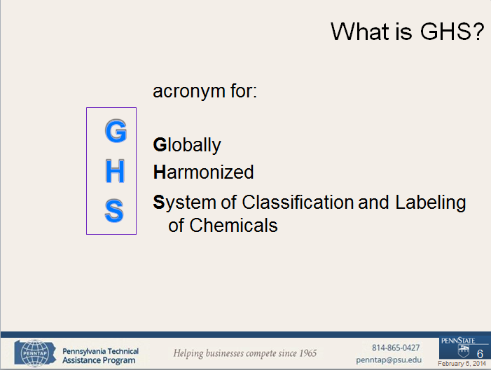
What is GHS

Slide 7
What is GHS?
The Globally Harmonized System (GHS) is an international approach to hazard communication, providing agreed criteria for classification of chemical hazards, and a standardized approach to label elements and safety data sheets.
The GHS was negotiated in a multi-year process by hazard communication experts from many different countries, international organizations, and stakeholder groups.
It is based on major existing systems around the world, including OSHA's Hazard Communication Standard and the chemical classification and labeling systems of other US agencies

Slide 8
What is GHS?
GHS establishes
  Harmonized definitions of hazards
    Physical , health, environmental
  Specific criteria for labels
    Pictograms, signal words, hazard and
precautionary statements
  Harmonized format for safety data sheets
    16 sections (ANSI format)

Slide 9

How was GHS developed?
United Nations Organization (UN) initiative since 1992 to provide a system for the standard handling of chemicals
The system used as reference several existing system from various countries. It is now
available for adoption by competent authorities around
the world.
Revision 3 of the GHS was be used by OSHA as the reference for the proposed Hazard Communication rule (5th edition is out)

Slide 10
Principles of Harmonization
Principles of Harmonization
Harmonization should not reduce the level of
protection.
Requires changes in all existing systems .
The scope includes both hazard classification criteria and hazard communication tools (labels, SDS’s).

Slide 11
Principles of Harmonization
Principles of Harmonization
Target audiences include consumers, workers, transport workers and emergency responders.
Information should be presented in a comprehensive manner to all audiences
Regarding chemicals Confidential Business Information (CBI) should be protected without compromising worker safety.

Slide 12
Guiding Principles
Guiding Principles
All hazardous chemicals are covered to some extent, including mixtures
The GHS does not include requirements for additional testing for health hazards nor establishes uniform test methods
The system should take account existing data from testing for hazard determination.

Slide 13
Why is the GHS needed?
Why is the GHS needed?
The correct handling of chemicals requires that material information be provided by means of labels, symbols and data sheets.
Differences in countries regulations have resulted in non standardized information for the same material leading to mishandling and /or unsafe situations

Slide 14


Why is the GHS needed?
Why is the GHS needed?
These differences impact both protection and trade.
  Protection: inconsistent information for the same chemical can lead to mishandling.
  Trade: compliance with multiple regulations regarding hazard classification and labelling is costly and time-consuming.

Slide 15
Application of GHS
The system is created as a “building-block” (modular) approach
  This means that each authority/agency/ adopts the “blocks” that are applicable to existing or new regulations under their scope
    For Example: one regulatory agency is expected to adopt provisions for various elements such as labels and SDS, while the other agency only adopts provisions for labels due their sector of interest

Slide 16

Building Block approach
Hazard classes
Health
Physical
Acute Toxicity
Skin
Explosives
Category 1-4 Category 1-6
The building blocks are the hazard classes and categories and each competent
authority adopts the building blocks that are applicable to their specific sector.

Slide 17
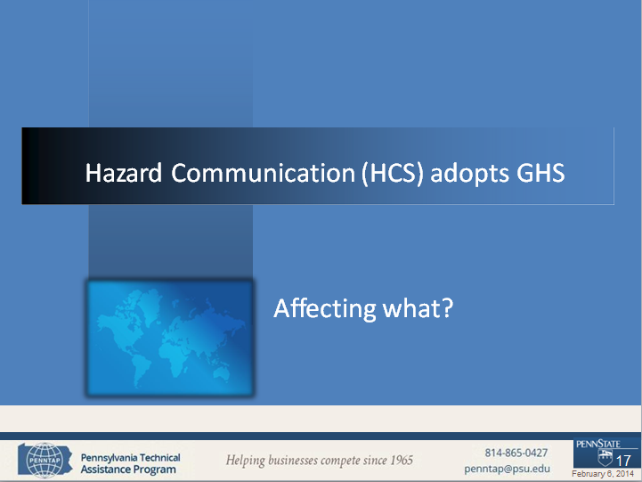
Hazard communication adopts GHS

Slide 18
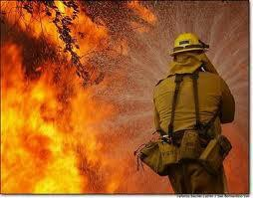



Target Sectors
GHS targets these sectors :
Workplace
Consumers
Transport
Emergency Responders

Slide 19
GHS impact
Based on those sectors GHS impacts several US agencies:
Environmental Protection Agency (EPA)
  Pesticides Program
Consumer Product Safety Commission (CPSC)
  User end of products or materials
Department of Transportation (DOT)
  Hazardous Materials Regulations

Slide 20

GHS impact
Occupational Safety and Health Administration (OSHA)
  Under HAZCOM, OSHA has more requirements affected by the GHS than any other US agency
    hazards,
    labels,
    safety data sheets,
    training
  Main impact is on the Hazard Communication Standard which covers 945,000 hazardous chemical products and 7 million workplaces.

Slide 21
HCS History
HCS History
First publication on Nov.1983. Only covered manufacturing sector. Final Rule was published on Aug 1987 covering all employers except for the construction industry (temporary)
Supreme Court decision to enforce all provisions in all industrial segments was on Feb 1990.
Publication of final rule on Feb. 1994 including
technical amendments and minor changes

Slide 22
HCS Framework
HCS Framework
Purpose - to ensure that the hazards of all chemicals produced or imported are evaluated, and that information concerning their hazards is transmitted to employers and employees.
Scope – worksites where employees could be
exposed to hazardous chemicals

Slide 23
HCS Framework
HCS Framework
How – transmitting information by means of a complete hazard communication program that includes:
list of hazardous chemicals present
container labeling and other forms of warning,
safety data sheets and
employee training

Slide 24
Responsibilities under HCS
OSHA requires manufacturers and importers to evaluate the hazards related to chemicals they produce or import.
  This evaluation will be changed to a hazard classification
Employers are required to inform their employees about the hazards related to chemicals they might be exposed to and corresponding protective measures.
  Labels and safety data sheets change
  Training needs to include GHS adopted elements

Slide 25

GHS main elements
Classification criteria
  Standardized for health, physical and
environmental hazards
Hazard communication elements
  Labels
    Standardized elements and format
  Safety Data Sheets
    Standardized sections and format

Slide 26

Health, Physical, Environmental
Health, Physical, Environmental
GHS – Hazard Classification

Slide 27

GHS: Environmental Hazards
GHS: Environmental Hazards
Hazardous to the Aquatic Environment
✓Acute – injury after short term exposure
✓Chronic – injury during the organism life cycle
- Includes fish, crustaceans, and algae or other aquatic plants
The environmental hazards are not covered by OSHA . The competent authority for those would be EPA

Slide 28
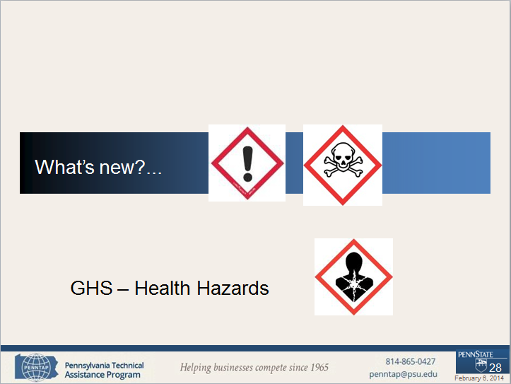
New GHS health hazards

Slide 29

GHS Health Hazards (10)
GHS Health Hazards (10)
Acute Toxicity
Skin corrosion/Irritation
Serious eye damage/eye irritation
Respiratory or skin sensitization
Germ cell mutagenicity
Carcinogenicity
Reproductive toxicity
Specific Target organ toxicity – Single exposure
Specific Target organ toxicity – repeated exposure
Aspiration hazard

Slide 30

Definitions: Health Hazards
Definitions: Health Hazards
Acute toxicity “refers to those adverse effects occurring following oral or dermal administration of a single dose of a substance, or multiple doses given within 24 hours, or an inhalation exposure of 4
hours”.
– Substances are assigned to one of five included categories based on oral, dermal, and inhalation toxicity.
OSHA did not adopt category 5

Slide 31
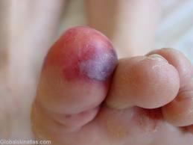
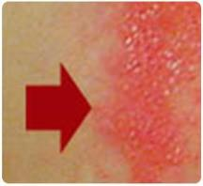
Definitions: Health Hazards
Skin corrosion is defined as “the production of irreversible damage to the skin; namely, visible necrosis through the epidermis and into the dermis, which was followed by the
application of a test substance for up
to 4 hours”.
– GHS does not require additional testing.
Based on available data for that chemical
Corrosive reactions are typified by ulcers, bleeding, bloody scabs.
Visible damage to skin after contact with substance

Slide 32

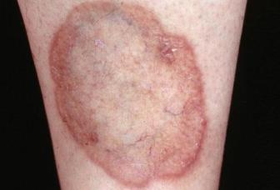
Definitions: Health Hazards
Skin irritation is defined as “the production of reversible damage to the skin following the application of a test substance for up to 4 hours”.
Before contact
OSHA adopted two categories for the Skin Corrosion/irritation hazard class
After contact

Slide 33
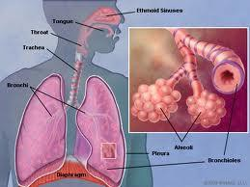
Definitions: Health Hazards
Skin sensitizer “means a chemical that induces an allergic response following skin contact”.
Respiratory sensitizer “means a chemical that will lead to hypersensitivity of the airways following inhalation of the chemical”.
– There are two categories for the Respiratory or Skin
Sensitization hazard class

Slide 34
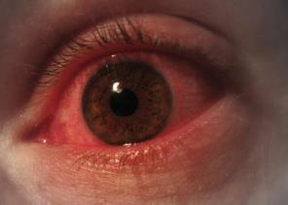
Definitions: Health Hazards
Definitions: Health Hazards
Two categories for eye hazards
Eye irritation is defined as “the production of changes in the eye following the application of test substance to the anterior surface of the eye, which are full reversible within 21 days of application”.

Slide 35

Definitions: Health Hazards
Definitions: Health Hazards
Serious eye damage is defined as the production of tissue damage in the eye, or serious physical decay of vision, following application of a test substance to the anterior surface of the eye, which is not fully reversible within 21 days of application”.

Slide 36


Definitions: Health Hazards
Definitions: Health Hazards
Germ Cell Mutagenicity
A mutation “is defined as a permanent change in the amount or structure of the genetic material in a cell”.
The term mutagenic and mutagen “will be used for agents giving rise to an increased occurrence of mutations in populations of cells and/or organisms”.
Two categories in this hazard class

Slide 37
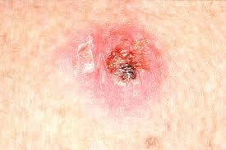
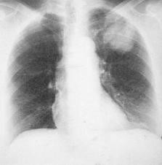
Definitions: Health Hazards
Definitions: Health Hazards
Carcinogen “means a substance or a mixture of substances which induce cancer or increase its incidence.”
Skin cancer
– Substances and mixtures which have induced benign and malignant tumors in well-performed experimental studies on animals are considered also to be presumed or suspected human carcinogens.
Two categories in this hazard
Lung cancer

Slide 38


Definitions: Health Hazards
Reproductive toxicity “includes adverse effects on sexual function and fertility in adult males and females, as well as adverse effects on development of the offspring”.
– Adverse effects on development of the offspring means “any effect of chemicals which interferes with normal development of the conceptus either before or after birth”.
Two categories in this hazard

Slide 39

Definitions: Health Hazards
Definitions: Health Hazards
Specific Target Organ Toxicity (STOT)
  Single exposure means “specific, non-lethal target organ toxicity arising from a single exposure to a chemical”.
  Repeated exposure requires more than one instance of exposure.

Slide 40

Definitions: Health Hazards
STOT is caused by chemicals that are specific target organ toxicants and, as such, present a potential for adverse health effects in people who are exposed to it.
  STOT – single exposure has three hazard categories
  STOT – repeated exposure has two hazard categories.

Slide 41

Definitions:Health Hazards
Definitions: Health Hazards
Aspiration means “the entry of a liquid or solid chemical directly through the oral or nasal cavity, or indirectly from vomiting, into the trachea and lower respiratory system”.
  Includes severe acute effects such as chemical pneumonia, varying degrees of pulmonary injury or death following aspiration.
  Two categories but Only one category adopted by OSHA

Slide 42





New Definitions
New Definitions…
GHS – Physical Hazards

Slide 43

GHS Physical Hazards (16)
GHS Physical Hazards (16)
Explosives
Flammable gases
Flammable aerosols
Oxidizing gases
Gases under pressure
Flammable liquids
Flammable solids
Self-reactive substances and mixtures
Pyrophoric liquids
Pyrophoric solids
Self-heating substances and mixtures
Substances and mixtures which, in contact with water, emit flammable gases
Oxidizing liquids
Oxidizing solids
Organic peroxides
Corrosive to metals

Slide 44

Physical Hazards
Physical Hazards…
Explosive Substances and Mixtures
  Solid or liquid substances capable of producing gas at such a high temperature and pressure that it can cause damage to surroundings.
  Divided into 7 categories based on type of damage produced

Slide 45

Physical Hazards
Physical Hazards...
Flammables, include
  Flammable Gases
  Flammable Aerosols
  Flammable Liquids
  Flammable Solids

Slide 46

Physical Hazards
Physical Hazards...
Flammable gas means a gas having a flammable range with air at 20°C (68°F) and a standard pressure of 101.3 kPa (14.7 psi).
– Two categories

Slide 47

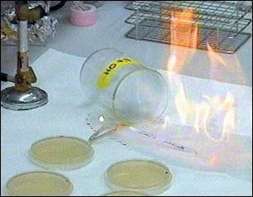

Physical Hazards
Physical Hazards...
Flammable Liquids
  Any liquid with a flash point of
93°C (199.4°F) or less.
  Four categories
Flammable Solids means a solid, usually in a powder or granular form, that is easily combustible through friction
  Two categories

Slide 48

Physical Hazards
Physical Hazards...
Aerosol means “any non-refillable receptacle containing a gas compressed, liquefied or dissolved under pressure, and fitted with a release device allowing the contents to be ejected as particles in suspension in a gas, or as a foam, paste, powder, liquid or gas.”
Flammable Aerosols
  Contain Flammable components
  Two categories

Slide 49

Physical Hazards
Physical Hazards …
Oxidizing gas “means any gas which may, generally by providing oxygen, cause or contribute to the combustion of other material more than air does”. One category.
Oxidizing Liquids and Solids
  Though not necessarily combustible on their own, generally by yielding oxygen cause or contribute combustion of other material.
  Three categories

Slide 50

Physical Hazards
Physical Hazards ...
Gases Under Pressure
  Gases contained in a receptacle at a pressure of 200 kPa (29 psi) or more, which are liquefied or liquefied and refrigerated
  Includes 4 groups: compressed gases, liquefied gases, dissolved gases and refrigerated liquefied gases

Slide 51

Physical Hazards …
Self-reactive substances & mixtures are thermally unstable liquid or solid chemicals liable to undergo a strongly exothermic decomposition even without participation of oxygen (air).
Divided in 6 categories similar to those in
the transport sector
Excludes oxidizers, organic peroxides and
explosives.

Slide 52

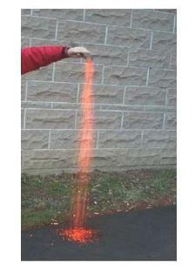
Physical Hazards
Physical Hazards …
Pyrophoric Solids / Liquids means a solid or liquid “which, even in small quantities, is liable to ignite within five minutes after coming into contact with air”.
  Mildly pyrophoric solids can be handled in the air for brief periods of time.
  One category for each

Slide 53
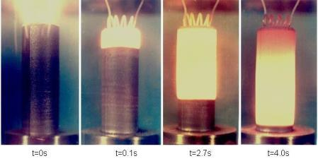

Physical Hazards …
Self-Heating Substances & Mixtures
Solids or liquids, other than pyrophoric, which by reaction with air and without energy supply is liable to self heat. (Two categories)
They require large amounts of material and long periods of time to ignite.

Slide 54
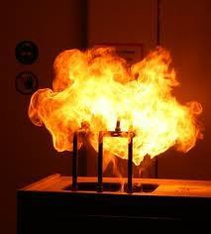
Physical Hazards …
Substances & Mixtures which in contact with water, Emit Flammable Gas are solid or liquid chemicals which, by interaction with water, are liable to become spontaneously flammable or to give off flammable gases in dangerous quantities
– Divided into 3 categories

Slide 55


Physical Hazards …
Corrosive to Metals “means a chemical which by chemical action will materially damage, or even destroy, metals”
  One category.
Organic Peroxides
  Organic liquids or solids that can decompose explosively, burn rapidly, be sensitive to friction and react dangerously with other chemicals.
  7 categories adopted similar to those in
transport sector

Slide 56

Labels
Labels
GHS – Hazard Communication Tools

Slide 57
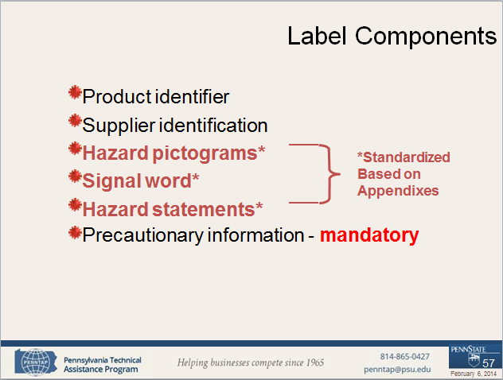
Label Components

Slide 58

Product Identifier
States the identity of the chemical, including all the ingredients that contribute to the hazard of the mixture.
Unique means by which the chemical can be identified within the particular use setting.

Slide 59
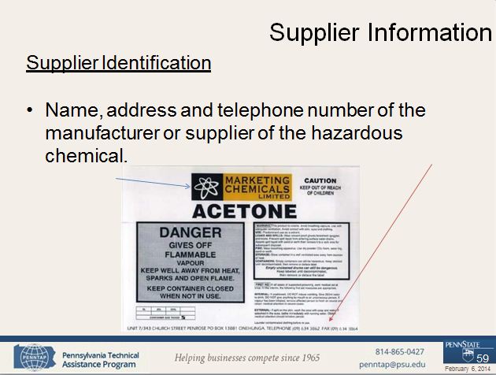
Supplier Information

Slide 60

New GHS Pictograms
These are new…
GHS - Pictograms

Slide 61
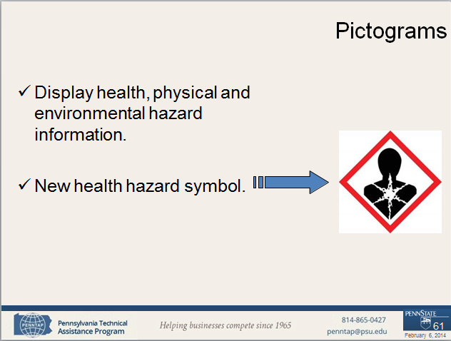
Pictograms

Slide 62
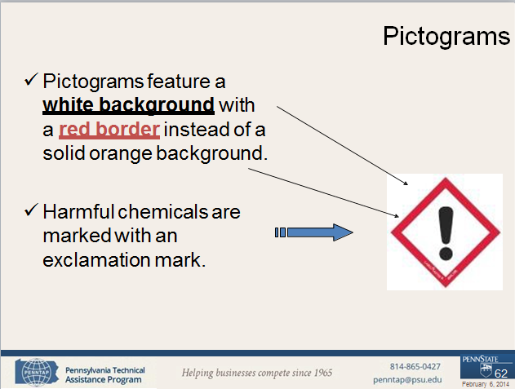
Pictograms

Slide 63
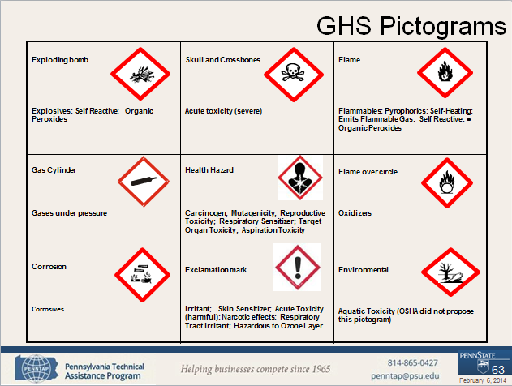
GHS Pictograms

Slide 64
Pictogram shape and colour
Pictogram Shape & Colour
For transport, pictograms will not change
For other sectors, pictograms will have a black symbol on a white background with a red diamond frame.
For the same hazard, where a transport pictogram
appears, the GHS pictogram should not appear.

Slide 65
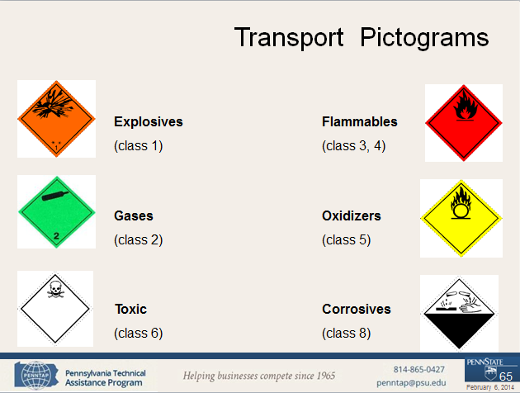
Transport Pictograms

Slide 66
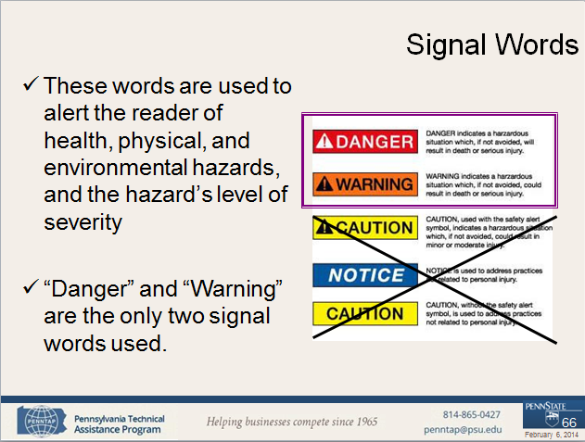
Signal Words

Slide 67

Pause

Slide 68

GHS Hazard statements
… On the labels
GHS - Hazard statements

Slide 69
Hazard Statements
Hazard Statements
GHS label should include appropriate hazard and precautionary information.
A hazard statement is a phrase assigned to a hazard class that describes the nature of the hazard, and its level of severity.
  “Highly Flammable,” “Unstable Explosive,” “Toxic if Inhaled”.
There are three types: Physical, Health and
Environmental

Slide 70
Precautionary Information
Phrases indicate measures recommended to help minimize or prevent the effects resulting from exposure, improper storage or handling of hazardous products
Precautionary statements include provisions for
storage, handling, response and disposal
Appendix C contains, among other information, statements recommended for each level of hazard within each hazard class.

Slide 71
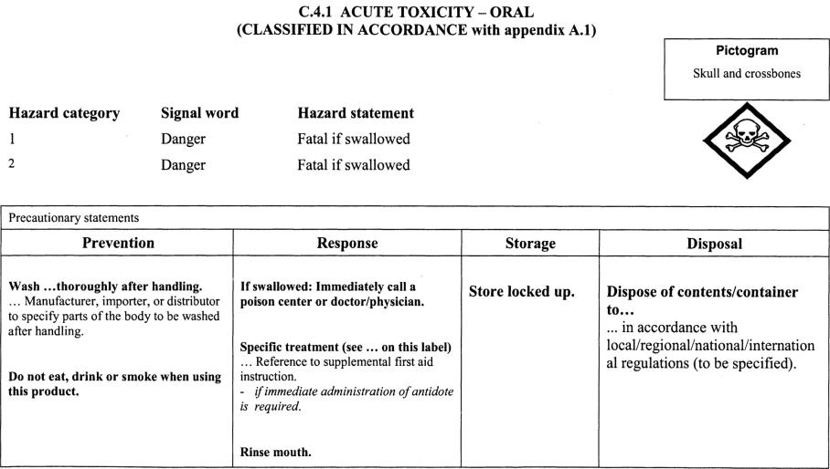
Appendix C

Slide 72
Precedence
Where a chemical is classified for a number of hazards, and the precautionary statements are similar, the most stringent shall be included on the label (this will be applicable mainly as preventive measures).
An order of precedence may be imposed by the manufacturer, importer or responsible party in situations where phrases concern “Response.”

Slide 73

From MSDS to SDS
From MSDS to SDS
GHS – Hazard Communication Tools: Safety Data Sheets

Slide 74

Role of the SDS in the GHS
Role of the SDS in the GHS
Primary Use of SDS: The Workplace
Employers and workers use them as an information source about hazards of a chemical substance or mixture and to obtain advice on safety precautions.
SDS information can be used by those involved in the transport of dangerous goods and emergency responders.

Slide 75
When is an SDS required?
When is an SDS required?
An SDS should be produced for all chemicals (substances and mixtures) which meet the harmonized criteria for physical, health or environmental hazards under the GHS and …
For all mixtures which contain substances that
meet the criteria for:
  Carcinogens,
  Toxic to reproduction or
  STOT in concentrations exceeding the cut-off limits
specified by the criteria for mixtures.

Slide 76
Safety Data Sheet content
Safety Data Sheet content
Identification
Hazard (s) identification
Composition/ information on ingredients
First-aid measures
Fire-fighting measures
Accidental release measures
Handling and storage
Exposure control/ personal protection
Physical and chemical properties
Stability and reactivity
Toxicological information
Sections 1-11 and 16 are mandatory for informational requirements
Ecological information
Disposal considerations
Transport information
Regulatory information
Not under OSHA jurisdiction for informational requirements
16. Other information

Slide 77

Global Harmonization System Exercises
Global Harmonization System (GHS)
Exercises

Slide 78
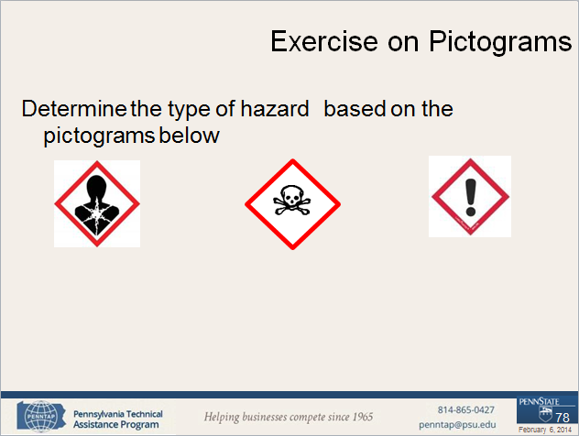
Exercise on Pictograms

Slide 79
Exercise on Pictograms
Exercise on Pictograms
Determine what pictogram would use the following chemical using the information provided
Material is extremely toxic to humans
Keep away from flames and sparks.
Corrosive to metals

Slide 80
Exercise on Hazards
Exercise on Hazards
Determine the type of precautionary statement (prevention, response, storage, disposal) of these materials given the following information
Wear cold insulating gloves
Dispose of contents in accordance with local
regulations
If exposed: call poison center or doctor/ physician
Stored in a well ventilated place

Slide 81
Data Sheets Exercise
Using the handout provided, identify in which section of the data sheet you can find the following:
Health effects
Flammability of material
Storage precautions
Toxicity of material
Material identity

Slide 82
Labels Exercise
With the information provided for each chemical, identify the following elements of the label. Please reference Appendix C.
Pictogram
Signal words
Hazard statements
Precautionary statement

Slide 83

The Changes to HCS
The Changes to HCS
Old vs. new….

Slide 84
Past rule
Current HAZCOM standard rule
  (a) Purpose
  (b) Scope and Application
  (c) Definitions
  (d) Hazard Determination
  (e) Written Hazard Communication Program
  (f) Labels and Other Forms of Warning
  (g) Material Safety Data Sheets
  (h) Employee Information and Training
  (i) Trade Secrets
  (j) Effective Dates
  Appendix A - E

Slide 85
Past rule to be revised
Appendices
Appendix A (mandatory) – Health hazards definitions
Appendix B (mandatory) – Hazard determination
Appendix C (advisory) – Information sources [removed
1996]
Appendix D (mandatory) – Trade secret definition
Appendix E (advisory) – Compliance guidelines

Slide 86
Organization of HazCom 2012
(a) Purpose
(b) Scope and Application
(c) Definitions
(d) Hazard Classification
(e) Written Hazard Communication Program
(f) Labels and Other Forms of Warning
(g) Safety Data Sheets
(h) Employee Information and Training
(i) Trade Secrets
(j) Effective Dates
Appendices A -F

Slide 87
… HazCom 2012
Appendices
Appendix A (mandatory) – Health hazards criteria
Appendix B (mandatory) – Physical criteria
Appendix C (mandatory) – Allocation of Label Elements
Appendix D (mandatory) – Safety Data Sheets
Appendix E (mandatory) – Definition of “Trade Secret”
Appendix F (non mandatory) - Guidance for Hazard Classifications Re:
Carcinogenicity

Slide 88
HazCom 2012 changes
Basic Framework will not change
  The scope and application is basically
unchanged
  Minimum changes to written program requirements, worker training, and trade secret provisions
Changes from performance oriented to
specification standard using standard criteria

Slide 89

Section comparison
Section comparison
Where are the changes?

Slide 90
Purpose
Purpose
(a) Purpose
  The primary modification to this paragraph is to state affirmatively that part of the purpose is to harmonize with international requirements..
  The word evaluation was substituted with classification to be consistent with GHS provisions

Slide 91
Scope and Application
Scope and Application
(b) Scope and Application
  No substantive changes are proposed, only
terminology changes in accordance with GHS
    Hazard determination changed to hazard classification
    Use of word classify, in lieu of assess
    MSDS are changed to Safety Data Sheets
  Elimination of Appendix E reference

Slide 92
Definitions
Definitions
(c) Definitions
  OSHA has changed a number of the definitions, as well as the actual terms used, to be consistent with the GHS.
  The terms removed from this section are generally relevant primarily to the hazard classification process which are defined in Appendices A (Health hazards) and B (Physical hazards).

Slide 93
Definitions: Health Hazards
Health hazards are assigned to Appendix A of the HazCom 2012 regulation
Appendix A includes information related to the principles of classification from GHS Parts 1 & 3
Definitions and specific classification criteria from GHS Part 3 is discussed

Slide 94
Definitions: Physical Hazards
Definitions: Physical Hazards
Physical hazards are assigned to Appendix B of HazCom 2012
Appendix B begins with information related to the principles of classification from GHS Parts 1 & 2
Definitions and specific classification criteria were adopted to be consistent with GHS

Slide 95

How to determine hazard
How to determine hazard…
GHS- Hazard classification

Slide 96
HazCom 2012 changes
Hazard Classification
  Appendixes A and B covers criteria for health and physical hazards, respectively
  OSHA has included the general provisions for hazard classification in paragraph (d) of the HazCom 2012, and added extensive appendixes that address the criteria for each health or physical effect.
  The hazard classification criteria contained in HazCom 2012 is test method “neutral.” That is, the person classifying a chemical should use available data and no additional testing is required to classify a chemical.

Slide 97
Hazard statements
Hazard information contained in Appendix C of HazCom 2012, for each hazard class:
  the pictogram,
  signal word,
  the proposed hazard statement
    Health or Physical
  the proposed types of precautionary statements
    Prevention, Response, Storage, Disposal

Slide 98
Hazard statements
The text of all applicable hazard statements shall appear on the label, except as otherwise specified.
Hazard statements may be combined where appropriate to reduce the information on the label and improve readability, as long as all of the hazards are conveyed as required.

Slide 99
Hazard Statements
Where the manufacturer, importer, or distributor chooses to add supplementary information on the label, the placement of such information shall not interfere with information required by this section.

Slide 100
Written program elements
Written program elements…
Labels, safety data sheets and training
100
February 6, 2014

Slide 101
HazCom 2012 changes
Written Hazard Communication Program
  The GHS does not have provisions regarding hazard communication written programs, and thus this paragraph is essentially the same as in the current HCS. No substantive (only terminology) changes have been made in this paragraph of the HCS.
  Key elements of this program are labels,
safety data sheets and employee training
101
February 6, 2014

Slide 102

HazCom 2012 changes
(f) Labels and Other forms of Warning
– Under this paragraph, chemical manufacturers and importers must provide a label that includes a harmonized signal word,
pictogram, and hazard and precautionary statements for each hazard class and category. In addition, precautionary statements
must also be provided, as well as product
identifier and supplier information.
102
February 6, 2014

Slide 103
HazCom 2012 changes
Labels and Other forms of Warning
  New mandatory Appendix C indicates what specific information is to be provided for each hazard class and category once a
chemical is classified.
  OSHA will require the use of
pictograms, specific signal words, hazard and precautionary statements in accordance with GHS principles.
103
February 6, 2014

Slide 104
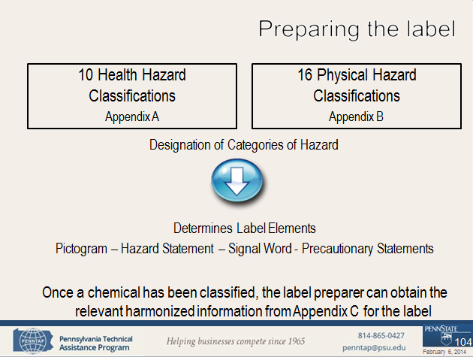
Preparing the label

Slide 105
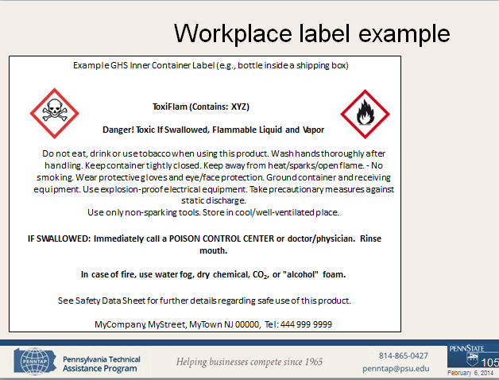
Workplace label example

Slide 106
HazCom 2012 changes
SDS…
  Found in HazCom 2012 Appendix D, changes include a 16 section format with specific information contained in each section.
Sections 1-11, 16 are mandatory
  Section 1. Identification: The requirements in this section are not new with two exceptions. The format and the requirement to identify recommendations for use of the chemical and restrictions on use are new.
106
February 6, 2014

Slide 107
HazCom 2012 changes
(g) SDS…
– Section 2. Hazard(s) identification: employer must identify the hazards by means of a hazard determination, and must classify a hazardous chemical according to the changed conditions provided in HazCom 2012 Appendices A and B.
A separate SDS will be required for each mixture rather
than one for each chemical comprising the mixture
Pictograms (OR NAME OF SYMBOL), standardized hazard statements, signal words, and precautionary statements are now required.
107
February 6, 2014

Slide 108

HazCom 2012 changes
SDS…
  Section 3. Composition/ information on ingredients. No new requirements other than format and the requirement that a separate SDS will be required for each mixture rather than one for each chemical comprising the mixture
  Section 10. Stability and reactivity.
Although the information on conditions to avoid and hazardous decomposition products are new to HCS, it has been required in the ANSI Z400.1 standard.
108
February 6, 2014

Slide 109
HazCom 2012 changes
SDS…
Sections contain no new requirements, only format
  Section 4. First-aid measures.
  Section 5. Fire-fighting measures.
  Section 6. Accidental release measures.
  Section 7. Handling and storage.
  Section 8. Exposure controls /Accidental release measures.
  Section 9. Physical and chemical properties.
  Section 11. Toxicological information
  Section 16. Other information
109
February 6, 2014

Slide 110
HazCom 2012 changes
SDS…
To be GHS-compliant in the SDS, the requirements for these sections are provided but compliance is outside of OSHA jurisdiction.
  Section 12. Ecological information
  Section 13. Disposal considerations
  Section 14. Transportation information
  Section 15 Regulatory information
– These are all Non-mandatory sections.
110
February 6, 2014

Slide 111
HazCom 2012 changes
Employee Information and Training
  Indicates that the new label and data sheet formats and presentation of information must be discussed in training. Make sure information & training is effective.
  All employers will be required to conduct additional training to ensure that their employees are familiar with the standardized labels and safety data sheets.
  Other training provisions remain the same.
111
February 6, 2014

Slide 112
HazCom 2012 changes
Trade Secrets
  HazCom 2012 includes few changes from the
existing standard.
  The GHS requires disclosure of the percentage composition of mixtures on the SDS. HazCom 2012 adopts this requirement, but allows the manufacturer to claim trade secret protection for this rule, only if worker safety is maintained and the provisions of trade secret are followed.
112
February 6, 2014

Slide 113

HazCom 2012 changes
Effective Dates
  OSHA required that all of the revised provisions in HazCom 2012 become effective in three years (2016).
  Training is being required by 12/1/13,
so employers and employees will recognize and understand the new labels and safety data sheets as they are received.
113
February 6, 2014

Slide 114

Approach to Other Standards
Many other OSHA standards contain criteria related to defining hazards, as well as other provisions that rely on those criteria
OSHA undertook a comprehensive review of its
rules to identify what needed to be changed
OSHA has proposed modifications to all of those standards that it determined needed to be consistent with the GHS
114
February 6, 2014

Slide 115
Other OSHA Standards
Other OSHA Standards
1926.152 Flammable and Combustible Liquids
All substance specific standards that contain a
generic hazard communication statement.
1910.119 Process Safety Management Standard
1910.1450 Occupational Exposure to Hazardous
Chemicals in Laboratories
115
February 6, 2014

Slide 116

Global Harmonization System(GHS)
Global Harmonization System(GHS)
Summary and
References
116
February 6, 2014

Slide 117
Why does OSHA needs it?
OSHA’s Hazard Communication Standard (HCS) has performance-oriented requirements for labels and safety data sheets, producing inconsistencies in the communication of the hazard
A standardized approach for labels and safety data sheets is preferred. Adoption of the GHS will address this domestic concern and also align OSHA with DOT’s Hazard Criteria
117
February 6, 2014

Slide 118
HazCom 2012 rule
Under HazCom 2012, the hazard determination requirements are not performance-oriented.
  Definitions section, Appendix A and B provide information for health and physical hazard determination
HazCom 2012 uses the GHS concept of “classification” instead of determination of a hazardous effect .
  Appendix C provides hazard criteria for
classification
118
February 6, 2014

Slide 119
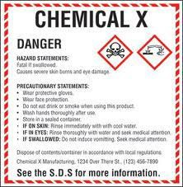
HazCom 2012 changes
Hazard classification: Provides specific classification criteria for health and physical hazards, for chemicals (substances / mixtures).
Labels: Chemical manufacturers and importers will be required to provide a label that includes a harmonized signal word, pictogram, and hazard statement for each hazard class and category. Precautionary statements must also be provided.
119
February 6, 2014

Slide 120
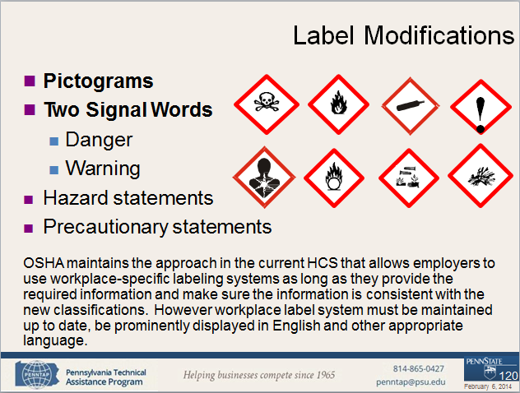
Label Modifications

Slide 121


HazCom 2012 changes
HazCom 2012 changes
Safety Data Sheets: Will now have a specified 16-section format.
Information and training: HazCom 2012 requires that workers are trained by 12/1/13 to facilitate recognition and understanding of the new labels and safety data sheets.
121
February 6, 2014

Slide 122
How does this affect the workplace?
Employers
  Initial employee training on pictograms, signal words,
hazard and precautionary statements by 12/1/13
  Training on new SDS format
  Continue to maintain the updated labels & SDSs.
Update within 3 months of new and significant
information for SDS’s & 6 months for labels.
For manufacturers
  Initial start-up costs associated with reclassification,
producing new labels, safety data sheets, training
122
February 6, 2014

Slide 123
Benefits of Harmonization
Benefits of Harmonization
Benefits for users and producers of chemicals, countries, and international organizations.
  Enhance protection of humans and environment.
  Facilitate chemical international trade.
  Reduce duplicate testing and evaluation.
  Aid countries and international organizations in the proper handling of chemicals.
123
February 6, 2014

Slide 124
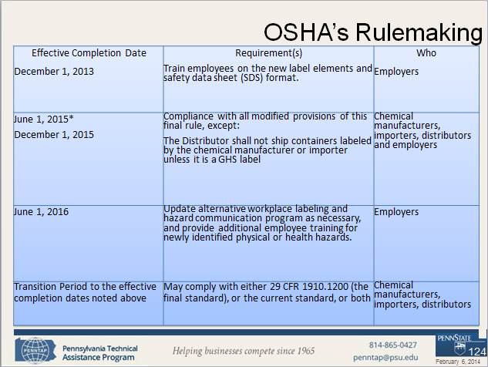
OSHA’s Rulemaking

Slide 125

Additional Information
OSHA’s website on GHS
  http://www.osha.gov/dsg/hazcom/global.html
UN Website
  http://www.unece.org/trans/danger/publi/ghs/ghs_welcome_e.html
The Pennsylvania Technical Assistance Program
  http://www.penntap.psu.edu
125
February 6, 2014

Slide 126


HAZCOM- GHS
126
February 6, 2014

