Slide 1

Principles of internal traffic control for roadway construction
Internal Traffic Control
PREVENTING RUNOVERS AND BACKOVERS IN ROADWAY CONSTRUCTION
Principles of
for Roadway Construction
Internal Traffic Control

Slide 2

ARTBA Disclaimer
This material was produced under the grant SH-24861-SH3 from the Occupational Safety and Health Administration, U.S. Department of Labor. It does not necessarily reflect the views or policies of the U.S. Department of Labor, respectively, nor does mention of trade names, commercial products, or organizations imply endorsement by the U.S. Government.
Additional assistance came from contract 212-2009-M-32109 from the National Institute for Occupational Safety and Health.
Contact ARTBA for information about Student Handbooks.
American Road & Transportation Builders Association

Slide 3
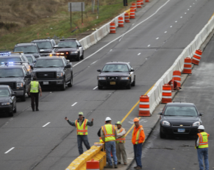
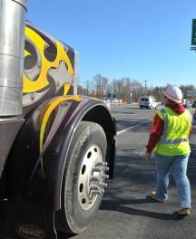
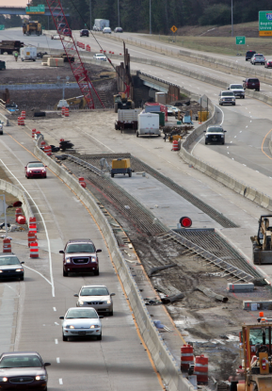
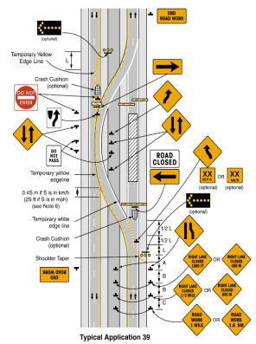
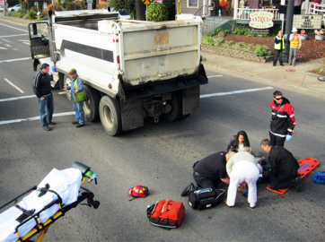
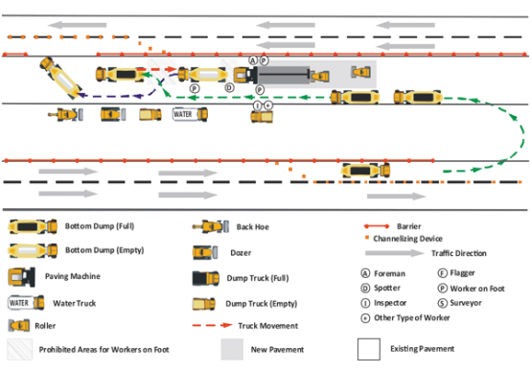
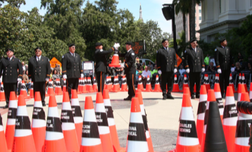
ITC Course outline
Internal Traffic Control
PREVENTING RUNOVERS AND BACKOVERS IN ROADWAY CONSTRUCTION
At the end of this module, you will know
Meaning of Internal Traffic Control
How ITC works
The differences between ITC and TTC
Why ITC is needed
The causes of most work zone fatalities
How to prevent fatalities from construction vehicles
How to prevent fatalities from motorists
If you understand the purpose and function of ITC, everyone in the work zone will be safer.

Slide 4
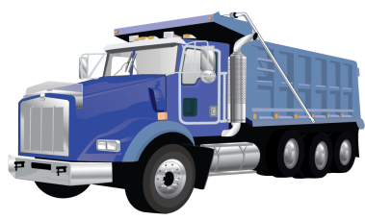


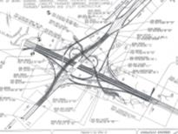
What is Internal Traffic Control
Internal Traffic Control
PREVENTING RUNOVERS AND BACKOVERS IN ROADWAY CONSTRUCTION
What Is Internal Traffic Control?
ITC coordinates construction traffic inside activity area of a temporary traffic control zone (TTCP)
*
Goal is a plan to separate construction vehicles/equipment from workers on foot
ITC plan fills in details on how construction traffic should flow inside area marked by hatched box on TTCP
*
TTCP Temporary Traffic Control Plan for facilitating road users through a work zone
Notes:
So what is an internal traffic control plan, or an ITCP? We are all familiar with the cones, barrels and signs that are guide motorists so that they can safely travel through work zones. The internal traffic control plan (ITCP) is a process that project managers and others who have production responsibility for roadway construction projects can use to coordinate and control the flow of construction vehicles, equipment, and workers operating in close proximity within the work space to ensure the safety of workers.
The ITCP organizes work activity inside the work zone to minimize the risk of workers being struck by operating equipment. The area where construction work takes place is shown on temporary traffic control plans and MUTCD “typical applications” as a hatched box. Internal traffic control plans fill in the details on how construction traffic should be set up inside this hatched box.

Slide 5
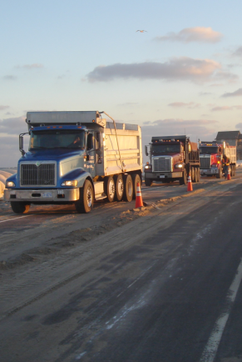
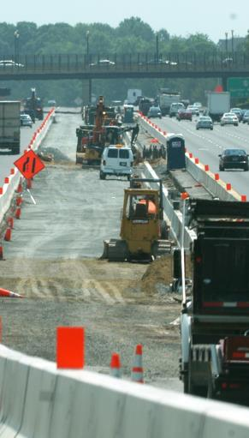
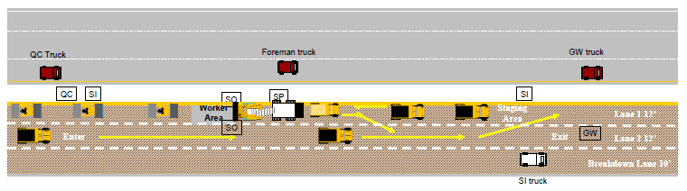
Overview of internal traffic control
Internal Traffic Control
PREVENTING RUNOVERS AND BACKOVERS IN ROADWAY CONSTRUCTION
Overview of Internal Traffic Control
Effective ITC protocol informs all parties operating within the work space of the locations of others
ITC creates ‘zones’ to minimize interaction between workers on foot and construction vehicles
ITC plan designates routes and operating procedures for large trucks delivering materials
ITC plan creates a traffic pattern to minimize backing by construction vehicles/equipment
ITC facilitates communication among key work zone parties in advance of arrival to the site
Notes:
In simple terms, ITCPs are a protocol to inform all parties operating within the work space about the location of others. ITCPs create “zones” designed to minimize interaction between workers on foot and construction vehicles by designating routes and operating procedures for large trucks delivering materials inside the “cone zone.”
An effective plan enables communication among all work zone parties in advance of arrival to the construction site.

Slide 6
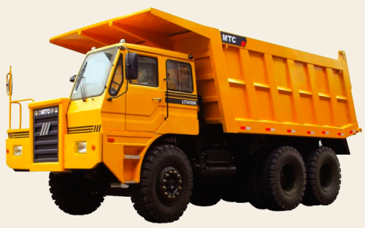
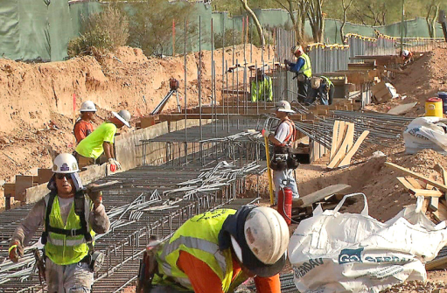
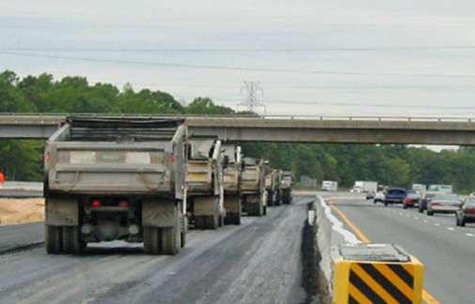
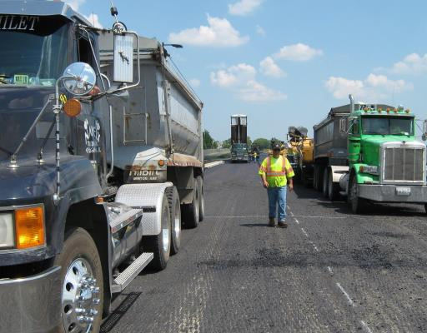
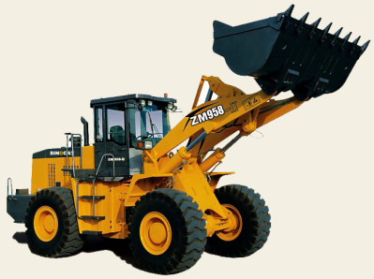
How does ITC work
Internal Traffic Control
PREVENTING RUNOVERS AND BACKOVERS IN ROADWAY CONSTRUCTION
How Does ITC Work?
Limits work zone access and egress points
Coordinates truck and equipment movements
Provides information on traffic paths and safe or unsafe areas for workers
Heightens awareness of workers on foot to vehicle traffic in work area
Notes:
The ITC Plan makes sure all parties know the location of access points and the proper path for truck and equipment movement, including pickup trucks and other work vehicles.
When construction drivers understand there is an ITC Plan, they will be motivated to take ownership of the program and contribute to its success. The drivers may also provide input if they see a problem if they feel part of the “team.” Drivers rarely receive a “thank you” for their efforts, and expressions of gratitude for safe performance can go a long way towards getting their buy-in and cooperation. Once all parties understand how an ITCP operates, they will better understand instructions and verbal communications used to explain daily plans and changes.

Slide 7
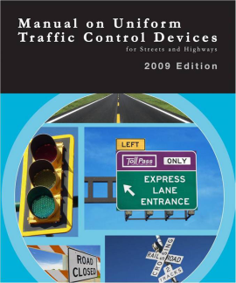
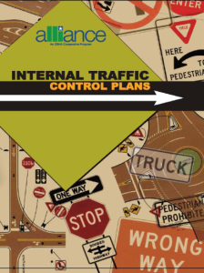


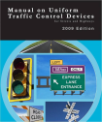

Shat is the difference between TTC and ITC
Internal Traffic Control
PREVENTING RUNOVERS AND BACKOVERS IN ROADWAY CONSTRUCTION
What Is the Difference Between TTC and ITC?
Temporary Traffic Control Plans
Internal Traffic Control Plan
Prescribed in U.S. Federal Highway Administration Manual on Uniform Traffic Control Devices (MUTCD)
Industry recommended best practice not prescribed by law or regulation
Move traffic safely through work zone
Prevent workers on foot being struck within activity area
Notes:
Temporary Traffic Control Plans (to guide traffic) are REQUIRED by federal regulations. Internal Traffic Control to prevent runovers is an industry BEST PRACTICE. The movement of workers and equipment within the work space should be planned in a manner similar to the way the TTC plan guides road users through a work zone. Whereas Temporary Traffic Control Plans focus on moving traffic safely through a work zone, Internal Traffic Control Plans focus on keeping workers on foot from being struck by construction equipment and large trucks

Slide 8

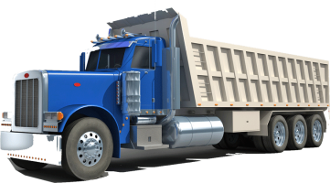

More differences between TTC and ITC
Internal Traffic Control
PREVENTING RUNOVERS AND BACKOVERS IN ROADWAY CONSTRUCTION
More Differences Between TTC and ITC
Temporary Traffic Control Plan | Internal Traffic Control Plan
Motor Vehicles | Construction Equipment
FHWA MUTCD or State Guide | NIOSH Development Guide
Typicals | ITC Diagrams
Typical Application Notes | Internal Traffic Control Notes
Traffic Safety Engineer | Supervisor/Site Superintendent
Notes:
Compare and contrast the differences between temporary traffic control and internal traffic control. A significant contrast between TTCPs and ITCPs is that TTCPs are a formal document; changes may require engineering judgment. ITCPs are informal plans and should be changed regularly as site conditions change.

Slide 9
What do ITCPs and TTCPs share in common
Internal Traffic Control
PREVENTING RUNOVERS AND BACKOVERS IN ROADWAY CONSTRUCTION
What Do ITCPs and TTCPs Share in Common?
Common Themes
Providing clear direction to drivers
Separating moving vehicles from workers on foot
Using temporary traffic control devices to mark traffic paths
Maintaining a smooth traffic flow
Notes:
TTCPs and ITCPs contain common principles, including:
Providing clear direction to drivers
Separating moving vehicles from workers on foot
Using temporary traffic control devices to mark traffic paths, and
Maintaining a smooth traffic flow

Slide 10
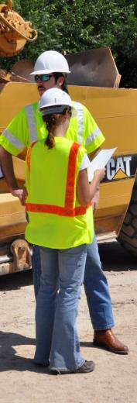
Why implement internal traffic control
Internal Traffic Control
PREVENTING RUNOVERS AND BACKOVERS IN ROADWAY CONSTRUCTION
Why Implement Internal Traffic Control?
ITC protects worker on foot
Workers on foot or pedestrian workers do most of their work outside vehicles and equipment
Workers on foot are particularly vulnerable to being struck by vehicles and equipment
ITC reduces hazards for equipment operators.
Every person on the site has the responsibility to be vigilant and work safely
Notes:
Workers on foot – or pedestrian workers - ground workers – are those employees who perform their tasks outside construction equipment and other vehicles. They are exposed to the hazards of being struck by motorists and construction vehicles. While there are many terms used to describe such workers, in this course we will refer to them as “workers on foot.”

Slide 11
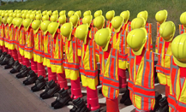
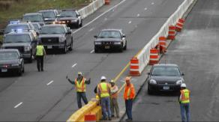

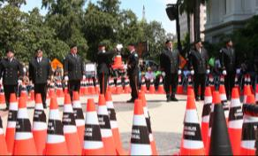
There are two types of runovers backovers
Internal Traffic Control
PREVENTING RUNOVERS AND BACKOVERS IN ROADWAY CONSTRUCTION
There Are 2 Types of Runovers/Backovers
Workers Struck By Motorists
Workers Struck By Equipment
More workers are killed by construction vehicles than by motorists

Slide 12
Job related fatalities in road construction
Internal Traffic Control
PREVENTING RUNOVERS AND BACKOVERS IN ROADWAY CONSTRUCTION
Job-Related Fatalities in Road Construction
Runovers and backovers are number one cause of death
Source: U.S. Bureau of Labor Statistics
Notes:
On average, 50-60 workers are killed in struck-by incidents on roadway construction sites. Greater industry and public education needs to be focused on eliminating distractions, such as cell phone use, which can contribute to these deaths and injuries to reduce incidents caused by motorists. ITCPs can protect against accidents caused by construction vehicles. See article on worker fatalities by Stephen Pegula contained in the Instructor Background Materials.

Slide 13
More workers are killed by construction vehicles than by motorists
Internal Traffic Control
PREVENTING RUNOVERS AND BACKOVERS IN ROADWAY CONSTRUCTION
More workers are killed by construction vehicles than by motorists
Source: Bureau of Labor Statistics / Stephen Pegula
Notes:
More workers are killed by construction-related vehicles or equipment (38 percent) than by cars, tractor-trailer trucks, and vans (33 percent). Coordination of workers and equipment doing different activities in close proximity can improve work flow and reduce conflicts between workers on foot and equipment operators. (See state –by-state statistics in instructor materials.)

Slide 14
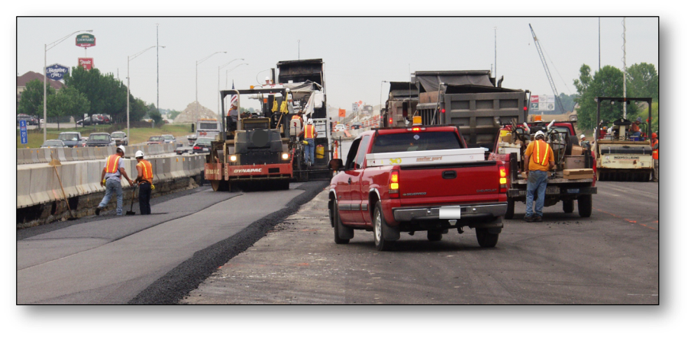
Construction vehicles are the greatest hazard
Internal Traffic Control
PREVENTING RUNOVERS AND BACKOVERS IN ROADWAY CONSTRUCTION
Construction vehicles are the greatest hazard
Notes:
Compliance with the MUTCD and OSHA regulations is a necessary first step in providing a safe work environment. However, these sources, taken together, do not provide comprehensive guidance to ensure worker safety in roadway work zones. The interaction between workers on foot and construction trucks and equipment is the single biggest hazard in the heavy and highway industry. There are several hazards workers should be aware of to enable them to protect themselves against work zone hazards.

Slide 15
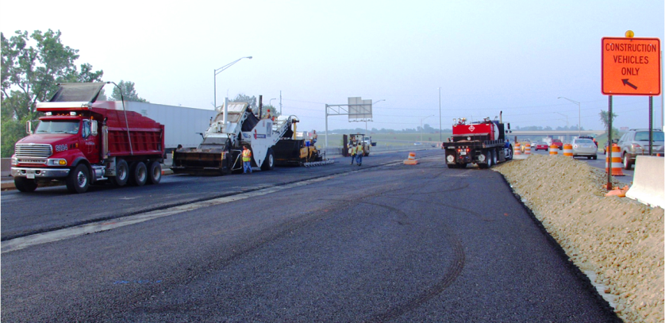
Vehicles frequently enter and exit
Internal Traffic Control
PREVENTING RUNOVERS AND BACKOVERS IN ROADWAY CONSTRUCTION
Vehicles frequently enter and exit
Notes:
The constant movement of vehicles in and out of the work area can create hazards if the travel paths are not set and coordinated. ITCPs can also be used to communicate the need to keep entry and exit points free of parked vehicles and equipment. Note the tire marks on the pavement indicating vehicles are turning around in the work area. Ideally, ITCPs minimize backing and turning. Start each day with a risk assessment discussion with workers and subcontractors (including employees).

Slide 16
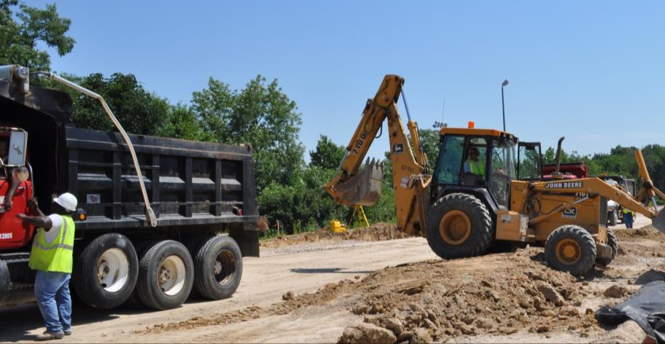
workers on foot may work close to large vehicles
Internal Traffic Control
PREVENTING RUNOVERS AND BACKOVERS IN ROADWAY CONSTRUCTION
Workers on foot may work close to large vehicles
Notes:
Note the size of workers on foot in relation to the size of the construction equipment and vehicles. Because workers are relatively short compared to construction vehicles, it can be difficult or impossible to see them, especially in areas known as “blind spots.”

Slide 17
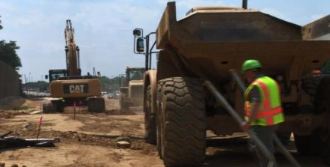

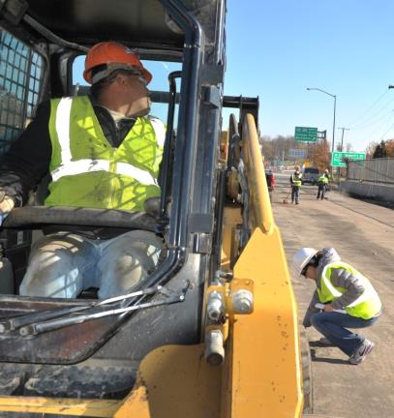
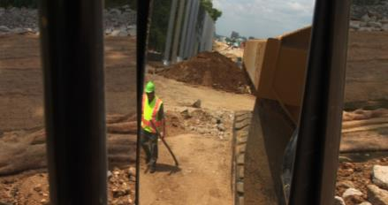
what are blind spots
Internal Traffic Control
PREVENTING RUNOVERS AND BACKOVERS IN ROADWAY CONSTRUCTION
Workers on foot are vulnerable in blind spots
What Are Blind Spots?
Behind Vehicle
Blind Spots
Locations around equipment and vehicles where workers on foot are invisible to the operator through the windows/mirrors
Outside Mirror Range
Notes:
A blind spot (or blind area) is the area around a vehicle or piece of construction equipment that is not visible to the operator, either by direct line-of-sight or indirectly by use of internal and external mirrors. As a worker on foot, if you can’t see the driver and the driver can’t see you, you’re in a dangerous situation. Companies and projects should identify a specific side of the vehicle where a worker should walk for each operation. Consistency is important for safety.

Slide 18
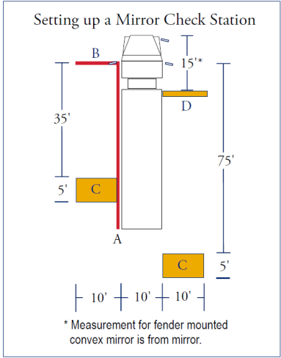
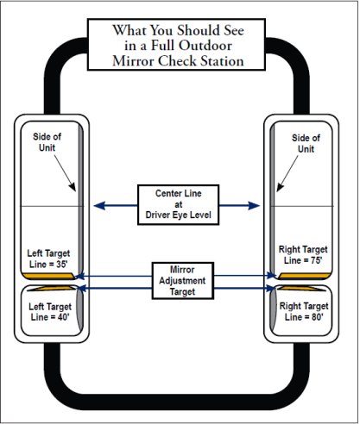
Setting up a mirror check station
Internal Traffic Control
PREVENTING RUNOVERS AND BACKOVERS IN ROADWAY CONSTRUCTION
Notes:
Blind areas can be reduced by properly setting mirrors on equipment in a “mirror check station.”
Images provided by, and used with permission of Liberty Mutual Insurance. See Liberty Mutual Mirror Check Station handout in Instructor Materials.

Slide 19
Contact ARTBA for video on Dump Trucks Video Name (Dump Truck.wmv)

Slide 20
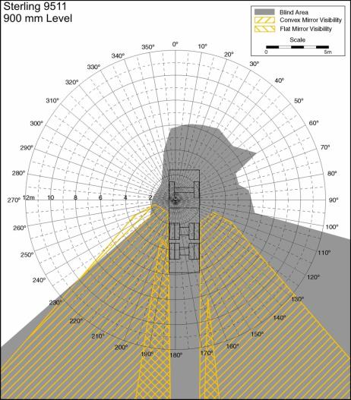
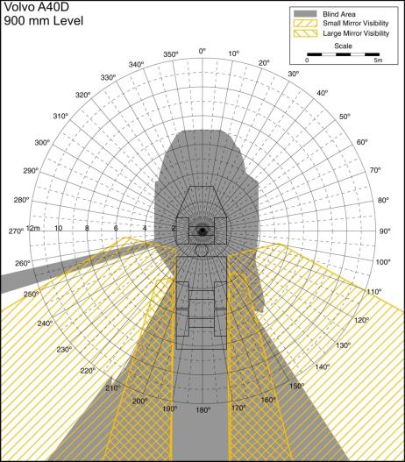
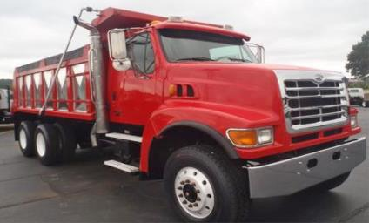
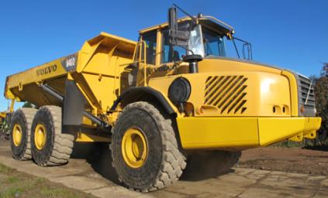
Blind spots
Internal Traffic Control
PREVENTING RUNOVERS AND BACKOVERS IN ROADWAY CONSTRUCTION
Blind Spots
Be familiar with unique blind spots of each vehicle EXAMPLES:
Gray areas = blind spots Yellow hatch lines = visible in mirrors
http://www.cdc.gov/niosh/topics/highwayworkzones/BAD/imagelookup.html
Notes:
Each vehicle has its own, unique blind spots. Operators should be familiar with the blind spots surrounding each piece of equipment he or she operates and should be sensitive to the fact workers and other objects cannot be seen – even when using mirrors. Note the gray areas in the diagrams indicating the various shapes and sizes of blind spots for different vehicles. The yellow hatched lines show areas visible using the mirrors. More examples can be found at: http://www.cdc.gov/niosh/topics/highwayworkzones/BAD/imagelookup.html.

Slide 21
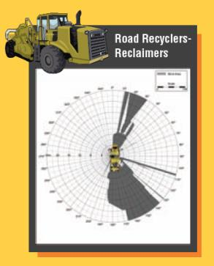
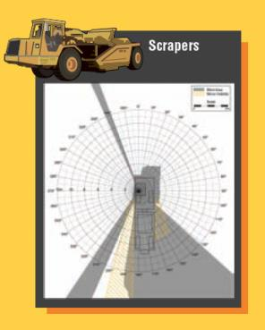
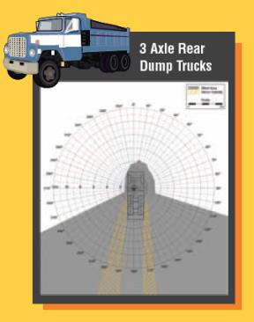
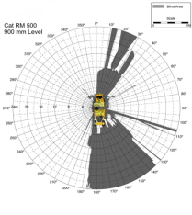
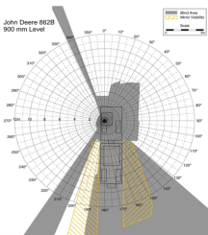
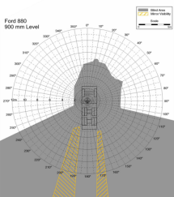
Each type and make of vegicle has unique blind spots
Internal Traffic Control
PREVENTING RUNOVERS AND BACKOVERS IN ROADWAY CONSTRUCTION
Each type and make of vehicle has unique blind spots
http://www.cdc.gov/niosh/topics/highwayworkzones/BAD/imagelookup.html
MORE EXAMPLES:
Notes:
See also Blind Spot poster from the National Work Zone Safety Information Clearinghouse. These posters are available for free from the Clearinghouse and would make a good handout for this section. You can create maps like these--and appreciation for the blind areas for your vehicles--by having workers on foot take turns sitting in the cab and viewing their surroundings. Have another worker walk around the vehicle so the person in the cab can identify the blind spots.

Slide 22
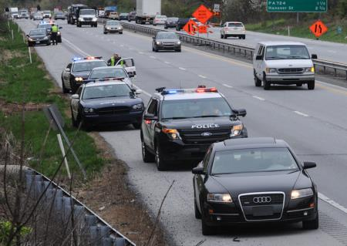

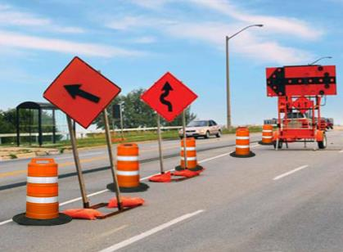
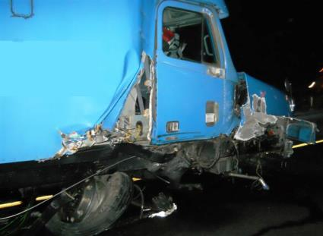
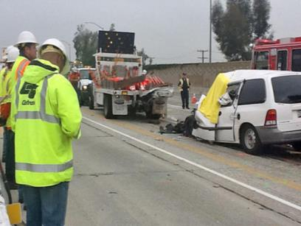
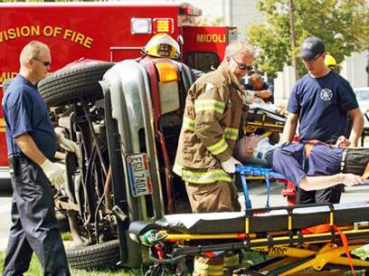
workers are also struck and killed by motorists
Internal Traffic Control
PREVENTING RUNOVERS AND BACKOVERS IN ROADWAY CONSTRUCTION
Workers are also struck and killed by motorists
Motorists are likely to enter the work space when
Workers are not visible to motorists
Motorists are surprised by work zone and TTC set up
TTCDs are confusing/non-compliant
Motorists ignore warnings
Drivers are distracted or impaired (phones, food, drugs, alcohol, drowsy, etc.)
Traffic is traveling at high speed through work zone
Being struck by motorists/vehicle crashes is the second leading cause of worker deaths in road construction
Notes:
As the previous slides demonstrated, he primary cause of worker deaths in roadway construction is workers being struck by construction vehicles and equipment. The second highest cause is workers being struck by motorists or when a vehicle crashes. In situations where motorists strike workers, those in the construction industry often assume the fault is with the driver. We must be effective in both the design and execution of the TTCP and ITCP so that our work is not a contributing factor. Improper TTC design and workers straying into the traffic space are often cited as a cause of worker fatalities. One of the most common reasons drivers stray into the work space is because they are impaired, distracted or speeding.

Slide 23
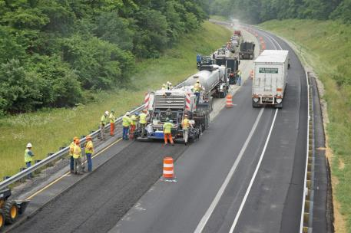
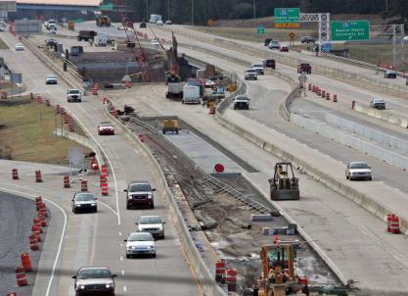


workers are also struck and killed by motorists
Internal Traffic Control
PREVENTING RUNOVERS AND BACKOVERS IN ROADWAY CONSTRUCTION
Workers are also struck and killed by motorists
Workers may stray into traffic when
Preoccupied by work
Become ‘comfortable’ in dangerous environment
No convenient access to and from work space
- Rest rooms
- Food and water
- Shade breaks
- Other local work areas
- Staging of company and personal vehicles
Workers cross traffic lanes (especially in high-speed locations)
Notes:
The organization of the work space can and does impact worker behavior. Workers are more likely to take risks such as entering the traffic space if circumstance entice or compel them to do so. When creating your safety/ITCP plan, consider the location of rest areas, water stations, parking, etc. To the extent feasible, these should be located to minimize workers crossing traffic or construction vehicle pathways. (This will be discussed in more depth in the following module.)

Slide 24






How can we prevent deaths caused by motorists
Internal Traffic Control
PREVENTING RUNOVERS AND BACKOVERS IN ROADWAY CONSTRUCTION
How can we prevent deaths caused by motorists?
Set up Temporary Traffic Control Devices (TTCDs) properly
Comply with MUTCD or corresponding state doc
Inspect and maintain TTCDs
Ensure only a qualified engineer makes necessary modifications
Set up safe procedures for deployment and retrieval of TTCDs
Ensure sufficient TTCDs for all parts of the project (ramp geometry, exits, closures, etc.)
Notes:
Depending upon the nature of the work being done, TTCDs may be set up by the site workers or, on more complex or large jobs, this will be accomplished by a specialized contractor or crew. In any situation, the devices should be set up in compliance with the MUTCD or comparable document. TTCDs not only provide guidance for traffic, but are part of the worker safety strategy.

Slide 25






How can we use TTCDs properly
Internal Traffic Control
PREVENTING RUNOVERS AND BACKOVERS IN ROADWAY CONSTRUCTION
How can we use TTCDs properly?
Make workers aware of TTCDs in their work location
Train workers to notify supervisor immediately if devices are
Not in proper position
Damaged or dirty
Not being observed or recognized by motorists
Workers may correct misaligned devices if it is safe to do so and they understand where the device is supposed to be positioned
Notes:
Workers should be able to recognize if TTCDs are out of place. They should be informed if they have the authority to re-set misaligned devices or the process for notifying their supervisor when they see a problem. In all situations, misaligned, missing or non-performing devices should be corrected immediately.

Slide 26

Workers should know basic TTC and ITC concepts
Internal Traffic Control
PREVENTING RUNOVERS AND BACKOVERS IN ROADWAY CONSTRUCTION
Workers should know basic TTC and ITC concepts
Most workers will not be trained to set up and maintain TTC or ITC plans. But they should understand the purpose and function of both plans so they can recognize when setups are not functioning.
Notes:
Most workers will not be trained to set up and maintain temporary traffic control. Nevertheless, they should understand the purpose of a temporary traffic control plan and function of temporary traffic control devices so they can recognize when they are not functioning correctly.

Slide 27
Discussion and questions
Internal Traffic Control
PREVENTING RUNOVERS AND BACKOVERS IN ROADWAY CONSTRUCTION
Discussion and Questions

