Slide 1

Construction vehicle access and egress for roadway construction
Access and Egress
PREVENTING RUNOVERS AND BACKOVERS IN ROADWAY CONSTRUCTION
Construction Vehicle
for Roadway Construction
Access and Egress
Notes:
This module focuses on how ITCP planning can improve safety at vehicle entry and exit points. It explains how access/egress locations provide transitions between TTC plans and ITC plans.

Slide 2

ARTBA Disclaimer
This material was produced under the grant SH-24861-SH3 from the Occupational Safety and Health Administration, U.S. Department of Labor. It does not necessarily reflect the views or policies of the U.S. Department of Labor, nor does mention of trade names, commercial products, or organizations imply endorsement by the U.S. Government.
Additional assistance came from contract 212-2009-M-32109 from the National Institute for Occupational Safety and Health.
Contact ARTBA for information about Student Handbooks.
American Road &
Transportation Builders Association

Slide 3
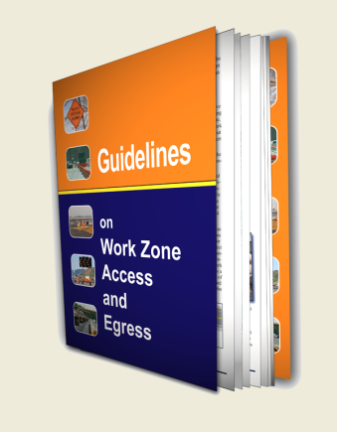
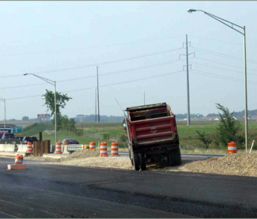
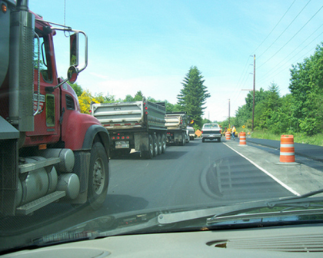
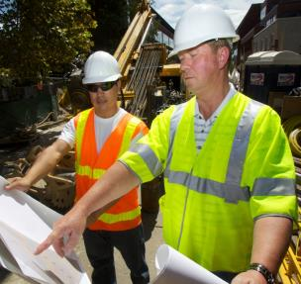
Course goals
Access and Egress
PREVENTING RUNOVERS AND BACKOVERS IN ROADWAY CONSTRUCTION
At the end of this module, you will know
  Why control of access and egress is so important
  Challenges in access and egress
  How the ITCP addresses each challenge
  How FHWA Subpart K impacts
  access and egress
Access and egress are a critical aspect of a well-planned ITCP.

Slide 4
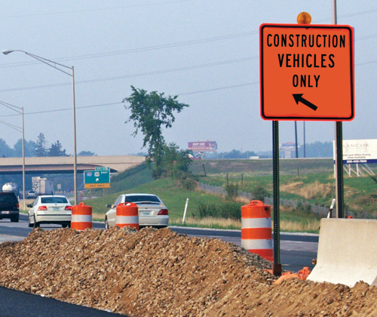
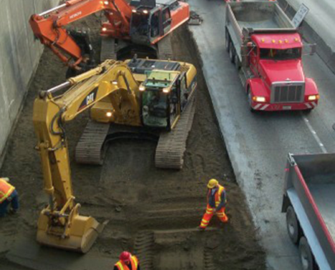
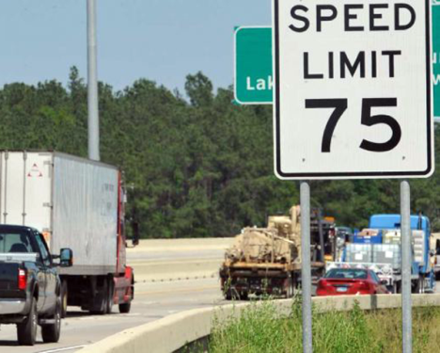
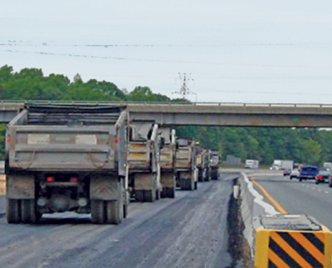
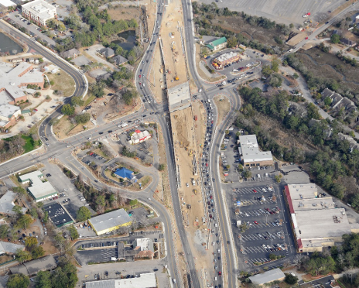
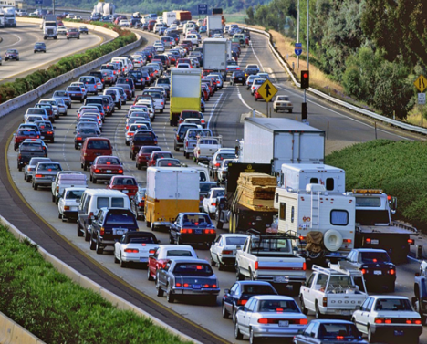
Why is access and egress control important
Access and Egress
PREVENTING RUNOVERS AND BACKOVERS IN ROADWAY CONSTRUCTION
Why Is Access and Egress Control Important?
Access to / egress from work zones presents significant challenges
Hazards compound when a roadway
  - Carries high traffic volumes
  - Operates at high traffic speeds
Safety challenges include
  - Motorists following construction
  vehicles into the work space
  - Acceleration and deceleration
  of construction vehicles as
  they exit/enter open traffic lanes
  - Proximity of workers on foot to
  access and egress locations
Notes:
Why is access and egress control important? (Discuss this question.)
The establishment and maintenance of safe access and egress points are key determinants of project safety. In order for roadway construction jobs to maintain safe operations, there must be procedures to allow for safe and efficient passage of work vehicles into and out of the work space and for motorists to travel through the work zone. Effectively addressing safe access and egress at the project level requires planning during the project development phase and implementing traffic control plans throughout the entire project.

Slide 5
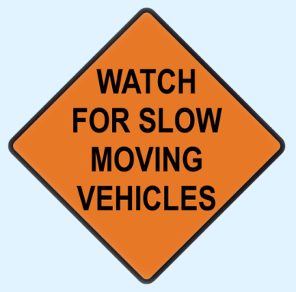
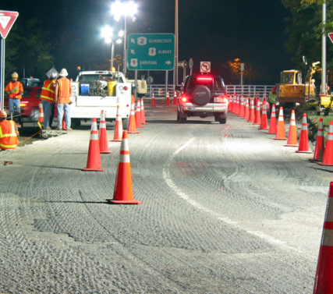
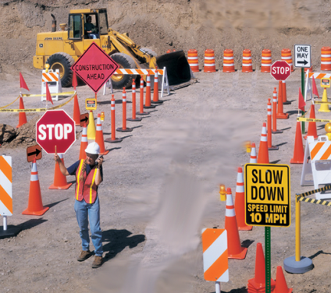
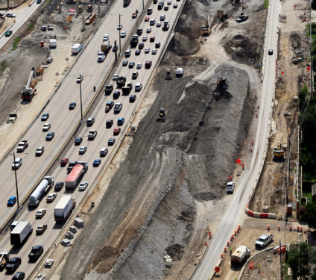


Access and egress challenges
Access and Egress
PREVENTING RUNOVERS AND BACKOVERS IN ROADWAY CONSTRUCTION
Access and Egress Challenges
Primary Challenge: Safely and efficiently getting materials and equipment
into and/or out of work zone
Attendant Challenges:
Acceleration / Deceleration Lanes
  - Short or Non-existent
Signing for Merge / Exit Points
  - Signs giving vague information
  - Messages left up 24 / 7
Flagging Operations
  - Best with low traffic, moderate trucks
  - Low trucks = intermittent flagging
  - Rules are forgotten
Night Work
  - Poor sight distance, impaired
  drivers, others?
Notes:
The primary challenge with regards to work zone access and egress is getting materials in and out of the work space. Of necessity, this involves acceleration and deceleration of large, heavy trucks and equipment hauling the materials. These construction vehicles must leave and enter the traffic space, where motorists often drive at high speeds, and transition to the work space, filled with slow moving equipment and workers on foot.

Slide 6
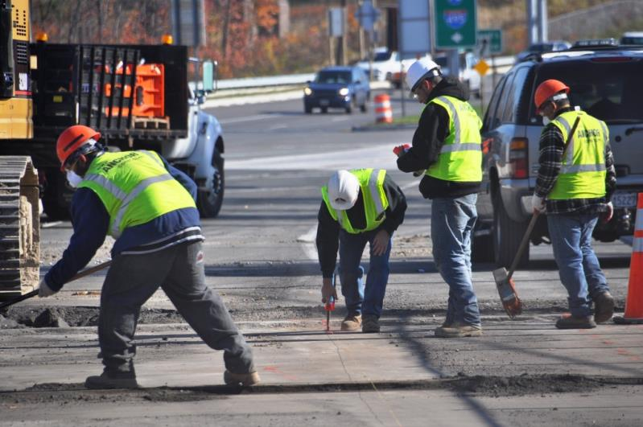
Access and egress picture
Access and Egress
PREVENTING RUNOVERS AND BACKOVERS IN ROADWAY CONSTRUCTION
Parked employee
vehicles.
ITCPs Coordinate Tasks
Delivery access
and egress point.
Moving construction
Equipment.
Workers
on Foot.
SEE WORKBOOK PAGE 5
Notes:
The work area can be complex with delivery trucks entering and exiting the work space near workers on foot and other operating/moving equipment. The ITCP should coordinate these activities so all know what the other is doing and each stays out of the path of the other. In this slide, the employee vehicle and worker on foot would be in direct path of a vehicle entering the work area. A risk analysis would identify the location of the parked vehicle as a hazard; a different parking site should be identified. Employer should train employees on where to and where not to park on site. Employers should also train on particularly hazardous areas like access and egress points.
Workers, operators and drivers inside the workspace should be aware and vigilant when working near access and egress points. Drivers entering the work space likewise need to be very attentive when doing so as this is a high-hazard area for all workers.

Slide 7


Access and egress challenges can be addressed by an ITCP
Access and Egress
PREVENTING RUNOVERS AND BACKOVERS IN ROADWAY CONSTRUCTION
Access/egress challenges can be addressed by an ITCP
QC Truck
Foreman Truck
GW Truck
QC
SI
SO
SP
SI
Worker Area
Staging Area
Lane 1 10’
Enter
Exit
Lane 2 10’
GW
SI Truck
Breakdown Lane 10’
  - Isolating workers on foot from trucks and equipment
  - Limiting/controlling vehicle access points
  - Coordinating truck and equipment movements
  - Providing guidance to workers on foot, truck drivers, and equipment operators
  - Designating locations for parked vehicles and equipment
  - Raising awareness about vehicle intrusions with workers and operators/drivers

Slide 8
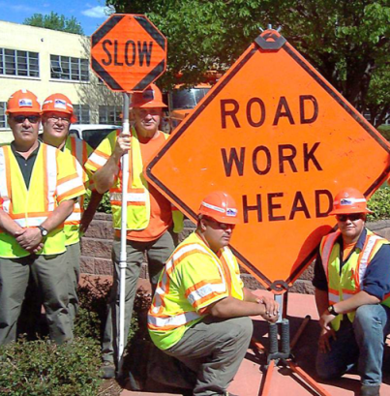
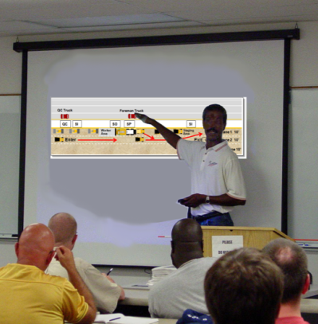
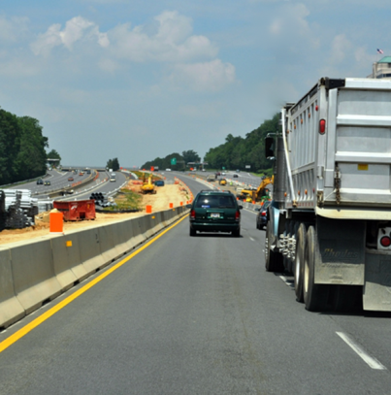
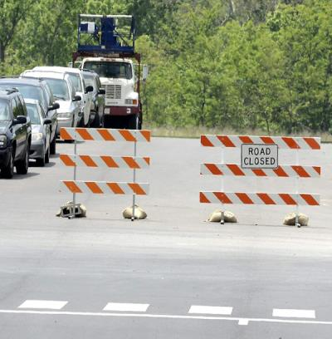
Challenge number 1
Access and Egress
PREVENTING RUNOVERS AND BACKOVERS IN ROADWAY CONSTRUCTION
Challenge #1
Trucks entering the work zone
put motorists and those on
other side of wall at risk
ITCP solutions
Train truckers to pay attention
to work space dynamics
Instruct workers to stay clear
of access and egress points
Instruct employees on proper
locations for parking and
staging vehicles, away from
entry and exit points
Notes:
Entering and exiting the work space can require rapid acceleration and deceleration. (Discuss with the class the dynamics of how this situation is impacted if the truck in loaded or empty. Taking the load into consideration, how might that knowledge be used to make the work environment safer?
Activities that occur under the direction of construction contractors include maintaining a clear/open area around access/egress points where equipment or vehicles should not be parked. Contractors are also responsible for educating on-site employees about areas near access/egress points that are prone to heavy truck traffic. Workers should avoid crossing open traffic lanes, particularly those on high-speed roadways.

Slide 9
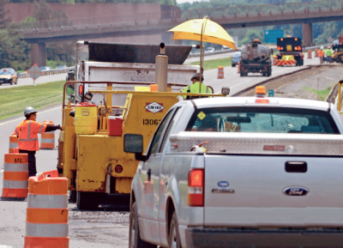
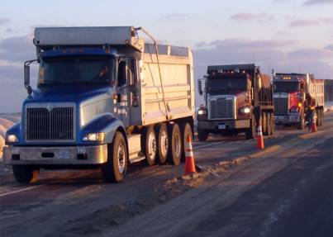
Challenge number 2
Access and Egress
PREVENTING RUNOVERS AND BACKOVERS IN ROADWAY CONSTRUCTION
Challenge #2
Trucks queued inside work
zone create obstacles for
workers and operators
ITCP solution
If queues threaten to block
access and egress locations,
queues should be redirected,
or different access and egress
spots should be opened and
identified for drivers to use
Notes:
When truck queues form near exit and entry points they create hazards for other vehicles attempting to enter (with little deceleration space) and exit (with little acceleration space). If queues threaten to block these spots, queues should be redirect, or different access and egress spots should be identified for drivers to use.
If queues threaten to block access and egress locations, queues should be redirected, or different access and egress spots should be opened and identified for drivers to use.

Slide 10
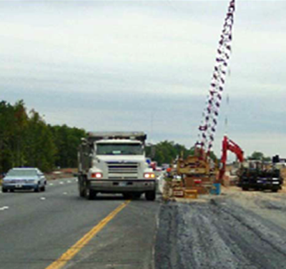
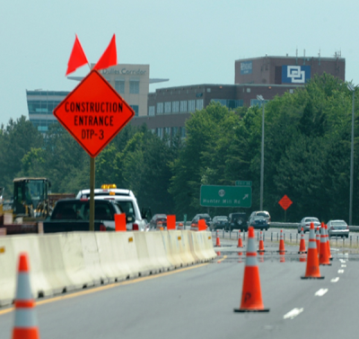
Challenge number 3
Access and Egress
PREVENTING RUNOVERS AND BACKOVERS IN ROADWAY CONSTRUCTION
Challenge #3
Trucks do not have enough
space to slow down when
entering or to match traffic
speeds when exiting
ITCP solution
Use shoulder areas or closed
lanes to create ramps for safe
acceleration/deceleration zones
Notes:
Speed differential between traffic lanes and work space is a challenge for truck drivers, and can create significant hazards for both workers and motorists.
In addition to creating special ramps or other lanes, all access and egress areas should be kept clear of debris, signage, parked vehicles, etc.

Slide 11
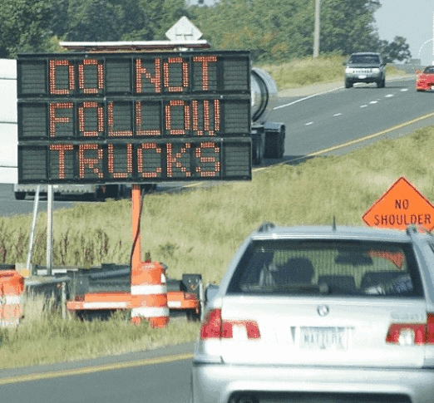
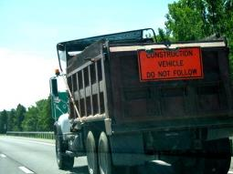
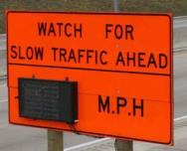
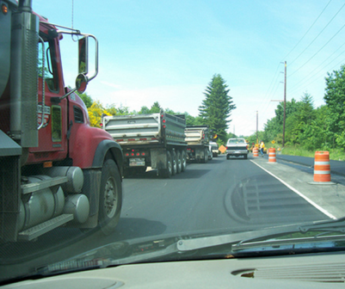
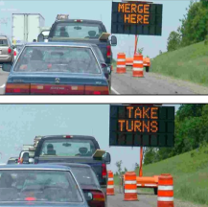

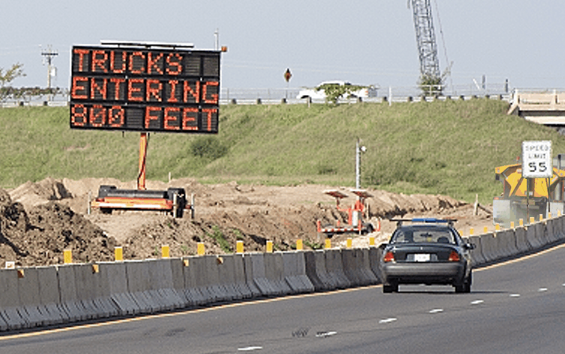
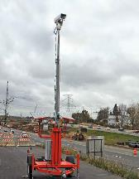
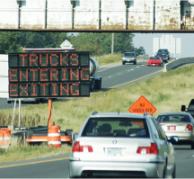

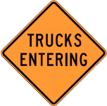
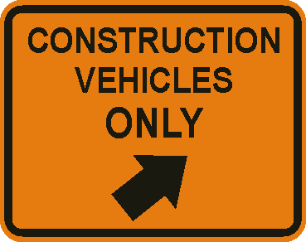
Challenge number 4
Access and Egress
PREVENTING RUNOVERS AND BACKOVERS IN ROADWAY CONSTRUCTION
Challenge #4
Motorists follow construction
trucks into the work area
ITCP solutions
Traditional warnings
- Slow speed advisory
  - Dynamic Lane Merge
  - Travel time/delay
  - Excessive speed warning
  - Traffic surveillance
  - Stopped traffic warning
- Trucks entering/exiting
  - Maintain TTCDs in good condition
  Vehicle-activated warning signs
  - Replace signs on vehicles
  - Real-time information
Notes:
Because construction trucks tend to be very large, motorists directly behind them cannot see the road ahead or some traffic signs. Because of this lack of sight distance, they may not realize the truck is leaving the traffic space and entering the work space and follow it. Signs mounted on the truck or additional work zone signs or signals can provide additional guidance to drivers.
Warning signs alert motorists to be aware of slow moving construction vehicles. If motorists make room for trucks to enter and exit travel lanes, safety is improved inside the work space as construction drivers may not need to change their speeds so abruptly.
Motorists are likely to pay more attention to information that is correct, up-to-date and relevant. Vehicle activated signs that provide warning messages only when trucks are entering or exiting the work space are more likely to be heeded by motorists than static signs that may not be relevant to the immediate situation. Use of these signs improves access and egress safety by informing motorists to slow down and to expect and encounter with a slow-moving truck or other vehicle.

Slide 12

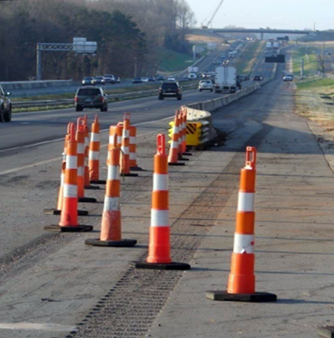
Challenge number 5
Access and Egress
PREVENTING RUNOVERS AND BACKOVERS IN ROADWAY CONSTRUCTION
Challenge #5
Crew, operators, inspectors,
subcontractors, others may not
be up-to-date on access/egress
locations as work progresses
ITCP solutions
Hold pre‐shift meeting
with all involved
Inform everyone on daily
activities and changes
Notes:
Roadway construction involves moving operations. As the work progresses, so moves the work site. With continual changing conditions, access and egress points may change.
The best way to keep all members of the construction team up-to-date is to hold pre-shift meetings where the day’s activities are discussed and those involved can receive updates.

Slide 13
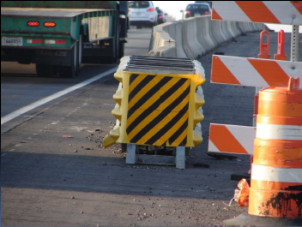
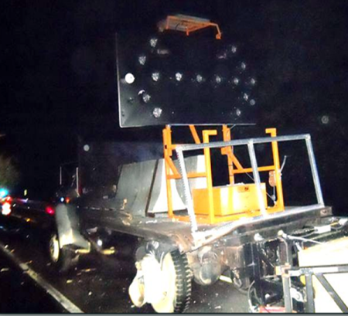
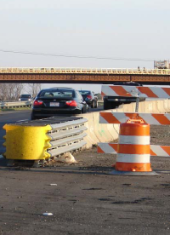
Challenge number 6
Access and Egress
PREVENTING RUNOVERS AND BACKOVERS IN ROADWAY CONSTRUCTION
Challenge #6
Motorists may breach barriers
and strike workers near access
and egress points
ITCP solutions
When openings are not in use
they should be evaluated to see
if it is necessary to close them
Watch for vehicles that do not
belong in or near the work area
Check for problems such as
blunt ends on barriers
Notes:
Access and egress points require gaps in barriers and traffic delineation. These gaps can allow traffic to enter the work space unimpeded and therefore create increased exposures to workers.
Temporary traffic control devices, particularly end treatments, should be checked regularly to ensure they are in good operating condition. Part of the ITCP is to evaluate end treatments when access/egress points are opened and closed.

Slide 14
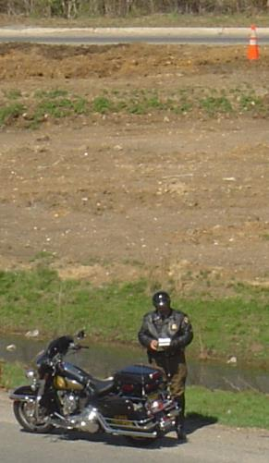
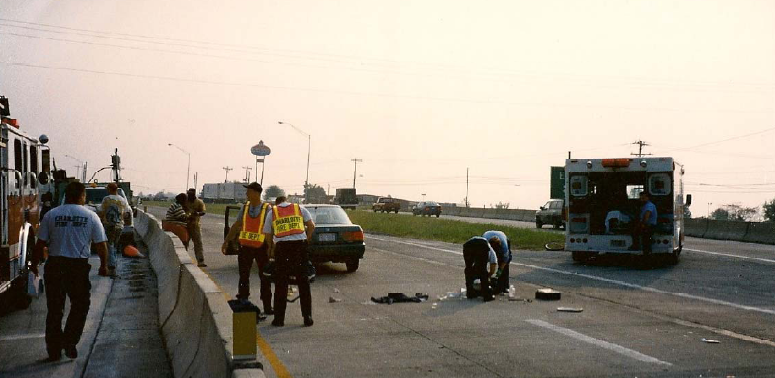
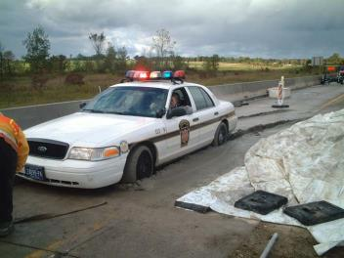
Challenge number 7
Access and Egress
PREVENTING RUNOVERS AND BACKOVERS IN ROADWAY CONSTRUCTION
Challenge #7
Emergency responders need access
when incidents occur within the work zone
ITCP solutions
The Temporary Traffic Control Plan (TTCP)
and the Internal Traffic Control Plan (ITCP)
should function together to allow access
for emergency responders
Evaluate each job – when appropriate,
local police should be kept up to date on
activities that disrupt traffic and have the
potential for workers to be harmed
Law enforcement and emergency responders need to know what is
happening on your jobsite
Notes:
Each place of work should have a site-specific plan in place to deal with an emergency. There should always be someone onsite that knows who to call in the event of an emergency and can provide instructions on what actions to take.
The TTCP and ITCP need to include provisions for providing access to emergency responders in the event there is an incident within the work space. Communicating current conditions about traffic control within the workspace to first responders is an important consideration in the ITCP. This will change with every job. Even in non-emergency situations, it is helpful to keep local law enforcement officials informed about site conditions and operations should their assistance be required.

Slide 15

Federal regulations
Access and Egress
PREVENTING RUNOVERS AND BACKOVERS IN ROADWAY CONSTRUCTION
Federal Regulations
Traffic Control Devices Rule - 23 CFR 630 (Subpart K)
Effective December 04, 2008
Requires States to consider
road user and worker safety
by addressing:
Use of positive protection
devices to prevent intrusions
Exposure control measures
Other traffic control measures
to minimize crashes
Safe entry/exit of work vehicles/
equipment from the travel lanes
Notes:
The Federal Highway Administration included language in its recent regulation, known as Subpart K, requiring agencies and contractors to give more attention to the hazards posted by roadway construction access and egress points.

Slide 16
Discussion and questions
Access and Egress
PREVENTING RUNOVERS AND BACKOVERS IN ROADWAY CONSTRUCTION
Discussion
and
Questions

