Slide 1

Technology solutions
Technology Solutions
PREVENTING RUNOVERS AND BACKOVERS IN ROADWAY CONSTRUCTION
in ITC Planning
Technology
Solutions
Notes:
NIOSH has been heavily engaged in research and product testing to review the practicality and effectiveness of various technologies designed to warn operators when they are near workers on foot. This module reviews some of those technologies that are now available—or will soon be available—for roadway construction applications.
Credit: Much information in this presentation is taken from research conducted by Todd Ruff, NIOSH Office of Mine Safety and Health Research.

Slide 2
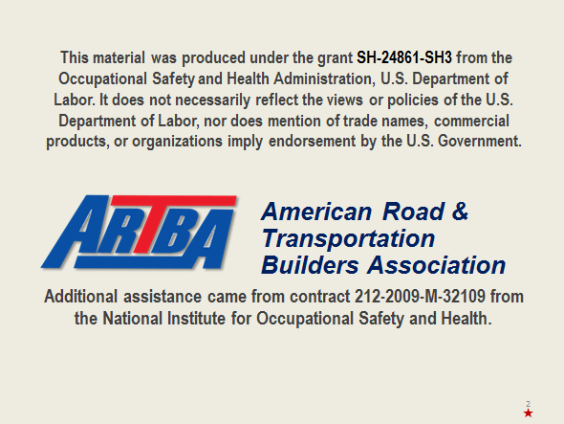
Course disclaimer
Contact ARTBA for information about Student Handbooks

Slide 3
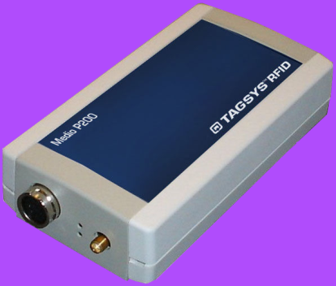
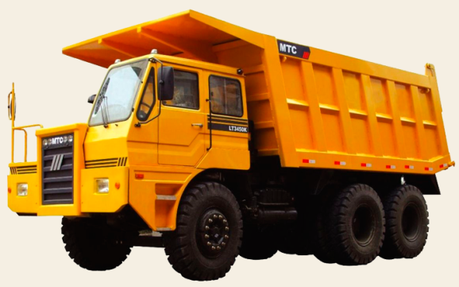
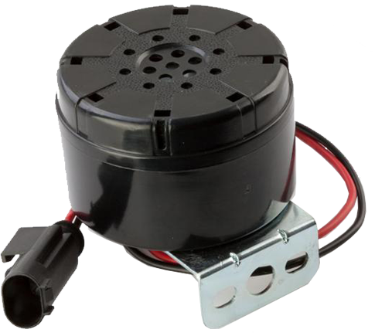
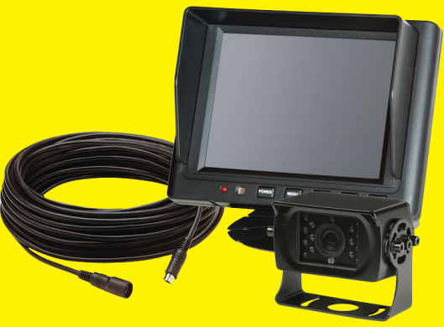
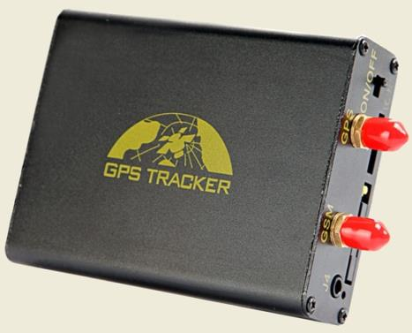
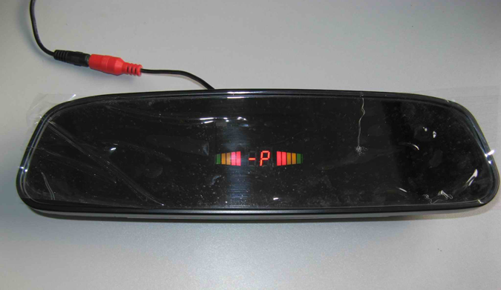
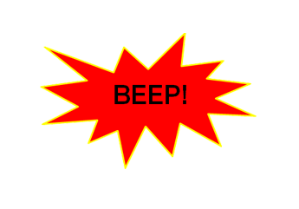
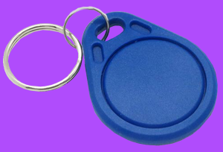
Six technologies to prevent runovers and backovers
Technology Solutions
PREVENTING RUNOVERS AND BACKOVERS IN ROADWAY CONSTRUCTION
At the end of this module, you will know
  Six types of technological solutions available for prevention
  of runovers and backovers
  Alarms
  Cameras
  Radar
  Sonar
  Tag systems
  GPS
3
Notes:
The role of technology in the ITCP is essentially one of communication. Through cameras, radar, sonar and other warning technologies, workers and operators have enhanced ability to see each other and be warned when a dangerous situation arises. Technology will not necessarily “protect” against a runover or backover incident, but it can provide an additional level of warning and notification in those instances where either workers on foot, operators or truck drivers do not follow the ITCP, or where the ITCP did not fully anticipate or control for a hazardous situation that arises.

Slide 4

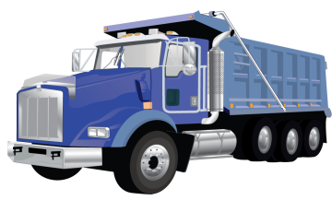

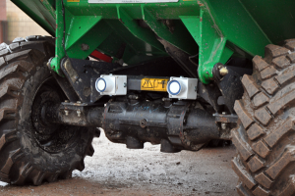
terminology
Technology Solutions
PREVENTING RUNOVERS AND BACKOVERS IN ROADWAY CONSTRUCTION
Terminology
Proximity Detection: Detection of personnel, vehicles, other objects
near a machine using a sensor technology
Proximity Warning
(Collision Warning):
Detection of personnel,
vehicles, other objects
generates alarms
  Warn only operator
  Warn operator and nearby personnel (two-way)
Collision Avoidance: Processing of sensor
information resulting in control signals or actions
that alter machine status/movement
  Computer control
  Human control
Notes:
Proximity Detection: Detection of personnel, vehicles and other objects near a machine using a sensor technology.
Proximity Warning (Collision Warning): Detection of personnel, vehicles and other objects near a machine resulting in alarms.
Collision Avoidance is the processing of sensor information resulting in control signals or actions that alter machine status/movement to avoid a collision.

Slide 5

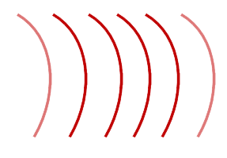
Proximity detection
Technology Solutions
PREVENTING RUNOVERS AND BACKOVERS IN ROADWAY CONSTRUCTION
Proximity Detection
Independent or stand alone systems
  Passive sensing of obstacles and personnel
  - Reflected Signals
  - Non-discriminating
  Cooperative systems mounted on
  machines, obstacles, personnel
  communicate with one another
Network-based systems
Require supporting infrastructure
  Cooperative, require other infrastructure on jobsite (GPS or other system)
Actions: Range from simple alarms to machine
control (setting brakes, limiting movement, etc.)
Notes:
There are a variety of proximity detection systems, some are stand along while others are network based.
Independent systems may have passive sensing of obstacles and personnel. Cooperative systems require communication between machine-mounted systems and systems on obstacles or personnel.
Network-Based Systems are cooperative and require other infrastructure on the job-site.

Slide 6
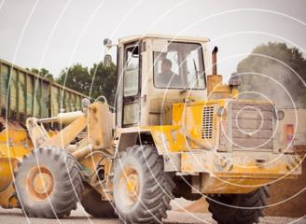
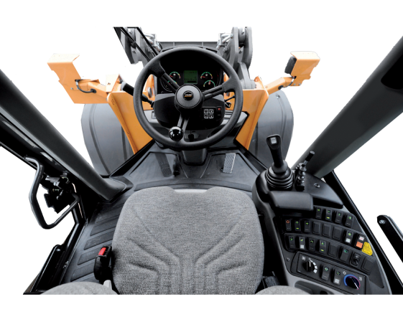



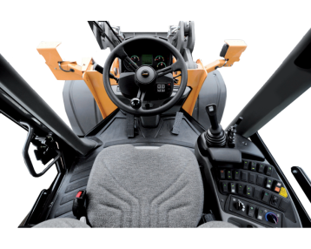
Collision avoidance approaches
Technology Solutions
PREVENTING RUNOVERS AND BACKOVERS IN ROADWAY CONSTRUCTION
Collision Avoidance Approaches
  Increase situational awareness
  Visual, audible, tactile alarms
  Two-way alarming
  Human in the loop
  Machine Control
  Processing of sensor
  information
  Automatic control of
  machine functions
  Combination of both

Slide 7
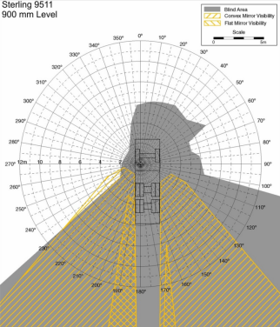
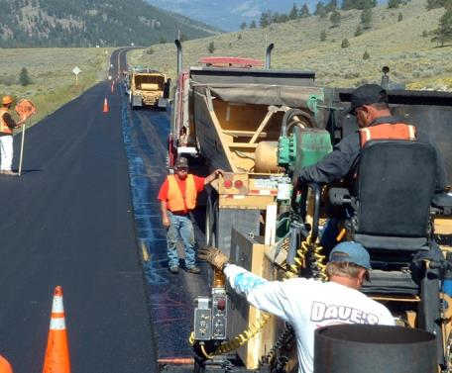
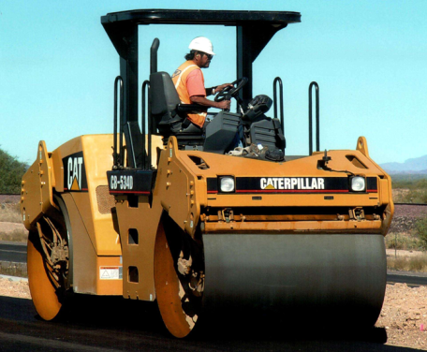
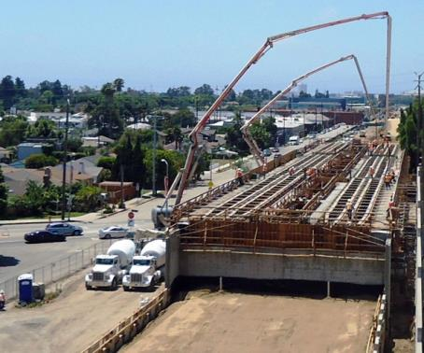
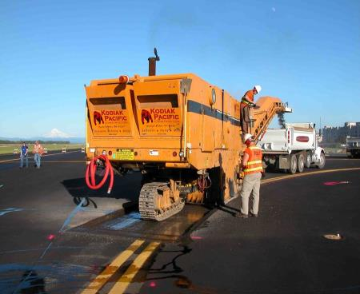
Considerations
Technology Solutions
PREVENTING RUNOVERS AND BACKOVERS IN ROADWAY CONSTRUCTION
Considerations
  Correct approach to avoiding runovers, backovers, or pinning workers
  depends on type of equipment and associated risks
  Operator on board
  Operator adjacent to equipment
  Blind areas
  Speed of machine
  Risk to near-by workers
  or vehicles
Notes:
The approach to avoiding runovers, backovers, or pinning workers depends upon the type of equipment and its associated risks. The system will be contingent upon factors such as whether the operator is on board or adjacent to equipment. One should consider hazards such as blind areas, speed of the machine and the risk to near-by workers or vehicles.

Slide 8

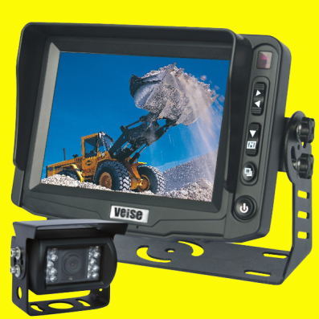
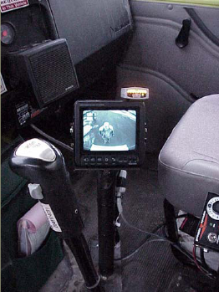
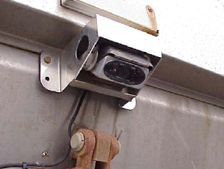
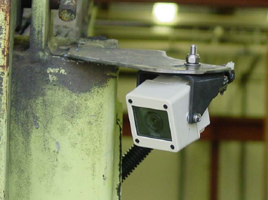
Camera systems
Technology Solutions
PREVENTING RUNOVERS AND BACKOVERS IN ROADWAY CONSTRUCTION
Camera Systems
  Cameras covering blind spots are a proven technology in many industries
  Special considerations for roadway construction
  Appropriate mounting locations
  (especially dump trucks)
  Keeping camera clear of dirt
  and grime
  Ensuring drivers/operators
  look at monitor
Notes:
Though cameras are a very useful tool in eliminating blind spots, they also have limitations. For example, it may require the use of multiple cameras for the operator to see all blind areas around his or her equipment. Also, as construction work is very dirty, camera lenses can get covered with dirt, mud, asphalt etc. effectively blinding them. Finally, even though the camera may capture an image of a worker on foot and display it on the monitor, if the operator is focused on his task, he may not look at the monitor. There are a growing number of manufacturers of camera/video systems and pricing is getting more competitive.

Slide 9
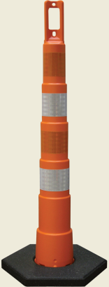
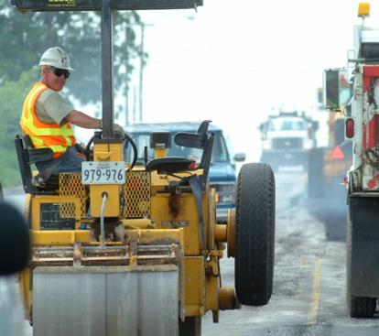
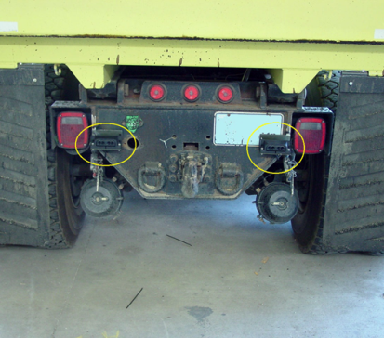
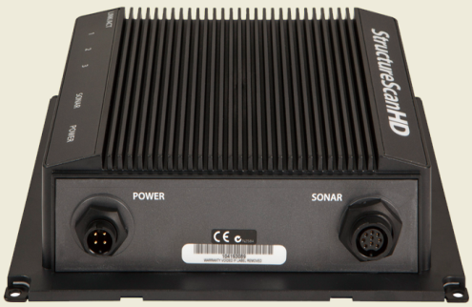
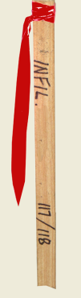
Sonar systems
Technology Solutions
PREVENTING RUNOVERS AND BACKOVERS IN ROADWAY CONSTRUCTION
Sonar Systems
  Detect person or object entering field, sound alarm
  Challenges
  Cannot discriminate
  among ‘objects’
  Detection triggers alarm
  Operator hears ‘false alarms, when object is not a hazard
  Relatively short detection distance
  Detector must be carefully
  mounted so as not to detect the
  ground or parts of the equipment
Notes:
Sonar devices use sonic waves to detect a person or object that enters their field of perception. When something is detected in the field, it sounds an alarm. Sonar devices are not as common as cameras, but their use continues to grow.

Slide 10
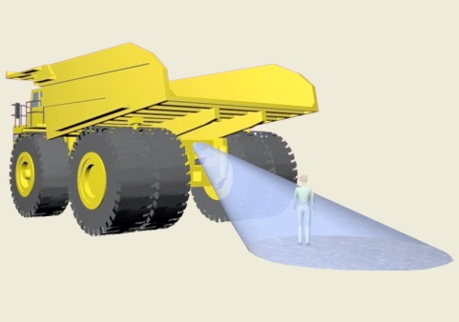

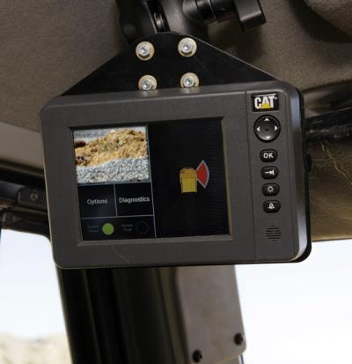
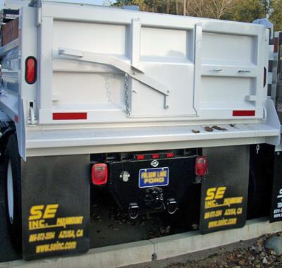
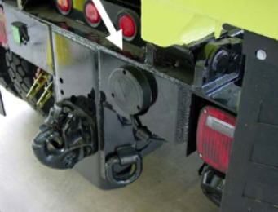
Radar systems
Technology Solutions
PREVENTING RUNOVERS AND BACKOVERS IN ROADWAY CONSTRUCTION
Radar Systems
  Radar-based proximity detection
  Pulsed or continuous wave
  Multiple antennas positioned
  to monitor blind areas
  Display in cab provides
  audible and visual warnings
  often with graded alarms
  Typically short range
  scenarios (25-75 feet)
  Challenge
  Detector must be carefully
  mounted so as not to detect the
  ground or parts of the equipment
Notes:
Like sonar, radar waves create a field that will detect an object when it enters the area and create an alarm to warn the operator. The challenge in working with radar or sonar alone is the system will alert the driver to any object in the monitored area, including cones, piles of dirty, shovels, etc. Because radar and sonar do not discriminate, the operator will receive false alarms, which can cause him or her to become complacent.

Slide 11
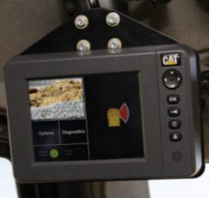
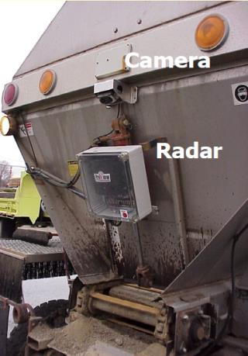
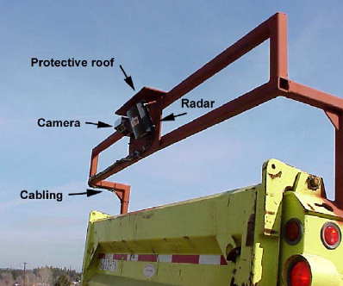
Radar and camera systems
Technology Solutions
PREVENTING RUNOVERS AND BACKOVERS IN ROADWAY CONSTRUCTION
Radar and Camera
  Most effective is radar
  combined with camera
Notes:
Radar and sonar systems function best when coupled with camera technology. The radar or sonar sensing devices send an alarm when an object enters their sensor field. The alarm alerts the operator to look into his monitor to see the person or object in his blind spot so he can take appropriate action.

Slide 12
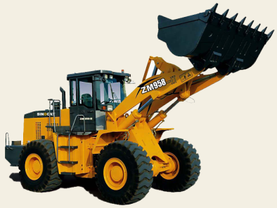
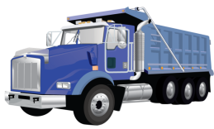
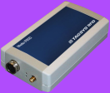
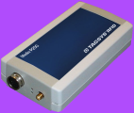
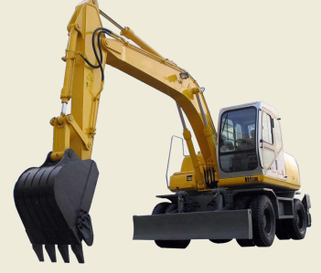
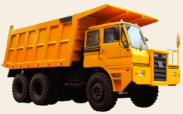

Tag systems
Technology Solutions
PREVENTING RUNOVERS AND BACKOVERS IN ROADWAY CONSTRUCTION
Tag Systems (RFID – Radio Frequency Identification)
  Two-way communication between an RF device mounted on equipment
  and detectors (tags) on workers and/or other machines
  Radio Frequency Transceivers and Tags
  Heavy equipment and light vehicles
  fitted with transceivers – UHF or VHF
  Challenge
  Every worker must be tagged
  and all equipment must have
  detection devices
Location displayed is determined
by the RF unit that detects a tag.
Range is adjustable.
Often used with cameras.
Notes:
An emerging technology with effective results in other industries involves two-way communication between a system mounted on equipment and detectors on workers (or other machines). This is known as a ‘Tag Based’ system. As a technology, RFID (Radio-Frequency IDentification) shows a lot of promise. Some systems have a two-way alarm warning feature, which enables both the equipment operator and the worker to receive individual warning alarms. The driver receives an alarm from a device installed in the truck cab, and the worker receives an alarm from a device or tag worn on his/her belt. RFID systems offer the most comprehensive collision avoidance protection because they alert both the driver/operator and the worker on foot when they are in close proximity to one another.

Slide 13

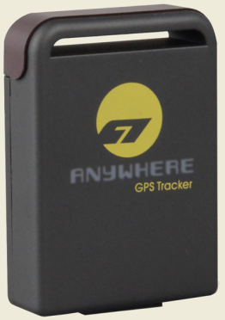
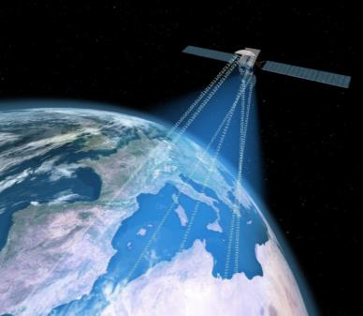
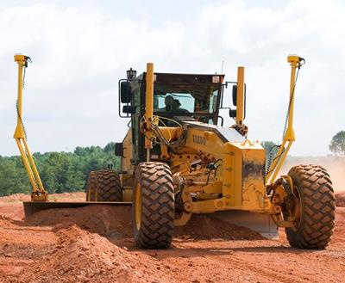
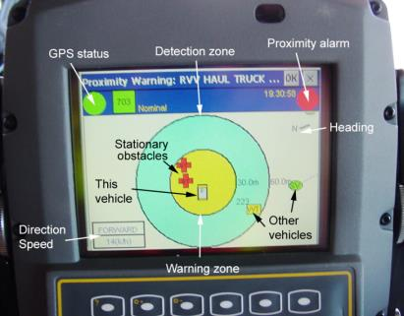


Global positioning system
Technology Solutions
PREVENTING RUNOVERS AND BACKOVERS IN ROADWAY CONSTRUCTION
Global Positioning System (GPS)
  Equipment or vehicle location determined using GPS
  Location broadcast to other nearby equipment
  Proximity warning alarms and location displays
  GPS installed on equipment
  (dump trucks, pavers, rollers)
  Challenges
  GPS receivers must be
  installed on all workers
  GPS is slower than
  other technologies
  presented – signal must
  go up to satellite and back
Notes:
Like the GPS unit used for finding addresses or locations, equipment or vehicle locations can be determined using GPS. The location of equipment is broadcast to other nearby equipment or workers. Proximity warning alarms are sounded and locations displayed to may and warn of hazardous situations.

Slide 14
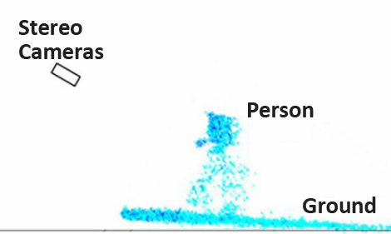
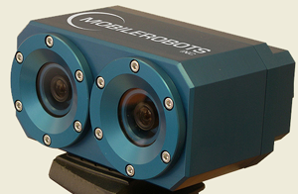
Emerging technologies
Technology Solutions
PREVENTING RUNOVERS AND BACKOVERS IN ROADWAY CONSTRUCTION
Emerging Technologies
  Intelligent Video Systems
  Computer-assisted stereovision cameras
  - Video signal processing allows detection based on 3D position
  - View of blind area near equipment, proximity warning w/only cameras
  - HAZ CAM system trials on haul trucks
Notes:
There are other technologies which are relatively new that show promise for our industry. One is an intelligent video system which uses computer-assisted stereovision cameras. The video signal processing allows for detection based on 3D position and provides view of blind area near equipment and proximity warning using only cameras. The image is a sample of the camera and a person as he/she appears in the monitor.

Slide 15
Additional work, considerations and resources
Technology Solutions
PREVENTING RUNOVERS AND BACKOVERS IN ROADWAY CONSTRUCTION
Additional Work & Considerations
  Reduce nuisance alarms and false stops
  Effective alarm presentation and context considerations
  Operator interfaces and combined displays
  Are systems overloading operators? Are they distractions?
  Behavior changes in operators
  Wearable sensors appropriate for tasks and environment
Resources
NIOSH Proximity Detection Web Page
www.cdc.gov/niosh/topic/highwayworkzones/
www.cdc.gov/niosh/mining/topicspage58.htm
Notes:
As with any technology, special consideration must be given for the location and manner in which the technology will be used. Some considerations might include a need to reduce nuisance alarms and false stops in urban areas. Nevertheless, there is a balance between using technology and distracting the operator with too many interfaces. Are systems overloading operators? Are they distractions?

Slide 16
Discussion and questions
Technology Solutions
PREVENTING RUNOVERS AND BACKOVERS IN ROADWAY CONSTRUCTION
Discussion
and
Questions

