Slide 1
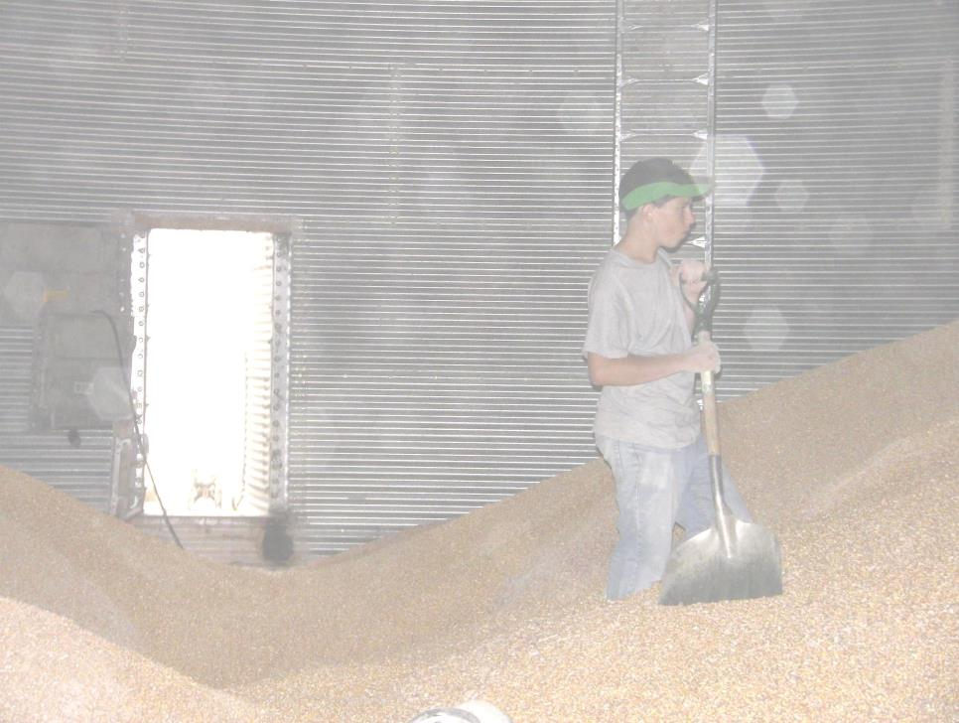
Title Page
Against the Grain
Safe Grain Storage and Handling Practices for Young and Beginning Workers
Unit 2 – Confined Spaces in Agriculture
Developed by:
Purdue University
Agricultural Safety and Health Program
Department of Agricultural and Biological Engineering
West Lafayette, IN
This material was produced under grant number SH24885-SH3 from the Occupational Safety and Health Administration, U.S. Department of Labor. It does not necessarily reflect the views or policies of the U.S. Department of Labor, nor does mention of trade names, commercial products, or organizations imply endorsements by the U.S. Government.
Notes:
Instructor Notes:
This unit is the second in the Against the Grain curriculum on safe grain storage and handling for young and beginning workers. It will provide a general overview of the types of confined spaces and their related hazards that are found at agricultural workplaces. A general foundation related to all agricultural confined spaces is provided because of their many common characteristics.
Since most incidents involving agricultural confined spaces involve grain and feed storage, handling, and processing facilities, the focus will be on these facilities.
The unit begins with short, but powerful interview with Mrs. Linda Osier, a mother from Michigan, who lost her son at a farm in a silo being used to store grain.
Information will be presented on the different definitions used to identify various types of confined spaces, the hazards related to confined spaces, and current applicable regulations. The unit ends with a discussion about rights of a worker to say NO to performing unsafe jobs or tasks they are not trained for.

Slide 2
Objectives
Identify key terms related to agricultural confined spaces
Identify the typical types of confined spaces found in agricultural workplaces
Identify the hazards related to agricultural confined spaces
Locate and be familiar with the Federal OSHA safety and health standards relevant to agricultural confined spaces
Explain the difference between OSHA exempt and non-exempt confined spaces
Explain worker rights under OSHA with respect to agricultural confined spaces
Notes:
Instructor Notes:
To help everyone get on the same page, definitions of several basic terms related to agricultural confined spaces will be reviewed. A more comprehensive list of terms and definitions can be found in the Instructor’s Guide. Please review this list before conducting the class.
The typical types of confined spaces found in agricultural workplaces will be described and shown. Time doesn’t allow for discussion of every possible confined space that might be encountered by a young or beginning worker. But the key characteristics will be identified so participants will know what to look for and recognize the most significant hazards. A fairly comprehensive list of agricultural confined spaces is included as an attachment in the Instructor’s Guide. This can be copied and used as a handout.
The most serious hazards will be identified which will be repeated throughout the training. These hazards include entrapments, engulfments, entanglements, falls, respiratory hazards, and electrocution.
There is considerable confusion over the Federal OSHA standards that apply to agricultural confined spaces and grain handling facilities. In some cases, certain confined spaces at facilities such as farms, feedlots, and seed processing operations are exempt from the standards. The relevant standards should be reviewed and their exemption provisions discussed. The two most relevant standards (29 CFR 1910.146 and 29 CFR 1910.272) are included as attachments to the Instructor’s Guide. Students will not be expected to know the contents of the standards but be aware that they exist and how to access them.
The rights of workers under the OSHA regulations are important for every young and beginning worker to know. They need to be encouraged to exercise these rights if asked to perform unsafe tasks or tasks they are not trained to do.

Slide 3
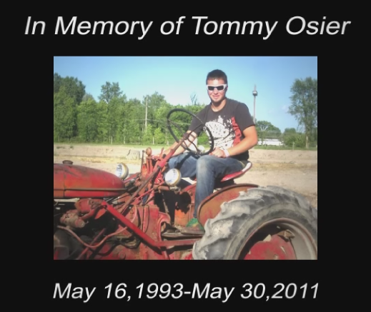
In Memory of Tommy Osier
Notes:
Instructor Notes:
The interview with Mrs. Linda Osier is a short, but powerful reminder of the tragic results of a young worker being assigned a task without adequate training or supervision. The scenes at the site of Mrs. Osier’s son’s death are not fabricated and may be difficult for some to watch.
Point out to participants that as young and beginning workers they are not “expendable workers”, but deserve the same right to return home from the work place safe and healthy as every other worker.

Slide 4
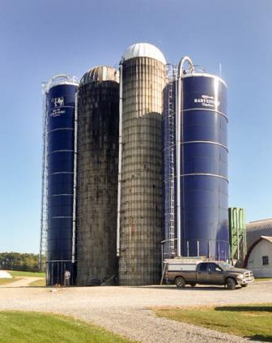
What is an Agricultural Confined Space
Any space found in an agricultural workplace that was not designed or intended as a regular workstation, has limited or restricted means of entry or exit, and has associated with it potential physical and/or toxic hazards to workers who intentionally or unintentionally enter the space.
Notes:
Instructor Notes:
A review of the technical literature reveals that there are numerous definitions for what constitutes a confined space. There are engineering descriptions, regulatory definitions and definitions that apply to specific applications. The definition shown in the slide was developed specifically to communicate to agricultural workers the characteristics of agricultural confined spaces. It actually goes beyond the current regulatory definition used by OSHA for compliance purposes.
As will be noted later, not all agricultural confined spaces are covered by OSHA regulations.
The point that needs to be made is that there are spaces found in agricultural work places that are extremely dangerous and require specialized training and protective equipment to enter safely.
Ask the class if anyone has worked in a space that fits this definition of an agricultural confined space.

Slide 5
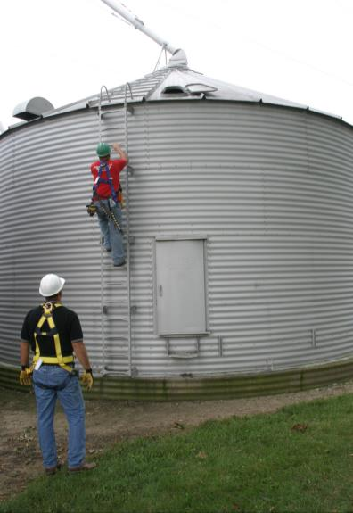
A Hands on Definition of a Confined Space
A Hands on Definition of a Confined Space
“If you need to use your hands to get in and out, consider it a confined space”
Notes:
Instructor Notes:
Young and beginning workers need simple easy to remember definitions. One that has been widely used is:
“If you need to use your hands to get in and out, consider it a confined space.”
This easy to remember definition will hopefully come to mind when the worker is trying to access a space, causing him or her to stop and consider whether it is a safe place to be.
It should be noted that this simple definition does not cover all agricultural confined spaces. For example, some environmentally-controlled fruit storage and large grain bins with walk through doors and grain dump pits with steps can be classified as confined spaces.

Slide 6
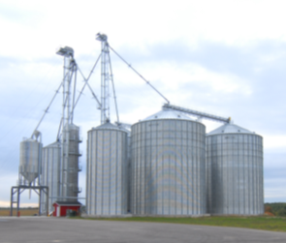
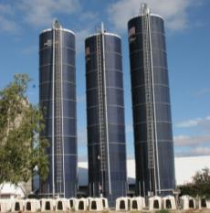
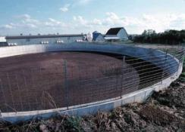
Confined Space – OSHA Definition
A Confined Space:
is large enough for an employee to enter fully and perform assigned work
has a limited or restricted means of entry or exit
is not designed for continuous employee occupancy
Notes:
Instructor Notes:
This definition for a confined space is drawn from 29 CFR 1910.146 (OSHA Confined Space Entry Standard). It is a legal definition that is used in most industries to classify a confined space.
The Confined Space Entry Standard is included as an attachment in the Instructor Guide and a single copy can be copied to circulate around the class. Most students, however, will find it difficult reading. The OSHA Grain Safety Hazard Alert on Worker Entry into Grain Storage Bins would be a more appropriate handout. A copy is included in the Instructor Guide that can be freely copied and distributed.
The defining characteristics of a confined space are quite simple and should not be complicated to communicate. They include:
a space that is accessible to a worker (That means you can get in the space.)
a space that has limited or restricted means of entry or exit (It takes some effort to access, or as noted the use of the hands.)
a space not designed for continuous occupancy (The space is not a place where workers are typically found working. They only go in the space if there is a good reason.)
Ask class to identify examples of confined spaces that they are aware of at their homes, workplaces, or even recreational areas. These might include:
crawl spaces under a home
garbage dumpsters
culverts and drainage pipes
refrigerators/freezers
large storage tanks
abandoned wells
caves

Slide 7

Permit Required Confined Space OSHA Definition
A Permit-Required Confined Space – has one or more of the following:
Contains or has the potential to contain a hazardous atmosphere
Contains a material with the potential to engulf someone
Has an internal configuration that might cause an entrant to be trapped or asphyxiated by inwardly converging walls or by a floor that slopes downward and tapers to a smaller cross section
Contains any other recognized serious safety or health concerns
Notes:
Instructor Notes:
The definition for a “permit-required confined space” is more descriptive and specifically addresses the hazards that may be present such as toxic atmospheres and engulfment hazards. This definition is drawn from 29 CFR 1910.146 (OSHA Confined Space Entry Standard). Again this standard is included in the Instructor’s Guide.
What is meant by “permit-required”? It is the need for a written permit to be issued by the employer or management to the worker prior to accessing the space. Not all “confined spaces” are “permit-required confined spaces”.
Specialized training is required by OSHA regulations to enter a “permit-required confined space”, therefore, it is unlikely that a young or new worker will be assigned tasks inside this type of work space. Even if they volunteer, such entry is forbidden without proper training and appropriate supervision.
Participants should know that entering a “permit-required confined space” without a permit or proper authorization and procedures in place is illegal under the OSHA workplace safety and health regulations. In most commercial grain storage and handling operations, there are also safety policies in place regarding access to confined spaces. Violating this rules can result in disciplinary action or even being fired.

Slide 8
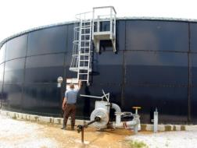
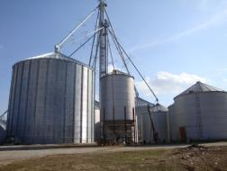
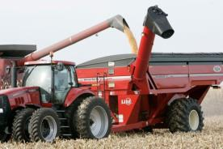
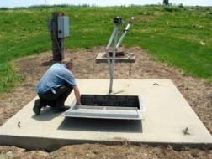
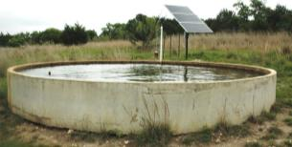
Types of Confined Spaces in Agriculture
Examples:
Grain & feed facilities
Silo
Manure storage facilities
Grain transport vehicle
Agricultural equipment
Septic tank
Liquid and fertilizer storage tank
Wells and cisterns
Fermentation tank
Other_________
Notes:
Instructor Notes:
There is no comprehensive listing of all types of confined spaces that could potentially be encountered on agricultural production sites or at grain storage and handling facilities. A fairly comprehensive listing of agricultural confined spaces is found as Attachment 13 in the Instructor’s Guide. This document can be reproduced and used as a handout.
The Department of Labor provides a list of examples of 23 industry types of confined spaces, but does not include spaces generally found in agriculture. As will be described later, agricultural workplaces are generally exempt from having to comply with the provisions of the OSHA Confined Space Entry Standards.
The general categories of agricultural confined spaces include:
Grain and feed storage facilities
Forage storage structures and silos
Manure storage structures
Agricultural grain transport vehicles
Agricultural equipment
Sewage and septic systems
Liquid storage structures for water, fuel, fertilizers, and pesticides
In ground structures – wells, cisterns, culverts, ditches
Biological processing and food storage equipment/facilities
Ask participants to identify specific examples of agricultural confined spaces that they are aware of where they live or work. If available, list identified spaces on the board.
The following nine slides provides images of some of the primary types of confined spaces found in agriculture.

Slide 9
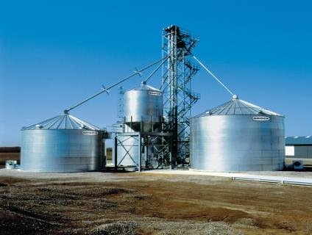
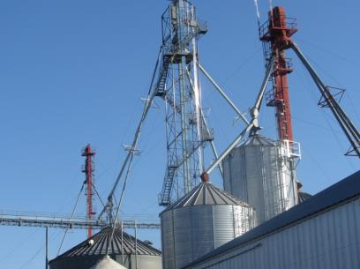
Grain and Feed Storage Facilities
Grain and Feed Storage Facilities
Notes:
Instructor Notes:
These facilities can range from a single 10,000 bushel structure in an isolated location to a complex facility containing multiple structures capable of storing hundreds of thousands of bushels of grain and feed. On some modern farm operations, the grain storage capacity can exceed that of many commercial, OSHA non-exempt facilities.
Point out, using the images shown, the potential hazards that may exist in and around grain and feed storage structures. These might include:
Slips and falls from heights
Entering a hopper bottom bin with sloped walls
Exposure to powered equipment
Exposure to overhead power lines
Entrapment and engulfment

Slide 10
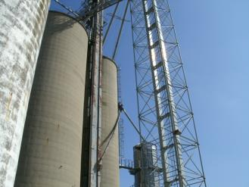
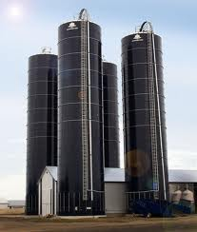
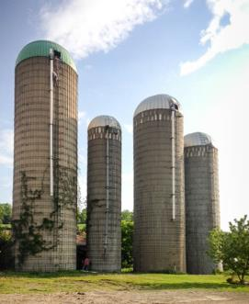
Forage Storage Structures
Forage Storage Structures
Concrete Poured Silo
Oxygen-limiting silo
Concrete Stave Silo
Notes:
Instructor Notes:
There are several types of vertical or tower silos in use in agricultural workplaces. They include:
Poured concrete silos that can be 30-60’ in diameter and stand over 100’ tall. They generally unload from the bottom and load through the top. If not ventilated properly or contain spoiled material they can contain either a toxic atmosphere or oxygen levels insufficient to support life.
Oxygen limiting steel silos (Harvestore) that were designed to store high moisture grain, corn silage or fermented forages. Due to the lack of adequate ventilation they can contain high concentrations of nitrogen dioxide and carbon dioxide that are released during the fermentation process. They are designed to be nearly air tight and when working properly will not support life. They load from the top and unload from the bottom. Access is limited to a roof hatch and a bottom access point where the unloader is installed. The roof hatch is approximately 25” in diameter. When material is removed from the bottom of these structures it is considered plug flow since the first material in is the first out.
Concrete, and sometimes wooden, stave silos are still widely used on dairy farms and load from the top and can be unloaded from either top or bottom.
Most on-farm silos have ladders in place that do not meet current OSHA standards because the lack of full fall protection such as cages and rest platforms at required intervals, and adequate anchor points. At the time many of these structures were built there were no applicable safety standards.
The general trend in agricultural production is away from vertical or tower silos due to the energy costs to put the crop into and remove it from the structure. They are also physically demanding on the farmer to access.
Photo Credit:
Oxygen-limiting silo: http://www.cstindustries.com/products/harvestore
Concrete Stave Silo: http://www.franklinsilorepair.com/types-of-silos

Slide 11
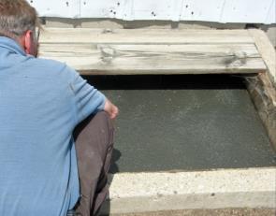
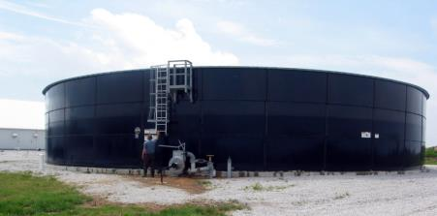
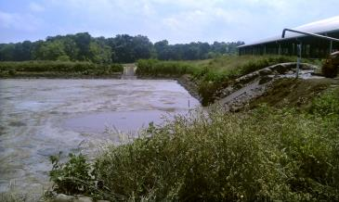
Manure Storage /Structures
Manure Storage /Structures
Below ground pit
Above ground storage tank
Lagoon
Notes:
Instructor Notes:
Manure storage facilities have accounted for several hundred incidents resulting in deaths and injuries, including at least two cases in which there were five fatalities in each incident. It is estimated that nearly one-third of all fatalities in manure storage facilities have been first responders, including both untrained employees or family members, and trained emergency personnel.
All manure releases toxic or flammable gases as it decomposes during storage. These include methane, carbon dioxide, hydrogen sulfide, and ammonia. Each has the potential of reducing the oxygen level below the acceptable level of 19% needed to sustain life. No one should enter a manure storage facility to perform any tasks or attempt a rescue without full respiratory protection and compliance with all permit-required confined space entry requirements.
Because of the generation of methane, there is a potential for fires and explosions to occur if the right concentrations develop. Before accessing any facility built over a manure storage structure, the facility should be well ventilated to ensure that methane levels are not excessive.

Slide 12
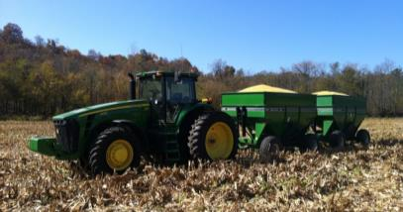
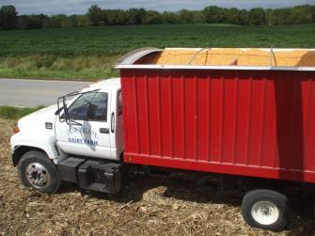
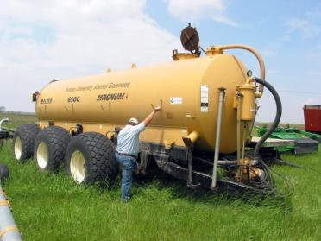
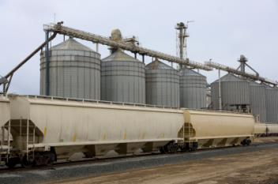
Agricultural /Grain Transport Vehicles
Agricultural /Grain Transport Vehicles
Grain wagon
Truck
Manure transport tank/vehicle
Rail car
Notes:
Instructor Notes:
Historically, agricultural/grain transport vehicles have not been generally considered as confined spaces, however, they meet the classification for being confined spaces. For example, they are difficulty to access, contain material that can cause entrapment or asphyxiation and are not designed as an employee workplace.
The most frequent type of grain transport vehicle involved in entrapments or engulfments are gravity flow grain wagons. The most frequent victim is a boy ages 10-12 who was either riding on top of a load of grain that is being unloaded, or being transported in an empty vehicle and being covered by grain unloading from a combine or auger.
Entrapments and engulfments are less frequent in trucks and rail cars, but have a high fatality rate.
No worker should enter a wagon, truck or rail car while grain is being loaded into it or unloaded from it.
Multiple deaths have also occurred in manure transport tanks used to transport liquid manure from a storage facility to the field for application. No one should enter one of these tanks unless properly trained, equipped, and supervised.

Slide 13
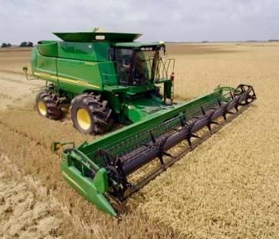
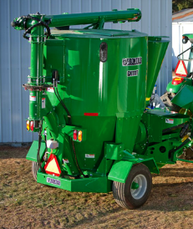
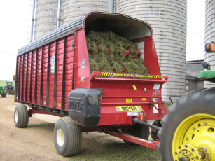
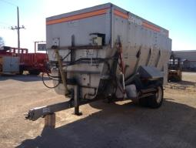
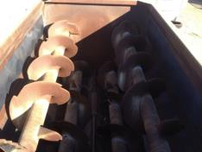
Agricultural Equipment
Agricultural Equipment
Feed grinder/mixer
Combine
Auger mixing wagon
Forage box
Notes:
Instructor Notes:
Some agricultural equipment has become so large that it includes within its configuration spaces that could be classified as confined spaces.
Injuries and deaths have involved youth working inside powered forage wagons that contain moving cross conveyors, revolving beaters, and augers. Incidents have also involved auger mixing wagons used to blend feed and feed grinder/mixer tanks.
Again, if it takes the use of the hands to access the space, it is probably a confined space and may contain serious hazards.
In some cases younger workers are asked to enter these confined spaces because of their smaller physical size. Most access hatches are about 24” in diameter which greatly limits the number of people who can physically access the space.
Photo credit:
Combine: http://www.genusasset.com/agriculture-finance/
Feed grinder/mixer: https://www.deere.com/en_US/products/equipment/frontier_implements/livestock_and_equine_equipment/gx11_series_grinder_mixer/gx11_series_grinder_mixer.page

Slide 14
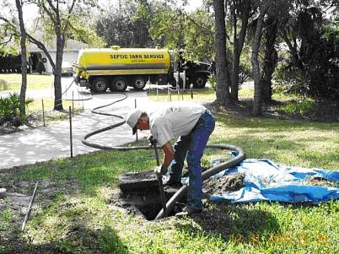
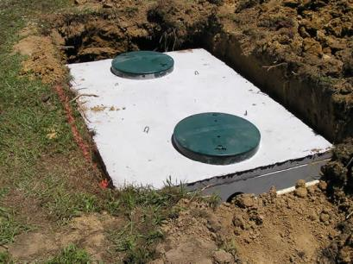
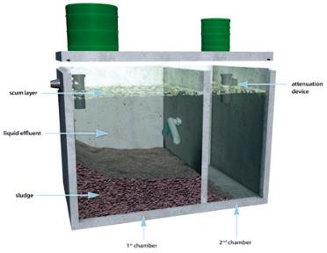
Sewage and Septic Systems
Sewage and Septic Systems
Septic tank
Notes:
Instructor Notes:
Nearly all farms have sewage systems in place to dispose of household wastes, waste water from cleaning operations and some livestock waste. In some cases tanks of 1,000-5,000 gallon capacities can be found. In addition, underground storage tanks, filter systems, pump pits, large pipes, and inspection covers provide potential access to unsafe confined spaces. Many of these spaces may contain high levels of toxic gases that require special personal protective equipment.
There is no justification for an employer to ever send a young or beginning worker into a sewage or septic system.

Slide 15
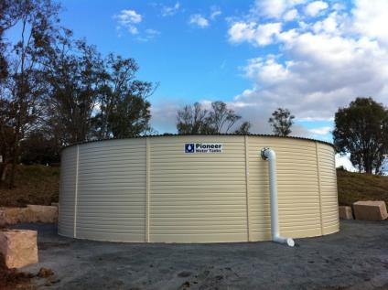
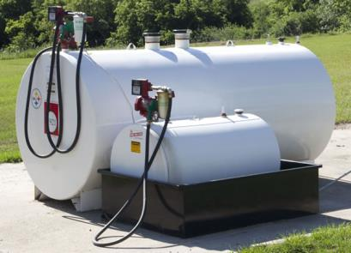
Liquid Storage Structures
Liquid Storage Structures
Fuel and chemical storage tanks
Water tank
Notes:
Instructor Notes:
The demand for large quantities of fuels, crop chemicals, such as liquid fertilizers, and liquid feed supplements on larger agricultural operations has resulted in the installation of large storage tanks that are sometimes entered for servicing. These tanks clearly fit the definition of a confined space and must be treated as such. Due to the characteristics of the materials being stored they should only be entered by specially trained workers with the necessary personal protective equipment, including self-contained breathing apparatus.
No youth or beginning worker is qualified to work in fuel or chemical storage tanks and should be aware of and be able to exercise their right to refuse such an assignment.
Photo credit:
Fuel storage tank: http://www.truenorthsteel.com/farm-fuel-tanks.php
Water tank: http://www.divinewatertanks.com.au/gallery/

Slide 16
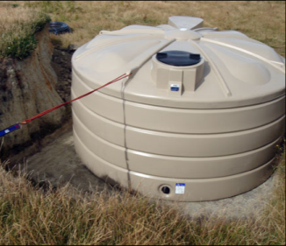
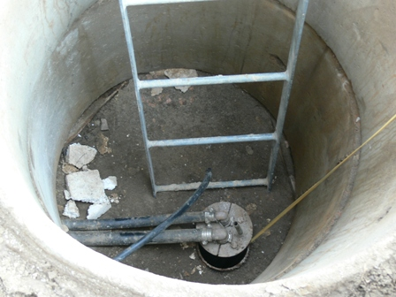

In Ground Structures
In Ground Structures
Water tank
Well pit
Retention Ponds
Notes:
Instructor Notes:
Incidents have been documented in a wide range and configuration of in ground structures and spaces, most often used related to the movement and storage of water. These include:
Deep and shallow wells, in some cases they may be abandoned
Well pits where pumps and pressure tanks are installed
Ditches dug to install drainage tile
Surface drains and culverts
Sump pump pits
Retention ponds with steep sides
Accessing these spaces can present special risks, especially to young and beginning workers.

Slide 17
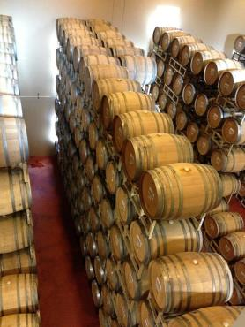
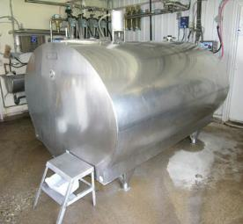
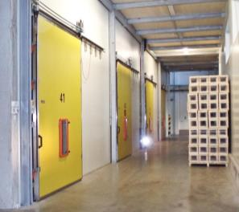
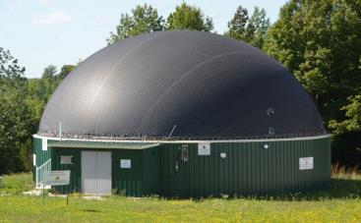
Biological Processing and Food Storage Equipment/Facilities
Biological Processing and Food Storage Equipment/Facilities
Bulk milk tank
Environmentally controlled fruit storage
Wine vat
Biodigester
Notes:
Instructor Notes:
As agricultural operations have become larger and more diversified, new types of confined spaces have come into the picture. These include large vats and tanks to process foods, wine fermentation tanks, and pickeling tanks. They also include tanks used to carry out bioprocessing of grain for production of biofuels. In some cases the byproducts of these processes can produce fumes and vapors that are toxic, explosive, or reduce the oxygen levels to a point that suffocation is possible.
For example, deaths have occurred to workers entering milk storage tanks with toxic cleansing chemicals and buildings sealed and cooled to protect fruits and vegetables.
Young and beginning workers need to be able to identify these facilities and recognize them as confined spaces with all the risks of any other confined space.
Photo credit:
Bulk milk tank: http://www.letstalkfarmanimals.ca/2014/05/23/inside-farming-want-safety-think-milk/
Fruit storage :http://neutec.it/v2/en/projects/obstlager-oswald/
Biodigester: http://www.owensoundsuntimes.com/2014/10/12/provincial-support-pending-on-biodigester

Slide 18
Hazards Related to Agricultural Confined Spaces
Asphyxiation due to exposure to toxic environments
Carbon Dioxide
Methane
Hydrogen Sulfide (manure)
Ammonia (manure)
Smoke/Carbon monoxide (fires)
Suffocation due to oxygen limited environments
Entrapments requiring extrication from flowable agricultural materials
Engulfments – fully buried in flowable agricultural material
Entanglements in energized machinery
Falls
Electrocutions
Drowning
Respiratory distress due to exposure to dust and microtoxins
Burns from fires and explosions
Notes:
Instructor Notes:
The list summarizes the types of hazards that young and beginning workers might be exposed to in and around agricultural confined spaces.
Quickly review each and respond to questions, if any. Some students may not realize that there are health risks such as exposure to excessive heat and toxic dusts and molds.
The biggest killers in agricultural confined spaces are entrapments in flowing grain and exposure to toxic gases.
To increase student retention, consider going online and downloading an actual case to read to the students, including the victims name, age, and location. Several actual case studies are also found in the Instructor’s Guide.

Slide 19
Relevant Federal OSHA Standards
29 CFR 1910.146 – Permit-required confined space standard
Exempts agriculture
29 CFR 1910.272 – Grain handling standard
Covers all commercial grain storage and handling operations
Original focus on preventing grain dust explosions
Exempts farms, feedlots, and seed processing operations
Notes:
Instructor Notes:
Participants in this training are at an age that makes understanding or interpreting federal workplace safety and health rules almost impossible. In most cases they have difficulty even seeing the value or relevance of the rules.
What should be communicated to them in this training is that the OSHA Standards are not suggestions or just good work practices, but, in fact, are the law for the commercial grain industry and other industrial settings with confined spaces. Failure to comply with these laws can lead to being dismissed from the job, citations, fines, and in rare cases criminal charges.
One of the values of this training is that participants are getting a jump start on what will be expected of them if they go to work at a facility that must comply with the OSHA Standards, especially those related to confined spaces.
Time does not allow review of all the provisions of either 29 CFR 1910.146 or 29 CFR 1010.272 which are most relevant to the confined spaces and grain storage and handling facilities found in agricultural workplaces. Encourage participants to review the two standards that are included in the Instructor’s Guide or can be found at www.osha.gov.

Slide 20
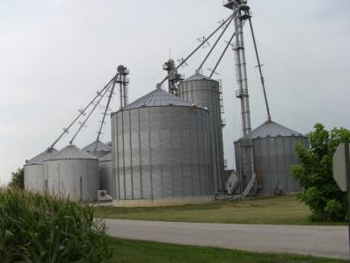
Exempt Facilities
The OSHA Grain Handling Standard (1910.272) currently exempts from compliance certain farming operations:
Farms with 10 or fewer employed
Feedlots
Operations that prepare seeds for future crops
The OSHA Permit-required Confined Spaces Standard (1910.146) generally exempts agricultural operations that:
Grow or harvest crops
Raise livestock or poultry
Notes:
Instructor Notes:
There has been considerable confusion regarding the application of OSHA standards to grain storage and handling facilities. The two most relevant standards, 29 CFR 1910.272 Grain Handling Standard and 29 CFR 1910.146 Permit-required Confined Space Standard, are not universally applicable to all grain facilities due to exemption provisions included in the standards. The reasons why these exemptions exist are complex and include political pressure placed by special interest groups on legislators when the standards were drafted and the potential cost of bringing existing facilities into compliance. In some cases, these exemptions don’t make sense. For example, a 100,000 bushel bin at a commercial, OSHA non-exempt, storage operation that employs any number of employees must comply with the provisions of CFR 1910.146 and CFR 1910.272, while a grain facility with the capacity of 500,000 bushels, and several employees across the highway from the first, but classified as a farm or feedlot that does not buy or sell grain, is exempt from compliance with the OSHA workplace grain handling standards. Whether or not the rules make sense is immaterial. To assist in better understanding the applicability of the two standards, instructors should review both standards found as attachments in the Instructor’s Guide, and the relevant OSHA Quick Takes also found as attachments.
It should be noted that many incidents, especially non-fatal, at exempt facilities go unreported since there are no reporting requirements for these facilities.

Slide 21

Non-Exempt Facilities Must Have
Confined space entry permit system
Appropriate confined space entry equipment
Lifeline and harnesses
Air monitoring equipment
Communication system
Emergency action plan
Documented training
Incident reporting policies in place
1
2
3
Notes:
Instructor Notes:
Again, non-exempt facilities under current OSHA standards includes almost all commercial grain storage and handling operations regardless of size.
Confined space entry permits, in most cases, must be filled out by all employees and filed with the employer or management prior to entering the space.
Prior training is required to use lifeline, body harnesses, certain personal protective equipment, and retrieval equipment.
Air monitoring must include at a minimum an oxygen monitor.
Communications equipment must be tested at that facility at least annually and documented.
Emergency Action Plans must be communicated to employees, reviewed and updated regularly and include procedures for the facility operators and local responders.
Training must be documented and on file along with a training roster. In many cases, employees will need to sign up a register confirming that they have participated in the training.
Non-exempt operations are required to report to OSHA workplace injuries or incidents involving multiple workers. This is why there are such a high percentage of documented events at non-exempt facilities as compared to exempt farms.

Slide 22

You Have the Right to Say NO!
As a young and beginning worker you have the right to:
Refuse to perform tasks that you are not trained or equipped to perform safely – without retaliation
Receive information and training about the hazards you are exposed to in the work place
Have access to and training regarding emergency action plans
Notes:
Instructor Notes:
Throughout these training materials, students will be reminded of their rights to safe working conditions. They need to be encouraged to speak up if they are uncomfortable about performing unfamiliar tasks that they believe or know pose a risk of serious harm.
This does not mean that they can pick and chose what their employer assigns to them, but rather have the judgment/maturity to ask questions and raise concerns about tasks they see as potentially dangerous.

Slide 23
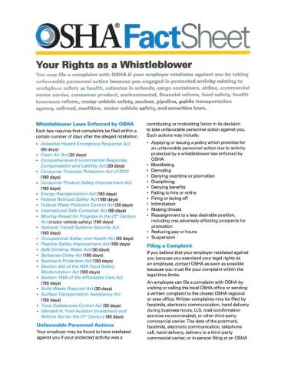
Whistleblower Protection Act
Right to a safe workplace
Right to report unsafe work conditions
Protection from reporting
Notes:
Instructor Notes:
Every young and beginning worker has the right to a safe workplace. That means an environment where communication occurs regarding hazard recognition and use of safe work practices. If an employee feels that he or she is in an environment that isn’t safe and are not getting the support needed from the supervisor or management, he or she has the right to report the issue to OSHA. An employee can file a complaint with OSHA by visiting or calling the local OSHA office or sending a written complaint to the closest OSHA regional or area office. When filing a complaint with OSHA, employees are protected from any retaliation from their employer. Retaliation could include demoting, denying overtime or promotion, discipline, denying benefits, failing to hire or rehire, or firing. It could also include intimidation, threats and reassignment. Encourage participants that if they feel they are being discriminated against because of their workplace concerns to report it to OSHA immediately.

Slide 24

Questions?
Notes:
Instructor Notes:
Answer any questions anyone has from this unit before moving on

