Slide 1

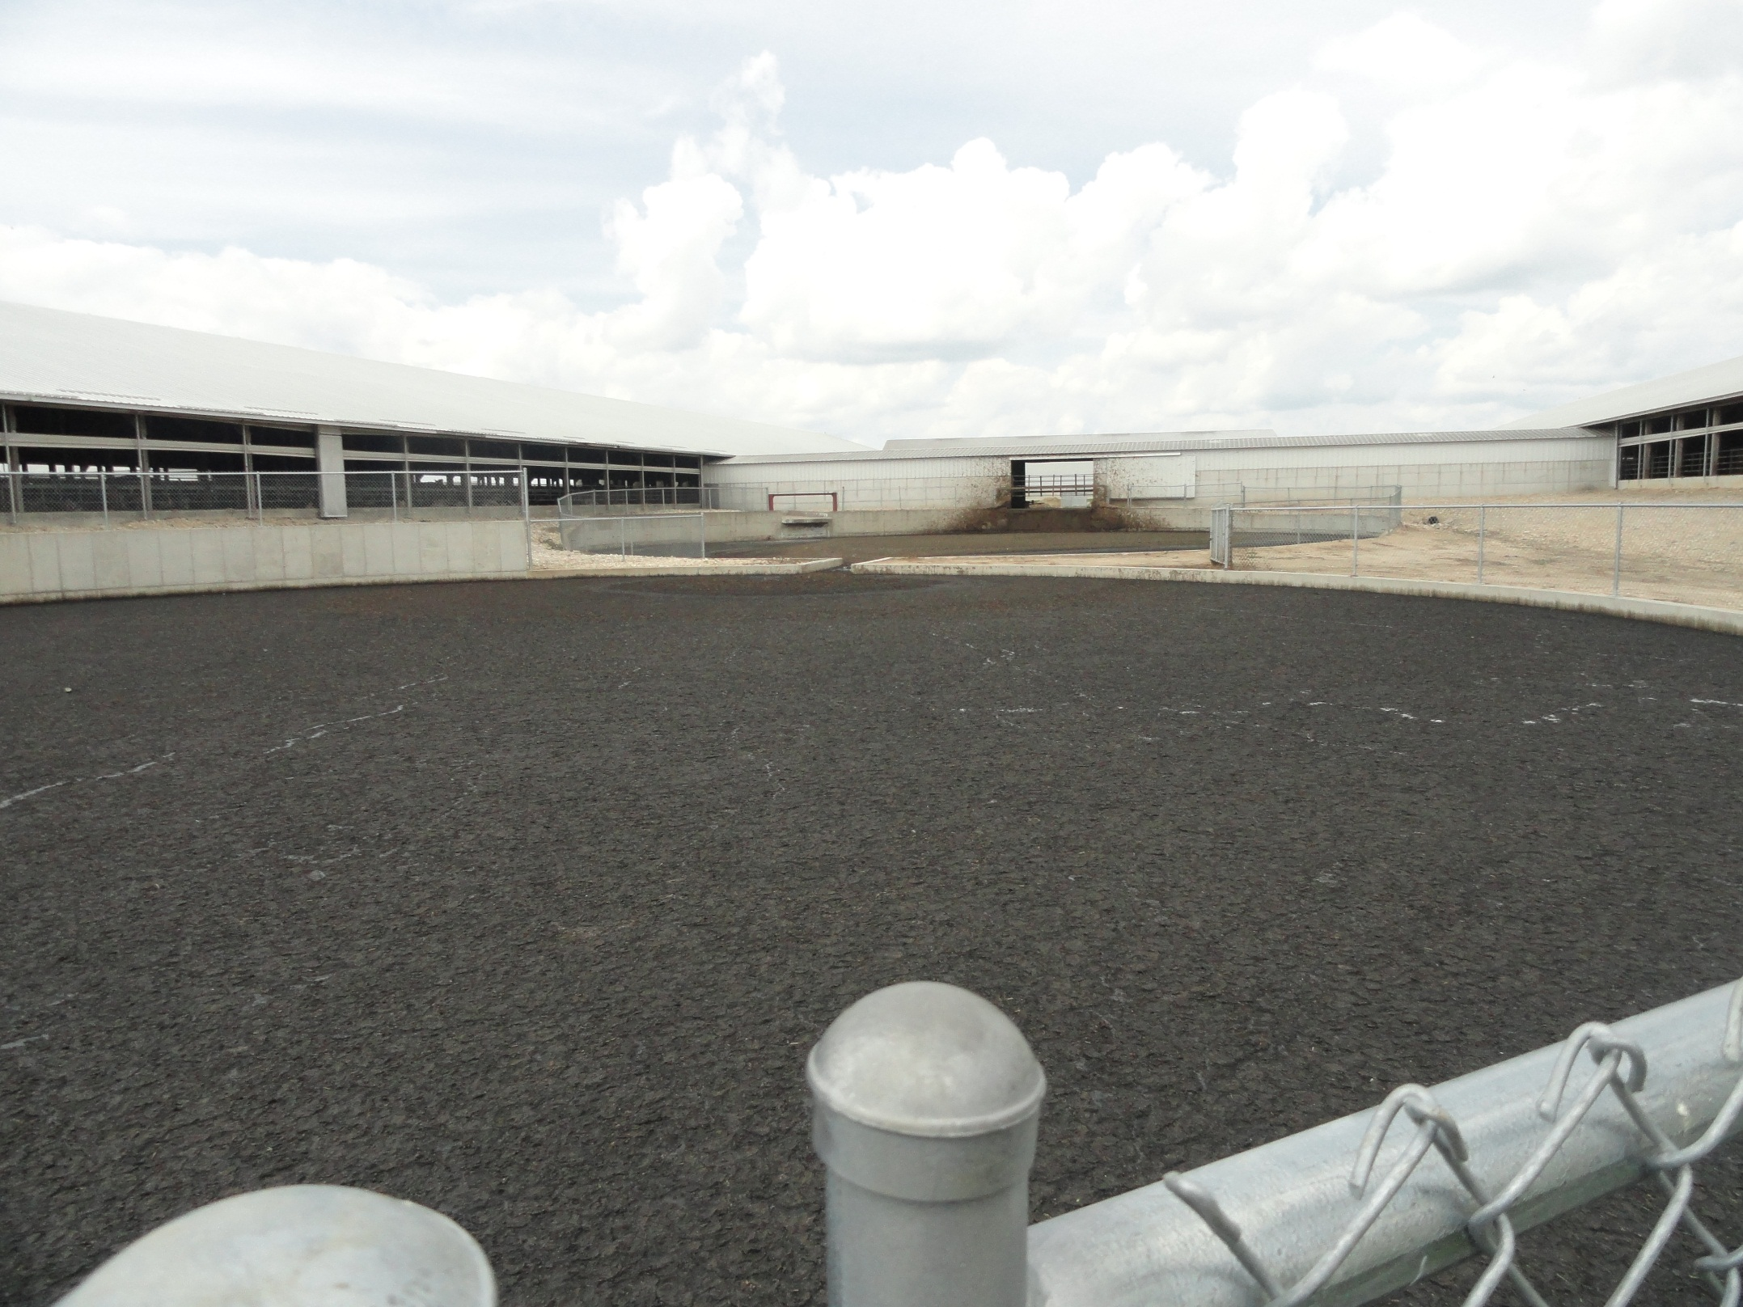
Foaming Manure Pits
Foaming Manure Pits
The National Education Center for Agricultural Safety (NECAS) 888-844-6322
Notes:
Picture is from the National Education Center for Agricultural Safety. Permission given to use photo
High concentration of methane gas is flammable: if there is any ignition source in the room when high
concentrations of methane are released, an explosion could occur. Many Midwestern barns, both empty barns and barns with workers and hogs inside, have exploded when the surface of the foam has been disturbed. Sources sufficient to ignite methane include: cigarettes, electric motors (such as those for pressure washers and feed system), pilot lights, welding, metal cutting, or faulty or damaged wiring that can produce sparks. It is critical to eliminate all sources of heat or sparks before conducting tasks inside a barn with foaming manure when these activities can break the foam.

Slide 2
Susan Harwood Training Grant
This material was produced under a grant (SH – 26280 - SH4) from the Occupational Safety and Health Administration, U.S. Department of Labor. It does not necessarily reflect the views or policies of the U.S. Department of Labor, nor does the mention of trade names, commercial products, or organization imply endorsement by the U.S. Government

Slide 3
Program Objectives
At the conclusion of this presentation, participants will:
Be able to identify hazards associated with Manure Pits that develop foam on top of the liquids and solids
Understand the process for mitigating the Manure gases released when the foam is disturbed.
Know where to look for OSHA references and resources related to confined space entry in the agricultural industry

Slide 4
Statistics: Involvement in Farming in the U.S.
2.1 Million farmers
2% of the population
Reference: http://www.epa.gov/oecaagct/ag101/demographics.html
Notes:
5
Here in the US it include about 2% of the population and we are seeing a shift from the family farm to larger production units.
The wife is working off the farm to bring revenue and insurance back to the farm.
Reference: http://www.epa.gov/oecaagct/ag101/demographics.html

Slide 5
Statistics of Injury/Mortality: U.S.
70,000 Disabling Injuries
568 Fatalities (2014)
24.9 deaths per 100,000 workers
Notes:
7
24.9 deaths per 100,000 workers
2014 CFOI-BLS

Slide 6
Manure Produced
Livestock type | Total manure | Nitrogen | Phosphorus
 | ------- lbs/day/1000-lb animal unit -------
Beef¹ | 59.1 | 0.31 | 0.11
Dairy² | 80.0 | 0.45 | 0.07
Hogs and pigs³ | 63.1 | 0.42 | 0.16
Chickens (layers) | 60.5 | 0.83 | 0.31
Chickens (broilers) | 80.0 | 1.10 | 0.34
Turkeys | 43.6 | 0.74 | 0.28
¹High forage diet. ²Lactating cow. ³Grower.
Notes:
USDA Animal Manure Management.

Slide 7
Tips to prevent injuries
There is currently no consistent solution to controlling this foaming in pig manure pits. Researchers do not yet understand all the factors (diet, manure pH, others) that cause this problem. Several research projects are ongoing to better understand the causes and eventually provide solutions to this serious problem.
Notes:
Follow These Tips To Prevent Injuries When Pumping Barn Manure Pits
http://nationalhogfarmer.com/facilities-equipment/manure-handling/caution-surface-foam-pits-1006

Slide 8
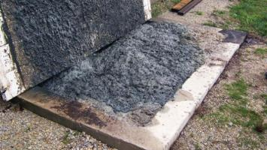
Pit Gases
When foaming occurs, gases become trapped in the foam’s bubbles, which may be comprised of 50 to 70% methane.
Photo Courtesy of: David Schmidt, University of Minnesota
Notes:
The foam can be broken when agitating the manure, pressure‐washing, or dropping feed through the floor slats. When this happens, these gases are rapidly released into the air, resulting in potential explosive concentrations of methane. Hydrogen sulfide is released from the foam and is hazardous to breathe above 10 ppm. Methane gases are explosive when concentrations are between 50,000 to 150,000 parts per million (ppm). Within the foam, the methane concentrations are above the explosive limit, meaning there is not sufficient oxygen to be flammable. However, when the foam is broken and the gas is released, the gas dilutes in the air and quickly becomes explosives

Slide 9
IDLH
IMMEDIATELY DANGEROUS TO LIFE OR HEALTH
Any condition which poses an immediate threat to the life of an entrant, or;
Would cause irreversible adverse health effects, or;
Would interfere with an individual’s ability to escape unaided from a permit space.
Notes:
Source: NIOSH

Slide 10
IDLH
No person shall:
Enter – Work – or Remain
in an IDLH condition until such time that the condition has been eliminated or controlled.
Source: CDC/NIOSH
Notes:
Source: NIOSH

Slide 11

Develop an Emergency Action Plan
1910.38
1910.39
http://www.cdc.gov/niosh/docs/2004-101/emrgact/emrgact.pdf
Notes:
Graphic from Emedco, used with permission
Link is to a CDC template of an emergency action plan
1910.38(a)Application. An employer must have an emergency action plan whenever an OSHA standard in this part requires one. The requirements in this section apply to each such emergency action plan. 1910.38(b)Written and oral emergency action plans. An emergency action plan must be in writing, kept in the workplace, and available to employees for review. However, an employer with 10 or fewer employees may communicate the plan orally to employees. 1910.38(c)Minimum elements of an emergency action plan. An emergency action plan must include at a minimum: 1910.38(c)(1)Procedures for reporting a fire or other emergency;

Slide 12
Toxic Atmospheres
Toxic atmospheres can be caused by:
Product stored in a confined space.
Gases released by decomposing manure.
Decomposition of materials stored.
Gases released when cleaning.
Oxidation of metals
Work Performed in a confined space.
Welding, cutting, painting, scraping, sanding, etc.
Toxic materials adjacent to a confined space.
Notes:
Davis E Hill, EMT-P, Sr. Extension Associate, The Pennsylvania State University, www.agsafety.psu.edu

Slide 13
Oxygen Deficient Atmospheres
19.5% Minimum acceptable oxygen level.
15 –19% Decreased ability to work strenuously.
Impaired coordination.
12 –14% Respiration increases - Poor Judgment.
10 –12% Respiration increases – Lips Blue.
8 –10% Mental failure – Fainting, Nausea, Unconscious, Vomiting.
6 – 8% Possible recovery 4-5 minutes, 50 percent fatal after 6 minutes, fatal after 8 minutes
4 – 6% Coma in 40 seconds – Death.
Source: NIOSH Datasheet
Notes:
Source: NIOSH Datasheet

Slide 14
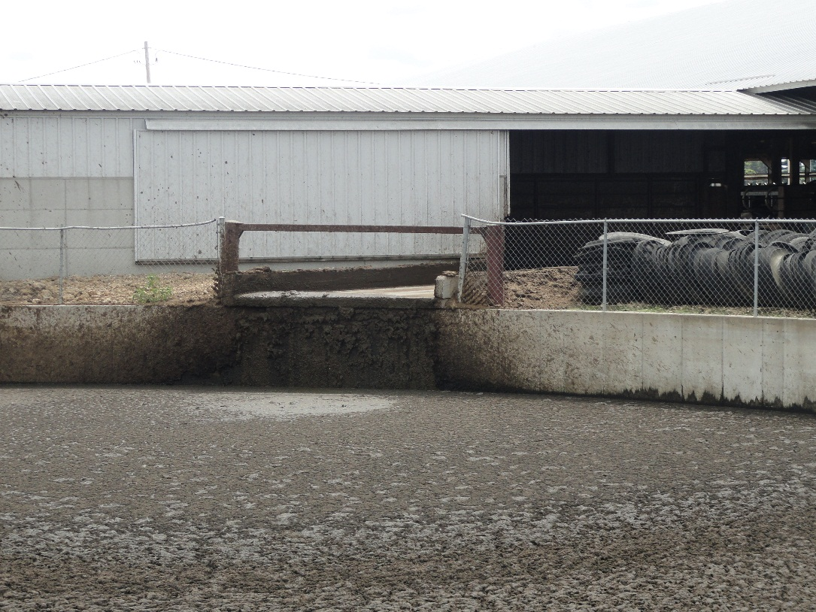
Oxygen Deficient Atmospheres
Hydrogen Sulfide
Carbon Dioxide
Ammonia
Carbon Monoxide
Methane
Notes:
Davis E Hill, EMT-P, Sr. Extension Associate, The Pennsylvania State University, www.agsafety.psu.edu
Picture is from the National Education Center for Agricultural Safety. Permission given to use photo

Slide 15
Hydrogen Sulfide (H2S)
Hydrogen sulfide (H₂S) is a highly toxic gas with a "rotten egg" odor at low concentrations [NIOSH/OSHA 1981].
At high concentrations, hydrogen sulfide can paralyze the olfactory senses [NIOSH 1979]. Because this gas is heavier than air, it can settle near the bottom of the manure pit. Hydrogen sulfide is a severe eye irritant and may cause tissue damage [NIOSH/OSHA 1981].
Notes:
NIOSH Alert / CDC: Preventing Deaths of Farm Workers in Manure Pits.

Slide 16
Hydrogen Sulfide
At low concentrations, gas can cause dizziness, headache, nausea, and irritation of the respiratory tract. At high concentrations, hydrogen sulfide can cause unconsciousness, respiratory failure, and death within minutes. In addition, hydrogen sulfide may be explosive at a wide range of concentrations in air--4.3% to 46% by volume [NIOSH 1985a].
Notes:
NIOSH Alert / CDC: Preventing Deaths of Farm Workers in Manure Pits.

Slide 17
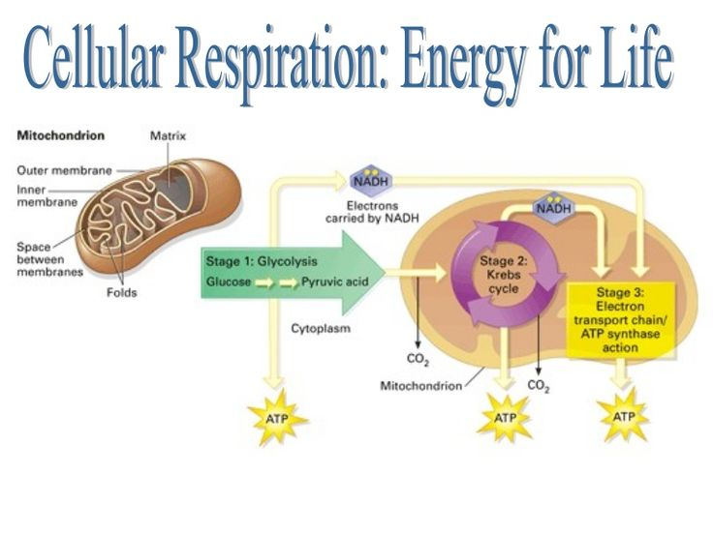
Hydrogen Sulfide
H2S poisons the mitochondria
Mitochondria loses the ability to use oxygen to create energy to power the cells of the body- most notably the brain
Notes:
Mitochondrian-
a small spherical or rodlike body, bounded by a double membrane, in the cytoplasm of most cells: contains enzymes responsible for energy production
mitochondria. (n.d.). Online Etymology Dictionary. Retrieved August 28, 2015, from Dictionary.com website: http://dictionary.reference.com/browse/mitochondria

Slide 18
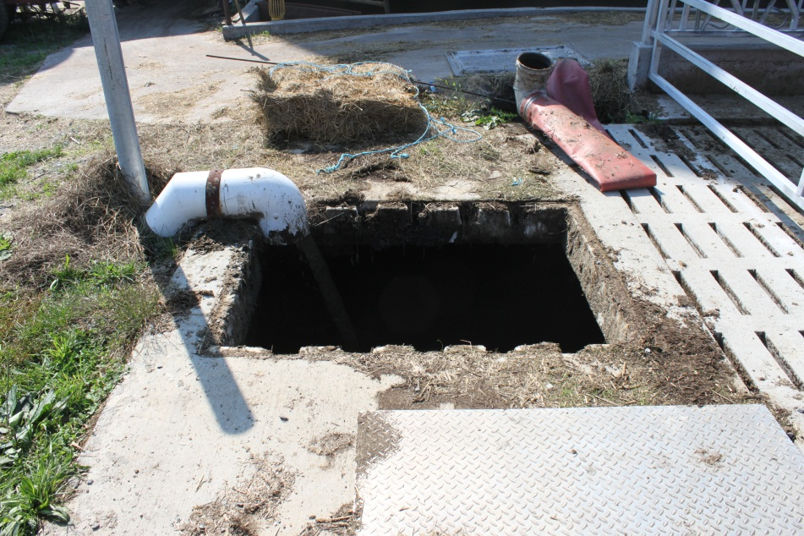
Carbon Dioxide (CO₂)
Product of decomposition
Common in manure storages.
Odorless, colorless.
Difficult to measure.
Displaces oxygen.
Notes:
Davis E Hill, EMT-P, Sr. Extension Associate, The Pennsylvania State University, www.agsafety.psu.edu

Slide 19
Carbon Dioxide
Carbon dioxide (CO₂) is an odorless gas that is normally in the atmosphere [NIOSH/OSHA 1981]. Because this gas is heavier than air, it can settle near the bottom of the manure pit. At low concentrations, carbon dioxide can result in labored breathing, drowsiness, and headache. At high concentrations, carbon dioxide can displace enough oxygen to cause death by suffocation.
Notes:
NIOSH Alert / CDC: Preventing Deaths of Farm Workers in Manure Pits.

Slide 20
Ammonia (NH₃)
Ammonia (NH₃) has the sharp odor characteristic of household ammonia [NIOSH/OSHA 1981]. This gas can severely irritate the eyes, nose, throat, and lungs. Ammonia is lighter than air. Exposure to high concentrations can be fatal.
Notes:
NIOSH Alert / CDC: Preventing Deaths of Farm Workers in Manure Pits.
PEL permissible Exposure Limit

Slide 21
Ammonia
IDLH: 300 ppm
Physical Description: Colorless
Exposure Limits: NIOSH (PEL) 35 OSHA (PEL) 50 ppm
Exposure Routes: inhalation, ingestion, ski or eye contact
Symptoms: irritation eyes, nose, throat; dyspnea (breathing difficulty), wheezing, chest pain; pulmonary edema; pink frothy sputum; skin burns, vesiculation; liquid: frostbite

Slide 22
Carbon Monoxide (CO)
Odorless, cannot see or taste
By-product of combustion
Found in the operation of gas/oil furnaces, engines and small motors.
Notes:
Instructor notes: Carbon Monoxide is produced from combustion.
Think about shutting off tractors and other fuel powered equipment around the area. Wind direction.

Slide 23
Carbon Monoxide
IDLH: 1200 ppm
Exposure Limits: NIOSH REL- TWA 35 ppm, OSHA PEL- TWA 50 ppm
Physical Description: Colorless, odorless gas. Roughly the same specific gravity as oxygen
Exposure Routes: Inhalation, skin &/or eye contact. CO attaches to Hemoglobin taking a receptor from Oxygen.
Symptoms: Headache, Tachypnea, Nausea, Weakness, Exhaustion, Dizziness, Confusion, Hallucinations, Cyanosis, Depressed S-T segment of electrocardiogram, Angina, Syncope
Notes:
NIOSH Pocket Guide to Chemical Hazards

Slide 24
Methane (CH4)
Methane (CH₄), is an odorless gas that is flammable or explosive at concentrations of 5% to 15% by volume of air [NIOSH 1985b]. At high concentrations, methane can displace enough oxygen to cause death by suffocation. Because this gas is lighter than air, it occurs near the top of the pit. Methane should be expected to be present in manure pits.
Notes:
NIOSH Alert / CDC: Preventing Deaths of Farm Workers in Manure Pits.

Slide 25
Methane
IDLH: 2100 ppm (10%LEL)
Physical Description: Colorless, odorless gas. [Note: A foul-smelling odorant is often added when used for fuel purposes. Shipped as a liquefied compressed gas.]
Exposure Limits: NIOSH REL 1000ppm OSHA (PEL) 1000ppm
Exposure Routes: inhalation, skin and/or eye contact (liquid)
Symptoms: dizziness, confusion, excitation, asphyxia; liquid: frostbite
Notes:
Source: NISOH pocket guide Methane

Slide 26
Air Monitoring
Air monitoring

Slide 27
Test the Atmosphere
In this order:
Check for Oxygen Content:
At least 19.5% and less than 23.5%
Check for Combustibles:
Less than 10% of the LEL
Check for Toxic Gases:
Most commonly carbon monoxide (PEL 50 ppm)
or any other hazardous materials as determined by the use of the space.
Notes:
The 4 gas detector needs to be tested regularly. Bump test (Calibration) before every use. Follow manufactures recommendation.

Slide 28

Multiple Gas Monitors
Visual and audible alarms
Specific detector heads may be incorporated based on your hazards
This one detects:
Oxygen content
Percent LEL
Carbon monoxide
Hydrogen sulfide
PPT-045-01
49
Notes:
Photo permission by RKI.
Mike Johnson
Marketing Manager
(510) 441-5656 | (800) 754-5165
Gas Detection for Life

Slide 29

Gas Monitors
Read oxygen level first to verify correct level between 19.5 percent to 23.5 percent or reading for LEL will be incorrect for the challenge gas/vapor
PPT-045-01
50
Notes:
Photo permission by RKI.
Mike Johnson
Marketing Manager
(510) 441-5656 | (800) 754-5165
Gas Detection for Life

Slide 30
Monitor Response Time.
No instrument is truly instantaneous- Some respond in 5 to 10 seconds, others require 30-60 seconds.
Notes:
Consult the instrument operation manual and allow appropriate time for the instrument to respond completely before recording the reading. Continue sampling in the same location while waiting for the response.
IAFF Training for Hazardous Materials: Technician

Slide 31
Air quality
Always test the air at different levels of the structure to make sure it is safe. The air might be clear at the top and deadly at the bottom.
GOOD AIR
BAD AIR
DEADLY AIR
Notes:
Picture is from the National Education Center for Agricultural Safety. Permission given to use photo

Slide 32
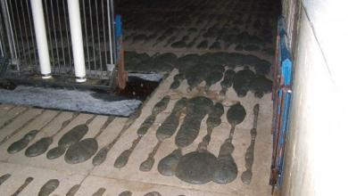
Foaming manure ppits are dangerous
To guard against pumping accidents, agricultural engineers, animal scientists and pork industry consultants have developed a series of recommendations to help producers address this serious safety concern:
Notes:
Foaming Manure Pits are Dangerous
Oct 12, 2011 Lora Berg, contributing editor
http://nationalhogfarmer.com/environmental-stewardship/manure-management/1013-foaming-manure-pits?intlink=rceoc
Foaming manure rises up through the slats, raising the risk of a potentially explosive and deadly situation in this Iowa State University photo.
Photo courtesy of Iowa State University.

Slide 33
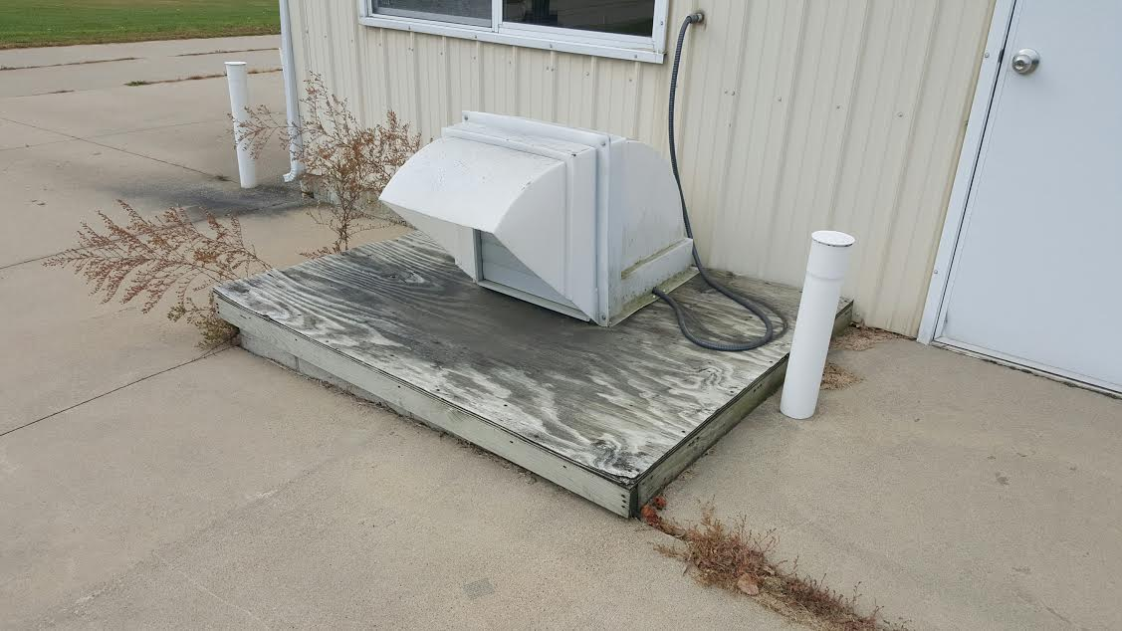
Ventilation
Provide continuous ventilation to prevent gas build-up. Increase ventilation during agitation to quickly dissipate released gases.
Notes:
Provide continuous ventilation to prevent a gas build-up. Increase ventilation during agitation to quickly dissipate released gases. Sufficient ventilation or exchange of air in the barn is always essential to keep the concentration of methane below its explosive threshold.
Sufficient air exchange in a barn while agitating and pumping a manure pit is at least two to three times the minimum ventilation rate (or around 10 air changes per hour) for the barn.
Foaming Manure Pits are Dangerous
Oct 12, 2011 Lora Berg, contributing editor
http://nationalhogfarmer.com/environmental-stewardship/manure-management/1013-foaming-manure-pits?intlink=rceoc
Picture courtesy of NECAS

Slide 34
Pumping full pits
When pumping pits that are close to being full, pump without agitation until manure is about 2 ft. below the slats.
Notes:
If the pit is full or nearly full, do not rely only on pit fans to supply this airflow rate, since these fans may be severely restricted. It may be better to use only wall fans to supply this air exchange while agitating/pumping the barn’s manure pit since methane gas is lighter than air.
Make sure your normal ventilation inlets are open and operating properly to ensure good air distribution in the barn. This is also important in preventing animal deaths (if animals must be present in barns) during agitation and pumping of the manure pit.

Slide 35

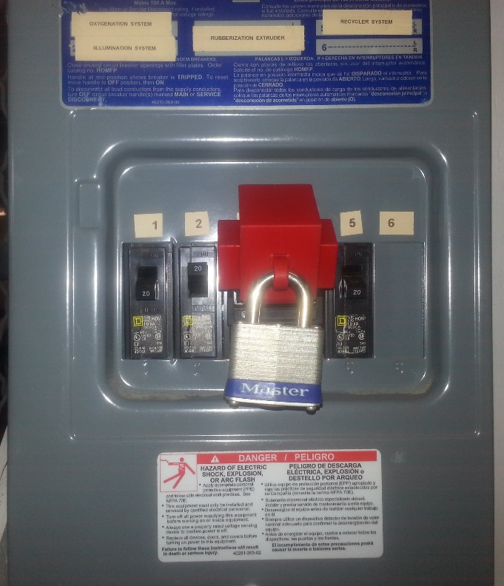
Pumping a pit when foam is present
Remove people and animals from building
Lock-Out and Tag Out all devices except the pit fans
Notes:
Any ignition sources should be turned off and locked out. Possible ignition sources include welders, heaters, motors, and other equipment, such as a feeding system, that uses electricity. (Because of the importance of ventilation, discussed in the next section, ventilation systems that use electricity may operate during agitation and pumping.)
Source: http://www.extension.org/pages/63144/manure-foaming#.VOtW8Wd0zZ4

Slide 36
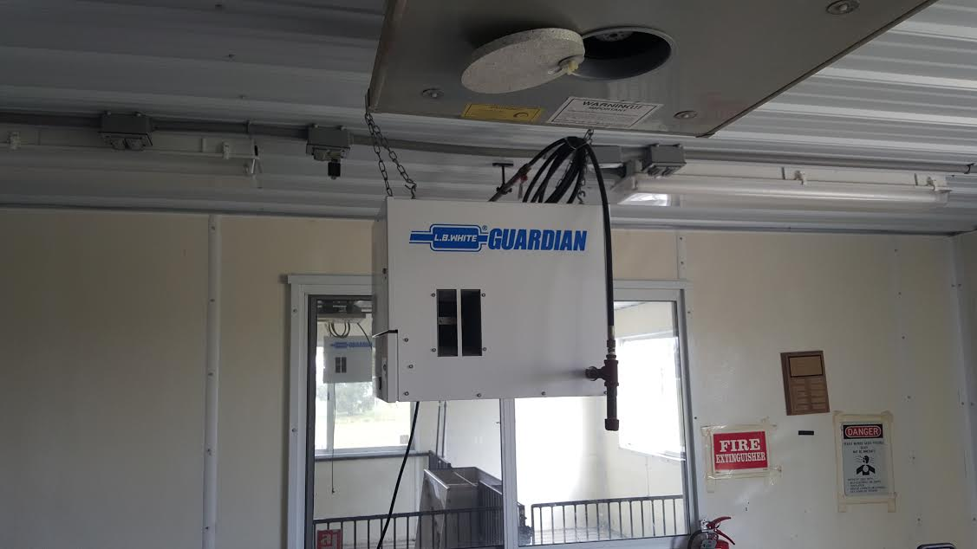
Lockout tagout
Turn off heater pilot light and other non-ventilation electrical systems (such as the feeding system), that might produce an ignition spark. Lock Out- Tag Out
Notes:
Turn off heater pilot lights and other non-ventilation electrical systems (such as the feeding system) that might produce an ignition spark. Not providing supplemental heat in the barn may be problematic for cases when there are no animals in the barn or there are only small animals that require warmer inside temperatures. This may restrict when you pump manure from such a barn to warmer days or a warmer part of the day.
Follow These Tips To Prevent Injuries When Pumping Barn Manure Pits
http://nationalhogfarmer.com/facilities-equipment/manure-handling/caution-surface-foam-pits-1006
Picture courtesy of the National Education Center for Agricultural safety (NECAS) used with permission

Slide 37
Lockout/Tagout
OSHA Regulation 29 CFR 1910.147
“Lockout” To physically insure that all mechanical or electrical systems, that can be energized or started up, or release stored energy, are secured, isolated, disabled, or rendered inoperative.
“Tagout” The placement of a device to indicate that the energy isolating device and the equipment being controlled may not be operated until the tagout device is removed.
Notes:
This is the OSHA regulations to Lock out Tag out
OSHA Regulation 29 CFR 1910.147

Slide 38
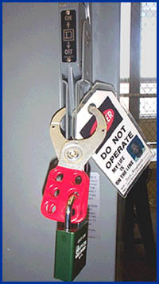
General Requirements
All mechanical, electrical, hydraulic and pneumatic which presents a danger to employees inside of the storage structures shall be de-energized and shall be disconnected, locked-out and tagged, blocked off, or otherwise prevented from operating from other equally effective means or methods.
Notes:
272
This would prevent the movement of manure
Picture from OSHA Lockout/Tagout ttps://www.osha.gov/dts/osta/lototraining/hottopics/ht-relche-1-4.html

Slide 39
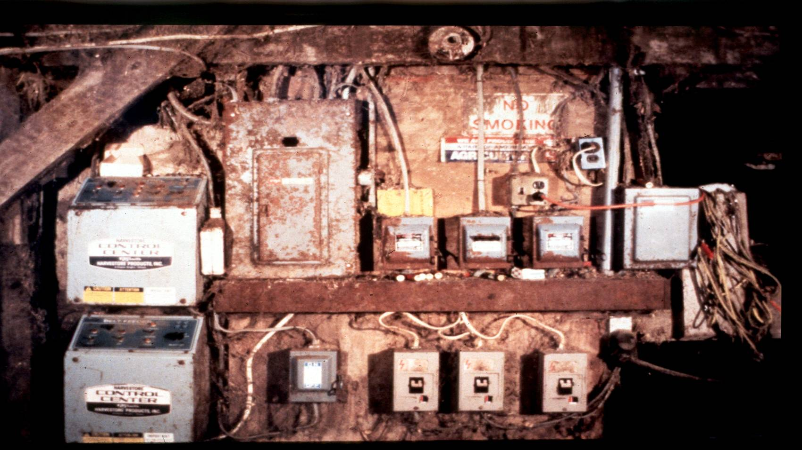
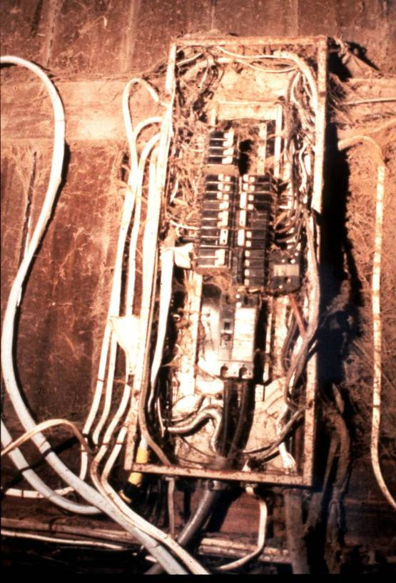
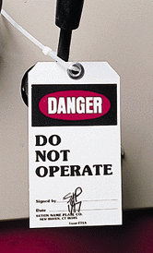
Unsafe farm electrical systems
Lockout / Tagout
Where? How?
Notes:
Most farm electrical systems are not what you would call up to code. You may have to shut off power to the farm to be sure the pit is off.
OSHA Regulation 29 CFR 1910.147

Slide 40

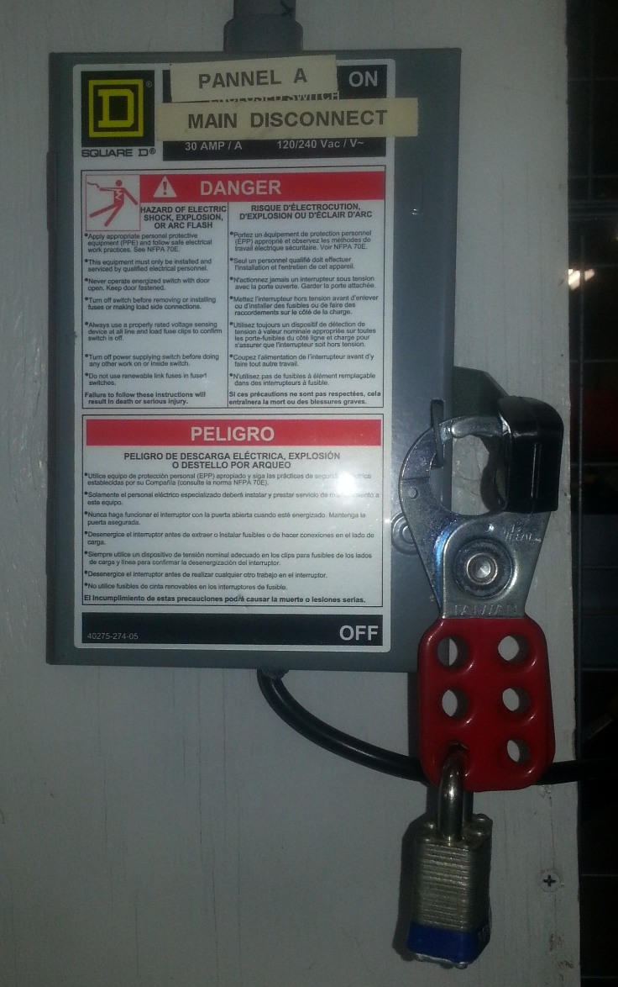

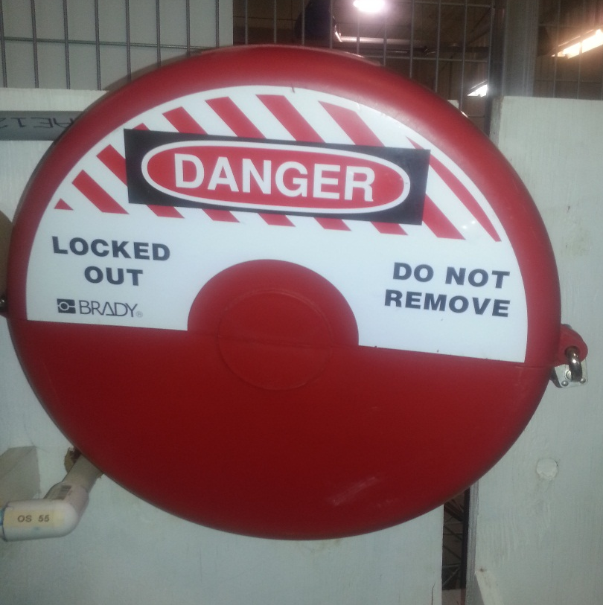
Electrical and valves lockout/tagout
Electrical & Valves Lockout /Tag out
Notes:
Picture is from the National Education Center for Agricultural Safety. Permission given to use photo

Slide 41
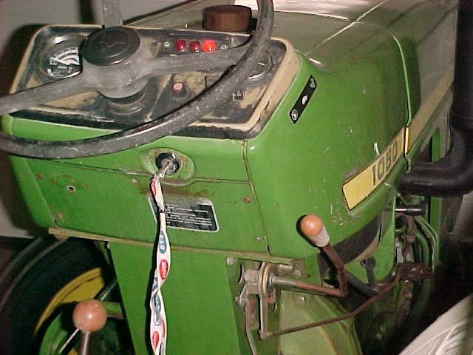
Shut off the tractor
Shut off the tractor and power equipment.
Keep ventilation fans operating.
Notes:
Picture is from the National Education Center for Agricultural Safety. Permission given to use photo

Slide 42
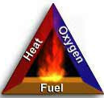
Combustible Gas Hazards
Components must be present at once
Fuel (combustible gas)
Methane
Air (oxygen)
Heat (some source of ignition)
Cutting torch, spark from electric equipment or cell phone, scraping, smoking etc.
Notes:
Davis E Hill, EMT-P, Sr. Extension Associate, The Pennsylvania State University, www.agsafety.psu.edu
Picture from OSHA Evacuation Plans and Procedures.

Slide 43
Beware of pressure washing
Pressure washing above a manure pit with foam will allow the water droplets to fall into the pit and disturb the layer of foam causing Methane to be released.

Slide 44
In case of Fire… Remember to RACE
Rescue- those in immediate danger
Announce- the need to evacuate the building
Contain the fire by closing doors and windows as you exit the facility
Evacuate immediately and go to designated meeting spot to confirm everyone has safely exited.
Source: Pork Check off
Notes:
April 2015: Volume 11 no 2

Slide 45
Review
Ventilate the building- Keep the pit fans exhausting and ventilate the room with 10 air exchanges per hour
If you are going to pump the pit: Agitate only when there are 2 feet of air space between the top of the foam and the floor slats, when the pits fans are able to evacuate air from the pit.
Continue ventilating the barn after the foam-breaking activities have been completed. Wait at least 30 minutes with full ventilation
Monitor air quality in the barn to ensure methane is fully ventilated before turning the systems back on
No Smoking
Notes:
Follow These Tips To Prevent Injuries When Pumping Barn Manure Pits
http://nationalhogfarmer.com/facilities-equipment/manure-handling/caution-surface-foam-pits-1006

Slide 46
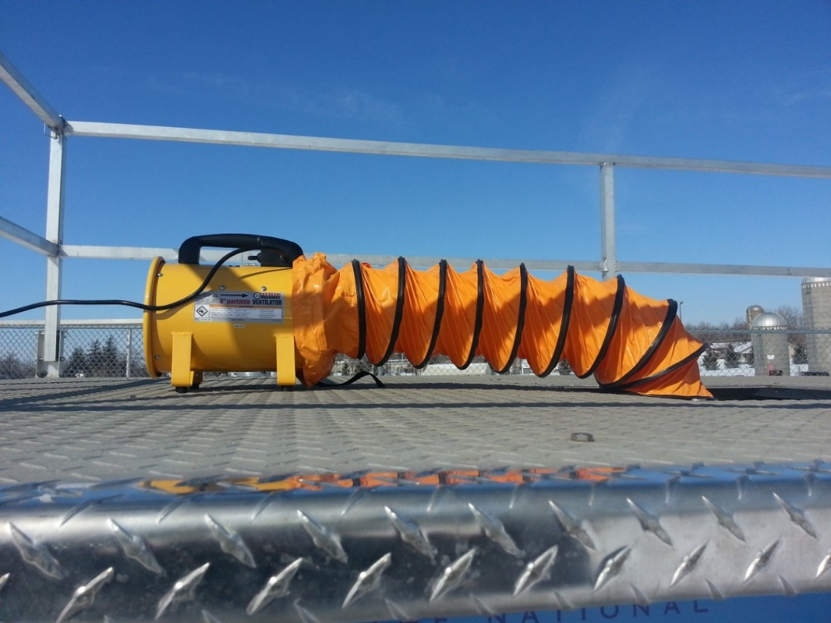
Review
Prevent entry into the barn; prohibit agitating the pit
Shut off gas (Propane) to the building to prevent additional fuels from feeding a fire
Turn off electrical sources in the building,
except for ventilation systems.
Notes:
This includes lights, heaters, and feeders. Extinguish any pilot lights, put breakers to the “off” position and Lock Out/ Tag Out to prevent and automated systems from energizing

Slide 47
Agriculture Exemption
Enforcement Guidance for Small Farming Operations
The Appropriations Act exempts small farming operations from enforcement of all rules, regulations, standards or orders under the Occupational Safety and Health Act. A farming operation is exempt from all OSHA activities if it:
Employs 10 or fewer employees currently and at all times during the last 12 months; and
Has not had an active temporary labor camp during the proceeding 12 months.
Note: Family members of farm employers are not counted when determining the number of employees.
Important to check with your state OSHA since there are 25 states that match or exceed this OSHA Instruction
Source: OSHA Instruction CPL 02-00-051
Notes:
Agricultural Exemption - Appropriations Act
Enforcement Guidance for Small Farming Operations. The Appropriations Act exempts small farming operations from enforcement of all rules, regulations, standards or orders under the Occupational Safety and Health Act. A farming operation is exempt from all OSHA activities if it: Employs 10 or fewer employees currently and at all times during the last 12 months; and Has not had an active temporary labor camp during the proceeding 12 months.
Note: Family members of farm employers are not counted when determining the number of employees.
Important to check with your state OSHA since there are 25 states that match or exceed this OSHA Instruction
Consider giving an example from a state – California is typically more stringent
Source: OSHA Instruction CPL 02-00-051

Slide 48
Employee Rights and Responsibilities
You have the right to:
A safe and healthful workplace
Know about hazardous chemicals
Information about injuries and illnesses in your workplace
Complain or request hazard correction from employer
Notes:
48

Slide 49
Employee Rights and Responsibilities
You have the right to:
Training
Access to Hazard exposure and medical records
File a complaint with OSHA
Participate in an OSHA inspection
Be free from retaliation for exercising safety and health rights
Notes:
49

Slide 50
Employee Rights and Responsibilities
OSHA website: www.osha.gov and OSHA offices: Call or Write (800-321-OSHA)
Compliance Assistance Specialists in the area offices
National Institute for Occupational Safety and Health (NIOSH) – OSHA’s sister agency
OSHA Training Institute Education Centers
Doctors, nurses, other health care providers
Public libraries
Other local, community-based resources
Notes:
50

Slide 51

Whistle Blower Fact Sheet
Whistle Blower Fact Sheet (FS 3638)
Notes:
Review Employee Rights – OSHA Publication Fact Sheet (FS) 3638

Slide 52

Whistle Blower Protection Program
Notes:
With in OSHA is the whistle blower program
Website resources
22 statutes

