Slide 1

Hearing Conservation Program Adapted to Agriculture

Slide 2

Susan Harwood Training Grant
This material was produced under grant #SH-24891-SH3 and SH-26280-SH4 from the Occupational Safety and Health Administration, U.S. Department of Labor. It does not necessarily reflect the views or policies of the U.S. Department of Labor, nor does the mention of trade names, commercial products, or organization imply endorsement by the U.S. Government
Notes:
Explain the Susan Harwood Training Grant

Slide 3

Focus Areas
At the conclusion of this webinar, participants will be able to:
Identify the required components of the OSHA hearing conservation program(monitoring, testing, protective equipment, training, and recordkeeping).
Recognize OSHA hearing conservation program components that relate to agricultural operations.
Describe established time weighted averages and decibel ratings present in agricultural settings.
Locate a minimum of three reliable resources that provide workplace hearing conservation program development tools and educational materials.

Slide 4

Scope of Webinar
This webinar is intended to provide an overview of hearing conservation practices related to the production agricultural arena and recommendations for reliable personal protective equipment.
It is not intended to be an in-depth training program for safety managers or health care providers.

Slide 5

Which role do you play?
Business owner/manager –responsible for providing safe working environment and understanding the safety regulations, parameters, and policies that are relative to your industry
Health care provider – need to know which regulatory policies and guidelines have an impact on your community ag industries, understand acceptable noise level ranges, conduct or make referrals for approved hearing tests, be able to provide reliable educational resources to business owners, managers, and workers.
Agricultural producer or worker – acquire an understanding of dangerous noise levels, comply with hearing conservation guidelines if applicable, request hearing protective devices from employer if indicated by noise exposure

Slide 6

What is Noise Induced Hearing Loss?
Noise induced hearing loss (NIHL) is a permanent impairment resulting from prolonged exposure to high levels of noise.
NIHL can develop gradually from chronic or long term exposures to noise (i.e.: engines, animal)
NIHL can develop suddenly as a result of a sudden extreme noise (i.e.: gunfire, explosions)

Slide 7

Hearing Loss : A Real Concern
1 in 10 Americans has a hearing loss that affects his/her ability to understand normal speech
15% of Americans ages 20 – 69 have high frequency hearing loss related to work or leisure activities
30 million people are exposed to hazardous noise levels at work
NIHL is one of 21 priority areas for NIOSH research http://www.cdc.gov/niosh/topics/noise/
NIHL has been listed as one of the most prevalent occupational health concerns in the U.S. for over 25 years. www.osha.gov/SLTC/
Source: American Hearing Resource Foundation http://American-hearing.org/
Notes:
OSHA Publication # is OSHA 3074-2002

Slide 8

Hearing : a Valuable Asset
The ability to hear affects quality of life
Low hearing levels can result in stressful and frustrating attempts at conversation
Spoken words can be misinterpreted
Driving, as well as equipment and machinery operation, will be affected
Once it’s gone – it’s gone!

Slide 9

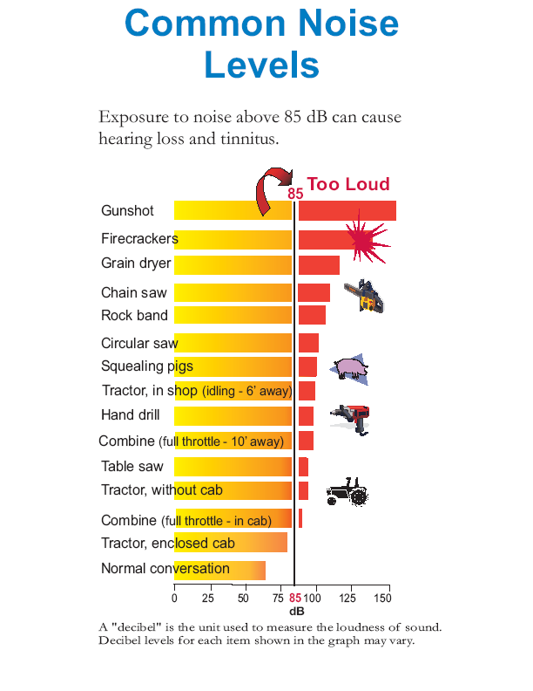
Common Noise Levels chart
Notes:
Source - http://www.cdc.gov/niosh/docs/2007-176/pdfs/2007-176.pdf Have You Heard

Slide 10

Assessment of NIHL
We will review:
Normal sound conduction
Cochlear hair cell damage
Measuring hearing loss
Defining decibels and hertz
Defining TWA

Slide 11

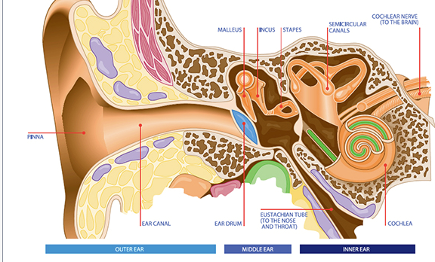
Anatomy of the Ear
Notes:
Review sound conduction pathway

Slide 12
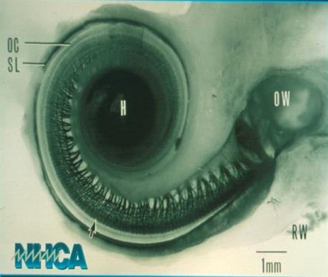
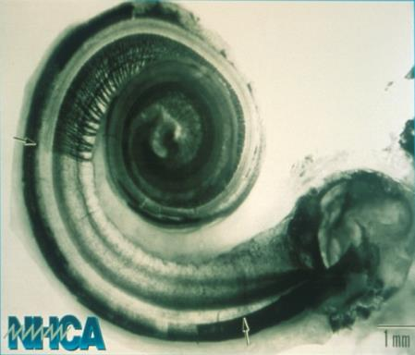
Cochlear Damage
Healthy Cochlea
Damaged Cochlea
Notes:
Source: http://www.hearingconservation.org/ National Hearing Conservation Association

Slide 13
Decibels
Decibel – the degree of loudness of a sound; an expression of the relative loudness of sound as perceived by the human ear [named after A.G. Bell]
dB or dBA – An A-weighted sound closely matches the perception of sound by the human ear
When screening children, guidelines recommend starting at 20 dB*
When screening adults, 25 dB is a standard starting level **
Source – American Speech & Language Association
Notes:
Ambient noise may indicate beginning screening for children at 25 dB
** There is debate over using this 25 dB level for older adults – 65 and over

Slide 14
Hertz
Hertz (Hz) is the term used for the frequency of sound [named after a German physicist]
Frequency is determined by the number of sound vibrations per second
The faster the cycles – the higher the frequency (the sound’s pitch)

Slide 15

Frequency (Hz)
500
1000
2000
3000
4000
6000
0
10
20
30
Hearing Level (decibels)
40
50
60
70
80
90
Notes:
http://www.cdc.gov/niosh/topics/noise/noisemeter_html/hp180.html
Hearing tests measure ability to hear various decibel levels at specific frequency (Hz) levels. Red line indicates the typical starting level of testing for adults
Source: Council for Accreditation in Occupational Hearing Conservation (CAOHC)

Slide 16

Time Weighted Average(TWA)
TWA refers to the average noise exposure level over a given time period (an 8 hour TWA refers to exposure over an 8 hour period)
OSHA’s permissible exposure level (PEL) is 90 dBA for an 8 hour day
OSHA Standard 1910.95 uses a 5 dBA exchange rate – if noise is increased by 5 dBA, the exposure time must be cut in half

Slide 17
OSHA’s Hearing Conservation Program
OSHA implemented the Hearing Conservation Program (HCP) for general industry in 1981.
Requires employers to implement a HCP where workers are exposed to a TWA noise level of 85 decibels or higher over an 8 hour period
Usually referred to as the Action Level

Slide 18
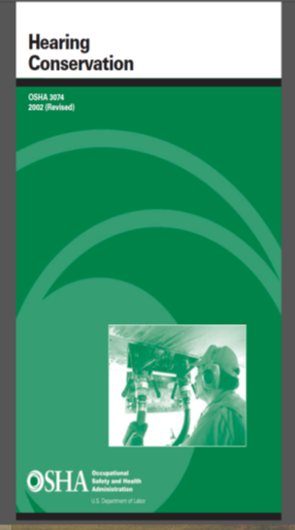
OSHA’s Hearing Conservation Program
Notes:
OSHA Publication # is OSHA 3074-2002

Slide 19

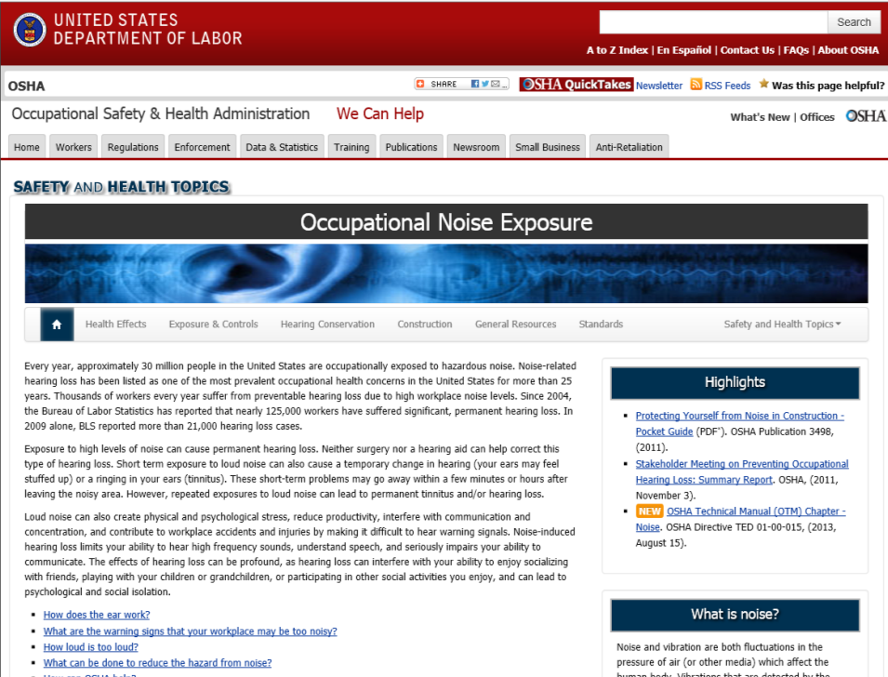
Notes:
www.osha.gov OSHA Safety & Health Topics page – O – Occupational Noise Exposure. Note the NEW: OSHA Technical Manual – revised in August, 2013.

Slide 20
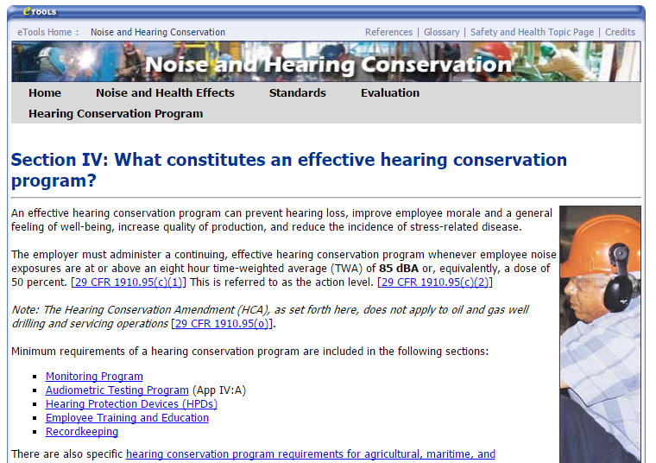
OSHA Hearing Conservation Program
Notes:
https://www.osha.gov/dts/osta/otm/noise/hcp/

Slide 21
OSHA’s Hearing Conservation Program
The HCP requires employers to:
Measure/ monitor noise levels/ provide exams
Conduct evaluation of adequacy of hearing protection –
Unless changes are made to equipment and/or schedules so they are less noisy and exposure is less than 85 dBA
Provide a selection of hearing protection
Provide training
Keep adequate records
Source: www.osha.gov/SLTC/noisehearingconservation/

Slide 22
Hearing Conservation Program(HCP) – Monitoring
Monitoring requirement allows employers to choose a method that works for them (personal or area)
Personal monitoring is usually considered the best method
Noise measurements must integrate levels for 80 to 130 dBA
Monitoring should be repeated if a change in process or equipment increases noise levels
Each employee that is exposed at or above action level must be notified of monitoring results
Employees ( or representative) must be allowed to observe monitoring procedures
Is any of this adaptable (or already being done) in agriculture?
Notes:
Keep Best Management Practices in mind – even if your operation does not fall under OSHA

Slide 23

HCP – Hearing Protective Devices
Hearing protection is considered the last option in noise control
May be the only feasible option
OSHA considers technical feasibility to be a considered option – but not financial feasibility
Employees must be given a suitable variety of hearing protection to choose from
Employer must provide training in use, fit and care of hearing protection devices
Adequacy of devices must be assessed if noise exposure increases
Is any of this adaptable (or already being done) in agriculture?

Slide 24

HCP – Training & Education
The employer must institute a training program for all employees with noise exposures at or above action level
Training must be repeated annually for each employee
Information must be updated to be consistent with changes in protective equipment and work processes
Employees must have access to training and informational materials
Is any of this adaptable (or already being done) in agriculture?

Slide 25
HCP - Recordkeeping
Recordkeeping assists employers in recognizing and correcting hazards
Employers must maintain accurate exposure records for 2 years
Audiometric test records must be retained for duration of employment
Access to records required by the noise standard must be accessible to employees, former employees, their representatives, OSHA
Employers who cease to do business must transfer records to successor employer
Is any of this adaptable (or already being done) in agriculture?

Slide 26

Role of Agricultural Business Owner/Manager
Know the OSHA agricultural standards
Understand application of exemptions
Review HCP and use what is relevant
Provide regular training/education programs
Provide hearing protection that meets NIOSH recommendations
Monitor use of hearing protection
Implement Best Management Practices!

Slide 27
National Institute for Occupational Safety & Health (NIOSH)
NIOSH:
recommends all worker exposures to noise should be controlled below a level equivalent to 85 dBA for 8 hours
found significant NIHL occurs at levels equivalent to OSHA PEL (90 dBA)
recommends a 3 dBA exchange rate
Notes:
NIOSH is more protective…OSHA is looking at the recommendations – but regulatory issues take longer.

Slide 28
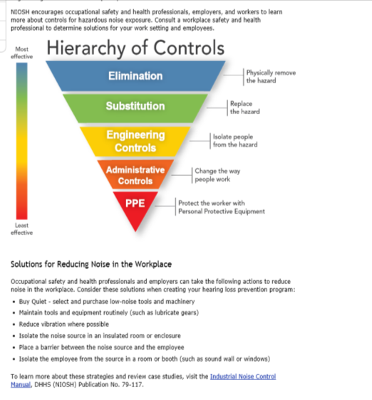
NIOSH Hierarchy of Controls
Notes:
Resources to review: Buy Quiet / Total Worker Health

Slide 29

Best Management Practices
Engineering Controls
Choose low noise tools and equipment when possible
Place a barrier between machine and worker (i.e. tractor cab)
Assess confined areas for noise levels and controls
Maintain & lubricate equipment
Dosimeters offer real time/TWA exposure data ( you don’t have to do all the math!)
Administrative Controls
Limit amount of time employee spends at high noise source
Provide quiet areas for relief from hazardous noise
Alternate work duties
Quiet or enclosed break area
Notes:
In open spaces – noise exposure is decreased by 6 dBA when distance between noise source and worker is doubled…

Slide 30
Best Management Practices
Provide hearing protection (ppe) with adequate Noise Reduction Rating (NRR)
Current NRR is a single number (NRR 28 30, etc.)
NIOSH recommends derating hearing protectors by a factor that corresponds to the available real-world data. Specifically, NIOSH recommends that the labeled NRRs be derated as follows:
Earmuffs - Subtract 25% from the manufacturer's labeled NRR
Formable earplugs - Subtract 50% from the manufacturer's labeled NRR
All other earplugs - Subtract 70% from the manufacturers labeled NRR
Store hearing protection in easy-to–access areas
Provide education on proper use of hearing protection devices

Slide 31
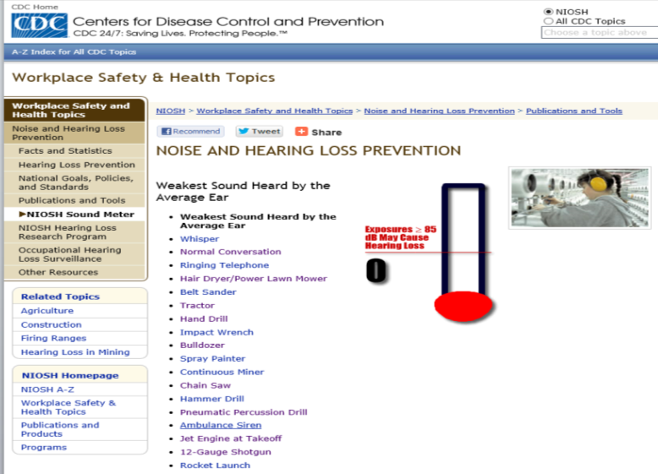
On-line Noise Meter
Notes:
http://www.cdc.gov/niosh/topics/noise/noisemeter_html/hp180.html

Slide 32

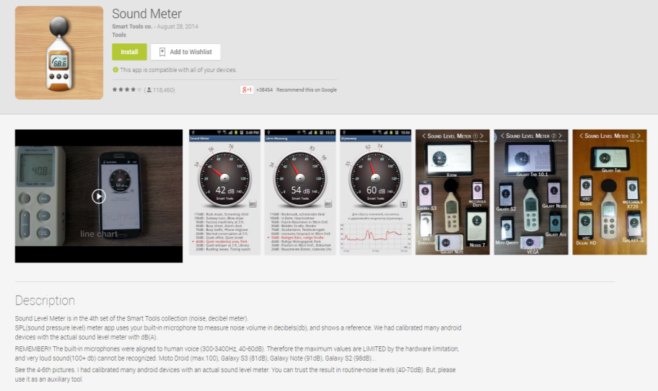
Sound Meter App
Notes:
https://play.google.com/store/apps/details?id=kr.sira.sound&hl=en
https://itunes.apple.com/us/app/decibel-meter-pro/id382776256?mt=8

Slide 33
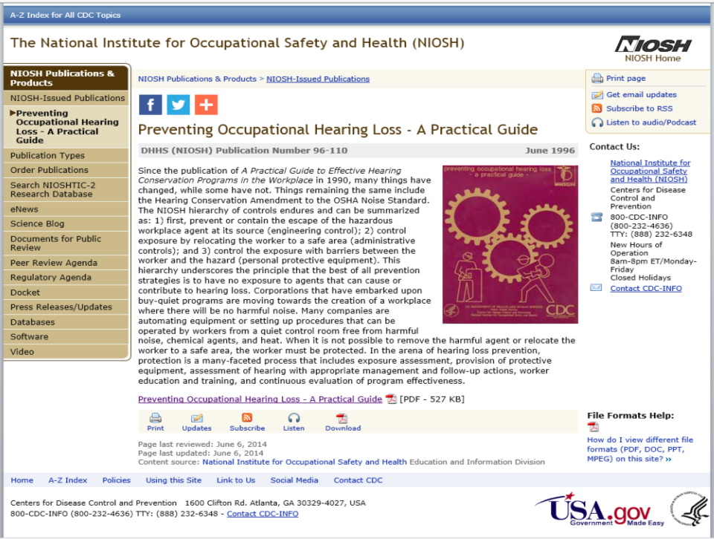
NIOSH webpage on preventing hearing loss
Notes:
NIOSH document developed in 1996/updated in June 2014. Good b/w pictures for teaching. Excellent examples of layout for program development. Easy to read.

Slide 34
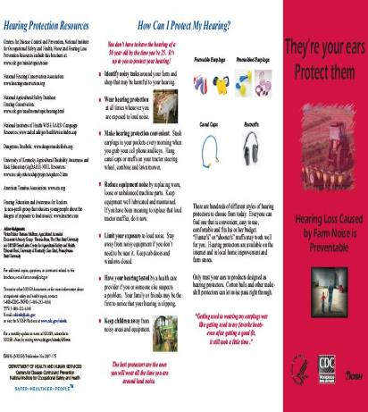
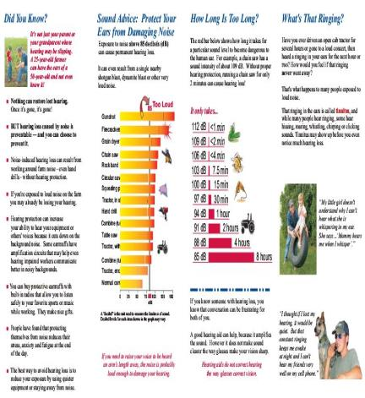
NIOSH Brochure for Agriculture
Notes:
Download from NIOSH web site

Slide 35
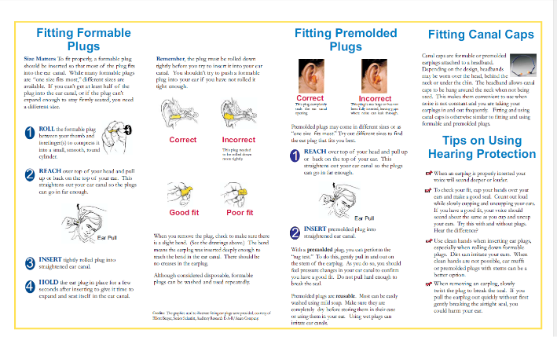
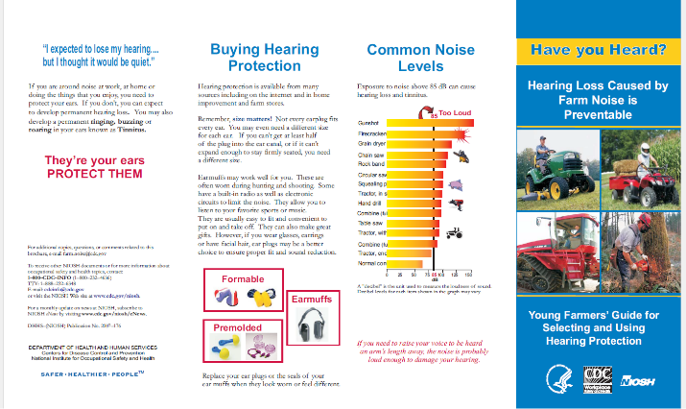
NIOSH brochure for Agriculture
Notes:
Download from NIOSH website

Slide 36
Clinician’s Role
Develop an awareness of clients’ common noise exposures
Become familiar with the OSHA Standards related to occupational noise exposure
Understand agricultural exemption status and general duty clause
Know the Whistleblower parameters

Slide 37

Clinician’s Role
Provide credentialed resources for employers and employees for hearing tests -
Council for Accreditation in Occupational Hearing Conservation (COAHC)
OSHA requires hearing tests to be performed by audiologists, otolaryngologists or other physicians, or qualified technicians, such as those certified by CAOHC (Council for Accreditation in Occupational Hearing Conservation). OSHA also says that a technician who performs tests must be responsible to an audiologist, otolaryngologist, or other physician – unless a microprocessor is used
Notes:
Many AgriSafe nurses are OHCs – just rarely use the title

Slide 38
Clinician’s Role
Client history and physical
History of:
pain or feeling of fullness (chronic / acute)
ringing in ears
known allergies
current or recent cold, sinus infections, etc.
medications (some can cause tinnitus/may be ototoxic*)
family history
noise exposure
use of ppe
Notes:
*Ototoxicity may result from heavy doses of aspirin or some NSAIDs, cancer treatment medications, anti-hypertension drugs (loop diuretics), high powered antibiotics
If you have a client or employee that will be starting some of these medications, you may want to consider having a baseline test done – especially for cancer meds

Slide 39

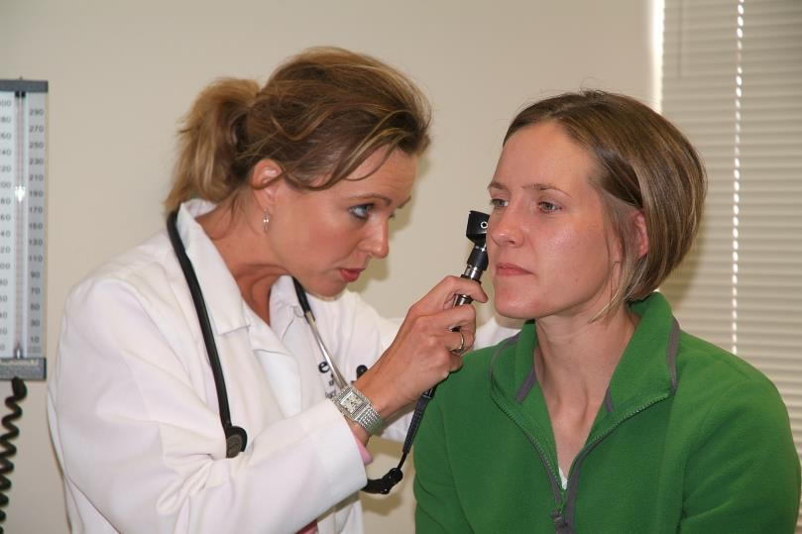
Clinical Exam

Slide 40
Clinician’s Role
Client history and physical
Look for:
swelling
redness
drainage
scar tissue
wax plugs
Document findings!

Slide 41
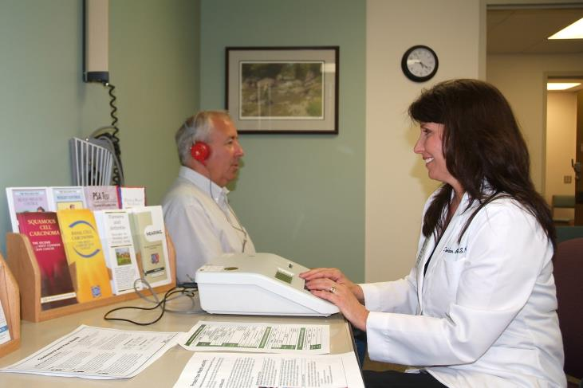
Hearing Test

Slide 42
Perception
A study of 150 farmers who received audiometric screenings revealed 67% exhibited hearing loss over 25dB at 4,000 Hz.
This would indicate we may think we hear better that we really do hear.
This also supports the value of professional auditory screening
Source: American Journal of Industrial Medicine. 2003 Oct;44(4):431-7Kerr,MJ;McCullagh,M;Savik,K;Dvorak,LA.
Perceived and measured hearing ability in construction laborers and farmers.

Slide 43
Frequency (Hz)
500
1000
2000
3000
4000
6000
0
10
20
30
Hearing Level (decibels)
40
50
60
70
80
90
Notes:
Remember this from a few minutes ago ? Keep in mind with the next slide. Source: Council for Accreditation in Occupational Hearing Conservation (CAOHC)

Slide 44
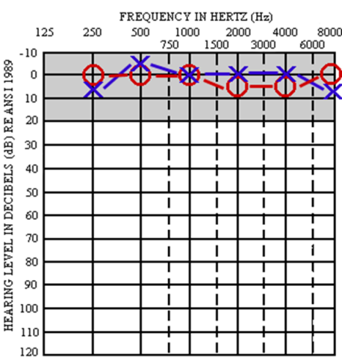
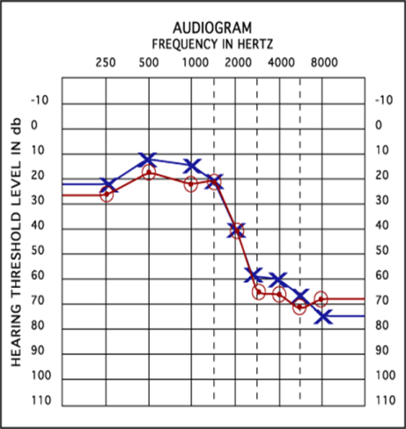
Hearing Screening Results
Notes:
Source: Council for Accreditation In Occupational Hearing Conservation (CAOHC)
First diagram – a normal hearing test / Second diagram – indicates hearing loss…caused by noise exposure or possibly a disease like measles

Slide 45
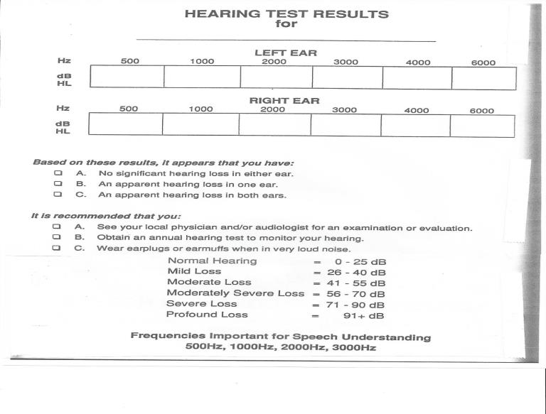
Several types of documentation forms

Slide 46
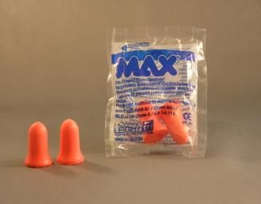
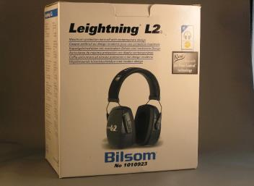
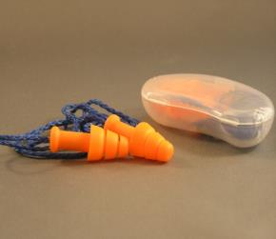
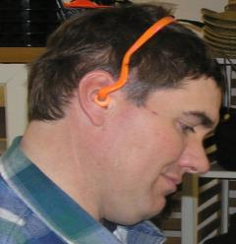
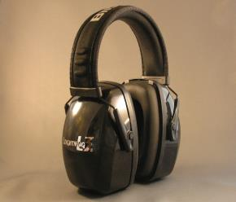
PPE
Muffs
Pre Molded
Formable
Bands
Notes:
Photos property of AgriSafe Network

Slide 47

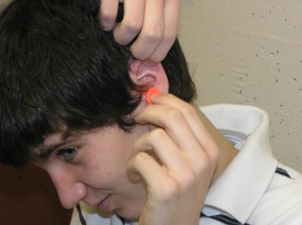
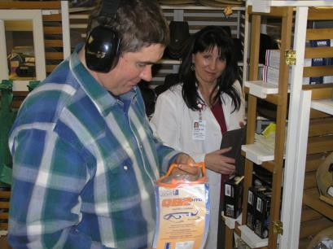
Hearing Protection
Proper Insertion
Variety of Choices
Wearing muff over plugs only adds 5-10 dB more protection!

Slide 48
Clinician’s Role
Understand noise reduction ratings (NRR) and noise exposures levels in production agriculture
Make reliable recommendations for appropriate hearing protection to employers and employees utilizing NIOSH established formulas

Slide 49
Warning Signs of Sensorineural Hearing Loss
If a producer/worker/employee experiences any of these – it’s time to have a full hearing test by a hearing conservation professional:
Ringing or buzzing in ears
Increasing the volume on a radio or television
Difficulty with phone conversations (especially cell phones)
Consistently asking someone to repeat what was said
Difficulty hearing a normal speaking voice at arm’s length
Notes:
Sensorineural Hearing Loss – Hearing loss caused by noise.

Slide 50


OSHA Resources
Available on www.OSHA.gov Website
In search bar type “Hearing Program”
Notes:
OSHA Resources available on OSHA.gov
How to get to this location
Search Bar
A-Z Index

Slide 51
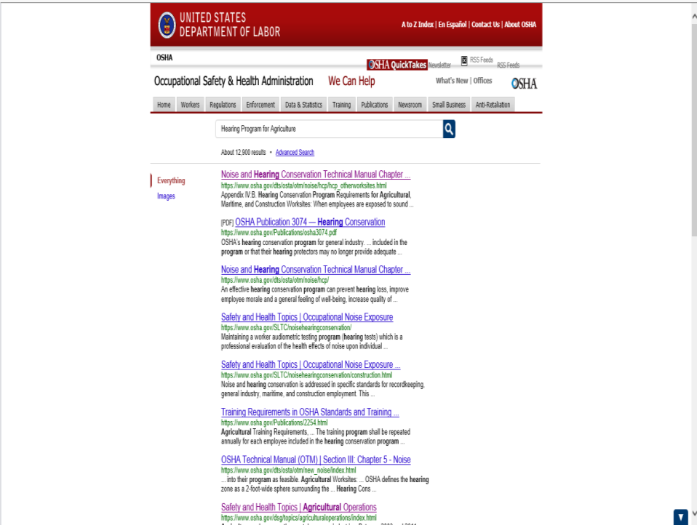
OSHA web page for noise and hearing conservation s

Slide 52
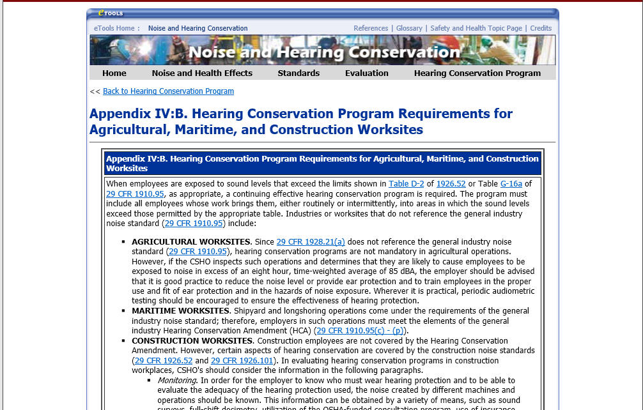
Noise and hearing conservation

Slide 53


Agriculture Operations Safety and Health Topics Page
General Resources

Slide 54
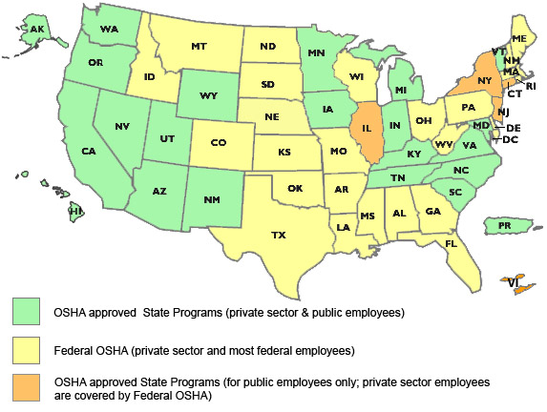
State to State
Important to check with your state OSHA. There are 25 states &
2 territories that match or exceed OSHA instruction

Slide 55
OSHA Resources
www.osha.gov
https://www.osha.gov/SLTC/noisehearingconservation/hearingprograms.html
https://www.osha.gov/SLTC/noisehearingconservation/
https://www.osha.gov/pls/oshaweb/owadisp.show_document?p_table=standards&p_id=9735
https://www.osha.gov/Publications/osha3074.pdf
https://www.osha.gov/dsg/topics/agriculturaloperations/index.html

Slide 56
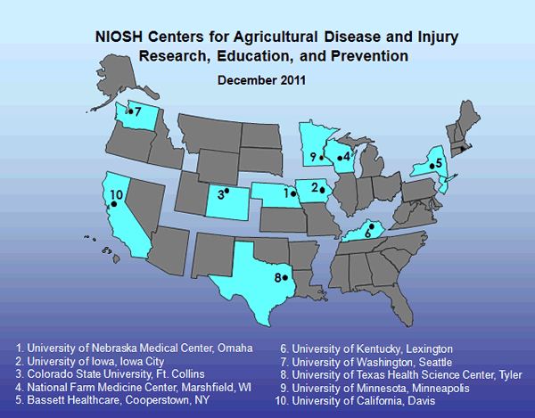
Recommended NIOSH Resources
NIOSH is the home of the 10 U.S. Ag Centers
www.cdc.gov/niosh
http://www.cdc.gov/niosh/topics/noisecontrol/
http://www.cdc.gov/niosh/twh/practices.html
http://www.cdc.gov/niosh/topics/noise/noisemeter_html/hp0.html
http://www.cdc.gov/niosh/docs/96-110/default.html
* Specific to agriculture
http://www.cdc.gov/niosh/docs/2007-175/pdfs/2007-175.pdf
http://www.cdc.gov/niosh/docs/2007-176/pdfs/2007-176.pdf
Notes:
1.Portions of these documents can be adapted for use in the world of production agriculture
2.* Specific to Agriculture

Slide 57

Webinars
AgriSafe Network Webinars related to these topics:
Agriculture Exemption
Personal Protective Equipment for Agricultural Producers
Respiratory Protection for Agricultural Producers
Notes:
AgriSafe Network Webinars that are related to this webinar which can be additional resources

Slide 58
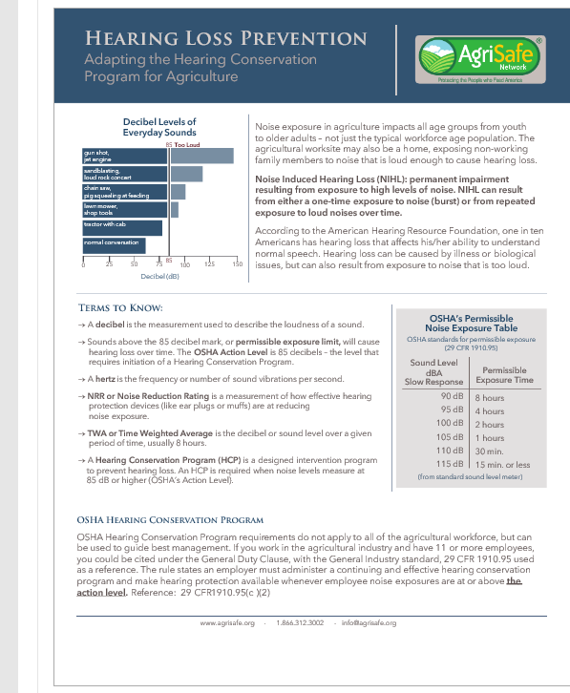
Hearling loss prevention
Notes:
New AgriSafe fact sheet

Slide 59
Employee Rights and Responsibilities
You have the right to:
A safe and healthful workplace
Know about hazardous chemicals
Information about injuries and illnesses in your workplace
Complain or request hazard correction from employer
Access to hazard exposure and medical records
File a complaint with OSHA
Participate in an OSHA inspection
Be free from retaliation for exercising safety and health rights
Notes:
Review Employee Rights

Slide 60

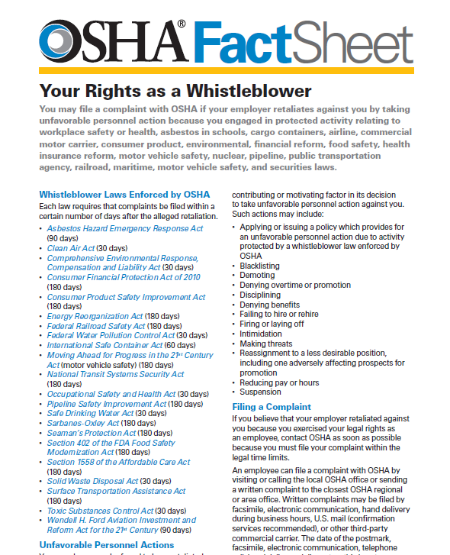
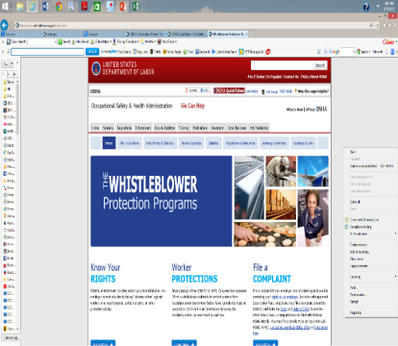
Whistleblower Protection Program

Slide 61

Evaluation
It is the goal of AgriSafe to provide information and education that is vital and pertinent to your agricultural operation.
Please take a few minutes to honestly evaluate this program. Your input and suggestions will help us in our effort to continually improve our work on behalf of the agricultural community.
Notes:
Provide AgriSafe Network with valuable Evaluation information to help improve our presentations

Slide 62
Hearing Conservation Program Adapted to Agriculture Pre- & Post Test Questions
Hearing Conservation Program Adapted to Agriculture Pre- & Post Test Questions
1. Noise induced hearing loss (NIHL) is permanent and cannot be reversed with protective equipment and treatment. T F
Answer: True – NIHL cannot be reversed and is permanent
2. NIHL has been a prevalent occupational health concern for 10 years. T F
Answer: False - OSHA has listed NIHL as one of the important and prevalent concerns in the U.S. for over 25 years
3. Damaged cochlear hair-like cells will regenerate over several years. T F
Answer: False - Damaged cochlear cells cannot regenerate
4. Hertz is defined as:
a. the frequency of sound
b. the loudness of sound
c. the length of sound exposure
Answer: a. the frequency or pitch of sound
5. The standard starting level for adult hearing screenings is 25 dbA. T F
Answer: True
6. An A weighted sound closely matches the perceived sound heard by the human ear. T F
Answer: True

Slide 63
Hearing Conservation Program Adapted to Agriculture Pre- & Post Test Questions page 2
7. Noise measurement must integrate levels for
a. 80 – 130 dbA
b. 50 – 90 dbA
c. 70 – 110 dbA
Answer: a. Noise measurement must inegrate levels for 80 – 130 dbA
8. OSHA permissible exposure is 90 dbA for an eight hour period in a day T F
Answer: True– the OSHA permissible exposure level is 90 dbA in an eight hour period; the action level is 85dbA
9. The OSHA Hearing Conservation Program (HCP) requires employers to:
a. monitor noise levels
b. provide hearing protective devices
c. provide employee training on a regular basis
d. keep clear and adequate records of testing and training
e. all of the above
Answer: e. all of the above
10. Hearing protection is the primary resource option in noise exposure control in agricultural settings. T F
Answer: False. Elimination of noise is the primary option; personal protection (ppe) is the last option.

