Slide 1

Prevention of Heat Related Illnesses in Agriculture

Slide 2

Susan Harwood Training Grant
This material was produced under a grant (SH – 26280 - SH4) from the Occupational Safety and Health Administration, U.S. Department of Labor. It does not necessarily reflect the views or policies of the U.S. Department of Labor, nor does the mention of trade names, commercial products, or organization imply endorsement by the U.S. Government.
Notes:
Explain about the Susan Harwood Training Grant

Slide 3

Focus Areas for Presentation
At the conclusion of this webinar, participants will
be able to:
Explain the pathophysiology of heat related illnesses (HRI) including heat stroke, heat exhaustion, syncope, heat rash, and heat cramps.
Recognize pre-existing health conditions and medications that are contraindicated when working in extreme heat.
Describe personal protective equipment options and considerations in extreme heat.
Identify action steps to prevent heat stress.

Slide 4

Heat Illness Awareness is Important in Agriculture
Extensive exposure to direct sunlight
Exposure to high humidity
Workers span the age spectrum
Risks encompass vulnerable populations: youth,
older adult, mobile population

Slide 5

Statistics
CDC 15 year study published in 2008: between
1992 & 2006, 423 agricultural and non- agricultural workers died from heat exposure… 67% were crop workers.
2010 N. Carolina study of 300 farm workers:
94% reported working in extreme heat
Of these cases, 40% experienced symptoms of heat related illnesses.
Sources: National Center for Farm Worker Health 2013
www.cdc.gov

Slide 6
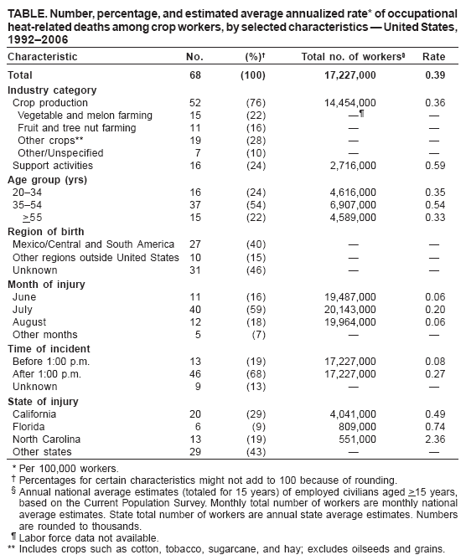
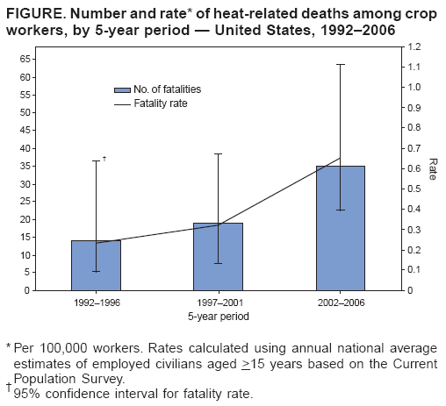
Statistics
Notes:
www.cdc.gov - Graphics courtesy of North Carolina Agromedicine – an AgriSafe state affiliate

Slide 7

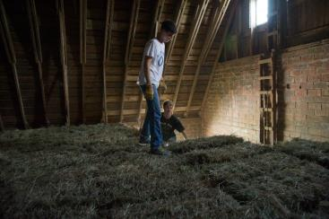
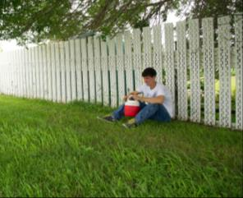
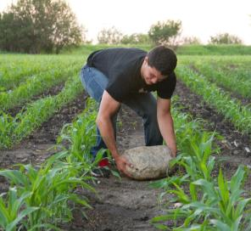

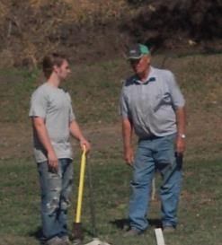
All Ages are Impacted by Heat
Notes:
Photos are the property of AgriSafe Network

Slide 8

Vulnerable Populations - Youth
Children of all ages are at risk for HRI – especially heat exhaustion.
Infants and children under age 4 – very high risk
Children sweat less and quickly produce more heat than adults
Children do not adjust to environmental heat level changes quickly
Children do not think to take a break in activity
( example: when at play)
Children’s Hospital of Wisconsin 2014 www.chw.org/medical-care/sports-medicine/conditions/heat-illness
Safe Kids Worldwide 2013 www.safekids.org
Mayo Clinic http://www.mayoclinic.org/healthy-living/tween-and-teen-health/in-depth/dehydration/art20047470
Notes:
Many farm and ranch children are involved in community sports programs – soccer, basketball, football, baseball, track, cross country

Slide 9

Older Adults
Older adults tend to sweat less than younger or middle aged adults – body cooling ability is lessened.
Older adults have a greater tendency toward high blood pressure – may also have a lower cardiac pumping capacity
A natural central nervous system slow down is a risk factor

Slide 10
Mobile/ Migrant Workers
Field workers may be a long distance from shade and water supplies
Workers may experience a language barrier
Some mobile population workers may have a fear of reporting symptoms
Some workers may have an unknown or unrecorded medical history
Risk of child exposure to high heat may be increased
Risk of pesticide absorption may be elevated

Slide 11

Personal Risk Factors that Increase Potential for Heat Related Illnesses (HRI)
Pregnancy:
a rise in core body temperature can put the fetus at risk
fluid retention
as the baby grows, the center of gravity shifts – requiring more energy to move about (especially important in hand picking work and machinery accessibility)
Diabetes – avoid extreme heat; keep feet dry and well cushioned
Hypertension – avoid extreme heat
Skin conditions – may prevent release of body heat

Slide 12
Contributing Factors to Heat Related Illnesses
History of heart disease or diabetes
Chronic respiratory diseases
Age factor – elderly or very young children
Not acclimated to heat conditions
Low level of physical fitness
Obesity
Lack of restorative sleep
Current respiratory infection
Extensive skin conditions

Slide 13

Contributing Factors to HRI
Dehydration*
Intestinal illnesses
Decreased sodium intake
High caffeine or sugar intake
Alcohol consumption
Use of contraindicated prescription or over the counter (otc)medications
Use of illegal substances
Language or other communication barriers
Notes:
* Workers cannot wait until they are thirsty to drink water. Signs of dehydration – thirst; concentrated urine output

Slide 14
Heat Related Illnesses (HRI)
Heat Stress – an umbrella term used to describe a condition or process that can raise the deep core body temperature:
Heat Exhaustion
Heat Stroke
Heat Syncope
Heat Cramps
Heat Rash
Sources: OSHA Campaign to Prevent Heat Illnesses in Outdoor Workers / Using the heat Index Guide

Slide 15
Heat Exhaustion
Heat Exhaustion results when there is:
a decrease in body water volume or blood volume
an excessive loss of body salts
the amount of water lost in perspiration exceeds water intake
Usually a gradual onset

Slide 16
Heat Exhaustion – Signs & Symptoms
Skin becomes pale and cool or flushed
Headache
Sweating, clammy skin
Abdominal cramping, nausea, vomiting
Weakness, lethargy
Dizziness, confusion
Elevated body temperature

Slide 17
Heat Exhaustion -Treatment
Move to a cool, shaded area & sit or lie down with legs slightly elevated
Loosen clothing, remove excess clothing
Call for medical attention
Apply cool compresses
Sip cool water or electrolyte beverage*
Do not return to work for several hours after symptoms subside
Do not leave victim alone
Notes:
*Avoid sodium if worker has a history of heart or high blood pressure issues

Slide 18
Sources for Heat Related Illnesses
Sources :
www.cdc.gov/niosh/topics/heatstress
www.extension.org/pages62261/heat-relatedillnesses-and-agricultural-producers
www.rce.Rutgers.edu Fact sheet #FS747
www.osha.gov/SLTC/heatillness/heat_index

Slide 19
Heat Stroke
Heat Stroke is life threatening and the most serious of the heat related illnesses.
It is a medical emergency!
Heat stroke is a central nervous system failure
the body loses the ability to regulate temperature
the ability to sweat is lost
the heat regulating system is overwhelmed and body temperature rises rapidly

Slide 20
Heat Stroke - Signs & Symptoms
Skin is hot and dry
Body temperature is high: 104 +
Heart rate is rapid
Sweating is usually absent
Chills may be present
Victim may be confused, dizzy, and might have slurred speech
Seizures or loss of consciousness are possible

Slide 21
Heat Stroke - Treatment
Call 911 or designated emergency number immediately!
Move to a cool, shaded area until help arrives
Remove restrictive clothing
Cool body with compresses, wet sheets, or towels
If water is not available, fan the person
Do not leave the person alone!

Slide 22
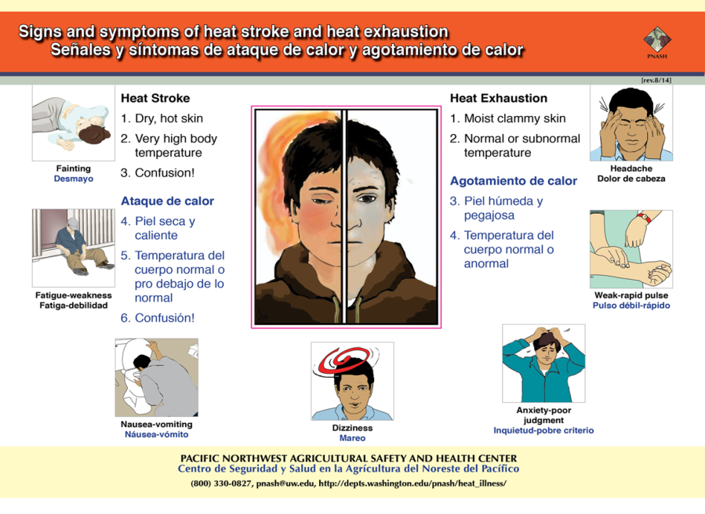
Sign and Symptions of heat stroke/exhausion

Slide 23
Heat Syncope
Heat Syncope results when blood pools in the skin or lower parts of the body
indicates a decreased flow of blood to the brain
may happen when a worker is standing in one place for an extended period or suddenly moves from a sitting or lying position

Slide 24
Heat Syncope
Signs & Symptoms
Treatment
Dizziness
Light headed feeling
Fainting
Move to a cool, shaded area
Lie down with feet elevated
Drink cool, non-caffeinated, non-alcohol liquids

Slide 25
Heat Cramps
Heat Cramps are usually the result of a temporary sodium or fluid imbalance while exposed to heavy work or exercise in a high heat environment.

Slide 26
Heat Cramps
Signs & Symptoms
Spasms and pain in muscles of arms, legs, or abdomen
Treatment
Stop activity
Rest in cool, shaded area
Apply firm pressure or massage to affected muscle area
Drink sips of water

Slide 27
Heat Rash
Heat rash:
is frequently a red, blotchy rash that may have clusters of small pimples or blisters
if it covers a large area, the body’s ability to regulate temperature through sweat may be impeded.
can potentially be an early sign of possible heat related illnesses

Slide 28
Heat Rash
Signs & Symptoms
Treatment
Red, blotchy areas on skin that has contact with damp or tight clothing
Small pimples
Blisters
Remove damp or restrictive clothing
Keep affected area(s) dry
Treat with a corn powder or skin calming lotion (check for allergies)
Seek medical care if rash persists or does not improve in a few days

Slide 29

Prevention Strategies
Heat Related Illnesses are Preventable!

Slide 30
Engineering Controls
Air conditioned facilities or areas
Efficient ventilation
Heat blocking shields or insulation if possible
Installation of cooling/exhaust/cross circulation fans where feasible
Source: https://osha.gov/SLTC/emergencypreparedness/guides/heat.html

Slide 31
Environmental Controls
Use of air circulating (man cooling) fans – as long as the air is cooler than the body temperature – when possible
Provide adequate shaded areas for rest

Slide 32
Administrative Controls – Employer/Owner/Operator
Provide accessible, fresh, cool potable water
Encourage adequate hydration ( one 6 - 8 ounce cup every 15 minutes)
Remind workers that if they feel thirsty, he or she is already dehydrated
Acclimatize workers to a hot environment*
Implement a schedule for routine checks to monitor for signs of excessive heat exposure
Source: OSHA Fact Sheet – Protecting Workers from the Effects of Heat 2011
Notes:
* Acclimatize – increase exposure by starting exposure time each day by 50% of work load and ½ time spent in high heat; increase each day over a week’s time period

Slide 33
Administrative Controls – Employer/Owner/Operator
Try to re-schedule job that require greater physical demands to cooler times of day
Schedule frequent rest periods
Monitor workers for appropriate and adequate protective attire without over protection with heavy or cumbersome clothing
Limit time that workers wear chemical resistant ppe – moist skin & clothing will increase potential and rate of chemical absorption
Review ppe requirements on protective equipment package labels
Notes:
Source: https://www.extension.org/pages/62261/heat-related-illnesses-and-agricultural-producers#.U-L_3ul0yUk
*Acclimatize – increase exposure by starting exposure time each day by 50% of work load and ½ time spent in high heat; increase each day over a week’s time period

Slide 34
Employee/ Operator Responsibilities
Do not wait until you are thirsty to drink water!
Modify work schedules/ frequent rest periods
to avoid heat related illness
Let your supervisor know if you are not feeling well
Wear light colored, light weight clothing
Avoid alcohol, large amounts of caffeine, large amount of sugar when exposed to heat or prior to exposure
Source: About Work / Rest Schedules https://www.osha.gov/SLTC/heatillness/heat_index/work_rest_schedules.html
Notes:
Recommendations vary depending on extent of heat exposure

Slide 35
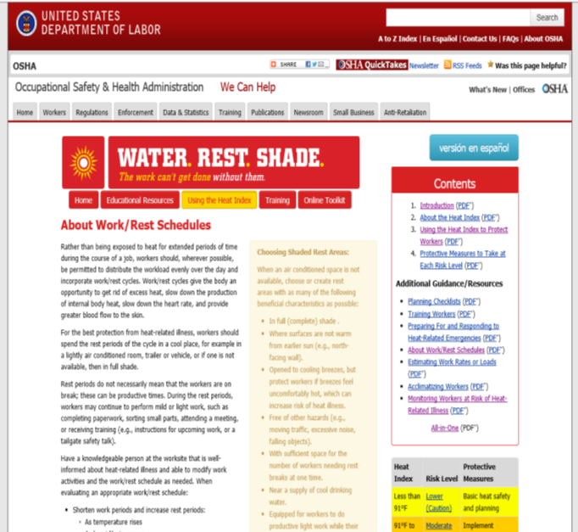
OSHA webpage for Water, Rest, and Shade campaign

Slide 36
Employee/ Operator Responsibilities
Check your medications (including over the counter drugs) for warnings related to use in high heat conditions
Let your supervisor know about any chronic health conditions you may have
If work entails chemical exposure, discuss appropriate ppe with your supervisor – use enough to be safe but don’t over protect as moist skin & clothing will increase potential for chemical absorption
Watch out for co-workers – use a buddy system!

Slide 37

PPE Selection
Provide an appropriate and safe level of protection for workers
Use ppe original package manufacturer labels for guidelines to minimum protection
Select ppe designed to be as cool as possible
Cooling vests and scarves are options under heavy gear
Non-woven polyolefin (Tyvek) does not allow for air passage – use for as short a time as possible in high heat
Rubber and chemical coatings also prevent air passage
Long sleeved cotton shirts, long pants, wide brimmed hats shoes with good soles and toe coverings are often adequate

Slide 38
Medication Contraindications
Several medication groups can cause a photosensitivity – either a phototoxic or photo allergic reaction.
Phototoxic – complaints of burning, stinging and redness can occur within 24 hours
Photoallergic – present with itching, redness, possible swelling and/or eruptions; may not take place until several days after initial dose. Subsequent exposures may result in a more rapid onset.
Notes:
Sources: http://www.ncbi.nlm.nih.gov/pubmed/17688387
Clinical Pharmacology –Drug Precautions for Ambient Temperature Increase
Consumer Health Information – Drugs Sensitive to Heat

Slide 39
Medications to Avoid in Extreme Heat
Antibiotics :
Quinolones
Tetracyclines
Sulfonamides
Antihistamines
Cardiac medications
Diuretics:
- Furosemide
- Thiazides
Sources: http://www.ncbi.nlm.nih.gov/pubmed/17688387
Clinical Pharmacology –Drug Precautions for Ambient Temperature Increase
Consumer Health Information – Drugs Sensitive to Heat
Cancer medications
Chemotherapy
Diabetic medications
Psychiatric medications:
Phenothiazines
Tricyclics
Painkillers : NSAIDs
(non steroidal anti-inflammatory drugs)
Notes:
Quinolones :Cipro, Levaquin, Proquin XR / Tetracyclines: Vibramycin, Tetracycline ,Achromycin / Sulfonomides – Bactrim, Septra, Gantanol
Antihistamines : Benedryl / Cardiac: Diltiazem (Tiazac or Cardizem) ; Nifedipine (Procardia) ; Quinidine; Amiodarone / Diuretics – Furosemide (Lasix) / Phenothiazine (Thorazine) /
NSAIDS – Aleve, Motrin, Naprosyn, Anaprox, etc.

Slide 40
Educating Employers
Employers are expected to provide training on
Risk
Signs & symptoms of heat illnesses
Prevention
Treatment
PPE
Instruction to watch out for co-workers

Slide 41
Teaching Tools for Employers
Develop an Action Plan
OSHA: Heat Index Document
OSHA: Water. Rest. Shade Campaign Program
OSHA Heat Illness Training Guide

Slide 42
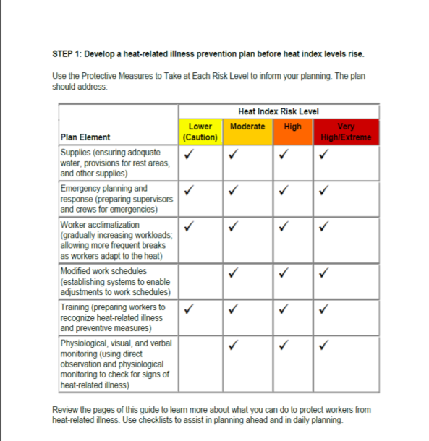
Action Plan

Slide 43
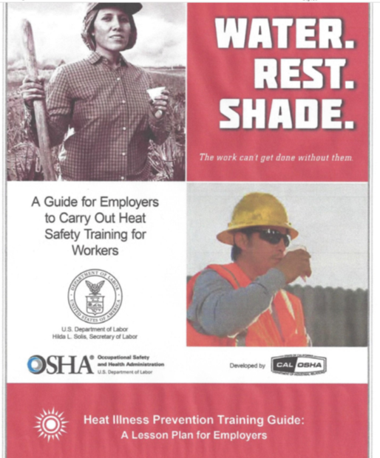
Water. Rest. Shade.

Slide 44
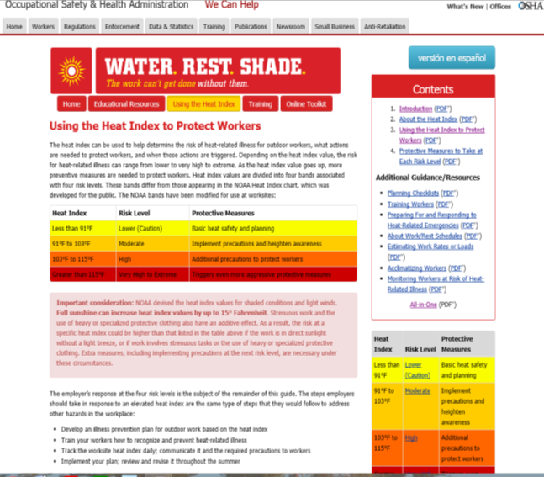
Heat Index Document

Slide 45

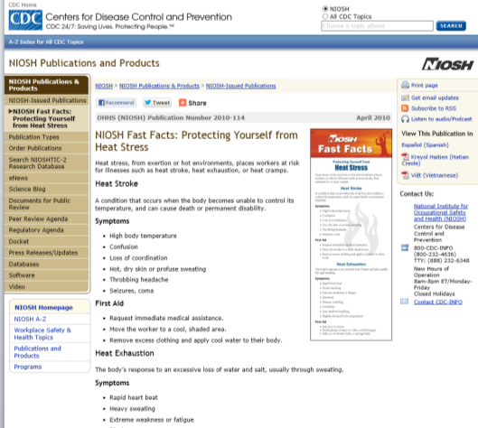
NIOSH Fast Facts

Slide 46
Educating Agricultural Workers
Utilize a variety of education formats to communicate safety
Use interactive and demonstration techniques whenever possible
Be prepared to provide for non- English speaking workers
Include pictorial teaching formats
Encourage questions and feedback!!

Slide 47
Educating Agricultural Workers
Place educational materials in accessible locations
for managers and workers
Work site
Dining areas
Rest stations
Local community centers
Grocery markets
Worship centers

Slide 48
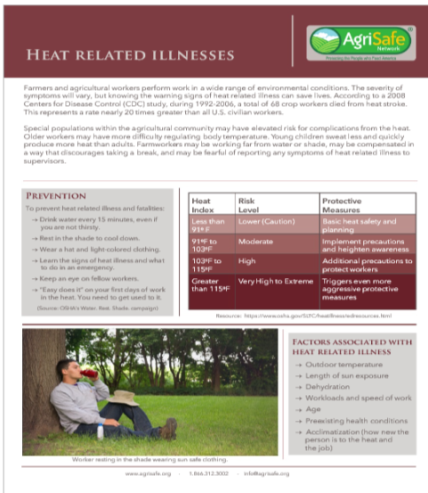
AgriSafe Fact Sheet

Slide 49
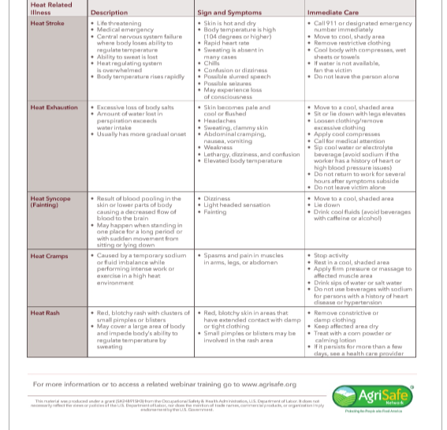
AgriSafe Fact Sheet

Slide 50

Physiological Monitoring
Basic physiological monitoring can be used to establish work/rest schedules and prevent HRI
Implementation of basic monitoring in the agricultural setting is dependent on several factors:
structure and staffing of agricultural operation
component of overall employee health program
worker understanding of the process and willingness to participate
implementation is monitored by professional knowledgeable in the process
procedures need to be valid and appropriate for the job
http://www.hse.gov.uk/temperature/heatstress/measuring/monitoring.htm

Slide 51
Physiological Monitoring
Components of a basic program
Heat exposure history
Heart rate - taken during start of rest period*
Blood pressure – baseline and again at end of work period
Respiratory rate- baseline and again at end of work period
Level of alertness – assess during and after work periods
Oral temperature – at end of work period**
Weight loss – measured at beginning and end of day (checking for water loss)***
Additional parameters
- perceived skin wetness
- personal skin temperature & heart rate monitors
Notes:
*If heart rate over 110 – shorten work period ** temperature taken for 3 minutes; if over 99.6 – shorten work periods *** water loss should not exceed 1.5% of total wgt loss in a day

Slide 52
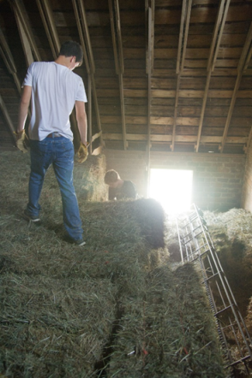
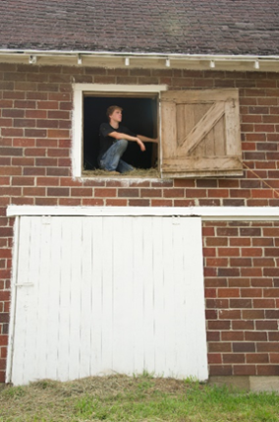
Case Study 19 year old and 20 year old males stacking hay bales in old brick barn
Outside temperature = 94 degrees
Barn temperature much higher
Work load = moderate to strenuous
Length of time working = over 2 hours
Is this high risk for heat stress?
Symptoms to be aware of?
What precautions would you advise?

Slide 53
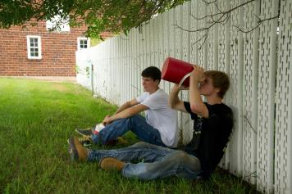
Case Study – Stacking Hay in Barn
Is this high risk for heat stress?
Yes, heat index indicates Moderate risk
Being in an enclosed barn may increase risk to High
Take protective measures at each risk level
What precautions would you advise?
Provide drinking water
Remind to drink water (4 cups/hour)
Schedule frequent breaks in cool and shaded area
Acclimate workers
Set up buddy system
Schedule actives at a time when heat index is lower
Develop work /rest schedules
Review illness topics with workers on how to recognize heat – related illnesses
OSHA Resource – Protective Measures to Take at Each Risk Level
https://www.osha.gov/SLTC/heatillness/heat_index/protective_measures.html

Slide 54


OSHA Resources
Available on www.OSHA.gov Website
In search bar type: Heat Stress Program
Notes:
OSHA Resources available on OSHA.gov
How to get to this location
Search Bar
A-Z Index

Slide 55

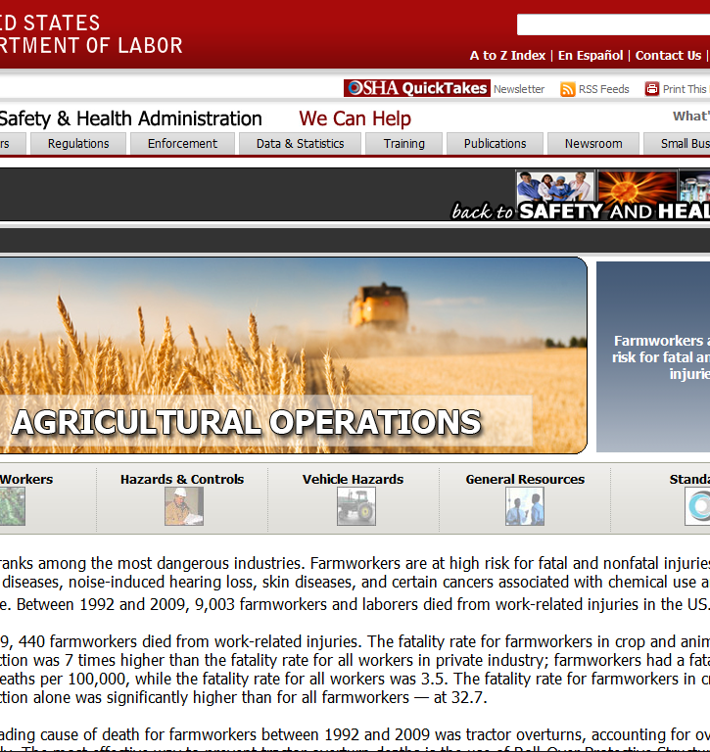
Agriculture Operations Safety and Health Topics Page
Young Workers

Slide 56
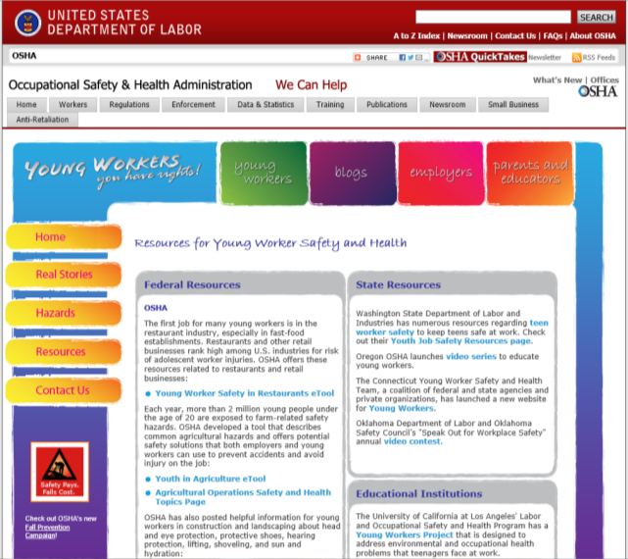
Quick Takes
Young Workers
Notes:
Quick Takes

Slide 57

Related OSHA Standards
The Sanitation standards at 29 CFR 1910.141, 29 CFR 1915.88, 29 CFR 1917.127, 29 CFR 1918.95, 29 CFR 1926.51 and 29 CFR 1928.110 require employers to provide potable water.
The Medical Services and First Aid standards at 29 CFR 1910.151, 29 CFR 1915.87, 29 CFR 1917.26, 29 CFR 1918.97, and 29 CFR 1926.50, require that persons onsite be adequately trained
Source: OSHA Occupational Safety & HealthTopicshttps://www.osha.gov/SLTC/heatstress/standards.html

Slide 58

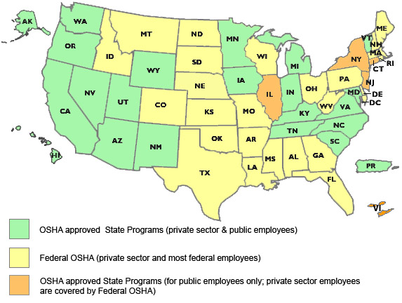
State to State
Important to check with your state OSHA since
there are 25 states that match or exceed this OSHA Instruction
Notes:
Many states have different OSHA Instruction
Could require more under each state plan – be sure to check with your state
State OSHA can be a resource

Slide 59

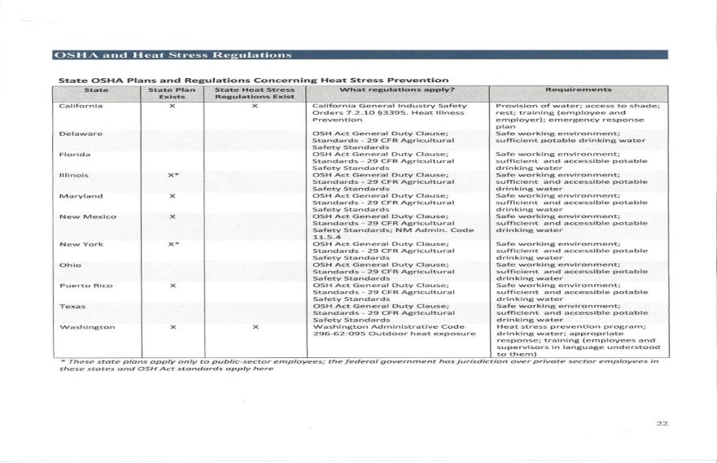
States with OSHA Heat Stress Regulations
Notes:
Source: Association of farmworkers Opportunity Programs – funded by 2010 Susan Harwood Training grant

Slide 60
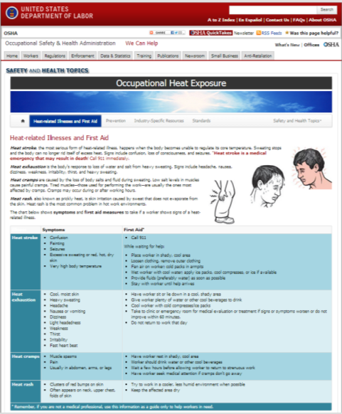
OSHA Heat Related Illnesses and First Aid
https://www.osha.gov/SLTC/heatstress/heat_illnesses.html
Notes:
Source: Association of farmworkers Opportunity Programs – funded by 2010 Susan Harwood Training grant

Slide 61
Additional Resources
https://www.osha.gov/SLTC/heatillness/edresources.html
https://www.osha.gov/OshDoc/data_Hurricane_Facts/heat_stress.pdf
https://www.osha.gov/SLTC/heatillness/heat_index/
http://depts.washington.edu/pnash/heat_illness
http://www.nclabor.com/posters/English/HeatPrev.pdf
http://www.cdc.gov/mmwr/preview/mmwrhtml/mm5724a1.htm
http://www.ncfh.org/docs/fsOcc%20Health.pdf

Slide 62

Resources
Occupational Safety & Health Administration www.osha.gov
Institute for Occupational Safety & Health www.cdc.gov/niosh ~ home for NIOSH Ag Centers
AgriSafe – www.agrisafe.org
National Education Center for Agricultural Safety www.necasag.org
National Safety Council- www.nsc.org
Notes:
Web site resources

Slide 63

Employee Rights and Responsibilities
You have the right to:
A safe and healthful workplace
Know about hazardous chemicals
Information about injuries and illnesses in your workplace
Complain or request hazard correction from employer
Notes:
Review Employee Rights

Slide 64
Employee Rights and Responsibilities
You have the right to:
Training
Access to hazard exposure and medical records
File a complaint with OSHA
Participate in an OSHA inspection
Be free from retaliation for exercising safety and health rights
Notes:
Review Employee Rights

Slide 65
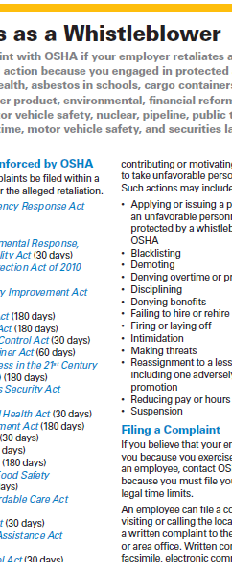

OSHA Fact Sheet of whistleblower protection program
Whistle Blower Protection Program

Slide 66

Evaluation
It is the goal of AgriSafe to provide information and education that is vital and pertinent to your agricultural operation.
Please take a few minutes to honestly evaluate this program. Your input and suggestions will help us in our effort to continually improve our work on behalf of the agricultural community.
Notes:
Provide AgriSafe Network with valuable Evaluation information to help improve our presentations

Slide 67

Prevention of Heat Stress Related to Agriculture
Test Questions:
Children adjust to environmental heat level changes faster than adults
Skin infections can impede the body’s ability to sweat
Of the major heat related illnesses, which is the most dangerous:
Sweating, clammy skin that is pale and cool is a symptom of
Dry skin and an elevated body temperature are symptoms of:
Acclimatization refers to gradual exposure to high heat environments.
Chemical resistant protective wear helps protect field workers from high heat exposure.
A photo toxic response to medication use.

