Slide 1

Integration of Behavioral Health Practices in Agriculture

Slide 2

Susan Harwood Training Grant
This material was produced under a grant (SH – 26280 - SH4) from the Occupational Safety and Health Administration, U.S. Department of Labor. It does not necessarily reflect the views or policies of the U.S. Department of Labor, nor does the mention of trade names, commercial products, or organization imply endorsement by the U.S. Government
Notes:
Explain about the Susan Harwood Training Grant

Slide 3

Intended Audience
This webinar presentation is intended primarily for frontline primary care health service providers in agricultural communities.
By nature of the rural environment where these services take place, it is expected that additional care services, educators, producer groups, and agencies will have a vested interest in this discussion.
Notes:
In an agricultural community, issues that have an impact on a ranch or farm operation will likely impact the greater community.

Slide 4

Focus Areas for Presentation
At the conclusion of this presentation, participants will be able to:
Identify a minimum of three common stressors prevalent among agricultural producers
Describe at least four signs and symptoms of depression and anxiety
Describe population based and individual based behavioral health interventions
Locate professionals and current resources in the field of agricultural behavioral health
Notes:
Discuss Primary Goal of Webinar
Goals:
Recognize the diverse respiratory hazards unique to agricultural and the justification for a comprehensive respiratory program.
Identify the OSHA respirator standards that apply to an agricultural setting.
Understand key components of an effective respiratory protection program
Access resources, templates, medical evaluations, and further trainings to effectively implement a respiratory program.
Discuss who the intended audience is

Slide 5

Recognize the Leaders
Over the past twenty five years, several leaders and organizations in the field of agricultural health and safety have worked hard to provide research data and develop educational resources to help care providers and educators identify many of the issues related to stress in agriculture.
The AgriSafe staff is most grateful for their efforts and their work will be recognized throughout this presentation.
Notes:
Recognize the work of Dr. Mike Rosmann, Dr. Roger Williams, Dr. Paul Lasley, Dr. Angeline Bushy / Extension and land grant universities

Slide 6

By Definition
Mental Health – a state of well-being in which every individual realizes his or her own potential and can cope with the normal stresses of life, can work productively and fruitfully, and is able to make a contribution to her or his community. World Health Organization (WHO)
Behavioral Health – the term used to describe care given to people to promote optimal emotional and social well being- the emphasis is on activities of daily living rather than a state of mind (in contrast to mental health). Migrant Clinicians Network (MCN)

Slide 7
By Definition
Stress – a feeling of emotional or physical tension. It is a body’s reaction to a challenge or demand. In short bursts, it can be positive. Stress can be acute or chronic. National Institute of Health (NIH)
Anxiety – an emotion characterized by feelings of tension, worried thoughts, and physical changes (i.e.: increase in blood pressure) Anxiety is stress that continues after the stressor is gone. American Psychological Association / National Institute of Health (NIH)
Depression – an illness that involves the body, mood, and thoughts interfering with daily life and normal function. It is a bio-chemical imbalance. Depression can be short term or long term(dysthymic). Psychology Today

Slide 8

Some Statistics
60 – 80 % of visits to healthcare providers in U.S. are related to stress --almost 20% of people live in rural areas. Substance Abuse and Mental Health Services Admiration (SAMHSA )
Nearly 74% of Americans who seek help for symptoms of depression will go to a primary care provider. Mental Health America
Unfortunately, the diagnosis of depression is missed about 50% of the time in a primary care setting. Mental Health America
According to SAMHSA, in 2012- 18.7% of non-metro county residents experienced mental illness within the past year…over 7 million people.
    3.6% of these residents contemplated suicide

Slide 9

Economic Concerns
There are troubling storm clouds gathering once again on farming’s economic climate…
low commodity prices
high land values & rent
high input production costs
avian flu epidemic – may reduce exports and reduce demand for feed grains
persistent drought in western states
The next two to five years may be stressful for many farm families and rural communities….
Paul Lasley, PhD - Iowa State University May 2015
Notes:
Dr. Lasley has been a leading researcher and educator in the filed of rural and agricultural economic impact

Slide 10
Agricultural Traits
Ranchers and Farmers:
have a sense of “rootedness”- a way of life
home site and work site are often the same site
perseverance - difficulty in asking for help
responsibility – “so many people depend on me”
tradition – the family farm or ranch
long workdays – lack of adequate rest or inability to sleep exacerbates stress levels
frequently work alone – isolation

Slide 11
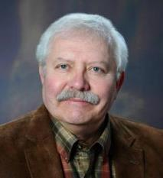
Agricultural Traits
“Losing the family farm is the ultimate loss…….. Farming has always been a stressful occupation because many of the factors that affect agriculture production are largely beyond the control of the producers.”
Mike Rosemann, PhD Farm and Ranch Life, Iowa Farmer Today

Slide 12
Rural vs. Urban
Rural and Agricultural residents:
    are older
    have a smaller average annual income
    will not readily trust an “expert” – need to develop a comfort level
    more likely to experience high psychological stress
    less likely to seek and obtain treatment
    more likely to report consuming alcohol as a youth
    must travel greater distances to seek care
    may have limited or no mental health services available
    World Health Organization (2005)
Notes:
Get Reference Promoting Mental Health
CONCEPTS ■ EMERGING EVIDENCE ■ PRACTICE (World Health Organization – 2005)

Slide 13
Barriers
Challenges in the agricultural setting:
accessibility: travel distance
          insurance coverage
availability: shortage of professionals
acceptability: stigma remains
            Rural Assistance Center www.raconline.org

Slide 14
The Mental Illness Stigma
Stigma – refers to severe social disapproval of personal characteristics or beliefs that are against cultural norms. U.S. Dept. of Health & Human Services
In spite of educational efforts, there is still a stigma associated with care and treatment for mental illnesses.
This is still widely evident in rural communities
Contributes to the lack of early intervention until a crisis point is reached

Slide 15
Stressors
Financial & Economic:
  low commodity prices
  high land values
  high production costs
  animal / crop health
Environmental:
  weather
Physical:
  age related
  illness – physical or emotional
Social:
  family obligations
  family discord
  community responsibilities

Slide 16

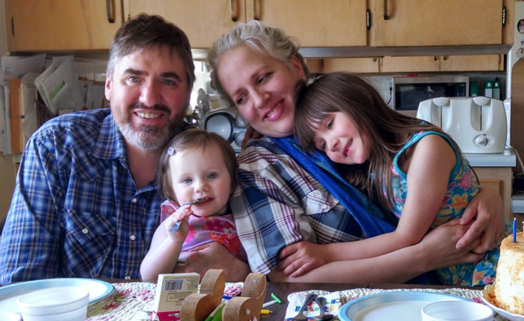
Testimonial
“ The biggest challenge is the juggling act we do between our household and our farm. In that is the fact that we do not have any leeway for sickness or even inefficiency. Other jobs I’ve had one could call in sick if needed but we have no such luxury. That leads to the worry that if Paul ever hurt himself it would unhinge the whole delicate balance. I worry about him working alone for this reason”. Janna
Notes:
Photo – property of AgriSafe Network

Slide 17
Manifestations of Unmanageable Stress
Anxiety
  symptoms present for several weeks or months
  most common mental disorder
Depression
  a disease process that affect biochemical balance in the brain
  determined when several symptoms are present for over 2 weeks
Notes:
Note: In depression, the chemicals in the brain that are affected are serotonin and norepinephrine – the levels decrease and cause a change in brain structure
Source: Mental Health America and Mayo Clinic

Slide 18
Manifestations of Unmanageable Stress
Substance Abuse
  data specific to agricultural populations is inconsistent or lacking
  alcohol, inhalants, and meth use are reported as higher in rural youth compared to urban youth among rural youth
Suicide
  suicide rates in rural communities are much higher than in urban areas – nearly double in the young male population
  greater access to lethal means – firearms and farm chemicals
  limited access to care
Notes:
Note: Rural populations include but are not limited to agricultural residences. The U.S. Census Bureau identifies two types of urban areas: Urbanized Areas (UAs) of 50,000 or more people;
Urban Clusters (UCs) of at least 2,500 and less than 50,000 people. "Rural” encompasses all population, housing, and territory not included within an urban area. Feb. 2015
Note: Source: American Psychological Assoc. 2010 and 2014

Slide 19

Anxiety: Signs / Symptoms
Psychological
Physical
Persistent and uncontrollable worry
Inability to concentrate
Restlessness
Irritability
Fear of illness/dying
Escapism
Avoidance
Nervousness
Short of breath / chest pain
Rapid heart beat
Muscle tension
Skeletal pain
Headaches / dizzy
Excessive perspiration
Insomnia
Muscle tremors
Fatigue
Vomiting / diarrhea
Frequent urination
Notes:
Sources: National Council on Alcoholism and Drug Dependence
Mayo Clinic Foundation

Slide 20
Depression: Signs / Symptoms
Psychological
Physical
Depressed mood
Crying frequently
Loss of interest or diminished pleasure in typically enjoyable activities
Feeling worthless
Persistent worry about the future
Poor judgement
Extreme guilt
Difficulty concentrating
Anger without provocation
Decline in care of livestock and property
Insomnia
Sleeping constantly
Significant weight change
Eating all the time or rarely eating
Headache
Unexplained musculoskeletal pains
Unexplained gastrointestinal symptoms
Overuse of tobacco, alcohol, other drugs
Notes:
Sources: National Council on Alcoholism and Drug Dependence
Mayo Clinic Foundation

Slide 21

Substance Abuse: Signs / Symptoms
Psychological
Physical
Secretive/hiding
Lying
Stealing
Unexplained absence from work, school, etc.
Reckless behavior
Lack of interest in usual activities
Emotional “roller coaster”
Hyperactive
Argumentative
Change in peer group
Change in appearance/dress
Erratic sleep/wake patterns
Avoiding eye contact
Eyes blood shot
Ill frequently
Changes in appetite
Tremors
Altered or slurred speech pattern
Abrasions / bruises
Tripping injuries
Accidents
Notes:
Sources: National Council on Alcoholism and Drug Dependence
Mayo Clinic Foundation

Slide 22
Suicide – Warning Signs
Increased substance abuse
Stop taking medications – or hoarding medications
Depression
Disruptive behavior
Preoccupation with death /dying
Stating that others will be better off without him/her
Insomnia
Obtaining firearms
Increased irritability
Admitting to thoughts of suicide
Family history of suicide or history of friends’ suicide

Slide 23

Suicidal Thoughts vs. Lashing Out
Those who blame themselves for problems
- may have suicidal thoughts
Those who blame others for problems
- may become irrationally angry, combative, and strike out against another
Responding to Farm Stress Thomas Anderegg, PhD. Clinical Psychology, Dubuque IA

Slide 24
Coping
Definition: an adaptation to environmental stress that is based on conscious or unconscious choice and that enhances control over behavior or gives psychological comfort. Random House dictionary.
The stressful experiences can be so intense that positive coping strategies cannot work

Slide 25

Coping Strategies
Positive
Negative
Humor
Seeking Support
Problem solving
Relaxation
Deep breathing
Physical recreation
Adjusting expectations
Positive venting (talking it out)
Socialize
Denial
Avoidance
Procrastination
Rationalization
Self blame
Consistently blaming others/ displacement
Negative venting
Passive –aggressive behavior
Notes:
Source: American Psychological Assoc.
UCLA Dual Addiction Program
Promises Treatment Program

Slide 26

Who Is Affected?

Slide 27
Who is Affected
Producer
Family
Older adult
Youth
Community
Notes:
Picture AgriSafe property

Slide 28

Stress
Women in Agriculture Stress
  Multiple roles
  Off farm work
  Live with risk every day
  Lack of mental health providers

Slide 29

Challenges
I think the biggest thing is that everything else takes a back seat. Nothing else gets done. No time for myself and I can’t keep up with the other things like laundry, cleaning and even cooking. When we both leave the door at the same time in the morning and come back at the same time I can’t keep up. We just eat and hit the bed.
I don’t have the same physical strength as a man would and sometimes I just can’t do what needs to be done. The equipment is so big now (tractors and wagons) it would be hard without all the auto stuff.
Much of the time we work alone – fields away from each other. It is better now with 2-way radios and cell phones.
I also have an off the farm job that I take time off from (with no pay) during harvest and spring. They understand - but when it rains and I should maybe try and get caught up at home, I feel guilty and so I go to work. Diane (60 something)
Notes:
Interview with farm woman, permission to use quotes

Slide 30

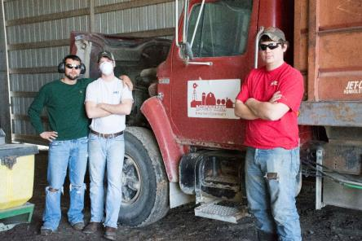
Youth
Economic stress within a farm or ranch family can have major effects on children:
Fear of what will happen to them
Decrease in academic performance
Lack of family communication
Loss of hope
Loss of peer status
Isolation from friends
Notes:
Source: University of Wyoming Cooperative Extension - R Weigel
Ohio State University Wexner Medical Center -Between 1996 and 2010, the rate of teen and young adult suicide in rural communities was twice that of urban communities.

Slide 31
Youth
Watch for:
Change in eating and sleeping habits
Signs of apathy or depression
Defiance or defensiveness
Withdrawal from friends, family, school
Aggressive behavior
Sleep disturbances
Complaint of headaches, fatigue, gastrointestinal distress
Signs of substance abuse
Notes:
Source: University of Wyoming Cooperative Extension - R Weigel

Slide 32

VETERANS
Rural veterans have a heightened risk of suicide
44% of vets returning from Iraq & Afghanistan come home to rural zip codes Mark Ward, PhD, Portland,OR Veterans Affairs Medical Center
Rural veterans must travel long distances to VA facilities
Many community based mental health centers lack expertise in treating PTSD
Stigma especially high in the military
“We often see them 2 years after they return – when they have lost jobs and spouses and are in real trouble.”
Mark Ward, PhD - Portland,OR Veterans Affairs Medical Center
Notes:
Source: American Psychological Association 2014

Slide 33
Co-Occurring Disorders
The rate of depression in those seen in primary care settings is estimated at 5 – 10%
The rate of depression in those admitted to hospitals for care is estimated at 10 to 14%
Medical conditions contribute biologically to depression
    Reaction to prognosis
    Response to pain
Notes:
Source: Mental Health America

Slide 34
Prevalence of Co-Occurring Disorders
Prevalence of Depression and –
Heart Disease: Depression occurs in 40 to 65% of patients who experienced a heart attack; in 18 to 20% of patients with coronary heart disease but have not had a heart attack
Stroke: Depression occurs in 10 to 27 % of stroke survivors and lasts about one year
Cancer: One in four persons with cancer also suffer clinical depression
Notes:
Source: Mental Health America

Slide 35
Prevalence of Co-Occurring Disorders
Prevalence of Depression and –
Diabetes: People with adult onset diabetes have a 25% chance of also having depression. Depression also affects as many as 70% of patients with diabetic compilations
Eating Disorders: Research shows a strong relationship between depression and eating disorders (bulimia and anorexia)
Alcoholism: One in three patients with depression suffer from drug or alcohol dependence
Notes:
Source: Mental Health America

Slide 36

Providers Respond
    Do your homework!
    Get a sense of the economical climate in your community – talk with producers, agricultural businesses, service providers ( veterinarians, bank managers, pastors, school principals, commodity and member organizations, etc.)
    Become familiar with primary insurance carriers and coverage limitations on mental health services
    Know the local agencies and organizations who may provide information, assistance, or emotional support for a producer or family member experiencing extreme stress

Slide 37
Providers Respond
    Be an attentive listener!!
      It is the first step in developing a trust relationship
    Non –judgmental
    Not defensive
    Try to clearly understand
  People in crisis need:
    To know the variety of options for care and counseling
    Honest responses and truth telling – do not mask reality

Slide 38
Depression Screening Tools
Health care providers in general clinic settings are not expected to be mental health specialists
Appointment times do not allow for extensive tests
Two easy to use tools designed for clinicians
  PHQ -2
  PHQ-9

Slide 39
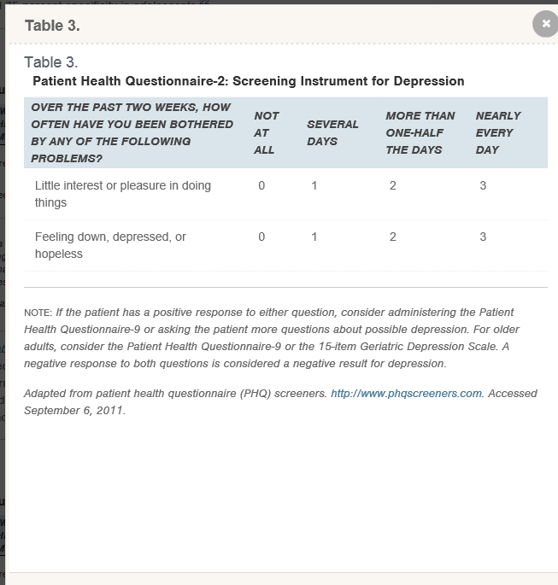
Patient Health Questionnaire-2 (PHQ-2)
Notes:
Source: American Academy of Family Practice 2012

Slide 40
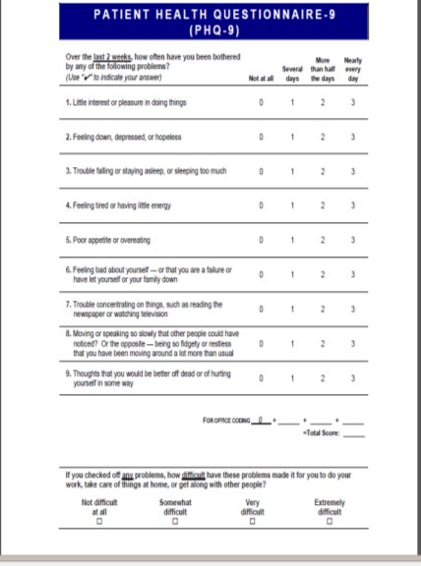
Patient Health Questionnaire-9(PHQ-9)
Notes:
Source: American Academy of Family Practice 2012
Prime MD
There are also anxiety screening tools and tools for bipolar and PTSD screening available from Mental Health America

Slide 41

Making Referrals
Knowing when, where, and how to make referrals is crucial to the care and welfare of your client/patient.
Referral resource may require significant travel for a patient
When making referrals and recommendations, be specific about symptoms
Insurance coverage may be a factor
Assurance of confidentiality is more difficult in a smaller community – but it is vital! *
Remind client that you care and will follow up
Notes:
* In cases of imminent harm to self or others, family or worksite notification may be required.

Slide 42

Community Educator
Rural health care providers often serve as community educators on two levels:
Population based intervention
    Services provided to large groups
Individual based intervention
    Services provided directly to individuals/families

Slide 43
Community Role
Population based
Individual/Family based
Identifying community wide needs
Liaison / linking services
Group education
Responding to media
Stay connected with other care providers, educators, Extension service, etc.
Client /patient referral
Serve as primary care provider
Conduct initial screenings if indicated
Provide current and accurate printed and electronic resource material

Slide 44
Self Care
As care professionals, producer group organizers, or business managers, we all want to provide compassionate care, excellent service, support, and guidance to our production works and neighbors
To serve others well, we need to take care of ourselves

Slide 45

Self Care
Reminders to avoid burn out and compassion fatigue:
7 to 8 hours of restorative sleep each night
Physical exercise each day
Adequate hydration
Balanced diet
Emotional and spiritual care – meditation, prayer, etc.
Socialize – network of friends
Family time
Set workplace limits and boundaries: time, emotional immersion
Laugh!
Notes:
Sources: Journal of Nursing Management July 2010
G Couser, MD,MPH Spurn the Burn April 2015
Compassion fatigue: also called STS – secondary traumatic stress or secondary victimization – results from multiple exposures to traumatic incidents or care …can become isolated and physically ill.
Burn out: is related to chronic tedium and not traumatic incidents

Slide 46
Thank You!
While there are challenges in rural practice, the rewards can be great. In the end, highly skilled and creative nurses are prepared to “leave no stone unturned” when caring for patients in rural and remote communities.
Angeline Bushy, PhD, RN, FAAN Nursing in Rural and Frontier Areas: Issues, Challenges and Opportunities

Slide 47
Resources
Rural Health Information Hub (formerly RAC – Rural Assistance Center) https://www.ruralhealthinfo.org - links to each state
Mental Health America http://mentalhealthamerica.net
eXtension http://www.extension.org/pages/70313/production-agriculture-and-stress
University of Minnesota Extension Dealing with Stress: A Web-based Educational Series
    http://www.extension.umn.edu/family/live-healthy-live-well/healthy-minds/dealing-with-stress/
Mental Health First Aid http://www.integration.samhsa.gov/mental-health-first-aid
The National Institute of Mental Health Education Topics http://www.nimh.nih.gov/health/index.shtml

Slide 48
Resources
National Alliance for Mental Illness www.nami.org
Rosmann, M.R. (2008) Behavioral Health Care if the Agricultural Population: A Brief History Journal of Rural Mental Health. 32(1), 39-48 http://www.agbehavioralhealth.com/
Migrant Clinicians Network http://www.migrantclinicain.org/issues/behavioralhealth.html
Farming through Difficult Times – UW Cooperative Extension http://fyi.uwex.edu/farmfinances/2009/09/30/communication-skills-to-deal-with-farm-stress/
PHQ-9 &PHQ-2 Screening Tools from American Academy of Family Physicians. Drs. R Spritzer, J Williams, K Kroenke, et al. http://www.aafp.org/afp/2012/0115/p139.html
American Psychological Association http://www.apa.org/topics/anxiety/

Slide 49

Resources
Occupational Safety & Health Administration www.osha.gov
Institute for Occupational Safety & Health www.cdc.gov/niosh ~ home for NIOSH Ag Centers
AgriSafe – www.agrisafe.org
National Education Center for Agricultural Safety www.necasag.org
National Safety Council- www.nsc.org
Notes:
Web site resources

Slide 50

Employee Rights
You have the right to:
  A safe and healthful workplace
  Know about hazardous chemicals
  Information about injuries and illnesses in your workplace
  Complain or request hazard correction from employer

Slide 51
Employee Rights
You have the right to:
  Training
  Access to hazard exposure and medical records
  File a complaint with OSHA
  Participate in an OSHA inspection
  Be free from retaliation for exercising safety and health rights

Slide 52


OSHA WEB PAGES
Whistle Blower Protection Program

Slide 53

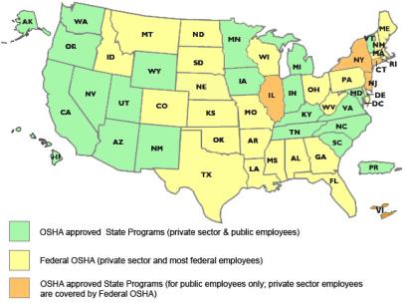
State to State
Important to check with your state OSHA since there are 25 states that match or exceed this OSHA instruction
Notes:
Many states have different OSHA Instruction
Could require more under each state plan – be sure to check with your state
State OSHA can be a resource

Slide 54
Test Questions
1. Which of the following is not a sign of anxiety
a. avoidance
b. rapid heart beat
c. excess perspiration
d. persistent worry for 4 -5 days
e. insomnia
Answer: d. Anxiety is considered serious if persistent worry takes place over several weeks.
2. Rural veterans have less risk of suicide than urban counterparts due to a safer and less intense environment. T___ F___
Answer: False – the risk for suicide among rural veterans is increased due to easier access to firearms and farm chemicals and diminished access to mental health services.
3. Behavioral health is described as the promotion of optimal emotional and social well-being with an emphasis on activities of daily living rather than a state of mind. T___ F___
Answer: True
4. Combativeness and blaming others is a common indicator for suicide risk. T___ F___
Answer: False Blaming self for negative events is an indicator for suicide risk.
5. Which of the following are effects on youth during times of stress
a. sleep disturbances
b. clinging to friends
c. lack of family communication
d. change in eating habits
__all of the above
__b, c, d
__a, c
__a, c, d
Answer: a, c, d: Typically, young people will isolate themselves from friends as they don’t want to talk about issues or feel incompetent

Slide 55
Test Questions
6. The Patient Health Questionnaire-9 (PHQ-9) is a common screening tool and can be administered as a confirmation of the Patient Health Questionnaire-2(PHQ-2) T___ F___
Answer: True The PHQ-9 is commonly used and only takes a few minutes to complete. The PHQ-2 consists of the first 2 questions on the PHQ-9.
7. Dysthymic disorder refers to depression that is
a. long term
b. short term
c. a combination of long and short term
Answer: a. Dysthymic disorder is long term – typically lasting at least two years.
8. Anxiety is stress that continues after a stressful event is gone. T___ F___
Answer: True
9. Less than 50 % of visits to healthcare providers in U.S. are related to stress. T___ F___
Answer: False: According to the Substance Abuse and Mental Health Services Administration (SAMHSA), 60 – 80 % of visits to healthcare providers in U.S. are related to stress.
10. One in three patients with depression suffer from drug or alcohol dependence T___ F___
Answer: True

