Slide 1

Understanding OSHA’s
Agriculture Exemption
& Standards

Slide 2
Disclaimers
This material was produced under a grant (SH26280SH4) from the Occupational Safety and Health Administration, U.S. Department of Labor. It does not necessarily reflect the views or policies of the U.S. Department of Labor, nor does the mention of trade names, commercial products, or organization imply endorsement by the U.S. Government.

Slide 3
Objectives of Training
Identify OSHA standards specific to Agriculture
Identify General Industry OSHA standards that should be considered in Agriculture
Understand OSHA exemption
Differentiate between Federal OSHA, State OSHA, NIOSH, EPA (Environmental Protection Agency) and WPS (Worker Protection Standard)
Disseminate resources to aid in OSHA standard compliance
Notes:
State what the initials mean or spell out
WPS is Worker Protection Standard

Slide 4
Occupational Safety and Health Act of 1970
The OSH Act was passed to prevent workers from being killed or seriously harmed at work. The law requires employers to provide their employees with working conditions that are free of known dangers. The Act created the Occupational Safety and Health Administration (OSHA), which sets and enforces protective workplace safety and health standards. OSHA also provides information, training and assistance to workers and employers. Workers may file a complaint to have OSHA inspect their workplace if they believe that their employer is not following OSHA standards or that there are serious hazards.
Source: OSHA.gov – OSH Act

Slide 5
Limitations
This one hour training is NOT intended to replace:
  Business research and investment into understanding OSHA standards
  Trainings that reflect OSHA standards
  Safety professional’s responsibility to follow standards
Notes:
Information is awareness level training and providing resources

Slide 6
Navigating OSHA Standards
Understanding standards, regulations, terminology, and definitions is not always easy
Understanding how OSHA relates to agriculture can be confusing…but there is help and access to resources
29 CFR refers to Title 29 Code of Federal Regulations (Standards)
Notes:
Introductory slide

Slide 7
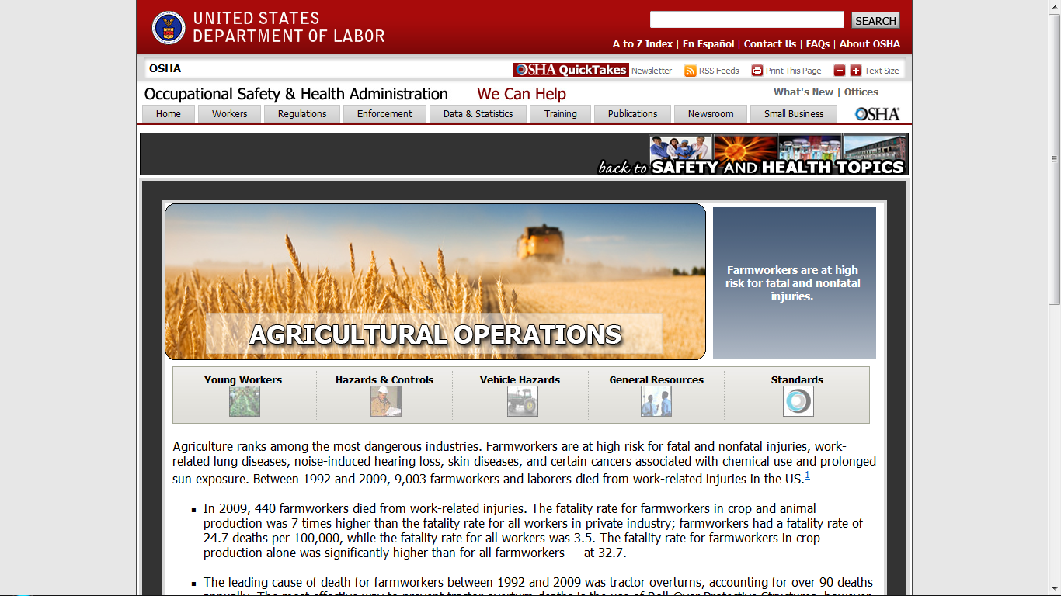
Agriculture OSHA Resources
Available on www.OSHA.gov Website
In search bar type
Agriculture Operations Safety and Health Topics
Notes:
Go to our website to find more information

Slide 8
Agriculture Operations
Safety and Health Topics Page
General Resources

Slide 9
Agriculture Operations
Safety and Health Topics Page
Standards

Slide 10
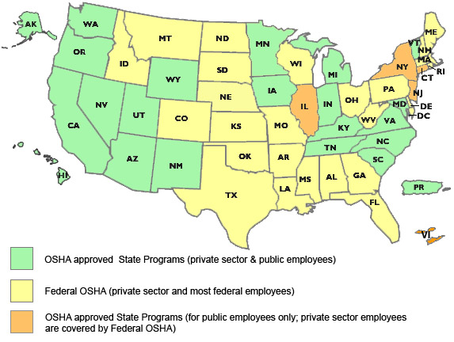
OSHA Approved State Programs
There are 27 states and U.S. territories that have their own OSHA-approved occupational safety and health programs called State Plans. State Plans are required to have standards that are at least as effective as OSHA's.
Notes:
Source: OSHA.gov
How to get in contact with your state plan
Google
with in state department of labor

Slide 11
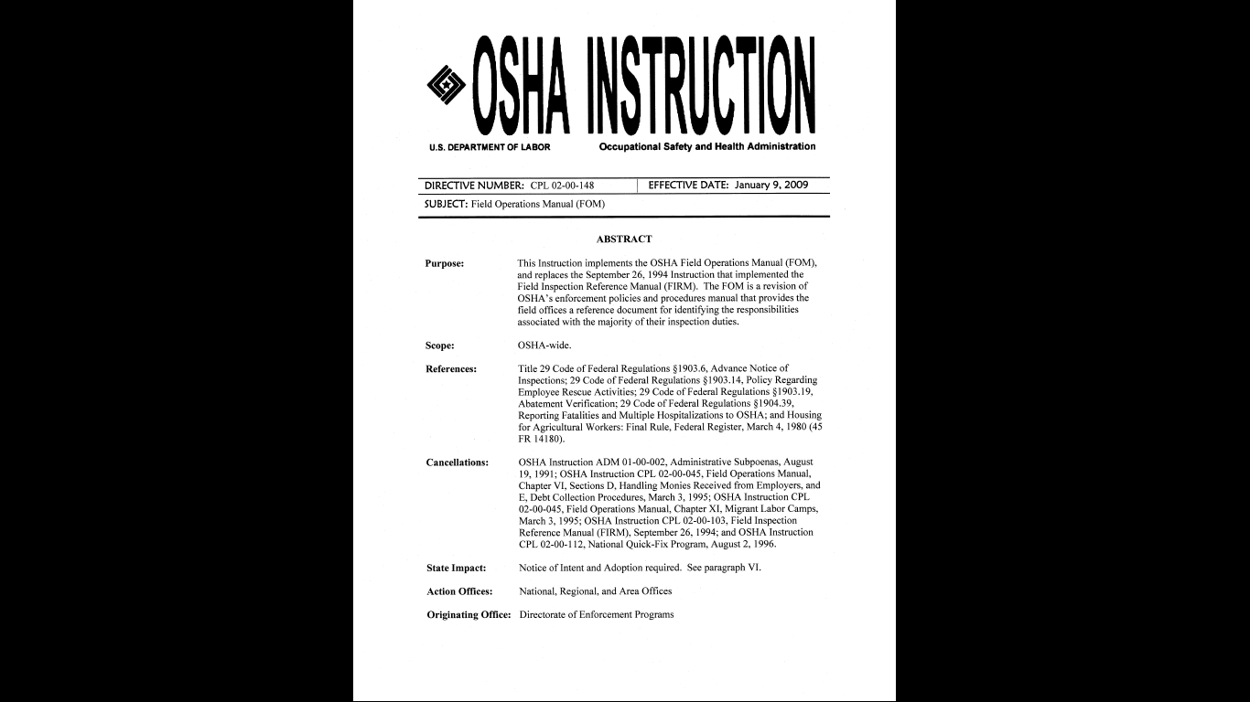
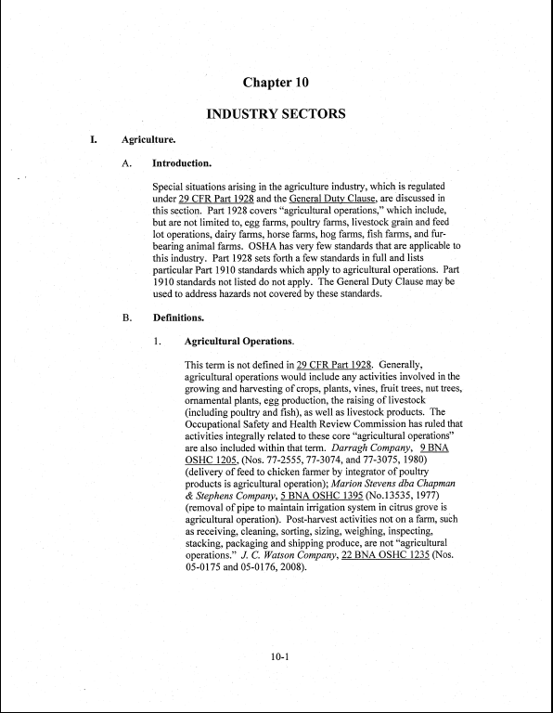
OSHA Instruction
Field Operations Manual
Chapter 10
Agriculture

Slide 12
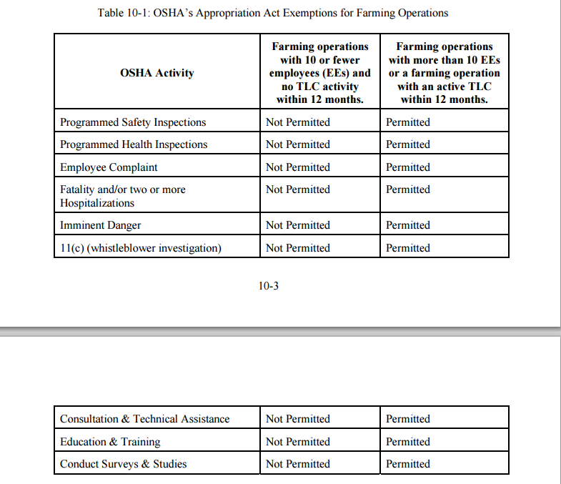
Table 10-1: OSHA’s Appropriation Act Exemptions for Farming Operations

Slide 13
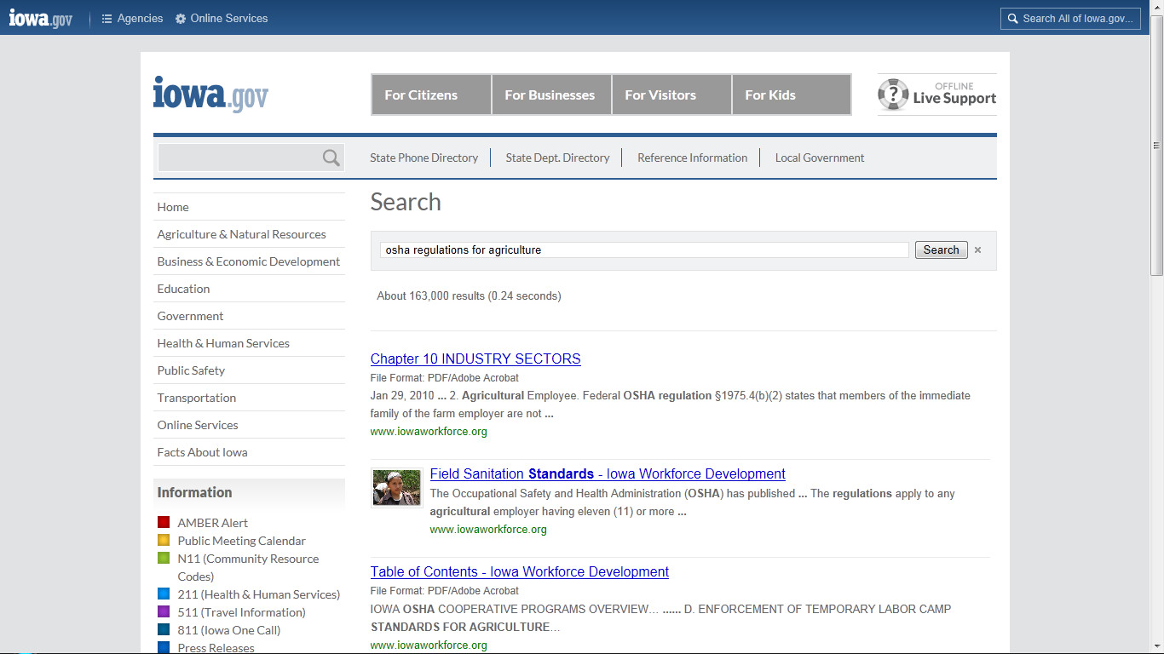
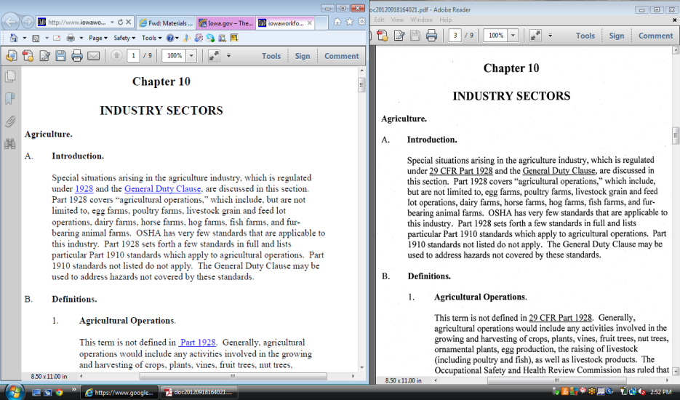
Example - Iowa
State plan must meet Federal Regulation and can exceed Federal
Chapter 10
State
Federal

Slide 14
Ag Exemption
Enforcement Guidance for Small Farming Operations
The Appropriations Act exempts small farming operations from enforcement of all rules, regulations, standards or orders under the Occupational Safety and Health Act. A farming operation is exempt from all OSHA activities if it:
  Employs 10 or fewer employees currently and at all times during the last 12 months; and
  Has not had an active temporary labor camp during the proceeding 12 months.
Source: OSHA Instruction CPL 02-00-051

Slide 15
Enforcement
What does exempt from enforcement of all rules, regulations, standards or orders mean?
Can not use Federal funds to inspect or cite.
A state plan can not use federal funds to inspect
But the state plans can use state funds to inspect.
Notes:
If exempt – encourage to comply
Can’t use Federal funds to inspect or cite
A state plan can’t use federal funds to inspect ---- but the state plans can use state funds to inspect.
Can call local state plan to find out - contact information is located on OSHA.gov

Slide 16
Injury or Fatality
Does the Exemption still hold true with injuries and a fatality? YES
  Small farms, however, are not actually exempt from OSHA regulations because:
    Legally OSHA covers all farms, even though OSHA cannot inspect or cite farms with 10 or fewer employees.
  One important reason for understanding that small farms still fall under OSHA is that, in a court of law, OSHA rules and regulations may be used to identify safe and unsafe conditions on the farm.
  State plan - state may be more stringent based on the state regulations.
Notes:
Federal OSHA may send someone out to confirm the information;
if they found out that it was actually agriculture SIC and there were 10 or fewer employees, then would back out at that time.
State OSHA may continue if use state funds and not federal funds
Personal liability issue
State plans may have more stringent regulations
Have to accept Federal OSHA (minimum standards)

Slide 17
Define your farming operation:
Define your farming operation:
Do you have employees?
Source: Occupational Safety & Health Act 1970

Slide 18
Farming Operation
A "farming operation" means any operation involved in the growing or harvesting of crops, the raising of livestock or poultry, or related activities conducted by a farmer on sites such as farms, ranches, orchards, dairy farms or similar farming operations.
Source: OSHA.gov
Notes:
Find your SIC code to determine classification as a business
Workers Compensation insurance will know this
If a corporation – the corporation has to be registered in the state
It is your responsibility to know what classification your business is – you may be classified as general business versus agriculture.

Slide 19
Standard Industrial Classification (SIC)
These are employers engaged in businesses that
have a two digit Standard Industrial Classification (SIC) of:
01 (Agricultural Production - Crops)
02 (Agricultural Production - Livestock and Animal Specialties)
Four digit SIC
  0711 (Soil Preparation Services)
  0721 (Crop Planting, Cultivating, and Protecting)
  0722 (Crop Harvesting, Primarily by Machine)
  0761 (Farm Labor Contractors and Crew Leaders)
  0762 Farm Management Services).
To find your SIC code:
Insurance policy
tax preparers
Notes:
Need to know what classification is for the businesses
Workers comp insurance will know the code
Factory
agriculture

Slide 20
Employees
Do you employ 10 or fewer people (excluding family) at any time during the year?
Background. In providing funding for OSHA, Congress has placed restrictions on enforcement activities regarding two categories of employers:
  small farming operations
  small employers in low-hazard industries. The Appropriations Act contains limits for OSH Act activities on a year-by-year basis.

Slide 21
Family Members
  Family members of farm employers are not counted when determining the number of employees.
  Who are family members:
    Children
    Spouse
    Parents
    Grandparents
  OSHA typically looks at blood relatives, spouses, or immediate relatives.
Notes:
OSHA typically looks at blood relatives and spouses.
Chapter 10 states – Immediate family members.
Case by case basis may take the EPA definition.
This can still be seen as a gray area.
Legally a family member (step child, adopted)

Slide 22
WPS Definition
However under the Worker Protection Standard
their family exemption states the following:
The Agricultural Worker Protection Standard 40 CFR Parts 156 & 170 Interpretive Policy 7.17 Immediate family exemption states the following:
  The rule defines immediate family as including only spouse; children; step children; foster children; parents; stepparents; foster parents; brothers; and sisters. (40 CFR part 170.3)
source: EPA.gov
Notes:
WPS defines this differently that OSHA

Slide 23
Temporary Labor Camp
A "temporary labor camp" means farm housing directly related to the seasonal or temporary employment of farm workers.
"Housing" includes both permanent and temporary structures located on or off the property of any employer who meets the above definition.
Source: OSHA.gov --- http://www.osha.gov/pls/oshaweb/owadisp.show_document?p_table=DIRECTIVES&p_id=1519#GEN
Notes:
Use OSHA.gov Search box and put in your topic

Slide 24
Housing on Farm
Scenario: Farmer employs a hired man. He and his family live in a house on the farm with his wife and children. The hired man does not pay rent or utilities.
  This is not considered a temporary labor camp according to OSHA.
  Temporary labor camp is considered a group of people who come in to do a specific task.
  Leave after the job is done. Mobile
Notes:
Temporary labor camp is considered a group of people who come in to do a specific task. Leave after the job is done. Mobile

Slide 25
General Duty vs Ag Standards
OSHA has an Agriculture standard (29 CFR 1928)
If the hazard cannot be addressed in the Agriculture Standard (29 CFR 1928) OSHA defers to the General Industry Standard (29 CFR 1910)
If there is not a standard that is applicable to agriculture in the General Industry Standards then go to the General Duty Clause
  Section 5(a)(1) Each employer shall furnish to each employee a place of employment which is free from recognized hazards that are causing or are likely to cause death or serious harm
  Section 5(a)(2) requires employers to "comply with occupational safety and health standards promulgated under this Act
Notes:
If you look at the Ag operations standard tab
1928 standards (limited number)
handful of general industry standards that are applicable to Ag (7)
If outside of those 7standards then go to the general industry (general duty clause) standard
So if you do not fall under the AG Exemption and your state is not more stringent than Federal OSHA – this is how OSHA would work to determine if they can cite or fine you.
If your state is more stringent you may have to follow additional standards even if you meet the Ag Exemption
- Example is California

Slide 26
State to State
Important to check with your state OSHA since there are 25 states that match or exceed this OSHA Instruction

Slide 27
Ag Standards
Occupational Safety & Health Act of 1970 – Federal Laws & Regulations Affecting Agricultural Employers (29 CFR 1928)
  8 sections:
  . 1 Purpose and Scope
  . 21 Applicability and standards
  Followed by 6 specific Agriculture standards

Slide 28
OSHA Standards Specific to Agriculture
29 CFR 1928.51: Roll over protective structures (ROPS) for agricultural tractors – refers to 2 or 4 wheel drive or track vehicles of over 20 horsepower
29 CFR 1928.52: Protective frames for wheel-type agricultural tractors
29 CFR 1928.53: Protective enclosures for wheel-type agricultural tractors

Slide 29
OSHA Standards
Specific to Agriculture
29 CFR 1928.57: Guarding of farm field equipment, farmstead equipment, and cotton gins
29 CFR 1928.110: Field Sanitation – refers to provision of drinking water, hand washing and toilet facilities for hand labor workers.
29 CFR 1928.1027: Cadmium – refers to exposure to toxic metal fumes; some phosphate sources in fertilizer may contain cadmium(*also identified under General Industry 29 CFR 1910.1027)

Slide 30
General Industry
Some standards are general industry standards (29 CFR 1910)
Need to be aware of these because OSHA can cite under the General Industry standards
Examples

Slide 31
General Industry
Applicable Standards
  29 CFR 1910.142: Temporary Labor Camps
  29 CFR 1910.111(a) and (b): Storage & Handling of Anhydrous Ammonia
  29 CFR 1910.266: Logging Operations
  29CFR 1910.145: Slow Moving Vehicles
  29 CFR 1910.1201: DOT Markings
  29 FR 1910.1200: Hazard Communication (changes)
  29 CFR 1910.1027 Cadmium (welding, grinding, painting)
These standards can be cited directly
Reference Chapter 10

Slide 32
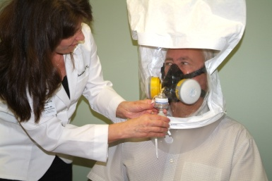

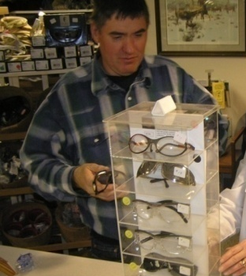
Additional OSHA Standards Related to Agriculture
29 CFR 1910.134: Respiratory Protection
29 CFR 1910.95: Hearing Conservation & Noise Exposure
29 CFR 1910.133: Eye & Face Protection
29 CFR 1910.132: General Requirements for Personal Protective Equipment

Slide 33
Additional General Industry Standards to be aware of:
29 CFR 1910.22 -28: Slips, Trips, & Falls – refers to walking surfaces, working surfaces, ladders, and scaffolding.
29 CFR 1910.14 6 -147: Confined Space Entry – refers to definition of confined space, hazards, lock out/tag out.

Slide 34
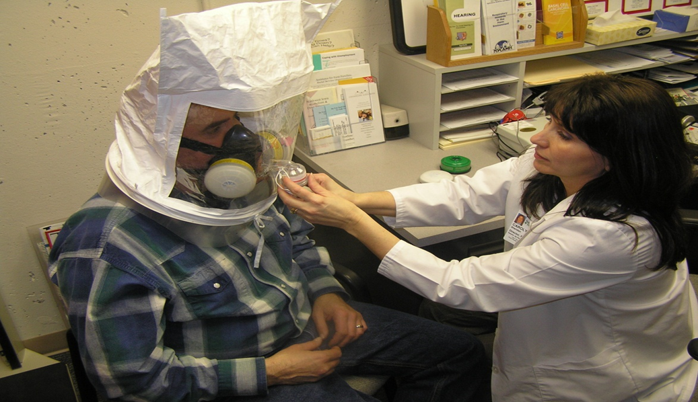
How does this apply?
Frequently asked question:
How does the application of the OSHA Respirator Standard, 1910.134 apply to agriculture, and particularly farming operations.
Section 5(a)(2) requires employers to "comply with occupational safety and health standards promulgated under this Act".
Agricultural operations are covered by several Occupational Safety and Health standards including Agriculture (29 CFR 1928), General Industry (29 CFR 1910), and the General Duty Clause.’
Notes:
Source: OSHA.gov
If you haven’t spent time looking at what OSHA has to offer you may not be aware of all of the resources that are available to promote worker safety and health.
Safety and Health Topic pages
Water Rest Shade
Smart Phone application
This is a good example of how things change on the website and are based on current urgent topics.

Slide 35
Respiratory example
OSHA’s respirator standard, 1910.134, is applicable indirectly
OSHA’s General Duty Clause, Section 5(a)(1) of the OSH Act, requires employers to "furnish to each of his employees employment and a place of employment which are free from recognized hazards that are causing or are likely to cause death or serious physical harm to his employees".
The General Duty Clause is used to cite employers for recognized hazards where there is no direct standard that applies to the operation.
Since the scope of 1910.134, doesn’t apply directly to agricultural operations, OSHA would utilize the General Duty Clause, referencing the respirator standard.

Slide 36
10 or fewer employees
Small farming operations with 10 or fewer employees are exempted from OSHA enforcement activities, per the Appropriations Act.
However, it is suggested that these employers should follow the standards, and could be liable under a court of law.

Slide 37
Updates to OSHA’s Record Keeping Rule
As of January 1, 2015, all employers must report
  All work-related fatalities within 8 hours.
  All work-related inpatient hospitalizations, all amputations and all losses of an eye within 24 hours.
The Occupational Safety and Health Administration's revised recordkeeping rule includes two key changes:
First, the rule updates the list of industries that are exempt from the requirement to routinely keep OSHA injury and illness records, due to relatively low occupational injury and illness rates. The previous list of industries was based on the old Standard Industrial Classification (SIC) system and injury and illness data from the Bureau of Labor Statistics (BLS) from 1996, 1997, and 1998.
The new list of industries that are exempt from routinely keeping OSHA injury and illness records is based on the North American Industry Classification System (NAICS) and injury and illness data from the Bureau of Labor Statistics (BLS) from 2007, 2008, and 2009.
Notes:
Photo property of AgriSafe Network

Slide 38
Updates to OSHA’s Record Keeping Rule
Second, the rule expands the list of severe work-related injuries that all covered employers must report to OSHA.
Note: The new rule retains the exemption for any employer with ten or fewer employees, regardless of their industry classification, from the requirement to routinely keep records.
Interpretation for Agriculture:
Agriculture would not be affected. However, the Cooperatives and other entities may have a SIC or NAICS in general industry, so they need to check with their insurance carrier.
Establishments located in States under Federal OSHA jurisdiction must begin to comply with the new requirements on January 1, 2015. Establishments located in states that operate their own safety and health programs (State Plan States) should check with their state plan for the implementation date of the new requirements.
Notes:
Photo property of AgriSafe Network

Slide 39
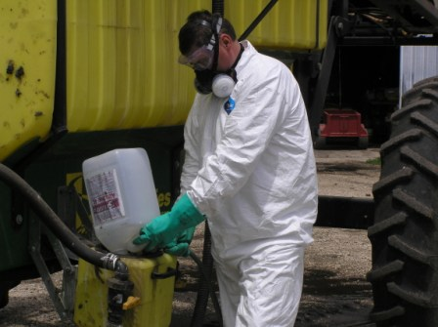
Hazard Communication
What is the Hazard Communication Standard?
How does it impact Agriculture?
Notes:
Photo property of AgriSafe Network

Slide 40
Hazard Communication
1910.1200, Hazard communication
  The purpose of this section is to ensure that the hazards of all chemicals produced or imported are classified, and that information concerning classified hazards is transmitted to employers and employees.
  This transmittal of information is to be accomplished by means of comprehensive hazard communication programs, which are to include container labeling and other forms of warning, safety data sheets and employee training.

Slide 41
Hazard Communication
Changes to the Occupational Safety and Health Administration's (OSHA) Hazard Communication Standard bring the United States into alignment with the Globally Harmonized System of Classification and Labeling of Chemicals (GHS)
The Hazard Communication Standard in 1983 gave the workers the ‘right to know,' but the new Globally Harmonized System gives workers the ‘right to understand.‘
OSHA Fact Sheet
Hazard Communication Standard Final Rule http://www.osha.gov/dsg/hazcom/HCSFactsheet.html
Notes:
New changes to the Occupational Safety and Health Administration's (OSHA) Hazard Communication Standard are bringing the United States into alignment with the Globally Harmonized System of Classification and Labeling of Chemicals (GHS), further improving safety and health protections for America's workers. Building on the success of OSHA's current Hazard Communication Standard, the GHS is expected to prevent injuries and illnesses, save lives and improve trade conditions for chemical manufacturers. The Hazard Communication Standard in 1983 gave the workers the ‘right to know,' but the new Globally Harmonized System gives workers the ‘right to understand.'

Slide 42
Hazard Communication
For Agriculture, the labeling of pesticides remains the same
The only exemption is the labeling requirement for pesticides covered under FIFRA (Federal Insecticide, Fungicide, Rodenticide Act) ; other chemical hazards are required to have the new labeling.
If it is a pesticide, and the employer would be covered under OSHA (more than 10 people), then the other requirements, such Safety Data Sheets (SDSs), formerly MSDSs, and training is needed under the new standard.
Notes:
The only exemption is the labeling requirement
Need to comply with everything else including training

Slide 43


OSHA and EPA
Notes:
Relationship
Role of OSHA – primary role for worker protection
Role of EPA – primary purpose – environmental – cover other things such as Worker Protection (will cover next)
How they work together
Memorandum of understanding
In 1991, EPA and OSHA signed a Memorandum of Understanding, The purpose of this interagency Memorandum of Understanding (MOU) is to establish and improve the working relationship between the Office of Enforcement of the Environmental Protection Agency (EPA) and the Occupational Safety and Health Administration (OSHA) of the Department of Labor.
The goals of the agencies are to improve the combined efforts of the agencies to achieve protection of workers, the public, and the environment at facilities subject to EPA and OSHA jurisdiction; to delineate the general areas of responsibility of each agency; to provide guidelines for coordination of interface activities between the two agencies with the overall goal of identifying and minimizing environmental or workplace hazards.

Slide 44
OSHA and EPA
Relationship
Role of OSHA – primary role for worker protection
Role of EPA – primary purpose is environmental and covers other things such as Worker Protection Standard.
How they work together
In 1991, EPA and OSHA signed a Memorandum of Understanding
  Purpose of MOU was to establish and improve the working relationship between EPA and OSHA.
The goals of the agencies are:
  to improve the combined efforts of the agencies to achieve protection of workers, the public, and the environment at facilities subject to EPA and OSHA jurisdiction;
  to delineate the general areas of responsibility of each agency;
  to provide guidelines for coordination of interface activities between the two agencies with the overall goal of identifying and minimizing environmental or workplace hazards.
Notes:
Relationship
Role of OSHA – primary role for worker protection
Role of EPA – primary purpose – environmental – cover other things such as Worker Protection (will cover next)
How they work together
Memorandum of understanding
In 1991, EPA and OSHA signed a Memorandum of Understanding, The purpose of this interagency Memorandum of Understanding (MOU) is to establish and improve the working relationship between the Office of Enforcement of the Environmental Protection Agency (EPA) and the Occupational Safety and Health Administration (OSHA) of the Department of Labor.
The goals of the agencies are to improve the combined efforts of the agencies to achieve protection of workers, the public, and the environment at facilities subject to EPA and OSHA jurisdiction; to delineate the general areas of responsibility of each agency; to provide guidelines for coordination of interface activities between the two agencies with the overall goal of identifying and minimizing environmental or workplace hazards.

Slide 45
Worker Protection Standard
Regulation aimed at reducing the risk of pesticides and injuries among agricultural workers and pesticide handlers.
Contains requirements for:
  pesticide safety training
  notification of pesticide applications
  use of PPE
  restricted entry after pesticide application
  decontamination supplies
  emergency medical assistance
  Recognition and Management of Pesticide Poisonings Manual
  Information available at: www.epa.gov

Slide 46
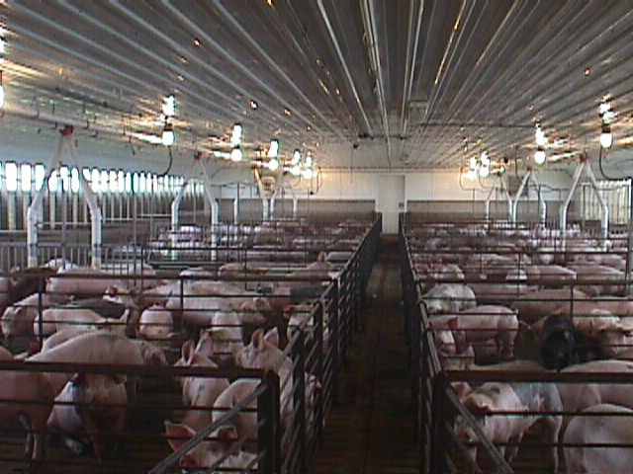
Case Study – Hog Confinement
Hog confinement farm
8 full time employees
5 Seasonal workers – live in trailer on site.
Notes:
Photo property of AgriSafe Network

Slide 47
Hog Case Study Response
Does not meet Agriculture exemption
OSHA has ability to follow general enforcement activities
  No family members
  More than 10 employees
  Temporary labor camp in past 12 months

Slide 48
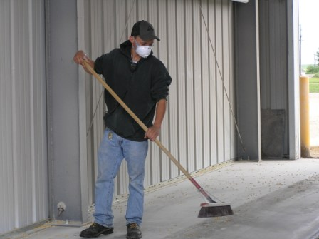
Case Study- Grain Elevator
Grain Elevator with 22 employees
5 employees are seasonal
Notes:
Photo property of AgriSafe Network

Slide 49
Grain Elevator Case Response
OSHA has ability to follow general enforcement activities
If Grain Elevator will fall under General Industry 29CFR. 1910.272
Classified as Industry under SIC code
Even with 1 employee
Agriculture Exemption does not apply

Slide 50
Family Farm Case Study
Family Farm (grain and hogs)
Father and son equal partnership in farming operation
Son and daughter in law work on farm
Grandson / son works on farm after school and in summer
2nd son helps during harvest season

Slide 51

Family Farm Response
Meets the Agriculture exemption
All family members qualify as family
(son, daughter in law, grandson)
Continuum of Life

Slide 52
Family and Hired Worker Case Study
Family Farm
6 hired workers (3 couples)
1 Hired worker his and family live on the farm in house and they do not pay rent or utilities.
2nd and 3rd couples live in own home
2 High school age sons and 1 daughter work on farm
Wife works on farm
Father works on farm seasonally

Slide 53
Family – Hired Case Response
Meets agriculture exemption
11 workers but less than 10 employees by OSHA standards
Family members are not part of count towards 10 employees
Not a temporary labor camp
Paying Health Insurance or Social Security does not impact

Slide 54
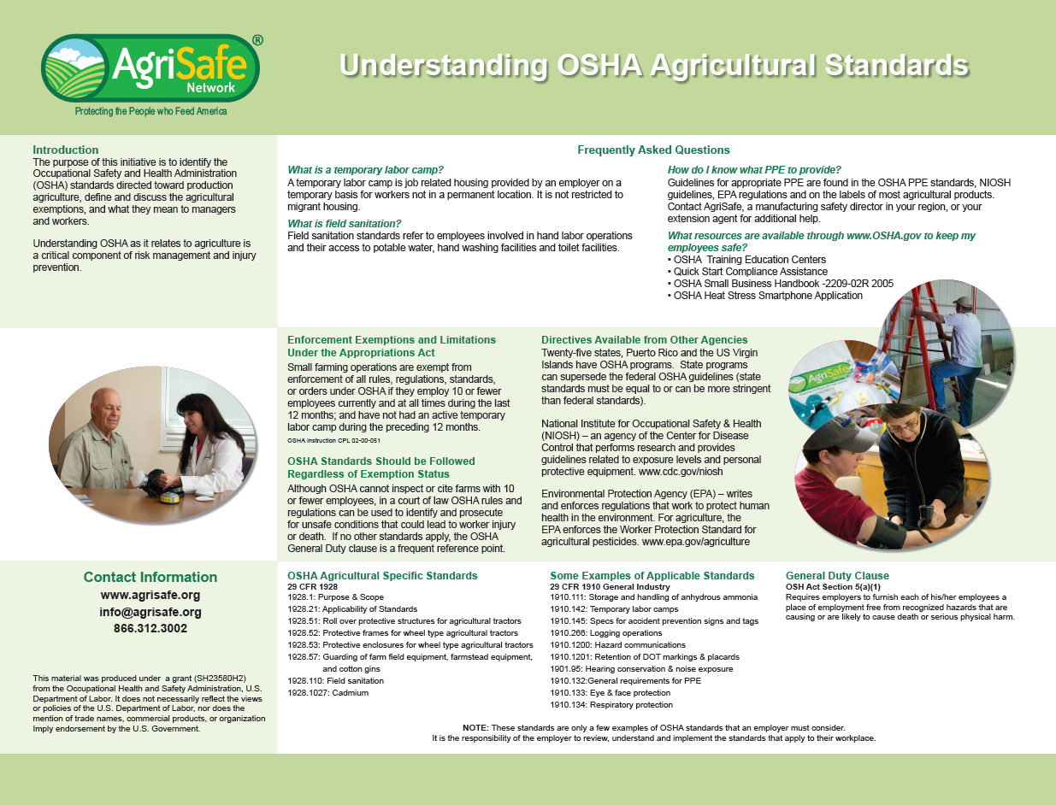
Poster – Handout

Slide 55
Resources
Resources in Go To Training Materials
Occupational Safety & Health Administration www.osha.gov
Institute for Occupational Safety & Health www.cdc.gov/niosh Home for NIOSH Ag Centers
OSHA offices: 1-800-321-OSHA

Slide 56
Employee Rights and Responsibilities
You have the right to:
  Training
  Access to hazard exposure and medical records
  File a complaint with OSHA
  Participate in an OSHA inspection
  Be free from retaliation for exercising safety and
  health rights

Slide 57
Employee Rights and Responsibilities
You have the right to:
  A safe and healthful workplace
  Know about hazardous chemicals
  Information about injuries and illnesses in your workplace
  Complain or request hazard correction from employer

Slide 58
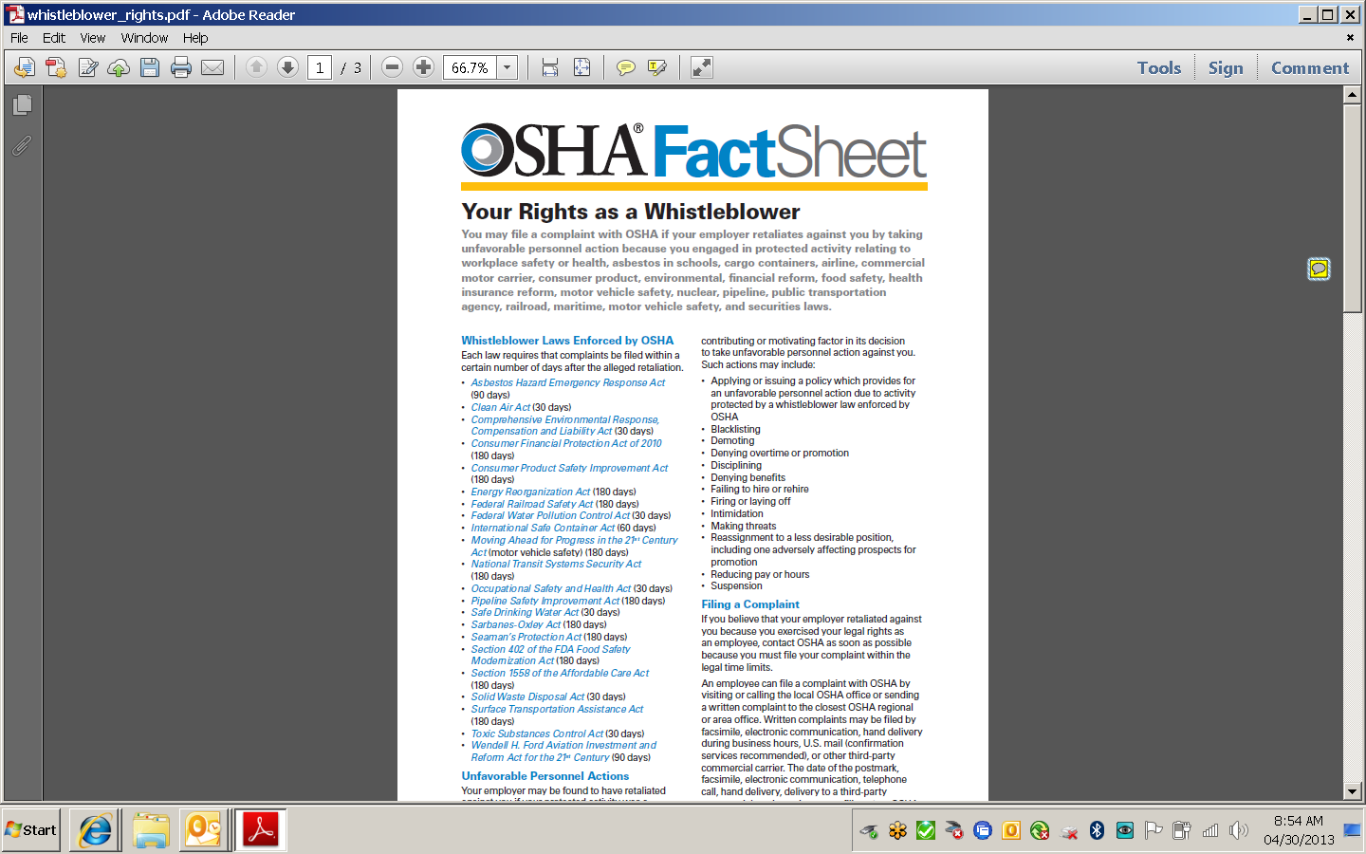

Whistle Blower Protection Program

Slide 59
Test
Test Questions
1. The OSHA General Duty Clause is never applicable to agriculture.
    True
    False
2. OSHA establishes Worker Protection Standards in agriculture.
    True
    False
3. OSHA regulations for small farms with less than 10 employees may vary from state to state.
    True
    False
4. Agricultural operations are addressed in specific standards for agriculture and the general industry
    True
    False
Agriculture must follow the OSHA revised record keeping rule which went into effect on January 1, 2015.
    True
    False
    6. Small farming operations with 10 or fewer employees are exempted from OSHA enforcement activities
    True
    False

