Slide 1

Prevention of Zoonotic Diseases in Agriculture

Slide 2

Focus Area for Presentation
This presentation is intended primarily for agricultural workers, farm and ranch managers, and community agribusinesses. Some of the most common zoonotic diseases will be reviewed.
Agricultural safety and health educators and health care professionals are invited and encouraged to participate.

Slide 3

Susan Harwood Training Grant
This material was produced under a grant (SH-26280-SH4) from the Occupational Safety and Health Administration, U.S. Department of Labor. It does not necessarily reflect the views or policies of the U.S. Department of Labor, nor does the mention of trade names, commercial products, or organization imply endorsement by the U.S. Government
Notes:
Explain about the Susan Harwood Training Grant

Slide 4

Program Objectives
At the completion of this webinar, participants will be able to:
Define zoonotic disease and identify various modes of transmission
Identify a minimum of four significant zoonotic diseases affecting the production agricultural population
Discuss warning signs and symptoms of major zoonotic diseases
Locate a minimum of three recommended educational resources for use in educational programs
Notes:
Discuss Primary Goal of Webinar
Discuss who the intended audience is

Slide 5
What is a Zoonotic Disease?
A zoonotic disease is a disease that can be passed between animals and humans.
Zoonotic diseases can be caused by viruses, bacteria, fungi, and parasites.
www.cdc.gov/onehealth October 2013

Slide 6


Emerging Zoonotic Diseases
Infectious diseases whose incidence in humans has increased in the past two decades or threatens to increase in the near future have been defined as emerging.
http://wwwnc.cdc.gov/eid/page/background-goals

Slide 7

Prevalence
Majority of emerging infectious diseases in U.S. are zoonotic – over 75% of emerging pathogens are considered zoonotic (i.e.: cat scratch & leptospirosis)*
Infectious refers to diseases caused by bacteria, viruses, fungus, or parasites that can be transferred to humans
Difficult to determine numbers as many are unreported
Symptoms are not severe or individual may not realize a disease is reportable (notifiable)
Public health and agriculture agency surveillance is conducted at the state level. **
Notes:
Iowa State University, Center for Food Security & Public Health 2015
*Public health services and agricultural agencies may not have the same objectives or guidelines for reporting.
**Scotch, M. et al. State-level Zoonotic Disease Surveillance in the U.S. Zoonoses_Public Health, 2011 Dec. 58(8): 523-528 HS Public A

Slide 8

Economic Concerns
Costs related to loss of diseased livestock*
Cost of disease prevention and treatment of infections * - money & time involved
Costs related to herd replacement
Production costs impacted by operator/worker illness
Notes:
*Donham, K.J., Thelin, A. Agricultural Medicine. Occupational and Environmental Health for the Health Profession. Blackwell Publishing. 2006

Slide 9
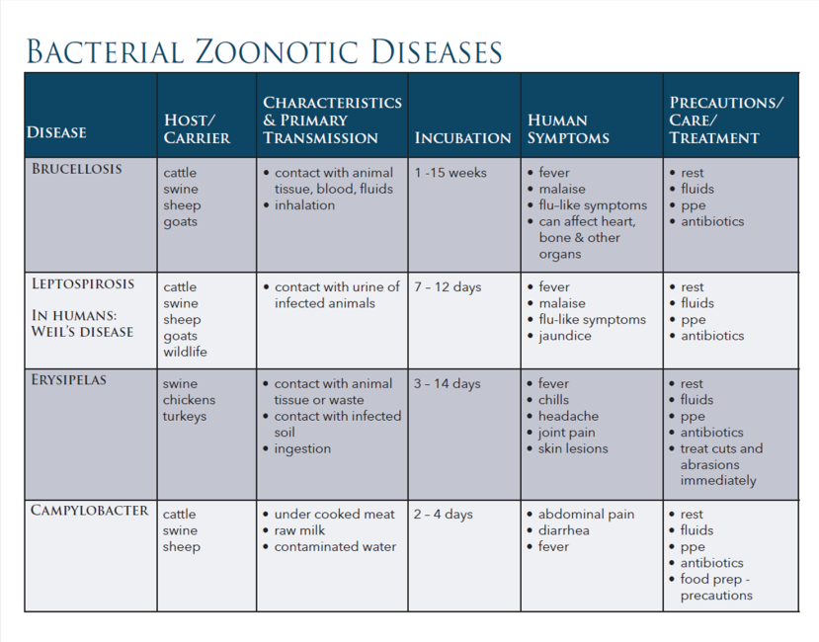

Bacterial Zoonotic Diseases

Slide 10
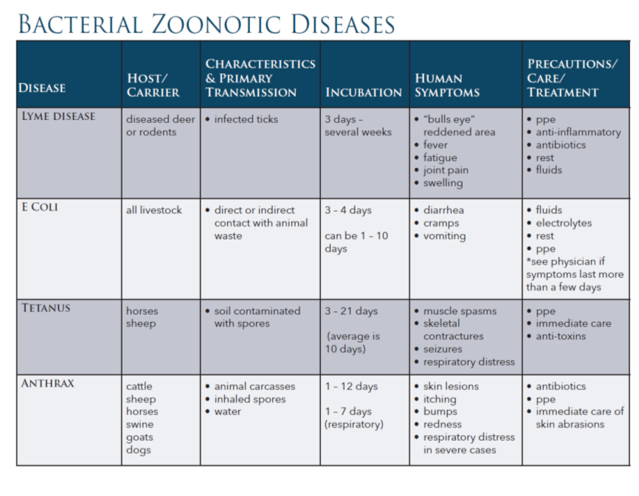

Bacterial Zoonotic Diseases 2

Slide 11
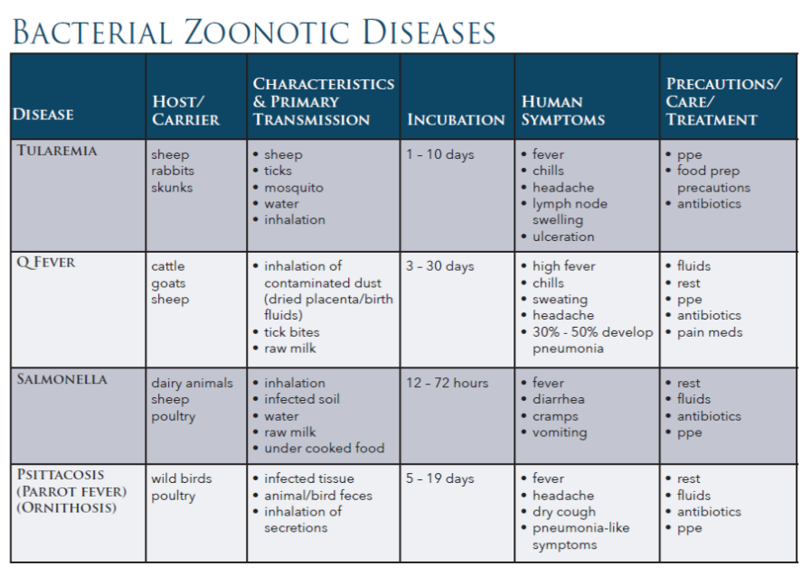

Bacterial Zoonotic Diseases 3

Slide 12

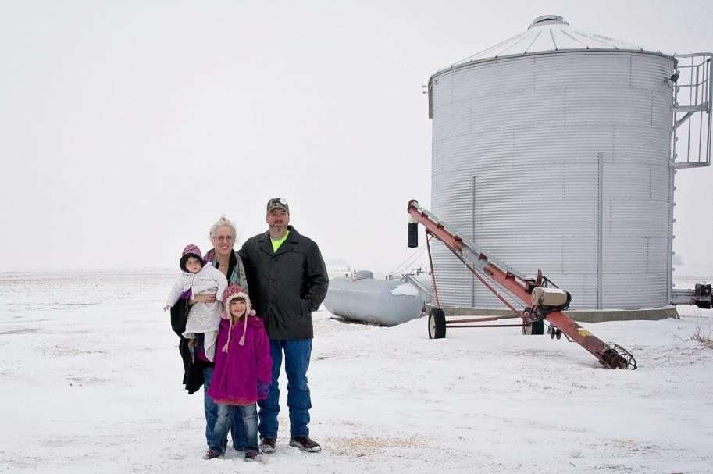
Family

Slide 13

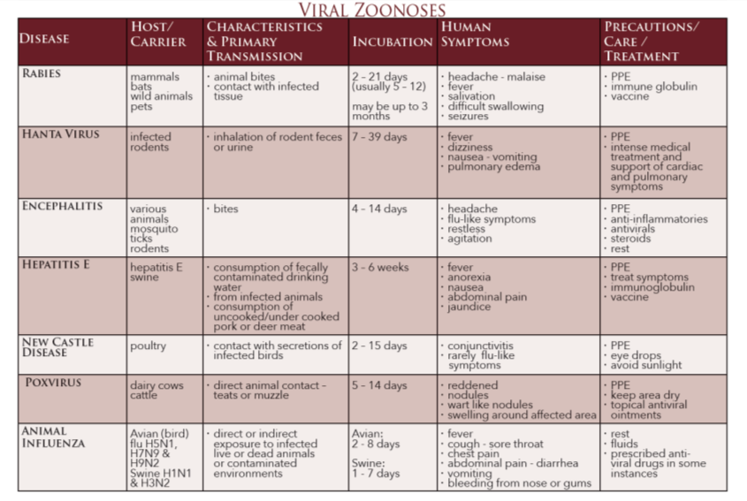
Viral Zoonotic Diseases
Notes:
Sources: http://www.cdc.gov
http://www.ncbi.nlm.gov.pmc/articles/PMC3291207/
http://www.absa.org/pdf/ZoonoticFactSheet.pdf
www.cfsph.iastate.edu/WallChartReferences/
www.merckmanuals.com/professional/infectious_diseases/
Donham, K.J., Thelin, A. Agricultural Medicine. Occupational and Environmental Health for the Health Profession. Blackwell Publishing. 2006

Slide 14
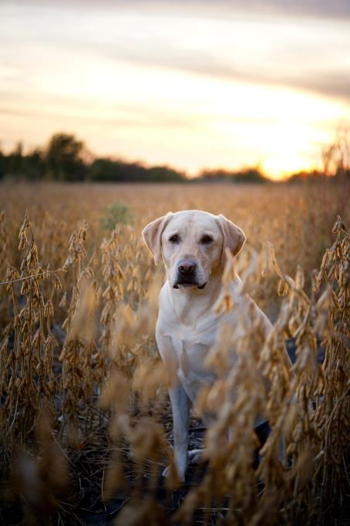
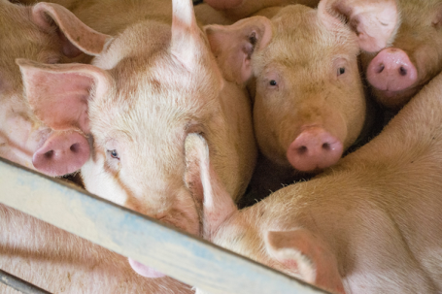
Animals and pets

Slide 15
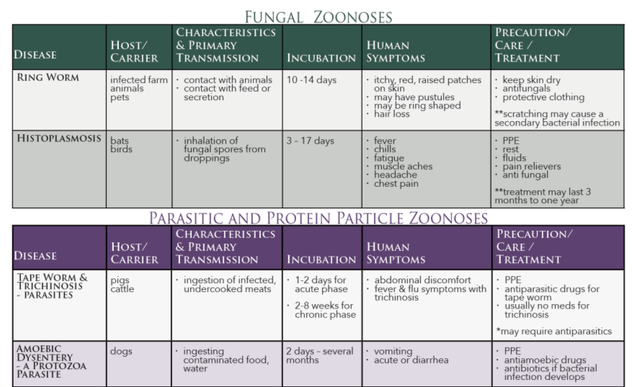
Fungal, Parasitic, Protein Zoonotic Diseases
PHOTO SLIDE

Slide 16
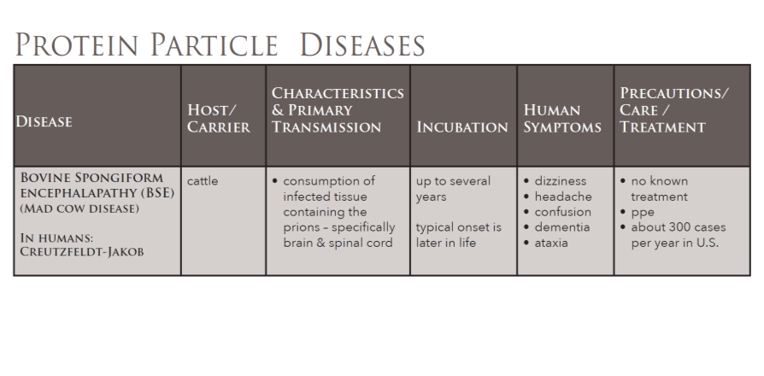

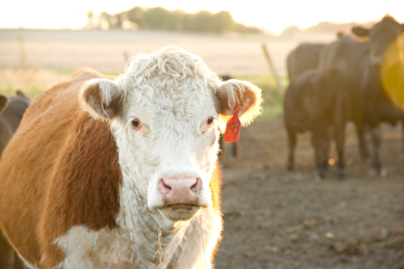
Protein Particle Disease

Slide 17

Disease Prevention
Know your animals and potential for disease
Talk with your veterinarian – they are experts in zoonotic disease prevention
Be aware of your surroundings – at home and when you travel
Discuss safe animal handling with your family – livestock and pets
Notes:
How to approach animals
Parental supervision
Handwashng

Slide 18

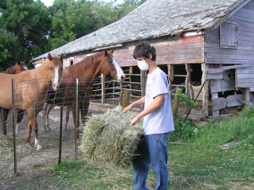
Disease Prevention
Choose appropriate protective equipment:
respiratory protection (i.e.: N-95 respirator)
gloves
safety glasses
clothing: coveralls, aprons, etc.
foot gear
Designate specific work clothes for farm and ranch work
Notes:
Penn State Extension

Slide 19

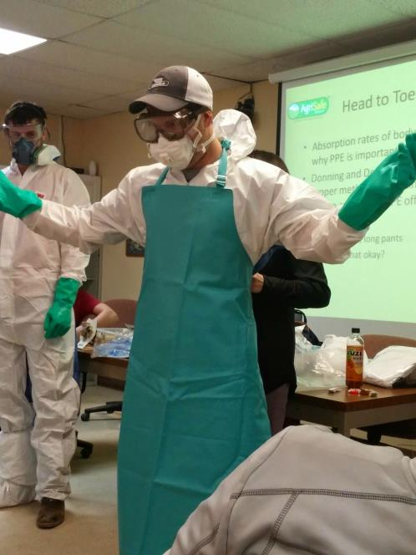
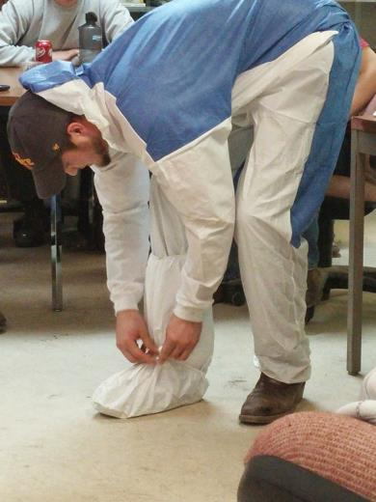
PPE
PPE SLIDE

Slide 20

Disease Prevention
Disinfect work spaces with designated cleaning solutions:
EPA registered disinfectant (AVMA)
1/10 bleach solution – often recommended
Hand washing with soap and use of paper toweling to dry will decrease chances for disease transmission
provide designated hand washing area for workers – hot water use is recommended
hand washing station should be designed hands free if possible
Notes:
AVMA – American Veterinary Medicine Association
CDC – Center for Disease Control
http://fcs.tamu.edu/health/infectious-diseases/prevent-zoonotic-diseases-english.pdf

Slide 21

Protecting Your Family On & Off the Farm
Hiking & exploring –
Sturdy shoes
Long pants
Insect repellant
DEET is frequently recommended by the CDC
EPA registered repellants contain 20% or more DEET
Petting zoos –
check rules and policy for visitors
wash hands well with soap and warm water
Notes:
DEET – diethyl-meta-tolumide

Slide 22

Child Exposures
Children are at higher risk of injury from animal bites
An estimated 4.5 million people in the U.S. are bitten by dogs each year
They are often unaware of a pet’s temperament or health status
Animals with babies are fiercely protective of their young – a fact that young children may not recognize
Young cats are the most likely source of cat scratch fever- spread by scratch, lick, or bite
Notes:
Source: Washington State Dept. of Health http://www.doh.wa.gov/YouandYourFamily/IllnessandDisease/AnimalTransmittedDiseases

Slide 23

Concerns During Pregnancy
Several diseases that cause abortions in animals have the same results in humans
avoid handling tissue from aborted fetus
Pregnant women have compromised immune and respiratory systems
Increased vigilance is called for in hand washing, ppe use, avoidance of animal body fluids & excrement
Know the risks related to toxoplasmosis, listeria, influenza, Q fever, pharmaceuticals
Notes:
Source: National Association of Veterinary Technicians in America. The NAVTA Journal July/August 2012

Slide 24

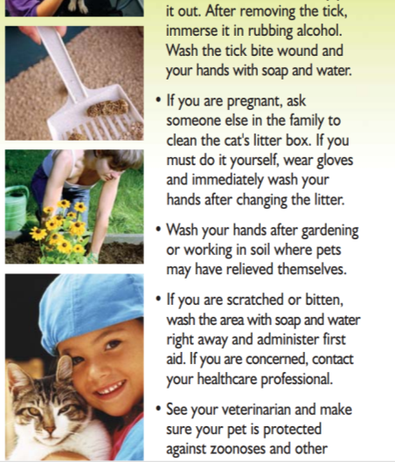
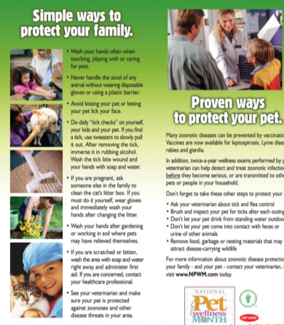

Example of Home/Family Resource
Notes:
Source: http://www.slocounty.ca.gov/Assets/PH/Communicable+Disease/Zoonotic+Diseases/What+are+Zoonotic+Diseases-Pamphlet.pdf

Slide 25

Wound Care
Inspect extremities, neck and face for cuts or scrapes daily
Thoroughly clean , treat and cover any open areas prior to working with animals
Check your medical records to be sure your tetanus vaccine is up to date
CDC recommendation is Td/Tdap booster every 10 years*
Notes:
*Unless otherwise recommended by your health care provider
- Tetanus, diphtheria, pertussis
https://www.osha.gov/dsg/topics/agriculturaloperations/hazards_controls.html http://www.cdc.gov/features/tetanus/

Slide 26

Worker Health
Clearly communicate expectations and worksite rules to workers in language that is readily understood
Provide adequate and on-going worker education
also address worker’s personal vaccinations
Review worksite ppe protocol
Provide approved sharps containers
for disposal of used needles (animal vaccinations, antibiotics, etc.)
Note: the OSHA Blood Born Pathogen Standard affects only human to human contact
Notes:
www.osha.gov/dsg/topics/agriculturaloperations/hazards_controls.html

Slide 27
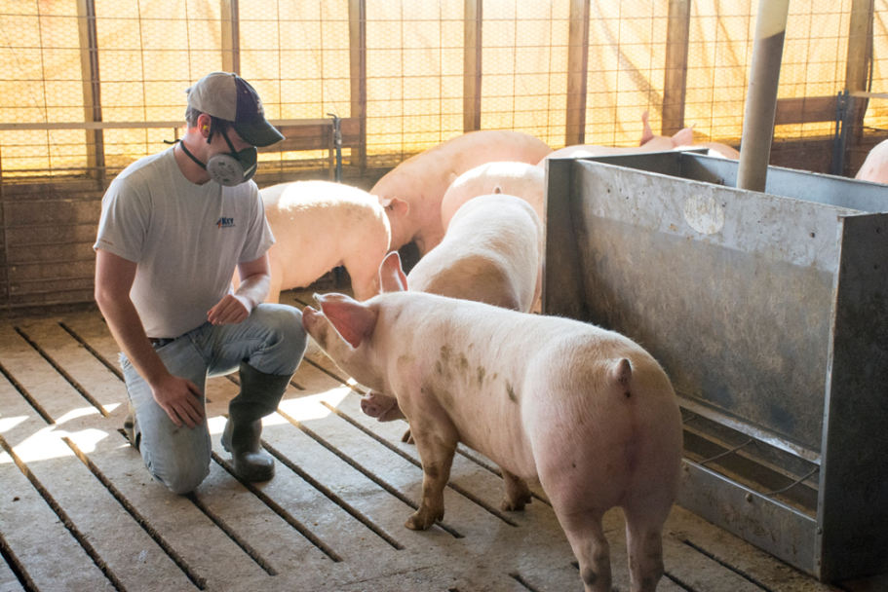
Pigs

Slide 28

A Word About Reportable Diseases
Notifiable diseases are reported at the state level – via local and state health departments…usually by health department authorities, healthcare professionals, and/or veterinarians
Web sites will list reportable diseases and process for filing a report
Notifiable disease list is periodically updated
National Notifiable Disease Surveillance System – NNDSS*
Notes:
* http://wwwn.cdc.gov/nndss/

Slide 29

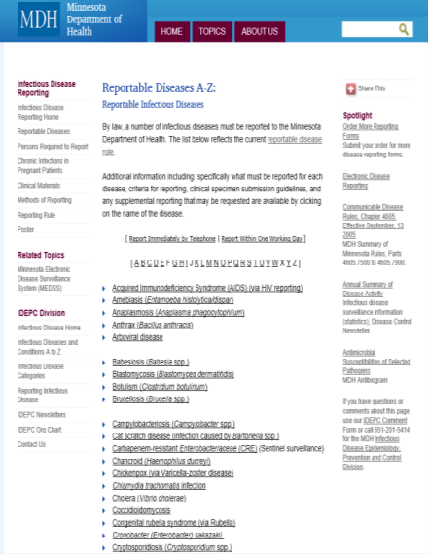
Minnesota Dept. of Health
Notes:
http://www.health.state.mn.us/divs/idepc/dtopics/reportable/disease.html

Slide 30
Proposal for the Future
U.S. Dept. of Agriculture
Animal & Plant Health Inspection Service has put forth a Strategic Plan: 2015 – 2019
Proposes a National List of Reportable Diseases for more consistent reporting procedures – focus on domestic and agricultural animals
supported by the AVMA
meets WHO obligations
will partner with fellow USDA agencies
Notes:
www.aphis.usda.gov/about_aphis/downloads/APHIS_Strategic_Plan-2015.pdf

Slide 31

Important Information for Your Health Care Provider
Your HCP needs to know:
What is your occupation?
Do you work with animals?
Do you have pets?
Have you been exposed to any animals or birds with known or suspected diseases?
Have you traveled to a different part of the country or out of the country recently?

Slide 32
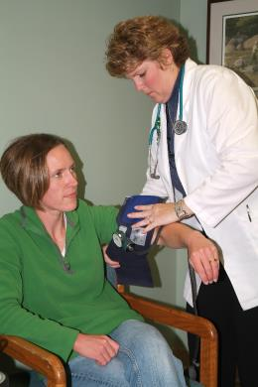
Important Information for Your Health Care Provider
It is important to let your HCP know these facts:
Do you have any of the following symptoms?
Fever – short time or intermittent
Headache
Chills
Fatigue
Joint pain or swelling
Redness over joints

Slide 33
Important Information for Your Health Care Provider
Do you have any of the following symptoms?
Rashes or hives
Menstrual cycle changes or a recent spontaneous abortion/miscarriage
Orchyitis
Diarrhea
Darkened or blood tinged urine
Nausea
Vomiting

Slide 34


Agriculture OSHA Resources
Available on www.OSHA.gov Website
In search bar type
Agriculture Operations Safety and Health Topics
Notes:
Type in: zoonotic disease information

Slide 35
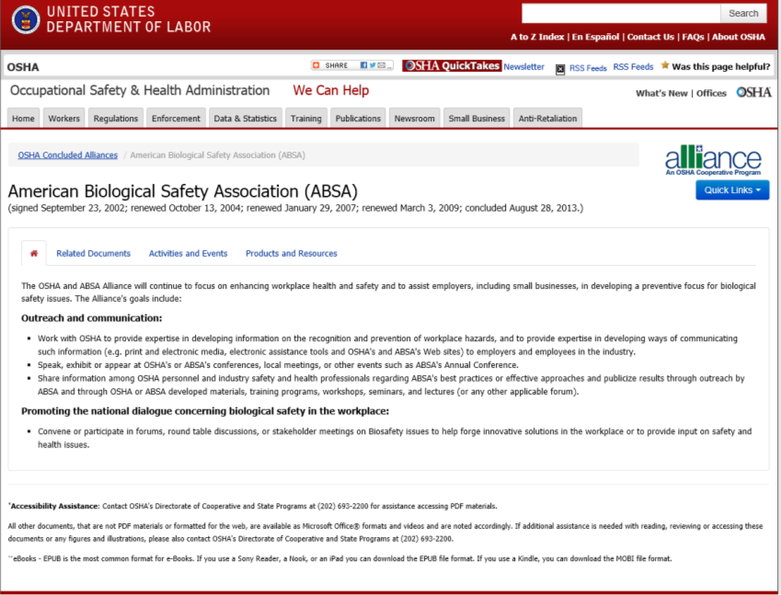
OSHA page

Slide 36
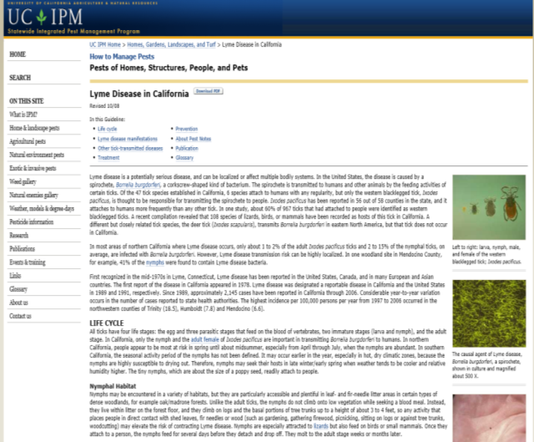
Example of State Resources
Notes:
http://www.ipm.ucdavis.edu/PMG/PESTNOTES/pn7485.html

Slide 37
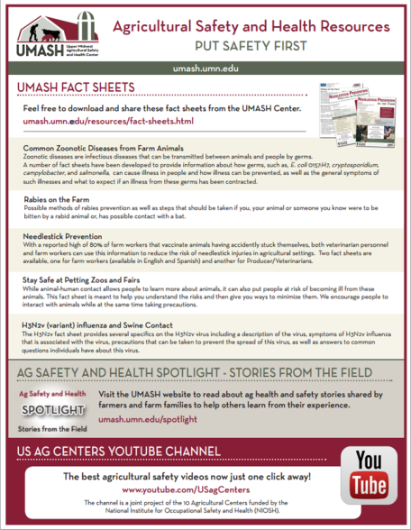
Example of Regional Resources
Ag Centers
Notes:
http://www.ipm.ucdavis.edu/PMG/PESTNOTES/pn7485.html

Slide 38
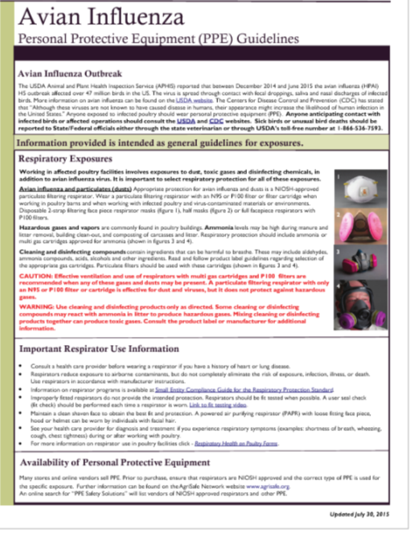
Avian Influenza

Slide 39
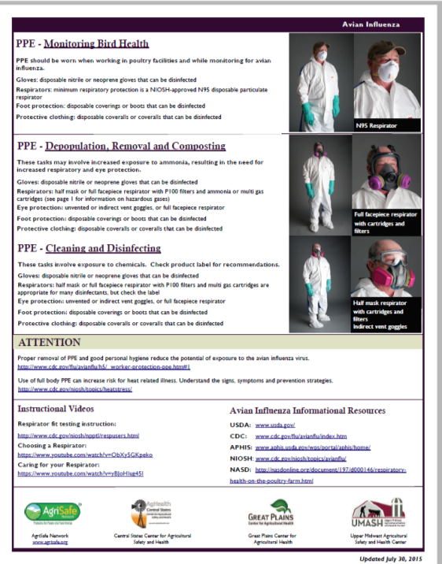
PPE

Slide 40

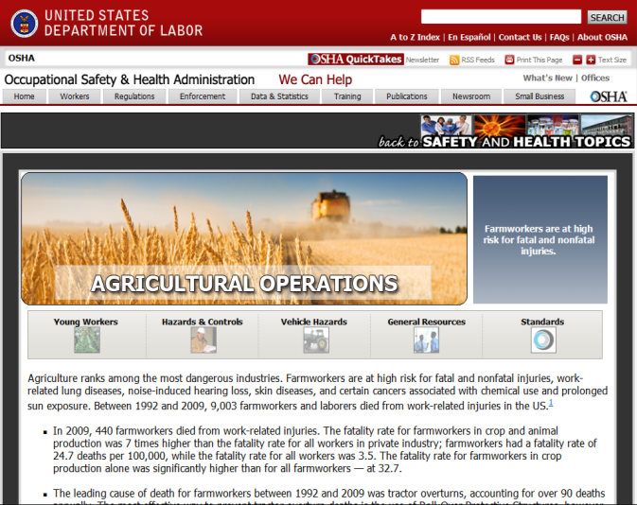
Agriculture Operations Safety and Health Topics Page
General Resources

Slide 41

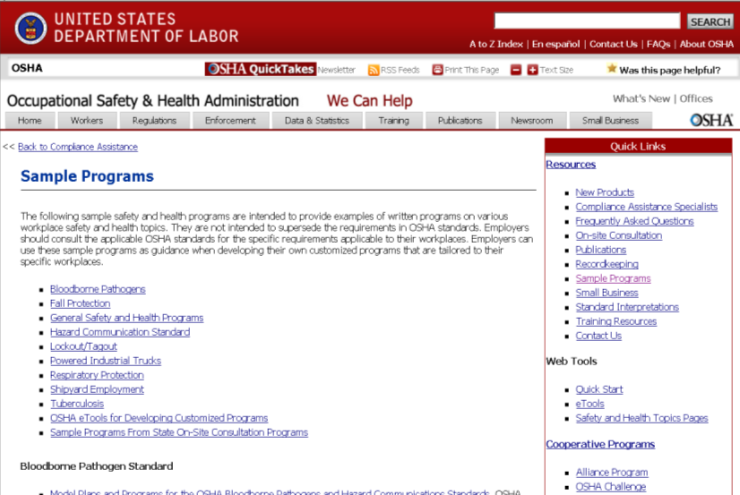
Information Resources - Sample programs
Respiratory Protection Respiratory Program
OSHA 29CFR1910:132 requires ppe hazard assessments – check your state for directions and forms
Notes:
Step by Step on how to get to right area

Slide 42
Recommended Resources for Producers
OSHA / Alliance Zoonotic Disease Fact Sheet
http://www.absa.org/pdf/ZoonoticFactSheet.pdf
CDC and Zoonotic Disease
http://www.cdc.gov/24-7/cdcfastfacts/zoonotic.html
CDC – One Health Zoonotic Diseases
http://www.cdc.gov/onehealth/zoonotic-diseases.html
Texas A&M AgriLife Extension
http://fcs.tamu.edu/health/infectious-diseases/prevent-zoonotic-diseases-english.pdf
National Children's Center for Rural & Agricultural Health & Safety
https://www3.marshfieldclinic.org/nccrahs/?page=nccrahs_welcome

Slide 43

Resources
Occupational Safety & Health Administration www.osha.gov
Institute for Occupational Safety & Health www.cdc.gov/niosh ~ home for NIOSH Ag Centers
AgriSafe – www.agrisafe.org
National Education Center for Agricultural Safety www.necasag.org
National Safety Council- www.nsc.org
Notes:
Web site resources

Slide 44

Employee Rights
You have the right to:
A safe and healthful workplace
Know about hazardous chemicals
Information about injuries and illnesses in your workplace
Complain or request hazard correction from employer

Slide 45
Employee Rights
You have the right to:
Training
Access to hazard exposure and medical records
File a complaint with OSHA
Participate in an OSHA inspection
Be free from retaliation for exercising safety and health rights

Slide 46

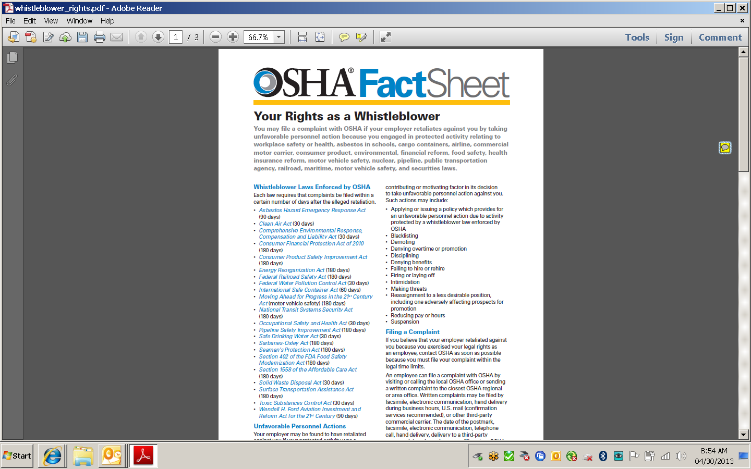
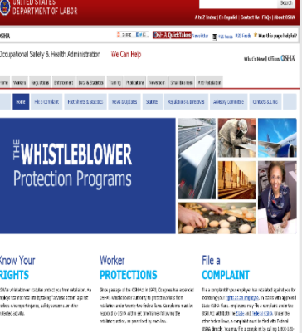
WhistleBlower Facts
Whistle Blower Protection Program

Slide 47

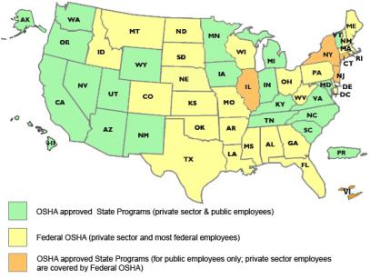
State to State
Important to check with your state OSHA since there are 25 states that match or exceed this OSHA instruction
Notes:
Many states have different OSHA Instruction
Could require more under each state plan – be sure to check with your state
State OSHA can be a resource

Slide 48
Test Questions
Test Questions
Emerging zoonotic diseases are those infectious diseases discovered to be harmful within the past 10 years.
True
False
A significant symptom of brucellosis is a fever that goes away and then returns.
True
False
Your Tdap (tetanus, diphtheria, and pertussis) vaccine should be updated every __ years.
a.3
b.5
c.10
Almost one-half of the emerging diseases in the U.S. are zoonotic by definition.
True
False
An estimated ____ million children in the U.S. are victims of dog bites each year.
a.1.5
b.4.5
c.7.0
Symptoms of Lyme disease may include:
painful, swollen joints
a raised area with a red ring
fever
all of the above
The most common symptom of New Castle disease is conjunctivitis (reddened, watering, painful eyes).
True
False
Histoplasmosis is typically caused by:
direct contact with bird feathers
a laceration from a bite
inhalation of fungus spores
One-third to one-half of persons infected with Q fever develop:
jaundice
pneumonia
rheumatoid arthritis

