Slide 1

Ergonomics in Agriculture Slips, Trips and Falls
.

Slide 2
Objectives
At the conclusion of this presentation, you will
Be able to identify some actions you can integrate to prevent slips, trips, and falls.
Have the opportunity to begin an action plan to diminish or eliminate workplace hazards that could result in fall injuries
Know where to find resources to help in eliminating fall hazards
Know the resources to find the OSHA standards pertaining to slips, trips, and falls incidents
Polling Question

Slide 3
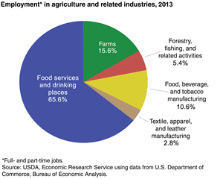
USDA Department of Agriculture Economic Research Services
In 2013, 16.9 million full- and part-time jobs were related to agriculture—about 9.2 percent of total U.S. employment. Direct on-farm employment provided over 2.6 million of these jobs.
Employment in the related industries supported another 14.2 million jobs. Of this number, food services and drinking places accounted for the largest share—11.1 million jobs—and food/beverage manufacturing supported 1.8 million jobs. The remaining agriculture-related industries together supported another 1.4 million jobs.

Slide 4
Prevalence of Injury
Agriculture consistently ranks in the top three occupations for disabling injury and death

Slide 5
Statistics of Injury/Mortality: U.S. Agriculture
568 fatalities in 2014
- increase from 500 in 2013
24.9 deaths per 100,000 workers
– highest of any industry in 2014
52,400 nonfatal injuries and illnesses in 2014
- decrease from 54,900 in 2013
Source: Bureau of Labor Statistics/Census of Fatal Occupational Injuries

Slide 6

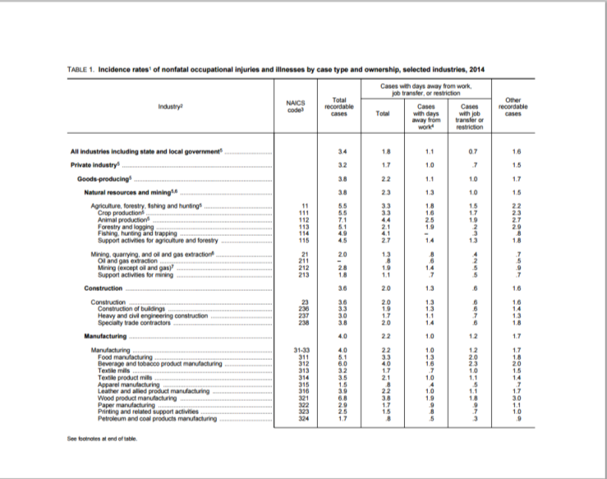
BLS Date
Notes:
Per 100 full time workers

Slide 7
Incidents Under Reported
It is believed that the number of agricultural injuries far exceeds the reported numbers…
Why do you think that is the case?

Slide 8
Un-reported Injuries & Illnesses
Paul Leigh, PhD, UC Davis: BLS surveys miss nearly 45% of non-fatal occupationally injuries in agriculture…unreported injuries
Source: Leigh, J. Paul. University of California, Davis. “Costs of Occupational Injury & Illnesses Combining All Industries..” Presentation November 3, 2008
Leigh, J. Paul. Economic Burden of Occupational Injury and Illness in the United States. Milbank Quarterly Vol. 89 Issue:4 Pages: 728-772 Dec. 2011

Slide 9
Incidents Under Reported
Enforcement Guidance for Small Farming Operations
The Appropriations Act exempts small farming operations from enforcement of all rules, regulations, standards or orders under the Occupational Safety and Health Act. A farming operation is exempt from all OSHA activities if it:
Employs 10 or fewer employees currently and at all times during the last 12 months; and Has not had an active temporary labor camp during the proceeding 12 months.
Note: Family members of farm employers are not counted when determining the number of employees.
Important to check with your state OSHA since there are 25 states and 2 territories that match or exceed this OSHA instruction
Source: www.OSHA.gov
Source: www.OSHA.gov Polling Question

Slide 10
OSHA Standards
OSHA has an Agriculture Standard (29 CFR 1928)
If the hazard cannot be addressed in the Agriculture Standard (29 CFR 1928), OSHA defers to the General Industry Standard (29 CFR 1910)
If there is not a standard that is applicable to agriculture in the General Industry Standards then go to the General Duty Clause Section 5(a)(1)
Source: www.OSHA.gov

Slide 11
OSHA Standards
Section 5(a)(1) of the OSH Act, often referred to as the General Duty Clause, requires employers to "furnish to each of his employees employment and a place of employment which are free from recognized hazards that are causing or are likely to cause death or serious physical harm to his employees".
Section 5(a)(2) requires employers to "comply with occupational safety and health standards promulgated under this Act".

Slide 12
Farmers Invented Multi-Tasking! Multi-disciplinary experts:
Grain & feed expert
Electrician
Weight lifter
Marketing manager
Office administrator
Legal eagle
Machinist
Chemist
Biologist
Veterinarian– large & small
Heavy equipment operator

Slide 13
Contributing Factors to Injury
Physiological & Social Factors
Working alone
“Shift time” varies frequently and is seldom an 8 hour day
Age
Hearing acuity
Visual acuity
Arthritis

Slide 14
Contributing Factors to Injury
Environmental & Engineering Factors
Weather frequently changes
Extreme heat or cold
Humidity
Slippery surfaces
Uneven surfaces
Dusty conditions
Higher elevation work site

Slide 15
Contributing Factors to Injury
Environmental & Engineering Factors
Poorly lit travel areas and walkways
Steps or walkways in poor repair
Ladders not in optimal condition i.e.: ladders on bins loose or rusty
Distraction by other activity – weather, animals , crops, loud or unfamiliar noise
Others?

Slide 16
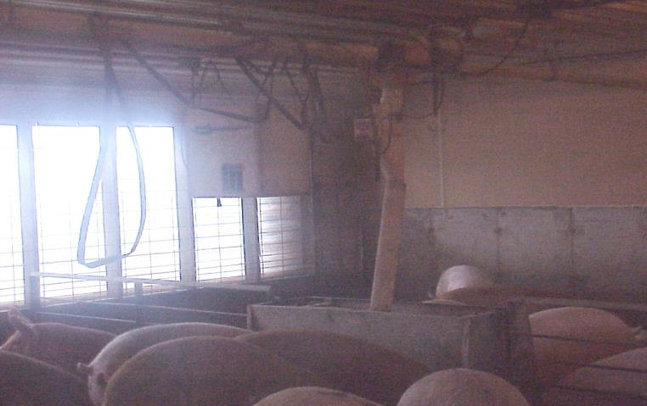
Moisture and low visibility issues

Slide 17
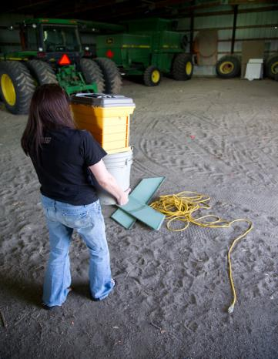
Heave Ho!
Carrying improper load levels can not only cause back injuries but may result in head injuries, lacerations, or fractures
Improper rope and harness handling can potentially result in a fall or arm and shoulder injury

Slide 18
Tripping Hazards
Slips and falls on electrical cords can cause musculoskeletal damage or be potential electrocution hazards
Tripping over equipment in a walkway can result in anything from minor sprains or scrapes to severe head and musculoskeletal injuries – upturned rakes & shovels have potential for internal injuries, puncture wounds, eye injuries

Slide 19
Contributing Factors to Injury
Personal or Habitual Factors
Running
Carrying objects that are too heavy or cumbersome
Distraction by other individuals or groups of people
Not using handrails when present
Improper ladder/equipment dismount
Clothing entanglement dangers
Cleaning or working on equipment with tools placed out of reach
Exiting moving equipment or equipment designed for only one person
Mobile device conversations/texting (illegal in some states when operating vehicles on roadways)

Slide 20
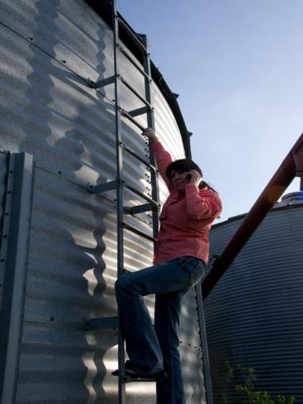
Distractions Are Costly!
Not paying attention and being distracted can have disastrous results

Slide 21
Where Do Falls Take Place?
Same level or low level falls: (also referred to as slips & trips) refer to falls under 10 feet. They represent a higher level of frequency but typically* lower level of severity
Steps
Curbs
Uneven surfaces
Slippery surfaces (water, oil spill, ice)
Objects in walk path (shovels, rakes, rope, cords, boxes)
Trip over small or shorter animals (pets, young pigs, etc.)
Falls from horses – extremely dangerous as they are usually in motion!
* Even low level falls can result in severe head and spinal injury, serious fractures, or the loss of vision (i.e.: upturned rakes)

Slide 22
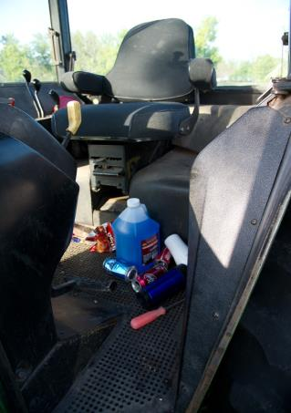
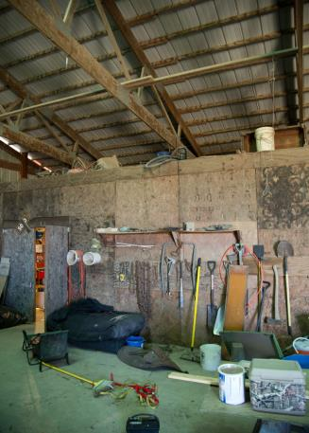
Clutter

Slide 23
Where Do Falls take Place?
Elevated areas: over 60% of elevated falls are from 10 feet or less – Falls that are over 10 feet are of lower frequency but higher level of severity
Ladders
Machinery
Tractors
Truck beds
Barn roofs
Silos
Source: National Safety Council – www.nsc.org

Slide 24
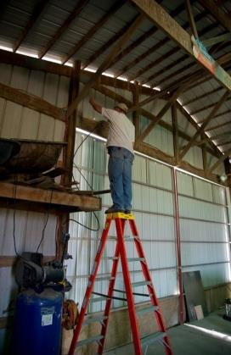
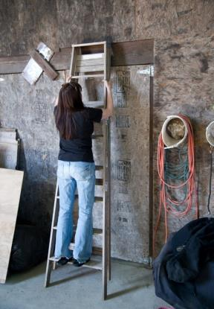
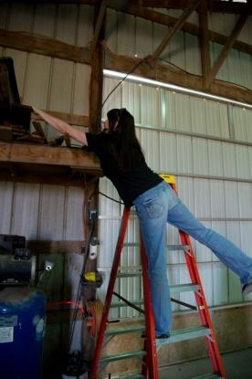
Improper use of Ladder

Slide 25
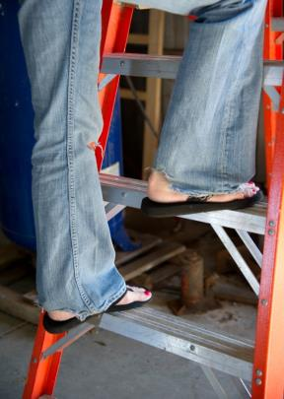
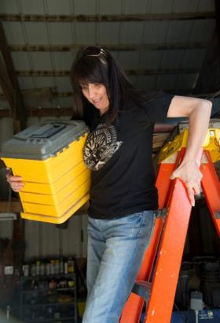
Mounting or dismounting a ladder improperly can result in a slip that causes severe head or spinal injuries

Slide 26
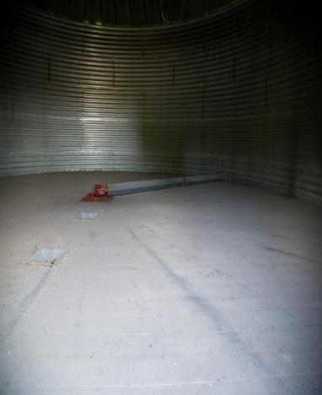
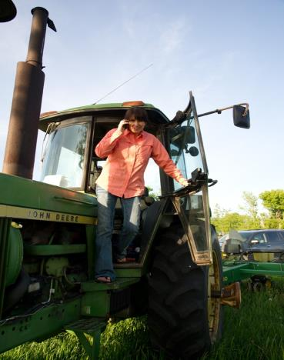
Machinery

Slide 27
What Can Happen?
Slips from machinery can cause a worker to fall into or against dangerous or moving equipment resulting in severe lacerations, amputations, or fatalities
Combine heads
Grain Augers
Gears / belts
PTO (Power Take Off)
Others

Slide 28
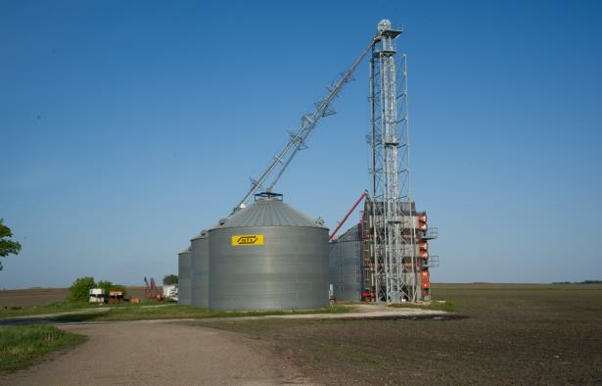
Grain Bins
Falls in a grain storage structure or wagon can result in a suffocation death

Slide 29
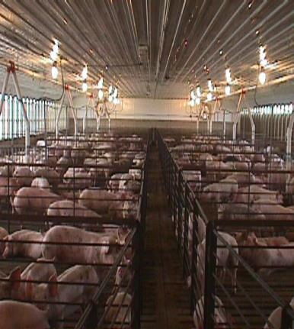
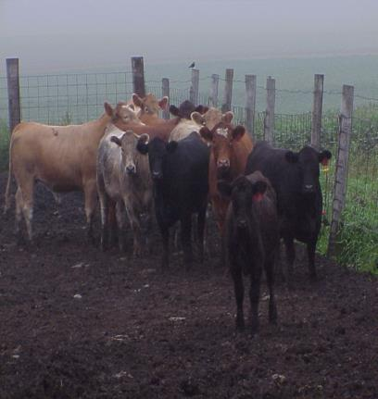
Livestock

Slide 30
What Can Happen?
Slips in an animal space will startle and /or agitate an animal into running or charging a human …
Trampling will result in severe or debilitating injuries or death
Moving or working in the kicking/flight zone of a large animal can result in injury
Improper rope / harness handling can potentially result in a fall or arm and shoulder injury
A fall from a horse can result in boots caught in stirrups, dragging, head injuries, spinal injuries, fractures

Slide 31
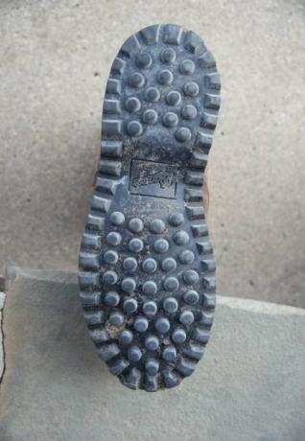
Safety Considerations - What Can we Do?
Footwear:
Wide grooves to channel water
Large flat soles
No heel (with exception of riding and horse work boots)
Nitrile rubber compound on soles of shoes

Slide 32
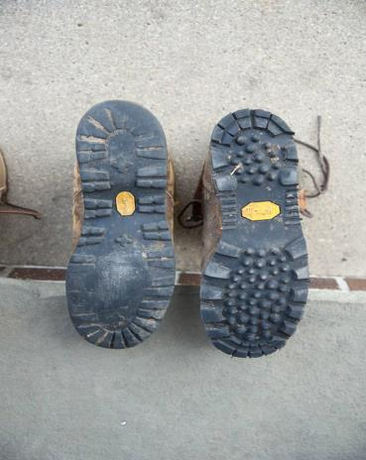
Tread Carefully
Well worn footwear will not have necessary traction on damp or uneven surfaces – resulting in a variety of hazardous slipping injuries
NSI Standard 1-75 C-25

Slide 33
Safety Considerations - What Can We Do?
Engineer dangers out of environment if at all possible!
Walkways:
Clear clutter and objects from walking paths
Install railings where appropriate
Increase lighting in dim areas
Maintain surface area
Steps: Keep them clear of objects and in good repair
Long handled tools: store on secure wall hooks and smaller items in drawers or adequate shelves

Slide 34
Safety Considerations - What Can We Do
Carry loads that are not too heavy and that do not obstruct your vision
Keep riding tack, saddles in good repair – check them frequently
Figure 8 lead harnesses – never wrap them around your hand

Slide 35
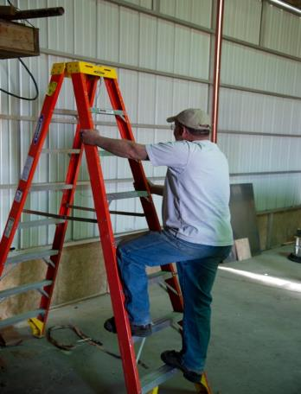
Safety First with Ladders
Always face a ladder when climbing
Always utilize a 3-point contact approach

Slide 36
Grain Bins
Grain bins OSHA – 29 CFR 1910.272 and ANSI – Z359.1-2007
should have grip handles
chains in place and approved
PFP (Personal Fall Protection)
harnessing available for trained individual
(OSHA 29 CFR 1926.500-503)

Slide 37
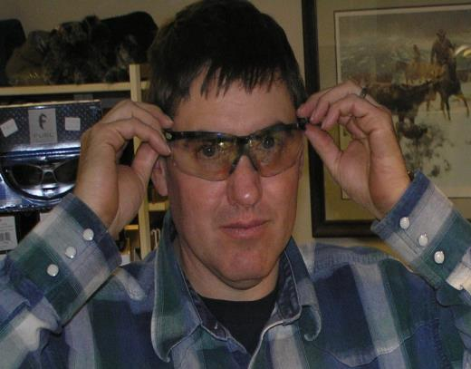
Safety Considerations - What Can We Do?
Eyewear:
Sunglasses: remove when entering low lit areas
Wear approved impact resistant safety glasses or goggles
(ANSI Standard Z87)
Regular eye exams will assure visual acuity
Get used to bifocals prior to wearing in work areas

Slide 38
Safety Considerations - What Can We Do?
Gloves:
Secure grips and good fit to prevent slippage when reaching
Good fitting gloves can prevent ergonomic related injures
Clothing:
avoid ragged or torn legs and sleeves to prevent catching in equipment

Slide 39
Safety Considerations - Awareness
Does someone know where you are?
Do you have a communication plan?
Is the phone call that urgent ?
If an injury occurs, is there a first aid kit nearby?
Are you familiar with emergency service numbers in your community?
Are you on a 911 grid?

Slide 40
Age Related Issues in the Workforce
The agricultural workforce is an aging population – average age is 58.3years old www.usda.gov/agcensus
Risk factors for injury include:
altered visual acuity
slower reflex reaction
alteration in hearing acuity
potential for joint pain and stiffness
potential for compromised cardiovascular status

Slide 41
Role of Arthritis in Agriculture
There are over 100 musculoskeletal disorders classified as arthritis (1)
Farmers with mobility issues are twice as likely to experience injury as farmers with no mobility issues (2)
Arthritis affect one-third of adults farmers in U.S. (3)
Source: 1.American Arthritis Association
2.Heaton,K.,et al. University of Alabama –www.ncbi.nlm.nih.gov/pubmed/23556148
3. AgrAbility 2008
Notes:
Source: 1.American Arthritis Association
2.Heaton,k.,et al. University of Alabama –www.ncbi.nlm.nih.gov/pubmed/23556148
3. AgrAbility 2008

Slide 42
Financial Impact
Injuries to you, a family worker, or your employee can be disabling, cause lost time hours, and huge costs in medical care and insurance!
Polling Question

Slide 43
Safety Pays
$afety Pays" uses a sliding scale to calculate the indirect costs of the injuries and illness
Allow users to pick an injury type from a drop-down list or to enter their workers' compensation costs
Prompt users for information to do the analysis, including their profit margin and number of injuries
Generate a report of the costs and the sales needed to cover those costs OSHA Safety Pays http://www.osha.gov/dcsp/smallbusiness/safetypays/index.html

Slide 44
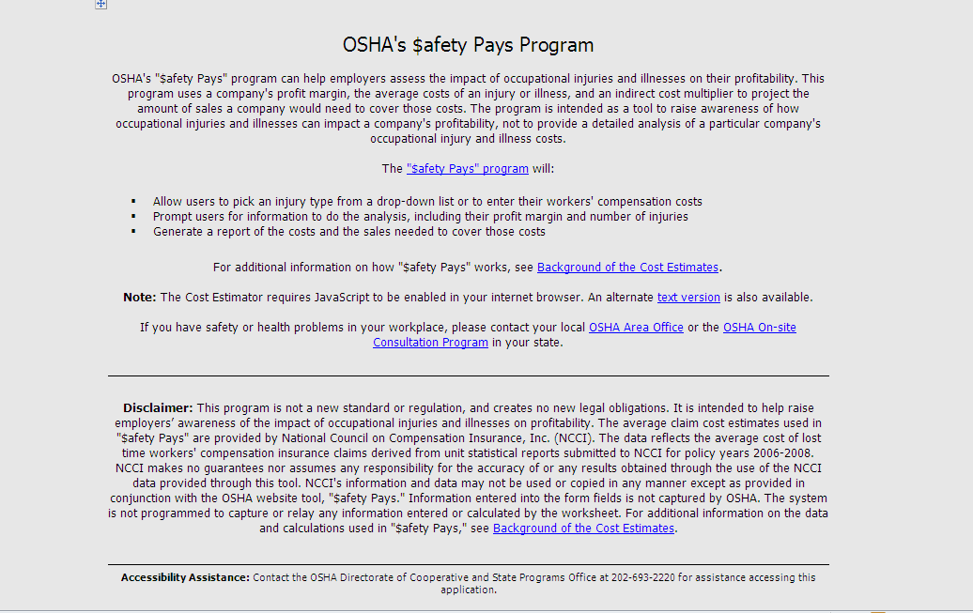
OSHA Safety Pays Program

Slide 45
What Does An Injury Cost?
National Safety Council
Taking into account direct and indirect expenses, each lost workday can cost over $34,000!

Slide 46
What Does An Injury Cost?
Direct costs
Medical costs
Workers’ Compensation
Indirect costs
Cost of replacing staff and training time
Loss of productivity due to learning curves
Accommodating injured employee
Wages paid to employee not covered by workers’ compensation
Cost of work stoppage
Cost of replacing damaged materials, equipment & property

Slide 47
Return On Investment
Take time to assess and evaluate what an injury will cost your operation
Communicate safety to family and employees – involve them in safety plan
Take time now to write an outline or update for your farm/operation safety plan

Slide 48
Action Plan
Action Needed | Barriers to Overcome | How Will I Remove Barriers | Action Taken | Cost of Project
Reduce Clutter in Machinery | Several operators with lack of ownership | Get buy in from operators to take ownership of removing clutter and maintaining clutter free area | Assess machinery in use for clutter – talk with all operators about new process to keep areas clutter free. | $ Labor costs
Improve Ladder Safety | Multiple ladders in various locations in various conditions | Develop plan to assess all ladders and the type of ladder needed in each area. | All ladders assessed and plan made to replace or repair as needed. | $ Labor and ladder repairs / or new ladders
Improve visibility in livestock facility | Cost of installing new lights and repairing existing lights | Obtain accurate evaluation of lighting needs | Worked with local contractor to get accurate quote of cost for project. Prioritize which areas to fix first. | $ 500 - $5000 depending on what needs to be done

Slide 49
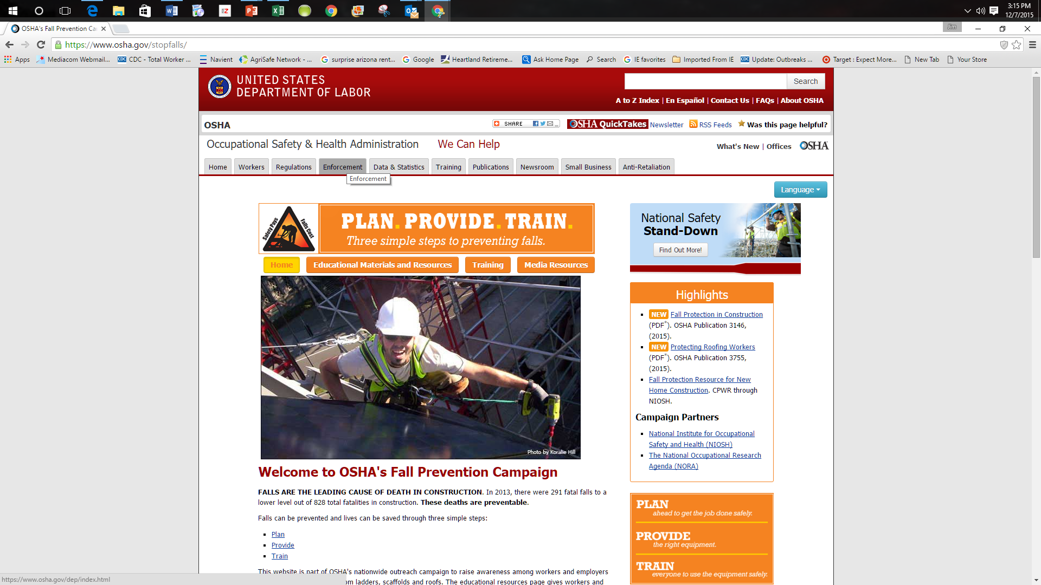
OSHA Plan Provide traiain page

Slide 50

Safety Management

Slide 51
Resources for You
AgriSafe – www.agrisafe.org
Occupational Safety & Health Administration www.osha.gov
Institute for Occupational Safety & Health www.cdc.gov/niosh ~ home for NIOSH Ag Centers
National Education Center for Agricultural Safety – www.necasag.org
National Safety Council- www.nsc.org

Slide 52
Evaluation
It is the goal of AgriSafe to provide information and education that is vital and pertinent to your minimize agricultural health and safety risks.
Please take a few minutes to honestly evaluate this program. Your input and suggestions will help us in our effort to continually improve our work on behalf of the agricultural community.

Slide 53
Test
Test questions
In 2013, direct on-farm U.S. employment provided:
a.over 2.6 million jobs
b.approximately 4 million jobs
c.almost 1.5 million jobs
There is an OSHA Agricultural Standard for slips, trips, and falls?
True
False
Same level falls are also referred to as slips and trips?
True
False
Same level/low level falls have a higher level of severity but a lower level of frequency than high level falls?
True
False
Elevated/ high level falls are considered to be at or over?
a.5 feet
b.10 feet
c.15 feet

Slide 54
Test page 2
Water is best channeled on workplace footwear by:
a.multiple narrow channels
b.several wide grooves
The average age of a farmer/rancher is:
a.almost 57
b.over 58
c.60.5
Which statement is true?
a.High quality sunglasses or tinted safety glasses transition easily from bright to low lit areas.
b.Sunglasses or tinted eyewear should be removed when entering lower lit areas.
It is estimated that ____________ of agricultural injuries are unreported.
a.almost 25%
b.almost 45%
c.almost 60%
In 2014, agriculture had:
a.the highest rate of deaths per 100,000
b.tied construction with the second highest rate of deaths per 100,000
c.the third highest rate of deaths per 100,000

