Slide 1

Prevention Strategies to Protect Women Working in Agriculture

Slide 2
Susan Harwood Training Grant
This material was produced under grant # SH–26280-SH4 from the Occupational Safety and Health Administration, U.S. Department of Labor. It does not necessarily reflect the views or policies of the U.S. Department of Labor, nor does the mention of trade names, commercial products, or organization imply endorsement by the U.S. Government

Slide 3

Goals
Upon completion of this webinar, participants will be able to:
List a minimum of four factors related to women’s health and safety in agriculture.
Discuss potential solutions that would address the unique safety and health challenges to women engaged in agriculture.
Locate a minimum of three recommended clinical and community health resources that address women’s agricultural health and safety program development and education needs.

Slide 4

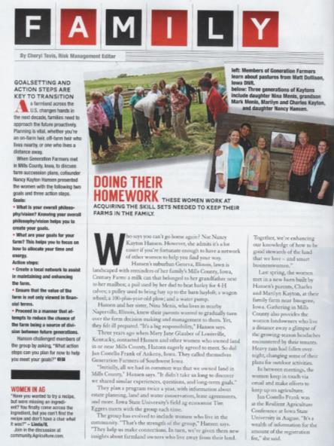

In the News
Notes:
Sources are publications (Agriculture Magazines)
Family – Successful Farming Magazine
Women in Ag – Farm News Publications
Channel Arrow – Channel Arrow Publication (Channel –Seedsmanship at work)

Slide 5

From the Home front to the Forefront
They’re Wives
They’re Mothers
They’re Chauffeurs
They're Cooks
They're Housekeepers
They're Businesswomen
And They're Farmers
Notes:
Source: Channel Arrow – public AG publication

Slide 6

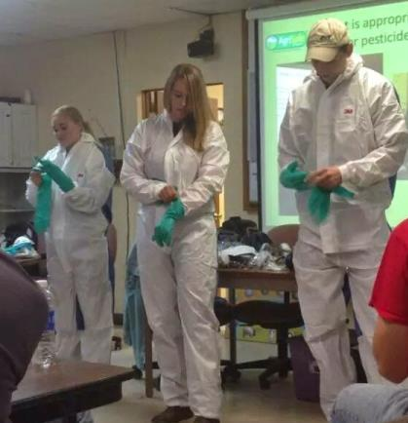
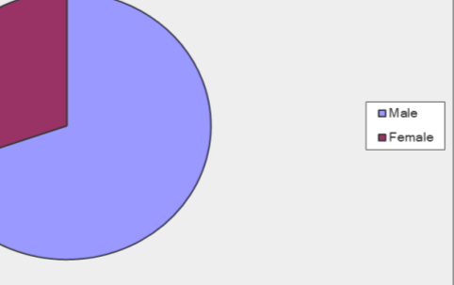
Iowa State -AG 450 Farm
Number of females increasing
Out of 79 students
Male 69.6% 55
Female 30.4% 24
Notes:
Source:
Picture from 450 Farm – AgriSafe Property
Data – Survey by AgriSafe Network

Slide 7

Women in Agriculture
The Power of Women in Agriculture Posted by Agriculture Secretary Tom Vilsack, on March 21, 2014;
“Across the country, nearly 300,000 women serve as principal operators on 62.7 million acres of farm and ranchland, accounting for $12.9 billion in farm products in 2012. Countless more women live, work and raise families in rural America”.
“ Better representation of women in agriculture means more than just an increase in the amount of food produced on women-owned or women-operated farms and ranches. It means expanded opportunity for today’s women agriculturists to access credit and grow their operations, assume leadership roles at the local, state and federal level, and perform cutting edge research that will help ensure the future food security of our nation and the world.”

Slide 8
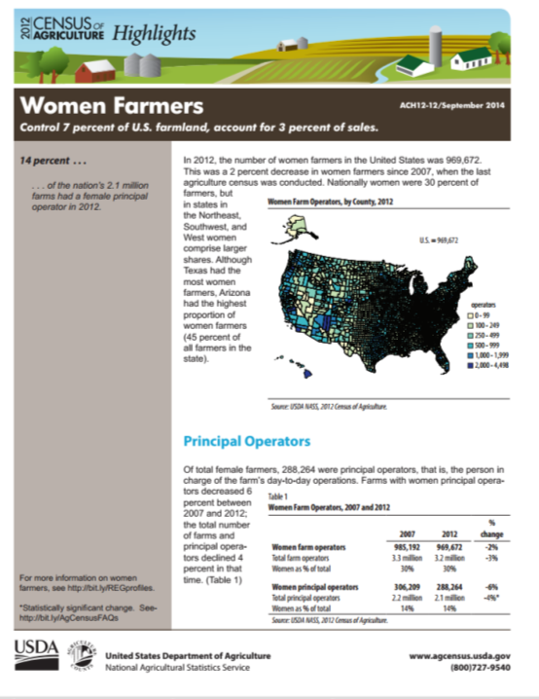
Women Farmers
The number of U.S. farms operated by women nearly tripled over the past three decades, from 5 percent in 1978 to 14 percent by 2007.
According to the 2012 USDA Census of Agriculture among 2.1 million principal farm operators in 2012, 86% were men and 14% were women.
Of the 2.1 million principal operators in the United States, 288,264 were women.
This was a 6 percent decrease since 2007 – larger than the decrease in male principal operators.
But for all female operators (principal, second, and third), the decrease was only 1.6 percent. Women were 14 percent of principal operators but 30 percent of all operators.
Notes:
2012 public Census report from USDA

Slide 9
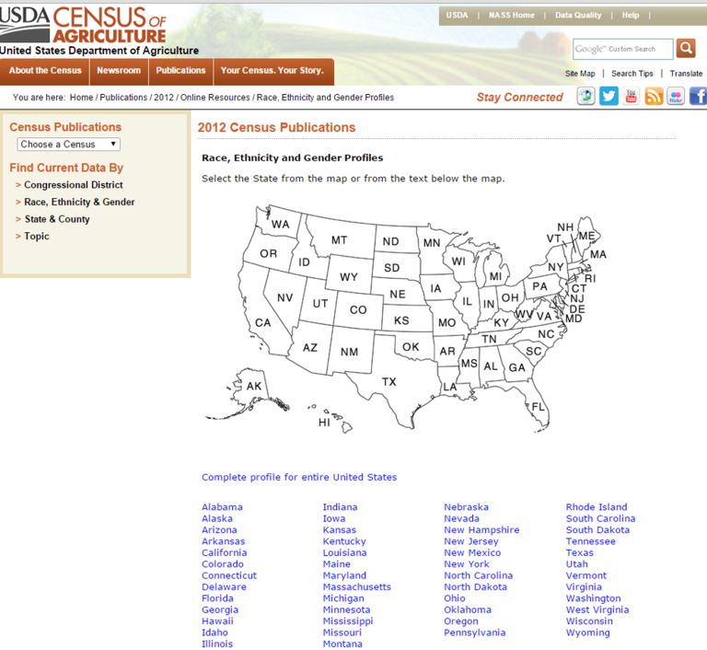
2012 Census
2012 Census by Race, Ethnicity & Gender

Slide 10
Prevalence
The range of farm activities compound the problem of assuring a safe worksite for farm women who have their own inherent contraindications.
NIOSH lists numerous women’s safety and health issues related to an agricultural job including;
acute and chronic pesticide exposures,
chronic bronchitis among nonsmoking farm women,
pregnancy related risks,
farm work-related injuries,
exposures to inhaled substances in the workplace and
risk factors for female infertility in an agricultural region.

Slide 11

Literature
Donham and Thelin describe similar risk areas for women in agriculture with inclusion of livestock related injuries, fatigue, risk for cancer and depression. (Agricultural Medicine, Rural Occupational Health for the Health Professions, 2006)
“Women on farms are exposed to a multitude of biologic, chemical, physical, and mechanical agents while performing farm tasks. It is evident that women will be an increasing force in agriculture” (Ann K. Carruth, Carrie A. McCoy and Deborah Reed; Women in Agriculture: Risks for Occupational Injury within the Contexts of Role, and Haddon's Injury Model)
Notes:
Sources: (Agricultural Medicine, Rural Occupational Health for the Health Professions, 2006)
(Ann K. Carruth, Carrie A. McCoy and Deborah Reed; Women in Agriculture: Risks for Occupational Injury within the Contexts of Role, and Haddon's Injury Model)

Slide 12
Literature
Each farm family has its own set of values that are influenced by the family's ethnicity, socioeconomic status, level of education, and cultural traditions
These values influence the division of labor on farms, and women's potential exposure to multiple roles, factors contributing to occupational illness, stress, fatigue, and agricultural injuries. ( Weinert & Burman, 1994)
Notes:
Source: (Weinert & Burman, 1994)

Slide 13

Continuum of Life

Slide 14
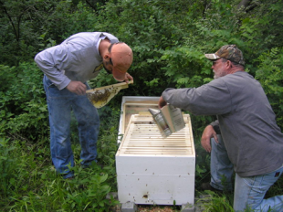


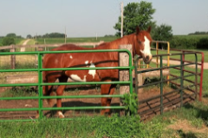


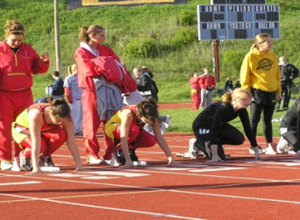
Life’s Priorties
Priorities
Notes:
Photos property of AgriSafe Network

Slide 15
Health and Safety Education
Safety education for the agricultural population is often aimed at the men in farming operations resulting in this high risk population being less educated and prepared to prevent acute injuries and illness as well and long term chronic conditions related to agricultural work.
Occupational health research on farm workers struggle to incorporate gender analysis into research design and analytical approaches. The role of gender in shaping health outcomes is evident in occupational health research. (Habib RR, Elzein K, Hojeij S)

Slide 16

Quotes
Challenges
“Balancing family and farming is the biggest challenge.
My husband is often busy at the same time I am but many times when I get home he will have fed the children and put them to bed. I rely on my Mom who lives close to pick them up from day care and school. With the new equipment women can do most anything men can do”.
“Balancing my off farm full time job and helping farm. We farm a lot of acers by ourselves so it is just the two of us. We don’t have new equipment so break downs can be stressful. It can be hard run some of the equipment because I am not strong enough.”
Notes:
Source: Interviews with farm women. Permission to use quotes.

Slide 17


Migrant Workers
Important Population
Migrant Clinicians Network (MCN )
Reproductive Health Effects of Pesticides
Tool Kits
“Rural Women's Health Project”

Slide 18


I think the biggest thing is that everything else takes a back seat. Nothing else gets done. No time for myself and I can’t keep up with the other things like laundry, cleaning and even cooking. When we both leave the door at the same time in the morning and come back at the same time I can’t keep up. We just eat and hit the bed.
I don’t have the same physical strength as a man would and sometimes I just can’t do what needs to be done. The equipment is so big now (tractors and wagons) it wo
Much of the time we work alone – fields away from each other. It is better now with 2-way radios and cell phones.
I also have an off the farm job that I take time off from (with no pay) during harvest and spring. They understand - but when it rains and I should maybe try and get caught up at home, I feel guilty and so I go to work.
Notes:
Interview with farm woman, permission to use quotes

Slide 19

Ergonomics
Women have anatomical and physiological differences that may place them at risk for farm injuries (Engberg, 1993).
Females are, on average, shorter than men and have more adipose tissue. Females also have narrower shoulders, wider hips and proportionally have shorter legs and arms than their male counterparts (Mackay, & Bishop, 1984).
On average upper body strength is 40% - 75% less in females than in males, while lower body strength is 5% - 30% less in females (Falkel, Sawka, Levine, Pimental, & Pandolf., 1986).
Notes:
Articles obtained through Pub Med Literature search

Slide 20
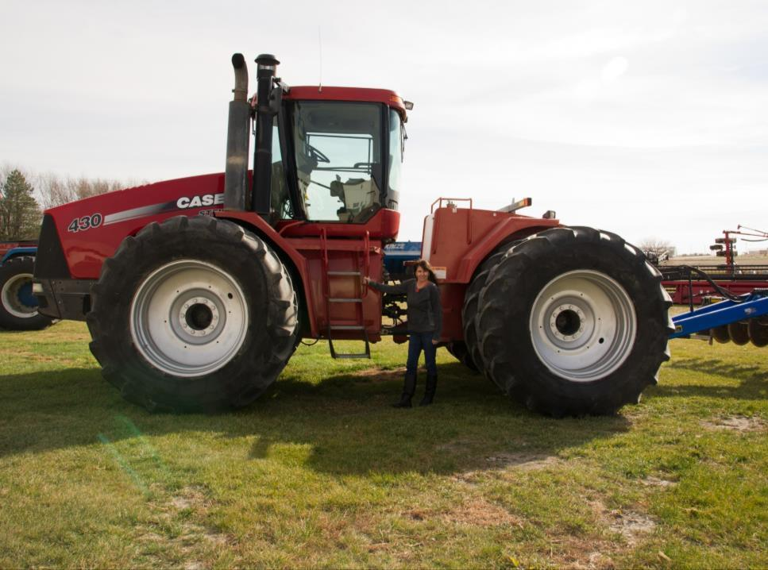
Equipment Size
Equipment size and length of time driving equipment also may be a factor in injuries. Most farm equipment is sized and designed for men. (Carruth et al., 2001).
Notes:
Photo property of AgriSafe Network

Slide 21
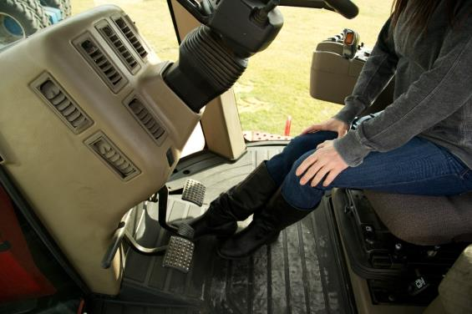
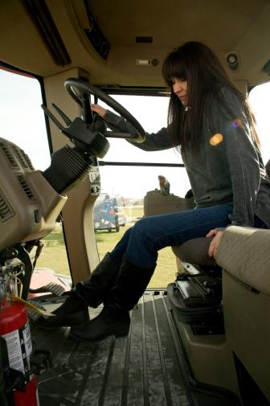
Challenges for women
The placement of levers and the strength required to move them may be more suited to the average male. (Carruth et al., 2001).
Notes:
Photo Property of AgriSafe Network

Slide 22
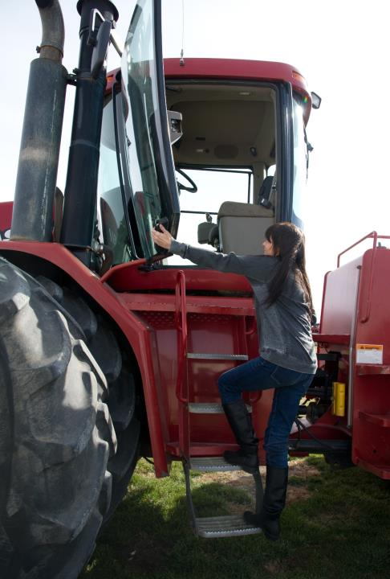
Driving tractors an average of one day a week has been found to increase the risk of nonfatal farm injury (Carruth et al., 2001).
Notes:
Photo Property of AgriSafe Network

Slide 23
Clinician Solutions
Agricultural Health Risk Assessment
Assessment to determine of signs of injury that may be related to agricultural work
Fitting tools and tasks to the persons performing them in such a way that the strengths of the human body and psychology are maximized and exposure of weaknesses to stressors is minimized.

Slide 24
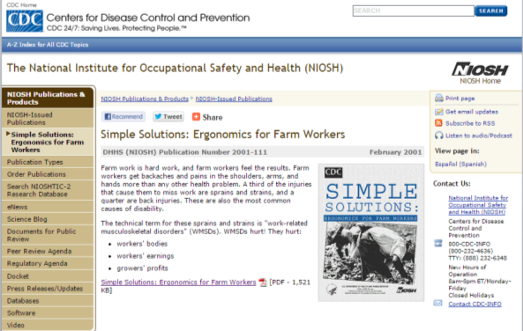
Clinician Solutions
While it is logical and useful to apply general strategies to generally similar tasks, significant development and application work is usually required to result in effective intervention.
Simple Solutions – NIOSH Resource

Slide 25

Pesticides Literature
US Agriculture Health Study – wives of pesticide applicators
Self report or MD diagnosed depression in women 3.26 x higher risk if earlier poisoning
Breast Cancer Risk
US Agriculture Health Study shows an unclear risk
Proximity of farm to areas of pesticide application
Husband’s use of 2,4,5-TP and possibly dieldrin, captan, and 2,4,5-T Children exposures
Take home exposure
Source: Beseler C, et al. Depression and Pesticide Exposures in Female Spouses of Licensed Pesticide Applicators in the Agricultural Health Study Cohort. J Occ Env Med •Volume 48, Number 10, October 2006.
Source: Engel L, et al (2005). Pesticide Use and Breast Cancer Risk among Farmers' Wives in the Agricultural Health Study American Journal of Epidemiology, 161: 121-135.

Slide 26
Pesticides
Documented health effects include a wide variety of illnesses and diseases:
Eye irritation,
skin rashes
respiratory problems
neurological damage
birth defects
cancer and death.
The risk for and severity of adverse health effects from pesticide exposure varies significantly depending on many factors, including individual characteristics such as age and health status, the specific pesticide, and exposure circumstances.
Exposure to pesticides at certain developmental stages of life can result in irreversible damage to organ structure and function. Of particular concern is the effect of exposure at during the reproductive cycle, from preconception to breast feeding, because of the possibility of poor birth outcomes, congenital anomalies, developmental deficits, and possibly childhood cancer.
Source: Sanborn M, Cole D, Kerr K, Vakil C, Sanin Luz Helena, Bassil K. Pesticides Literature Review:
Systematic Review of Pesticide Human Health Effects. Ontario, The Ontario College of Family
Physicians. 2004
Notes:
Source: Sanborn M, Cole D, Kerr K, Vakil C, Sanin Luz Helena, Bassil K. Pesticides Literature Review:
Systematic Review of Pesticide Human Health Effects. Ontario, The Ontario College of Family
Physicians. 2004
Documented health effects include a wide variety of illnesses and diseases, from eye irritation, skin rashes and respiratory problems to neurological damage, birth defects, cancer and death. The risk for and severity of adverse health effects from pesticide exposure varies significantly depending on many factors, including individual characteristics such as age and health status, the specific pesticide, and exposure circumstances. Exposure to pesticides at certain developmental stages
of life can result in irreversible damage to organ structure and function. Of particular concern is the effect of exposure at during the reproductive cycle, from preconception to breast feeding, because of the possibility of poor birth outcomes, congenital anomalies, developmental deficits, and possibly childhood cancer.

Slide 27
Pesticide Literature
Women using pesticides have 1.5 x increased odds of
Longer cycles
Missing a period
Hormonally active pesticides increase odds of missed periods, long cycles, bleeding mid cycle.
Lindane
Atrazine
Mancozeb or Maneb
Source: Farr SL, Cooper GS, Cai J, Savitz DA, Sandler DP. Pesticide use and menstrual cycle characteristics among premenopausal women in the Agricultural Health Study. (2004). American Journal of Epidemiology, 160(12):1194-204.
Notes:
Power point from MCN

Slide 28

Clinical Solutions
Health care providers are in an ideal position to identify and assess a patient’s risk for exposure.
The first step is to obtain an environmental history that covers
residential and employment histories,
types of work activities performed currently and in the relevant past, and
possible sources of exposure to biological or chemical agents. For each exposure source identified, additional information needs to be collected, such as frequency, duration, and intensity.
Source: Reproductive Health Effects of Pesticide Exposure ;Issues for Farmworker Health Service Providers
Pamela Rao PhD, Farmworker Justice
Migrant Clinicians Network
Notes:
Source: Reproductive Health Effects of Pesticide Exposure
Issues for Farmworker Health Service Providers
Pamela Rao PhD, Farmworker Justice
Migrant Clinicians Network
Documented health effects include a wide variety of illnesses and diseases,
from eye irritation, skin rashes and respiratory problems to neurological damage, birth defects, cancer
and death. The risk for and severity of adverse health effects from pesticide exposure varies significantly
depending on many factors, including individual characteristics such as age and health status, the
specific pesticide, and exposure circumstances. Exposure to pesticides at certain developmental stages
of life can result in irreversible damage to organ structure and function. Of particular concern is the
effect of exposure at during the reproductive cycle, from preconception to breast feeding, because of
the possibility of poor birth outcomes, congenital anomalies, developmental deficits, and possibly
childhood cancer

Slide 29
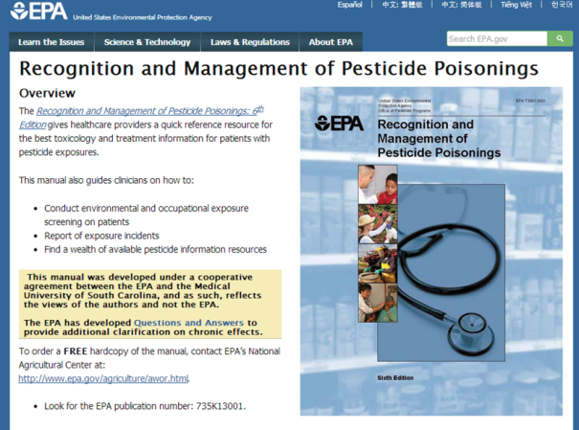
Clinical Resources
EPA Recognition and Management of Pesticide Poisonings
Online or
Free manual

Slide 30
Clinical Solutions
EPA - Recognition and Management of Pesticide Poisonings
Women who are pregnant or planning a pregnancy, especially those currently performing farm work, should be informed of the implications of exposure before, during and after pregnancy, and assisted in making decisions that are appropriate for their individual work and home situations .
Providers should encourage mothers to avoid exposure that might contaminate breast milk without unduly alarming them, perhaps by associating it with the importance of not smoking or drinking alcohol during pregnancy and nursing .
Of course, breast feeding should continue to be strongly encouraged since all evidence indicates that the known benefits far outweigh the potential risks .
Notes:
EPA - Recognition and Management of Pesticide Poisonings
Reproductive Health Effects of Pesticide Exposure
Issues for Farmworker Health Service Providers
Migrant Clinicians Network
Pamela Rao PhD
Farmworker Justice

Slide 31
Clinical Solutions
Education about pesticide safety is an important measure for preventing exposure.
Education on ways they and the farmworkers with which they live can reduce take‐home exposure:
Remove work clothes and shoes before entering the home
Shower or bath upon returning home and before touching other people
Store and launder dirty work clothes separately from other clothing
Notes:
Power point from MCN

Slide 32
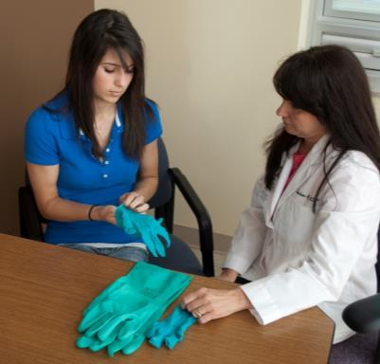
Pesticides
Read the label
Wear appropriate PPE
Find PPE that fits
Gloves
Goggles
Tyvek
Respirator
Notes:
Photo Property of AgriSafe Network

Slide 33
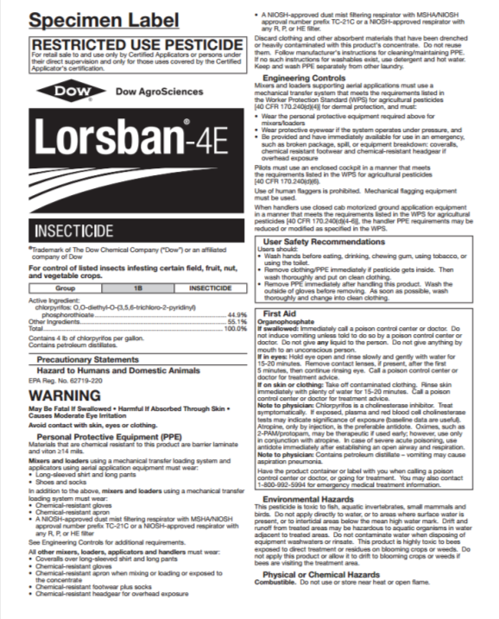
Label is Key Precautionary Statement Personal Protective Equipment

Slide 34

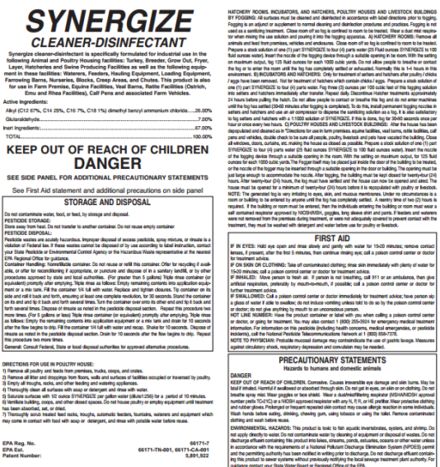
Synergize disinfectant
Causes irreversible eye damage and skin burns.
May be fatal if inhaled.
Harmful if swallowed or absorbed through skin.
Do not get in eyes, on skin or on clothing.
Do not breathe spray mist.
Wear goggles or face shield.
Wear a dust/mist/filtering respirator (MSHA/NIOSH approval number prefix TC-21C) or a NIOSH approved respirator with any N, P, R, or HE prefilter.
Wear protective clothing and rubber gloves. Prolonged or frequent repeated skin contact may cause allergic reaction in some individuals.
Wash hands before eating, drinking, chewing gum, using tobacco or using the toilet. Remove contaminated clothing and wash before reuse
Notes:
Photo property of AgriSafe Network

Slide 35
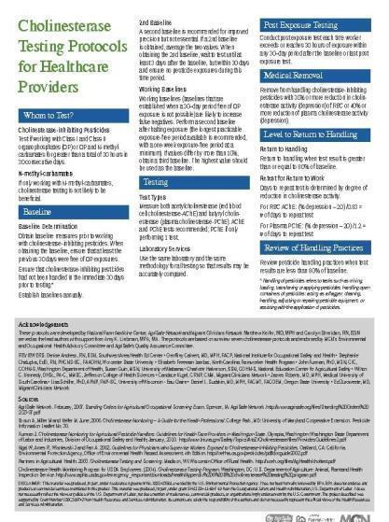
Cholinesterase Protocol for Healthcare Providers
Cholinesterase Protocol for Healthcare Providers
Whom to Test?
Testing
Post Exposure Testing
Medical Removal
Level of Return to Handling
Review of Handling Practices
Archived Webinar
Notes:
We developed this protocol after review of 7 different protocols and came up with one standard protocol.

Slide 36
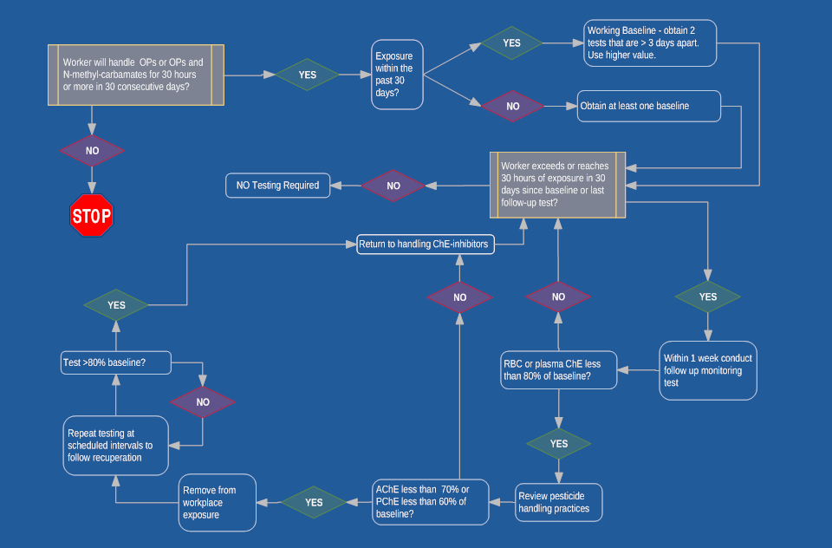
Cholinesterase Algorithm
Cholinesterase Algorithm
Notes:
This is the cholinesterase algorthim
Handy map to guide you through the thinking of cholinesterase monitoring

Slide 37

Client Resource
National Pesticide PPE Training Solutions Committee
Source: National Association of County Agricultural Agents: nacaa.com
Source: Pesticide Environmental Stewardship: pesticidestewardship.org
Source: Syngenta Environmental Stewardship: syngentacropprotection.com/Env_Stewardship
Notes:
Brochure focuses on some of the basics of PPE but does not substitute for following the pesticide label, the PPE user instructions, and all applicable government regulations to reduce exposure, the required PPE must be handled properly from purchase through disposal, whether you apply a pesticide at home, or work in an agricultural or non-agricultural occupation.
The plan is to use it as a template for creating the comprehensive brochure with the committee.
1) Anyone can order quantities of the actual brochure from me for their pesticide safety/stewardship outreach efforts. The brochures are free.
2) The PDF version of the brochure will be available on the Pesticide Environmental Stewardship (PES) website, the NACAA website, and the Syngenta website. Any other organization desiring to post the brochure or link to it is welcome to do so.
3) With the addition of this brochure, there will now be seven general pesticide stewardship brochures on the PES website (http://pesticidestewardship.org/Pages/Resources.aspx). Anyone can view or download these brochures from PES, or order quantities for pesticide stewardship outreach. PES also welcomes new partners that provide content, editorial assistance, or financial support, so any organization that assisted with the PPE brochure is already eligible to join!
4) All of the partners on these seven brochures have also agreed to provide the Word versions to any organization desiring to modify or extract content, and/or put their own logo on the brochure. The goal is widespread distribution of basic messages related to pesticide stewardship and safety.
It was a pleasure working with the National Pesticide PPE Training Solutions Committee. After committee members review the PPE brochure, we would welcome opinions on whether it should be translated to Spanish “as is�, or used to prepare a two-sided handout at the 6-8th grade reading level in English and Spanish. These were previous requests from members of the Committee.

Slide 38

Respiratory Literature
Farm women have been overlooked in the evaluation of respiratory hazards of agriculture although they commonly perform tasks that are similar to those done by men
Pesticides as well as grain and dust exposures were associated with chronic bronchitis among non-smoking farm women.
CHRONIC BRONCHITIS AMONG NON-SMOKING FARM WOMEN IN THE AGRICULTURAL HEALTH STUDY (Martin Valcin1,2, Paul K. Henneberger2, Greg J. Kullman2, David M. Umbach3, Stephanie J.London1, Michael CR Alavanja4, Dale P. Sandler1, and Jane A.)

Slide 39
Prevalence
In agriculture, farmers, ranchers and workers including women can be exposed to multiple respiratory hazards that can cause short- and long-term health problems. Examples of respiratory exposures:
organic dusts,
molds
bacteria
gases
Pesticides
Rural providers are on the front lines and are in an excellent position to decrease morbidity and disability resulting from acute and chronic exposure to agricultural respiratory toxins.
Prevention of unnecessary exposures and the early accurate diagnosis of respiratory disease resulting from the agricultural environment is best performed initially in the primary care clinic, rather than the tertiary referral center. ( A PRIMER FOR WISCONSIN PRACTITIONERS AND HEALTH/SAFETY PROFESSIONALS, Steven R. Kirkhorn, M.D., M.P.H., F.A.C.O.E.M.)
Notes:
Source: A PRIMER FOR WISCONSIN PRACTITIONERS AND HEALTH/SAFETY PROFESSIONALS
Steven R. Kirkhorn, M.D., M.P.H., F.A.C.O.E.M.
University of Minnesota Family Practice and Community Health
Faculty-University of Minnesota Rural Family Practice Residency, Waseca, MN.
The agriculture workplace has long been known to be associated with respiratory disease. Respiratory disease is among the main chronic health conditions affecting farmers (Brackbill et al, 1994). Those who are at potential risk include farmers and farm families, agricultural workers, abattoir workers,
greenhouse and nursery workers, veterinarians, and grain elevator workers. While the massive exposures leading to severe acute disease have decreased, it is postulated that there has been a significant increase in subacute and chronic respiratory disease resulting from increased indoor air exposure (Donham 2000; Von Essen and Donham, 1999).
Rural providers are on the front linesand are in an excellent position to decrease morbidity and disability resulting from acute and chronic
exposure to agricultural respiratory toxins. Prevention of unnecessary exposures and the early accurate diagnosis of respiratory disease resulting from the agricultural environment is best performed initially in the primary care clinic, rather than the tertiary referral center. Unfortunately, it is recognized that
rural primary care health care providers often do not have the training to provide this method of preventive health care.

Slide 40
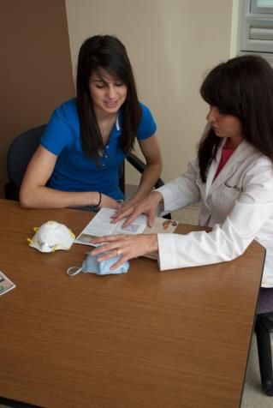

Head to Toe Protection Includes Respiratory Protection
Notes:
Photo Property of AgriSafe Network

Slide 41
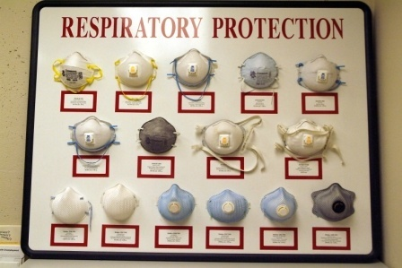
Filtering Face Piece Masks

Slide 42
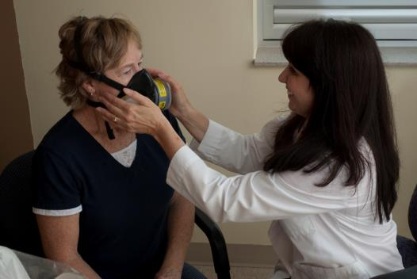
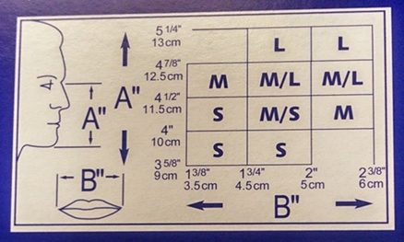
The right mask The right fit
Notes:
Photos property of AgriSafe Network

Slide 43
Clinical Solutions
Agricultural specific Health Risk Assessment
Understand Exposures
Understand importance of appropriate protection
Right mask, for the right job with the right fit.

Slide 44
Agricultural Respiratory Selection Guide

Slide 45

Stress
A person’s mental health and well-being is affected on a daily basis by a myriad of external and internal forces. Nowhere is this more evident than in an agricultural setting where work and family life intersect 24/7.
An agricultural worker well-being and ability to make a living are dependent on market values, weather, family structure, labor costs, livestock health, and machinery upkeep – to name a few.
Personal health, safety, and overall well-being can often be ignored and sidelined.

Slide 46

Literature
Review of literature supports women in farming work in multiple roles.
“A farm woman with an off farm job faces very difficult demands in addition to being the traditional nurturer for the rest of the family”. (Moolgaard and Miller, 1996)
Notes:
Farm women may experience additional stressors. Besides working as a full partner in the farm business, many farm women have full responsibility for home and family matters. A farm woman with an off farm job faces very difficult demands in addition to being the traditional nurturer for the rest of the family.(Moolgaard and Miller, 1996)
(Moolgaard and Miller, 1996)

Slide 47
Stress
Women in Agriculture Stress
Multiple roles
Off farm work
Live with risk every day
Lack of mental health providers

Slide 48
Factors affecting stress
Many factors that influence a farm’s viability are out of a farmer’s control. Often what we cannot control causes us to feel the most stressed.
The weather
Increased input costs
Large debt loads
Animal disease outbreaks
Increased government regulation
Long working hours
Disagreements with other family members in farming operation
Uncertain crop yield
Machinery breakdowns
Handling dangerous goods
Notes:
Source: Difficult Times: Stress on the Farm
Approval to use this source
Canada: CASA-ACSA CCHSA CCSMA

Slide 49
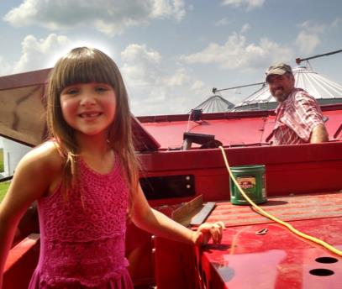
Stress
“ I really want to help more but my children are young (6 and 18 month) and it is hard to find child care. I want to keep them safe so I end up not helping and that feels stressful. I am not from the farm so it has been a big adjustment certain times of the year when I don’t see my husband except when he eats and sleeps. My father-in – law helps a lot but he is 87 so we worry about him too. “
Notes:
Photo property of AgriSafe Network

Slide 50

Family Challenges
“ The biggest challenge is the juggling act we do between our household and our farm. In that is the fact that we do not have any leeway for sickness or even inefficiency. Other jobs I’ve had one could call in sick if needed but we have no such luxury. That leads to the worry that if Paul ever hurt himself it would unhinge the whole delicate balance. I worry about him working alone for this reason”.
Notes:
Photo – property of AgriSafe Network

Slide 51
Shortage of Rural Mental Health Care Providers
Integration in existing care models
Include depression screening with Preventive Health Care.
Standard questions
Support systems
Appropriate referrals
Help with coping

Slide 52
Patient Questionnaire
PHQ-9 GAD -7
The Patient Health Questionnaire (PHQ)and GAD-7 offer clinicians concise, self-administered screening and diagnostic tools for mental health disorders, which have been field-tested in office practice.
The screeners are quick and user-friendly, improving the recognition rate of depression and anxiety and facilitating diagnosis and treatment.
Notes:
Advantages of the PHQ-9
This tool :
Is shorter than other depression rating scales,
Can be administered in person, by telephone, or self-administered,
Facilitates diagnosis of major depression,
Provides assessment of symptom severity,
Has proven effective in a geriatric population, (Löewe B,et al, 2004 Medical Care)
Is well validated and documented in a variety of populations

Slide 53

Social Networks
Face book - Life on an Iowa Farm
Notes:
Permission from Steph Essick to use her Face Book and any posts.

Slide 54

Social Networks
Face Book – Ask the Farmer

Slide 55


Social Networks
Face Book
The Farmer’s Daughter
Women in Ag

Slide 56

Social Networks
Face Book - Ag Nurse
This site is for nurses and others interested in agricultural health and safety issues. You can share ideas, resources, and learn about the latest research to improve practice and instruction.

Slide 57

Network Blog

Slide 58
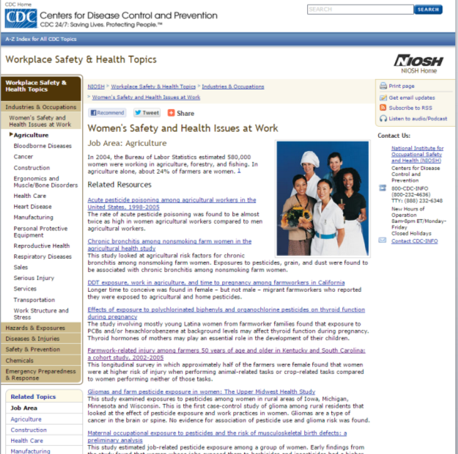
Women’s Safety and Health Issues at Work Job Area: Agriculture

Slide 59

Susan Harwood Training Grant
This material was produced under a grant (SH23580SH2 ) from the Occupational Safety and Health Administration, U.S. Department of Labor. It does not necessarily reflect the views or policies of the U.S. Department of Labor, nor does the mention of trade names, commercial products, or organization imply endorsement by the U.S. Government.

Slide 60
Employee Rights
You have the right to:
A safe and healthful workplace
Know about hazardous chemicals
Information about injuries and illnesses in your workplace
Complain or request hazard correction from employer

Slide 61
Employee Rights
You have the right to:
Training
Access to hazard exposure and medical records
File a complaint with OSHA
Participate in an OSHA inspection
Be free from retaliation for exercising safety and health rights

Slide 62


Whistleblower information
Whistle Blower Protection Program

Slide 63
Prevention Strategies to Protect Women Working in Agriculture Pre/Post-test Questions
1. Women as principal operators in U.S. farm and ranchland account for over $12 billion in farm product in 2012. T___ F___
Answer: True - $12.9 billion
2. In the U.S., nearly _____ women serve as principal farm/ranch operator.
a. 175,000
b. 285,000
c. 300,000
Answer: 300,000
3. Although women, on average, are shorter than men and have narrower shoulders, they have about an equal amount of lower body strength as men. T___ F___
Answer: False - Lower body strength in females is 5 – 30% less than in males.
4. Upper body strength in women is ____
a. actually about the same as men
b. 40 – 75 % less than men
c. 30 – 35 % less than men
d. 20 – 25 % less than men
Answer: b. 40 – 75% less than men.
5. Women using pesticides have an______ risk of menstrual cycle disruptions as women with no pesticide exposure.
a. equal risk
b. 1.5 times increased risk
c. 2 times increased risk
d. no epidemiologic research has been done in this area.
Answer: b. 1.5 times the risk
6. Women in agriculture have fewer options in proper fitting respiratory protection than men. T___ F___
Answer: True – the majority of 2 strap filtering face pieces are made in one size. A few are made in smaller sizes.

