Slide 1
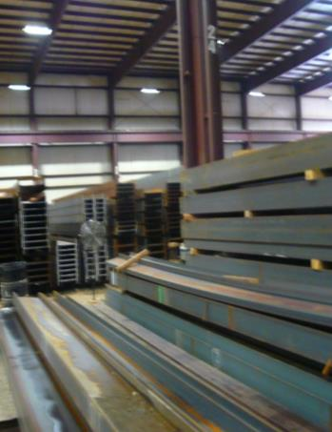
Warehouse Worker Hazards in Structural Steel Fabricating and Supply Companies Insert Location Insert Date
Notes:
This module is to be presented at the “Train the Trainer” sessions.

Slide 2
Today’s Presenter
Insert Presenter Name and Contact Information
Notes:
Include speaker name and contact information.

Slide 3
Housekeeping
Distribution of attendee training materials
Sign-in and sign-out sheets
Cell phones off
Breaks
Facilities
Emergency exit procedures
Lunch
Notes:
Speakers should present logistics and event rules. Present emergency exit procedures.

Slide 4
OSHA Grant Information
This material was produced under grant number SH-26316-SH4 from the Occupational Safety and Health Administration, U.S. Department of Labor. It does not necessarily reflect the views or policies of the U.S. Department of Labor, nor does mention of trades names, commercial products, or organizations imply endorsement by the U.S. Government.
Notes:
Speaker to provide grant materials acknowledgment.

Slide 5
Current Training Program
This Outreach Training Program provides training for workers and employers on the Recognition, Abatement, Avoidance and Prevention of safety and health hazards in Warehousing Activities in Structural Steel Fabricating and Supply Companies.
The training also provides required OSHA information regarding workers rights, employer responsibilities and how to file a complaint.
Notes:
Speaker to stress “Recognition, Abatement, Avoidance and Prevention” as well as worker rights.

Slide 6




Program Development
This program was developed by faculty and students in the School of Planning Design and Construction at Michigan State University in conjunction with
the American Institute of Steel Construction - Safety Committee and the University of Puerto Rico
July 2015

Slide 7
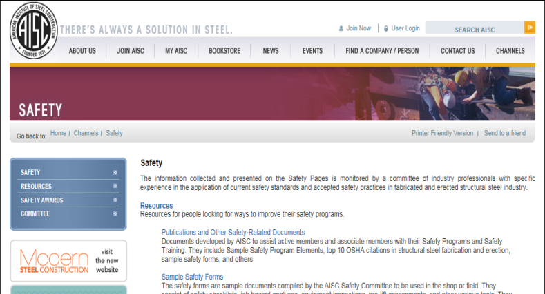
AISC Resources - Safety Channel
AISC has additional safety materials available at its website:
Safety Channel AISC Safety Resources
Date visited December 7, 2014
Notes:
The American Institute of Steel Construction (AISC) has many useful resources. Speaker should direct attendees to visit the AISC safety channel. The URL is listed on the slide.

Slide 8
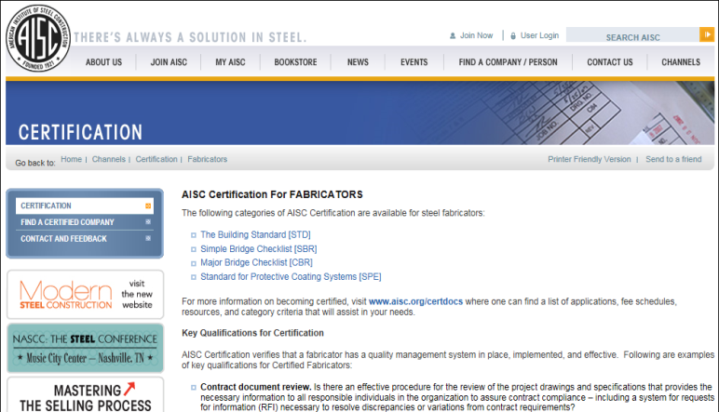
AISC Resources - Fabricator Certification
AISC has fabricator certification information at its website:
Fabricator Certification AISC Fabrication Certification URL
Date visited December 7, 2014
Notes:
The American Institute of Steel Construction (AISC) has a certification program for fabricators. The URL is listed on the slide.

Slide 9

AISC Resources - Safety Elements
AISC, separately from this
training program has
developed a document entitled “Sample Safety Program Elements for Structural Steel Fabricators” which is available for its members at:
AISC Safety Ekements Document URL
Notes:
The American Institute of Steel Construction (AISC) has developed a safety program for fabricators. The URL is listed on the slide.

Slide 10
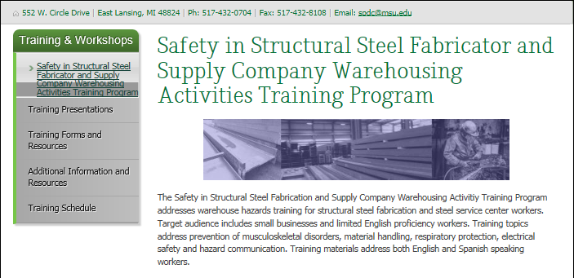
Training Website - Michigan State University
All training resources will be available at:
Notes:
Michigan State University developed a training website for this safety training program.

Slide 11
State Plans
There are 27 states that have some form of State Plan
which are enforced by state departments. This program
references the OSHA 1910 General Industry Standards.
Always check your state plan for additional requirements.
Notes:
Training should address State Plans in states where training is conducted in a state with a State Plan. This slide indicates to check your state plan.

Slide 12
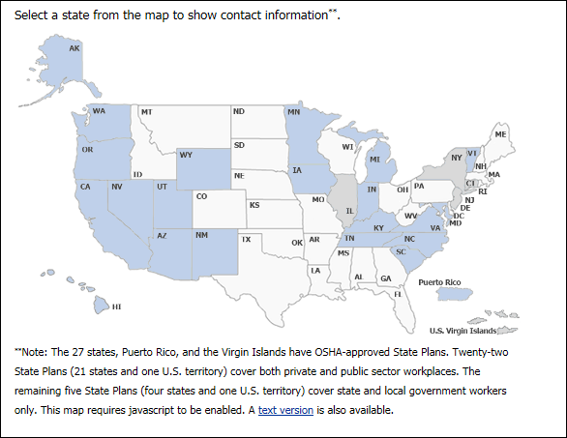
State Plans
State Plans Map URL
Date visited December 7, 2014
Notes:
This slide presents an OSHA map showing states with State Plans.

Slide 13
State Plans
Information on State Plans can be found at:
https://www.osha.gov/dcsp/osp/index.html
Notes:
Speaker should provide a link to the State Plan when presenting in states with State Plans.

Slide 14
Program Objective
To reduce injuries through the development and delivery of safety training - focusing on Warehouse Worker Hazards in Structural Steel Fabricating and Supply Companies emphasizing:
Material Handling and Storage
Hazard Communication
Musculoskeletal Safety
Electrical Safety
Respiratory Safety
Workers Rights
Notes:
Speaker should identify the program objectives.

Slide 15
Trainer Morning Schedule*
7:30-8:00 Registration
8:00-8:15 Program introduction, Program Objectives, Procedures
8:15-8:30 Pretest
8:30-8:45 Overview of special Warehouse Worker Hazards in Structural Steel Fabricating and Supply Companies
8:45-9:00 Hazard mapping exercise
9:00:10:00 Material Handling and Storage
10:00-10:15 Break
10:15-11:15 Material Handling and Storage
11:15-11:45 Hazard Communication
11:45-12:00 Hazard Identification Exercise
12:00-1:00 Working Lunch
Notes:
*Please note that this schedule is for the “Train the Trainer” session. The schedule can be broken into multiple sessions for the secondary trainings.
Speaker to provide an overview of the day training schedule.

Slide 16
Trainer Schedule Overview*
12:00-1:00 Prevention of Musculoskeletal Injuries
1:00- 1:30 Electrical Safety and Lockout/Tagout
1:30- 1:45 Electrical Safety Exercise
1:45-2:00 Break
2:00- 2:30 Respiratory Protection
2:30- 3:00 Workers Rights
3:30- 4:00 Learning Assessment
4:00-4:30 Secondary Training Procedures and Adult Learning
Instructor Closing Comments, Issue Certificates
Program Assessment Survey
(7 contact hours total program)
Notes:
*Please note that this schedule is for the “Train the Trainer” session. The schedule can be broken into multiple sessions for the secondary trainings.
Speaker to provide an overview of the day training schedule.

Slide 17
Pretest: 8:15-8:30
Please complete the pre-training multiple choice test. We will compare the results to the end of program learning assessment.
Attendees are to take the distributed written multiple choice pretest.
Notes:
Administer the Pre-Test to document attendee knowledge prior to the attendees training.

