Slide 1
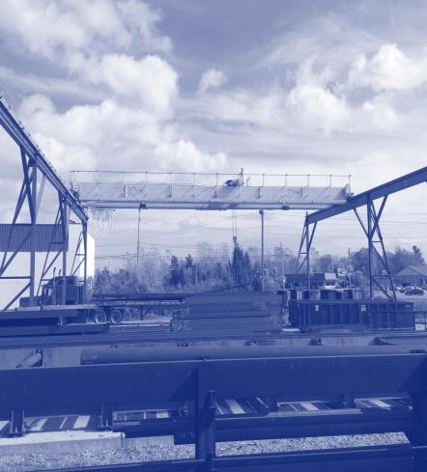
Material Handling and Storage
Module 2
Special Warehouse Worker Hazards
in Structural Steel Fabricating and Supply Companies
0
Notes:
Modules 2 and 3 present detailed information on identification and avoidance of safety hazards in handling and storage of steel shapes.

Slide 2
Material Handling and Storage – OSHA Grant Information
Material Handling and Storage
Module 2
OSHA Grant Information
This material was produced under grant number
SH-26316-SH4 from the Occupational Safety and Health Administration, U.S. Department of Labor. It does not necessarily reflect the views or policies of the U.S. Department of Labor, nor does mention of trades names, commercial products, or organizations imply endorsement by the U.S. Government.
Notes:
Speaker to provide grant materials acknowledgment.

Slide 3




Material Handling and Storage – Program Development
Material Handling and Storage
Module 2
Program Development
This program was developed by faculty and students in the School of Planning, Design and Construction at Michigan State University in conjunction with
the American Institute of Steel Construction - Safety
Committee and the University of Puerto Rico
March 2015

Slide 4
Material Handling and Storage – Learning Outcomes
Material Handling and Storage
Module 2
Learning Outcomes: Participants shall be able to:
Identify key material handling hazards
Recognize hazards associated with material handling
equipment
Identify methods to abate, avoid, and prevent
accidents when moving material
Notes:
The speaker should emphasize the key learning outcomes of Modules 2 and 3.

Slide 5
Material Handling and Storage Addressed
Material Handling Equipment
Module 2
Material Handling Equipment Addressed:
Workers and ergonomics
Overhead cranes
Mobile cranes
Trucks for receiving and shipping
Powered Industrial Trucks (Forklifts)
Carts
Industrial magnetic lifting devices
Slings, wire ropes, and alloy chains
Lifting hardware
Loading docks
Notes:
The speaker should identify the key material handling equipment used in steel fabrication and supply companies for moving materials.

Slide 6
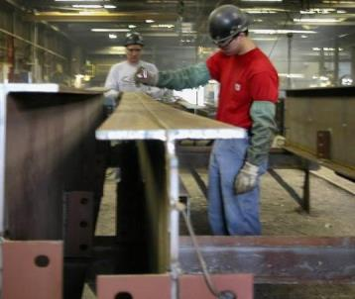
Material Handling Equipment - Workers
Material Handling Equipment
Module 2 Workers
Workers are a key part of the material handling chain
Use of equipment to help make the job easier can lead to certain injuries
Use proper lifting techniques
to avoid injury (Module 5)
Workers working on fabrication
5
Notes:
The speaker should emphasize that workers are also a key part of the material handling chain.

Slide 7
Material Handling Equipment – Workers Continued
Material Handling Equipment
Module 2
Workers
Obtain training on each piece of equipment you use
Use equipment properly
Pay attention to what you and others around you are doing
Use Personal Protective Equipment (PPE) specifically required for the task you are performing
Notes:
This slides addresses how workers can help themselves in working safe.

Slide 8

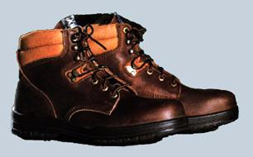
Material Handling Equipment – Personal Protective Equipment
Material Handling Equipment
Module 2
Personal Protective Equipment
For loads with sharp or rough edges, wear gloves or other hand and forearm protection
Steel-toed or composite toed safety shoes to prevent foot injuries if work is dropped
Wear a hard hat with a
good suspension system
Eye Protection
Hearing protection
Notes:
This slide presents typical PPE.

Slide 9
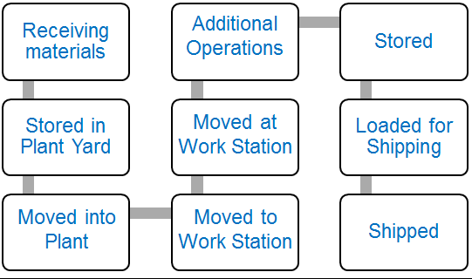
Material Handling and Storage – Equipment Use – Identifying Points of Risk
Material Handling and Storage
Module 2
Equipment Use-Identifying Points of Risk
♦
♦
♦ ♦ ♦
♦
♦
♦
♦
♦
8
Notes:
This slide presents the general process steps in handling steel materials in fabrication shops and emphasizes that risks can occur at each material handling step.

Slide 10
Material Handling and Storage – Topics addressed in Module 2 and 3
Material Handling and Storage
Module 2
Topics addressed in Modules 2 and 3
♦
♦
♦
♦
♦
♦
♦
♦
♦
♦
Notes:
This slide shows the topics addressed in the training program.

Slide 11
Material Handling and Storage – Receiving and Shipping
Material Handling and Storage
Module 2
Receiving and Shipping
♦
♦
Notes:
The next few slides focus on receiving and shipping.

Slide 12
Material Handling and Storage – Receiving and Shipping – Key Topics
Material Handling and Storage
Module 2
Receiving and Shipping-Key Topics
Rail
Trucks
Removing strapping
PPE
Loading Docks
Notes:
This slide presents the key topics for receiving and shipping

Slide 13
Material Handling and Storage – Receiving Material At The Shop
Material Handling and Storage
Module 2
Receiving material at the shop
Material typically delivered by rail or trucks
Offloaded with overhead cranes or mobile cranes
Smaller items may be offloaded with Powered Industrial Trucks (Forklifts)
Smaller items may be off loaded to loading docks
Notes:
This slide presents an overview of how materials are received and shipped.

Slide 14
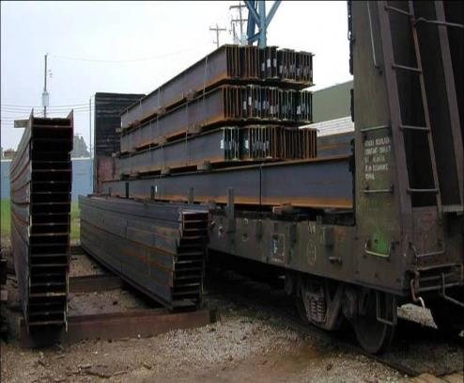
Material Handling and Storage – Receiving Material At The Shop Continued
Material Handling and Storage
Module 2
Receiving material at the shop
Steel arriving from the mill
Notes:
This slide introduces material receiving risks.

Slide 15
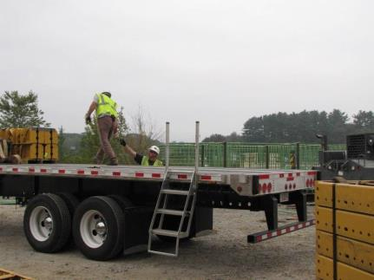
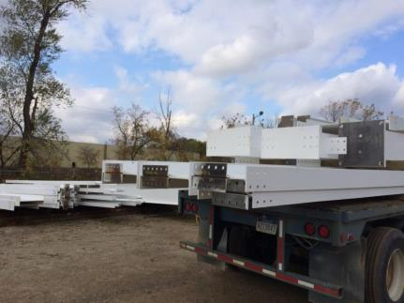
Material Handling Equipment – Trucks For Receiving and Shipping
Material Handling Equipment
Module 2
Trucks for Receiving and Shipping
Receiving material
Fabricated shapes loaded for shipping
Notes:
This slide introduces material receiving risks.

Slide 16
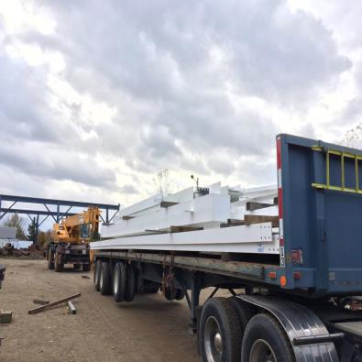
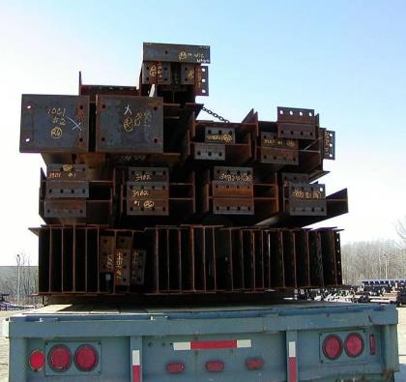
Material Handling and Storage – Loaded for Shipping
Material Handling and Storage
Module 2
Loaded for shipping
Fabricated shapes loaded and ready for shipping
Loads must be secured
Notes:
This slide depicts the irregular nature of fabricated steel items.

Slide 17
Material Handling and Storage – Potential Hazard – Moving Vehicle
Material Handling and Storage
Module 2
Potential Hazard: Moving vehicle/equipment accidents
Struck-by and caught-between accidents
Hazard Avoidance
Clear surfaces of ice and snow
Direct traffic movement and drivers with hand signals
Use trained “spotters”
Personnel should use personnel doors rather than doors intended for vehicles
Use backing-up audible warnings, lights and flashers
Stand clear of moving vehicles
Do not stand between vehicles and obstructions
Maintain clearances
Notes:
This slide addresses “struck by and caught between” hazards of receiving and shipping steel and provides strategies for avoiding these risks.

Slide 18
Material Handling and Storage – Poterntial Hazard – Moving Vehicle Continued
Material Handling and Storage
Module 2
Potential Hazard: Moving vehicle/equipment accidents
Struck-by and caught-between accidents
Hazard Avoidance
Set brakes of trucks to prevent trucks from moving during loading and unloading
Block/chock wheels to prevent movement
Follow company policy on whether drivers can remain in trucks during loading and off loading
Maintain guards at dropped loading areas
Other methods to avoid hazards that you use?
Notes:
This slide further addresses “struck by and caught between” hazards of receiving and shipping steel and provides strategies for avoiding these risks.

Slide 19
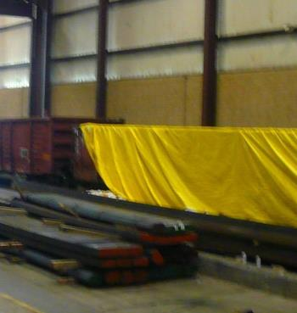
Material Handling Equipment – Rail for Receiving and Shipping
Material Handling Equipment
Module 2
Rail for Receiving and Shipping
OSHA 1910.178 (k) requires wheel stops or other recognized positive protection to prevent rail cars from moving during loading or unloading
Rail cars used for delivery of steel
Notes:
This slide presents OSHA 1910 178(k) requirements for preventing movement of rail cars when being loaded or unloaded.

Slide 20

Material Handling and Storage – Use of Spotters
Material Handling and Storage
Module 2
Use of Spotters
Link to Preventing Backovers on OSHA Website
Notes:
The next five slides address the use of spotters when unloading and loading trucks.

Slide 21
Material Handling and Storage – Use of Spotters – Backing Safety Solutions
Material Handling and Storage
Module 2
Use of Spotters - Backing Safety Solutions
“Spotters are a proven method of protecting employees on foot behind vehicles with an obstructed view, but spotters themselves can be at risk for injury or even death.”
Link to Spotters on OSHA Website
Notes:
Spotters can help protect others from risks when moving trucks, but spotters themselves can be at risk.

Slide 22
Material Handling and Storage – Backing Safety Solutions
Material Handling and Storage
Module 2
Use of Spotters - Backing Safety Solutions
Spotters and drivers agree on hand signals before backing
Spotters should maintain visual contact with the driver
Drivers should stop backing immediately if they lose sight of
the spotter
Spotters should not have additional duties while they are acting as spotters
Spotters should not to use personal mobile phones, personal headphones, or other items which could pose a distraction during spotting activities
Spotters should wear high-visibility clothing, especially during night operations
Link to Spotter Web Page on OSHA Website
Notes:
This slide provides tips for keeping spotters safe.

Slide 23
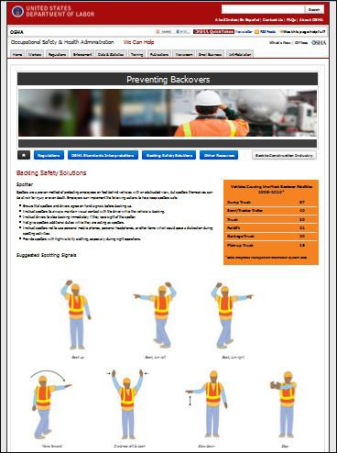
Material Handling Equipment – Hand Signals
Material Handling Equipment
Module 2
Hand Signals
Use hand signals to direct drivers
link to spotter web page on OSHA Website
Notes:
Spotters should use agreed upon hand signals that are known to both the driver and spotter.

Slide 24
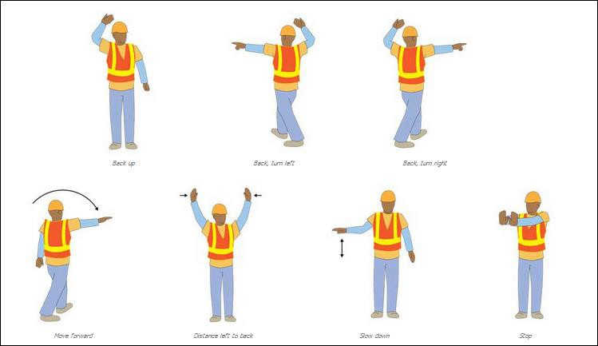
Material Handling Equipment – Hand Signals 2
Material Handling Equipment
Module 2
Hand signals
Link to Spotter Web page on OSHA Website
Notes:
This slide shows an OSHA resource which depicts standard spotter hand signals.

Slide 25
Material Handling Equipment – Truck Hand Signals
Material Handling Equipment
Module 2
Truck Hand Signals
In-class activity - Instructor to demonstrate with student proper hand signals
Each attendee to demonstrate one hand signal
Link to Spotter web page on OSHA website
Notes:
Speaker should lead an in-class demonstration of spotter hand signals. Encourage attendees to stand and repeat the hand signals. This is also a good opportunity for the attendees to stand and stretch.

Slide 26
Material Handling and Storage – Hazard Potential: Slips, Falls and Trips
Material Handling and Storage
Module 2
Hazard Potential: Slips, falls and trips from equipment or in storage yard
Slips, falls and trips may occur from equipment or in the storage yard due to slippery surfaces from inclement weather or obstructed walking paths
Hazard Avoidance:
Clear surfaces of ice and snow
Use proper foot-ware with treaded soles
Keep walkways clear of debris
Do not work fatigued
Use protection from falls when working on platforms above 4 feet
Notes:
This slide identifies slip, fall and trip risks and provides strategies for avoiding and preventing these risks.

Slide 27
Material Handling and Storage – Potential Hazard – Unstable loads
Material Handling and Storage
Module 2
Potential Hazard-Unstable loads due to shifting during transport
Loads may shift or otherwise become unstable during
transport or during unloading
Hazard Avoidance
Observe and evaluate load upon arrival and during
unloading
Stabilize and re-secure loads
Stand clear of unstable loads
Notes:
This slide identifies hazards from unstable loads and provides strategies for avoiding and preventing these risks.

Slide 28
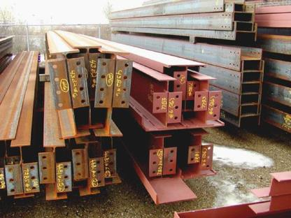
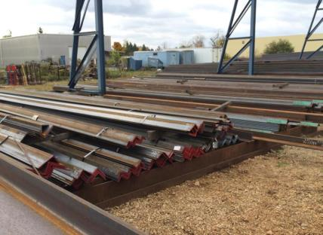
Material Handling and Storage – Potential Hazard – Cuts, Scrapes, Bumps, Pinches and Contact Injuries
Material Handling and Storage
Module 2
Potential Hazard - Cuts, scrapes, bumps, pinches and contact injuries from material sharp edges and being caught between materials
Fabricated material and material from the mill
will have sharp edges. Always wear proper clothing and PPE.
Notes:
This slide identifies hazards from materials such as cuts, bruises, bumps and pinches and provides strategies for avoiding and preventing these risks.

Slide 29

Material Handling and Storage – Potential Hazard – Cuts and Scrapes from Material Sharp Edges
Material Handling and Storage
Module 2
Potential Hazard-Cuts and scrapes from material sharp edges
Hazard Avoidance:
Wear appropriate personal protective clothing
Handle materials properly
Use tools properly
Notes:
Emphasize use of PPE and proper use of tools to prevent cuts, bruises, bumps and other injuries.

Slide 30
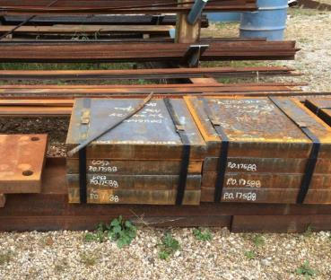
Material Handling and Storage – Potential Hazard – Injuries From Removing Metal Banding
Material Handling and Storage
Module 2
Potential Hazard-Injuries from removing metal banding
Cuts and eye injuries Hazard Avoidance-removing metal material banding
Wear appropriate personal protective clothing:
Use the right tools such as long
handled shears
Do not use tools like crowbars or claw hammers
Adapted from wyomingworkforce.org/Documents/OSHA/.../SteelStrapping.pdf date
visited December 8, 2014
29
Notes:
This slide presents risks from removing metal banding and presents strategies for avoiding hazards during these operations.

Slide 31
Material Handling and Storage – Hazard Avoidance – Removing Metal Material Banding
Material Handling and Storage
Module 2
Hazard Avoidance - removing metal material banding
Plan the job. Cut the band farthest away first.
Other personnel should stand clear
Make cuts squarely
Stay away from the area that straps springs to when cut
Clean up straps after cutting the straps, do not leave them laying around
Adapted from wyomingworkforce.org/Documents/OSHA/.../SteelStrapping.pdf date visited December 8, 2014,
Notes:
This slide presents additional strategies for avoiding hazards when receiving and storing loads.

Slide 32
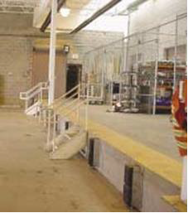
Material Handling Equipment – Potential Hazard – Loading Docks
Material Handling Equipment
Module 2
Potential Hazard-Loading docks
Injuries happen when forklifts run off the dock, products fall on employees or equipment strikes a person.
Hazard Avoidance:
Do not stand between a truck and a fixed surface
Block/chock wheels of trucks
Guide trucks with hand signals
Drive forklifts slowly around docks
Check if dock plates can safely support loads
Do not back up forklifts to dock edge
Avoid dock edges
Careful use of forklifts in areas of loading docks is needed to prevent fall-offs
Source OSHA 3220-10N 2004
Notes:
This slide presents loading dock hazards when receiving and shipping materials and presents strategies for avoiding hazards during these operations

Slide 33
Material Handling Equipment – Potential Hazard – Loading Docks Continued
Material Handling Equipment
Module 2
Potential Hazard-Loading docks
Injuries happen when forklifts run off the dock, products fall on employees or equipment strikes a person.
Hazard Avoidance:
“Provide visual warnings near dock edges”
“Prohibit “ dock jumping ” by employees”
Use non-slip surfaces and keep surfaces clean
Paint the edges of the loading dock to improve visibility
Meet OSHA standards for dock ladders, stairs, and guardrails
Source OSHA 3220-10N 2004
Notes:
This slide further presents loading dock hazards when receiving and shipping materials and presents strategies for avoiding hazards during these operations.

Slide 34
Material Handling and Storage – Movement Overhead
Material Handling and Storage
Module 2
Movement Overhead
♦
♦
♦
♦
♦
♦
♦
♦
♦
Notes:
This slide introduces hazard locations from overhead movement of materials in fabrication shops.

Slide 35
Material Handling and Storage – Movement Overhead – Key Topics
Material Handling and Storage
Module 2
Movement Overhead - Key Topics
Overhead Cranes
Mobile Cranes
Slings
Notes:
This slide identifies the key topics presented for overhead movement of materials.

Slide 36
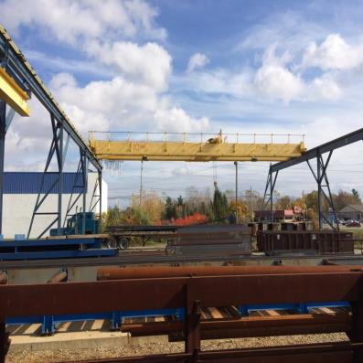
Material Handling and Storage – Cranes
Material Handling and Storage
Module 2
Cranes - Moving material in the yard
Typically by overhead
crane or mobile crane
Overhead crane in material yard
Notes:
This slide presents an example of moving materials by an overhead crane outside the fabrication facility. Encourage attendees to discuss how materials are moved in their material yard.

Slide 37
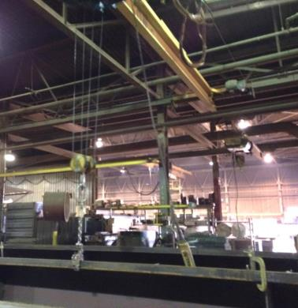
Material Handling and Storage – Cranes – Moving Material
Material Handling and Storage
Module 2
Cranes - Moving material within the shop
Typically material is moved within the shop with overhead, gantry or jib cranes
Overhead crane for moving material in shop
Notes:
This slide presents an example of moving materials within the fabrication facility by an overhead crane. Encourage attendees to discuss how materials are moved in their fabrication shops.

Slide 38
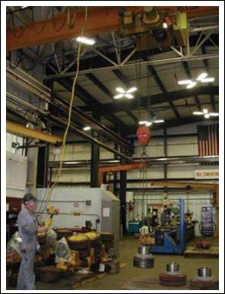
Material Handling Equipment – Overhead Cranes
Material Handling Equipment
Module 2
Overhead Cranes
1910.179 Overhead and gantry cranes
Photo from OSHA 3341-03N 2008
Notes:
OSHA 1910.179 addresses the use of overhead cranes and gantry cranes.

Slide 39
Material Handling and Storage – Potential Hazard: Dropped Loads
Material Handling and Storage
Module 2
Potential Hazard: Dropped loads
Loads carried by overhead cranes can be dropped or workers can be struck or caught between objects
Hazard Avoidance:
Do not work under loads being moved or suspended overhead
Maintain safe distances from loads being moved
overhead
Use only trained operators
Use “Spotters” when operator cannot see the load and a clear path
Operate cranes within load rating limits
Notes:
This slide presents hazards from dropped loads, and provides strategies for avoiding these hazards.

Slide 40
Material Handling and Storage – Potential Hazard: Dropped Loads Continued
Material Handling and Storage
Module 2
Potential Hazard: Dropped loads
Loads carried by overhead cranes can be dropped
Hazard Avoidance:
Maintain crane equipment
Conduct required safety inspections of lifting equipment
Use proper rigging hardware, slings, alloy chains and wire
ropes free of defects and properly sized
Inspect slings, chains, wire ropes and hardware for defects, corrosion and degradation. Discard if damaged.
Notes:
This slide further presents hazards from dropped loads, and provides strategies for avoiding these hazards.

Slide 41
Material Handling and Storage – Safety Measures for Cranes
Material Handling and Storage
Module 2
Safety measures for cranes:
Know the weight of the material that is being lifted
Always check the crane's rated capacity to make sure that the crane will not be overloaded
Plan lifts before starting them to make sure that they
are safe.
Know the “weakest” link in the lift, often rigging. Plan the path of travel, clear landing area, notify others in the area, etc.
Link to OSHA Publication 2236
Notes:
This slide presents safety measures for overhead cranes.

Slide 42
Material Handling and Storage – Safety Measures Employers Should Take With Cranes
Material Handling and Storage
Module 2
Safety measures employers should take with cranes:
Inspected at least quarterly “by persons thoroughly familiar with the crane, the methods of inspecting the crane, and what can make the crane unserviceable.
Crane activity, the severity of use, and environmental conditions determine more frequent inspection schedules.”
“Ensure that the critical parts of a crane—such as crane operating mechanisms, hooks, air, or hydraulic system components and other load-carrying components—are inspected daily for any maladjustment, deterioration, leakage, deformation, or other damage.”
Link to OSHA Publication 2236
41
Notes:
This slide further presents safety measures for overhead cranes.

Slide 43
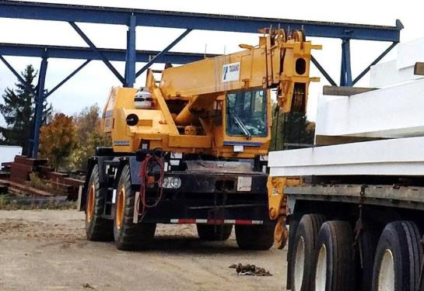
Material Handling Equipment – Mobile Cranes
Material Handling Equipment
Module 2
Mobile Cranes
1910.180 Crawler, locomotive, and truck cranes
Mobile crane being used
in yard to load trucks
Notes:
OSHA 1910.180 addresses use of mobile cranes.

Slide 44
Material Handling and Storage – safety Measures with Mobile Cranes
Material Handling and Storage
Module 2
Safety measures with mobile cranes:
Only thoroughly trained and competent workers should
operate cranes
Cranes operators must be National Commission of the Certification of Crane Operators (NCCCO) certified if operating cranes on a construction jobsite, although it is not mandated for work in the shop
Operators should know what they are lifting and what it weighs. Rated capacity of mobile cranes vary with boom length and radius
Link to OSHA Publication 2236
Notes:
This slide presents safety measures for overhead cranes.

Slide 45
Material Handling and Storage – Safety Measures with Mobile Cranes Continued
Material Handling and Storage
Module 2
Safety measures with mobile cranes:
To minimize the risks of crane use, employers shall
take the following precautions:
Equip all cranes with boom angle indicators
“Provide cranes with telescoping booms with some means to determine boom lengths unless the load rating is independent of the boom length.”
“Post load rating charts in the cab of cab-operated cranes. (All cranes do not have uniform capacities for the same boom length and radius in all directions around the chassis of the vehicle.)”
Link to OSHA Publication 2236
Notes:
This slide further presents safety measures for overhead cranes.

Slide 46
Safety Measures with Mobile Cranes Continued
Material Handling and Storage
Module 2
Safety measures with mobile cranes:
Know that there are regulations and limitations that operators need to know before working close to power lines
Outriggers if used must rest on firm ground, timbers, or cribbing to spread the crane weight and load over a large enough area
Link to OSHA Publication 2236
Notes:
This slide further presents safety measures for overhead cranes.

Slide 47
Material Handling Equipment – Cranes Reminders
Material Handling Equipment
Module 2
Cranes Reminders*
Check the load chart in the cab
Frequently inspect
Lift people only when permitted by OSHA Standards
Check overhead power lines if outdoors
Ensure area of travel is clear
46
Notes:
This slide presents crane reminders for operators for overhead cranes.

Slide 48
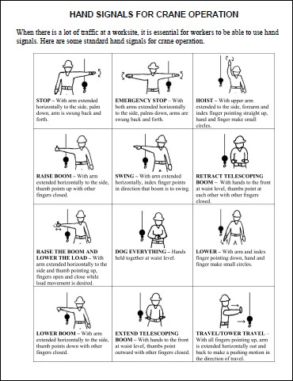
Material Handling Equipment – Mobile Cranes – Hand Signals
Material Handling Equipment
Module 2
Mobile Cranes
Use hand signals when necessary to guide load placement
Link to Hand Signals for Crane Operations Web page
Notes:
This slide introduces use of hand signals for guiding load movement.

Slide 49
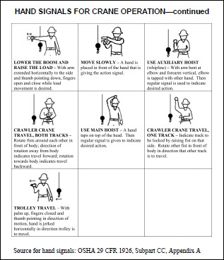
Material Handling Equipment – Mobile Cranes Continued
Material Handling Equipment
Module 2
Mobile Cranes
Hand signals continued
Link to Hand Signals for Crane Operations Web Page
Notes:
This slide presents an OSHA resource addressing standard hand signals.

Slide 50
Material Handling Equipment – Crane Hand Signals
Material Handling Equipment
Module 2
Crane Hand Signals
In-class activity - Instructor to demonstrate with student proper crane signals used by spotters
Each attendee to demonstrate one hand signal
Link to Hand Signals for Crane Operations Web Page
Notes:
The instructor should lead an in-class exercise with attendees demonstrating typical hand signals used to guide load movement using cranes. This is also another opportunity to engage attendees and allow them to stretch.

Slide 51
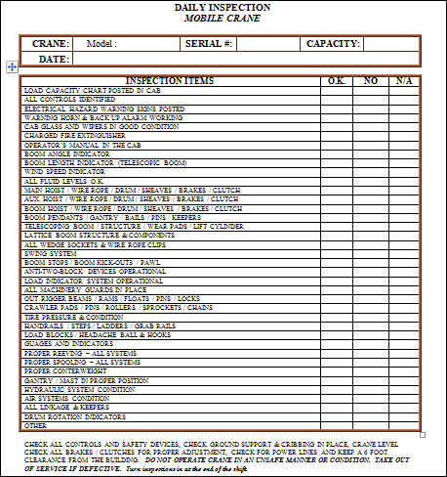
Material Handling Equipment – Mobile Cranes – Inspection Form
Material Handling Equipment
Module 2
Mobile Cranes
AISC has a sample daily inspection checklist available on its safety channel
Link to AISC Mobile Cranes Daily Inspection Form
Notes:
The American Institute of Steel Construction (AISC) has a daily crane inspection checklist posted at its website.

Slide 52
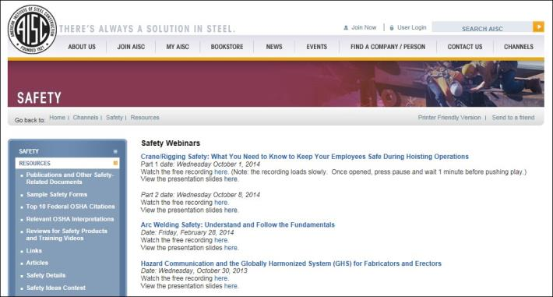
Material Handling Equipment – Mobile Cranes Webinars
Material Handling Equipment
Module 2
Mobile Cranes
AISC has two useful crane webinars available for viewing at its safety channel site for additional information
Link to AISC's crane safety webinars
Notes:
The American Institute of Steel Construction (AISC) has crane safety webinars posted at its website.

Slide 53
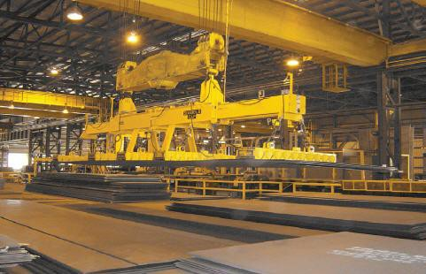
Material Handling Equipment – Industrial Magnetic Lifting Devices
Material Handling Equipment
Module 2
Industrial Magnetic Lifting Devices
Link to Walker Magnet
Notes:
This slide introduces the use of magnets as part of the material handling process.

Slide 54
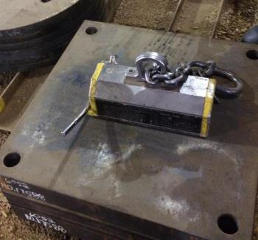
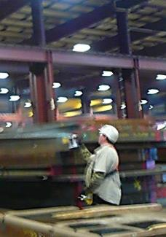
Material Handling Equipment – Industrial Magnetic Lifting Devices Continued
Material Handling Equipment
Module 2
Industrial Magnetic Lifting Devices
Permanent magnet
Using magnet to lift plate
Notes:
This slide depicts examples of lifting magnets.

Slide 55
Material Handling Equipment – Magnet Defined
Material Handling Equipment
Module 2
Industrial Magnetic Lifting Devices
1910.179(a)(47)"Magnet" means an electromagnetic device carried on a crane hook to pick up loads magnetically.
Notes:
OSHA 1910.179(a)(47) defines “magnet”.

Slide 56
Material Handling Equipment – Below-the-Hook Lifting Devices
Material Handling Equipment
Module 2
Industrial Magnetic Lifting Devices
The American Society of Mechanical Engineers has developed the ASME B30.20-20-3 Below-the-Hook Lifting Devices- Safety Standard for Cableways, Cranes, Derricks, Hoists, Hooks, Jacks, and Slings which addresses permanent and electric-rated lifting magnets and their operation.
Link to Understanding Lift Magent Compliance
Notes:
The American Society of Mechanical Engineers has a standard that addresses “below-the-hook” lifting devices (ASME B30.20-20-3).

Slide 57
Material Handling Equipment – Industrial Magnetic Lifting Devices Safety
Material Handling Equipment
Module 2
Industrial Magnetic Lifting Devices
ASME B30.20-20-3 addresses safety of magnetic lifting devices including:
User qualifications
Training
Operation practices
Link to Understanding Lift Magnet Compliance
Notes:
Elements addressed by ASME B30.20-20-3.

Slide 58
Material Handling Equipment – Main Types of Magnets
Material Handling Equipment
Module 2
Industrial Magnetic Lifting Devices
Three main types of magnets:
Electromagnets
Permanent magnets
Electro-permanent magnets
All three can be used to lift ferrous metals such as
plate, structural shapes, coils etc.
Link to magnetics 101 on Walker Magnet Website
Notes:
This slide lists the types of magnets used in material handling.

Slide 59
Industrial Magnetic Lifting Devices Continued
Material Handling Equipment
Module 2
Industrial Magnetic Lifting Devices
Permanent magnets typically will have “on” position and “off” position. The operator engages the magnet using the “on” position
Safety pins are engaged to protect against accidental switching to the “off” position and disengaging the magnet
May also include safety lifting features that can be used to test the load before a lift
Notes:
This slide describes characteristics of permanent magnets.

Slide 60
Material Handling and Storage – Potential Hazard Magnets: Dropped Loads
Material Handling and Storage
Module 2
Potential Hazard Magnets: Dropped loads
“Caught between” injuries can range from pinching, crushing to amputations (caught between) due to:
Dropped loads
“Struck by” caused by material being moved
Attracting unintended surrounding tools, material etc. due
to magnetic force
Hazard Avoidance:
Never work under the path of the load
Maintain safe distances from loads being moved overhead
Never put your fingers under the load when guiding loads
Use same precautions as crane hazard avoidance discussed previously
Notes:
This slide identifies hazards from use of magnets for lifting materials and identifies strategies for avoiding these hazards.

Slide 61
Material Handling Equipment – Dropped Loads Causes
Material Handling Equipment
Module 2
Industrial Magnetic Lifting Devices
Dropped loads can occur from factors such as
  Instantaneous loss of power
  Loss of magnetism of permanent magnets
  Irregular surfaces which may prevent the magnet from being fully engaged with the material being moved
Link to Understanding Lift Magnet Compliance
Notes:
This slide further identifies hazards from use of magnets for lifting materials and identifies strategies for avoiding these hazards.

Slide 62
Material Handling Equipment – Industrial Magnetic Lifting Devices Cont
Material Handling Equipment
Module 2
Industrial Magnetic Lifting Devices
Follow Manufacturer's instruction for safe operation
Magnets should have legible labels showing magnet lifting capacity
Lifting charts can be hard to read on magnets, and hard to keep legible. These charts can be enlarged and posted in the facility (as long as employees know where to find the information)
Remove from service defective equipment or when missing tags.
Link to Understanding Lift Magnet Compliance
Notes:
This slide further identifies strategies for avoiding hazards from use of magnets for lifting materials.

Slide 63
Material Handling Equipment – Strong Magnet Warnings
Material Handling Equipment
Module 2
Industrial Magnetic Lifting Devices
“Strong magnet warnings” should be placed in areas when lifting magnets are used
Strong magnets can attract unwanted materials such as tools, adjacent materials, table etc.
Remember magnets depending on their design can lift from several hundred lbs to 10,000 lbs
Link to Understanding Lift Magnet Compliance
Notes:
This slide further identifies strategies for avoiding hazards from use of magnets for lifting materials.

Slide 64
Material Handling Equipment
Module 2
Module 2
Q and A
Notes:
The speaker should encourage attendees to ask questions about this training module.

Slide 65
Take a Break!
Material Handling Equipment
Module 2
Notes:
If the material is presented in a day long program, give attendees a 15 minute break.

