Slide 1
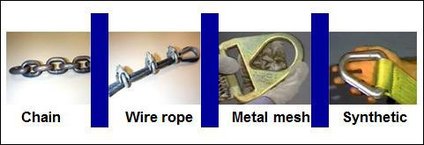
Material Handling Equipment
Material Handling Equipment
Module 3
Rigging Equipment
OSHA 1910.184 Slings: governs slings made from alloy steel chain, wire rope, metal mesh, natural or synthetic fiber rope, and synthetic web.
Link to Article Understanding Lift Magnet Compliance
0
Notes:
Module 3 is a continuation of Module 2 and presents detailed information on identification and avoidance of safety hazards in material handling and storage of steel shapes.

Slide 2
OSHA Grant Information
This material was produced under grant number SH-26316-SH4 from the Occupational Safety and Health Administration, U.S. Department of Labor. It does not necessarily reflect the views or policies of the U.S. Department of Labor, nor does mention of trades names, commercial products, or organizations imply endorsement by the U.S. Government.
Notes:
Speaker to provide grant materials acknowledgment.

Slide 3
Material Handling and Storage
Material Handling and Storage
Module 3
To safely use slings take the following precautions:
A competent person should conduct inspections of slings before and during use
Remove damaged or defective slings from service
Source 1910.84(d)
Notes:
This slide presents some sling safety tips.

Slide 4
Material Handling and Storage 2
Material Handling and Storage
Module 3
To safely use slings take the following precautions:
❑ “Do not kink sling legs
❑ Do not load slings beyond their rated capacity
❑ Keep suspended loads clear of all obstructions
❑ Remain clear of loads about to be lifted and
suspended
❑ Do not engage in shock loading
❑ Avoid sudden crane acceleration and deceleration
when moving suspended loads”
❑ Do not use knots or bolts or other makeshift devices
to shorten slings
Link to OSHA Publication 2236
Notes:
This slide presents additional sling safety tips.

Slide 5
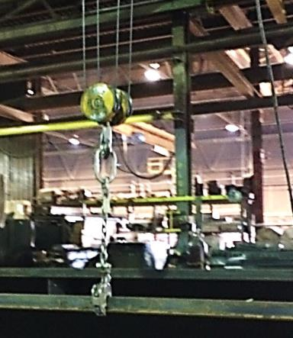
Material Handling Equipment 2
Material Handling Equipment
Module 3
Chains
Overhead crane, chain, hook and hardware used
to move beams during fabrication
Notes:
This slide identifies that chains are frequently used in moving materials.

Slide 6
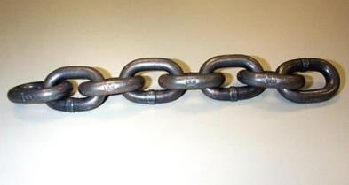
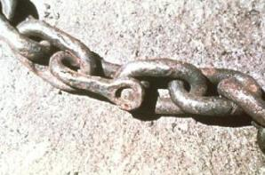
Material Handling Equipment 3
Material Handling Equipment
Module 3
Chains
Inspect prior to use – each shift and during use
Discard defective equipment
Do not over load rigging
Specialized Hooks – clamps – should be proof tested
Do not use because of different
Grade of material
Chain marking
Link to OSHA Guidance to Slings
Notes:
This slide presents chain safety tips.

Slide 7
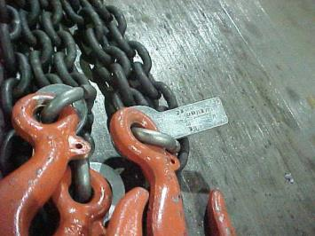
Material Handling Equipment 4
Material Handling Equipment
Module 3
ID tag attached
Listing -- size, grade, rated capacity & Mfg
Hook – ring – load rating not less than chain’s rating
No make shift equipment – hook, rods, bolts
When to discard chain?
Wear exceeds limits of 1910 Table N-184-1
Inspections based on:
Frequency of use
At least yearly
Severity of service
Nature of lift
Use common sense
Document dates of inspection
ID Attached to hook
5
Notes:
This slide presents additional chain safety tips.

Slide 8
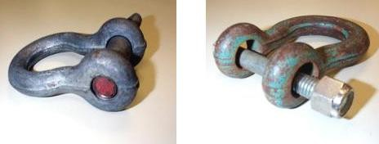
Material Handling Equipment 5
Material Handling Equipment
Module 3 Chains
Job or shop hooks and links or makeshift fasteners are not allowed
Use the correct size pin for the job
Right
Wrong
6
Notes:
This slide emphasizes that makeshift hardware should not be used.

Slide 9
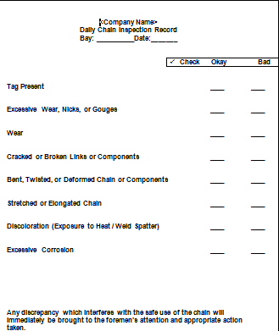
Material Handling Equipment 6
Material Handling Equipment
Module 3 Chains
AISC has a daily chain inspection form available at it’s website
link to AISC Daily Chain Inspection Checklist
7
Notes:
The American institute of Steel Construction (AISC) has a daily chain inspection checklist available at its website.

Slide 10
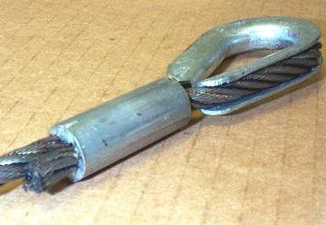
Material Handling Equipment 7
Material Handling Equipment
Module 3 Wire rope
Cover/protect protruding ends of strands from splices
Lubricate – protect wire rope
Splice requirements
Use wire rope ‘U-bolt’ clamp
Check load capacity tables
End attachments need to be
proof tested
Wire rope end attachment
Notes:
This slide presents safety tips for use of wire ropes.

Slide 11
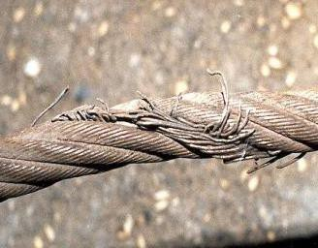
Material Handling Equipment 8
Material Handling Equipment
Module 3
Wire rope
Do not pull sling from under
loads
Do not use if:
More than 10% of visible
strands are broken
Signs of excess wear,
corrosion, or defect
Protect slings from
sharp edges
Sling – wires are kinked
Remove from service
Notes:
This slide further presents safety tips for use of wire ropes.

Slide 12

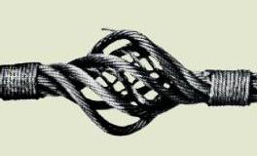
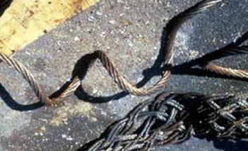
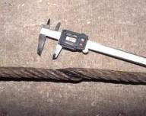
Material Handling Equipment – Defective Wire Ropes
Wire rope
Bird Caging
Kinking
Crushing
If these happen, remove the wire rope sling from service
Notes:
This slide depicts examples of defective wire ropes that should be removed from service.

Slide 13
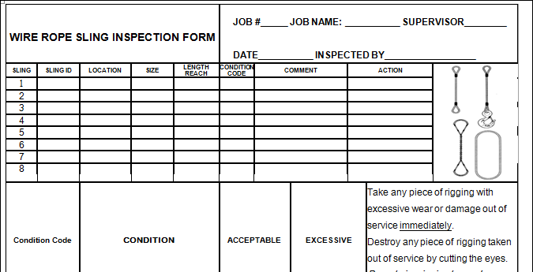
Material Handling Equipment – Inspection Form
Material Handling Equipment
Module 3 Wire Ropes
AISC has a wire rope inspection form posted at it’s website
Link to AISC Wire Rope Inspection Form
11
Notes:
The American institute of Steel Construction (AISC) has a wire rope inspection form available at its website.

Slide 14

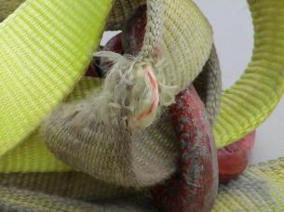
Material Handling Equipment Synthetic Web Slings
Material Handling Equipment
Module 3
Synthetic Web Slings Remove from service if any of these are present:
Acid or caustic burns
Melting or charring of any part
Snags, punctures, tears or cuts
Broken or worn stitches
Red core warning thread visible
Distortion of fittings
Heat Damage
Red core waning thread visible
Link to OSHA Guidance to Synthetic Web Slings
12
Notes:
This slide presents examples of defective slings that should be removed from service.

Slide 15
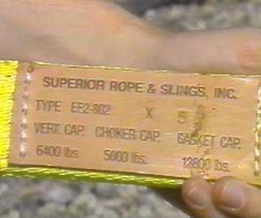
Material Handling Equipment – Synthetic Web
Material Handling Equipment
Module 3
Synthetic web
Mfg identification tag attached & legible
Tag list rated capacity for type of hitch used
Avoid sharp edges and high temperature with sling
Look for sling ID tag
13
Notes:
Slings should have identifying information on an ID tag.

Slide 16
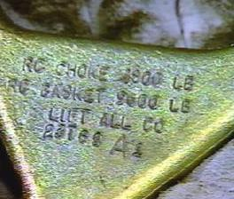
Material Handling and Storage
Material Handling and Storage
Module 3
Synthetic Web Slings
Fittings must be:
At least as strong as that
of the sling
Free of sharp edges that could damage the webbing
Link to OSHA Guidance to Synthetic Web Slings, 1910.184(i)
14
Notes:
This slide shows web fitting requirements and depicts an identification tag.

Slide 17
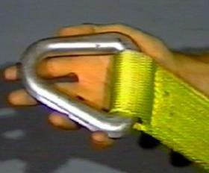
Material Handling and Storage – Synthetic Web Sling Stiching
Material Handling and Storage
Module 3
Synthetic Web Sling Stitching
Stitching is the only method allowed to attach end fittings to webbing, or to form eyes
Stitching
Link to OSHA Guidance to Synthetic Web Slings, 1910.184(i)
15
Notes:
This slides emphasizes that stitching is the only acceptable means for attaching fittings to the webbing.

Slide 18
Material Handling and Storage – Inspect Slings
Material Handling and Storage
Module 3
Inspect slings:
Each day before use
Where service conditions warrant
Remove them from service if damaged or defective
or the red core warning thread is visible
Link to OSHA Guidance to Synthetic Web Slings, 1910.184(i)
17
Notes:
This slide identifies sling inspection requirements.

Slide 19
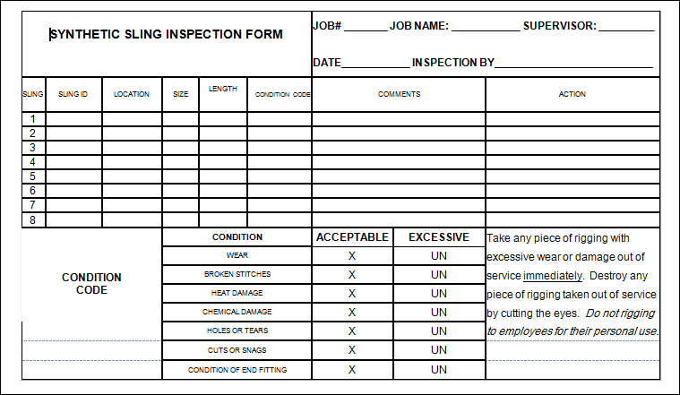
Material Handling and Storage – Synthetic sling inspection form
Material Handling and Storage
Module 3
AISC has a synthetic sling inspection form on its website
Link to AISC Syntheric Sling Inspection Form
Notes:
The American institute of Steel Construction (AISC) has a sling inspection form available at its website.

Slide 20
Questions on slings and rigging?
Material Handling and Storage
Module 3
Questions on slings and rigging?
Notes:
The presenter should encourage attendees to ask questions about rigging safety.

Slide 21
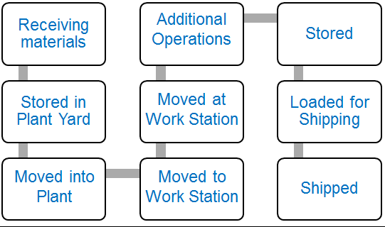
Material Handling and Storage
Module 3
Movement at Ground or Floor Level
♦
♦
♦
♦
♦
♦
♦
♦
♦
Notes:
This slide identifies process areas where materials are moved at the ground or floor level and that hazards can occur at each material handling step.

Slide 22
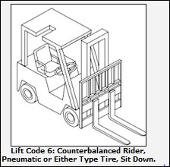
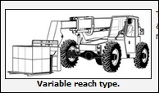
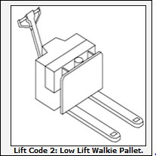
Material Handling and storage – Powered Industrial Trucks
Material Handling and Storage
Module 3
Movement at Floor or Ground Level-Key Topics
Powered Industrial Trucks-(Forklifts)
Drawings from
Link to OSHA Powered Industrial Trucks Web Page
Notes:
Powered Industrial Trucks (forklifts) may be used in some shops.

Slide 23
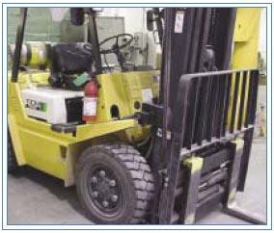
Powered Industrial Trucks
Material Handling Equipment
Module 3
Powered Industrial Trucks (Forklifts)
Hazard: “Approximately 100 employees are fatally injured and approximately 95,000 employees are injured every year while operating powered industrial trucks.”
“Forklift turnover accounts
for a significant number of
these fatalities.”
Link to OSHA Publication 3252
Notes:
This slide present Powered Industrial Truck fatality and injury statistics.

Slide 24
Material Handling and Storage – Potential Hazards
Material Handling and Storage
Module 3
Potential Hazards: Moving material within the shop-
Powered Industrial Trucks-(Forklifts)
Tipping, struck by caught between, wrong equipment for hazard classification
Hazard Avoidance:
Select proper equipment for application and hazard
Only qualified operators should use equipment
Check equipment before use
Do not overload
Center loads
Link to OSHA Publication 3252
Notes:
This slide identifies risks form use of Powered Industrial Trucks (forklifts) and identifies strategies for avoiding these risks.

Slide 25
Material Handling and Storage – Potential Hazards – Moving Material
Material Handling and Storage
Module 3
Potential Hazards: Moving material within the shop-
Powered Industrial Trucks-(Forklifts)
Tipping, struck by caught between, wrong equipment for hazard classification
Hazard Avoidance:
Drive safely
No horseplay
Watch for obstructions
Do not leave unattended vehicles running
Proper maintenance
Link to OSHA Publication 3252
Notes:
This slide further identifies risks from use of Powered Industrial Trucks (forklifts) and identifies strategies for avoiding these risks.

Slide 26
Material Handling Equipment – Powered Industrial Trucks Requirements
Material Handling Equipment
Module 3
Powered Industrial Trucks (Forklifts)-Equipment
Powered industrial trucks (forklifts) must meet requirements of American National Standard for Powered Industrial Trucks, Part II ANSI B56.1-1969
Do not modify or make attachments without written approval from the manufacturer
Nameplates and markings must be in place and legible
Forklifts that are used in hazardous locations are required to be appropriately marked/approved for such use
Link to OSHA Publication 3252
Link to OSHA Publication 2236
Notes:
This slide presents equipment requirements for Powered Industrial Trucks.

Slide 27
Material Handling Equipment – Power Industrial Trucks – Operator Qualifications
Material Handling Equipment
Module 3
Powered Industrial Trucks (Forklifts)-Operator Qualifications
Train and certify all operators to ensure safe operation
Do not operate a forklift if under 18 years old
Must be competent
Trainees must be supervised by a competent person and not endanger others
Refresher training
Reevaluation every three years
Training requirements defined in 1910.178
Link to OSHA Publication 2236
Link to OSHA Publication 3252
Notes:
This slide presents operator qualifications for using Powered Industrial Trucks.

Slide 28
Material Handling Equipment – Powered Industrial Trucks – Before You Operate
Material Handling Equipment
Module 3
Powered Industrial Trucks (Forklifts) Operation –before
you operate:
Check that rollover protective structure is in place
Check overhead guards are in place to protect from
falling objects
Reverse signal alarm should be operational
Check defects before using
Fill fuel tanks only when the engine is off
Link to OSHA Publication 3252
27
Notes:
This slide presents safe operating tips for use of Powered Industrial Trucks.

Slide 29
Material Handling Equipment – Powered Industrial Trucks Operation - Loads
Material Handling Equipment
Module 3
Powered Industrial Trucks (Forklifts) Operation-
Loads
Make sure loads are not heavier than the capacity of the industrial truck
Loads should be stable and safely arranged and within the
rated capacity of the truck
Follow safe operating procedures for picking up, moving, putting down and stacking loads
Center the load on the forks and as close to the mast as
possible to minimize tipping or load falling
Place the load at the lowest position for traveling
Don’t place extra weight on the rear of a counterbalanced forklift to allow an overload
Dock boards (bridge plates) are properly secured when
loading or unloading from loading docks
Link to OSHA Publication 3252
Notes:
This slide further presents safe operating tips for use of Powered Industrial Trucks.

Slide 30
Material Handling Equipment – Driving and Operating
Material Handling Equipment
Module 3
Powered Industrial Trucks (Forklifts) Operation-driving and operating
Drive safely-never over 5 mph- slow at congested areas
Always wear seat belts
Keep hands, arms legs and feet inside the truck
No riders unless there is an approved seat
Avoid traveling with elevated loads
Observe all traffic regulations and plant speed limits
Look in the direction of and keep a clear view of the path of travel
Run trucks at a safe speed that permits safe stopping
Link to OSHA Publication 3252
Notes:
This slide further presents safe operating tips for use of Powered Industrial Trucks.

Slide 31
Material Handling Equipment Operation - Continued
Material Handling Equipment
Module 3
Powered Industrial Trucks (Forklifts) Operation-
Continued
Stunt driving and horseplay are prohibited
Check for headroom for the fork- lift under overhead installations, lights, pipes, etc
Operators maintain a safe distance from the edge of ramps or platforms while using forklifts on any elevated dock, platform or freight car
Link to OSHA Publication 3252
Link to OSHA Publication 2236
Link to OSHA Warehousing Publication
Link to OSHA Powered Industrial Truck Web Page
Notes:
This slide further presents safe operating tips for use of Powered Industrial Trucks.

Slide 32
Material Handling Equipment – Powered Industrial Trucks – Unattended Vehicles
Material Handling Equipment
Module 3
Powered Industrial Trucks (Forklifts) Source OSHA
Operation-Unattended vehicles
“Load engaging means should be fully lowered, with controls neutralized, power shut off and brakes set when a forklift is left unattended”
3220-10N 2004
Notes:
This slide further presents safe operating tips for use of Powered Industrial Trucks.

Slide 33
Material Handling Equipment – Powered Industrial Trucks - Maintenance
Material Handling Equipment
Module 3
Powered Industrial Trucks (Forklifts)-Maintenance
Properly maintain equipment, including tires and batteries
Remove defective forklifts from service
Handling batteries can be dangerous and requires special care and qualified personnel
Charge batteries in designated areas
.
3220-10N 2004
Link to OSHA Publication 3252
Notes:
This slide presents maintenance requirements for Powered Industrial Trucks.

Slide 34
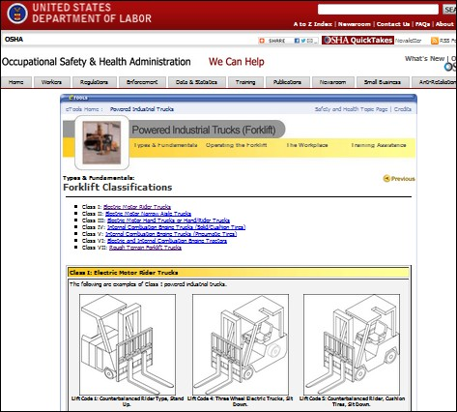
Powered Industrial Trucks on OSHA Website
Material Handling Equipment
Module 3
Powered Industrial
Trucks (Forklifts)
OSHA has a number
of helpful materials
available
Link to OSHA Powered Industrial Trucks Web Page
Notes:
OSHA has a number of informational resources addressing Powered Industrial Trucks.

Slide 35
OSHA resources addressing Powered Industrial Trucks
Material Handling Equipment
Module 3
Powered Industrial trucks (Forklifts)
Forklift Safety
Safety and Health Topics: Powered Industrial Trucks OSHA website index links to specific requirements and other Federal agency requirements. Link to OSHA Website Index
Sample Daily Checklists for Powered Industrial Trucks
Link to Sample Daily Checklists for Powered Industrial Trucks
3220-10N 2004
34
Notes:
This slide presents additional OSHA resources addressing Powered Industrial Trucks.

Slide 36
Material Handling and Storage – Movement at the Workstation - Key
Material Handling and Storage
Module 3
Movement at the Workstation-Key
Topics
♦
♦
Notes:
This slide introduces locations where material is moved at the work station.

Slide 37
Material Handling and Storage – Movement at the Workstation – Key Topics
Material Handling and Storage
Module 3
Movement at the Workstation-Key Topics
Jib Cranes
Carts
Hoist Balancers
Tool balancers
Notes:
This slide identifies typical equipment used at the work station for moving material.

Slide 38
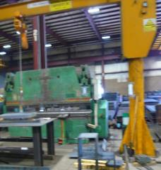
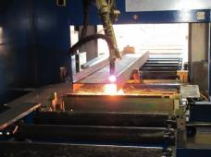
Material Handling and Storage – Moving Material at the Work Station
Material Handling and Storage
Module 3
Moving material at the work station
Steel may be moved at the work station or between work stations by:
Overhead cranes
Jib cranes
Rollers
Carts and dollies
Hoist balancers
Tool suspension devices
Workers or pairs of workers
Others in your shop?
Jib Crane
Roller system used to move material for fabrication
Notes:
This slide further identifies typical equipment used at the work station for moving material.

Slide 39
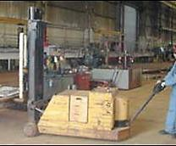
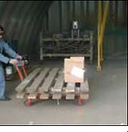
Material Handling equipment – Lighten the Load
Material Handling Equipment
Module 3
Lighten the Load- Use Material Handling Equipment
Pallet Jack
Hand carts for moving small materials in the shop
Photos from OSHA 3341-03N 2008
38
Notes:
Some shops use pallet jacks to move material within the shop.

Slide 40
Material Handling and Storage – Potential Hazards – Hazard Avoidance
Material Handling and Storage
Module 3
Potential Hazards: Moving material at the work station
Injuries from dropped work, pinches, cuts, scrapes,
burns from hot work, musculoskeletal injuries
Hazard Avoidance:
Use proper PPE for the task
Proper equipment use
Being aware
Being attentive of where your hands and feet are
Don’t work fatigued
Use proper lighting
Properly maintained equipment
Notes:
This slide identifies hazards from moving materials at the work station and identifies strategies for avoiding these hazards.

Slide 41
Material Handling Equipment - Lighten the Load
Material Handling Equipment
Module 3
Lighten the Load- Use Material Handling Equipment
Carts designed to transport and carry materials can reduce lifting, pushing, and pulling forces
Allow for heavy materials, tools, or equipment to be moved without carrying
Save time
Available in many shapes and sizes
Adapted from OSHA 3341-03N 2008
Notes:
Use of pallet jacks and carts can be used to lighten the load for workers.

Slide 42
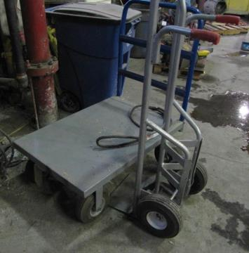
Material Handling Equipment - Carts
Material Handling Equipment
Module 3
Carts
Hand cart for small loads Photo from CIANBRO
Drawing from: https://www.osha.gov/SLTC/etools/pit/forklift/types/classes.html#class1
Notes:
This slide shows equipment examples.

Slide 43
Safe Operating Tips for Use of Pallet Jacks
Material Handling Equipment
Module 3
Lighten the Load- Use Material Handling Equipment Points to Remember:
Motorized pallet jacks, if available, can be used for frequent or distant movement of materials. Handles should be located at the rear of the cart and positioned at waist level
Don’t obstruct view with the load
Balance loads and keep load within manufacturer’s recommended weight limits
Pushing is easier than pulling
Use proper wheels
Adapted from OSHA 3341-03N 2008
Notes:
This slide presents safe operating tips for use of pallet jacks.

Slide 44
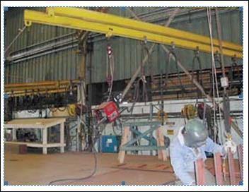
Material Handling Equipment – Jib Cranes
Material Handling Equipment
Module 3
Jib Cranes
“Wall, floor, or pillar mounted I-beam with a rolling trolley/hoist used to lift and position equipment and material”
Jib cranes can be used near a work stations to help with tasks
Photo from OSHA 3341-03N 2008
Notes:
This slide presents an example of a jib crane for movement of materials at the work station.

Slide 45
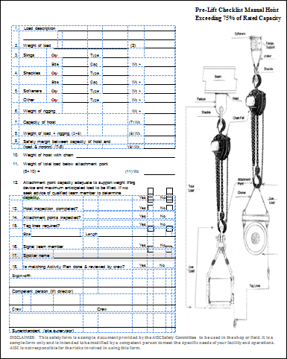
Material Handling Equipment – Pre-Lift Checklist for Jib Cranes
Material Handling Equipment
Module 3
Jib Cranes
AISC provides a useful pre-lift checklist. It is Included in the training packet.
Link to AISC Pre-Lift Checklist for Jib Cranes Form
Notes:
The American institute of Steel Construction (AISC) has a pre-lift checklist for jib cranes available at its website.

Slide 46
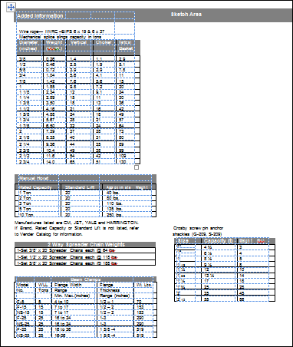
Material Handling Equipment – Pre-Lift Checklist Continued
Material Handling Equipment
Module 3
Jib Cranes
AISC pre-lift checklist continued
Link to AISC Pre-Lift Checklist for Jib Cranes Form
Notes:
This slide is a continuation of The American institute of Steel Construction (AISC) pre-lift checklist for jib cranes.

Slide 47
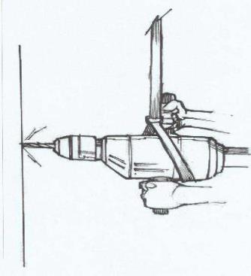
Material Handling Equipment – Tool Balancers
Material Handling Equipment
Module 3
Tool Balancers
Tool balancers help support tools comfortably for operators
Tools can be positioned over the work station
Can be used with a variety of
tools
Source CIANBRO
Notes:
This slide depicts an example of a tool balancer that can be used to reduce the weight of tools during various shop operations.

Slide 48
Material Handling and Storage – Storage and Stacking of Material
Material Handling and Storage
Module 3
Storage and stacking of material
♦
♦
♦
Notes:
This slide depicts points in the material handling process where material is stored and stacked. The slide also emphasizes that these are hazard points.

Slide 49
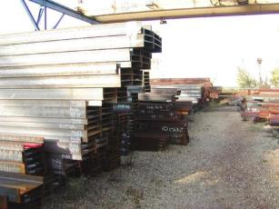
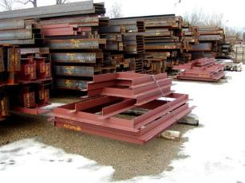
Storing Materials – Key Topics
Material Handling and Storage
Module 3
Storing Materials-Key Topics
Storing
Stacking
Housekeeping
Steel from the mill stored In the yard
48
Fabricated beams and spandrel frames ready to be shipped to a construction site
Notes:
This slide identifies the key material storage topics addressed in the presentation.

Slide 50
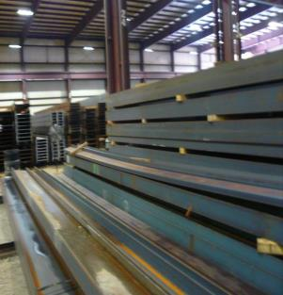
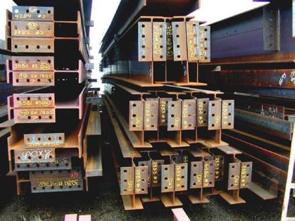
Material Handling and Storage – Storing and Stacking
Material Handling and Storage
Module 3
Storing and stacking
Steel from the mill stored
Inside shop
Fabricated beams ready to be shipped
to construction site
Notes:
This slide shows examples of steel shapes being stored and stacked.

Slide 51
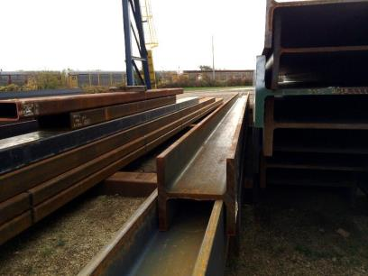
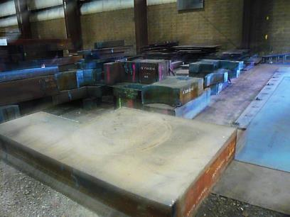
Material Handling Equipment – Storage and Stacking Continued
Material Handling Equipment
Module 3
Storage and stacking
Heavy steel shapes from the mill
Heavy plate from the mill
Notes:
This slide shows additional examples of steel shapes being stored and stacked.

Slide 52
Material Handling Equipment – Hazard Potential – Stored Materials
Material Handling Equipment
Module 3
Hazard Potential: Stored materials
Improperly stored materials may fall, and injure workers
Improper manual lifting or carrying loads that are too large or heavy
Being struck by materials or being caught in pinch points
Incorrectly cutting ties or securing devices
Hazard Avoidance:
“Stack loads evenly and straight
Place heavier loads on lower or middle shelves and racks
Remove one object at a time from shelves and racks
Keep aisles and passageways clear and in good repair”
Non-compatible materials should not be stored together
Adapted from Source OSHA 3220-10N 2004
51
Notes:
This slide identifies potential risks when storing and stacking steel materials, and presents strategies for reducing risks from this operation.

Slide 53
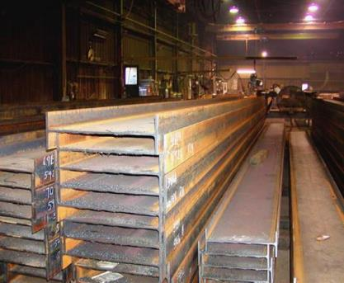
Material Handling Equipment – Materials Storage - Steel
Material Handling Equipment
Module 3
Materials Storage-Steel
American National Standard Z229.1-1982 lays out practices for steel fabrication and shops fabricating structural steel
Included in ANSI Z229.1- 1982 are practices for handling and storing steel material
Steel shapes stacked and nested
Adapted from source: ANSI Z229.1-1982
52
Notes:
The American National Standards Institute standard Z22.1-1982 addressed practices for handling and storing steel and provides some useful guidelines.

Slide 54
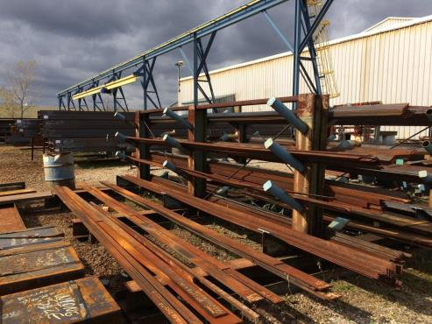
Material Handling Equipment – Tips for Storing Materials
Material Handling Equipment
Module 3
Store material in arrangements that allow for:
Easy movement
Easy access and movement
Materials and stacks to be stable
Racks used for storing plate and bar stock
Adapted from source: ANSI Z229.1-1982
53
Notes:
This slide provides tips for storing materials that promote efficiency and safety.

Slide 55
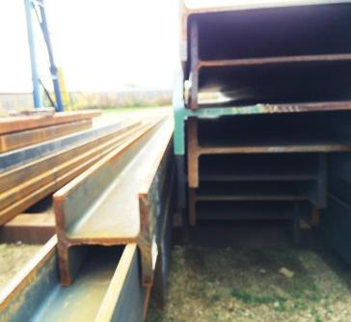
Material Handling Equipment – Guidelines for Storing and Stacking Steel Materials
Material Handling Equipment
Module 3
Structural shapes received
from the mill
Can be nested or blocked
Optimize pile height for space and
stability
ANSI Z229.1-1982 suggested maximum pile heights for wide flange shapes 6-8” deep should be limited to 6’-0” in height for shapes 10-16”, 11’-0” in height and for 18- 36”, is 14 ‘-0” feet in height.
Under general industry standards If workers must work on loads higher than 4 feet, fall protection is
Nested wide flange shapes
required
Adapted from source: ANSI Z229.1-1982
54
Notes:
This slide presents guidelines for storing and stacking steel materials.

Slide 56
Materials Handling Equipment – Storage Yards and Storage Areas
Material Handling Equipment
Module 3
Materials Storage - storage yards and storage areas
Store material on level surfaces free of trip hazards
Maintain walkways
Store on firm ground
In periods of freezing and thaws inspect areas for stability
Maintain approach aisles to piles
Use sound timber blocking for storing steel shapes to maintain pile stability
Do not extend blocking beyond piles interfering with walkways and adjacent lifts
Adapted from source: ANSI Z229.1-1982
Notes:
This slide presents safe storage tips.

Slide 57
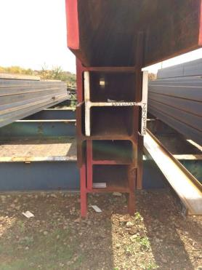
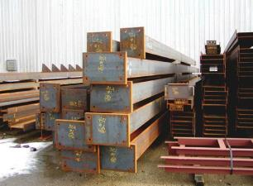
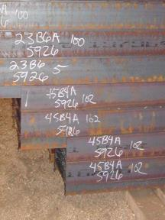
Material Handling Equipment - Stacking
Material Handling Equipment
Module 3
Stacking
The variety of raw and fabricated steel shapes at the shop require planning and care when stacking
Notes:
This slide shows examples of stacking of steel shapes and fabricated steel elements.

Slide 58
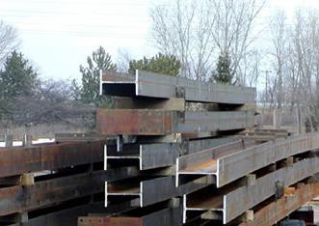
Material Handling Equipment – Wood Blocking
Material Handling Equipment
Module 3
Use of wood blocking between beam material
Wood Blocking
Wood blocking used between shapes
Notes:
This slide shows use of blocking between steel beams.

Slide 59
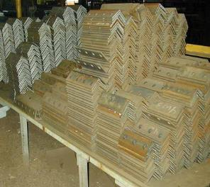
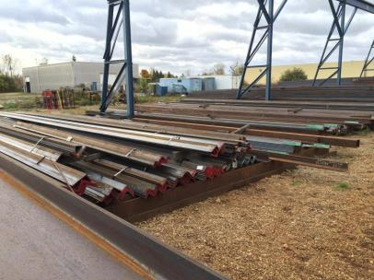
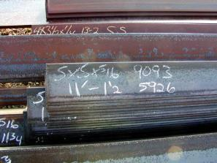
Material Handling Equipment – Stacking Small Steel Items
Material Handling Equipment
Module 3
Stacking Small steel items – angles
Notes:
This slide shows stacking of smaller steel shapes.

Slide 60
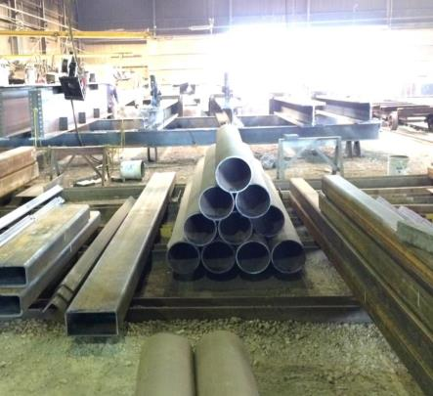
Material Handling Equipment – Stacking Steel Pipe
Material Handling Equipment
Module 3
Stacking Steel Pipe
Round HSS steel shapes should be blocked,
placed in racks or cribbing or bundled and tied together
Blocking
Round HSS shapes stored for fabrication
–blocking is used to prevent shapes from rolling
Notes:
Round material must be blocked or banded to prevent movement of stored material.

Slide 61

Material Handling Equipment – String Coils
Material Handling Equipment
Module 3
String coils
Steel coils should be blocked to prevent movement
Tapered Blocking
Steel coils weighing 10 tons are blocked to prevent rolling
60
Notes:
This slide shows an example of blocking of round coils.

Slide 62



Material Handling Equipment – Materials Storage
Material Handling Equipment
Module 3
Materials Storage
Secure materials stored in tiers by stacking, racking, blocking, or interlocking to prevent them from falling
Post safe load limits of floors and shelves.
Source OSHA 3220-10N 2004
Notes:
This slide presents tips for safe storage of miscellaneous materials used in the fabrication shop.

Slide 63
Material Handling Equipment – Materials Storage - Fuels
Material Handling Equipment
Module 3
Materials Storage-Fuels
Store fuel in portable containers
Transportation of gasoline requires USDOT container
Tank size – 8 gallon or less
Approved OSHA can
Approved USDOT – (stamp-imprint)
Diesel fuel containers
Tank size – 119 gallons or less
Except from using specified container
Notes:
This slide presents tips for safe storage of fuels used in the fabrication shop.

Slide 64

Storing Materials – Q and A
Material Handling Equipment
Module 3
Q and A
Storing
Materials
Notes:
The presenter should encourage attendees to ask questions about this module.

Slide 65
Take a Stretch!
Material Handling Equipment
Module 3
Notes:
Encourage attendees to stand and stretch.

