Slide 1
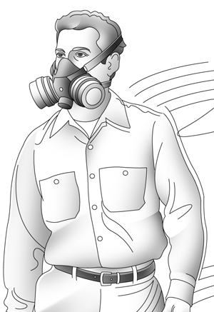
Respiratory Safety and PPE
Module 7
Special Warehouse
Worker Hazards
in Structural Steel
Fabricating and
Supply Companies
Drawing from OSHA 3384-09 2011
Notes:
Module 7 presents respiratory protection and PPE in steel fabrication and supply companies.

Slide 2
Respiratory Safety and PPE
Module 7 slide 2
OSHA Grant Information
This material was produced under grant number
SH-26316-SH4 from the Occupational Safety and Health Administration, U.S. Department of Labor. It does not necessarily reflect the views or policies of the U.S. Department of Labor, nor does mention of trades names, commercial products, or organizations imply endorsement by the U.S. Government.
Notes:
Speaker to provide grant materials acknowledgment.

Slide 3




Respiratory Safety and PPE
Module 7 slide 3
Program Development
This program was developed by faculty and students in the School of Planning Design and Construction, Michigan State University in conjunction with
the American Inistitute of Steel Construction, Safety Committee and the the University of Pureto Rico
March 2015

Slide 4
Respiratory Safety and PPE slide 4
Module 7
Learning Outcomes: Participants shall be able to:
Demonstrate understanding of respiratory risks
Know when respiratory protection should be worn
Know the types of respiratory protection
Know how a respirator should fit
Know how to maintain, clean and store a respirator
Know inspection requirements
Demonstrate understanding of requirements for PPE
Notes:
This slide identifies the intended learning outcomes of the module on respiratory protection and PPE.

Slide 5
Respiratory Safety and PPE
Module 7
Background on Safety and Respirator
Certain operations within your shop may require the use of a respirator
OSHA Standard 1910.134 Respiratory Protection, establishes requirements
1910.134 requires employers to have a Respiratory Protection Program that is worksite specific
Always comply with your employer’s program
Source: OSHA 3384-09 2011
Notes:
This slide provides background on use of respiratory protection and identifies OSHA 19190.134 as the standard addressing respiratory protection. This standard requires companies to have a Respiratory Protection Plan.

Slide 6
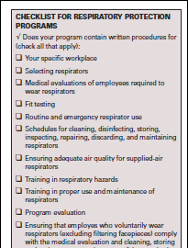
Respiratory Safety and PPE
Module 7 slide 6
Respiratory Protection Plan
The plan must be worksite specific and address:
Selecting respirators
Medical evaluations
Fit testing
Emergency respiratory use
Schedules for cleaning,
disinfecting, storing,
inspecting, repairing,
discarding and maintaining
Checklist from OSHA 3384-09 2011
Notes:
This slide presents the requirements of the company specific Respiratory Protection Plan.

Slide 7
Respiratory Safety and PPE slide 7
Module 7
Respiratory Protection Plan Continued
Ensure adequate air quality
Training in respiratory hazards
Train in proper use and maintenance of respirators
Program evaluation
Ensure employees comply with medical evaluations, cleaning, storing and maintenance requirements
Have a designated program administrator
Update the program periodically
Provide equipment, training and medical evaluations at no cost to employees
Source: OSHA 3384-09 2011
7
Notes:
This slide is a continuation of the previous slide and presents the requirements of the company specific Respiratory Protection Plan.

Slide 8
Respiratory Protection and PPE slide 8
Module 7
Typical shop operation examples that should be addressed by the plan may include:
Welding
Solvents
Metalworking Fluids (MWFs)
Shop Paint & Chemicals
Abrasive Blasting
Diesel fumes
Others?
8
Notes:
This slide presents typical shop operations that should be addressed by the Respiratory Protection Plan.

Slide 9
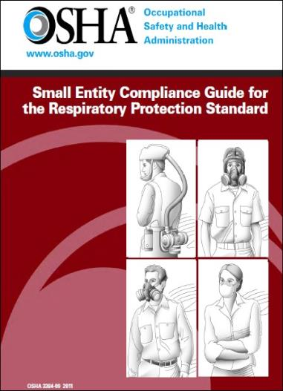
Respiratory Safety and PPE slide 9
Module 7
Background on Safety and Respirator
OSHA has developed a useful Small Entity Compliance Guide for the Respiratory Protection Standard which is available for free download
Source: OSHA 3384-09 2011
9
Notes:
OSHA has a useful guide entitled “Small Entity Compliance Guide for the Respiratory Protection Standard” available for free download.

Slide 10
Respiratory Protection and PPE slide 10
Module 7
An employer may reduce respiratory risks by using:
Engineering controls, such as: local or general dilution ventilation, change of the work process, isolation or enclosure, or substitution
Administrative controls, such as: employee rotation, or scheduling major maintenance for weekends or times when few employees are present
Source: OSHA 3384-09 2011
Notes:
Engineering and administrative controls should be used first to ty to reduce respiratory risks from operations for workers

Slide 11
Respiratory Protection and PPE slide 11
Module 7
Assessing the workplace:
Fumes, vapors and aerosols may cause damage and may require protection
Periodic air monitoring should be done to determine where and when respiratory protection is required
Where the monitoring indicates protection is required, respiratory PPE or engineering controls will be determined
Source: OSHA 3384-09 2011
Notes:
Assessments should be conducted to identify respiratory risks in the workplace.

Slide 12
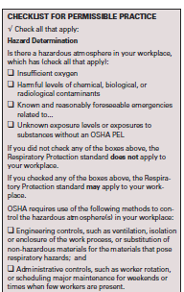
Respiratory Protection and PPE slide 12
Module 7
When should a respirator be worn?
Checklist for permissible practice
Check all that apply
12
Checklist from OSHA 3384-09 2011
Notes:
This slide provides a checklist for determining when respiratory protection should be worn.

Slide 13
Respiratory Protection and PPE slide 13
Module 7
When should a respirator be worn?
Employees should be supplied with respirators “when all preferred methods such as engineering controls and administrative controls for protecting them from breathing contaminated air have been determined to be insufficient to reduce the contamination to non- hazardous levels”
Source: OSHA 3384-09 2011
Notes:
This slide provides additional information for determining when respiratory protection should be worn.

Slide 14
Respiratory Protection and PPE slide 14
Module 7
When should a respirator be worn?
Where oxygen level is insufficient or potentially insufficient
If “exposed to harmful levels of hazardous gases or vapors”
If “exposed to other potential respiratory hazards,
such as dust, airborne biological hazards, mists, fumes, sprays, and other airborne particles”
Source: OSHA 3384-09 2011
Notes:
This slide provides additional information for determining when respiratory protection should be worn

Slide 15
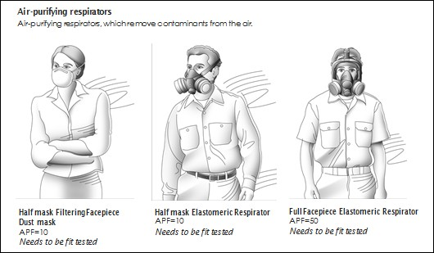
Respiratory Protection and PPE slide 15
Module 7
Types of respirators:
Drawing from OSHA 3384-09 2011
Notes:
This slide depicts various types of respirators.

Slide 16
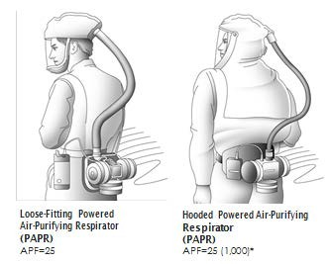
Respiratory Protection and PPE slide 16
Module 7
Types of respirators:
These types of respirators do not need to be fit tested
Drawing from OSHA 3384-09 2011
Notes:
This slide depicts types of respirators that do not require fit testing.

Slide 17
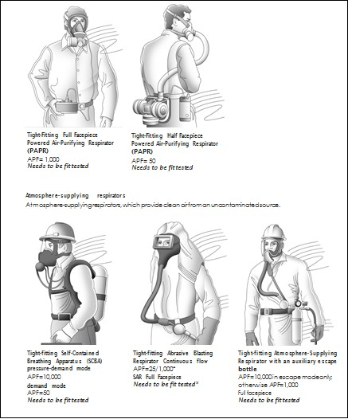
Respiratory Protection and PPE slide 17
Module 7
Types of respirators:
Drawing from OSHA 3384-09 2011
Notes:
This slide further depicts sample respirator types.

Slide 18
Respiratory Protection and PPE slide 18
Module 7
What protection is required for each task?
The employer will determine the type of respiratory protection based on the following criteria:
The company Respiratory Plan
Safety data sheets
Permissible exposure levels (PELS) listed in 1910.1000
Action Level (AL) ½ of the PEL*
Assigned Protection Factors (APF)
Maximum use concentrations (MUC)
Protection appropriate for the chemical state and physical form of the contaminate
Source: OSHA 3384-09 2011
Notes:
This slide lists conditions the employer should consider in determining when respirators should be worn and the types of respirators that are required for various tasks.
Action Levels (AL) Source: Adapted from http://www.ilpi.com/msds/ref/actionlevel.html AL express health or physical hazards
Action levels are typically set at 50% of PEL AL may vary from between standards
AL not defined for all compounds
May need to take additional measures if you exceed 50% of PEL
Safety Data Sheets- Exposure Rating Systems (Source: OSHA 3384-09 2011)
OSHA’s Hazard Communication standard (1910. 1200 Appendix D) requires that safety data sheets list: PEL
ACGIH® TLV®
any other exposure limit used or recommended by the chemical manufacturer, importer, or employer preparing the safety data sheet Exposure Rating Systems – TLVs (Source: OSHA 3384-09 2011)
Threshold Limit Values (TLVs) are guidelines developed by the American Conference of Industrial Hygienists (ACGIH).TLVs refer to airborne concentrations of chemical substances and represent conditions workers may be exposed to without adverse effects. Note these are not OSHA requirements

Slide 19
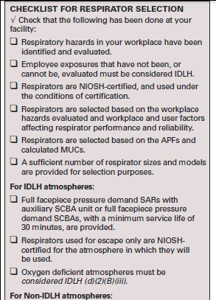
Respiratory Protection and PPE
Module 7 slide 19
What protection is required for each task?
Checklist from OSHA 3384-09 2011
Notes:
This slide presents a checklist the employer can use in determining what types of respirators are required for various tasks.

Slide 20
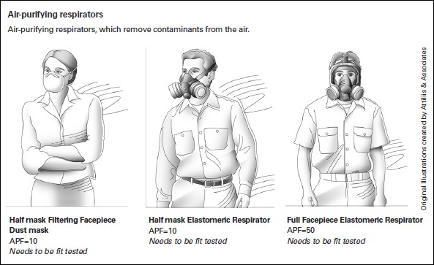
Respiratory Protection and PPE
Module 7 slide 20
How should a respirator fit?
Fit Testing
Drawing from OSHA 3384-09 2011
Notes:
This slide introduces “fit testing”.

Slide 21
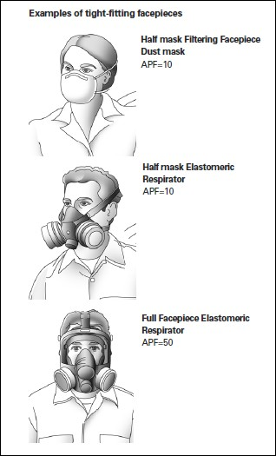
Respiratory Protection and PPE
Module 7 slide 21
21
How should a respirator fit?
Tight fit – forms a complete seal with wearer’s face
Loose fit-forms a partial seal
Drawing from OSHA 3384-09 2011
Notes:
This slide presents the types of respirator fit including “loose and tight”.

Slide 22
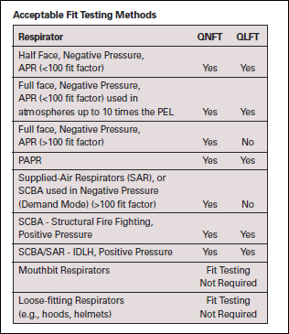
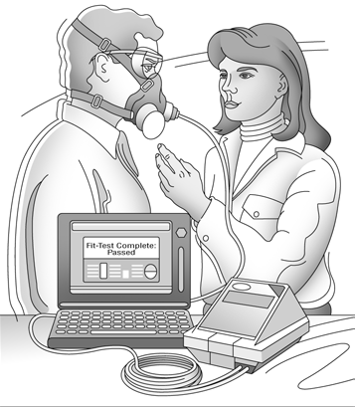
Respiratory Protection and PPE
Module 7 slide 22
Fit testing
Should be conducted by a qualified person
Drawing and Table from OSHA 3384-09 2011
22
Notes:
This slide presents fit test procedures.

Slide 23
Respiratory Protection and PPE slide 23
Module 7
Use of a Respirator
Respirators are an effective method of protection against designated hazards when properly selected and worn
Respirator use should be encouraged, even when exposures are below the exposure limit, to provide an additional level of comfort and protection for workers
Follow instructions provided by the manufacturer on use, maintenance, cleaning and care, and warnings
Source: OSHA 3384-09 2011
23
Notes:
This slide addresses proper use of respirators.

Slide 24
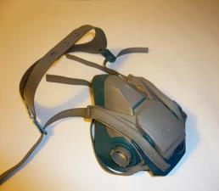
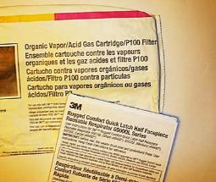
Respiratory Protection and PPE
Module 7 slide 24
Use of a Respirator
Choose respirators certified for use to protect against the contaminant of concern
NIOSH certifies respirators
A label or statement of certification should appear on the respirator or respirator packaging
The label tells you what the respirator is designed for and protection limits
Keep track of your respirator so that you do not mistakenly use someone else's respirator
Source: OSHA 3384-09 2011
24
Notes:
This slide addresses respirator requirements.

Slide 25
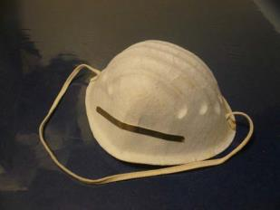
Respiratory Protection and PPE
Module 7 slide 25
Improper Use of a Respirator
If a respirator is used improperly or not kept clean, the respirator itself can become a hazard to the worker
Do not wear a respirator that fits improperly
Do not wear your respirator into atmospheres containing contaminants for which your respirator is not designed to protect against:
  For example, a respirator designed to filter dust particles will not protect you against gases, vapors, or very small solid particles of fumes or smoke
Dust mask does not protect
Source: OSHA 3384-09 2011
against vapors
Notes:
This slide addresses “improper” use of respirators.

Slide 26
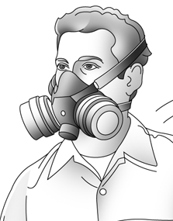
Respiratory Protection and PPE
Module 7 slide 26
Preventing Leaks
Facepiece seals and valves are important in tight-fitting respirators
Tight-fitting respirators should provide a complete seal to the face
If there is a leak then the respirator cannot effectively reduce the exposures to respiratory hazards
Be sure that nothing interferes with the respirator seal to your face
Conduct a user seal check each time you put on a respirator
Drawing from OSHA 3384-09 2011
Source: OSHA 3384-09 2011
Notes:
This slide presents information on preventing leaks when using respirators.

Slide 27
Respiratory Protection and PPE
Module 7 slide 27
Preventing Leaks-Conditions that can interfere with the seal or valve include:
“Facial hair
Facial scars
Jewelry or headgear that projects under the face- piece seal
Missing dentures
Corrective glasses or goggles or other protective equipment:
  Face shields
  Protective clothing
  Helmets
  Eyeglass insert or spectacle kits”
Source: OSHA 3384-09 2011
Notes:
This slide presents physical personal features that can interfere with the respirator seal and fit.

Slide 28
Respiratory Protection and PPE
Module 7 slide 28
Seal Checks-
Workers should perform a negative or positive pressure seal check.
For the negative pressure check:
Cover the respirator inlets (cartridges, canisters, or seals) gently inhale, and hold breath for 10 seconds.
The facepiece should collapse on your face and remain collapsed
For the positive pressure check:
Covers the respirator exhalation valve(s), and exhale
Source: OSHA 3384-09 2011
Notes:
This slide presents the importance of conducting a “Seal Check” each time the respirator is used.

Slide 29
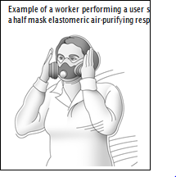
Respiratory Protection and PPE
Module 7 slide 29
Seal Checks
“The facepiece should hold the positive pressure for a few seconds
During this time, the employee should not hear or feel the air leaking out of the face-to-face- piece seal”
Instructor to demonstrate
in class – select a volunteer Demonstrate seal check and proper cleaning
Drawing from OSHA 3384-09 2011
Notes:
The speaker should demonstrate a respirator Seal Check for attendees. Note this demonstration requires the speaker to have a respirator available for the demonstration.

Slide 30
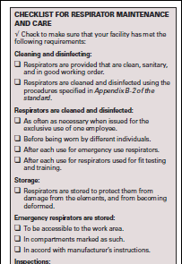
Respiratory Protection and PPE
Module 7 slide 30
How should a respirator be cleaned and maintained?
Checklist from OSHA 3384-09 2011
Notes:
This slide presents respirator cleaning and maintenance guidelines.

Slide 31
Respiratory Protection and PPE slide 31
Module 7
Cleaning and disinfecting
Only wear respirators that are clean, sanitary, and in good working order
Appendix B-2 of the standard covers cleaning and disinfecting procedures
Source: OSHA 3384-09 2011
Notes:
This slide presents additional information on respirator cleaning and maintenance.

Slide 32
Respiratory Protection and PPE slide 32
Module 7
When to clean and disinfect
Clean as often as necessary when issued for the exclusive use of one employee
Clean and disinfect before being worn by different individuals
Clean and disinfect after each use for emergency use respirators
Clean after each use for respirators used for fit testing and training
Source: OSHA 3384-09 2011
Notes:
This slide presents information on when a respirator should be cleaned.

Slide 33
Respiratory Protection and PPE slide 33
Module 7 Storage
“Respirators should be stored to protect them from damage from the elements, and from becoming deformed”
Source: OSHA 3384-09 2011
Notes:
This slide presents information on proper storing of respirators.

Slide 34
Respiratory Protection and PPE
Module 7 slide 34
Emergency use respirators
“Should be accessible to the work area
Should be stored in compartments marked as such
Store in accordance with manufacturer’s instructions”
Cartridges on respirators absorb fumes and therefore should be stored in air tight containers
Emergency use respirators
  Should be certified and documented by inspection, “and by tagging the information either to the respirator or its compartment, or storing it with inspection reports”
Source: OSHA 3384-09 2011
Notes:
This slide presents information on emergency respirators.

Slide 35
Respiratory Protection and PPE
Module 7 slide 35
Inspections
“Routine-use respirators should be inspected before each use and during cleaning
SCBAs and emergency respirators should be inspected monthly and checked for proper functioning before and after each use
Emergency escape-only respirators are inspected before being carried into the workplace for use”
Source: OSHA 3384-09 2011
Notes:
This slide presents information on respirator inspection requirements.

Slide 36
Respiratory Protection and PPE slide 36
Module 7
Inspections should include
“Check of respirator function
Tightness of connections
Condition of the facepiece, head straps, valves, cartridges, and other parts
Condition of elastomeric parts”
Source: OSHA 3384-09 2011
Notes:
This slide presents additional information on respirator inspection requirements.

Slide 37
Respiratory Protection and PPE slide 37
Module 7 Repairs
“Respirators that have failed inspection should be taken out of service
Repairs should only be made by trained personnel
Only NIOSH-certified parts should be used
Reducing and admission valves, regulators and alarms should only be adjusted or repaired by the manufacturer or a technician trained by the manufacturer”
Source: OSHA 3384-09 2011
Notes:
This slide presents respirator repair requirements.

Slide 38
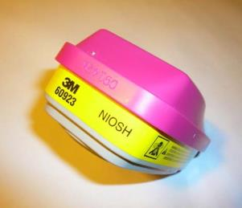
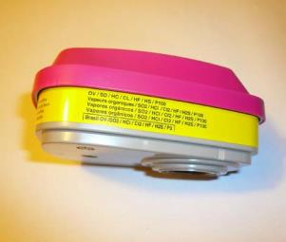
Respiratory Protection and PPE
Module 7 slide 38
Filters and cartridges
Use only filters, cartridges and canisters that are labeled and color coded with the NIOSH approval label
Do not remove labels and be sure to keep them legible
NIOSH Label
Cartridge Uses
Source: OSHA 3384-09 2011
Notes:
This slide addresses the use of respirator filters and cartridges.

Slide 39
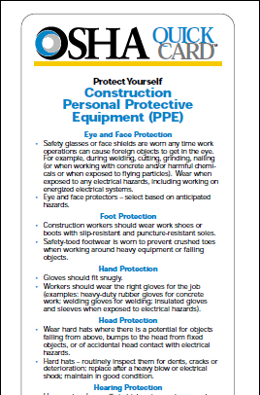
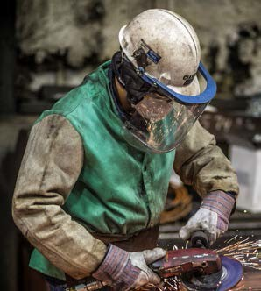
Respiratory Protection and PPE slide 39
Module 7 Other PPE?
Along with respiratory protection other forms (PPE) should be used
39
PPE Used during grinding
Photo from CIANBRO
Source OSHA Quick Card 3260-09N-05
Notes:
This slide addresses the use of other types of PPE by steel workers.

Slide 40
Respiratory Protection and PPE slide 40
Module 7
Eye and Face Protection
❑ “Safety glasses or face shields are worn any time
work operations can cause foreign objects to get in
the eye”
During welding, cutting, grinding using
harmful chemicals or when exposed to flying
particles)
❑ “Wear when exposed to any electrical hazards,
including working on energized electrical systems”
❑ Eye and face protectors – select based on
anticipated hazards
Source OSHA Quick Card 3260-09N-05
40
Notes:
This slide presents information on eye and face protection.

Slide 41
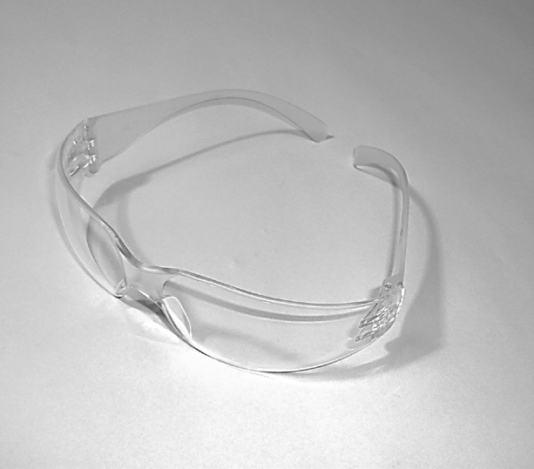
Respiratory Protection and PPE slide 41
Module 7
Eye Protection
Always wear safety glasses!
Glasses should be ANSI Z87.1 compliant
Source OSHA Quick Card 3260-09N-05
41
Notes:
This slide addresses use of eye protection and the ANSI Z78.1 compliance standard for safety glasses.

Slide 42
Respiratory Protection and PPE slide 42
Module 7
Foot Protection
“Workers should wear work shoes or boots with slip- resistant and puncture-resistant soles
Safety-toed foot wear is worn to prevent crushed toes when working around heavy equipment or falling objects”
Source OSHA Quick Card 3260-09N-05
42
Notes:
This slide addresses foot protection.

Slide 43
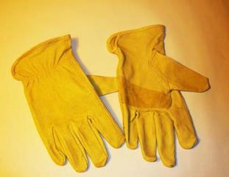
Respiratory Protection and PPE slide 43
Module 7
Hand Protection
“Gloves should fit snugly”
“Workers should wear the right gloves for the job”
Examples:
  Welding gloves for welding
  Strong cut resistant gloves when handling steel
  Gloves cushioned for anti-vibration when grinding
  Insulated gloves and sleeves when exposed to electrical hazards)
Always use gloves for material handling
Source OSHA Quick Card 3260-09N-05
Notes:
This slide addresses hand protection and the importance of selecting the correct type of glove for the task

Slide 44
Respiratory Protection and PPE slide 44
Module 7
Head Protection
“Wear hard hats where there is a potential for objects falling from above, bumps to the head from fixed objects, or head contact with electrical hazards
Hard hats – routinely inspect them for dents, cracks or deterioration; replace after a heavy blow or electrical shock; maintain in good condition”
An important part of hard hat protection is the suspension system. Inspect regularly and replace if defective.
Source OSHA Quick Card 3260-09N-05
Notes:
This slide presents information on head protection.

Slide 45
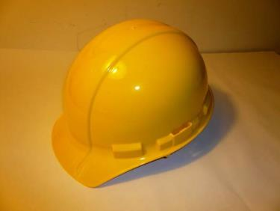
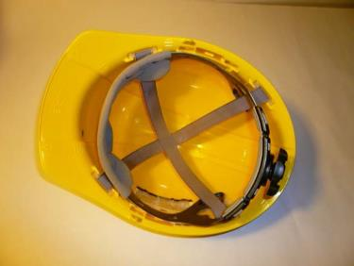
Respiratory Protection and PPE slide 45
Module 7
Head Protection
Hard hat and suspension system
Source OSHA Quick Card 3260-09N-05
Notes:
This slide depicts a typical hardhat and its suspension system.

Slide 46
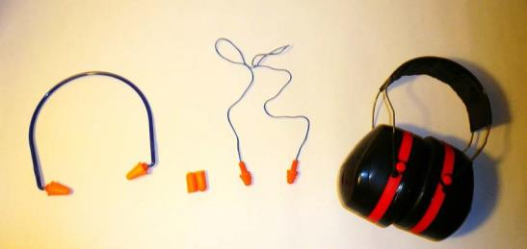
Respiratory Protection and PPE slide 46
Module 7
Hearing Protection
Use earplugs or earmuffs in high noise work areas
Clean or replace ear plugs regularly
Select hearing protection with sufficient decibel reduction
The higher the NRR the more protection is provided
Hearing protection options
Source OSHA Quick Card 3260-09N-05
Notes:
This slide depicts types of hearing protection and their selection including noise reduction.

Slide 47
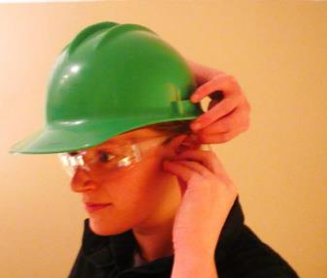
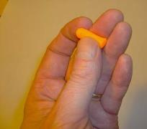
Respiratory Protection and PPE slide 47
Module 7
Hearing Protection ear plug installation
Roll plug into a tight crease free cylinder
Pull up on ear with opposite arm over your head
Insert into ear canal
Properly fit so it is not visible from the front
Ear plug installation
47
Notes:
This slide depicts proper installation of ear plugs. The speaker should demonstrate for the class how to properly install ear plugs. Note speaker should have ear plugs available at the training for demonstration.

Slide 48
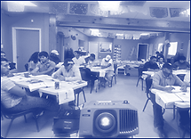

Respiratory Protection and PPE
Module 7 slide 48
Learning Activity
Questions?
48
Notes:
Speaker should encourage attendees to ask questions about use of respiratory protection and general PPE in steel handling operations.

