Slide 1


Workers’ Rights - Module 8
Special Warehouse
Worker Hazards
in Structural Steel
Fabricating and
Supply Companies
Notes:
This module presents federally protected worker rights in the work place

Slide 2

Workers’ Rights - Module 8 slide2
“Worker Protection is the law of the land”
Photo Courtesy of CIANBRO
Notes:
The speaker should emphasize that workers have rights.

Slide 3
Workers’ Rights - Module 8slide 3
OSHA Grant Information
This material was produced under grant number
SH-26316-SH4 from the Occupational Safety and Health Administration, U.S. Department of Labor. It does not necessarily reflect the views or policies of the U.S. Department of Labor, nor does mention of trades names, commercial products, or organizations imply endorsement by the U.S. Government.
Notes:
Speaker to provide grant materials acknowledgment.

Slide 4




Workers’ Rights – Module 1slide 4
Program Development
This program was developed by faculty and students in the School of Planning, Design and Construction at Michigan State University in conjunction with
the American Institute of Steel Construction - Safety Committee and the University of Puerto Rico
March 2015

Slide 5
Workers’ Rights - Module 1slide 5
Learning Outcomes: Participants shall be able to:
Demonstrate understanding of workers’ rights under the OSH Act
Demonstrate understanding of procedures for filing a complaint
Demonstrate understanding of whistleblower protections
Notes:
This slide presents the learning objectives of this module on worker rights.

Slide 6
Workers’ Rights - Module 8slide 6
Right to a Safe and Healthful Workplace
Employers’ “General Duty”
“Employers have the responsibility to provide a safe and healthful workplace that is free from serious recognized hazards. This is commonly known as the General Duty Clause of the OSH Act.”
Source OSHA 3021-09R 2011
Notes:
Emphasize that have a “general duty” to provide a safe workplace.

Slide 7

Workers’ Rights - Module 8 Slide 8
Worker rights
Under the OSH Act you have certain rights
OSHA Guide 3021 provides a general overview of worker rights under the Occupational Safety and Health Act (OSH Act)
It is available for free download from Link to OSHA Website and is included in your trainer packet
Notes:
This slide identifies OSHA Guide 3021 which provides useful information describing worker rights.

Slide 8
Workers’ Rights - Module 8 slide9
Worker Rights - you have the right to:
Receive information from your employer about hazards and safety measures in the workplace
“Refuse to work in an imminent danger situation, under certain conditions”
Source OSHA 3021-09R 2011
Source: Link to Workers' Rights on OSHA Website
Notes:
This slide identifies the rights of workers to receive safety information from employers and to refuse to work in an “imminent danger” situation, under federal law.

Slide 9
Workers’ Rights - Module 8 slide 1
Worker Rights - you have the right to:
Right to request an OSHA inspection for hazards, and violations under OSHA (may remain anonymous)
Have an authorized employee representative accompany the OSHA inspector during the inspection
Meet informally with the OSHA officer (may be a private meeting)
Ask OSHA about any tests performed in the workplace or results of inspections
Source: Link to Workers' Right on OSHA Website
Notes:
This slide identifies rights of workers to request OSHA inspections under federal law.

Slide 10
Workers’ Rights - Module 8 slide 10
Worker Rights - you have the right to:
“File a confidential complaint with OSHA to have their workplace inspected.
Receive information and training about hazards, methods to prevent harm, and the OSHA standards that apply to their workplace. The training must be done in a language and vocabulary workers can understand.
Review records of work-related injuries and illnesses that occur in their workplace.
Receive copies of the results from tests and monitoring done to find and measure hazards in the workplace.
Get copies of your workplace medical records.
Participate in an OSHA inspection and speak in private with the inspector.”
Source OSHA 3021-09R 2011
Notes:
This slide identifies additional rights that workers have under federal law.

Slide 11
Workers’ Rights - Module 8 slide 11
Worker Rights Continued
“File a complaint with OSHA if you have been retaliated or discriminated against by your employer as the result of requesting an inspection or using any other rights under the OSH Act.
File a complaint if punished or discriminated against for acting as a “whistleblower” under the additional 21 federal statutes for which OSHA has jurisdiction.”
Source OSHA 3021-09R 2011
Notes:
This slide emphasizes the right to file a complaint if discriminated against or punished by an employer as the result of requesting an OSHA inspection.

Slide 12
Workers’ Rights - Module 8 slide 12
Workers Rights Under OSHA
Right to file a complaint if dismissed, demoted, or discriminated against for exercising rights under OSHA
File a complaint with federal OSHA authorities if your state agency fails to administer a program effectively
Be notified by your employer of any citations issued
Source OSHA 3021-09R 2011
Notes:
This slide further presents rights of employees to file complaints.

Slide 13
Workers’ Rights - Module 8 slide 13
Employer Responsibilities:
Provide workers “with a workplace that does not have serious hazards”
“Follow all OSHA safety and health standards”
“Find and correct safety and health problems”
“Try to eliminate or reduce hazards first by making feasible changes in working conditions.”
Source OSHA 3021-09R 2011
Notes:
This slide identifies key employer responsibilities for providing a safe workplace

Slide 14
Workers’ Rights - Module 8 slide 14
Employer Responsibilities Continued:
“Inform employees about hazards through training, labels, alarms, color-coded systems, chemical information sheets and other methods.
Train employees in a language and vocabulary they can understand.
Keep accurate records of work-related injuries and illnesses.
Perform tests in the workplace, such as air sampling, required by some OSHA standards.
Provide hearing exams or other medical tests required by OSHA standards.
Post OSHA citations and injury and illness data where workers can see them”
Notes:
This slide further identifies key employer responsibilities for providing a safe workplace.

Slide 15
Workers’ Rights - Module 8 slide 15
Employer Responsibilities Continued:
Notify OSHA in accordance with the newly updated reporting requirements Link to new OSHA reporting requirements
effective on January 1, 2015.*
Notes:
This slide further identifies key employer responsibilities for providing a safe workplace.
OSHA recently updated its reporting requirements which became effective January 1, 205. The following is extracted from: http://www.osha.gov/recordkeeping2014/reporting.html
“What am I required to report under the new rule as of January 1, 2015?
Previously, employers had to report the following events to OSHA:
All work-related fatalities
All work-related hospitalizations of three or more employees
Now, employers have to report the following events to OSHA:
All work-related fatalities
All work-related in-patient hospitalizations of one or more employees
All work-related amputations
All work-related losses of an eye
Employers must report work-related fatalities within 8 hours of finding out about it.
For any in-patient hospitalization, amputation, or eye loss employers must report the incident within 24 hours of learning about it.
Only fatalities occurring within 30 days of the work-related incident must be reported to OSHA. Further, for an inpatient hospitalization, amputation or loss of an eye, then incidents must be reported to OSHA only if they occur within 24 hours of the work-related incident.
Employers have three options for reporting the event:
By telephone to the nearest OSHA Area Office during normal business hours.
By telephone to the 24-hour OSHA hotline (1-800-321-OSHA or 1-800-321-6742).
OSHA is developing a new means of reporting events electronically, which will be released soon and accessible on OSHA's website.”

Slide 16
Workers’ Rights - Module 8 slide 16
Employer Responsibilities Continued:
Display the official OSHA Job Safety and health poster.
Not discriminate against workers using their rights under (Section 11(c)) of the OSH Act
Provide and pay for necessary PPE
Source OSHA 3021-09R 2011
Notes:
This slide further identifies key employer responsibilities for providing a safe workplace.

Slide 17

Workers’ Rights - Module 8 slide 17
Worker Responsibilities:
“Read the OSHA poster in the workplace
Comply with all the OSHA standards, with all requirements of your State-approved plan (if any), and with the employer's safety and health rules”
Source: Link to Worker Responsibilities
Notes:
This slide identifies worker responsibilities to comply with OSAH standards and identifies the OSHA workplace poster as a source of information.

Slide 18
Workers’ Rights - Module 8 slide 18
Worker Responsibilities – Continued:
“Report any hazards immediately to your supervisor
Report to your supervisor any job-related illness or injury
Cooperate fully with the OSHA compliance officer who inspects your workplace”
Source: Link to Worker Responsibilities on OSHA Website
Notes:
This slide lays out other worker responsibilities.

Slide 19
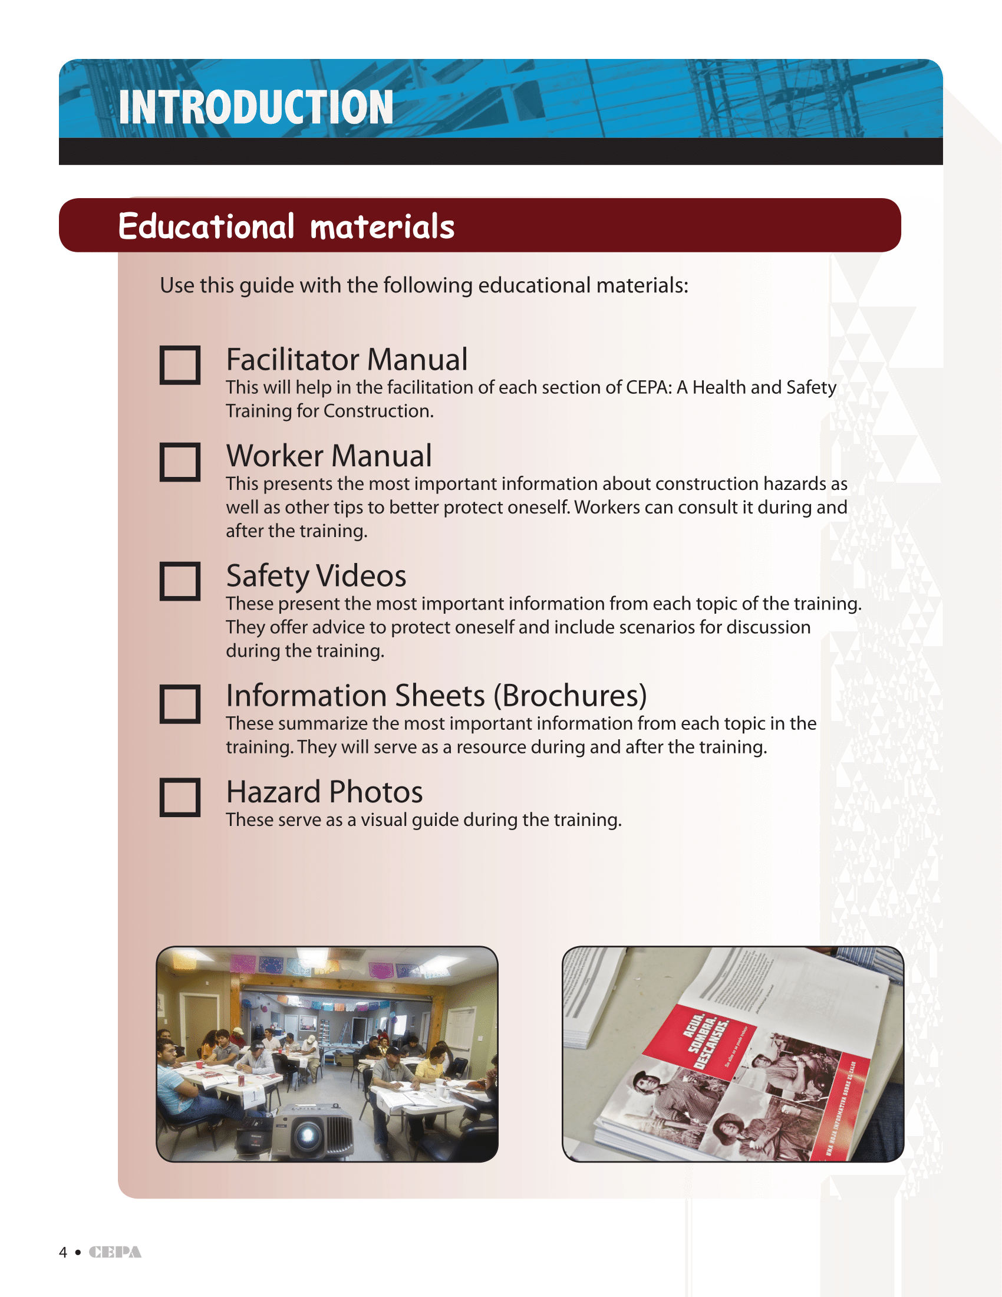
Workers’ Rights - Module 8 slide 19
Protection from discrimination
An employer cannot discriminate against an employee for the following:
Source OSHA 3021-09R 2011
Notes:
The speaker should emphasize that an employer cannot retaliate if a worker exercises their right to file a complaint or request an inspection.

Slide 20
Workers’ Rights - Module 8 slide 20
Protection from discrimination if worker has:
“Filed a complaint under or related to the Act
Instituted or caused to be instituted any proceeding under or related to the Act
Testified or is about to testify in any proceeding under or related to the Act
Exercised on his own behalf or on the behalf of others any right afforded by the Act”
Link to Protection from Discrimination on OSHA Website
Notes:
The speaker should emphasize that the actions that a worker takes in initiating or filing a complaint cannot be used to discriminate or punish the worker.

Slide 21
Workers’ Rights - Module 8 slide 21
How to file a complaint
Options to filing a health and safety complaint:
Online
Fax/Mail
Phone
Must file complaint within 30 days of alleged discrimination*
An employee may also have a representative on their behalf file the complaint
Complaints should be filed with the regional or area OSHA office.
Source OSHA 3021-09R 2011
Notes:
This slide addresses how to file a complaint.

Slide 22
Workers’ Rights - Module 8 slide 22
What information do you need?
“How many employees work at the site and how many are exposed to the hazard?
How and when are workers exposed?
What work is performed in the unsafe or unhealthful area?
What type of equipment is used? Is it in good condition?
What materials and/or chemicals are used?
Have employees been informed or trained regarding hazardous conditions?
What process and/or operation is involved?”
Link to Workers' Complain on OSHA Website
Notes:
This slide presents information that should be included with a complaint.

Slide 23
Workers’ Rights - Module 8 slide 23
What information do you need (continued)?
“What kinds of work are done nearby?
How often and for how long do employees work at the task that leads to their exposure?
How long (to your knowledge) has the condition existed?
Have any attempts been made to correct the problem?
On what shifts does the hazard exist?
Has anyone been injured or made ill as a result of this problem?
Have there been any "near-miss" incidents?”
Link to Workers' Complain on OSHA Website
Notes:
This slide further presents the information that should be included with a complaint.

Slide 24
Workers’ Rights - Module 8 slide 24
What information do you need?
Not all of the above has to be provided, OSHA only needs enough to determine whether or not they will investigate, for example: only two or three could be provided*
You do not need to know which specific standard has been violated*
Link to Workers' Compain on OSHA Website
Notes:
This slide further presents the information that should be included with a complaint.

Slide 25
Workers’ Rights - Module 8 slide 25
Can an employer retaliate against you for filing a complaint?
No, it is against the law.
Protection from discrimination means that an employer cannot retaliate by taking “adverse action” against workers.
Source OSHA 3021-09R 2011
Notes:
This slide emphasizes that an employer cannot retaliate against an employee for filing a complaint

Slide 26
Workers’ Rights - Module 8 slide 26
Right to Use Your Rights:
Protection from Discrimination
Whistleblower Protection
Source OSHA 3021-09R 2011
Notes:
This slide introduces “Whistleblower Protection”.

Slide 27
Workers’ Rights - Module 8 slide 27
Whistleblower Protection
“A whistleblower is a person who exposes misconduct, alleged dishonest or illegal activity occurring in an organization.”
Whistleblower protection program:
Enforces whistleblower provisions of more than 20 statutes who protect employees who report violations.
Link to Whistleblower Website , Link to Whistleblower Protection on OSHA Website
Notes:
This slide defines “Whistleblower” and indicates Whistleblowers have protections under a number of federal laws.

Slide 28
Workers’ Rights - Module 8 slide 28
If you file a complaint it is wrong for the employer to retailate against you by:
Firing or laying off
Blacklisting
Demoting
Denying overtime or promotion
Disciplining
Denying benefits
Failing to hire or rehire
Intimidation
Making threats
Reassignment affecting prospects for promotion
Reducing pay or hours
Sources OSHA 3021-09R 2011
Link to Whistleblower Website, Link to Whistleblower Protection on OSHA Website
Notes:
This slide indicates the actions for which an employer cannot retaliate.

Slide 29
Workers’ Rights - Module 8 slide 29
If your employer has punished you for filing a complaint:
“You can file a discrimination complaint with OSHA
Must file within 30 days of alleged adverse action
Contact your local OSHA office by calling 1-800-321- OSHA (6742), or send a letter to your closest regional or area office
No form is required
In states with approved state plans, employees may file a complaint with both the State and Federal OSHA”
Source OSHA 3021-09R 2011
Notes:
This slide presents complaint filing procedures if an employee is discriminated against for exercising their worker rights.

Slide 30
Workers’ Rights - Module 8 slide 30
Sources
OSHA 3021-09R 2011, Workers Rights (2011)
https://www.osha.gov/Publications/Mach_SafeGuard/rights.html
https://www.osha.gov/pls/oshaweb/owadisp.show_document?p_table=STANDARDS&p_id=11333
https://www.osha.gov/as/opa/worker/complain.html
http://www.whistleblowers.gov/
https://www.osha.gov/OshDoc/data_General_Facts/whistleblower_rights.pdf
https://www.osha.gov/dte/sharwood/best-practices-booklet.pdf
http://www.aisc.org/content.aspx?id=32
Notes:
This slide presents available sources of information on worker rights.

