Slide 1

Secondary Training - Module 9
Special Warehouse
Worker Hazards
in Structural Steel
Fabricating and
Supply Companies
Photo from OSHA 3686-09 2010
Notes:
Module 9 is intended for use with “Train the Trainer” sessions but can be modified for secondary training sessions as it addresses administering the post-program learning assessment, the program evaluation and awarding certificates.

Slide 2
Secondary Training - Module 9 slide 3
OSHA Grant Information
This material was produced under grant number
SH-26316-SH4 from the Occupational Safety and Health Administration, U.S. Department of Labor. It does not necessarily reflect the views or policies of the U.S. Department of Labor, nor does mention of trades names, commercial products, or organizations imply endorsement by the U.S. Government.
Notes:
Speaker to provide grant materials acknowledgment.

Slide 3




Secondary Training – Module 9 slide 4
Program Development
This program was developed by faculty and students in the School of Planning, Design and Construction at Michigan State University in conjunction with
the American Institute of Steel Construction - Safety Committee and the University of Puerto Rico
June 2015

Slide 4

Secondary Training Procedures
Module 9 slide 18
Adult Learning Tips:
Andragogy –
What is it?
Andragogy is a term which consists of teaching strategies geared towards adults and how adults learn. A process commonly used is engaging the adult learner, resulting in a learning experience.
Photo and content source: OSHA 3686-09 2010
Notes:
This slide introduces “andragogy” which is focused on how adults learn.

Slide 5

Secondary Training Procedures
Module 9 slide 19
How adults learn:
Adults are voluntary learners
They learn needed information quickly
They should share life experiences that relate
They need to be treated with mutual respect
Photo and content from OSHA 3686-09 2010
Notes:
This slide identifies some highlights of how adults learn.
https://www.osha.gov/dte/sharwood/best-practices-booklet.pdf

Slide 6
Secondary Training Procedures
Module 9 slide 20
How adults learn:
They learn best when they learn “by doing”
Need to know what the “end goal” is
Best when information is reinforced and repeated
Best when information is presented in a variety of ways
Source: OSHA 3686-09 2010
Notes:
This slide identifies additional highlights on how adults learn.

Slide 7
Secondary Training Procedures
Module 9 slide 21
How adults learn:
Adults are self-motivated
Expect to gain information that has immediate application to their lives
Learn best when actively engaged
Source: OSHA 3686-09 2010
Notes:
This slide identifies additional highlights on how adults learn.
https://www.osha.gov/dte/sharwood/best-practices-booklet.pdf

Slide 8

Secondary Training Procedures
Module 9 slide 22
How adults learn:
Best when they have time to interact, with the instructor and each other
Best when asked to share personal experiences at work and elsewhere
Photo from OSHA 3686-09 2010
Source: OSHA 3686-09 2010
Notes:
This slide identifies additional highlights on how adults learn.

Slide 9
Secondary Training Procedures
Module 9 slide 23
What does that mean?
Adults learn best in an environment of their peers, whom they are respected by
Best when participating in relevant activities to the situation, and when continuing activities or learning over a period of time

Slide 10
Secondary Training Procedures
Module 9 slide 24
Helpful Learning Exchanges
Participant-to-Participant
Participant-to-Facilitator
Facilitator-to-Participant
Source: OSHA 3686-09 2010
Notes:
This slide identifies learning exchanges between participants and facilitators.
https://www.osha.gov/dte/sharwood/best-practices-booklet.pdf

Slide 11

Secondary Training Procedures
Module 9 slide 25
Conducting Trainings
Use words that are easy to understand
Define technical terms or jargon.
Keep sentences short and simple
Use a conversational style and active voice, such as the kind of language that the particpants use
Photo from OSHA 3686-09 2010
Source: OSHA 3686-09 2010
Notes:
This slide identifies helpful hints in presenting the secondary trainings.

Slide 12
Secondary Training Procedures
Module 9 slide 26
Using PowerPoint - Delivery
Slides should serve as a focal point for issues
Do not read from the slides!
Review the speaker notes before the presentation
Remember: questions and discussion are part of the learning experience
Practice using PowerPoint before you use it in a class
Make sure you are comfortable moving between slides and between information on slides
Source: OSHA 3686-09 2010
Notes:
This slide identifies helpful hints in use of PowerPoints in the secondary trainings.

Slide 13
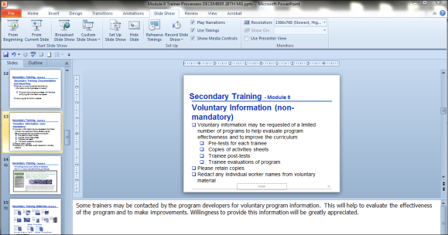
Secondary Training Procedures
Module 9 slide 27
PowerPoint Speaker Notes
Some slides have speaker notes*
You can end the presentation and see the notes at the bottom of the screen or view the notes page.
Speaker note
Source: OSHA 3686-09 2010
Notes:
This slide describes the speaker note feature of the PowerPoint slides.
* Speaker notes help to provide additional background information for the presenter. They should be reviewed before delivering the program.

Slide 14
Secondary Training Procedures
Module 9 slide 28
Flip Charts
Use dark marker colors, such as black, dark brown, or dark blue for the main text
Using many colors on a flip chart will catch your audience’s eye
Print in large block letters
Do a “test” flip chart page before the workshop and make sure it can be read from the back of the room
Be sure not to crowd the flip chart with too much information. Only key points should be written.
Source: OSHA 3686-09 2010
Notes:
This slide describes the benefits of use of “flip charts” in the training.

Slide 15
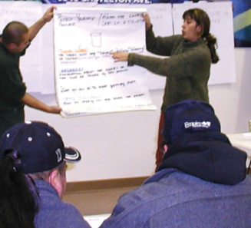
Secondary Training Procedures
Module 9 slide 29
Flip Charts
Watch your spelling
If you have problems with spelling, memorize correct spelling of words you are likely to use
But do not let spelling limit
use of a flip chart
Creating a “spell-free” zone will help to take some pressure off both you and the participants
Photo from OSHA 3686-09 2010
Source: OSHA 3686-09 2010
Notes:
This slides provides some tips for using “flip charts”.

Slide 16
Secondary Training Procedures
Module 9 slide 30
Training Assessments & Evaluation*
Adminster the assessment “Pre-test” before the training
Adminsiter assessment “Post-test” at end of program
Adminster the overall training evaluation
Notes:
This slide indicates the need to administer the Pre-test, Post-test and program evaluations.

Slide 17
Secondary Training Procedures
Module 9 slide 31
Resources and Current Training Programs
OSHA Outreach Training Program Materials:
https://www.osha.gov/dte/outreach/ (has specific resources for trainers - and can also be separated by industry).
Susan Harwood Training Materials (separated by topic)
https://www.osha.gov/dte/grant_materials/material_listing_topic.html
Notes:
This slide provides information on OSHA available training resources.

Slide 18
Secondary Training Procedures
Module 9 slide 32
Sources
https://www.osha.gov/dte/sharwood/best-practices-booklet.pdf
Noorie, N., “Application of an Andragogical Model in Developing a Michigan Residential Energy Code Training Curriculum for Building Inspectors and Officials in Michigan”, Masters Thesis, Michigan State University (2004).
Notes:
This slide provides a resource on development of training programs for adult learners

Slide 19
Secondary Training Procedures
Module 9 slide 36
Thank you!
and
Q and A
Notes:
The speaker should thank attendees and invite any final questions from attendees.

