Slide 1
Module 1 The Warehousing Industry
Industry overview and hazards related to pallet racking operations

Slide 2
Disclaimer
This material was produced under Grant SH-26328-SH4 from the Occupational Safety and Health Administration, U.S. Department of Labor.
It does not necessarily reflect the views or policies of the U.S. Department of Labor, nor does mention of trade names, commercial products, or organizations imply endorsement by the U.S. Government.

Slide 3
Purpose
This presentation is meant to:
Introduce students to the warehousing industry and pallet racking operations
Discuss common OSHA regulations
Give an overview of related hazards

Slide 4
Objectives/Outcomes
At the end of the presentation, students will
Understand the size and scope of the warehousing industry
Be able to identify common OSHA regulations related to the industry
Have an understanding of the complexity and hazards in the industry

Slide 5

Before we begin……….
Pre-test
Notes:
Hand out pre-test to students. Plan on 10-15 minutes to complete and review.

Slide 6
What is Warehousing?
Insert a warehousing video here
Notes:
Much of what is discussed in the video is recapped in several of the following slides.
A short clip gives an overview of how warehousing is classified in the U.S. The video script is as follows:
"Warehousing and storage is a burgeoning industry in the U.S. As a subsector of transportation and warehousing industries, warehousing and storage operations are primarily engaged in operating facilities for general merchandise, refrigerated items, and other warehouse products. These establishments take responsibility for storing the goods and keeping them secure. They may also provide a range of services, often referred to as logistics services, for distribution. Logistics services can include labeling, breaking down bulk loads, inventory control and management, light assembly, order entry and fulfillment, packaging, pick and pack, price marking and ticketing, and transportation arrangement. Given the range of work in warehousing and storage operations, many hazards exist. Hazards from semi traffic, forklift traffic, conveyor equipment, manual lifting, extreme temperatures, cuts from sharp edges, and more lead to potential injuries. These hazards must be controlled to prevent incidents, and awareness is the first step to prevention."

Slide 7
What is Warehousing?
According to BLS.gov
Operating warehousing and storage facilities for general merchandise, refrigerated goods, and other warehouse products. These establishments provide facilities to store goods. They do not sell the goods they handle. These establishments take responsibility for storing the goods and keeping them secure. They may also provide a range of services, often referred to as logistics services, related to the distribution of goods. Logistics services can include labeling, breaking bulk, inventory control and management, light assembly, order entry and fulfillment, packaging, pick and pack, price marking and ticketing, and transportation arrangement. However, establishments in this industry group always provide warehousing or storage services in addition to any logistic services. Furthermore, the warehousing or storage of goods must be more than incidental to the performance of services, such as price marking.
Notes:
After presenting the definition, emphasize the complexity and variety of operations.

Slide 8

What is Warehousing?
Warehousing and Storage is a subsector of transportation and warehousing
Millions of pounds of materials and goods are managed each day in warehouses
Notes:
Note – warehouse image downloaded from an image search on www.google.com.
Image for visual appeal only.

Slide 9
Warehousing Statistics for 2013 (www.bls.gov)
Warehousing Salaries
Laborers, freight, stock and materials movers - $14.25/hour
Shipping, receiving and traffic clerks - $15.45/hour
Stock clerks and order fillers - $15.01/hour
Transportation, storage and distribution managers $40.13/hour

Slide 10
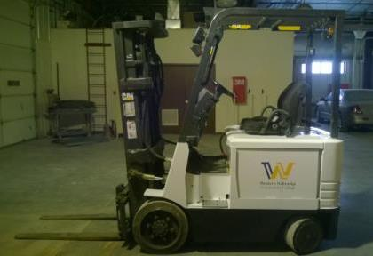
Warehousing Statistics for 2013 (www.bls.gov)
Number of job openings
Industrial truck and tractor operators - 82,130
Laborers and freight, stock, and material movers -180,180
Notes:
Note – Image is a Western Nebraska Community College stock photo.
Image for visual appeal only.

Slide 11
Warehousing Statistics for 2013 (www.bls.gov)
Number of job openings
Shipping, receiving, and traffic clerks - 32,750
Stock clerks and order fillers - 56,310
Transportation, storage, and distribution managers - 8,710
Notes:
Emphasize that there are over 358,000 jobs, most of the jobs are either labor intensive or machine intensive, and that this results in hundreds of thousands of workers exposed to hazards.
This is the last formal industry slide. You will be transitioning to discussion of what pallet raking is.

Slide 12
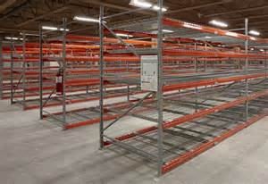
What is Pallet Racking?
A Pallet Rack is…
A common piece of warehouse equipment
Pallet racks look like scaffolding
Used to hold goods stacked on pallets
Often constructed from steel beams and uprights
May be several stories high
Notes:
Note – warehouse image downloaded from an image search on www.google.com.
Image is to show what pallet racks look like.

Slide 13
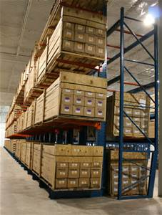
What is Pallet Racking?
Pallet Racks…
Are designed to make loading and unloading as efficient as possible
Store and display items so that people can organize them
Make packages easy to find and reach
Are made so that a forklift or pallet jack can grab the pallet
Notes:
Note – Warehouse image downloaded from an image search on www.google.com.
Image is to highlight how pallet racks make storage easy.

Slide 14
What is Pallet Racking?
As a result, pallet racking can be considered all operations related to managing palletized items
Foundational component to the warehousing industry
Operations are not simple

Slide 15
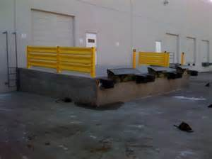
A Quick Hazard Glance
Wide Variety of Hazards in Warehousing and Pallet Racking
Struck by hazards
Falls from heights/docks
Back injuries from lifting
Slips, trips, falls
Protruding packages
Falling packages
Notes:
Note – Image downloaded from an image search on www.google.com.
Image is to highlight a potential fall hazard and struck-by hazard near docks.

Slide 16
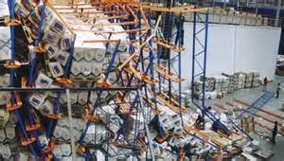

A Quick Hazard Glance
Hazards of Warehousing and Pallet Racking Operations (cont.)
Cuts
Falling/tipping loads
Machinery
Heat/cold stress
And many more
Notes:
Note – Images downloaded from an image search on www.google.com.
Images are meant to highlight cut hazards and falling load hazards, particularly when overloading pallet racks.
After going through hazards, ask the students what other hazards they can think of.
After some discussion, transition into the importance of being aware of rights to protect them in such environments.

Slide 17

Be Proactive
If you are unsure of safe operations
Stop!
Ask for clarification and/or help
Notes:
Note – Image downloaded from an image search on www.google.com.
Image for visual appeal only.

Slide 18

Be Proactive
If you see a hazard
Correct it
Report it
Notes:
Note – Image downloaded from an image search on www.google.com.
Image for visual appeal only.
This is the last overview slide. From here, you transition into worker rights slides.

Slide 19

Know Your Rights!
Notes:
Note – Image downloaded from an image search on www.google.com.
Image for visual appeal only.
The next several slides cover basic OSHA information

Slide 20

OSHA Basics
Occupational Safety and Health Act of 1970
The Occupational Safety and Health Act of 1970 (OSH Act) was passed to prevent workers from being killed or seriously harmed at work. This law created the Occupational Safety and Health Administration (OSHA), which sets and enforces protective workplace safety and health standards. OSHA also provides information, training, and assistance to employers and workers. Under the OSH Act, employers have the responsibility to provide a safe workplace.
Notes:
Note – Image downloaded from an image search on www.google.com.
Image for visual appeal only.

Slide 21
OSHA Basics
Occupational Safety and Health Administration
With the Occupational Safety and Health Act of 1970, Congress created the Occupational Safety and Health Administration (OSHA) to assure safe and healthful working conditions for working men and women by setting and enforcing standards and by providing training, outreach, education and assistance.
Notes:
If you have a web connection, take a moment to surf the OSHA website at www.osha.gov, particularly the Worker Rights tab.

Slide 22
OSHA Basics – Who Does OSHA Cover?
Private Sector Workers
Most employees in the nation come under OSHA's jurisdiction. OSHA covers private sector employers and employees in all 50 states, the District of Columbia, and other U.S. jurisdictions either directly through Federal OSHA or through an OSHA-approved state program. State-run health and safety programs must be at least as effective as the Federal OSHA program. To find the contact information for the OSHA Federal or State Program office nearest you, see the Regional and Area Offices map.

Slide 23
OSHA Basics – Who Does OSHA Cover?
State and Local Government Workers
Employees who work for state and local governments are not covered by Federal OSHA, but have OSH Act protections if they work in a state that has an OSHA-approved state program. Four additional states and one U.S. territory have OSHA approved plans that cover public sector employees only. This includes: Connecticut, Illinois, New Jersey, New York, and the Virgin Islands. Private sector workers in these four states and the Virgin Islands are covered by Federal OSHA.

Slide 24
OSHA Basics – Who Does OSHA Cover?
Federal Government Workers
Federal agencies must have a safety and health program that meet the same standards as private employers. Although OSHA does not fine federal agencies, it does monitor federal agencies and responds to workers' complaints. The United States Postal Service (USPS) is covered by OSHA.

Slide 25
OSHA Basics – Who is NOT Covered?
Not covered by the OSH Act:
Self-employed as a true Sole Proprietor;
Immediate family members of farm employers that do not employ outside employees; and
Workplace hazards regulated by another Federal agency (for example, the Mine Safety and Health Administration, the Federal Aviation Administration, the Coast Guard).
Notes:
Emphasize that theses are NOT covered.

Slide 26

OSHA Basics
Main Focus
Employer responsibilities
Employee rights
OSHA Standards
Inspections
Help for employers
Notes:
Note – Image downloaded from an image search on www.google.com.
Image for visual appeal only.
The Occupational Safety and Health Administration covers five areas:
Employer responsibilities
Employee rights
OSHA Standards
Inspections
Help for employers
Cover each of these one at time for a better understanding of what OSHA does.

Slide 27

OSHA Basics
Employer responsibilities – Employers MUST:
Provide employees with a safe workplace
Follow all relevant OSHA safety and health standards
Inform employees about hazards through training, labels, alarms, color-coded systems, and other methods
Keep accurate records of work-related injuries and illnesses
Perform tests in the workplace as required by some OSHA standards
Post OSHA citations, injury and illness data, and the OSHA poster
Notify OSHA about serious accidents and fatalities
Not discriminate or retaliate against workers for using their rights under the law
Notes:
Note – Image downloaded from an image search on www.osha.gov.
Image meant to show what an OSHA poster looks like.
Run through the list on the slide one at a time.
Employers have the responsibility to provide safe workplace. Employers must provide their employees with a workplace that does not have serious hazards and follow all relevant OSHA safety and health standards. Employers must find and correct safety and health problems. OSHA further requires employers to try to eliminate or reduce hazards first by making changes in working conditions rather than just relying on masks, gloves, earplugs or other types of personal protective equipment.
The OSHA poster is referenced in this slide. Inform students that they can get a copy of the OSHA poster at https://www.osha.gov/Publications/poster.html. If you have access to the internet, you should take a minute and visit the webpage.
This would also be a good time to discuss the new recordkeeping/reporting requirements. This information is at https://www.osha.gov/recordkeeping2014/index.html.

Slide 28
OSHA Basics
Employee Rights – Employees Have the Right to:
Working conditions that don’t pose a risk of serious harm
Information and training about:
Chemical and other hazards
Methods to prevent harm
OSHA standards that apply to their workplace
Review records of work-related injuries and illnesses
Get copies of test results done to find and measure hazards in the workplace
File a complaint asking OSHA to inspect their workplace
Use their rights under the law without retaliation
Notes:
Employees have the following rights under OSHA:
Working conditions that do not pose a risk of serious harm. • Receive information and training (in a language workers can understand) about chemical and other hazards, methods to prevent harm, and OSHA standards that apply to their workplace. • Review records of work-related injuries and illnesses. • Get copies of test results done to find and measure hazards in the workplace. • File a complaint asking OSHA to inspect their workplace if they believe there is a serious hazard or that their employer is not following OSHA rules. When requested, OSHA will keep all identities confidential. • Use their rights under the law without retaliation. If an employee is fired, demoted, transferred or retaliated against in any way for using their rights under the law, they can file a complaint with OSHA. This complaint must be filed within 30 days of the alleged retaliation.
The next three slides go into Whistleblower Protection to expand on retaliation protection.

Slide 29

Whistleblower Protection
Section 11(c) of the OSH Act
OSHA's Whistleblower Protection Program enforces the whistleblower provisions of more than twenty whistleblower statutes protecting employees who report violations
Notes:
Note – Image downloaded from an image search on www.google.com.
Image for visual appeal only.
Inform students that they can file a complaint if retaliation occurs related to safety and health. If you have access to the internet, take some time to review basic Whistleblower information at http://www.whistleblowers.gov/ .
At the time of development, there were 22 statutes, including 11(c).
Pass out whistleblower factsheet if available. You can download a copy at https://www.osha.gov/OshDoc/data_General_Facts/whistleblower_rights.pdf

Slide 30

Whistleblower Protection
An employer may not take an adverse action against an employee because the employee engages in protected activity.
Notes:
Note – Image downloaded from an image search on www.google.com.
Image for visual appeal only.
Inform students that they can file a complaint if retaliation occurs related to safety and health. If you have access to the internet, take some time to review basic Whistleblower information at http://www.whistleblowers.gov/ .

Slide 31
Whistleblower Protection
Protected activities may include:
Making a health and safety complaint to a supervisor
Making a health and safety complaint to the Government
Reporting a work-related illness or injury
Cooperating in an inspection/investigation
Requesting Safety Data Sheets
Testifying
Refusing to do dangerous tasks
Notes:
Note - You can refuse to do a serious dangerous work, but not walk off the job.
See https://www.osha.gov/right-to-refuse.html for details on refusing to do work.

Slide 32
OSHA Basics
OSHA Standards
Rules that describe methods that employers MUST use to protect employees
Standards for:
Construction
Agriculture
Maritime operations
General industry
Notes:
OSHA standards are rules that describe the methods that employers must use to protect their employees from hazards. There are OSHA standards for Construction work, Agriculture, Maritime operations, and General Industry, which are the standards that apply to most worksites. These standards limit the amount of hazardous chemicals workers can be exposed to, require the use of certain safe practices and equipment, and require employers to monitor hazards and keep records of workplace injuries and illnesses.
As we saw from the slide on Employer responsibilities, these standards limit the amount of hazardous chemicals workers can be exposed to, require the use of certain safe practices and equipment, and require employers to monitor hazards and keep records of workplace injuries and illnesses.

Slide 33
Common Standards for Warehousing
General Duty Clause
Section 5(a)(1)
(1) shall furnish to each of his employees employment and a place of employment which are free from recognized hazards that are causing or are likely to cause death or serious physical harm to his employees
Notes:
Employers must also comply with the General Duty Clause of the OSH Act, which requires employers to keep their workplace free of serious recognized hazards. This clause is generally cited when no OSHA standard applies to the hazard.
General Duty Clause can be found at the following web addresses
Section 5(a)(1) https://www.osha.gov/pls/oshaweb/owadisp.show_document?p_table=OSHACT&p_id=3359
It is recommended that you have a copy of these standards available prior to delivering training.

Slide 34

OSHA Basics
Inspections
Initiated without any advance notice
Conducted onsite inspections, or via telephone/fax Investigations
Performed by highly trained compliance officers
Based on the following priorities:
Imminent danger
Catastrophes
Worker complaints and referrals
Targeted inspections – particular hazards or high injury rates
Follow-up inspections
Employers can contest citations
Notes:
Note – Image downloaded from an image search on www.google.com.
Image for visual appeal only.
Inspections are initiated without advance notice, conducted using on-site inspections, or telephone/facsimile investigations, performed by highly trained compliance officers, and based on the following
priorities: • Imminent danger • Catastrophes – fatalities or hospitalizations •Worker complaints and referrals • Targeted inspections – particular hazards, high injury rates • Follow-up inspections.
When an inspector finds violations of OSHA standards or serious hazards, OSHA may issue citations and fines. A citation includes methods an employer may use to fix a problem and the date by when the corrective actions must be completed. Employers have the right to contest any part of the citation, including whether a violation actually exists. Workers only have the right to challenge
the deadline for when a problem must be resolved. Appeals of citations are heard by the independent Occupational Safety and Health Review Commission.

Slide 35
OSHA Basics
Help for Employers – OSHA Offers:
Free confidential advice
Programs and services to help employers identify and correct job hazard and improve injury and illness prevention programs
Free on-site consultations for small and medium-sized businesses. These are not enforcement actions and do not result in penalties or citations
Compliance assistance via specialists
Cooperative programs
Alliance Program
OSHA Strategic Partnerships (OSP)
Notes:
OSHA offers free confidential advice. Several programs and services help employers identify and correct job hazards as well as improve their injury and illness prevention programs.
OSHA provides funding to states for a free service, On-Site Consultation, for small and medium-sized businesses. On-site Consultation services are separate from enforcement and do not result in penalties or citations.
OSHA has compliance assistance specialists throughout the nation who can provide general information about OSHA standards and compliance assistance resources.
OSHA offers cooperative programs to help prevent fatalities, injuries, and illnesses in the workplace. Alliance Program – OSHA works with groups committed to worker safety and health to develop
compliance assistance resources and educate workers and employers. OSHA Strategic Partnerships (OSP) – Partnerships are formalized through tailored agreements designed to encourage, assist, and recognize partner efforts to eliminate serious hazards and achieve model workplace safety and health practices. Voluntary Protection Programs (VPP) – The VPP recognize employers and workers in private industry and federal agencies who have implemented effective safety and health management programs and maintain injury and illness rates below the national average for
their respective industries. In VPP, management, labor, and OSHA work cooperatively and proactively to prevent fatalities, injuries, and illnesses.

Slide 36
Break Time
Notes:
Note – Image downloaded from an image search on www.google.com.
Image for visual appeal only.
After break, plan to discuss regulations more specific to warehouses.

Slide 37
OSHA Regulations for Warehousing
Common OSHA Regulations
The Good Housekeeping Regulations - 29 CFR 1910.22(a)
Per 29 CFR 1910.22(a)(1) all places of employment, passageways, storerooms and service rooms must be kept clean and orderly and in a sanitary condition.
The floor of every workroom must be maintained in a clean and so far as possible, a dry condition. Where wet processes are used, drainage must be maintained, and false floors, platforms, mats or other dry standing places should be provided where practical. (29 CFR 1910.22(a)(2))
Notes:
Emphasize that simple housekeeping can prevent incidents from both pedestrian traffic and machine traffic.

Slide 38
OSHA Regulations for Warehousing (Cont.)
Common OSHA Regulations
The Good Housekeeping Regulations - 29 CFR 1910.141(a)
To facilitate cleaning, every floor, working place, and passageway shall be kept free from protruding nails, splinters, loose boards, and unnecessary holes and openings.
All sweepings, solid or liquid wastes, refuse, and garbage shall be removed in such a manner as to avoid creating a menace to health and as often as necessary or appropriate to maintain the place of employment in a sanitary condition

Slide 39

OSHA Regulations for Warehousing (Cont.)
Common OSHA Regulations
1910 Subpart I - Personal Protective Equipment
1910.132 - General requirements.
1910.133 - Eye and face protection.
1910.134 - Respiratory Protection.
1910.135 - Head protection.
1910.136 - Foot protection.
1910.137 - Electrical protective devices.
1910.138 - Hand Protection.
Notes:
Note – Image downloaded from an image search on www.google.com.
Image meant to highlight common PPE used.
Breakout Activity – Have the students break out into small groups. Then have student discuss different types of warehouse storage (i.e. chemical, retail, food, construction, etc.) they are familiar with or have interest in. Once they identify three to five types of warehouse operations, have the students generate lists of PPE for those environments. Compare the lists. As an additional component, have a variety of PPE with you, such as chemical proof gloves, leather gloves, face shields, and safety glasses. As you pass around this PPE, have the students take note of the type of material the PPE is made out of, the usefulness, and any ANSI or NIOSH specifications.

Slide 40
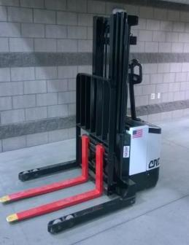
OSHA Regulations for Warehousing (Cont.)
Common OSHA Regulations
Forklifts and Handling Materials
1910.176 Handling Materials
1910.178 Powered Industrial Trucks
1910.179 Overhead and Gantry Cranes
1910.180 Crawler Locomotive and Truck Cranes
1910.181 Derricks
Notes:
Note – Image is a Western Nebraska Community College stock photo.
Image meant to show an example of a Powered Industrial Truck. The PIT is commonly known as a Walkie-Stacker.
Discuss how material must be loaded and unloaded and how a variety of equipment is used to do so.

Slide 41
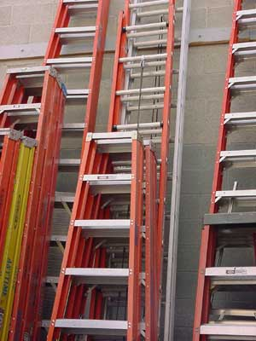
OSHA Regulations for Warehousing (Cont.)
Common OSHA Regulations
Ladders, Walking and Working Surfaces
1910.22 Aisles and passageways and loads on floors
1910.23 Floor openings
1910.24 Fixed industrial stairs
1910.25 Portable wood ladders
1910.26 Portable metal ladders
1910.27 Fixed ladders
1910.28 Safety requirements for scaffolding
1910.29 Manually propelled ladder stands
1910.30 Working surfaces – dockboards
Notes:
Note – Image is a Western Nebraska Community College stock photo.
Image meant to highlight that ladders are used in warehousing.

Slide 42
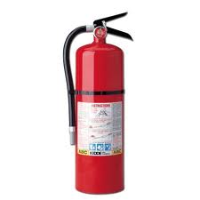
OSHA Regulations for Warehousing (Cont.)
Common OSHA Regulations - Fire Protection – Subpart L
1910.155 – Scope and application
1910.156 - Fire brigades
1910.157 - Portable fire extinguishers
1910.158 - Standpipe and hose systems
1910.159 - Automatic sprinkler systems
1910.160 - Fixed extinguishing systems, general
1910.161 - Fixed extinguishing systems, dry chemical
1910.162 - Fixed extinguishing systems, gaseous agent
1910.163 - Fixed extinguishing systems, water spray and foam.
1910.164 - Fire detection systems
1910.165 - Employee alarm systems
Notes:
Note – Image downloaded from an image search on www.google.com.
Image meant to highlight fire extinguishers as discussion topic.
Discuss the variety of materials stored in warehouses and how much of what is stored can be combustible or flammable.
29CFR1910.155-165 apply, with 1910.157 is most applicable.

Slide 43
So Many More….
Easy to see how complex warehouses are
Dozens more regulations apply
Let’s take a more generalized view of warehouse hazards
Notes:
This is the last regulation slide. Tell the students that there are literally dozens of other standards that could apply and that these were presented just to get them thinking. Modules 2 and 3 will dive deeper into specific hazards.
Now you will transition to general discussion of hazards in warehouses.

Slide 44

Warehousing Safety Issues
Potential Hazards for Workers in Warehouses
Vehicle traffic
Unsafe use of forklifts
Notes:
Note – Image is a Western Nebraska Community College stock photo.
Image meant to show an example of a Powered Industrial Truck. The PIT is a Class 1 Electric Forklift

Slide 45
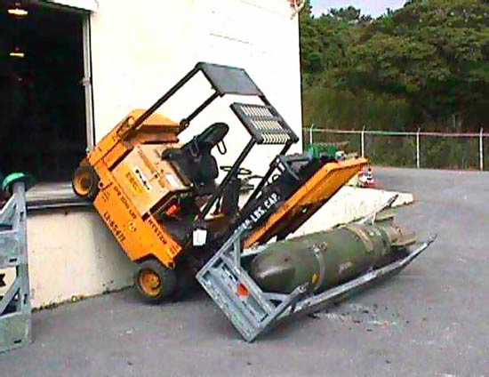
An Example
Notes:
Note – Image downloaded from an image search on www.google.com.
Image meant to highlight the unsafe use of forklift.

Slide 46
Warehousing Safety Issues
Forklifts
Region 7 (NE, IA, KS, MO) OSHA Statistics
251 fatal struck-by incidents from 2008 to 2013
70% were in industrial environments
18% of the accidents involved forklifts
Notes:
Hand out Regional Fact Sheet entitled Struck By Vehicles

Slide 47
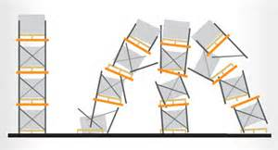
Warehousing Safety Issues
Potential Hazards for Workers in Warehouses
Inadequate lockout/tagout procedures
Improper stacking of products
Overloading pallet racks
Tipping Loads
Notes:
Note – Image downloaded from an image search on www.google.com.
Image meant to highlight the poor pallet racking operations. The next slide has actual photos of fallen material to emphasize pallet racking failure.

Slide 48
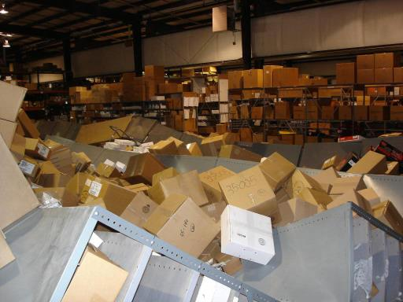
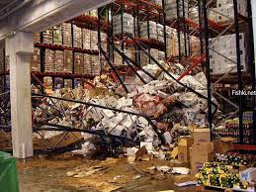
Examples
Notes:
Note – Warehouse images downloaded from an image search on www.google.com.
Images are meant to highlight failures in pallet racking and tipping loads.
This would be a good time to highlight the domino effect warehouse incidents often have. As the photos show, if one set of racking or shelving fails, often times others can be impacted.

Slide 49
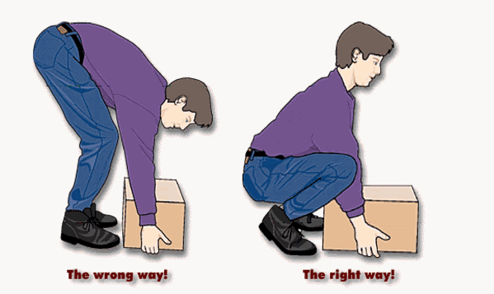
Warehousing Safety Issues
Potential Hazards for Workers in Warehouses
Repetitive motion injuries
Back strains/injuries
Notes:
Note – Image downloaded from an image search on www.google.com.
Image meant to highlight proper manual materials handling technique.

Slide 50
Warehousing Safety Issues
Potential Hazards for Workers in Warehouses
Inadequate fire safety provisions
Dollar General Warehouse in Alabama fined $25,000
Repeat violations of blocking emergency exits and fire extinguishers
Additional fine of $29,000 for other serious hazards in the warehouse environment
Notes:
Discuss how fires are common accidents in industry. If you have access to the internet, provide examples of citations like the one found at https://osha.gov/pls/oshaweb/owadisp.show_document?p_table=NEWS_RELEASES&p_id=356 . This example explains that Dollar General was fined $54,000 for safety violations in a warehouse, many of which related to fire safety provisions.
It is recommended that you have a hard copy of the news release to pass around.

Slide 51
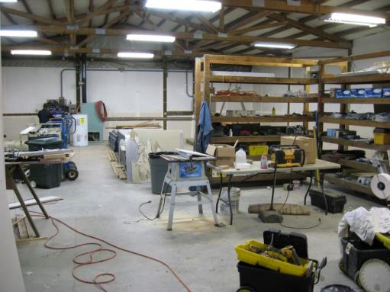
Warehousing Safety Issues
Housekeeping Issues
Tripping
Slipping
Sharp objects
Trash, water, oil and more
Notes:
Note – Image downloaded from an image search on www.google.com.
Image meant to highlight housekeeping issues.
Note on the photo the trip hazards (see arrows). These may seem like small issues, but can lead to serious injuries as well as property damage.

Slide 52

Warehousing Safety Issues
General Environmental Concerns
Noise
Heat stress
Lighting
Notes:
Note – Image downloaded from an image search on www.google.com.
Image meant to highlight high noise considerations.
Discuss how many warehouses are not climate controlled. Also discuss how equipment causes high levels of noise. These things can potentially lead to a lack of focus and injuries.

Slide 53
Summary
Warehousing is a huge industry
So much more than simple storage
Logistics, inventory management, ticketing, and more
Pallet racking operations present hazards

Slide 54
Summary
Respect the complexity of these environments
Be aware of hazards
Know your rights
STAY SAFE!

Slide 55

QUESTIONS?

Slide 56
Post Test and Evaluation
Notes:
Take about 10-15 minutes to complete and review the post-test and complete evaluations.

