Slide 1
Safe patient handling in healthcare

Slide 2
OSHA Disclaimer
DISCLAIMER: This material was produced under grant number SH-26274-SH4 from the Occupational Safety and Health Administration, U.S. Department of Labor. It does not necessarily reflect the views or policies of the U. S. Department of Labor, nor does mention of trade names, commercial products, or organizations imply endorsement by the U. S. Government. The U.S. Government does not warrant or assume any legal liability or responsibility for the accuracy, completeness, or usefulness of any information, apparatus, product, or process disclosed. COPYRIGHT INFORMATION: This material is the copyrighted property of Miami Dade College. By federal regulation, OSHA reserves a license to use and disseminate such material for the purpose of promoting safety and health in the workplace. Miami Dade College hereby authorizes employers and workplace safety and health professionals to use this material, distributed by or through OSHA, in their workplaces or practices in accordance with the guidance contained in the material. To this end, permission is granted to use such copyrighted material solely for non-commercial, instructional, personal, or scholarly purposes. The material may be used and incorporated into other workplace safety and health programs on the condition that no fee may be charged for the subsequent use of the material. Use of the material for any other purpose, particularly commercial use, without the prior, express written permission of the copyright owner/s is prohibited. Furthermore, any modification to the material is prohibited without the prior, express written permission of the copyright owners.
OSHA - Susan Harwood Training Grant

Slide 3

What is OSHA?

Slide 4
OSHA
R
I
G
H
T
S
A
N
D
E
S
P
O
N
S
I
B
I
L
I
T
I
E
S
E
m
p
l
o
y
e
r
s
m
u
s
t
:
•
F
o
l
l
o
w
a
l
l
r
e
l
e
v
a
n
t
O
S
H
A
s
a
f
e
t
y
a
n
d
h
e
a
l
t
h
s
t
a
n
d
a
r
d
s
.
•
F
i
n
d
a
n
d
c
o
r
r
e
c
t
s
a
f
e
t
y
a
n
d
h
e
a
l
t
h
h
a
z
a
r
d
s
.
•
I
n
f
o
r
m
e
m
p
l
o
y
e
e
s
a
b
o
u
t
c
h
e
m
i
c
a
l
h
a
z
a
r
d
s
t
h
r
o
u
g
h
t
r
a
i
n
i
n
g
,
l
a
b
e
l
s
,
a
l
a
r
m
s
,
c
o
l
o
r
-
c
o
d
e
d
s
y
s
t
e
m
s
,
c
h
e
m
i
c
a
l
i
n
f
o
r
m
a
t
i
o
n
s
h
e
e
t
s
a
n
d
o
t
h
e
r
m
e
t
h
o
d
s
.
•
N
o
t
i
f
y
O
S
H
A
w
i
t
h
i
n
8
h
o
u
r
s
o
f
a
w
o
r
k
p
l
a
c
e
f
a
t
a
l
i
t
y
o
r
w
h
e
n
t
h
r
e
e
o
r
m
o
r
e
w
o
r
k
e
r
s
a
r
e
h
o
s
p
i
t
a
l
i
z
e
d
(
1
-
8
0
0
-
3
2
1
-
O
S
H
A
[
6
7
4
2
]
)
.
•
P
r
o
v
i
d
e
r
e
q
u
i
r
e
d
p
e
r
s
o
n
a
l
p
r
o
t
e
c
t
i
v
e
e
q
u
i
p
m
e
n
t
a
t
n
o
c
o
s
t
t
o
w
o
r
k
e
r
s
.
*
•
K
e
e
p
a
c
c
u
r
a
t
e
r
e
c
o
r
d
s
o
f
w
o
r
k
-
r
e
l
a
t
e
d
i
n
j
u
r
i
e
s
a
n
d
i
l
l
n
e
s
s
e
s
.
•
P
o
s
t
O
S
H
A
c
i
t
a
t
i
o
n
s
,
i
n
j
u
r
y
a
n
d
i
l
l
n
e
s
s
s
u
m
m
a
r
y
d
a
t
a
,
a
n
d
t
h
e
O
S
H
A
“
J
o
b
S
a
f
e
t
y
a
n
d
H
e
a
l
t
h
-
I
t
’
s
T
h
e
L
a
w
”
p
o
s
t
e
r
i
n
t
h
e
w
o
r
k
p
l
a
c
e
w
h
e
r
e
w
o
r
k
e
r
s
w
i
l
l
s
e
e
t
h
e
m
.
•
N
o
t
d
i
s
c
r
i
m
i
n
a
t
e
o
r
r
e
t
a
l
i
a
t
e
a
g
a
i
n
s
t
a
n
y
w
o
r
k
e
r
f
o
r
u
s
i
n
g
t
h
e
i
r
r
i
g
h
t
s
u
n
d
e
r
t
h
e
l
a
w
.
*
E
m
p
l
o
y
e
r
s
m
u
s
t
p
a
y
f
o
r
m
o
s
t
t
y
p
e
s
o
f
r
e
q
u
i
r
e
d
p
e
r
s
o
n
a
l
p
r
o
t
e
c
t
i
v
e
e
q
u
i
p
m
e
n
t
.
E
m
p
l
o
y
e
e
s
h
a
v
e
t
h
e
r
i
g
h
t
t
o
:
•
W
o
r
k
i
n
g
c
o
n
d
i
t
i
o
n
s
t
h
a
t
d
o
n
o
t
p
o
s
e
a
r
i
s
k
o
f
s
e
r
i
o
u
s
h
a
r
m
.
•
R
e
c
e
i
v
e
i
n
f
o
r
m
a
t
i
o
n
a
n
d
t
r
a
i
n
i
n
g
(
i
n
a
l
a
n
g
u
a
g
e
w
o
r
k
e
r
s
c
a
n
u
n
d
e
r
s
t
a
n
d
)
a
b
o
u
t
c
h
e
m
i
c
a
l
a
n
d
o
t
h
e
r
h
a
z
a
r
d
s
,
m
e
t
h
o
d
s
t
o
p
r
e
v
e
n
t
h
a
r
m
,
a
n
d
O
S
H
A
s
t
a
n
d
a
r
d
s
t
h
a
t
a
p
p
l
y
t
o
t
h
e
i
r
w
o
r
k
p
l
a
c
e
.
•
R
e
v
i
e
w
r
e
c
o
r
d
s
o
f
w
o
r
k
-
r
e
l
a
t
e
d
i
n
j
u
r
i
e
s
a
n
d
i
l
l
n
e
s
s
e
s
.
•
G
e
t
c
o
p
i
e
s
o
f
t
e
s
t
r
e
s
u
l
t
s
d
o
n
e
t
o
f
i
n
d
a
n
d
m
e
a
s
u
r
e
h
a
z
a
r
d
s
i
n
t
h
e
w
o
r
k
p
l
a
c
e
.
•
F
i
l
e
a
c
o
m
p
l
a
i
n
t
a
s
k
i
n
g
O
S
H
A
t
o
i
n
s
p
e
c
t
t
h
e
i
r
w
o
r
k
p
l
a
c
e
i
f
t
h
e
y
b
e
l
i
e
v
e
t
h
e
r
e
i
s
a
s
e
r
i
o
u
s
h
a
z
a
r
d
o
r
t
h
a
t
t
h
e
i
r
e
m
p
l
o
y
e
r
i
s
n
o
t
f
o
l
l
o
w
i
n
g
O
S
H
A
r
u
l
e
s
.
h
e
n
r
e
q
u
e
s
t
e
d
,
O
S
H
A
w
i
l
l
k
e
e
p
a
l
l
i
d
e
n
t
i
t
i
e
s
c
o
n
f
i
d
e
n
t
i
a
l
.
•
U
s
e
t
h
e
i
r
r
i
g
h
t
s
u
n
d
e
r
t
h
e
l
a
w
w
i
t
h
o
u
t
r
e
t
a
l
i
a
t
i
o
n
o
r
d
i
s
c
r
i
m
i
n
a
t
i
o
n
.
I
f
a
n
e
m
p
l
o
y
e
e
i
s
f
i
r
e
d
,
d
e
m
o
t
e
d
,
t
r
a
n
s
f
e
r
r
e
d
o
r
d
i
s
c
r
i
m
i
n
a
t
e
d
a
g
a
i
n
s
t
i
n
a
n
y
w
a
y
f
o
r
u
s
i
n
g
t
h
e
i
r
r
i
g
h
t
s
u
n
d
e
r
t
h
e
l
a
w
,
t
h
e
y
c
a
n
f
i
l
e
a
c
o
m
p
l
a
i
n
t
w
i
t
h
O
S
H
A
.
T
h
i
s
c
o
m
p
l
a
i
n
t
m
u
s
t
b
e
f
i
l
e
d
i
t
h
i
n
3
0
d
a
y
s
o
f
t
h
e
a
l
l
e
g
e
d
d
i
s
c
r
i
i
n
a
t
i
W
The Occupation Safety and Health Act of 1970 was passed to prevent workers from being killed or seriously harmed at work. This law created the OSH Act, which sets and enforces protective workplace safety and health standards.
OSHA also provides information, training, and assistance to employers and workers.
Under the OSH Act, employers have the responsibility to provide a safe workplace.

Slide 5
Why is OSHA important to you?
OSHA began because, until 1970, there were no national laws for safety and health hazards.
On average, 15 workers die every day from job injuries.
Over 5,600 Americans die from workplace injuries annually.
Over 4 million non-fatal workplace injuries and illnesses are reported.

Slide 6
OSHA History
OSHA stands for the Occupational Safety and Health Administration, an agency of the U.S. Department of Labor
OSHA’s responsibility is worker safety and health protection
On December 29, 1970, President Nixon signed the OSH Act
This Act created OSHA, the agency, which formally came into being on April 28, 1971

Slide 7
OSHA’S Mission
The mission of OSHA is to save lives, prevent injuries and protect the health of America’s workers.
Some of the things OSHA does to carry out its mission are:
developing job safety and health standards and enforcing them through worksite inspections,
maintaining a reporting and recordkeeping system to keep track of job-related injuries and illnesses, and
providing training programs to increase knowledge about occupational safety and health.

Slide 8
Your Rights under OSHA
You have the right to:
A safe and healthful workplace
Know about hazardous chemicals
Information about injuries and illnesses in your workplace
Complain or request hazard correction from employer
Training
Hazard exposure and medical records
File a complaint with OSHA
Participate in an OSHA inspection
Be free from retaliation for exercising safety and health rights

Slide 9
OSHA Training
Must be done annually for returning employees and new hires
Attendance sheet must be kept on file for 3 years
All employees who are assigned to tasks where occupational exposure may take place must be provided with information and training at the time of initial assignment
Training must include Q&A

Slide 10
Filing a Complaint
Workers may bring up safety and health concerns in the workplace to their employers without fear of discharge or discrimination, as long as the complaint is made in good faith.
OSHA regulations [29CFR 1977.9(c)] protect workers who complain to their employer about unsafe or unhealthful conditions in the workplace.
Department of Labor 800-321-OSHA (6742)

Slide 11
Record Keeping
Medical records during employment
Injury Log
Sharps Injury Log must be kept for 5 years
Training Records must be kept for 3 years

Slide 12
Safe Patient Handling
One major source of injury to healthcare workers is musculoskeletal disorders (MSDs). In 2010, nursing aides, orderlies, and attendants had the highest rates of MSDs. There were 27,020 cases, which equates to an incidence rate (IR) of 249 per 10,000 workers, more than seven times the average for all industries.
In 2010, the average incidence rate for musculoskeletal disorder (MSD) cases with days away from work increased 4 percent, while the MSD incidence rate for nursing aides, orderlies, and attendants increased 10 percent.

Slide 13
Did you know?
Did you know that a hospital is one of the most hazardous places to work?
On average, U.S. hospitals recorded 6.8 work-related injuries and illnesses for every 100 full-time employees in 2011. That is almost twice the rate for private industry as a whole.

Slide 14
Hospital Injuries and Illnesses SH-26274-SH4
In 2011, U.S. hospitals recorded 58,860 work-related injuries and illnesses that caused employees to miss work.
In terms of lost-time case rates, it is more hazardous to work in a hospital than in construction or manufacturing. “Days away from work” include
only the more severe injuries, and they do not account for injuries where an employee continues to work, but on modified duty. Thus, the problem is even larger than the graph below suggests

Slide 15
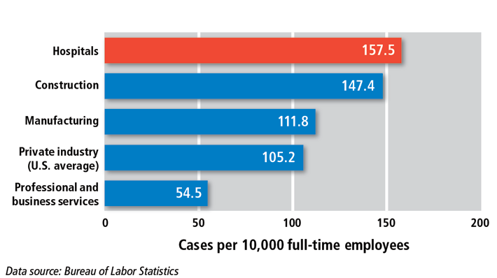
Bar Chart on Injuries

Slide 16
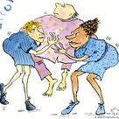
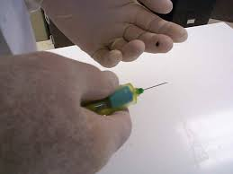
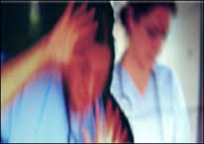
What makes hospitals such hazardous workplaces?
Unique risks:
Hospital workers lift, reposition, and transfer patients who have limited mobility. Other unique risks include needlesticks and violence.

Slide 17
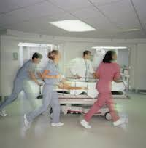
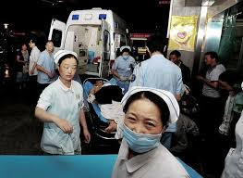
Unique Culture:
Caregivers feel an ethical duty to “do no harm” to patients. Some will put their own safety and health at risk to help a patient.

Slide 18
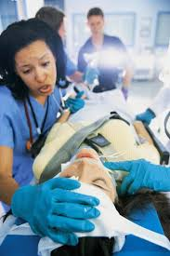
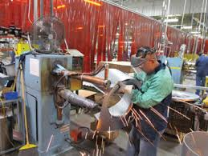
Unpredictable events
They are not assembly lines:
Employees must react to unpredictable events with split-second decisions.

Slide 19
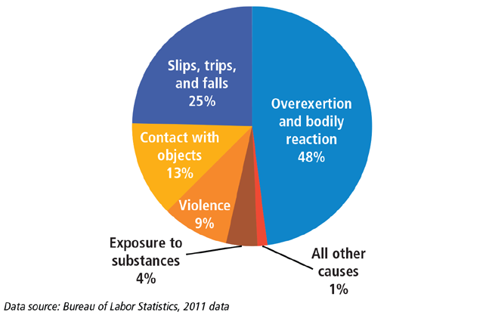
Most injuries result from a few well-known hazards.

Slide 20
Safe Patient Handling
These injuries are due in large part to overexertion related to repeated manual patient handling activities, often involving heavy manual lifting associated with transferring, and repositioning patients and working in extremely awkward postures.

Slide 21
Safe Patient Handling
Some examples of patient handling tasks that may be identified as high-risk include:
transferring from toilet to chair
transferring from chair to bed
transferring from bathtub to chair
repositioning from side to side in bed
lifting a patient in bed
repositioning a patient in chair
making a bed with a patient in it

Slide 22
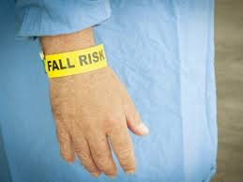
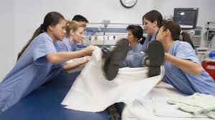
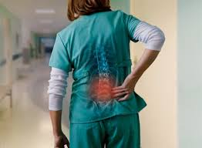
Back injuries

Slide 23
Sprains and Strains
Sprains and strains account for 54 percent of injuries that result in days away from work.
Strains also account for the largest share of workers’ compensation claim costs for hospitals.
In 2011, U.S. hospitals reported 16,680 cases in which workers missed work due to a musculoskeletal injury associated with patient interactions.
Nurses and nursing assistants each accounted for a substantial share of the total. Because most musculoskeletal injuries in the hospital setting are cumulative, any steps to minimize risks during patient handling tasks will offer substantial benefits for hospital caregiver.

Slide 24
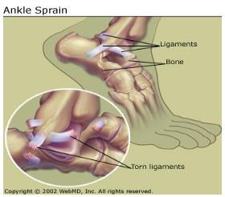
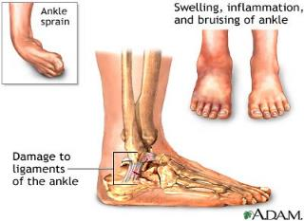
What is a Sprain?
A sprain is an injury involving the stretching or tearing of a ligament
Symptoms may include pain, inflammation, and in some cases, the inability to move a limb (arm, leg, foot).
Sprains occur when a joint is forced beyond its normal range of motion, such as turning or rolling your ankle.

Slide 25
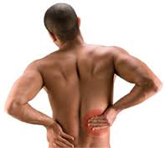
What is a Strain?
Strains are injuries that involve the stretching or tearing of a musculo-tendinous (muscle and tendon) structure.
Symptoms for an acute muscle strain may include pain, muscle spasm, loss of strength, and limited range of motion. Chronic (long-lasting) strains are injuries that gradually build up from overuse or repetitive stress, resulting in tendinitis (inflammation of a tendon).

Slide 26
Sprains and Strains
Sprains and strains are the most often reported nature of injuries, and the shoulders and low back are the most affected body parts.
The problem of lifting patients is compounded by the increasing weight of patients to be lifted due to the obesity epidemic in the United States and the rapidly increasing number of older people who require assistance with the activities of daily living.

Slide 27

Dangers of Pain and Fatigue
In addition, healthcare employees, who experience pain and fatigue, may be less productive, less attentive, more susceptible to further injury, and may be more likely to affect the health and safety of others.

Slide 28
Safer workplaces mean safer care
Caregiver fatigue, injury, and stress are tied to a higher risk of medication errors and patient infections.
Caregivers and patients face many related hazards. For example, manual lifting can cause caregiver injury and also put patients at risk of falls, fractures, bruises, and skin tears. Fear or reluctance to move patients can lead to pressure ulcers.
Strategies to improve patient safety and employee safety can go hand-in-hand—from high reliability management systems to specific steps like reducing
slippery floors.

Slide 29
Industries for Patient Handling Tasks
Long-Term Care (includes facilities that provide skilled or non-skilled nursing care);
Acute Care - (includes hospitals, out-patient surgical centers, and clinics);
Home Healthcare workers; and
Others - such as physical therapists, radiologists, sonographers, etc.

Slide 30
Technology for Patient Handling
Given the increasingly hazardous biomechanical demands on caregivers today, it is clear the healthcare industry must rely on technology to make patient handling and movement safe.
Patient transfer and lifting devices are key components of an effective program to control the risk of injury to patients and staff associated with lifting, transferring, repositioning or movement of patients.

Slide 31
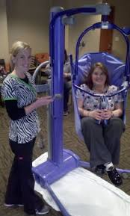
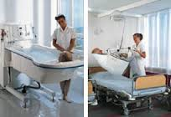
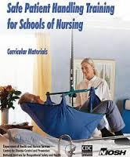
Safe Patient Handling

Slide 32
Equipment and Devices
The use of assistive patient handling equipment and devices is beneficial not only for healthcare staff, but also for patients.
Explaining planned lifting procedures to patients prior to lifting and enlisting their cooperation and engagement can increase patient safety and comfort, and enhance their sense of dignity.

Slide 33
Ergonomics
Ergonomics is the science of fitting the job to the worker. When there is a mismatch between the physical requirements of the job and the physical capacity of the worker, work-related musculoskeletal disorders (MSDs) can result.
Ergonomics is the practice of designing equipment and work tasks to conform to the capability of the worker, it provides a means for adjusting the work environment and work practices to prevent injuries before they occur.
Health care facilities especially nursing homes have been identified as an environment where ergonomic stressors exist.

Slide 34
Minimize Manual Lifting
OSHA recommends minimizing manual lifting of patients/residents in all cases and eliminating lifting when possible.

Slide 35
Safety and Health Management System
A safety and health management system (also known as an injury and illness prevention program) is a proactive, collaborative process
to find and fix workplace hazards before employees are injured or become ill. Almost all successful systems include six core elements:

Slide 36
Safety and Health Management System
Management leadership
Employee participation
Hazard identification and assessment
Hazard prevention and control
Education and training
Program evaluation and improvement

Slide 37
Management Leadership
Demonstrate a commitment to reduce or eliminate patient/residents handling hazards through establishing a written program that addresses issues, such as: Continued training of employees in injury prevention. Methods of transfer and lifting to be used by all staff. Compliance with transfer and lift procedures.
Procedures for reporting early signs and symptoms of back pain and other musculoskeletal injuries.

Slide 38
Employee Participation
Complaint/suggestion program which includes employee reports of unsafe working conditions. Prompt reporting of signs and symptoms as well as injuries.
Consult with workers in developing and implementing the program and involve them in updating and evaluating the program.
Include workers in workplace inspections and incident investigations.
Encourage workers to report concerns, such as hazards, injuries, illnesses and near misses.
Protect the rights of workers who participate in the program.

Slide 39
Hazard Identification and Assessment
Identify, assess and document workplace hazards by soliciting input from workers, inspecting the workplace and reviewing available information on hazards.
Investigate injuries and illnesses to identify hazards that may have caused them.
Inform workers of the hazards in the workplace.

Slide 40
Accident and Record Analysis
Records of injuries and illnesses should be analyzed to identify patterns of injury that occur over time, enabling the hazards to be addressed and prevented.
This includes reviewing
OSHA 300 logs,
OSHA 301 forms and
Workers' Compensation reports.

Slide 41

Hazard Prevention and Control SH-26274-SH4
Administrative controls: Provide for adequate staffing, assessment of patient/residents needs, and restricted admittance policies. Engineering controls: Help to isolate or remove the hazards from the workplace, for example providing proper selection, training, and use of assist devices or equipment

Slide 42
Medical Management SH-26274-SH4
Accurate injury and illness recording. Early identification and treatment of injured employees. "Light duty" or "no lifting" work restrictions during recovery periods. Systematic monitoring of injured employees to identify when they are ready to return to regular duty.

Slide 43
Education and Training
Provide education and training to workers in a language and vocabulary they can understand to ensure that they know:
Procedures for reporting injuries, illnesses and safety and health concerns.
How to recognize hazards.
Ways to eliminate, control or reduce hazards.
Elements of the program.
How to participate in the program.
Conduct refresher education and training programs periodically.

Slide 44
Program Evaluation and Improvement
Conduct a periodic review of the program to determine if it has been implemented as designed and is making progress towards achieving its goals.
Modify the program, as necessary, to correct
deficiencies.
Continuously look for ways to improve the
Program.

Slide 45
Lifting Guidelines
Never transfer patients/residents when off balance.
Lift loads close to the body.
Never lift alone, particularly fallen patients/residents, use team lifts or use mechanical assistance.
Limit the number of allowed lifts per worker per day.
Avoid heavy lifting especially with spine rotated. Training in when and how to use mechanical assistance.

Slide 46
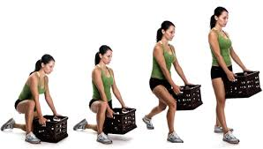
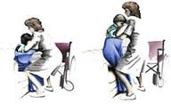
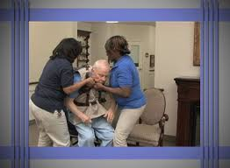
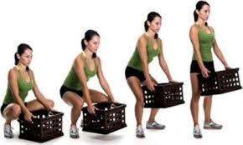
Lifting guidelines

Slide 47
Patient handling tasks pose increased ergonomic risks if they are:
repetitive (e.g., repeatedly cranking manual adjustments for beds), done in awkward postures (e.g., reaching across beds to lift patients/residents) done using a great deal of force (e.g., pushing chairs or gurneys across elevation changes or up ramps), lifting heavy objects (e.g., manually lifting immobile patients/residents alone) or combining these factors.

Slide 48
Other hazards include:
Overexertion; trying to stop a patient/residents from falling or picking patient/residents up from floor or bed. Multiple lifts per shift (more than 20). Lifting alone, no available staff to help. Lifting un-cooperative, confused patients/residents. Lifting patients/residents that cannot support their own weight.

Slide 49
Possible Solutions
Good work practice includes continually identifying the most hazardous tasks and implementing engineering and work practice controls to help reduce or prevent injuries in those tasks. Remember OSHA recommends minimizing manual lifting of patients in all cases and eliminating lifting when possible.

Slide 50
Possible Solutions
Provide employees with proper assist devices and equipment to reduce excessive lifting hazards. Proper equipment selection depends on the specific needs of the facility, patients/residents, staff, and management.

Slide 51
Devices
Shower chairs that fit over the toilet, using this device can eliminate multiple transfers, saving health care workers multiple lifts. A patient/residents can be moved to the shower chair, toileted, showered, and transferred back to the wheelchair. Shower stalls that allow for shower chairs to be pushed in and out on level floor surfaces. This is a standard shower without the front lip to allow for easy access.

Slide 52

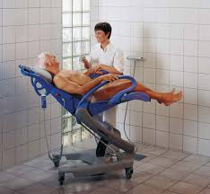
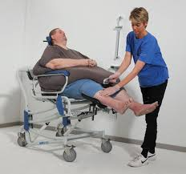
Devices SH-26274-SH4

Slide 53
Devices SH-26274-SH4
Toilet seat risers: Use toilet seat risers on toilets to equalize the height of wheelchair and toilet seat, making it a lateral transfer rather than a lift up and back into wheelchair. Mechanical lift equipment to help lift patients/residents who cannot support their own weight. Choose a lift that does not require manual pumping to avoid possible repetitive motion disorders to workers' arms or shoulders.

Slide 54
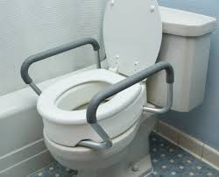
Devices SH-2627-SH4

Slide 55
Devices SH-26274-SH4
Sliding boards: A slick board used under patients/residents to help reduce the need for lifting during transfer of patient/residents from bed to chair, or chair to car. Patients/residents are slid rather than lifted
Repositioning Devices: Mechanically pulls patient/residents up in bed eliminating manual maneuvering by staff.

Slide 56
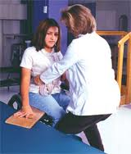
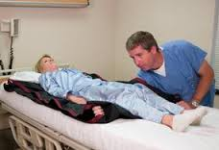
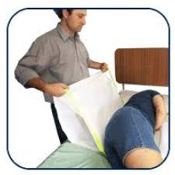
Devices SH-26274-SH4

Slide 57
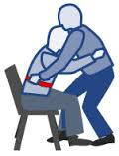
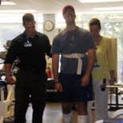
Devices
Walking belts or gait belts (with handles) that provide stabilization for ambulatory patients/residents by allowing workers to hold onto the belt and support patients/residents when walking. Not designed for lifting patients/residents.

Slide 58

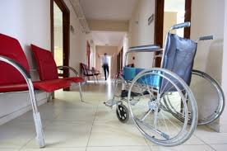
Slips/trips and falls from spills or environmental hazards.
Slippery or wet floors. Uneven floor surfaces. Lifting in confined spaces. Cluttered or obstructed work areas/passageways.

Slide 59
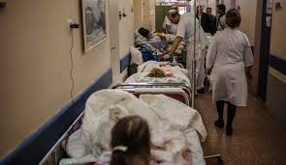
Environmental Hazards
Poorly maintained walkway or broken equipment. Inadequate staffing levels to deal with the workload, leading to single person lifts and greater chances of falls. Inadequate lighting, especially during evening shifts.

Slide 60
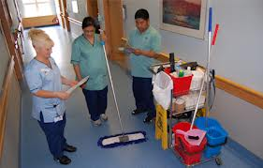
Possible Solutions
Eliminate uneven floor surfaces. Create non slip surfaces in toilet/shower areas. Immediate clean-up of fluids spilled on floor.

Slide 61
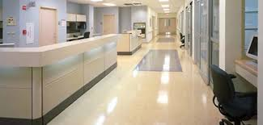
Eliminate Obstructions
Safely working in cramped working spaces-avoiding awkward positions, using equipment that makes lifts less awkward. Eliminate cluttered or obstructed work areas. Provide adequate staffing levels to deal with the workload.

Slide 62
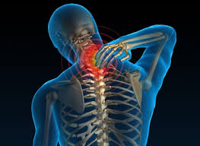
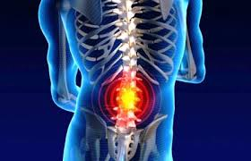
Awkward Postures
Awkward postures occur with twisted, hyper-extended or flexed back positions.
They are unsafe back postures for patient/residents lifting.

Slide 63
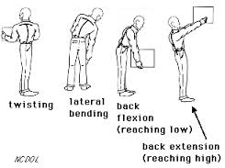
Awkward Postures
Awkward postures include:
Twisting while lifting.
Bending over to lift.
Lateral or side bending.
Back hyperextension or flexion.

Slide 64
Awkward Postures
Forces on the spine increase when lifting, lowering or handling objects with the back bent or twisted. This occurs because the muscles must handle your body weight in addition to the weight of the patient/residents being lifted. More muscular force is required when awkward postures are used because muscles cannot perform efficiently.

Slide 65
Awkward Postures
Fixed awkward postures (i.e., holding the arm out straight for several minutes) contribute to muscle and tendon fatigue, and joint soreness.
To be considered a risk factor, awkward postures need to last more than 1 hour continuously or for several hours in the work shift.
Reaching forward or twisting to support a patient/residents from behind to assist them in walking.

Slide 66
Possible Solutions
Good work practice recommends avoiding awkward postures while lifting or moving patients/residents.
Educate and train employees about safer lifting techniques.
Use assist devices or other equipment whenever possible.
Team lifting based on assessment.

Slide 67
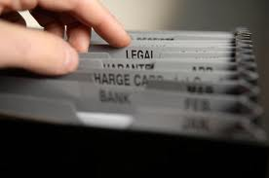
Recordkeeping
Without proper recordkeeping, illness and injury trends would go unreported and unstudied and valuable information about causes and possible prevention of injuries would be lost.

Slide 68
Recordkeeping
Exposure to ergonomic stressors in healthcare workplaces can result in a variety of disorders in affected workers referred to as musculoskeletal disorders (MSDs).
MSDs may develop gradually over time or may result from instantaneous events such as a single heavy lift. These conditions will be classified on recordkeeping forms as either injuries or illnesses. It is critical for recording keeping data to be kept accurately and that employers do not under report these events.

Slide 69


Reference
For more information, visit the Injury and Illness Prevention Program page on OSHA’s website at:
www.osha.gov/dsg/topics/safetyhealth
.

Slide 70
Thank you

