Slide 1

Brazilian Immigrant Center 5-Hour Course in Fall Protection for Residential Construction
This material was produced under grant number SH-26299-SH4 from the Occupational Safety and Health Administration, U.S. Department of Labor. It does not necessarily reflect the views or policies of the U.S. Department of Labor, nor does mention of trade names, commercial products, or organizations imply endorsement by the U.S. Government.

Slide 2
Safety Message to our fellow workers

Slide 3
We are giving you a ...

Slide 4
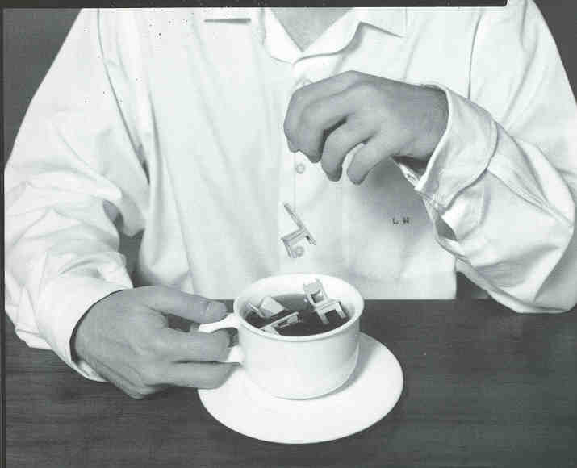
Notes:
Cha de cadeiras = “Tea with chairs” - Brazilian idiom for being stuck somewhere for a long time, like in a training, and having to listen passively for a long time.

Slide 5


Slide 6
So that you won’t...

Slide 7
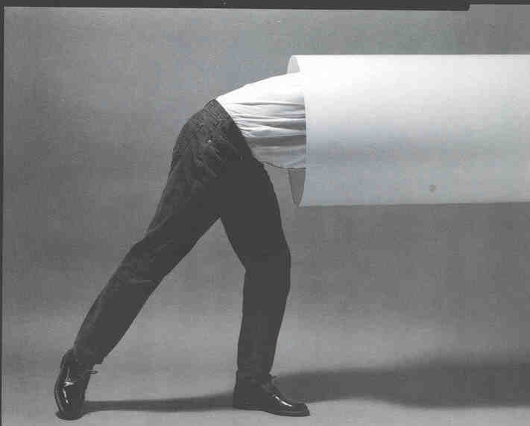
Notes:
Get stuck

Slide 8
This message is a....

Slide 9
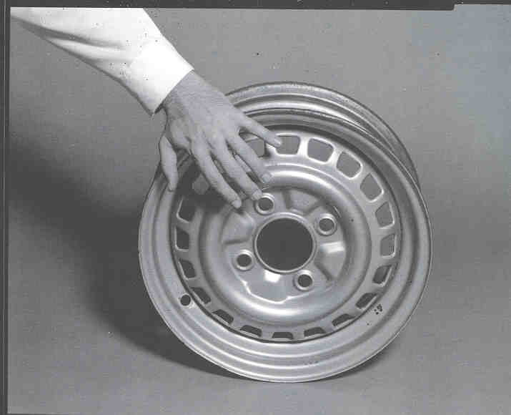
Notes:
Hand on the wheel = Brazilian idiom for “Something that’s very helpful to you”

Slide 10
And doesn’t happen as simply as ...

Slide 11
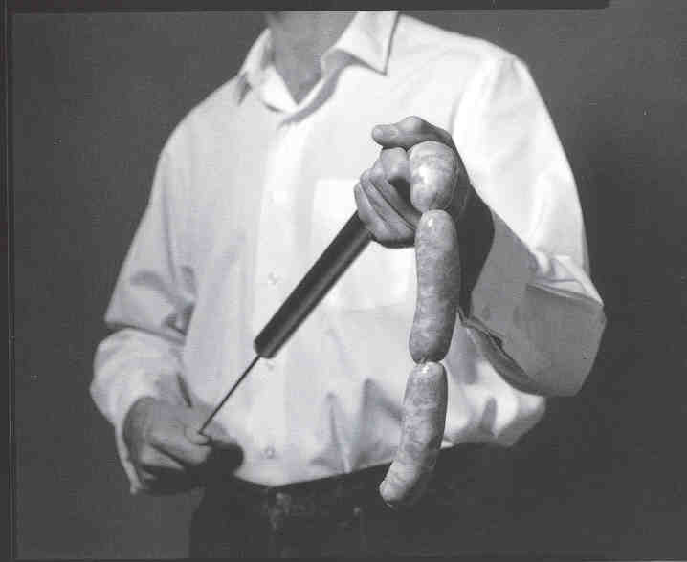
Notes:
Filling sausages = Brazilian idiom for something that’s simple and mindless to do

Slide 12
Every day problems arise, and we have to...

Slide 13

Notes:
Peel the pineapple = Brazilian idiom for something that is arduous and difficult to do.

Slide 14
Or even...

Slide 15

Notes:
Like “swallowing frogs” = Brazilian idiom for having to do something that is difficult and humbling

Slide 16
But before that...

Slide 17

Notes:
Don’t cry over spilled milk....

Slide 18
So that you don’t get caught with your pants too short...
Notes:
Photo shows short pants. In Brazil, the idiom is “caught with short pants” = caught with your pants down

Slide 19
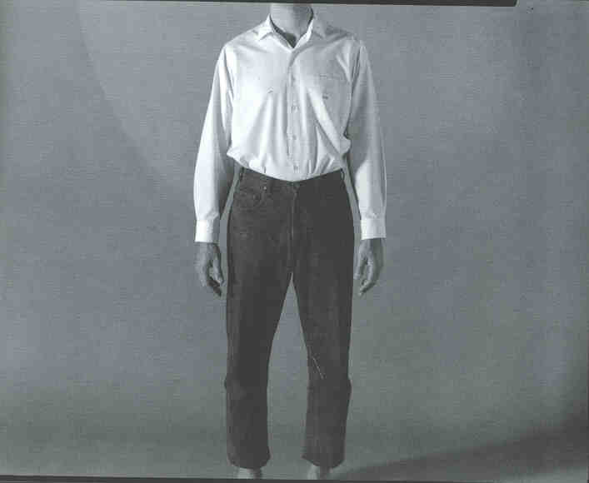

Slide 20
Or better yet, it’s like...

Slide 21
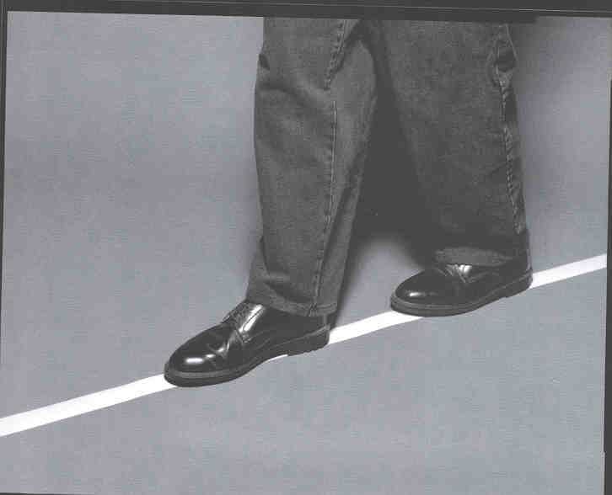

Slide 22
Avoid having to walk a tightrope, and having to hit a hard target..

Slide 23
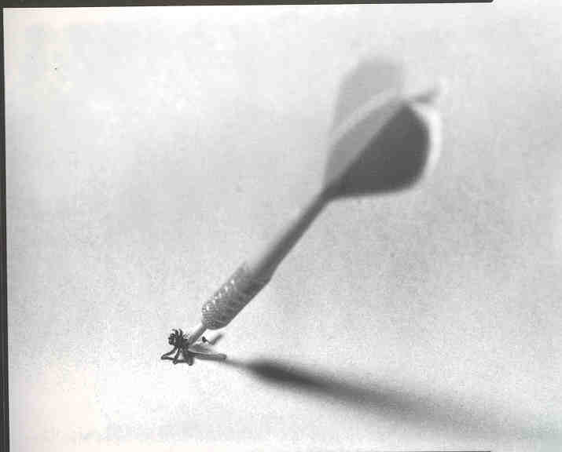

Slide 24
Work without having to ...

Slide 25
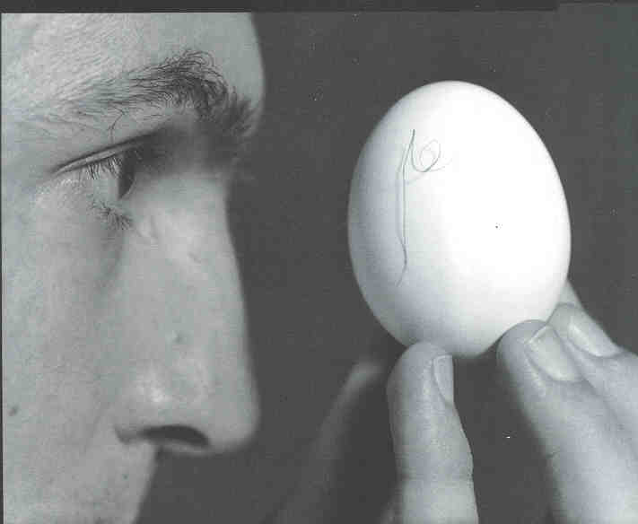
Notes:
Look for hair on an egg = Brazilian idiom for doing something that’s impossible

Slide 26
Or without having to ...

Slide 27

Notes:
Create a storm in a glass of water = Brazilian idiom for overdramatizing something (as in, creating a “tempest in a teapot”)

Slide 28
At times you encounter a ...

Slide 29
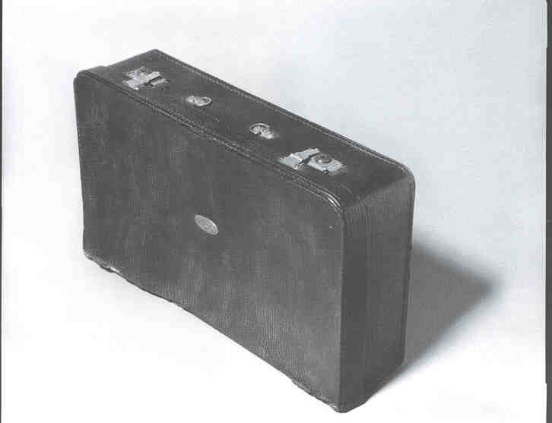
Notes:
Suitcase without handles = Brazilian idiom for something that is hard to handle

Slide 30
Making you into a

Slide 31

Notes:
John without arms = Brazilian idiom for someone who plays dumb, pretending they don’t know they broke the rule

Slide 32
Trying to put...

Slide 33
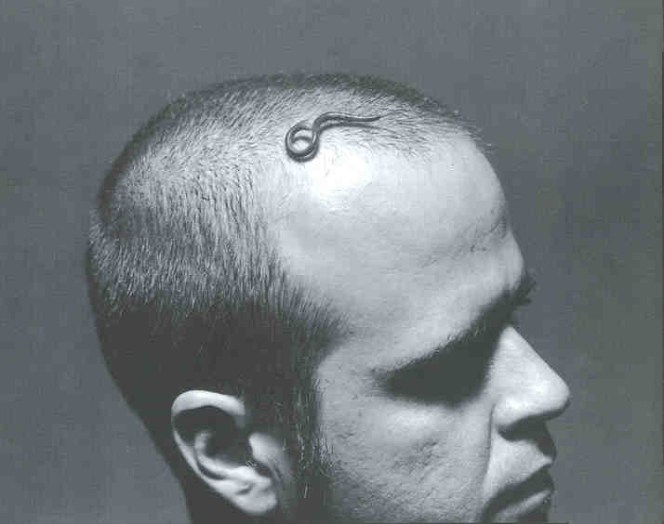
Notes:
Worms in someone’s head = Brazilian idiom for trying to put incorrect ideas in people’s heads, usually done with bad intentions

Slide 34
But don’t let it ...

Slide 35

Notes:
Make you become a target

Slide 36
Work with safety without...

Slide 37
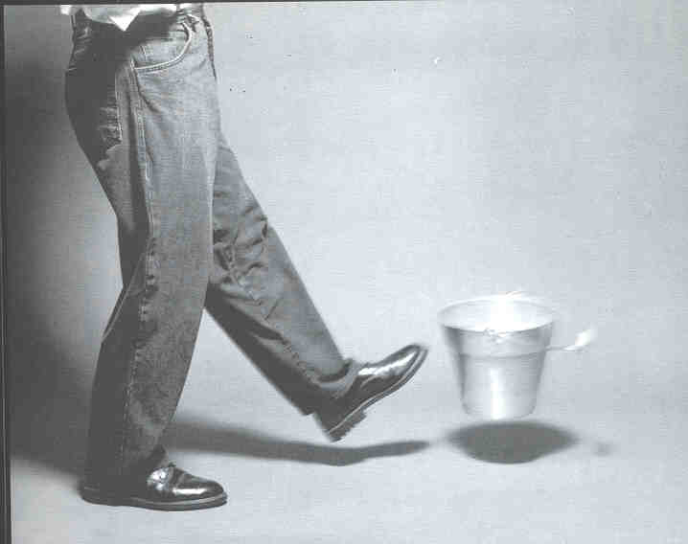
Notes:
Kicking the bucket = Brazilian idiom for not taking your time to remove obstacles [It doesn’t mean to die, as in English]

Slide 38
Sometimes you think that OSHA is just a...

Slide 39
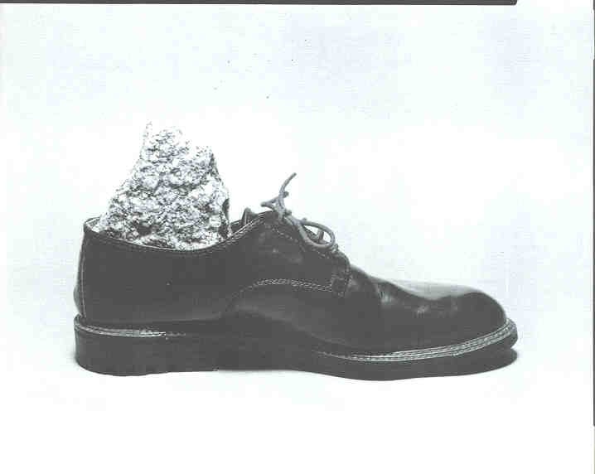
Notes:
Rock in your shoe == Brazilian idiom for something annoying or bothersome

Slide 40
But don’t hesitate by ...

Slide 41
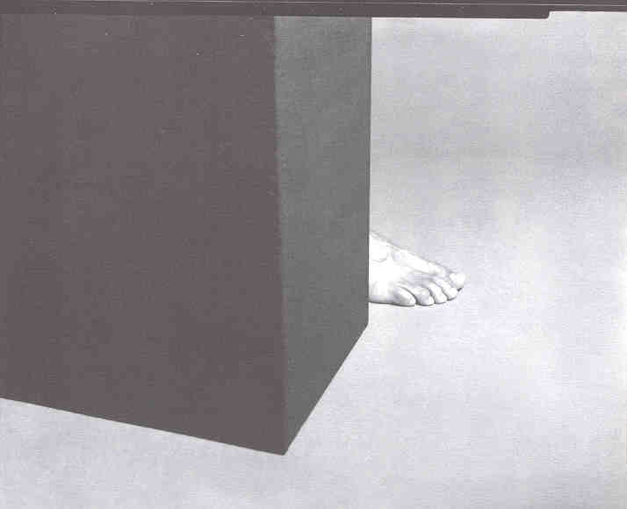
Notes:
Putting foot behind = Stepping back = Brazilian idiom for refusing to believe

Slide 42
Because when it comes to safety and health, you are the one who has to decide what to do, and who can have everything at hand that you need ...

Slide 43

Notes:
To have a knife and a wheel of cheese both in your hand means, in a Brazilian idiom, that you can do the job easily

Slide 44
And so take special care not to...

Slide 45

Notes:
Exchange balls = Brazilian idiom for “not paying attention to the simple rules, and causing a problem as a result.”

Slide 46
And do not break the rules ...

Slide 47
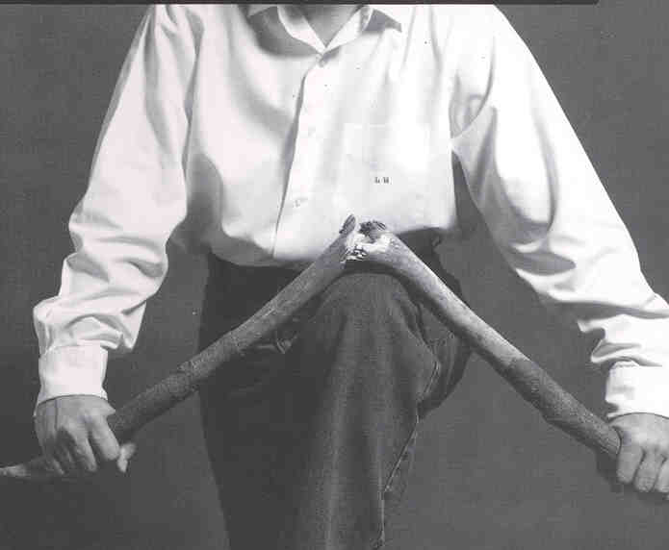

Slide 48
Because you can mess up...

Slide 49
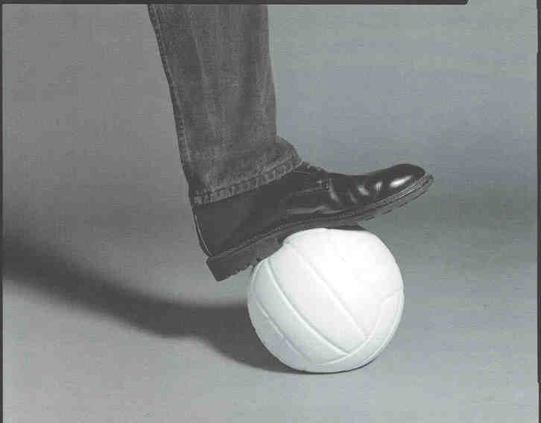
Notes:
“Stepping on a ball” is an idiom in Brazilian Portuguese for “messing up,” or “making a mistake”

Slide 50
So afterward you will feel like you have a rope around your neck ...

Slide 51
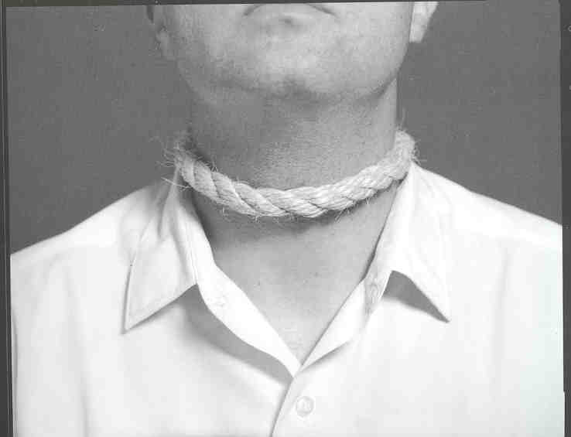

Slide 52
And then feel like an outlier...

Slide 53
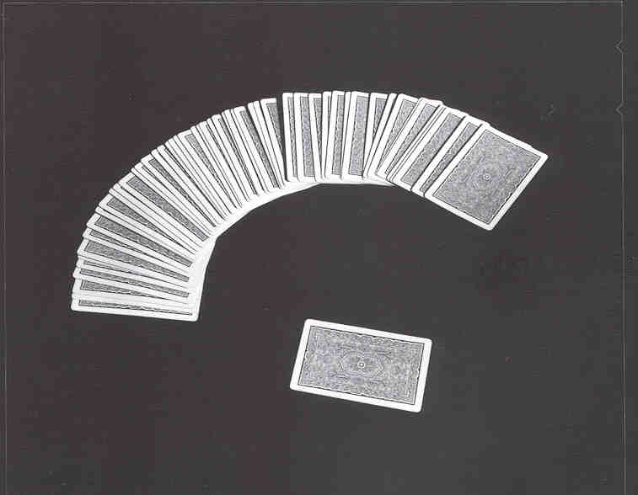

Slide 54
And then if an accident happens at the workplace because you’re not careful ..

Slide 55
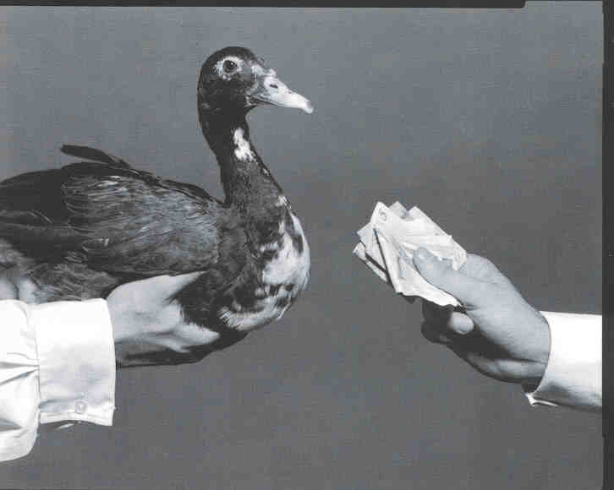
Notes:
Photo = “ You have to buy the duck” means in English “You’ll have to pay the price.”

Slide 56
And with an injury, you’ll be put out of work

Slide 57
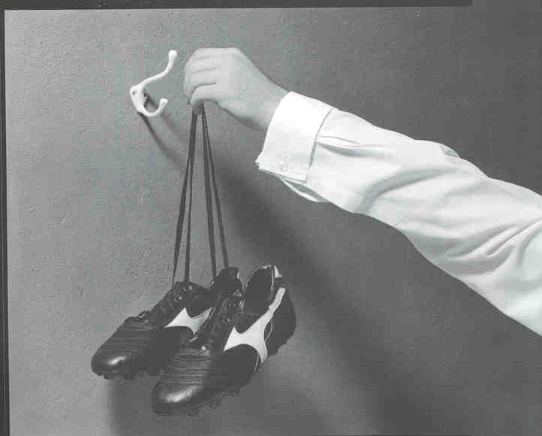
Notes:
“Hang up your shoes” means to be “put out of work.”

Slide 58
Or even...
Notes:
Photo = “bater as botas” [beat your shoes] = DIE

Slide 59
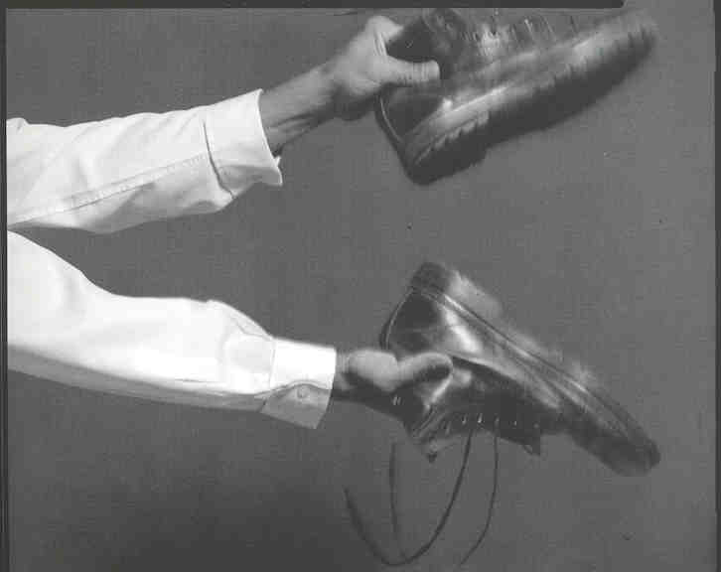
Notes:
“Beating the boots together” means to die.

Slide 60
You can always count on OSHA to improve the safety conditions in your workplace, so don’t let yourself become a statistic

Slide 61
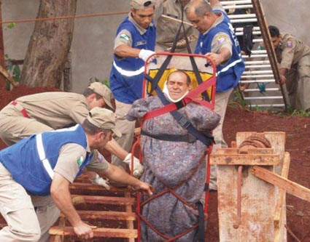
Notes:
Ask the audience if anyone has already had this happen to them, or seen this kind of thing happen in their workplace. If anyone has experienced or seen this situation at work, let them tell the story to the class.

Slide 62


Slide 63
Residential Fall Protection Program Update
Directorate of Construction - Office of Construction Services
Notes:
Good Morning/Afternoon and welcome to the Occupational Safety and Health Administration Residential Fall Protection Program update.
My name is ____________ and I am a Safety and Health Specialist in OSHA's Directorate of Construction, Office of Construction Services, and I am your facilitator for today's presentation.

Slide 64
This presentation is intended to provide information about STD 03-11-002, Compliance Guidance for Residential Construction. The Occupational Safety and Health Act requires employers to comply with safety and health standards promulgated by OSHA or by a state with an OSHA-approved state plan. However, this presentation is not itself a standard or regulation, and it neither creates new legal obligations nor alters existing obligations created by OSHA standards or the Occupational Safety and Health Act.
The examples of fall protection shown in the photographs contained in this presentation do not represent all possible work methods that can be used in residential construction. Moreover, employers should be aware that the examples of fall protection shown in the photographs contained in this presentation may not be suitable in all situations. Employers are responsible for ensuring compliance with applicable OSHA requirements.
Notes:
This presentation is designed solely to provide information about policy changes in OSHA’s Residential Construction Fall Protection enforcement policy.
This presentation is not itself a standard or regulation, and it neither creates new legal obligations nor alters existing obligations created by OSHA standards or the Occupational Safety and Health Act.
The examples of fall protection shown in the photographs contained in this presentation do not represent all possible work methods that can be used in residential construction. Moreover, employers should be aware that the examples of fall protection shown in the photographs contained in this presentation may not be suitable in all situations. Employers are responsible for ensuring compliance with applicable OSHA requirements.

Slide 65
Residential Fall Protection Program Update
STD 03-11-002, Compliance Guidance for Residential Construction was issued December 16, 2010.
STD 03-11-002 rescinds STD 03-00-001, dated June 18, 1999, Interim Fall Protection Compliance Guidelines for Residential Construction.
All letters that reference the canceled directive will be revised or withdrawn, as appropriate.
Notes:
On December 16, 2010, OSHA rescinded policy directive STD 03-00-001, the Plain Language Revision of OSHA Instruction STD 3.1, Interim Fall Protection Compliance Guidelines for Residential Construction, dated June 18, 1999.
The old guidance, which allowed employers engaged in certain residential construction activities to use specified alternative methods of fall protection, was replaced by STD 03-11-002, Compliance Guidance for Residential Construction.
The Agency is also reviewing all letters of interpretation that referenced the cancelled directive and will either revise, or withdraw, them as needed.

Slide 66
Residential Fall Protection Program Update
Effective June 16, 2011, employers utilizing alternative fall protection found in the rescinded 1999 Interim Fall Protection Compliance Guidelines for Residential Construction will be subject to OSHA citations if they fail to comply with 29 CFR 1926.501(b)(13).
Notes:
Enforcement of the new directive will begin on June 16, 2011.
OSHA and State Compliance Safety and Health Officers have attended training, such as this one, to help ensure consistency in enforcement throughout the country.

Slide 67
Residential Fall Protection Program Update
Why the rescission?
Never intended to be a permanent resolution.
Fall protection is safe and feasible for the vast majority of residential construction activities.
OSHA received recommendations to rescind the interim directive.
The residential fall protection requirements have always been established in Subpart M at 29 CFR 1926.501(b)(13). The new policy directive implements the standard as originally intended.
Notes:
So, why did OSHA rescind the old directive? Well, the truth is … it hasn't been working that well. Statistics still show that fatalities from falls are consistently high for residential construction activities.
And, the Agency never intended the old directive to be a permanent policy. All along, OSHA stated that the guidance would remain in effect until further notice or until completion of a new formal rulemaking effort.
And since that time, there have been significant advances in the types and capability of commercially available fall protection equipment available for use in residential construction.

Slide 68
Fatalities and Fatality Rates
in Construction
 | 2005 | 2006 | 2007 | 2008 | 2009 | 2010 | 2011*
Fatalities | 1186 | 1239 | 1204 | 969 | 816 | 774 | 721
Employment | 10.7M | 11.3M | 11.4M | 9.5M | 8.3M | 5.5M | 5.5M
Fatalities per 100,000 workers | 11.0 | 10.9 | 10.5 | 9.6 | 9.8 | 14.1 | 13.1
Source: BLS CFOI Data
* Preliminary Data
Notes:
Here are the stats for the fatalities, and the fatality rates, in the construction industry during the period between 2005 and 2011

Slide 69
The BLS Released Statistics Showing the Leading Causes of Construction Fatalities
FATALITIES | 2005 | 2006 | 2007 | 2008 | 2009 | 2010 | 2011
FALLS | 394 | 433 | 447 | 332 | 277 | 264 | 251
STRUCK BY | 130 | 120 | 106 | 108 | 79 | 64 | 73
ELECTROCUTIONS | 107 | 126 | 108 | 89 | 88 | 76 | 67
CAUGHT IN/BETWEEN | 111 | 96 | 98 | 92 | 34 | 33 | 19
Source: BLS CFOI Data
Notes:
Here we see the statistics for the Focus Four construction hazards. They continue to account for the greatest number of preventable fatalities that occur in the construction industry. And as you can see, falls accounted for more deaths than any of the other focus four hazards.
Falls accounted for 34% of the construction fatalities in 2008 and 2009 … and 35% of the fatalities since 2005.
And when we drill down further into the stats we find that there were 1,883 fall fatalities between 2005 and 2009. That equated to roughly 1 worker dying in a fall related incident everyday over a 5- year period. That's everyday ... a parent ... a brother ... a sister ... a child ... a friend, or a coworker did not go home to their family because they fell from heights and died while at work.
We can, and we must, reverse this undesirable trend

Slide 70
Residential Fall Protection Program Update
“We cannot tolerate workers getting killed in residential construction when effective means are readily available to prevent those deaths.”
“Fatalities from falls are the number one cause of workplace deaths in construction.”
Dr. David Michaels, Assistant Secretary of Labor for OSHA
Notes:
Workers should not have to pay with their lives trying to make a living.
Especially when we know that the means to protect them from falls are readily available.

Slide 71
The BLS Released Statistics Showing the Fall Fatalities in Residential Construction
FATALITIES | 2007 | 2006 | 2007 | 2008 | 2009
TOTAL FALLS | 71 | 62 | 55 | 40 | 42
FALLS FROM ROOFS | 24 | 21 | 19 | 11 | 17
Source: BLS CFOI Data
Notes:
Here's what the residential falls fatality picture looked like during that same period.
Residential falls accounted for roughly 14 percent of all construction fall fatalities and fall from roofs accounted for nearly 34 % of those.

Slide 72
Roofers are among the occupations with high fatal work injury rates, 2011*
Fatal work injury rate
(per 100,000 full-time equivalent workers)
All-worker fatal injury rate = 3.5
Roofers = 31.8
*Data for 2011 are preliminary.
SOURCE: U.S. Bureau of Labor Statistics, U.S. Department of Labor, 2012.
Notes:
Here we see the statistics for the Focus Four construction hazards. They continue to account for the greatest number of preventable fatalities that occur in the construction industry. And as you can see, falls accounted for more deaths than any of the other focus four hazards.
Falls accounted for 34% of the construction fatalities in 2008 and 2009 … and 35% of the fatalities since 2005.
And when we drill down further into the stats we find that there were 1,883 fall fatalities between 2005 and 2009. That equated to roughly 1 worker dying in a fall related incident everyday over a 5- year period. That's everyday ... a parent ... a brother ... a sister ... a child ... a friend, or a coworker did not go home to their family because they fell from heights and died while at work.
We can, and we must, reverse this undesirable trend

Slide 73
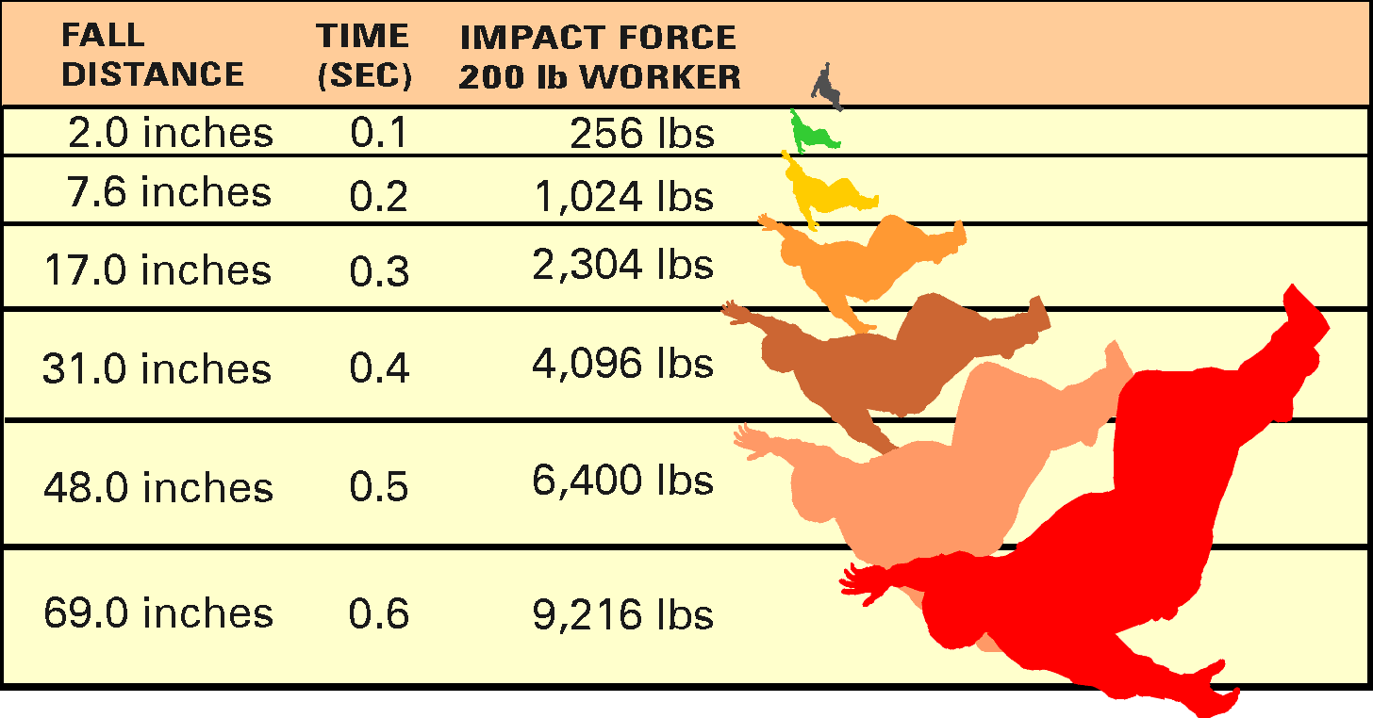
A fall from 6 feet high:
200 lb. Worker falling 6 feet = 9,000+ lbs. of energy.
Notes:
Trainer’s Notes:
There are a lot of ways to address the physics of falls. You may want to use miles per hour at impact, or weight of worker times distance divided by deceleration distance or any other calculations to stress the injury potential of falls of whatever nature. Whether its impact with a surface or force on the body in fall arrest – falling hurts.

Slide 74
Significant Changes in the Residential Fall Protection Policy
Under the new directive employers must follow 1926.501(b)(13).
1926.501(b)(13) states … workers “engaged in residential construction activities 6 feet (1.8 m) or more above lower levels shall be protected by guardrail systems, safety net system, or personal fall arrest system.”
… or, by alternative fall protection measures allowed under 1926.501(b) for particular types of work.
Notes:
Basically, the new directives simply states that all employers must protect their workers who are engaged in residential construction 6 feet or more, above lower levels by conventional fall protection systems (guardrail systems, safety net system, or personal fall arrest system).
… or, by other fall protection measures allowed under 1926.501(b) for particular types of work.
Gone are the special alternative procedures allowed under the old directive for certain residential construction activities.
Slide guards or safety monitor systems were allowed in lieu of conventional fall protection without first demonstrating infeasibility or the creation of a greater hazard.
The new directive has not outlawed the use of slide guards or safety monitors.
Now, employers must first demonstrate that it is infeasible to comply with the provisions of the standard, or that it creates a greater hazard.
Then they can use those systems as part of a written, site-specific fall protection plan that meets the requirements of 1926.502(k).
More simply put, all employers doing residential construction must now comply with 29 CFR 1926.501(b)(13).

Slide 75
Other Methods Allowed Under 1926.501(b)
1926.501(b)(2)(ii) - Controlled access zones and control lines can be used for some leading edge applications.
1926.501(b)(4)(i) and (ii) - Covers can be used to prevent workers from falling through holes.
1926.501(b)(5) - Positioning devices can be used while working on the face of formwork or reinforcing steel.
1926.501(b)(7)(i) and (ii) - Barricades, fences and covers can be used to prevent workers from falling into excavations.
Notes:
Here are some of the other fall protection measures allowed under 1926.501(b) for particular types of work. (pause)

Slide 76
Alternative Methods Allowed Under 1926.501(b)
1926.501(b)(8)(i) - Equipment guards can be used to prevent workers from falling into dangerous equipment.
1926.501(b)(10) - A combination of a warning line system and safety monitoring system can be used for roofing work on low-slope (4:12 or less) roofs. Or, on roofs 50-feet (15.25 m) or less in width, the use of a safety monitoring system without a warning line system is permitted.
Notes:
If an employer can use one of these methods for the specified process, they can do so without developing a site specific fall protection plan. (pause)

Slide 77
29 CFR 1926.501(b)(13)
If the employer can demonstrate that it is infeasible or creates a greater hazard to use the required fall protection systems, the employer must instead develop and implement a written site specific fall protection plan in accordance with 29 CFR 1926.502(k).
The Agency does not consider "economic infeasibility" to be a basis for failing to provide conventional fall protection.
Note: There is a presumption that it is feasible and will not create a greater hazard to implement at least one of the fall protection systems listed in 29 CFR 1926.501(b)(13).
OSHA expects that the fall protection methods listed in 1926.501(b)(13) can be used without significant safety or feasibility problems for the vast majority of residential construction activities.
Notes:
The Agency has never been convinced that there are significant safety or feasibility problems with the use of conventional fall protection equipment for the vast majority of residential construction activities.
But, we also acknowledge that there may be isolated situations where it may be infeasible or create a greater hazard to use conventional fall protection in residential construction. We believe that 29 CFR 1926.501(b)(13) provides sufficient flexibility to accommodate employers in those rare situations.

Slide 78
Significant Changes in the Residential Fall Protection Policy
OSHA did not define residential construction in 1926.501(b)(13). STD 03-11-002 includes an interpretation for the term “residential construction” for purposes of the standard.
Notes:
The new directive also provides an interpretation for the term “residential construction.” In order to be classified as residential, two important elements must be met:

Slide 79
Definition of Residential Construction
In order to be classified as residential construction, two elements must be met:
The end-use of the structure being built must be as a home, i.e., a dwelling; and
The structure being built must be constructed using traditional wood frame construction materials and methods.
The limited use of steel I-beams to help support wood framing does not disqualify a structure from being considered residential construction.
Notes:
The end- use of the structure being built must be as a home, i.e., a dwelling … and,
The structure must be constructed using traditional wood frame construction materials and methods.
The limited use of steel I-beams to help support wood framing does not disqualify a structure from being considered residential construction.

Slide 80
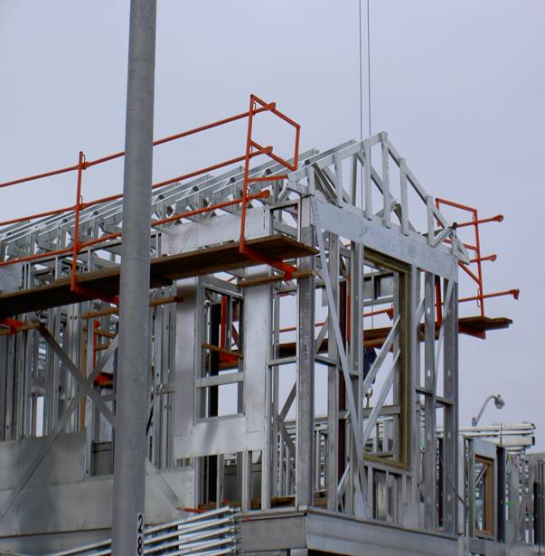
Residential Construction
Cold-formed metal studs will be considered within the bounds of traditional wood frame construction materials and methods.
Notes:
Homes built using cold-formed or light-gauge steel metal studs will be considered within the bounds of “traditional” wood frame construction materials and methods.

Slide 81
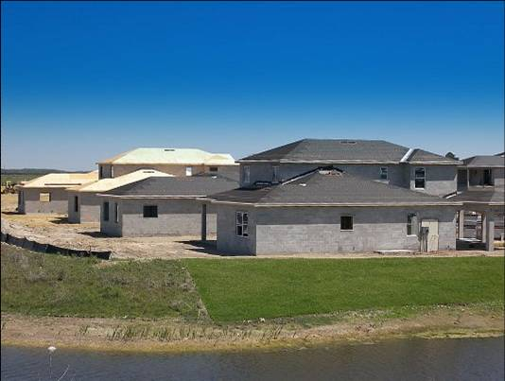
Residential Construction
The use of masonry brick or block in exterior walls will be treated as falling within the scope of traditional wood frame construction materials and methods.
Notes:
Also, homes built with masonry brick or block exterior walls, will also be considered to meet the Residential Construction definition.

Slide 82
Non-Residential Construction
These methods will not be considered “Residential Construction” as the term is interpreted in this directive.
Precast concrete
Steel I beams beyond the limited use of beams to support wood framing.
Notes:
However, construction activities that involve the use of precast concrete and steel I- beams beyond the typical use to support wood framing, will not normally qualify as residential construction.

Slide 83
Training Requirements
Under 29 CFR 1926.503, workers exposed to fall hazards must be trained to recognize potential fall hazards and in the procedures to be followed to minimize those hazards.
Notes:
Training is an important component of any fall protection program.
The workers who actually wear and use the equipment must be thoroughly trained.

Slide 84
Training Requirements 1926.503
Training must cover among other subjects:
The nature of fall hazards in the work area.
How to erect, maintain, disassemble, and inspect the fall protection systems to be used.
How to use and operate the fall protection systems to be used.
Subpart M requirements
Supplements 1926.21
Prepare training certification.
Documentation of the latest training certification must be maintained.
Retraining for:
Changes in the fall protection systems to be used or to the workplace.
Inadequacies in employee’s knowledge or use of fall protection indicates that retraining is necessary
Notes:
1926.21(b)(2) requires employers to train their workers how to recognize and avoid unsafe conditions; and, the applicable regulations to control or eliminate hazards in the work place.
Fall protection training must cover:
How to recognize and minimize fall hazards.
How to use fall protection systems.
How to inspect the systems.
Training must be documented and the most current certification must be available.
Also, provisions to conduct retraining must be established to correct less than satisfactory fall protection performance by workers.

Slide 85
Conventional Fall Protection Systems
Guardrail Systems
Safety Net Systems
Personal Fall Arrest Systems
Notes:
Now we’ll take a look at the conventional fall protection systems and some examples of them being used in residential construction.

Slide 86
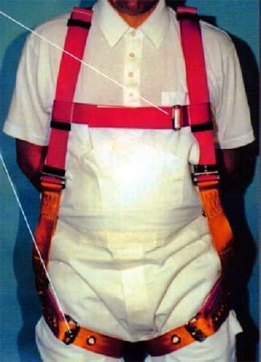
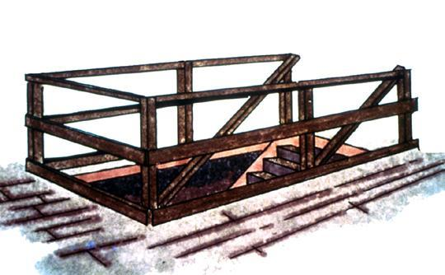
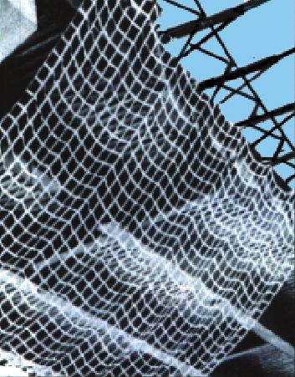
Fall protection
Notes:
Trainer’s Notes:
Explain that these are methods of conventional fall protection but that OSHA allows alternative methods for some construction activities including some roofing work that will be discussed later.
Mention that canopies are a method of catching objects from falling to the surface below. They are not designed to catch workers.

Slide 87
Conventional Fall Protection Systems
Guardrail Systems
1926.502(b)
Notes:
First we’ll look at guardrail systems as defined in 1926.502(b).

Slide 88
Guardrail Systems 1926.502(b)
Requirements for guardrail systems include:
Top rails 42” +/- 3”
Must withstand 200 pounds – 1926.502(b)(1) & 1926.502(b)(3)
Mid rails halfway
Must withstand 150 pounds – 1926.502(b)(2)(i) & 1926.502(b)(5)
Surface the guardrail to prevent punctures, lacerations and the snagging of clothing – 1926.502(b)(6)
No steel or plastic banding – 1926.502(b)(8)
Notes:
Guardrail systems are designed to prevent workers from falling. Once properly installed, guardrails are sometimes referred to as “passive fall protection.” That means it requires no action by the worker to be safe as long as the system is properly maintained.
And remember, whenever there’s a possibility for objects to fall on workers below, you must install toe boards.

Slide 89
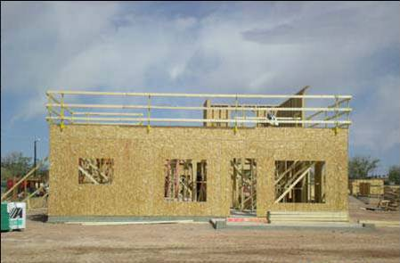
Guardrail Systems
Here we see a 2nd floor perimeter completely protected by a guardrail system.
Notes:
Here we see a 2nd floor perimeter completely protected by a guard rail system.

Slide 90
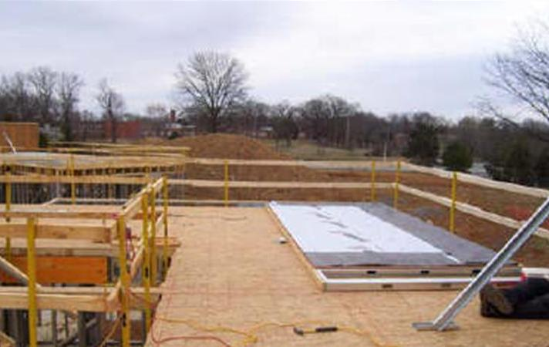
Guardrail Systems
A pre-fabricated wall panel positioned for installation behind a fully protected area -- potential fall to the exterior of the structure has been eliminated.
Stairwell is also protected by guardrails -- eliminating falls to the interior also.
Notes:
And from this angle we can see a pre-fabricated wall panel in position to be installed from within a fully protected area. The potential for a fall to the exterior in this instance has been eliminated.

Slide 91
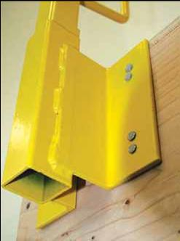
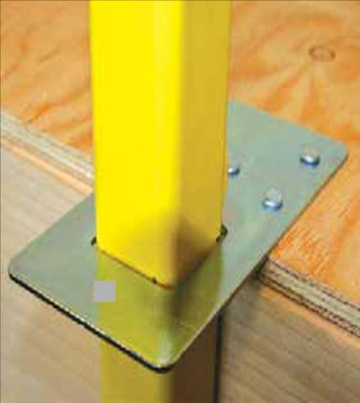
Guardrail Systems
Brackets for engineered guardrail systems can either be side mounted or deck mounted. Either way, employers should look to the manufacturer instructions or the recommendations of a registered professional engineer for proper installation.
.
Notes:
The ability to be either side mounted or deck mounted allows flexibility to employers when using the engineered guardrail systems we just observed.
Either way, consult the manufacturer’s instructions or a registered professional engineer to ensure proper installation.

Slide 92
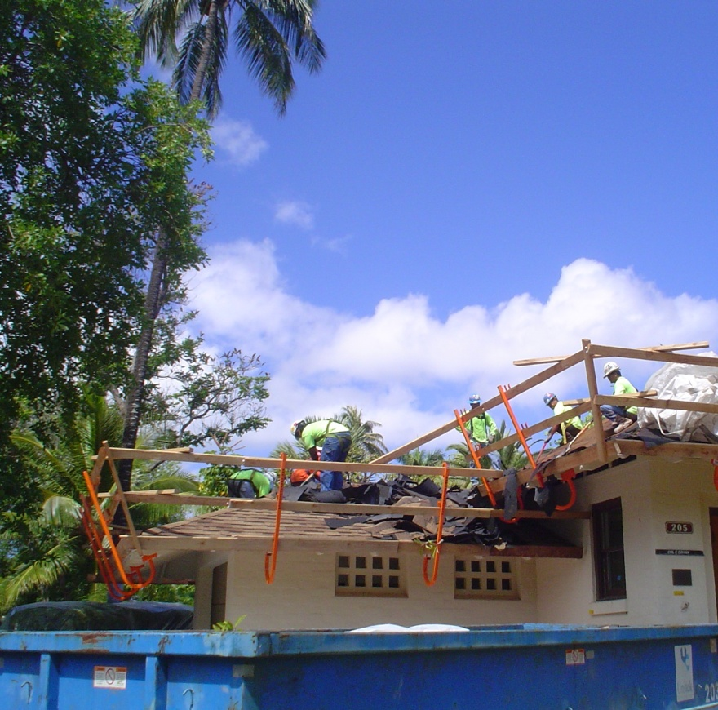
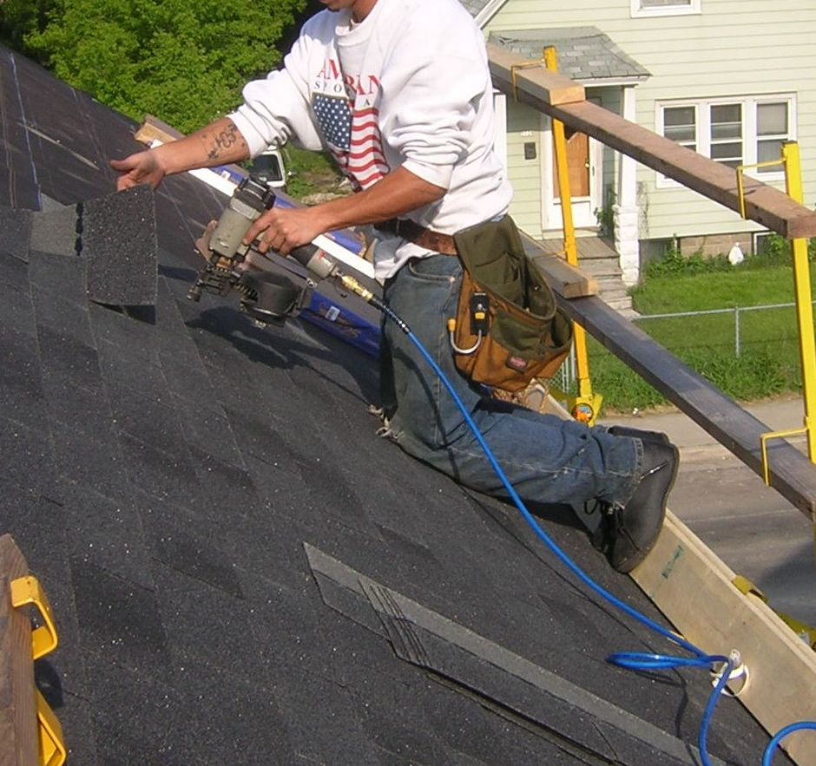
Guardrail Systems
Guardrails in place during re-roofing activities.
Note: The picture on the right lacks protection for the rake edge so some means of protecting this worker (guardrail, safety nets or PFAS) must be used.
Notes:
In this slide we see re-roofing activities being performed behind guardrails.
The picture on the right lacks protection for the rake edge so another means of protecting this worker (safety nets or Personal Fall Arrest System) must be used.

Slide 93
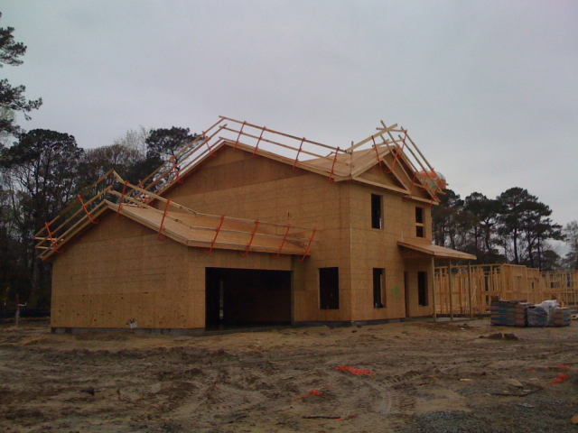
Guardrail Systems
Here we see a fully guardrailed roof ready to go.
Notes:
Here are guardrails that were either positioned prior to, or after, sheathing and left in place for the follow along trades to do their job.
Proper coordination can lead to one system serving the needs of several trades.

Slide 94
Conventional Fall Protection Systems
Safety Net Systems
1926.502(c)
Notes:
Next we’ll take a look at Safety Nets.

Slide 95
Safety Net Systems
Requirements for safety net systems include:
As close as practicable, no more than 30’ below – 1926.502(c)(1)
Sufficient clearance to prevent contact with surface or structures below – 1926.502(c)(3)
Drop tested or certified – 1926.502(c)(4)
Notes:
Although not frequently used in residential construction, safety nets are another means of arresting falls. These systems also fall under that passive system umbrella because when they are properly installed and maintained, the workers do not have to do anything with the system to be safe.
Installation, adjustments, and maintenance of the netting should only be made by properly trained personnel.
However, when safety nets are used, they must be:
Positioned as close as practicable under the walking/working surface on which employees are working.
Installed with sufficient clearance under them to prevent contact with the surface or structures below.
Drop tested or certified.

Slide 96
Safety Net Systems
Vertical distance from working level to horizontal plane of net | Minimum required horizontal distance of outer edge of net from the edge of the working surface
Up to 5 feet | 8 feet
5 to 10 feet | 10 feet
More than 10 feet | 13 feet
From 1926.502(c)(2)
Notes:
This chart shows the vertical and horizontal characteristics of netting if used.

Slide 97
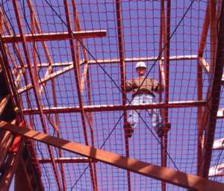
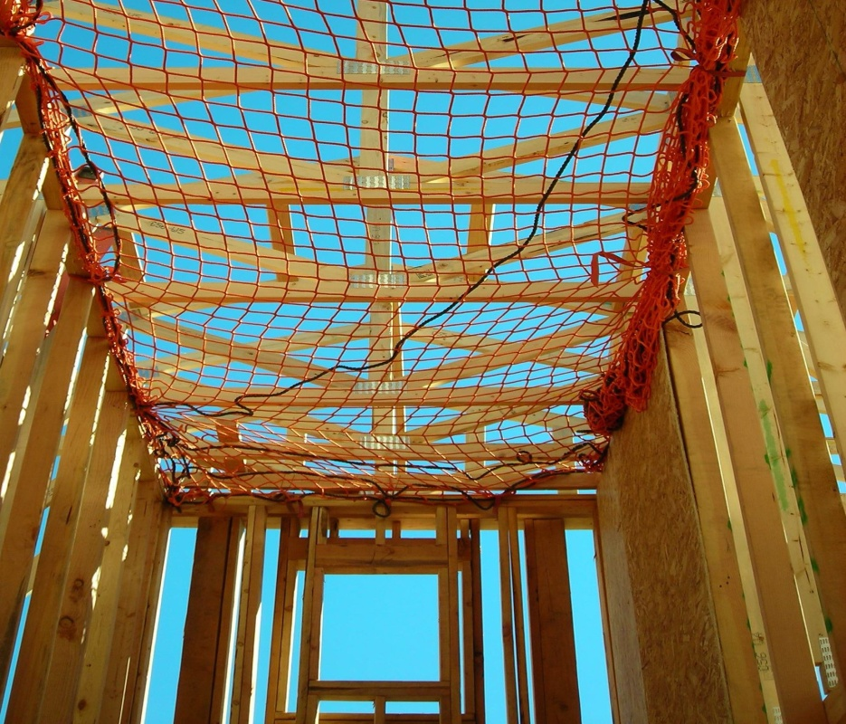
Safety Net Systems
These nets have been positioned to prevent falls to the interior of the building. Employers should consult the manufacturer’s instructions and/or a registered professional engineer to ensure proper installation of the net and bracing of the stud walls. Give due consideration to the potential impact load on the net and lateral load on the stud walls in the event of a fall.
Notes:
This slide shows safety nets in place and positioned to prevent a worker from contacting the lower surface.

Slide 98
Conventional Fall Protection Systems
Personal Fall Arrest Systems
1926.502(d)
Notes:
Lastly we’ll take a look at what may be the most widely used form of fall protection used in residential construction … “Personal Fall Arrest Systems.
”Personal Fall Arrest System must:
Be designed so an employee can neither free fall more than 6 feet, nor contact any lower levels. 1926.502(d)(16)(iii)
Bring an employee to a complete stop and limit maximum deceleration distance an employee travels to 3.5 feet . 1926.502(d)(16)(iv)
And, have sufficient strength to withstand twice the potential impact energy of an employee free-falling a distance of 6 feet, or the free fall distance permitted by the system, whichever is less. 1926.502(d)(16)(v)

Slide 99
Personal Fall Arrest System
A Personal Fall Arrest System (PFAS) must include the following components:
Anchorage
Body Harness
Connector/Lanyard
A PFAS may also include a lanyard, deceleration device, or lifeline.
Notes:
There are three primary components to a Personal Fall Arrest System.
We have:
The anchorage point
The body harness, and
The connector or lanyard
These three components are commonly referred to as the ABC’s of fall protection. We’ll take a detailed look at each of these components.

Slide 100
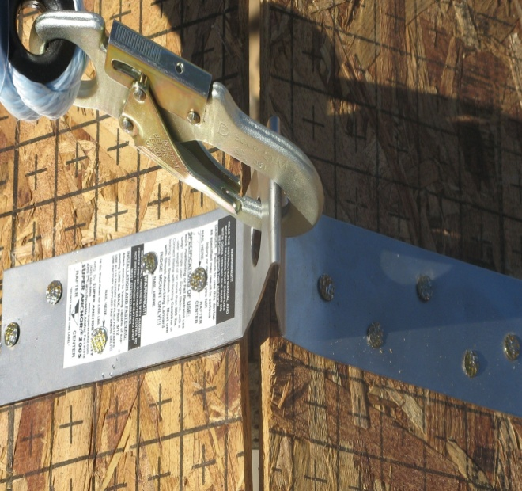
Personal Fall Arrest System Anchor Point
1926.502(d)(15): Anchorages used for attachment of Personal Fall Arrest equipment must be capable of supporting at least 5,000 pounds per employee attached, or must be designed and used as follows:
As part of a complete personal fall arrest system which maintains a safety factor of at least two.
Under the supervision of a qualified person.
Employer should look to the manufacturer’s instructions or the recommendations of a registered professional engineer for proper installation.
Notes:
Proper installation of the Anchorage point is critical to the success of this system. It must be designed and installed to support the amount of force that would be applied to it if a worker fell. Consulting the manufacturer’s instructions or a registered professional engineer will ensure this critical component is properly installed and maintained.

Slide 101
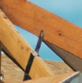
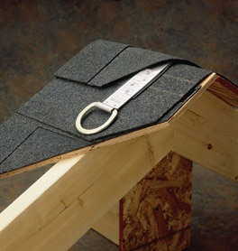
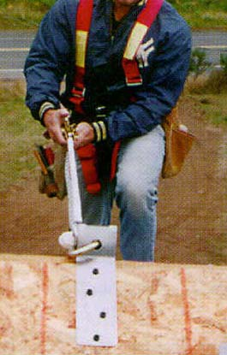
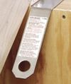
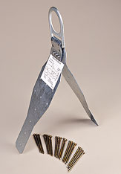
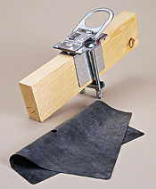
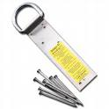
Personal Fall Arrest System Anchor Point
Notes:
Here are examples of various anchorage devices. All anchorage points must be capable of supporting at least 5,000 pounds per employee attached, or must be designed and used under the supervision of a qualified person and maintain a safety factor of at least two.

Slide 102
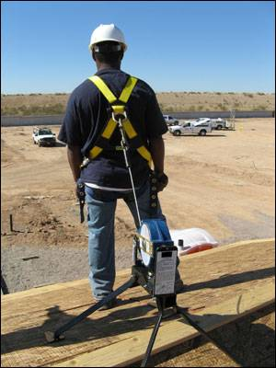
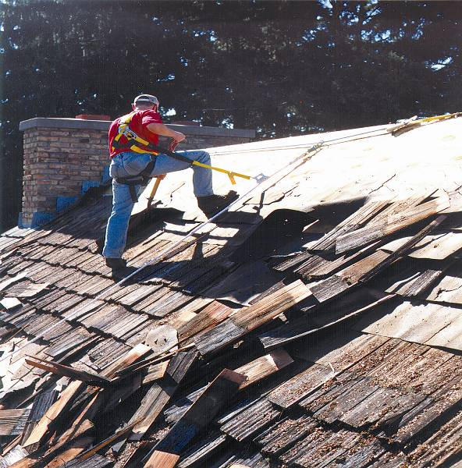
Personal Fall Arrest System Full Body Harness
PFAS in use during roofing and re-roofing activities.
Notes:
Next, the Full Body Harness – Here we see Personal Fall Arrest System in use during roofing and re-roofing operations.

Slide 103
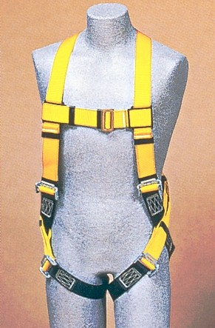
Personal Fall Arrest System Full Body Harness
A full body harness distributes the force of the fall over the thighs, pelvis, waist, chest and shoulders
Body belts have not been allowed as part of an arrest system since January 1998.
Notes:
A full body harness is designed to minimize the impact on the body during a fall by distributing the force of the fall over the entire torso.
And remember, body belts have not been allowed as part of an arrest system since Jan 1998. They can still be used as part of a fall restraint system and we’ll cover that in just a few moments.

Slide 104
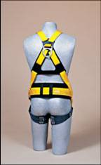
Personal Fall Arrest System Full Body Harness
The attachment point on a full body harness is a D-ring in the center of your upper back.
Be sure to use a size that fits properly.
Use with compatible equipment.
Notes:
Workers must be trained in the proper wear and use of the body harness. They are not a one size fits all component. Proper sizing is critical to preventing injuries. The harness must fit snugly across the chest and around the thighs and the D-ring must be positioned in the center of the back between the shoulder blades.
Employers must ensure workers use a size that fits properly.

Slide 105
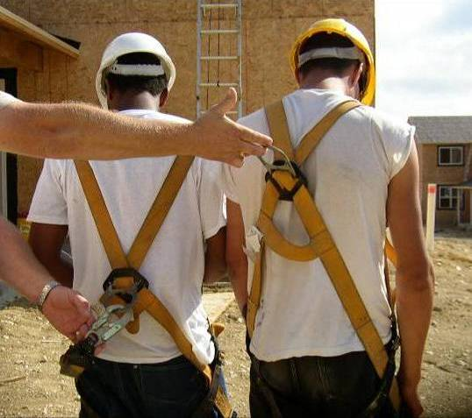
Personal Fall Arrest System Full Body Harness
Which worker is wearing the harness correctly?
Notes:
Which one of these workers is wearing his harness correctly? The one on left … or the one on the right?

Slide 106
Personal Fall Arrest System Full Body Harness
The worker on the right is wearing the harness correctly.
Notes:
The worker on the right is the correct answer.

Slide 107
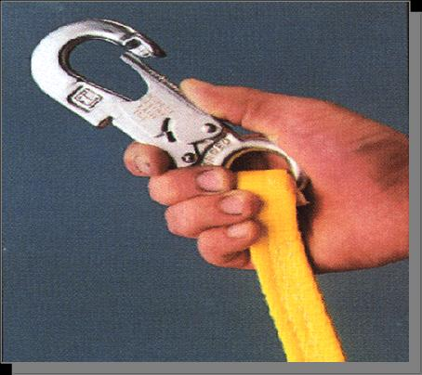

Personal Fall Arrest System Connector/Lanyard
Snaphooks must be locking type – 1926.502(d)(5).
Never hook two snaphooks together unless designed for that purpose – 1926.502(d)(6).
Notes:
Now for the device that ties the anchorage and the body harness together … the connector or lanyard.
Dee-rings and snap hooks shall have a minimum tensile strength of 5,000 pounds.
Snap hooks must be size compatible with the connection point to prevent unintentional disengagement, or shall be a locking type snap hook.
Unless the snap hook is a locking type and designed for the following connections, snap hooks shall not be engaged:
Directly to webbing, rope or wire rope; (1926.502(d)(6)(i))
To each other; (1926.502(d)(6)(ii))
To a Dee-ring to which another snap hook or other connector is attached; (1926.502(d)(6)(iii))
To a horizontal lifeline; (1926.502(d)(6)(iv)) or,
To any object which is incompatibly shaped or dimensioned in relation to the snap hook such that unintentional disengagement could occur by the connected object being able to depress the snap hook keeper and release itself. (1926.502(d)(6)(v))

Slide 108

Personal Fall Arrest System Connector/Lanyard
Notes:
Lanyards shall have a minimum breaking strength of 5,000 pounds. (1926.502(d)(9))
Self-retracting lifelines and lanyards which automatically limit free fall distance to 2 feet (0.61 m) or less shall be capable of sustaining a minimum tensile load of 3,000 pounds applied to the device with the lifeline or lanyard in the fully extended position. (1926.502(d)(12))
Self-retracting lifelines and lanyards which do not limit free fall distance to 2 feet (0.61 m) or less, rip stitch lanyards, and tearing and deforming lanyards shall be capable of sustaining a minimum tensile load of 5,000 pounds applied to the device with the lifeline or lanyard in the fully extended position. (1926.502(d)(13))
Ropes and straps (webbing) used in lanyards, lifelines, and strength components of body belts and body harnesses shall be made from synthetic fibers. (1926.502(d)(14))

Slide 109
Personal Fall Restraint System
Although the standard does not mention personal fall restraint systems, OSHA has previously stated that it accepts a properly utilized fall restraint system in lieu of a personal fall arrest system when the restraint system is rigged in such a way that prevents the worker from being exposed to the fall hazard.
Notes:
Although the standard does not mention personal fall restraint systems, OSHA has previously stated that it accepts a properly utilized fall restraint system in lieu of a personal fall arrest system when the restraint system is rigged in such a way that the worker cannot get to the fall hazard.

Slide 110

Personal Fall Restraint System
Fall restraint can be a body belt or full body harness.
Must be tied off so that the worker cannot go past the unprotected side or edge, no matter where the work is on the walking/working surface.
Lanyards should be adjustable to take up slack when workers move about.
Notes:
Personal fall restraint is used mainly for edge work. It can sometimes be difficult to keep the proper slack, and is not used for most residential roofing work.
Fall restraint can be a body belt or full body harness.
Must be designed so that the worker can not go past the leading edge, no matter where the work is being done.
The lanyard should be adjustable to take up slack when workers move around to perform their jobs.

Slide 111


When is fall protection necessary?
Notes:
Trainer’s Notes:
Very important for the participants to understand that both have their place, depending upon circumstances, but preventing the vertical is always better if possible.

Slide 112


When is fall protection necessary?
Notes:
Trainer’s Notes:
Very important for the participants to understand that both have their place, depending upon circumstances, but preventing the vertical is always better if possible.

Slide 113


When is fall protection necessary?
Notes:
Trainer’s Notes:
Very important for the participants to understand that both have their place, depending upon circumstances, but preventing the vertical is always better if possible.

Slide 114
Residential Fall Protection Program
Other Work Methods
Notes:
Now we’ll take a look at some of the other systems and processes that some contractors are using throughout the country to meet the fall protection challenges in residential construction.

Slide 115
Other Work Methods
Employers also have the option of having workers work from scaffolds (in compliance with Subpart L), ladders (in compliance with Subpart X) or aerial lifts (in compliance with 29 CFR 1926.453) instead of complying with 1926.501(b)(13).
Notes:
Now we all know the first principle of mishap prevention is to “eliminate” the hazard whenever possible. If you can’t eliminate it, you then have to minimize its effect. We cannot eliminate working at heights in construction, but using ladders, scaffolds and aerial lifts can help employers eliminate some falls from six feet or higher.

Slide 116



Other Work Methods
Platform Ladders
Step Ladder
Notes:
Platform ladders are becoming more and more prevalent in the industry. These industry best practices, provide workers with a stable work base and allows more flexibility while maneuvering and positioning things like floor joists and trusses.

Slide 117


Other Work Methods
Bakers / Perry Scaffolds
Notes:
These scaffold systems are primarily used on the interior of buildings and can provide stable work platforms while framing, hanging board, and rolling trusses.

Slide 118

Other Work Methods
Here is an example of a wall bracket, or top plate, scaffold system. Some contractors are using these systems for rolling trusses, cutting rafter tails and hanging fascia.
Notes:
Here are examples of wall bracket, or top plate scaffold systems. (pause)

Slide 119

Other Work Methods
This contractor is working with trusses from this wall bracket/top plate scaffold system.
Notes:
Some contractors are using these systems for rolling trusses and cutting rafter tails.

Slide 120

Other Work Methods
The positioning of an engineered guardrail system allows easy access for sheathing, roofing and utility installation. Multiple trades can be protected by these kinds of systems.
Notes:
The positioning of this guard rail system allows easy access for sheathing, roofing and utility installation.

Slide 121

Other Work Methods
Scaffold System
Notes:
Here we see a building completely enclosed with a scaffold system. Falls to the exterior have been eliminated entirely.

Slide 122

Other Work Methods
Pump-jack Scaffold
Notes:
Pump jacks are a popular system used by many contractors to install building wrap and siding. Some contractors have used different variations of the pump jack that allow them to jack it up to just under the fascia and be used as catch platforms. There the system can be used as perimeter protection while sheathing and roofing operations are performed.

Slide 123


Other Work Methods
Extensible Boom Aerial Lift
All-terrain Forklift with basket attachment
Notes:
An Aerial lift is a good alternative for reaching heights if properly used. They can also be used to install and remove guardrail and safety net systems.

Slide 124
Other Work Methods
Extensible Boom Aerial Lift
Alternative for reaching heights if properly used.
PFAS or fall restraint must be worn and lanyard attached to boom or basket when working from an aerial lift - 1926.453(b)(2)(v).
Notes:
PFAS or fall restraint must be worn and lanyard attached to the boom or basket when working from an aerial lift.

Slide 125

Other Work Methods
Here are properly installed guard/hand rails using a “safety boot” system to position the uprights installed during framing.
Notes:
Here is a properly installed guardrail using a “safety boot” system to position the uprights installed during framing.

Slide 126

Other Work Methods
Here is the same system still in place through MEP installation and dry wall. Priming and painting can be done before installing the permanent handrail and removing the guardrail.
Notes:
Here is the same system still in place through Mechanical, Electrical, Plumbing installation and dry wall.
Priming and painting can be done before installing the permanent handrail and removal of the guardrail.

Slide 127

Other Work Methods
Working at heights cannot be eliminated, but there are ways to minimize exposure to falls. Assemble as many parts of the building as possible on the ground.
Properly assembled and braced IAW the manufacturer’s instruction and the BCSI guide
Notes:
As we stated previously, working at heights cannot be eliminated, but there are ways to minimize exposure.
By assembling as many parts of the structure as possible on the ground we can reduce worker frequency and duration of exposure to falls.
Properly assembled and braced systems, erected in accordance with the Building Component Safety Information booklet, can be hoisted …

Slide 128

Other Work Methods
Flying pre-assembled structures into place will minimize worker exposure
to fall hazards.
Properly assembled and braced IAW the manufacturer’s instruction and the BCSI guide
Notes:
… and flown into place. This minimizes worker exposure to fall hazards.

Slide 129

Other Work Methods
Do as many things on the ground as possible. Here a contractor installed the building wrap prior to flying this section into place.
Properly assembled and braced IAW the manufacturer’s instruction and the BCSI guide
Notes:
Do as many things on the ground as possible. Here a contractor has installed the building wrap.

Slide 130

Other Work Methods
Some contractors are even pre-positioning portions of the guardrail system on the ground.
Notes:
And here another has pre-positioned portions of the guardrail system on the ground …

Slide 131

Other Work Methods
Pre-installed fall protection
Properly assembled and braced IAW the manufacturer’s instruction and the BCSI guide
Notes:
… and flown into place … what a concept.

Slide 132

FALL HAZARDS
All sites have unprotected sides and edges, wall openings, or floor holes at some point during construction.
If these sides and openings are not protected, injuries from falls can happen.
There’s no reason to work like this …
Notes:
Today, there’s no reason for this worker to work like this …

Slide 133

PFAS
… when at minimum, you can work like this.
If this worker should slip and fall, he will not hit the ground. PFAS works!
Notes:
… when there are systems available to protect them from falling and hitting the ground.

Slide 134

Fall Hazard
Some builders use 24” OC studs for non-load bearing walls. Prior to installation of drywall, temporary guardrail systems must be installed to prevent workers from falling through the studs.
Notes:
Falling from roofs is not the only area where fatalities have occurred. Open sides like this must be protected.

Slide 135

Guardrail System
Like this!
Notes:
Like this!

Slide 136

Fall Hazard
Each employee on walking/working surfaces shall be protected from falling through holes (including skylights) more than 6 feet (1.8 m) above lower levels, by personal fall arrest systems, covers, or guardrail systems erected around such holes (1926.501(b)(4)).
This open-sided stairwell opening can be protected by a guardrail system (and handrail system – 1926.1052(c)).
Notes:
And, this open-sided stairwell opening must be protected.

Slide 137


Guardrail System
Like this!
Notes:
Like this!

Slide 138
Fall Protection Plan 1926.502(k)
If an employer can demonstrate that conventional fall protection is infeasible or presents a greater hazard, the employer shall develop and implement a fall protection plan that complies with 1926.502(k).
The employer bears the burden of establishing that it is appropriate to implement a fall protection plan for a particular workplace situation.
Notes:
Hopefully we shared several ways workers can be protected while exposed to potential fall hazards. But, if employers can still demonstrate that using conventional fall protection is infeasible or presents a greater hazard to their employees, they must develop and implement a fall protection plan.
Employers bear the burden of proving that a fall protection plan is needed for a particular workplace situation.

Slide 139
Significant Changes in the Residential Fall Protection Policy
Under 1926.502(k) the fall protection plan:
Must be written.
Must be site-specific.
A written fall protection plan developed for repetitive use, e.g., for a particular style or model of home, will be considered site-specific with respect to a particular site only if it fully addresses all issues related to fall protection at that site. Therefore, a standardized plan will have to be reviewed, and revised as necessary, on a site by site basis.
Notes:
Employers must ensure the plan meets the requirements of 29 CFR 1926.501(b)(13) and 1926.502(k).
Under 1926.502(k) the plan:
Must be written and be site specific.
A Plan developed for repetitive use with a particular style home, must be reviewed to ensure it fully addresses all issues related to fall protection on each site it is used on.

Slide 140
Fall Protection Plan 1926.502(k)
The plan must be prepared by a “qualified person” - 1926.502(k)(1).
"Qualified” means one who, by possession of a recognized degree, certificate, or professional standing, or who by extensive knowledge, training, and experience, has successfully demonstrated his ability to solve or resolve problems relating to the subject matter, the work, or the project - 1926.32(m). (This could be the owner, supervisor, etc.).
Be developed specifically for the site where the residential construction work is being performed – 1926.502(k)(1).
Must be maintained up to date – 1926.502(k)(1).
All changes shall be approved by a qualified person – 1926.502(k)(2).
Notes:
The plan must be prepared by a “qualified person – ("Qualified” means one who, by possession of a recognized degree, certificate, or professional standing, or who by extensive knowledge, training, and experience, has successfully demonstrated his ability to solve or resolve problems relating to the subject matter, the work, or the project); and,
All changes to the plan must be approved by a qualified person.

Slide 141
Fall Protection Plan 1926.502(k)
Shall be maintained on the site – 1926.502(k)(3).
Shall be implemented under the supervision of a competent person – 1926.502(k)(4).
“Competent Person” means one who is capable of identifying existing and predictable hazards in the surroundings or working conditions which are unsanitary, hazardous, or dangerous to employees, and who has authorization to take prompt corrective measures to eliminate them – 1926.32(f). (This could be the owner, supervisor, etc.).
Shall include documentation of reasons why conventional fall protection systems are infeasible or create a greater hazard – 1926.502(k)(5).
Shall include a written discussion of the alternative work practices to be used that will eliminate or reduce the possibility of a fall – 1926.502(k)(6).
Notes:
Must be maintained on the site; … and be
Implemented under the supervision of a competent person – ("Competent person" means one who is capable of identifying existing and predictable hazards in the surroundings or working conditions which are unsanitary, hazardous, or dangerous to employees, and who has authorization to take prompt corrective measures to eliminate them).
The plan must also document why conventional systems are infeasible or create a greater hazard.
and it must include a written discussion of the alternative work practices that eliminate or reduce the possibility of a fall.

Slide 142
Fall Protection Plan 1926.502(k)
Shall identify each location where conventional fall protection systems cannot be used and designate them Controlled Access Zones (CAZ) – 1926.502(k)(7).
Implement a safety monitoring system in conformance with 1926.502(h) where no other alternative measure has been implemented – 1926.502(k)(8).
Shall identify all workers designated to work in the CAZ – 1926.502(k)(9).
Shall be reviewed and updated as appropriate if a fall, or near miss, occurs – 1926.502(k)(10).
Notes:
All locations where conventional systems cannot be used must be identified and be designated in the plan as controlled access zones.
Must identify all workers authorized to work in the controlled access zones.
and it must be reviewed if a fall, or near miss, occurs.

Slide 143
Fall Protection Plan Safety Monitor Duties
For a safety monitoring system under 1926.502(h) the monitor must:
Be a competent person.
Warn workers of fall dangers.
Be on same working level and within visual sighting.
Be close enough to communicate orally.
Not have responsibilities which take attention away from monitoring.
Notes:
The safety monitor’s sole purpose is to monitor the workers who are exposed to a potential fall hazard.
The safety monitor:
Cannot have any other job which would distract them from monitoring.
Must be a competent person.
Must have the authority to stop other worker activities
All workers in the CAZ must be directed to comply with the fall hazard warnings of the safety monitor.

Slide 144
Fall Protection Plan 1926.502(k)
A sample plan is in Appendix E to Subpart M and can be reviewed @
https://www.osha.gov/pls/oshaweb/owadisp.show_document?p_table=STANDARDS&p_id=10927
Notes:
OSHA included Appendix E in Subpart M to show employers and employees what a compliant fall protection plan might look like.

Slide 145
Ladders

Slide 146


Slide 147


Slide 148


Slide 149


Slide 150



Slide 151
Basic use of a ladder
Don´t move the ladder while it has been used.
Don´t overload the ladder.
Do inspections and maintenance of the ladders.
Don´t use ladders on a slippery surface.
Use non conductive ladders when working close to electricity.
Notes:
Trainer's Notes:

Slide 152
What is wrong?

Slide 153


Notes:
Trainer's Notes:

Slide 154





Slide 155


Slide 156

Why protection is necessary?

Slide 157


Slide 158


Slide 159


Slide 160


Slide 161


Slide 164
True or False Questions

Slide 165
1) Construction is one of the industries that more frequently causes fatalities and injuries among workers.
___True ___False
2) The main cause of deaths in construction is electrocution.
___True ___False
3) It’s possible to decrease costs for employers if workers do their jobs in a safe manner.
___True ___False

Slide 166
4) OSHA will ask about your immigration status.
___True ___False
5) OSHA only does worksite inspection in case of workers’ complaints.
___True ___False
6) Construction workers don’t need training because they are very experienced.
___True ___False
7) Workers only can be the “Competent Person” if they have an occupational safety degree.
___True ___False

Slide 167
8) Having an inspection program helps to keep the workplace environment safe.
___True ___False
9) Fall protection systems are required if the workers do their jobs at a height of six feet or more.
___True ___False
10) A Personal Fall Arrest System must include the following components: Anchorage, Body Harness, and Connector/Lanyard .
___True ___False

Slide 168
In Closing
All workers should return safely home to their families every day.
Employers must provide workers a place of employment free from recognized hazards.
Visit the OSHA Construction webpage for additional residential fall protection compliance assistance and guidance materials:
www.osha.gov/doc/residential_fall_protection.html
For Fall Protection Standards for States with OSHA-approved State Plans, please visit:
http://www.osha.gov/dcsp/osp/statestandards.html
The enforcement date for the new directive is June 16, 2011.
Notes:
In closing:
We believe that in most cases it IS FEASIBLE and WILL NOT CREATE A GREATER HAZARD to implement conventional fall protection systems for residential construction work.
There have been considerable advances in the types and capability of commercially available fall protection equipment.
We cannot let workers get killed when effective means are readily available to prevent those deaths.
The new directive will help us get there.
Companies that had been operating in accordance with the old directive have until June 16, 2011 to come into compliance with 1926.501(b)(13) as written.
All workers have a right to return safely home to their families every day.

Slide 169
Work Accidents Have Enormous Costs for:
* The Worker, who can have serious health problems, including becoming an invalid.
*The Family, who have their quality of life reduced due to the loss of earnings.
* The Employer, who apart from losing trained workers, has to pay high compensation costs.
* The Society, that has to support and sustain invalids and their dependents through social welfare.
For this reason, Workplace Safety is a field that grows and employs more people every year.
Notes:
Só leia isto e explica

Slide 170

Remember!!
There is no service so important, or job so urgent, that you can’t take the time to be safe in what you do

Slide 171
QUESTIONS
On-site Consultation
http://www.osha.gov/dcsp/smallbusiness/consult.html
To submit an information inquiry by Electronic Mail Form:
http://www.osha.gov/ecor_form.html
By Phone
1-800-321-OSHA (6742) Toll Free U.S.
Write To:
U.S. Department of Labor Occupational Safety & Health Administration Directorate of Construction – Room N-3468 200 Constitution Avenue Washington, D.C. 20210
Notes:
Thank you and please contact your local OSHA office if you have any questions. You can also contact your state “On-Site Consultation Program” office for assistance. These professional can come out to your jobsite and provide free consultation services. And lastly, you can also contact us directly by using one of the methods shown on this slide. Again, thank you and be safe.

