Slide 1
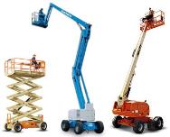
Aerial Lift Safety

Slide 2
Introduction
About this Power Point Presentation
This PPT was financed 100 percent through federal funds. It is offered to affected employees and owners of small businesses, including limited-English, low-literacy and hard-to-reach workers.
Affected employees, small business owners, and their trainers may request a free copy of this PPT by contacting TCIA, Inc. at 800-733-2622.
This material was produced under grant number SH-26301-SH4 from the Occupational Safety and Health Administration, U.S. Department of Labor. It does not necessarily reflect the views or policies of the U.S. Department of Labor, nor does mention of trade names, commercial products, or organizations imply endorsement by the U.S. Government.

Slide 3
Introduction
An aerial lift, for the purpose of this training, is any work platform that has an articulating boom with a bucket.
Only qualified employees can operate aerial lifts. Only your employer can certify that you are qualified operator.
This training program is based on OSHA and ANSI Z133 safety standards for arboricultural operations.
This manual presents general safety awareness, industry safety standards, and some operational guidelines for aerial lifts.
It is your responsibility to know and comply with your company’s policies. If unsure, ask your supervisor. This manual is not intended to replace or supersede company policies and procedures.

Slide 4
Aerial Device (ANSI Z133 Definition)
Any one of the following types of vehicle-mounted apparatus used to elevate personnel to jobsites above ground:
          Extensible boom platform
          Aerial ladder
          Articulating boom platform
          Vertical tower
          A combination of any of the above

Slide 5
Chapter 1:
Aerial Lift Safety
Objectives:
  The employee will:
    Name the most common types of accidents involving aerial lift devices.
    Interpret the meaning of common warning signs and labels.
    Identify appropriate personal protective equipment.

Slide 6
Only qualified employees can operate aerial lift devices.

Slide 7
OSHA Definition
OSHA DEFINITION of a "Qualified person" - a person who possesses a recognized degree, certificate, professional standing, or skill and who, by knowledge, training, and experience, has demonstrated the ability to deal with problems relating to the subject matter, the work, or the project.

Slide 8
Industry Statistics
2014 Fatalities
Struck-by’s - 42%
Falls - 31%
Electrocution - 16% (harmful environment)
Transportation - 11%
Assaults 1%
Courtesy of Dr. John Ball, 2014 data
Notes:
Transportation
▪ Most transportation incidents occur driving to and from job sites on highways or streets.
▪ Those that occur at the job site are either due to the worker being struck by passing traffic or hit by their own truck – frequently when it is backing up.
▪ Transportation is the third leading category for non-fatal injuries, behind chainsaws and struck by a limb.
Assault
▪ Every year at least one tree worker is killed, often by an angry neighbor.
▪ If someone says, “I’m going to kill you,” believe him or her!
▪ However we had a murder (robberies) and one fight between two tree workers that resulted in a death.
Contact with an object or equipment
▪ The majority of incidents in this category involve a branch or the entire tree striking the worker.
▪ Ground workers are the frequent target.
▪ While many of the “struck-by” occur during felling the tree, either the tree falling in the wrong direction or a branch breaking free during the fall, a number of contact incidents are due to rigging failures and workers standing beneath the load.
A command and rely system and using established drop zones would significantly reduce incidents in the category.
▪ Contact is the leading categories for non-fatal injuries such as fractures, concussions, punctures etc.
Other contact/caught in fatalities
▪ Other contact issues involve chippers and chain saws.
▪ Both are responsible for a significant proportion of the fatal injuries that occur in tree work.
▪ Chainsaw fatalities are increasing, primarily to climbers or lift operators.
▪ Chipper incidents, both fatal and nonfatal, are either from standing on the in-feed to kick brush in or scooping brush in with your hands and caught. Chipper incidents result in many of the amputations for our industry.
Falls
▪ Not too surprisingly, most falls occur to climbers and these numbers are increasing.
▪ Falls greater than 40 feet tend to be fatalities rather than injuries. The average height of a fatal fall last year was 46 feet, non-fatal was 32 feet.
▪ Many time climbers fall with the tree (or part of it), rather than from it. The tree failed at the base while the worker was in it or the branch that served as the anchor broke.
▪ Most times when an aerial lift operator falls it is due to equipment failure (and they fall with the boom) or a limb strikes the boom and they fall out of the bucket since they are not using fall protection.
Exposure to hazardous environment
▪ Still the single most common cause of fatalities among tree workers is electrical contact.
▪ Climbers are the group most likely to experience electrical shock, but ground workers are a close second. The group most likely to suffer electrical shock is a residential tree worker
▪ Generally it is through indirect contact – a branch or saw – but a surprisingly high percent is direct contact.
▪ Most electrical contacts are fatal; there relatively few non-fatal injuries proportion to the fatalities in this category.
▪ However, if you do survive the electrical contact, immediate medical treatment is required to deal with burns and fractures.
Emergency response
▪ Nonfatal injuries can become fatalities if co-workers do not respond in time or appropriately.
▪ If you are not trained in first-aid, your biggest value to the victim is calling for help on the cell phone.
▪ Don’t become the second victim – never enter the site unless it is safe to do so.
▪ Continuous training and practicing different types of accidents (both ground and aerial) are the keys to emergency response.

Slide 9
A Closer Look at Struck-by’s
42% of total fatalities (OSHA –Contact with an object)
  Limb
  Tree
  Chipper
  Saw
  Palm
  Stump Grinder
Courtesy of Dr. John Ball, 2014 data

Slide 10
A Closer Look at Falls
31% of total fatalities
From or with tree
  ½ from
  ½ with
  Often fall into tree
From or with aerial lift
  ½ from
  ½ with
Misc.
  Truck (Rack/body)
  Ladder
Courtesy of Dr. John Ball, 2014 data

Slide 11
A Closer Look at Falls - Aerial Lift
Working without fall protection/fall restraint of any kind
Misuse of the lift
Tree parts falling on the booms/basket
Failure to inspect/maintain the lift
Falls from headache rack

Slide 12
Exposure to Harmful Environment
16% of total fatalities
  Most working aloft
  Some working on ground
    Twice as many Indirect as Direct
Courtesy of Dr. John Ball, 2014 data

Slide 13
Aerial Lift Procedures
Bucket Operator Warnings
  The bucket does not keep you free from risk of electrocution
  Insulation provides only a measure of safety
  You can be electrocuted through other paths to ground:
    If you contact the conductor and the tree at the same time
    If you contact two conductors at the
    same time

Slide 14
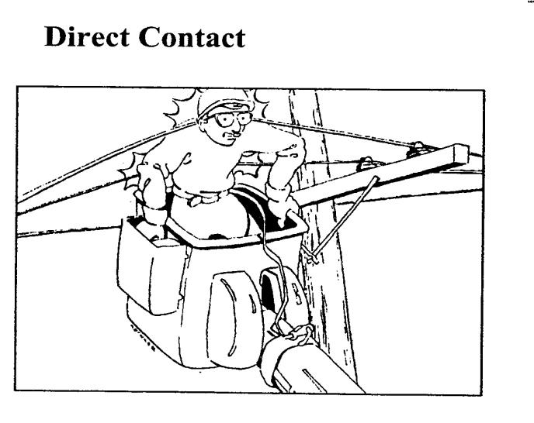
Electrical Shocks

Slide 15
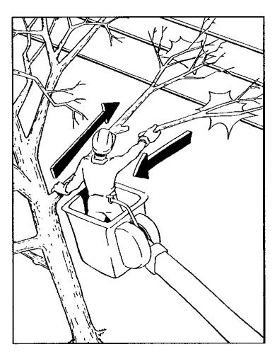
Indirect, phase-to-phase contact, bucket operator

Slide 16
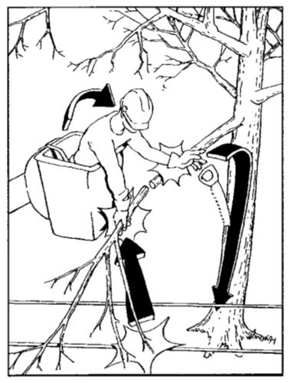
Indirect, phase-to-ground contact, bucket operator

Slide 17
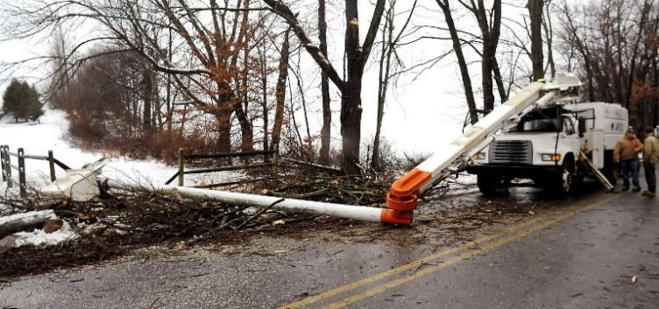
Failure to observe safety precautions may result in serious injury or death

Slide 18

Aerial Lift Safety
The triangle shape is the symbol for:
Caution, Warning, Danger
– the Exclamation Point Means “Pay Attention!”
The manufacturer puts important
messages on the equipment. It is our job
to read, know, and understand them!!

Slide 19
CAUTION, WARNING
DANGER!
Indicates a hazardous situation. Know what each word means!

Slide 20
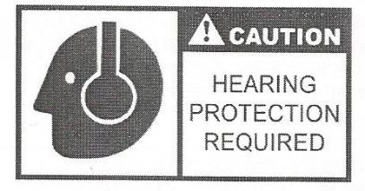
Symbol Meanings
CAUTION
means you need to be careful. Follow the directions on the sign or you could get hurt.
The triangle with the exclamation point and a picture to show you what you are supposed to use Caution for.
The triangle with an exclamation point will always remain the same for caution,
but the picture may change.

Slide 21
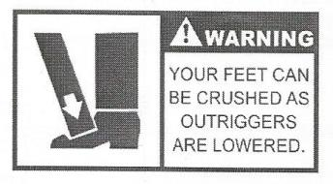
Symbol Meanings
WARNING more
Serious than CAUTION! Follow directions or injury and possibly death.
The triangle with the exclamation point and a picture to show and warn you - WARNING.
The triangle with an exclamation point will always remain the same for warning,
but the picture may change.

Slide 22
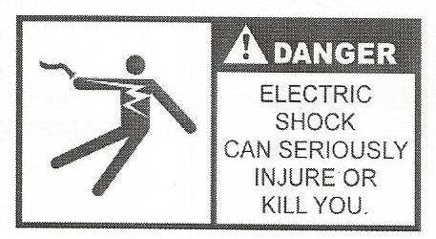
Symbol Meanings
DANGER – the most
Serious safety message! Serious injury or death may occur if you do not follow directions!
The triangle with the exclamation point and a picture to show you DANGER is present.
The triangle with an exclamation point will always remain the same for danger,
but the picture may change.

Slide 23
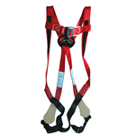
Aerial Lift Safety Personal Protective Equipment

Slide 24
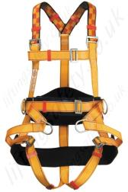
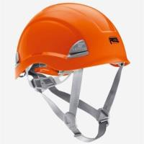
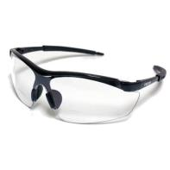
Aerial Lift Safety
Personal Protective Equipment (PPE)
Fall Protection – full body harness or body belt
with appropriate lanyard connected to designated anchor point. (OSHA)
Helmet – Class E for line clearance,
commercial Arborists can wear ventilated.
All helmets must meet ANSI Z89.1
3. Eye Protection – goggles or safety glasses,
including prescription safety glasses, must
meet ANSI Z87.

Slide 25
Aerial Lift Safety
PPE (cont)
4. Hearing protection – ear muffs of plugs (Chain
Saw use).
5. Leg Protection – may be worn, but is not required in
a bucket.
6. Face Shield – may be worn, but does not substitute
for safety glasses.
Sturdy, non-slip boots
Close fitting clothing and no jewelry.
Nothing to get caught in equipment.

Slide 26
Chapter 2:
Aerial Lift Inspection, Preparation and Driving
Objectives:
  The employee will:
    Indicate parts to be inspected before and after operation.
    Learn start-up procedures.
    Understand daily, weekly, monthly and annual inspection requirements.

Slide 27
Component
Identification
Chapter 2 Aerial Lift Inspection

Slide 28
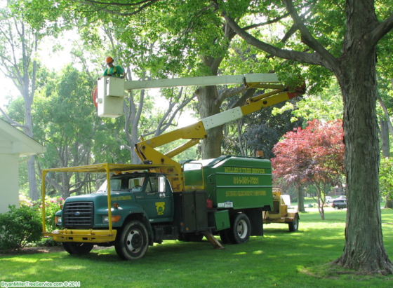
Pre-Use Inspection Process
7-step process to ensure safe operation of a bucket truck

Slide 29
Inspection: Step 2
Inspection: Step 1
Check oil level in hydraulic reservoir
  Outriggers are up
  Vehicle parked on level surface
  The need to add oil on a regular basis may indicate a leak
Conduct visual inspection of the unit

Slide 30
Step 3:
Check visual and audible safety devices

Slide 31
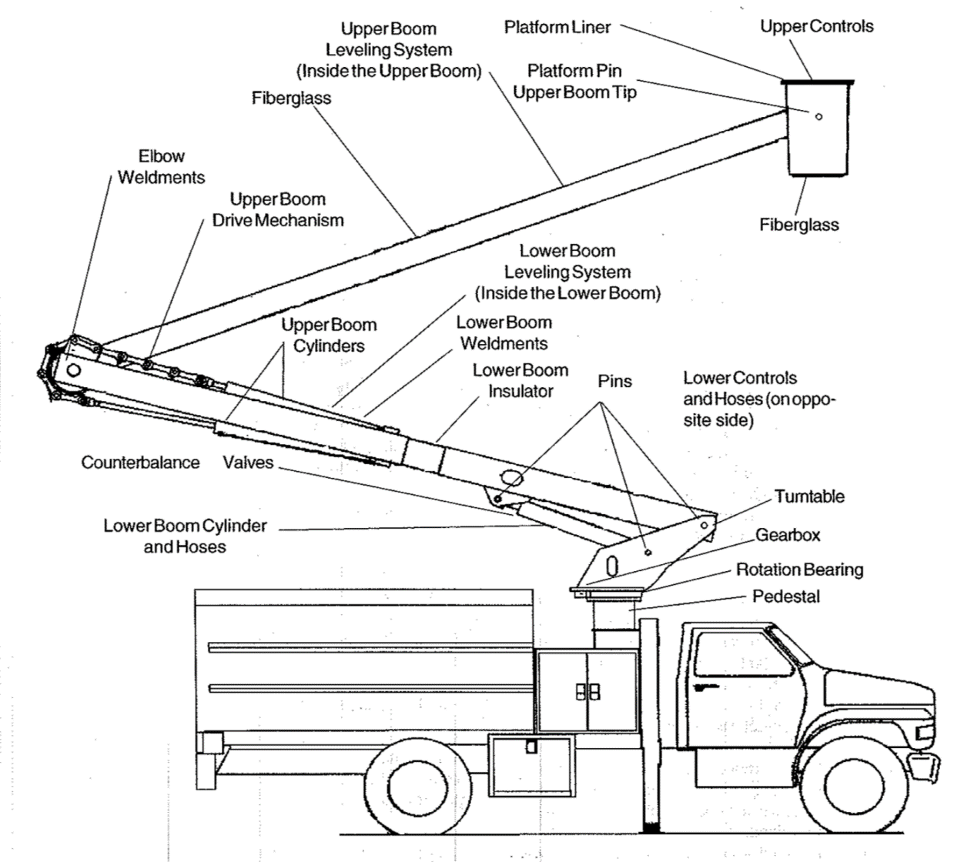
Step 4:
Inspect the fiberglass lower and upper boom insulator for dirt and damage caused by rubbing wires, tree sap etc.

Slide 32
Step 5:
Test the outrigger interlock system (if equipped)
Put truck on level surface and attempt to raise and lower booms without putting outriggers down

Slide 33
Inspection Step 6:
While setting the outriggers make sure they are working properly
  No leaks
  No signs of wear due to rubbing against outrigger weldment
  CAUTION: when testing the operation of the interlock system the platform and booms should be in such a position that no damage
  can result from unexpected movement

Slide 34
Inspection Step 7:
With no one in the platform, operate the functions from the lower controls
  If functions are operating normally, move to upper controls
  Test the interlock system for the upper controls
    First, try to operate booms with upper controls with the hydraulic stop pushed in
    Next, for trucks with interlock trigger, try to operate booms without squeezing trigger
      If boom movement occur, interlock system has failed – do not operate until problem is corrected
** While the unit is operating, look for leakage from hydraulic lines and components **

Slide 35
Inspection Step 8:
Test station selector at the lower control station
  When the station selector is set to the override position, the upper controls should not work
  The lower controls must always override the upper control

Slide 36
Inspection Step 9:
If the unit is equipped with a secondary stowage system, remote throttle system, stop/start system, or battery powered electrical drive, check these systems for proper operation

Slide 37
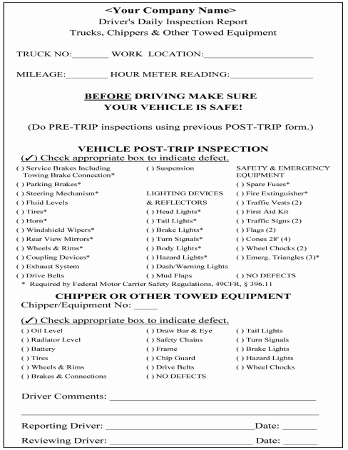
Vehicle
Inspection

Slide 38
The Federal DOT Requires At Least The Following To Be Covered
Service brakes, including trailer brake connections
Parking brake
Steering mechanism
Lighting devices and reflectors
Tires
Horn
Windshield wipers
Rear vision mirrors
Coupling devices
Wheels and rims
Emergency equipment

Slide 39
Aerial Lift Preparation
Shop Start-Up Procedures
  Check which equipment is scheduled for use.
  Check oil and coolant levels before starting the engine.
  Start engine as soon as possible for full warm-up.
  Perform visual inspection.
  Perform operational inspection of controls and outriggers.
  Inform supervisor if you find any broken items.
  Check truck storage boxes for all safety devices (i.e.: flags, vests, signs, cones, chocks, pads) and any other equipment needed.
  Be sure there are no loose tools on top of the lift or in the buck- et.
  Be sure all equipment doors are shut and locked.
  Before leaving your shop, be sure you have your DOT med. exam card (if applicable), driver’s license, work orders, directions to location(s), emergency numbers, and all co-workers you need to transport before leaving.
  Wear your seat belt.
  Be sure all passengers are wearing their seat belt.

Slide 40
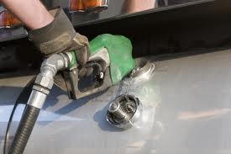
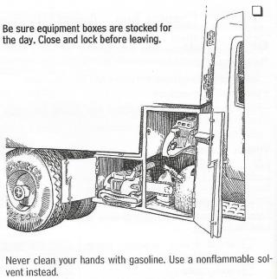
Aerial Lift Preparation
Fueling the Vehicle
Use correct fuel for equipment
Never smoke or have an open flame
Touch the nozzle to machine before removing the fuel cap to prevent static spark
Keep nozzle or funnel in contact with fuel tank.
Wipe up all spills immediately, before starting Engine.

Slide 41
Aerial Lift Safety
Daily, Weekly, Monthly, and Annual Lift Inspections
Consult manufacturer’s instructions for what is to be included in “daily,” “weekly,” monthly and annual inspections. Your DVIR form covers standard items inspected on a daily basis to meet USDOT Federal Motor Carrier Safety Regulations (FMCSR) for the vehicle on which the aerial lift is mounted. Lift manufacturers have additional inspection items for the lift itself, based on the specific model you are operating.
In general, “daily” inspections are conducted by aerial lifts specialists (qualified operators). Depending on your company, “weekly” inspections may be conducted by an aerial lift specialist or a qualified maintenance technician. Aerial Lift Specialists, at a minimum, should be aware of the items that are checked on a “weekly” basis.
Monthly and annual inspections are conducted by qualified maintenance technicians. “Daily” inspections are actually based on 8 hours of operation and “weekly” inspections are based on 40 hours of operation.

Slide 42
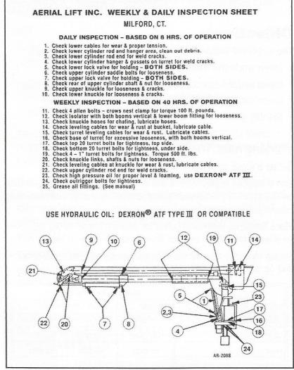
An Example of “Daily” and “Weekly” Inspection

Slide 43
Aerial Lift Safety - driving
While driving, parking at job, and returning…
  Know the height clearance of your vehicle!
  Drive defensively – not offensively!
  No tailgating – maintain the right following distance!
  Park your vehicle properly
  Conduct post trip inspection
  Unload equipment properly and Check equipment storage – locking them always.
  Turn in completed DVIR when back to
  office.

Slide 44
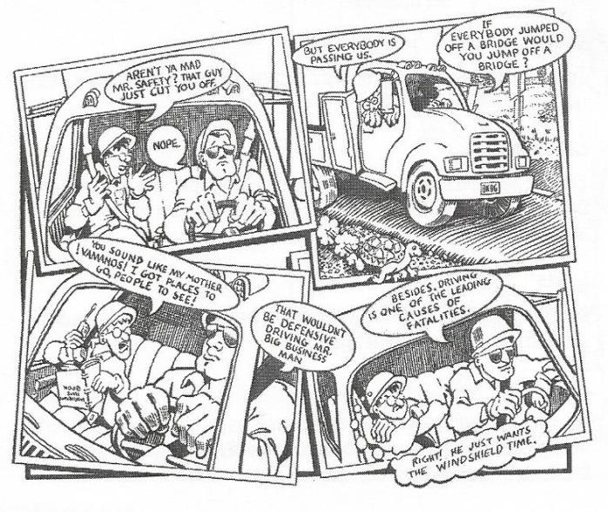
Aerial Lift Safety – driving

Slide 45
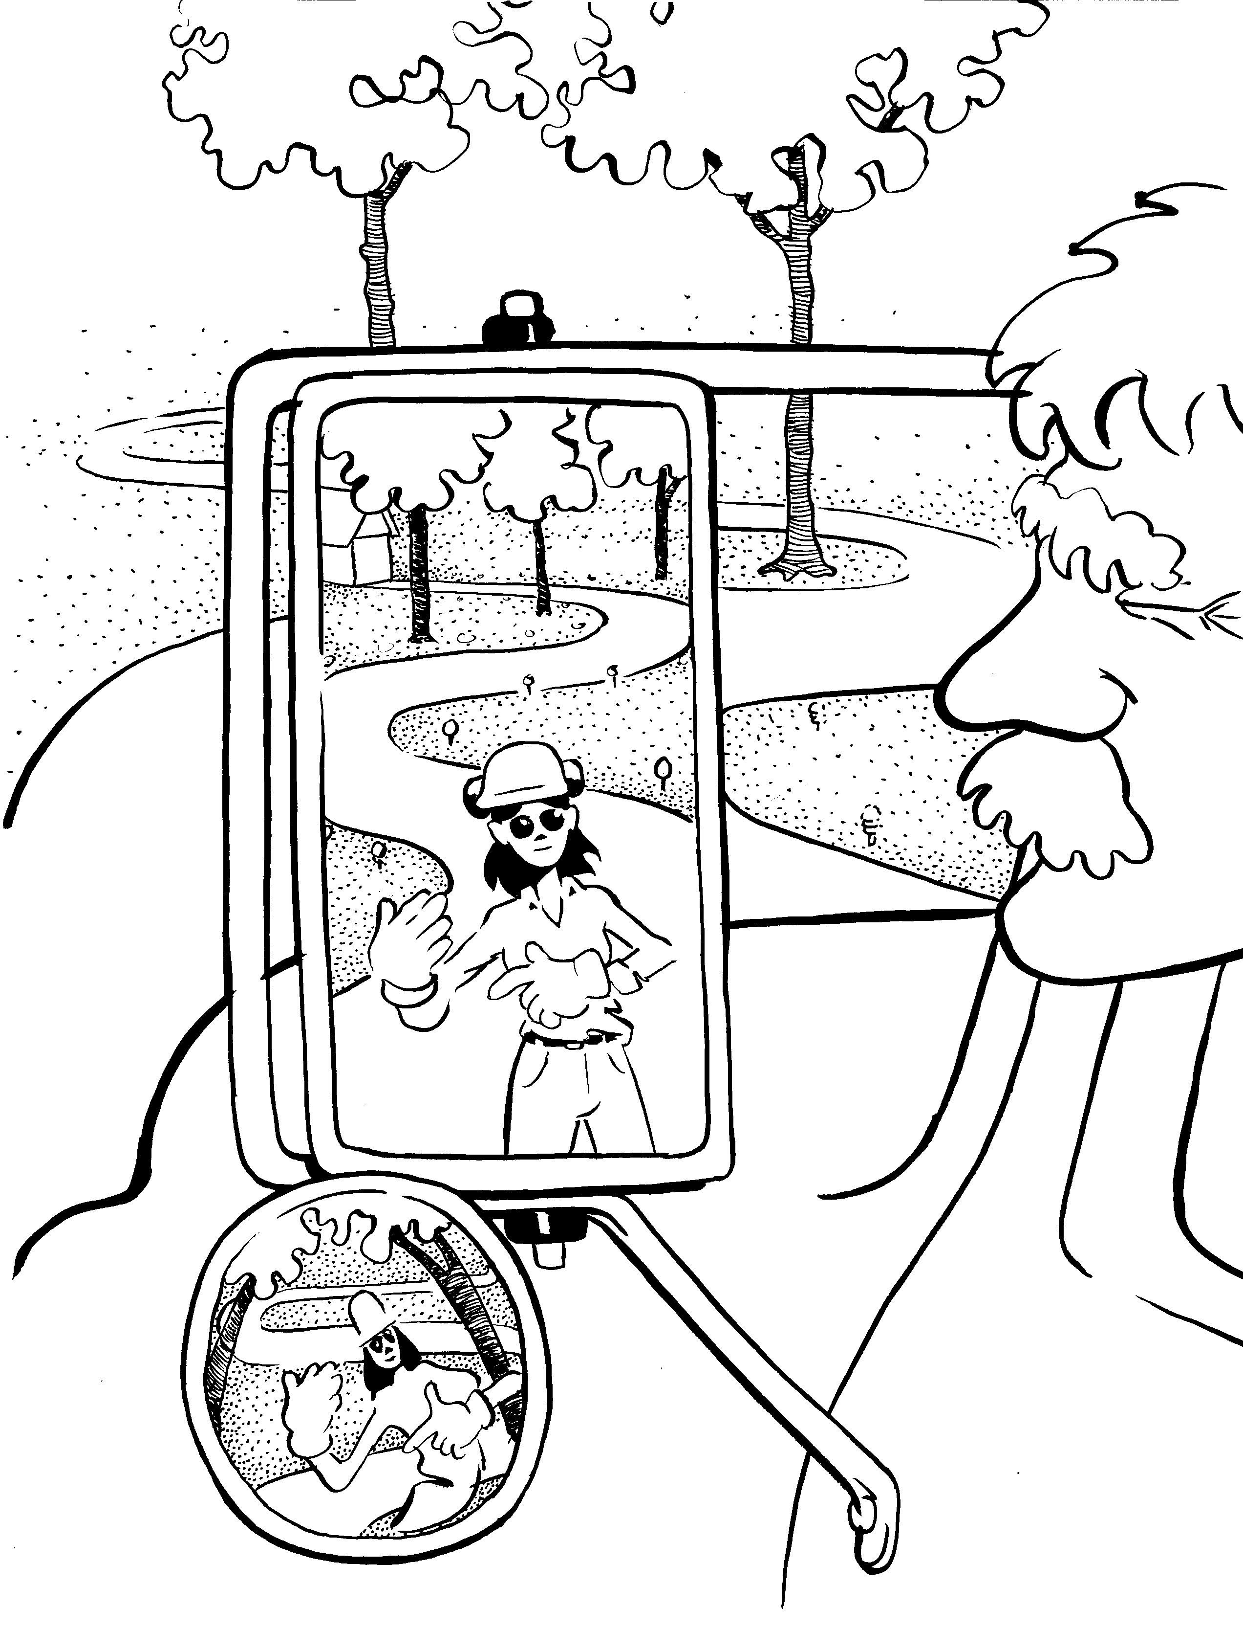
Aerial Lift Safety - Driving
Use a spotter when backing vehicles

Slide 46
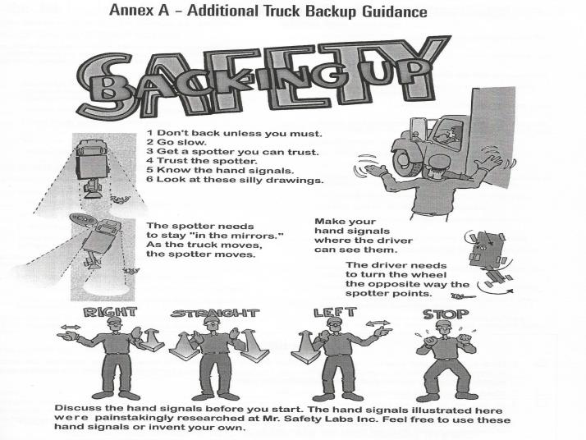
Aerial Lift Backing

Slide 47
Chapter 3 –
General Standards and Guidelines
Objectives:
  The employee will:
    Learn safety standards for working with an aerial lift
    Learn work-site traffic control procedures
    Learn aerial lift positioning and set-up procedures
    Identify good work-site set-up position

Slide 48
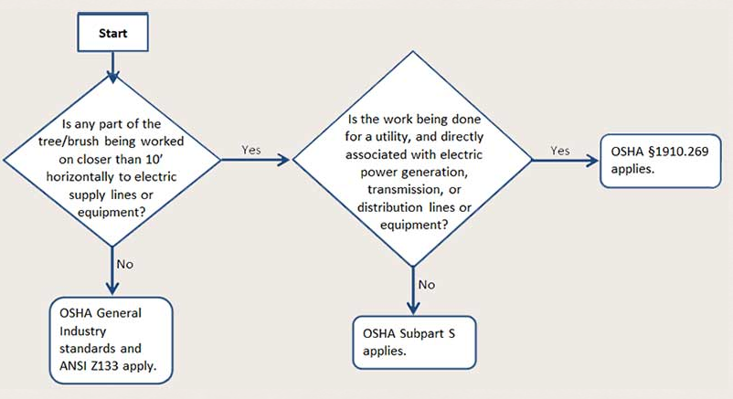
What standard(s) apply to you?
(More on this in Chapter 5)

Slide 49
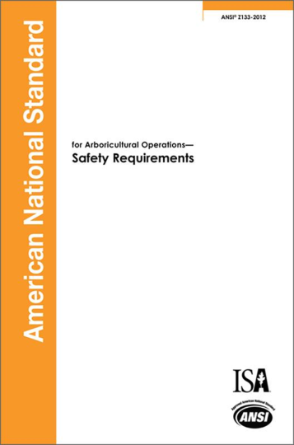
General Standards and Guidelines –
ANSI Z133

Slide 50

ANSI Z133 Key Sections for Aerial Lift Operations
3.2 Traffic Control
3.3 Emergency Procedures and Readiness
3.4 Personal Protective Equipment (PPE)
4 Electrical Hazards (All)
5.1 Vehicles and Mobile Equipment
5.2 Aerial Devices

Slide 51
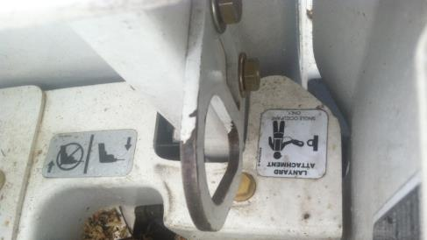
ANSI 5.2.2
5.2.2 Aerial devices shall be provided with an approved point of attached on which to secure a full-body harness with an energy-absorbing lanyard or body belt and lanyard which shall be worn when aloft.

Slide 52

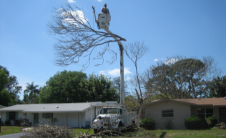
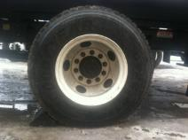
ANSI 5.2.4 and .5
5.2.4 Aerial devices or aerial ladders shall not be used as cranes or hoists to lift or lower material or tree parts, unless they were specifically designed by the manufacturer to do so
5.2.5 Wheel chocks shall be set before using an aerial device unless the device has no wheels on the ground or is designed for use without chocks

Slide 53
ANSI 5.2.3
5.2.3 Booms, buckets, or any other part of the aerial device shall not be allowed to make contact or violate minimum approach distances with energized electrical conductors, poles or similar conductive objects.

Slide 54
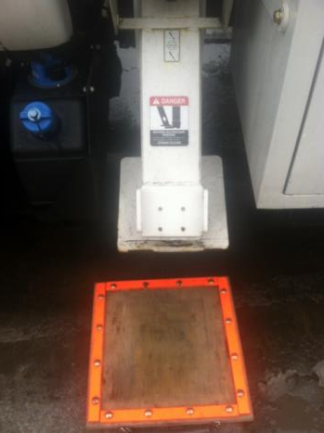
ANSI 5.2.6 and .7
5.2.6 Units equipped with outriggers or a stabilizing system shall be operated in a manner consistent with manufacturer’s requirements
5.2.7 The operator shall ensure adequate clearance exists and give warning prior to lowering outriggers. Pads shall be placed under outrigger feet when they are needed to ensure stable footing.

Slide 55
ANSI 5.2.8 – 5.2.10
5.2.8 When operating aerial devices, the operator shall look in the direction the bucket is traveling and be aware of the location of the booms in relation to all other objects and hazards
5.2.9 Clearances from passing vehicles shall be maintained, or traffic control shall be provided when booms or buckets are operated over roads
5.2.10 One-person buckets shall not have more than one person in them during operations

Slide 56
ANSI 5.2.11 – 5.2.15
5.2.11 Hydraulic/pneumatic tools shall be disconnected when they are being serviced or adjusted, except where manufacture’s procedure require otherwise.
5.2.12 To avoid flying particles or shipping hydraulic/pneumatic hoses, pressure shall be released before connections are broken, except where quick-acting connectors are used. Hydraulic pneumatic hoses shall never be kinked in order to cut off pressure
5.2.13 No part of the body shall be used to locate or stop hydraulic leaks
5.2.14 Hoses affecting dielectric characteristics of equipment shall meet manufacturer’s requirement
5.2.15 The flash point of hydraulic fluid shall meet
the minimum set by the manufacturer

Slide 57
ANSI 5.2.16 – 5.2.19
5.2.16 Combine loads shall not exceed rated lift capacities. Load ratings shall be conspicuously and permanently posted on aerial devices in accordance with ANSI A92.2.
5.2.17 Electric cables/cords used with electrics saws or lights, or other conductive material shall not be run from the vehicle to the bucket when arborists are working in proximity to energized electrical conductors.
5.2.18 aerial devices shall not be moved with an arborist in the platform (for example, a bucket) except when equipment is specifically designed for such a operation.
5.2.19 Holes shall not be drilled in buckets or liners.

Slide 58
ANSI 5.2.20
5.2.20 During aerial device operations, arborists and other workers who are not qualified line clearance arborists shall maintain a minimum approach distance from energized electrical conductors in accordance with Table 2.
Only a qualified line-clearance arborists or qualified line- clearance arborist trainees using an insulated aerial device may operate in accordance with minimum approach distances provided in Table 1.

Slide 59
ANSI 5.2.21 - .22
5.2.21 Arborists and other workers shall be instructed that insulated aerial buckets do not protect them from other electric paths to the ground, such as paths through trees, guy wires, or from one phase were to the second phase wire, any one of which can be fatal.
5.2.22 All underground hazards shall be located proper to operating aerial lift devices off-road. These hazards could include natural gas tanks, underground oil tanks and septic systems.

Slide 60
Chapter 3 - Guidelines
Aerial Lifts
  Need to be tested annually for dielectric insulating ability
  Inspected and operationally checked prior to use
  Maintenance done as recommended by manufacturer

Slide 61
Guidelines
Aerial Lifts . . .
  Insulating parts should be cleaned with non-filming agents
  Never drill holes in the bottom of the bucket, if water can drain out, electricity can get in!

Slide 62
Safe Work Practices
Job Briefing
  You are required to make sure that all workers understand the hazards associated with their work as well as their individual responsibilities
  This is required by OSHA and ANSI Z133

Slide 63
Safe Work Practices
Job Briefing should include:
  Job steps
  Potential hazards
  Specific work assignments
  Action steps needed to avert the hazards
  What PPE is required
Any new hazard or change in job
site needs to be addressed

Slide 64
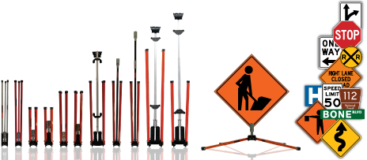
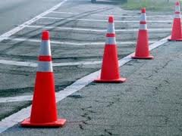
Temporary Traffic Control Stds.
Federal Regulations - All traffic control devices used for TTC shall conform to the U.S. Dept. of Transportation MUTCD
Notes:
This includes signs, sign stands, cones (or other channelizing devices).

Slide 65
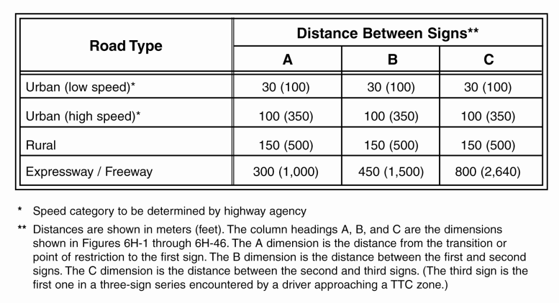
Working Near Traffic

Slide 66
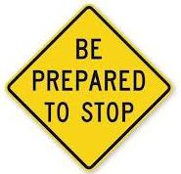
Avoid Being Struck-by a Vehicle
• 1st Sign—Attracts the driver’s attention.
• 2nd Sign—Shows what the driver is approaching.
• 3rd Sign—Shows the driver what must be done.
Why do you need to know this? This will help the aerial lift avoid being struck-by a vehicle!!!! Cones and signage are important for safety!

Slide 67
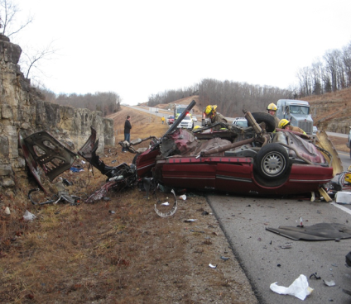
Distracted Drivers
Distracted drivers are a hazard to workers in work zones.
Setting up proper advanced warning signs, taper, channelizing devices and buffer space may give a distracted driver time to react
Notes:
Discuss- the company has had serious accidents where employees were struck and either killed or seriously injured in work zones were errant drivers weren’t paying attention.

Slide 68
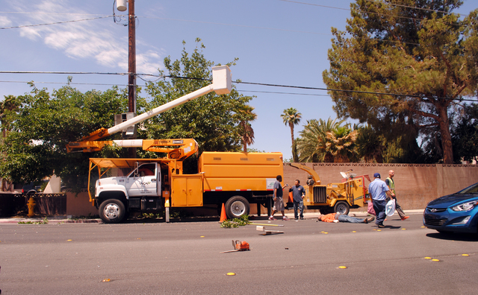
Aerial Lift and highline wires

Slide 69
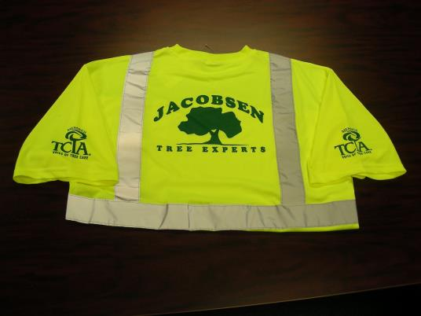
Hi-Visibility Clothing

Slide 70
Chapter 3 - TTC Standards
The primary function of TTC is to provide reasonably safe and efficient movement of road users through or around TTC while providing reasonable protection for the workers, equipment and emergency responders.
Employers must train their employees who are involved in TTC.
Notes:
TTC also provides safe passage for bicyclist, pedestrians or persons in wheelchairs.

Slide 71
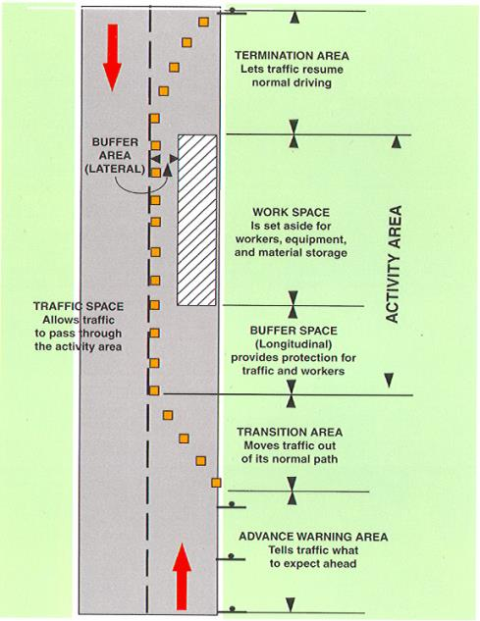
Five Parts of a Traffic Control Zone
The traffic control zone is the area between the first advanced warning sign and the point beyond the work space where traffic is no longer affected.

Slide 72
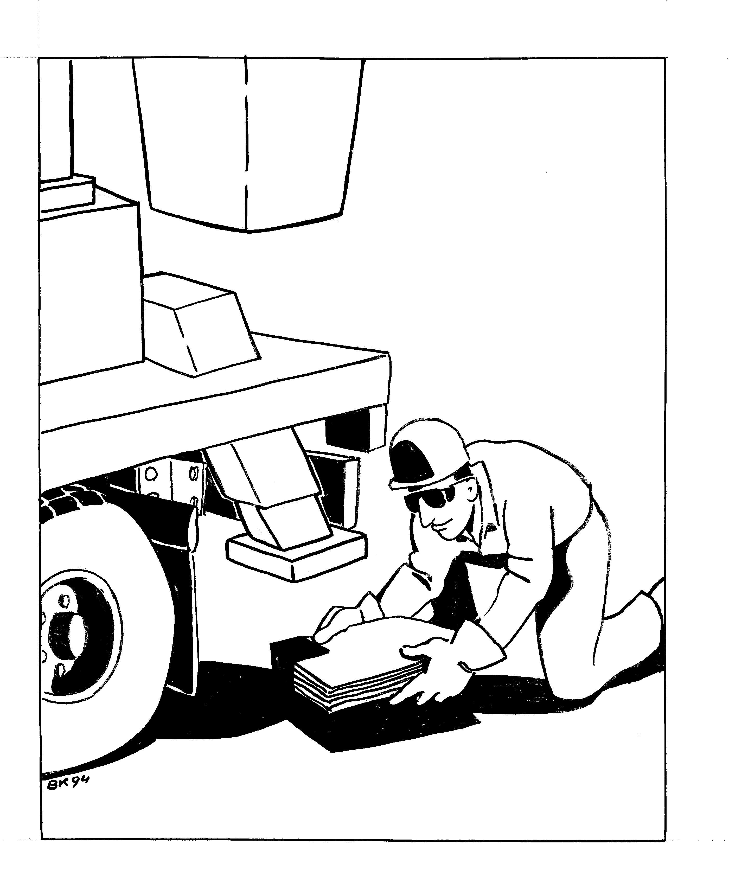
Chapter 3 - Aerial Lift Setup

Slide 73
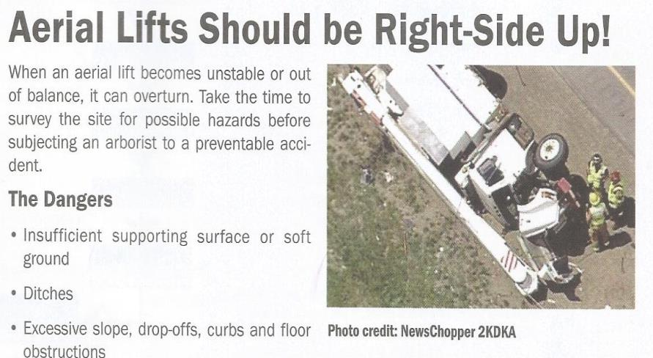
Aerial Lifts Should be Right-Side up!

Slide 74

Aerial Lift Safety
http://www.youtube.com/watch?v=IgDn8f27xvQ
Aerial Lift Accident

Slide 75
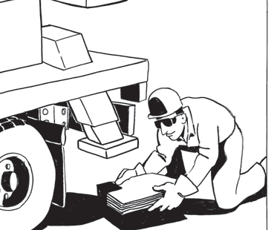
Chapter 3 - Work Site Procedures
Work-Site Set Up Procedures
1. Ensure the vehicle is positioned on level ground.
2. Set the parking brake.
3. Chock the wheels.
4. Engage the power supply.
5. Set the outriggers. When working on soft ground, place outrigger pads beneath outriggers to prevent sinking (according to the operator’s manual instructions).
6. Ensure the vehicle is stable before entering the bucket/platform and raising or lowering the boom.
7. Check the operator’s manual for additional procedures.

Slide 76
Aerial Lift Procedures
  Always know where the conductors are
  Face the direction of bucket travel
  Do not work with your back to the conductors
  NEVER move the bucket between to conductors
  Inspect and maintain the bucket

Slide 77
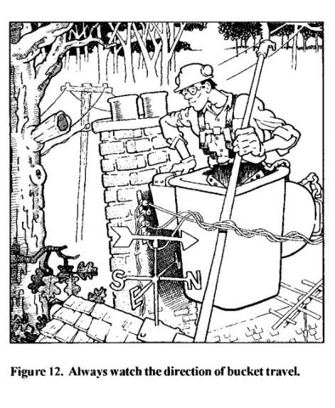
Drawing on hazards

Slide 78
Aerial Lift Procedures
The bucket, boom, tools, and the operator shall never contact the conductors or violate the Minimum Approach Distances (more on this later)
The truck and any attached equipment shall be considered energized if contact is made
If a worker on the ground contacts an energized vehicle, electrocution may occur

Slide 79
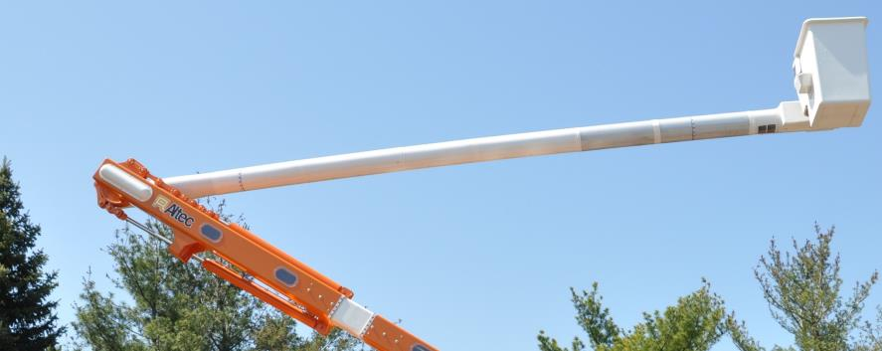
Aerial Lift Procedures
Upper insulator/isolator
Lower insulator/isolator

Slide 80
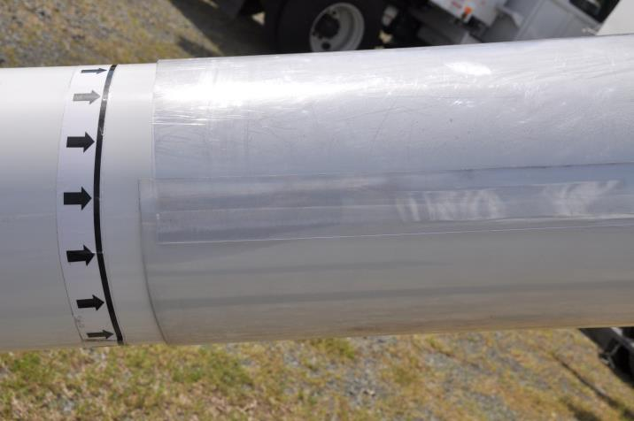
Aerial Lift Procedures
Dielectric protection is only within arrows (Left side only shown here)

Slide 81
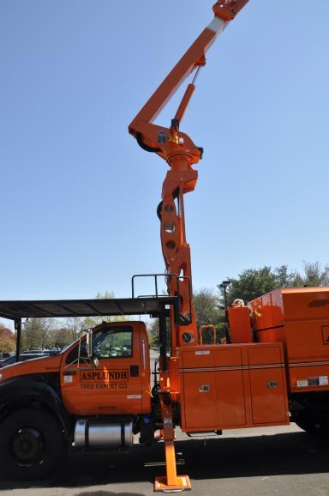
Aerial Lift Procedures
Lower insulator/isolator
Any electrical contacts below the lower isolator will energize the truck, ground around the truck and any towed equipment.

Slide 82
Workers On The Ground Can Be Electrocuted If The Boom Comes Into Contact With An Energized Line…

Slide 83
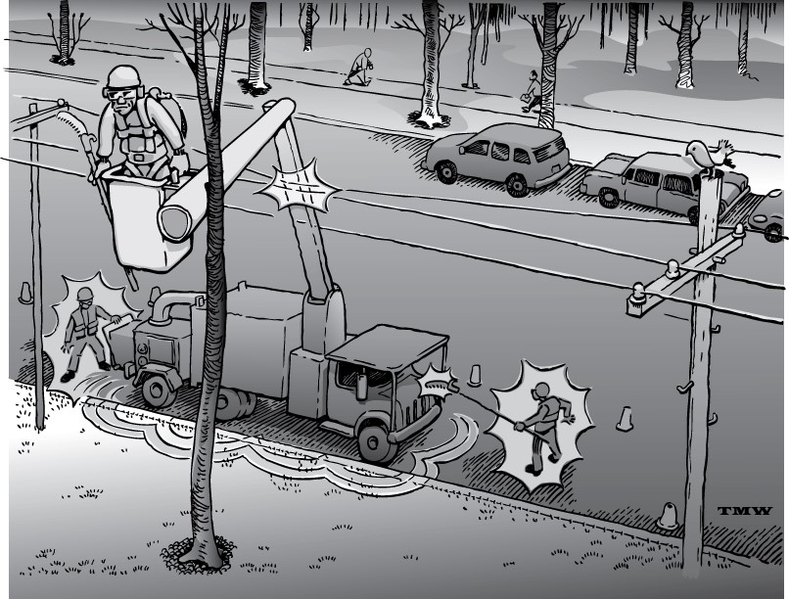
Drawing on Energized lift

Slide 84
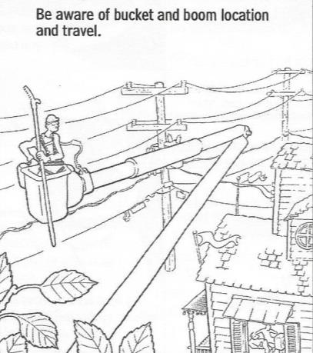
Chapter 3 - Aerial Lift Guidelines
Read the Guidelines For Aerial Lifts, adapted
from ANSI Z133 Safety Standards.
Make sure you and your co-workers follow
the standards!!!!!!!

Slide 85
Chapter 3 - Aerial Lift Guidelines
Never modify any part of the lift without permission from the manufacturer
A must – a grounder worker must be present, trained and qualified to make an Aerial rescue from the lower controls.
Never allow unauthorized users or pedestrians around lift or job site.
Stop working if a pedestrian approaches or enters the work zone.
Stop working if there is a malfunction – call your supervisor.
Stop working if you realize that you cannot complete the job safely or efficiently With the Aerial lift – call your supervisor.
Once a bucket operator is aloft, the lower controls
should only be operated by a Ground person
in case of an emergency and with permission
by the operator aloft.

Slide 86
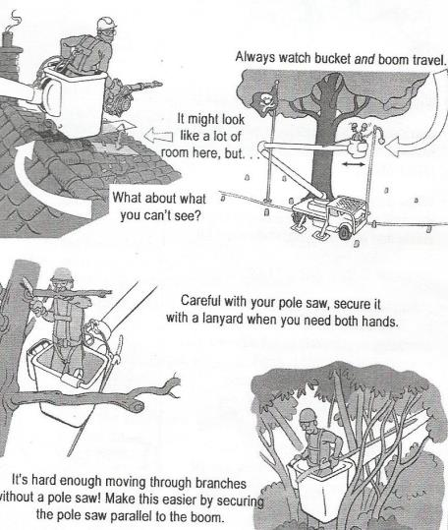
Chapter 3 - Aerial Lift Guidelines
When raising or lowering the boom, avoid:
Jerking the controls.
Obstacles, tree limbs, power lines, etc.
Don’t get crushed between bucket and object.
Secure tools before moving bucket.
Refer to owner’s manual for crush points on your equipment.

Slide 87
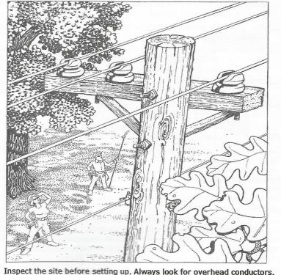
Aerial Lift Guidelines
Conduct a work-site and hazard assessment.
Conduct a job briefing – all employees must understand the assessment and work plan.
Discuss voice command and response system to be used – agree upon it – all of you.
Use this communications system while working.
Ensure that all workers on ground stay out from under the boom and bucket.

Slide 88
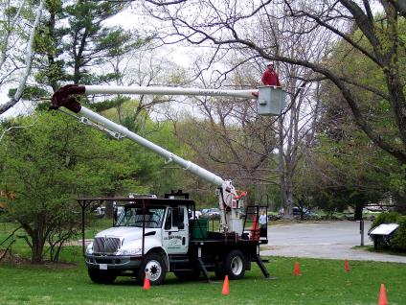
Chapter 3 - Shut Down Procedures
Slowly lower the boom to rest on is supports
Secure the boom according to the operator’s manual.
Raise the outriggers.
Shut off the power supply.
Depress the parking brake.
Remove the key.

Slide 89
Shut Down Procedures . . .
Stow the outrigger pads (if applicable).
Remove and stow the wheel chocks before leaving the work site.
Return all equipment and traffic control devices to tools boxes.

Slide 90
Chapter 4 –
Preventing Common Accidents
Objectives:
  The employee will:
    Identify steps to secure yourself in the bucket of the lift.
    Recognize safe operating procedures to avoid falling from an aerial lift.
    Identify safe work procedures to avoid being cut by a chain saw operated from a bucket.
    Indicate how to avoid being struck by
    objects while operating the bucket.

Slide 91
Chapter 4 – Common accidents
Common Types of Accidents for Aerial Lift Operators
Falls from Bucket – failure to secure yourself in bucket with a full body harness. Falls over 35 feet usually result in death. Many times an operator is knocked out of a bucket from being struck by another vehicle or a section of wood hitting the boom.
Chain Saw Cuts – failure to use two hands while operating a Chain Saw.
Struck-Bys – you and co-worker injured by branches. Create a work plan before going aloft. Use voice command or hand signals.
Contact Energized Conductors – Always maintain minimum approach distances.
Equipment Failure – inspect and maintain your boom. Most common failure is breakage of cables.
6. Lift Overturns – not as common, but it does happen. Don’t forget to use the outriggers.

Slide 92
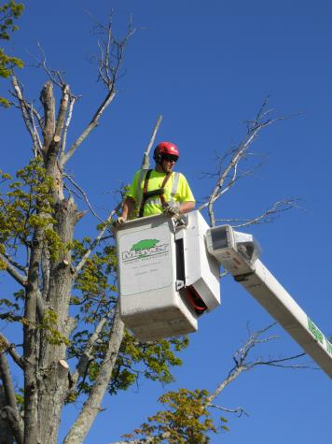
Preventing Falls from Aerial Lifts

Slide 93
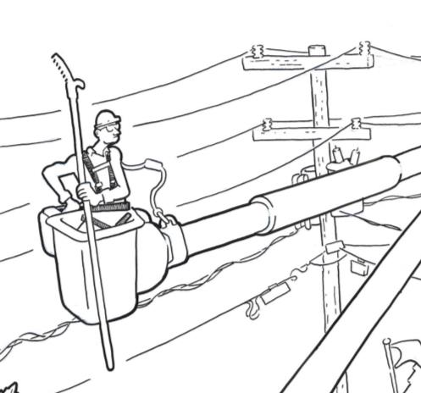
Fall Protection
Aerial Lifts
  Personal fall arrest system, or…
  Fall restraint system
  1910.269(g)(2)(vi)(C)

Slide 94
Fall Protection*
Fall restraint - system that prevents the user from falling any distance, or from reaching “unprotected edge” of a horizontal surface
Work positioning - system rigged to allow an employee (lineman) to be supported on an elevated vertical surface (pole, tower) and work with both hands free while leaning
Fall arrest - system used to arrest a fall from a working level, limits free fall to 6 feet, rigged so that worker cannot contact lower level
* Fall protection requirements vary depending on which OSHA regulations apply. More in Chapter 5…
Notes:
Fall protection equipment rigged to arrest falls is considered as one or more components of a fall arrest system and must meet the applicable requirements for the design and use of those systems. Fall protection equipment rigged for work positioning is considered as work positioning equipment and must meet the applicable requirements for the design and use of that equipment.

Slide 95
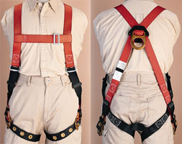
Do Gear Inspection
Do gear inspection prior to entering the bucket. Make sure you are properly positioned and attached with a properly fitted and worn harness and appropriate lanyard.

Slide 96
Compliance Issues/Deadlines
Fall Protection in Aerial Lifts - March 31, 2015
Personal fall arrest systems must meet the requirements of Subpart M of OSHA’s construction standards Part 1926

Slide 97
Compliance Issues/Deadlines
1926.502(d)(16) Personal fall arrest systems, when stopping a fall, shall:
  (i) limit maximum arresting force on an employee to 900 pounds (4 kN) when used with a body belt;
  (ii) limit maximum arresting force on an employee to 1,800 pounds (8 kN) when used with a body harness;
  (iii) be rigged such that an employee can neither free fall more than 6 feet (1.8 m), nor contact any lower level;
Lanyard length, shock absorbing?
  Free fall distance is defined as the total vertical displacement, measured at the dorsal attachment, from its starting point to its stopping point
  Whatever system you choose must also meet the
  “arresting force” (AF) requirement.
    Combined tool and body weight of 310 pounds

Slide 98
Compliance Issues/Deadlines
Conductors and tree branches do not constitute a “lower level” for purposes of enforcement
Lower level stipulation does not kick in during ascent to or descent from the working position.
In enforcement, six-foot “free fall” restriction cannot reasonably anticipate worker being ejected…going UP before going DOWN. Employer must take reasonable precautions to prevent ejection, may use lanyards longer than 3’ (4 to 4 ½’ recommended).
Notes:
Fall protection equipment rigged to arrest falls is considered as one or more components of a fall arrest system and must meet the applicable requirements for the design and use of those systems. Fall protection equipment rigged for work positioning is considered as work positioning equipment and must meet the applicable requirements for the design and use of that equipment.

Slide 99
Staying Secure Aloft
General Rules
  Inspect:
    Site
    Trees
    Truck
    Equipment
    PPE

Slide 100

Safe Work Procedures
Prevent Falls

Slide 101
Safe Work Procedures
Prevent Saw Cuts
Use two hands while operating a chain saw
Use a hand saw, “should” be carrying one in bucket with you

Slide 102


Avoid Struck-by Injuries from Falling Objects

Slide 103
Safe Work Procedures
Prevent Struck by Injuries
This includes injuries to you, the bucket operator, and anyone on the ground.
A work zone, controlled with flaggers, signs and cones should be set up as appropriate.
Keep co-workers from going underneath the bucket.
Use a command/response communication system before making the final cut and dropping branches.
Use Electronic Communication Systems

Slide 104

Keep Pedestrians at a Safe Distance

Slide 105

Identify Electrical Hazards

Slide 106
Minimum Approach Distance (MAD)
Two components of actual distance
  MAID (Minimum Air Insulation Distance)
  Ergonomic Factor-allows for inadvertent movement
OSHA and ANSI tables
  Distances based on training, voltage and elevation

Slide 107

Minimum Approach Distance

Slide 108

Minimum Approach/Separation Distances
Minimum approach distance listed in the ANSI Z133 table
Based on maximum nominal operating voltage in the energized conductors.
Line clearance arborist or line clearance arborists trainees

Slide 109
Safe Work Practices
Work planning when there is an electrical hazard:
  Inspect trees to determine proximity to all wires
  Consider all wires to be energized with potentially fatal voltages, this includes;
    Electric
    Fire alarm
    Communication
    Street light

Slide 110
Safe Work Practices
Coating on wires is weather proofing, not insulation
  Designed to protect the wire, not you
Never touch any electrical conductor, apparatus or any conductive object in contact with an electrical conductor

Slide 111
Chapter 5 - Additional Recommended Training: Qualified Line-Clearance Arborists (Tree Trimmers) and Aerial Rescue
Objectives:
  The employee will:
    Identify what defines line-clearance tree trimming.
    Define the term line-clearance arborist.
    Understand who is and who is not “qualified” to perform line-clearance tree trimming.
    Understand that Aerial Lift Safety training does not include aerial rescue training.

Slide 112
Which Standards Apply to Arborists’ Work?
Start
Is the work being done for a utility, and directly associated with electric power generation, transmission, or distribution lines or equipment?
Is any part of the tree/brush being worked on closer than 10’ horizontally to electric supply lines or equipment?
Yes
Yes
OSHA §1910.269 applies.
No
No
OSHA General Industry standards and ANSI Z133 apply.
OSHA Subpart S applies.

Slide 113

Aerial Lift Safety
Line-Clearance Tree Trimming
Definition – The pruning, trimming, repairing, maintaining, removing or clearing of trees, or cutting brush that is within 10 feet of electric supply lines and equipment.

Slide 114

Aerial Lift Safety
It’s line clearance when any part of the tree is closer than 10’ horizontally to the electric supply lines or equipment AND work is on behalf of a utility.

Slide 115

Chapter 5
Qualified Line-Clearance Arborist

Slide 116

Non Line Clearance Arborists

Slide 117

Aerial Rescue
This manual does not address aerial rescue training. Aerial rescue requires complex training that includes decision-making and knowledge of various techniques.
Possible aerial rescue scenarios involving Aerial Lifts
  Aerial Lift Specialists who are qualified to climb may need to use an aerial lift to access a tree when trying to reach a victim in the tree.
  Aerial Lift Specialists may need to use an aerial lift to rescue a rescue victim in a tree.
  Aerial Lift Specialists may need to rescue a victim in a bucket rescue another lift operator
  using the lower controls.

Slide 118
Chapter 6 –
Electrical and Environmental Hazards
Objectives:
  The employee will:
    Identify electrical hazards.
    Understand how electrocution occurs.
    Identify environmental hazards.
    Identify procedures during lightning or storm emergencies

Slide 119


Aerial Lift Safety
Did You Look for Electrical Hazards?

Slide 120
Aerial Lift Procedures –
Electrical Hazards Safe Work Practices
Bucket Operator Warnings
  The bucket does not keep you free from risk of electrocution
  Insulation provides only a measure of safety
  You can be electrocuted through other paths to ground:
    If you contact the conductor and the tree at the same time
    If you contact two conductors at the same
    time

Slide 121


Chapter 6 – Electrical and Environmental Hazards

Slide 122

Drawing on Line Clearing

Slide 123
General Precautions To Avoid Being Electrocuted
Use extreme caution when operating aerial lifts and tree trimming equipment around utility lines.
You must call the utility if there is an electrical hazard, such as a tree limb, closer to the line than your minimum approach distance.
Plan ahead to have power lines de-energized or shielded if possible.
Never use a non-insulated lift device around utility lines.
Keep far enough away from the utility lines to allow for sway of the boom and sway of the lines.
Never drill holes in the bucket or bucket liner; this will decrease the effectiveness of insulation, if equipped.
Insulated booms must be dielectrically tested at least once a year.
Never rely on boom insulation to protect you. An insulated boom may or may not work based on environmental factors, voltage involved, nature of the contact, condition of boom, etc.
Workers on the ground should not touch, lean on, and/or jump on and off the aerial lift when it is in use around utility lines.

Slide 124



Aerial Lift Safety
Current passing through the body can cause electrocution or severe burns.

Slide 125
Aerial Lift Safety
Electrical Current and the Human Body

Slide 126

How Electrocutions Occur

Slide 127

Direct Contact

Slide 128

Indirect Contact

Slide 129




Environmental Hazards
Environmental Hazards
Heat exhaustion
Heat stroke
Cold exposure
Stinging and biting insects
Animals and mammals
Lightning
Make sure your First Aid
and CPR are up to date.

Slide 130

Heat Illness
Heat exhaustion is one form of heat illness Symptoms include*:
  Dizziness
  Headaches
  Sweaty skin
  Weakness
  Cramps
  Nausea, vomiting
  Fast heart beat
  * People react differently to heat, you may have only a few,
  or all, of these symptoms

Slide 131

Heat Illness
Heat stroke is another form of heat illness Symptoms may include*:
  Red, hot, dry skin
  High temperature
  Confusion
  Convulsions
  Fainting
  * People react differently to heat, you may have only a few,
  or all, of these symptoms

Slide 132

Heat Illness Prevention
Drink water every 15 minutes
Use a water bottle or bladder system when aloft
Wear light clothing
Take breaks in the shade
Keep an eye on each other
For more resources see OSHA’s website https://www.osha.gov/SLTC/heatillness/index.html

Slide 133
Lightning
Lightning strikes injure and kill hundreds of people each year. Follow these precautions to stay safe:
If you hear thunder, suspend work and lower the bucket. Shut off the aerial lift and move indoors if possible. Remember that any time you hear thunder, you may be struck by lightning. Lightning can strike even when it’s not raining.
The cab of an enclosed vehicle provides some protection from lightning but a sturdy building provides the best protection.
Listen to the radio for weather updates and storm warnings.
If you can’t take cover inside…
Get to a low space. Lightning strikes the tallest objects.
Crouch down, but minimize contact with the ground.
Do not lie flat on the ground. This makes you a larger target.

Slide 134
Lightning (cont.)
Keep Away From:
  Large, lone trees and towers, fences, telephone poles and utility lines.
  Rivers, lakes, pools and other bodies of water.
  Metal objects, tools, equipment, wire fences
Lightning Facts:
  A person that is struck by lightning DOES NOT retain an electric charge that can shock you.
  Lightning can spread as far as 60 feet or more after striking the ground.
  Lightning can travel at speeds of 100,000 mph.
  The temperature of a bolt of lightning can be as high as 50,000° F.
  Lightning CAN strike the same place twice.

Slide 135
Emergency Response
– Aerial Rescue
Make sure you are practicing and demonstrating aerial rescue at least once a year – ANSI Standards.
The more you practice though, the more you are prepared – panic kills!
Prepare to respond now, so you don’t freak out later!

Slide 136

Safety Begins with Preparation

Slide 137
Grantee’s Website Address
http://www.tcia.org/training/

